Slide 1
Tidy: AI Interview Monitoring Assistant
Enhancing Focused & Fair Interviews

Slide 2
What is Tidy?
AI-powered video analysis tool for interview monitoring
Detects attention drops, absence, and gaze drift
Summarizes behavioral patterns using computer vision
Built using Streamlit, MediaPipe, OpenCV
Simple, friendly UI with a cartoon assistant

Slide 3
Organizational Benefits
Ensures candidate engagement during remote interviews
Enables data-backed post-interview evaluations
Supports fair, unbiased hiring decisions
Reduces manual monitoring needs for interviewers
Scalable and can be used across departments

Slide 4
How It Works
1. Interviewer records session via OBS (Zoom/Teams etc.)
2. Uploads video to Tidy via Streamlit UI
3. Tidy analyzes face, eye, and head movements
4. Generates session summary, focus log, and analyzed video
5. Downloads available instantly after processing

Slide 5
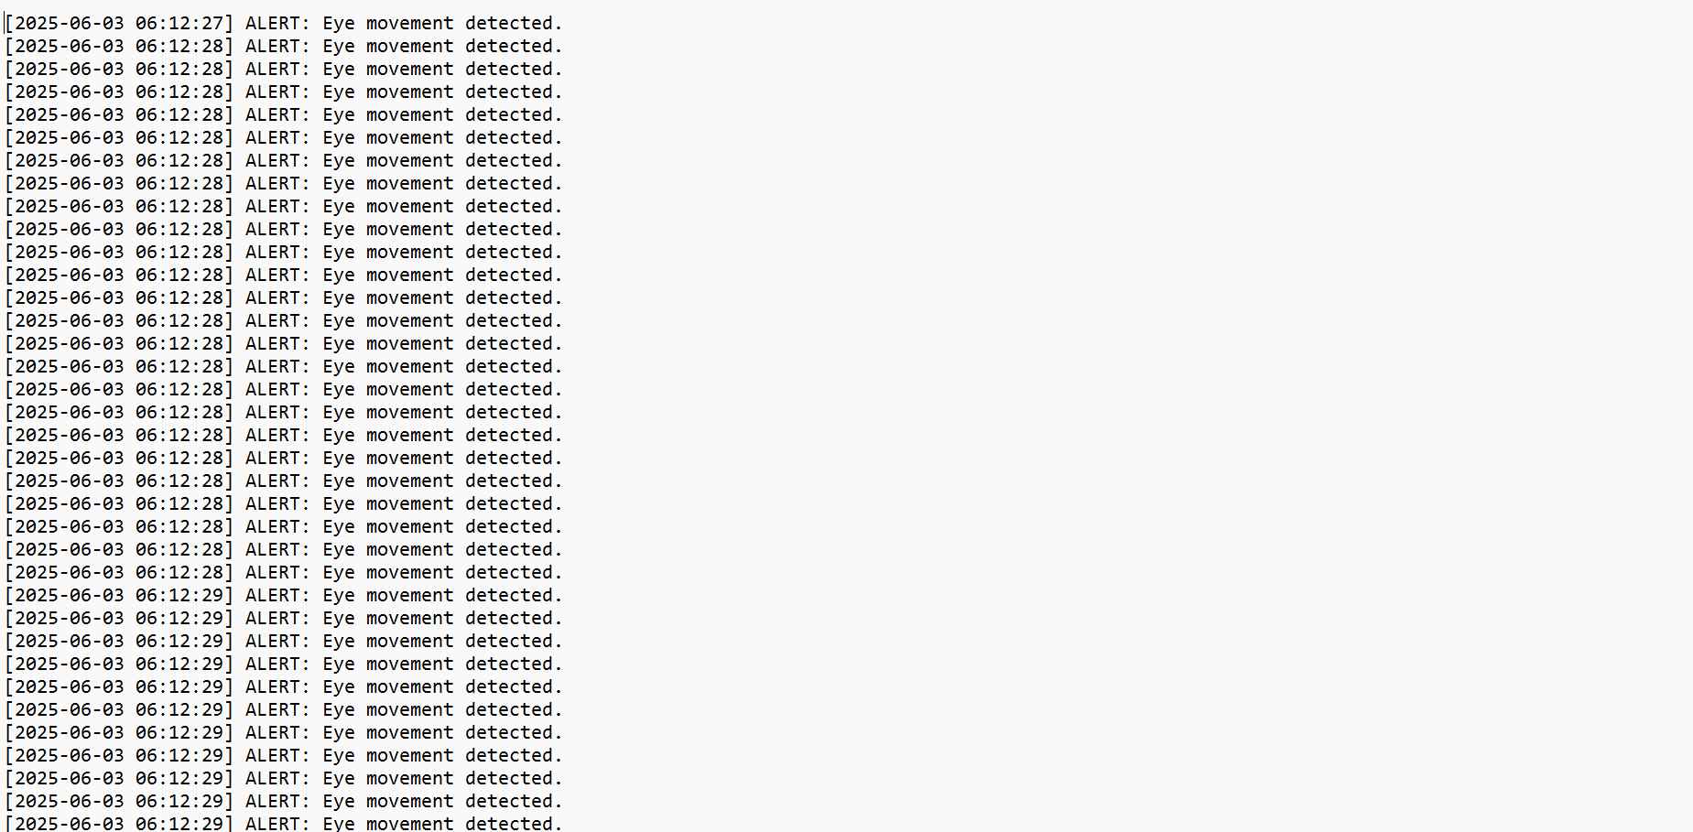
📊 Session Summary Output

Slide 6
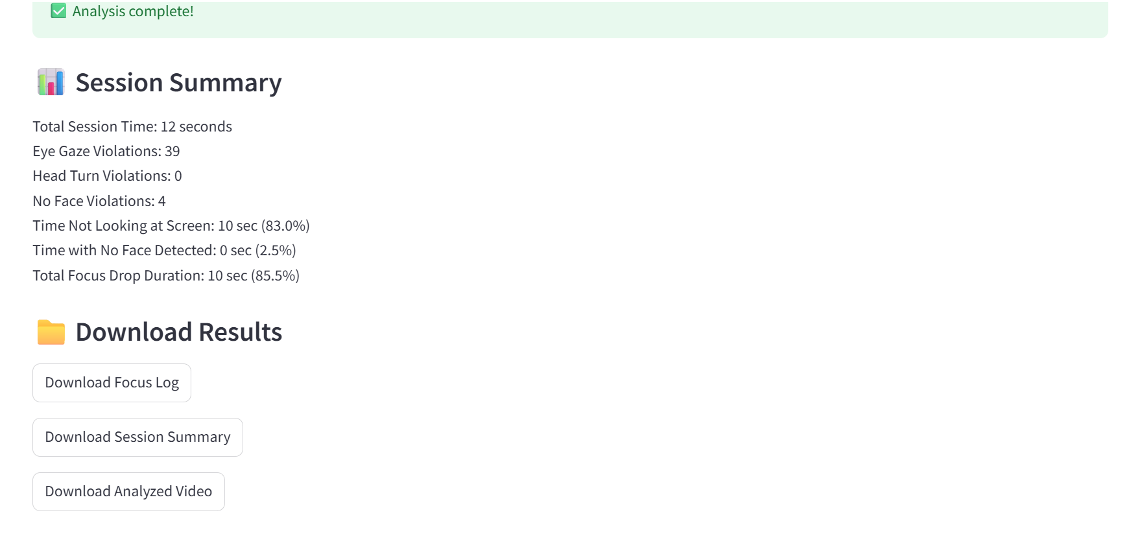
📄 Focus Log Report (Example)

Slide 7
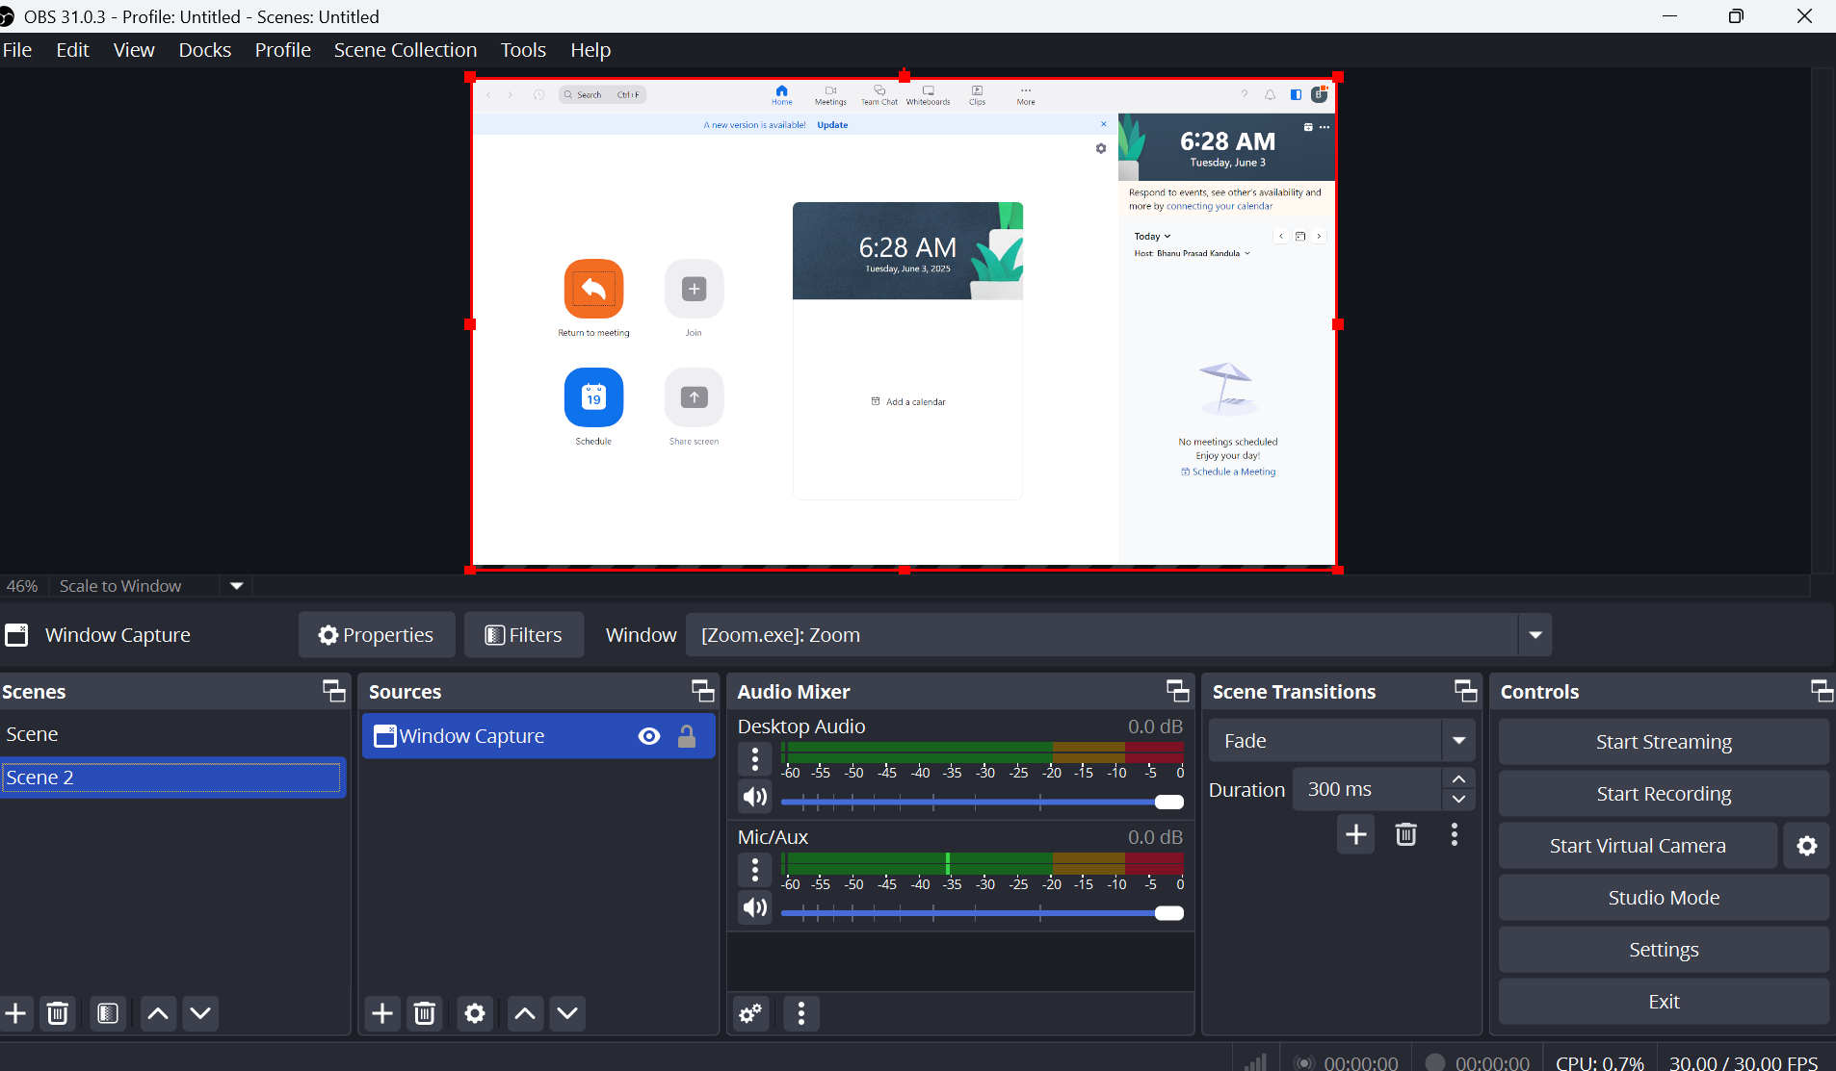
🎥 Video Capture Using OBS Tool

Slide 8
📈 Expansion Plan: Tidy as Zoom Bot
Integrate Tidy directly with Zoom as a bot
Bot joins the interview, records and auto-analyzes
Eliminates need for manual OBS recording
Email results directly to interviewers post-session
Supports enterprise-level automation

Slide 9
Conclusion & Vision
Tidy transforms how interviews are reviewed
Makes behavioral data visible and actionable
Positive monitoring → better hiring decisions
Ready for scale with potential bot integrations
Let's innovate how we interview!

