Slide 1

New Social Platform

Slide 2
Agenda
Introduction
Architecture (C4) Overview
Technology Choices
Scalability & Resilience
Next Step / Q&A

Slide 3
Introduction & Problem Statement
Goal: Build a social platform where users upload pictures and descriptions of their “NPU” (Nice Part Usage) creations.
Key Features:
Upload NPU images and descriptions
Rate other users’ creations
Search for ideas by element name or tags
Multi-Platform: Supports both mobile and web clients.
Constraints:
Written in C++
Runs on cloud hosting (AWS, Azure, etc.)
Present as a C4 model with a Container diagram

Slide 4
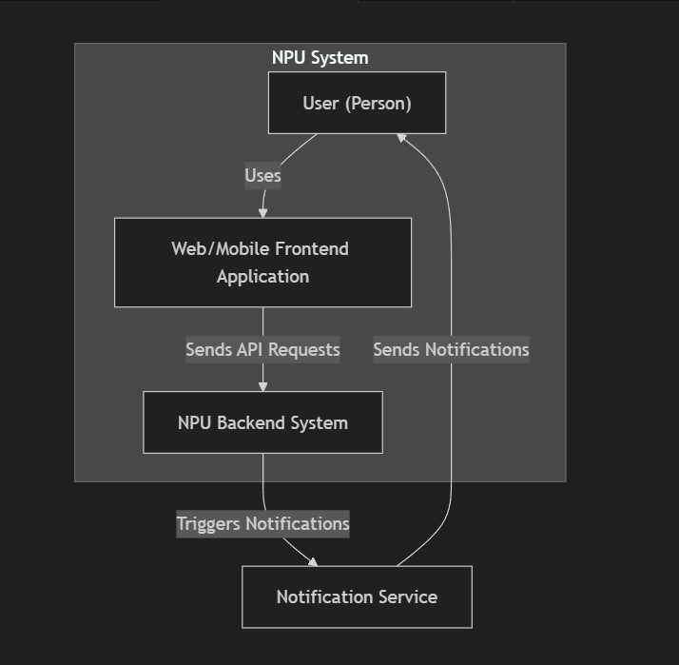
C4 Model - Context

Slide 5
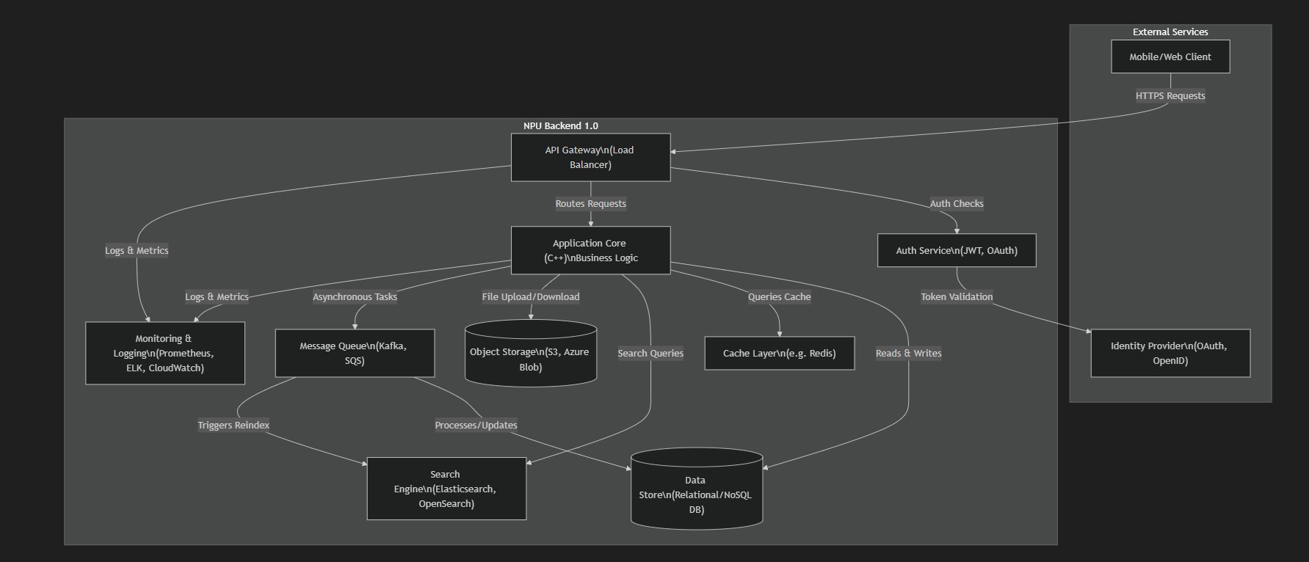
C4 Model - Container

Slide 6
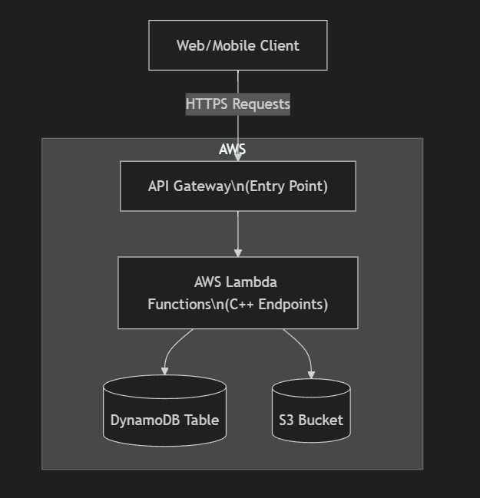
NPU Backend
AWS Lambda (C++): Each endpoint is a separate Lambda function.
API Gateway: Routes external HTTP requests to the appropriate Lambda function.
DynamoDB: Stores user data, ratings, creation descriptions.
S3: Stores images (user-uploaded NPU pictures).

Slide 7
Key Technology Choices
Language: C++
AWS Lambda
Serverless compute model.
Quick to deploy and scales automatically.
No need to manage servers for the short assignment timeline
DynamoDB
Integrates seamlessly with AWS Lambda and API Gateway
NoSQL database, fully managed by AWS.
Highly scalable for key-value operations.
Amazon S3
Object storage for images (NPU photos).
Durable and easy to manage.
Supports large file uploads without impacting the compute la
AWS Integration
All services (Lambda, DynamoDB, S3, API Gateway) work together seamlessly.
Minimizes operational overhead and setup time.

Slide 8
Scalability & Resilience
Lambda Auto-Scaling: Spawns more function instances under load.
DynamoDB Auto Scaling: Adjusts read/write throughput to handle spikes.
S3 Durability: Replicates objects across multiple Availability Zones.
API Gateway Throttling: Protects backend from excessive requests
Future Enhancements: Could integrate a search engine (OpenSearch) or caching layer (Redis) if needed.

Slide 9
Conclusion & Q&A
Minimal Serverless Approach: Using AWS Lambda + DynamoDB + S3 allows rapid development.
C++ in Lambda: Meets the assignment’s language requirement while staying cloud-native.
Trade-Offs: DynamoDB is great for speed, but relational features are limited.
Next Steps:
Introduce CI/CD pipeline for smooth deployments
Implement authentication (Cognito or Auth)
Add advanced search (OpenSearch)

