Slide 1
DATA-422
TEAM D

Slide 2
Objective
Whether population-based variables, GDP per capita, climate variables and strictness of government policy have influenced Covid-19 vaccinations rate and infection rate.

Slide 3
Project Plan
Select reliable data sources
Scrape and collect the raw data
Investigate the data collected
Use the appropriate packages too:
  Collect raw data
  Clean the data
  Combine the datasets
  Analyse the data
  Plot the data

Slide 4


Scraped the Variables from the Cia World Factbook
Dynamic Website
A selenium server was used to collect the information as seen by the user on the website.
Rvest was used to extract the variables from the HTML code
Stringr to extract variables from sentences and remove $,%

Slide 5
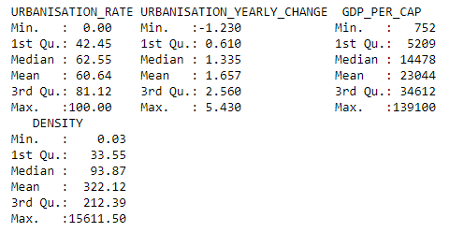
Variables Gathered
Population as at 2021
Urbanisation Rate
Population density (km²)
Real GDP per capita

Slide 6
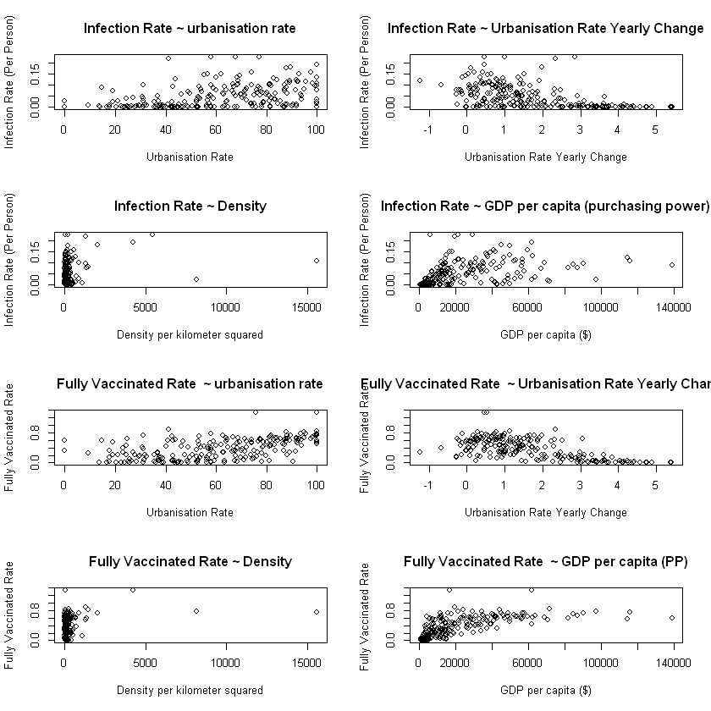
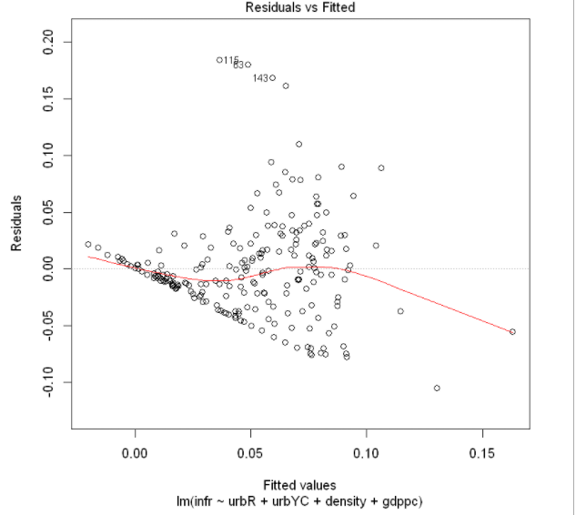
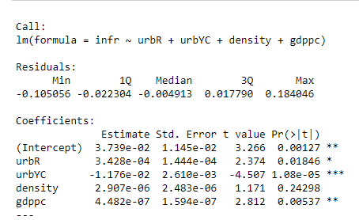

Slide 7
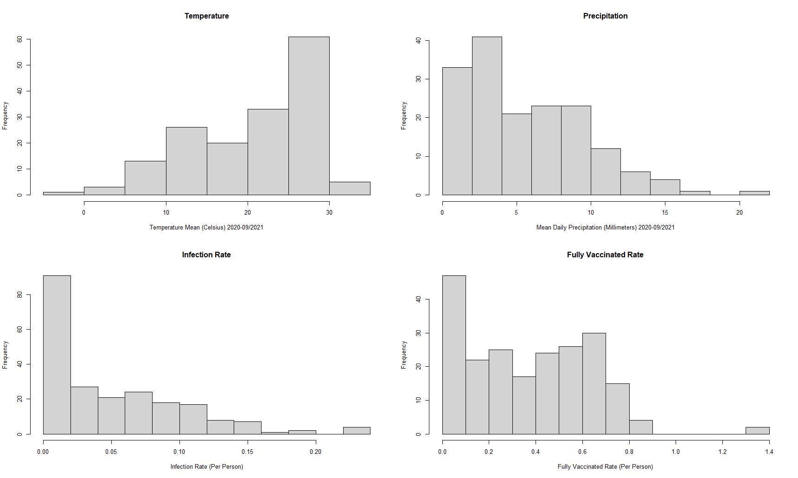
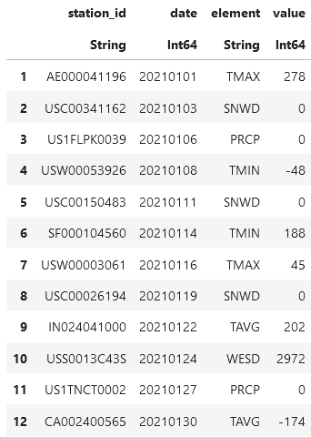
Global Historical Climatology Network (GHCN)
> 100,000 stations
> 180 countries & territories
Country Data Distributions
Data Wrangling Techniques
Select & filter
Change values to appropriate units
Group by substring & element
Long -> wide data frame
Join with FIPS codes library
Join to main data frame

Slide 8
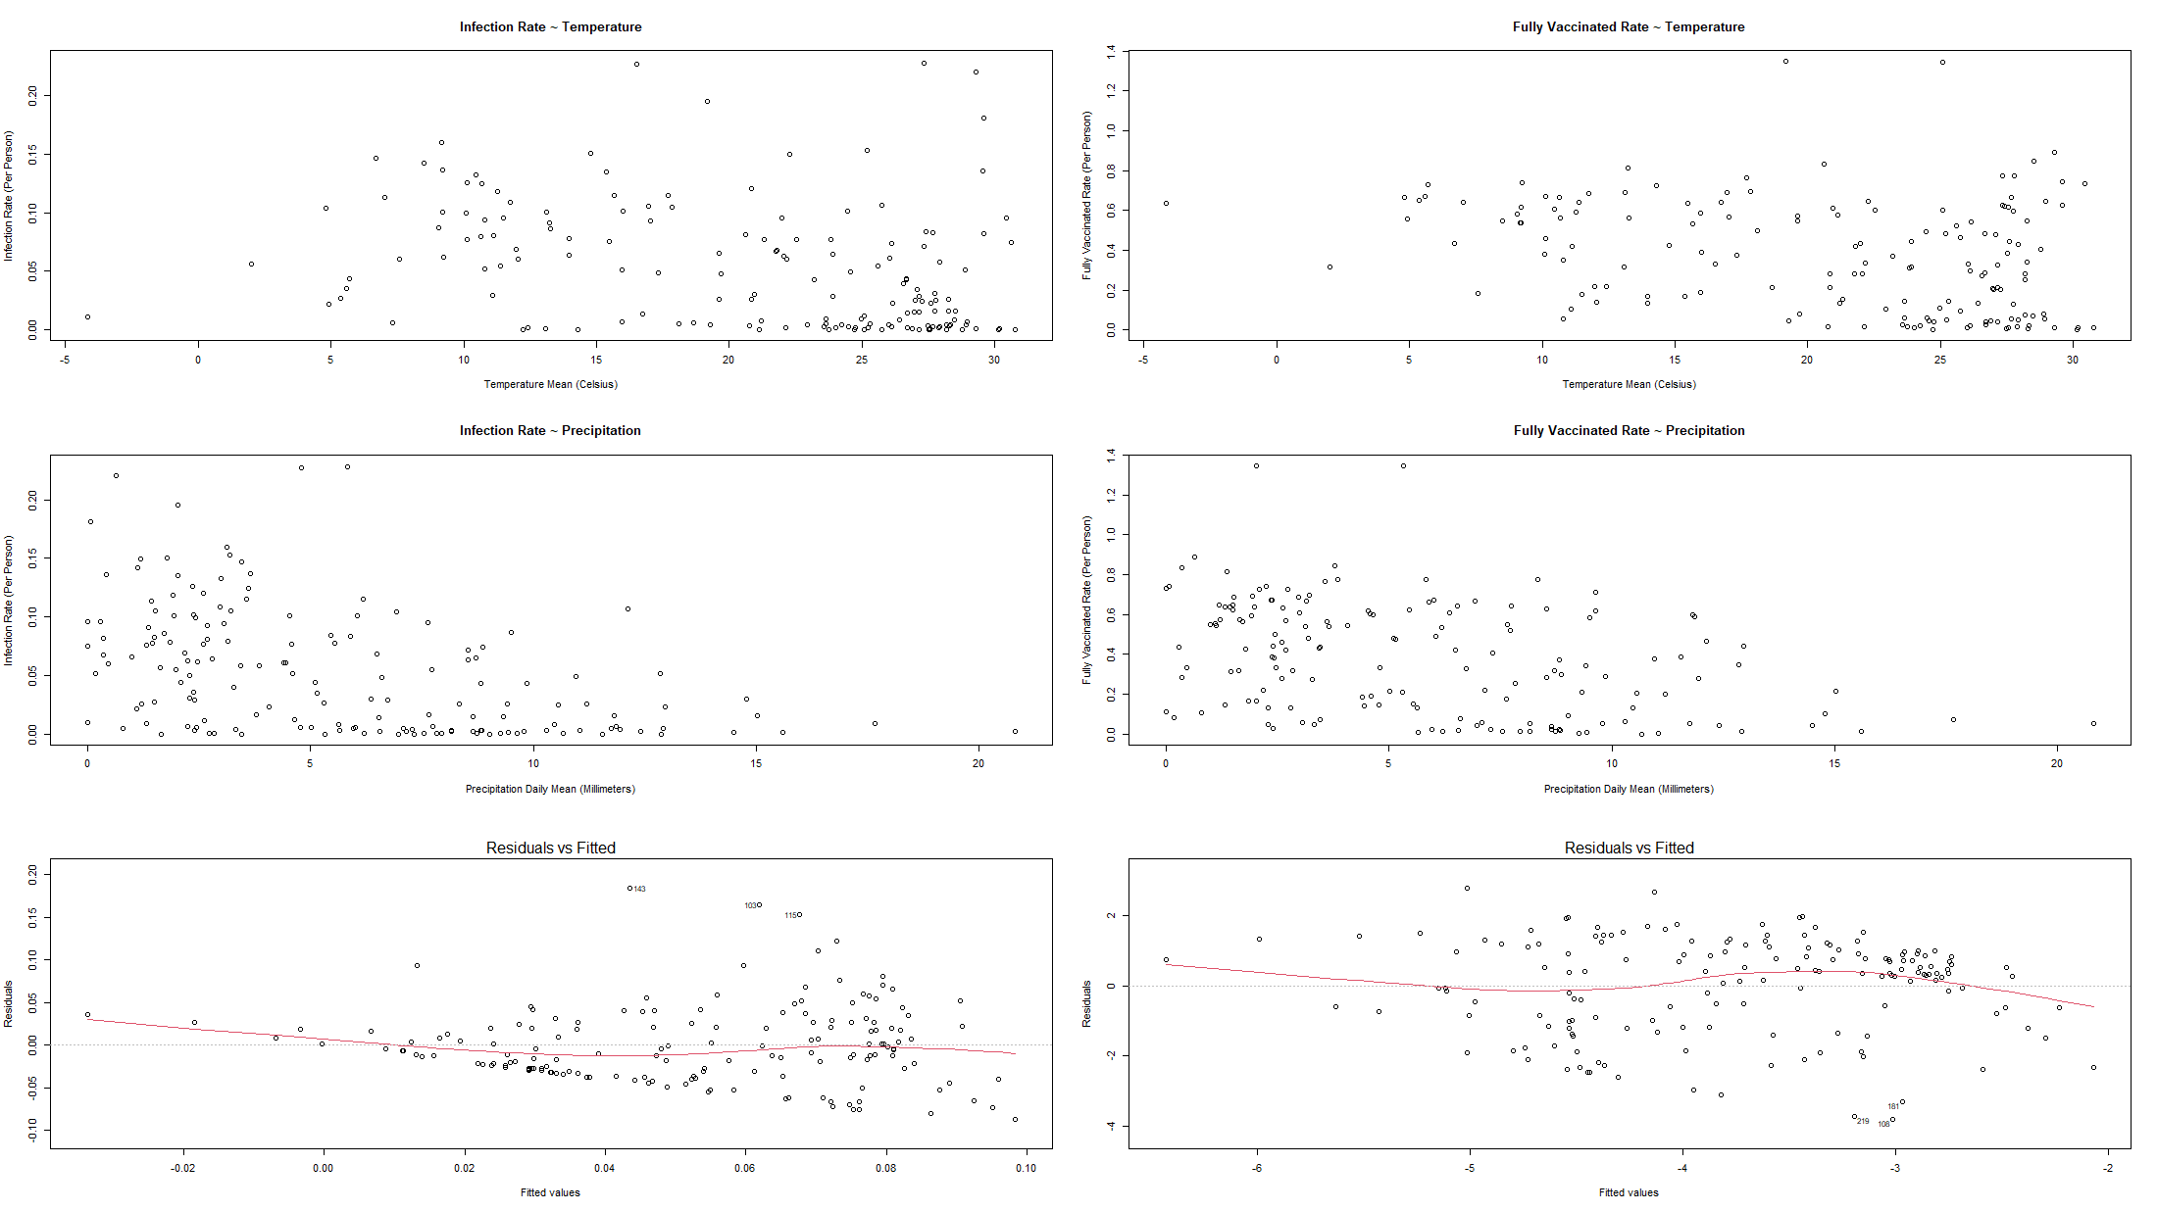
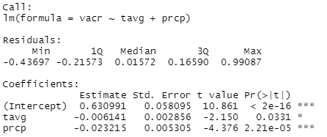
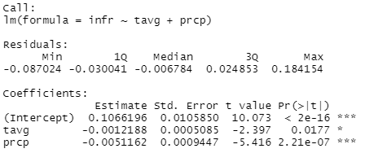
Country Covid Infected Rate
Country Covid Fully Vaccinated Rate

Slide 9
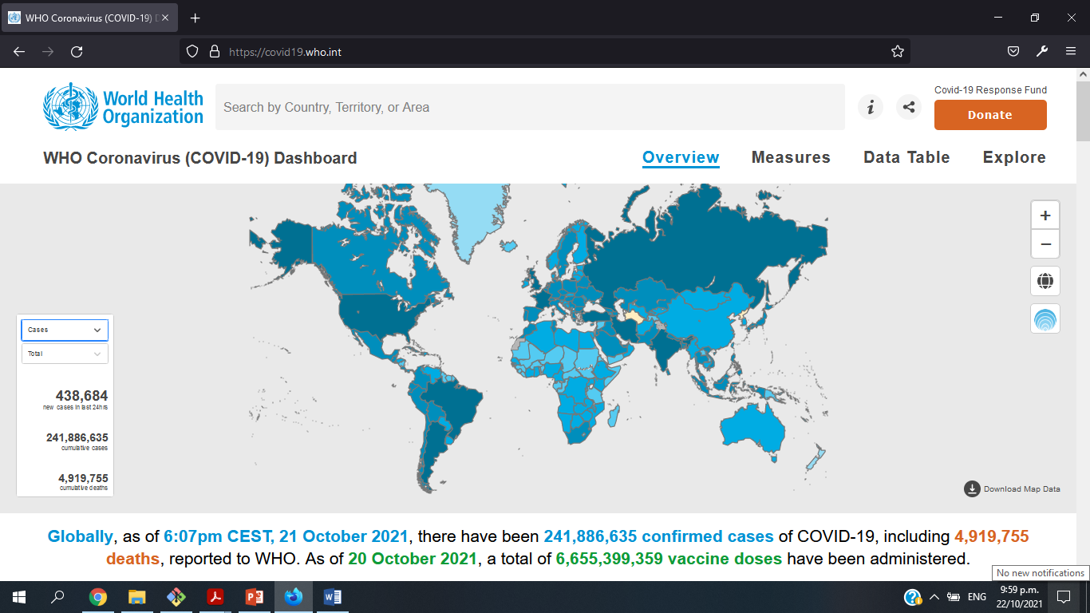
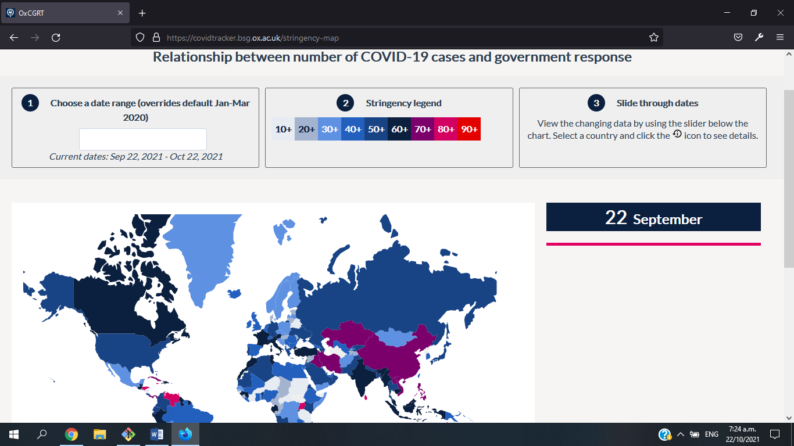

Websites

Slide 10
Methods
Collecting, scrapping and extracting
Cleaning the data using tidyverse, dplyr
Joined using countrycodes
Some of the variable were total number of cases, deaths, vaccinations and stringency index

Slide 11
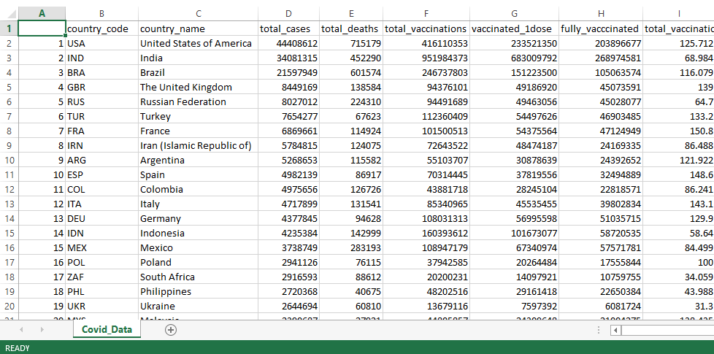
Covid-19 Dataset

Slide 12
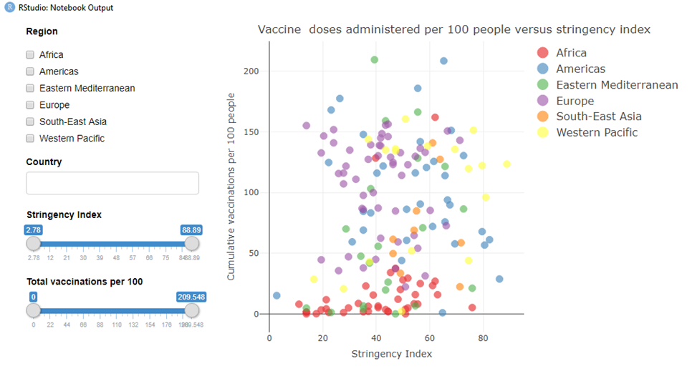
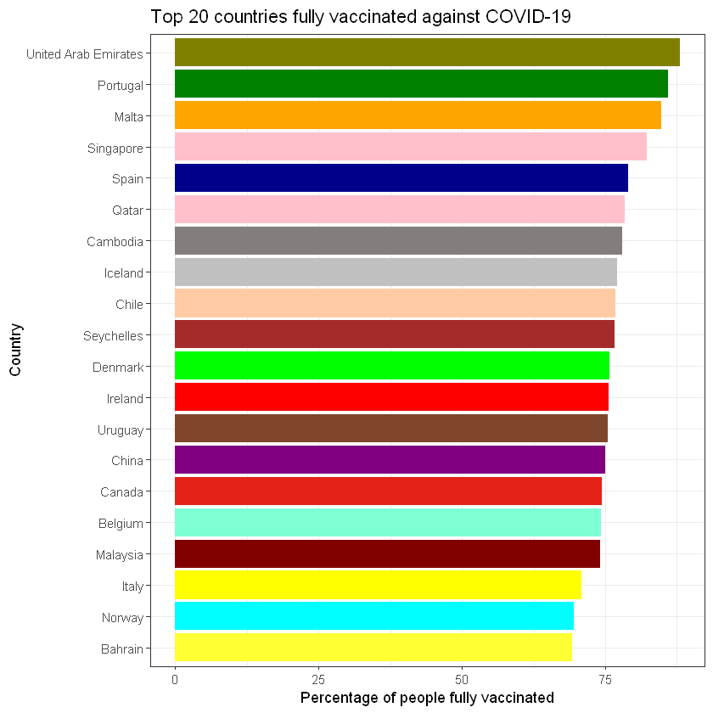

Slide 13
Data Processing
Packages used
Dplyr
countrycode
Clean, process, and Join the datasets
Change column names in climate dataset to suit the other two.
Join the Covid19 & Population datasets into one (by country code)
Join the climate dataset (by country code)
Filter the duplicate and NA values
Prepare the calculated columns and rename as needed
Categorize the countries into OECD (Yes/No)
Produce final dataset (21 columns, 220 rows)

Slide 14
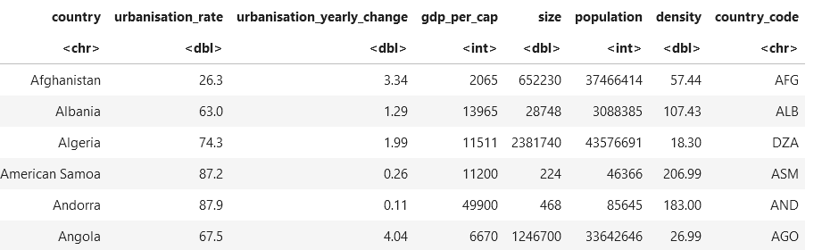
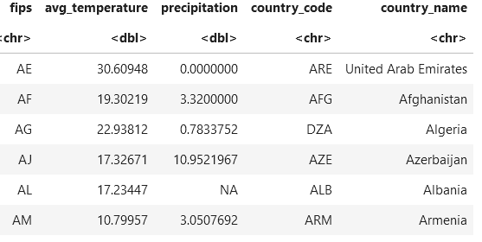
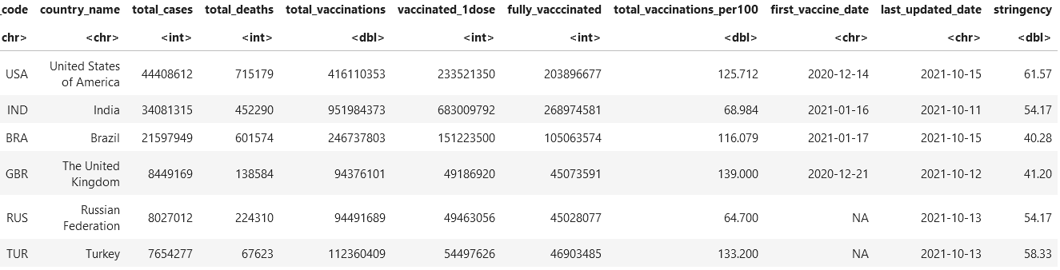
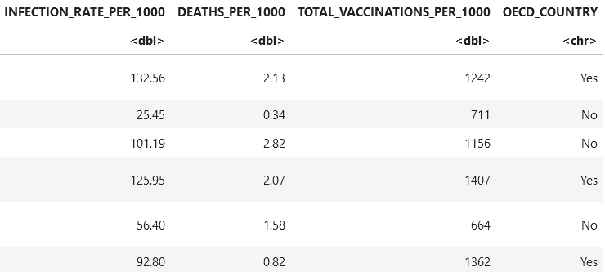
Datasets

Slide 15
