Slide 1

AlzDx : AI-Based Early Detection of Alzheimer's Disease Using Speech and Machine Learning
By-
Bhanu Prakash
Myneni Krishita
D.L.S. Laasya Priya
Notes:
Good morning everyone.
I am laasya
Today, we are presenting our project,
Neurological
Memory ,thinking
Early stage
Analyze speech
Alzdx upload speech

Slide 2
Problem Statement
Early Detection is Challenging
Alzheimer's symptoms often begin with subtle changes in speech, making them difficult to notice during the early stages.
Existing Screening Methods
Current diagnosis generally requires clinical evaluation and specialized tests, limiting accessibility for regular screening.
Need for an AI Solution
A simple, speech-based AI application can provide an accessible and non-invasive method for early risk screening.
Notes:
Early Detection is Challenging
The first challenge is that Alzheimer's develops gradually.
In its early stages, people may only experience very subtle changes in the way they speak or communicate. These changes are often difficult to notice, which leads to delayed diagnosis.
Existing Screening Methods
Another challenge is that current diagnosis usually involves clinical evaluations, cognitive tests, or brain imaging.
Although these methods are effective, they can be expensive, time-consuming, and are not practical for regular screening.
Need for an AI Solution
To overcome these limitations, we propose an AI-based solution.
By analyzing speech transcripts using machine learning, our system can identify early signs of Alzheimer's quickly and non-invasively.
This makes early screening more accessible and can also assist healthcare professionals in the diagnostic process.

Slide 3
Objectives
To Develop an Efficient Detection Model:
Develop an efficient Alzheimer's disease detection model
with high accuracy and reduced computational complexity.
To Improve Robust Speech Classification:
Improve the robustness of speech transcript classification by minimizing the impact of transcription errors.
To Evaluate Model Performance:
Evaluate and compare the proposed model using Accuracy, Precision, Recall, and F1-Score.
To Develop the AlzDx Web Application:
Develop a user-friendly web application for Alzheimer's disease prediction from speech transcripts.
Notes:
Objective 1
Our first objective is to develop an efficient machine learning model that provides high prediction accuracy while keeping computational complexity low.
Objective 2
Our second objective is to improve the robustness of speech transcript classification by minimizing the impact of transcription errors.
This ensures that our model remains reliable even if the speech-to-text output contains minor mistakes.
Objective 3
Our third objective is to evaluate the performance of our model using standard metrics such as Accuracy, Precision, Recall, and F1-Score, and compare it with existing approaches.
Objective 4
Finally, we developed a user-friendly web application called AlzDx.
Through AlzDx, users can upload speech transcripts, and the system predicts whether the speech patterns indicate possible Alzheimer's disease. This makes the solution simple, accessible, and easy to use.

Slide 4
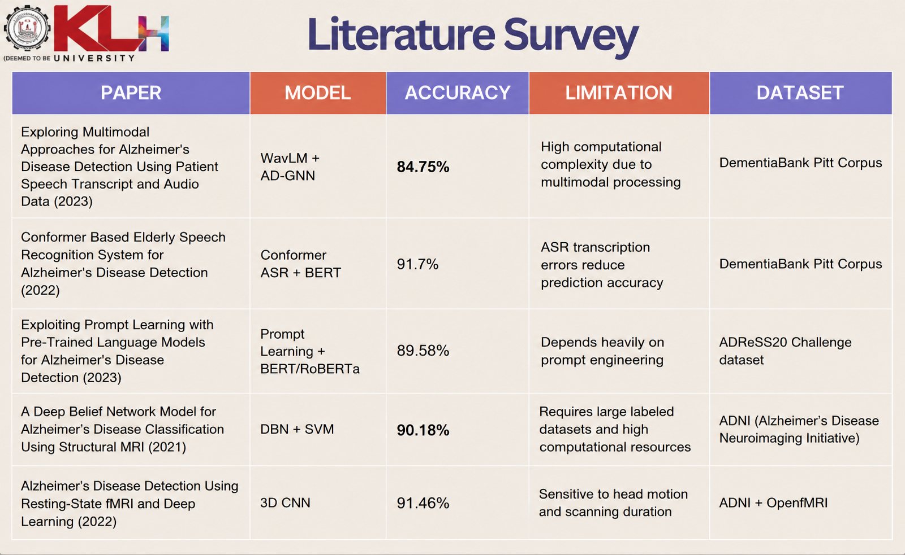
Literature Survey
PAPER | MODEL | ACCURACY | LIMITATION
Exploring Multimodal Approaches for Alzheimer's Disease Detection Using Patient Speech Transcript and Audio Data (2023) | WavLM + AD-GNN | 84.75% | High computational complexity due to multimodal processing
Conformer Based Elderly Speech Recognition System for Alzheimer's Disease Detection (2022) | Conformer ASR + BERT | 91.7% | ASR transcription errors reduce prediction accuracy
Exploiting Prompt Learning with Pre-Trained Language Models for Alzheimer's Disease Detection (2023) | Prompt Learning + BERT/RoBERTa | 89.58% | Depends heavily on prompt engineering
DATASET
DementiaBank Pitt Corpus
DementiaBank Pitt Corpus
ADReSS20 Challenge dataset

Slide 5
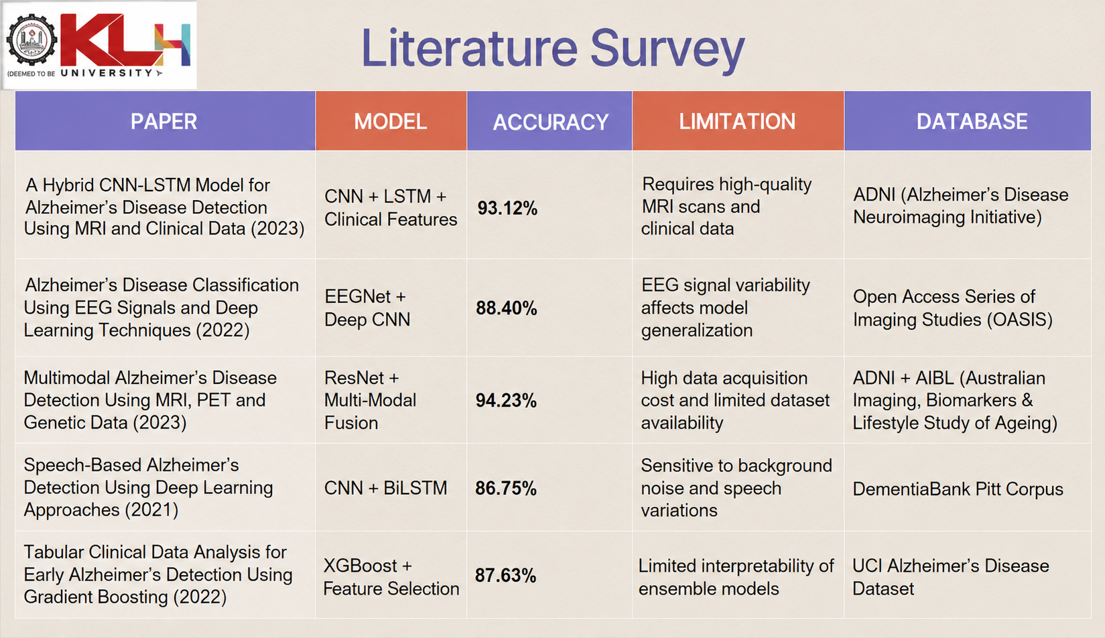

Slide 6
Research Gap
01
02
03
High Computational Cost
Multimodal models require significant processing power.
Difficult to deploy in real-time applications.
Lack of End-to-End Applications
Prediction accuracy relies on ASR quality.
Transcription errors affect classification.
Limited Model Robustness
Prompt engineering is required for good performance.
Reduces consistency across different datasets.
04
Lack of Practical Features
Most studies compare only one model.
Limited explainability and user-friendly reporting.

Slide 7
Innovation & Novelty
NLP-based early Alzheimer's screening using speech transcripts.
Comparative analysis of DeBERTa-v3 + Attention.
AI-powered chatbot for prediction explanation.
Automatic report generation with confidence scores and linguistic insights.
End-to-end web application with analysis history and downloadable PDF reports.

Slide 8
Feasibility
Technical Feasibility
The project uses established technologies including React, FastAPI, Python, PostgreSQL, and Scikit-learn.
Practical Feasibility
The application requires only a microphone or uploaded audio, making it easy to use and deploy.
Future Scalability
The architecture supports future features such as multilingual support, real-time transcription, and explainable AI.

Slide 9
Project Plan
Research
Evaluation
Conduct literature survey and study existing approaches.
Compare three ML models using standard performance metrics
Development
Deployment
Build the ML pipeline and develop the web application
Integrate the best model with reporting and AI assistant features.

Slide 10
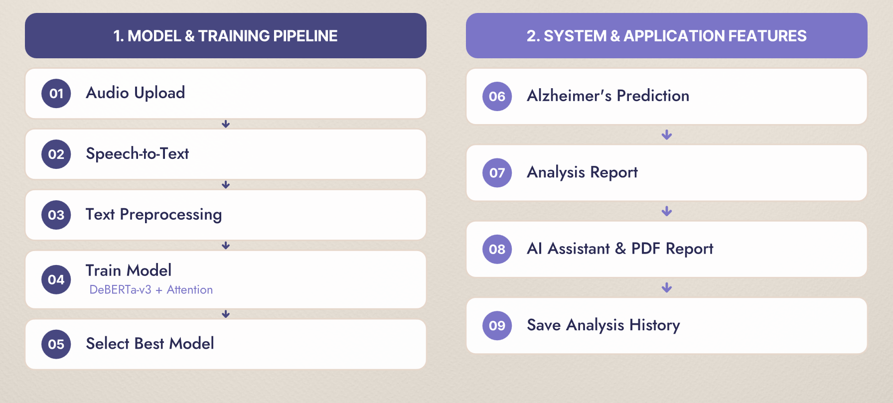

Proposed Methodology
1. MODEL & TRAINING PIPELINE
2. SYSTEM & APPLICATION FEATURES
Audio Upload
Alzheimer's Prediction
01
06
Speech-to-Text
02
Analysis Report
07
Text Preprocessing
03
AI Assistant & PDF Report
08
Train & Compare Models
DeBERTa-v3 + Attention
04
Save Analysis History
Select Best Model
09
05

Slide 11
Thank you

