Slide 1



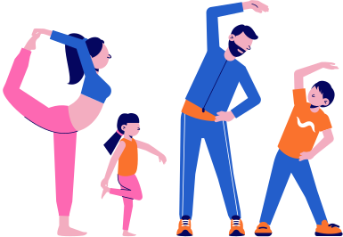

AMIFIT
NTCC
A Hybrid Approach to Exercise Recognition and Performance Analysis Using Artificial Intelligence
Bhanu Prakash Pandey

Slide 2

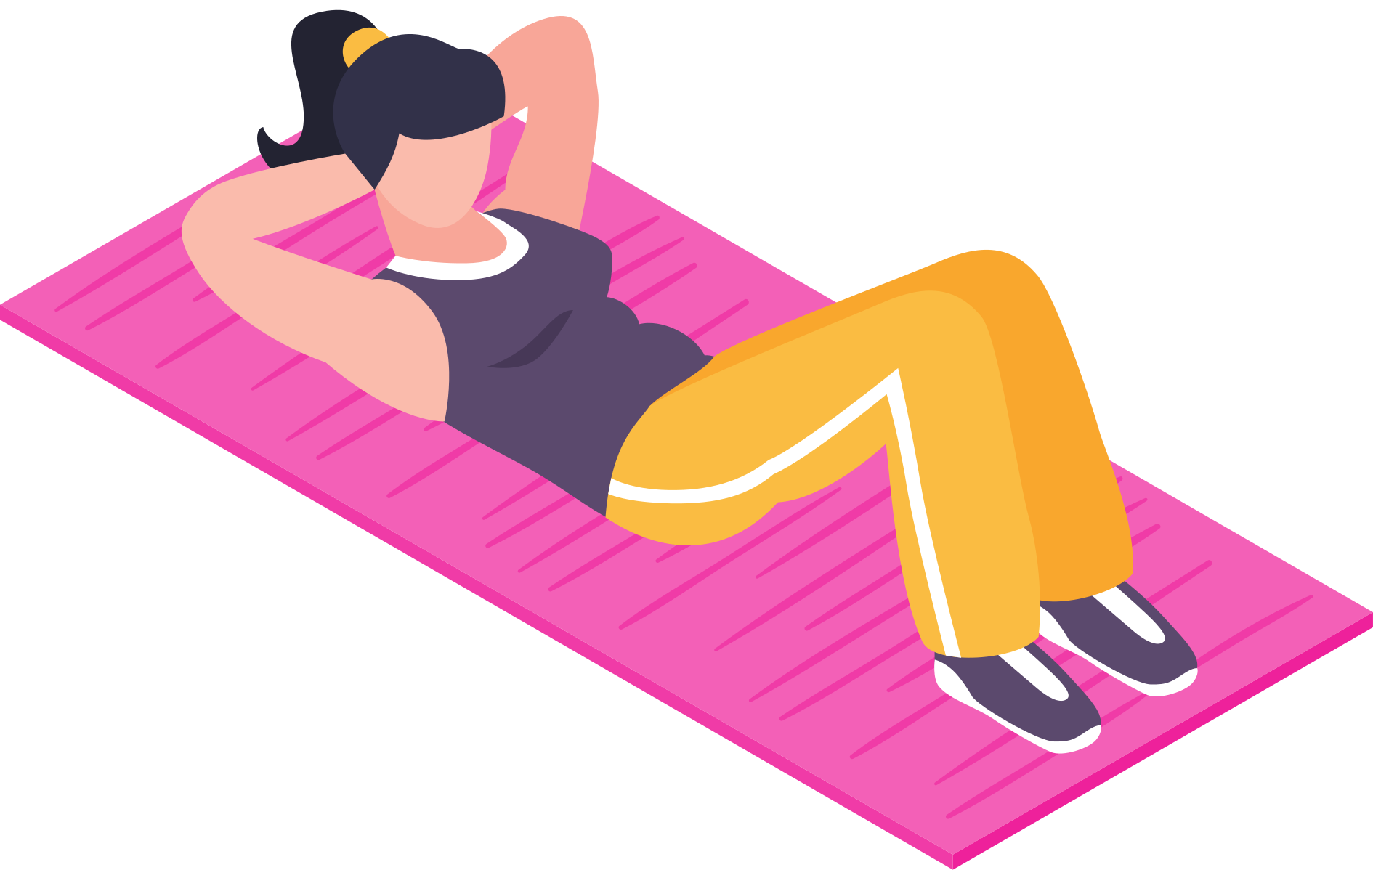

INTRODUCTION TO
AMIFIT
Physical fitness and proper exercise form are crucial for performance and injury prevention.
With the rise of home workouts and online training, supervision is often missing.
Incorrect posture can reduce exercise benefits and lead to injuries.
Artificial Intelligence (AI) offers real-time solutions through automation and feedback.
This research proposes a hybrid AI-based system combining vision and machine learning for accurate exercise recognition and posture analysis.
Goal: Improve user experience, ensure safety, and enable intelligent fitness trac

Slide 3
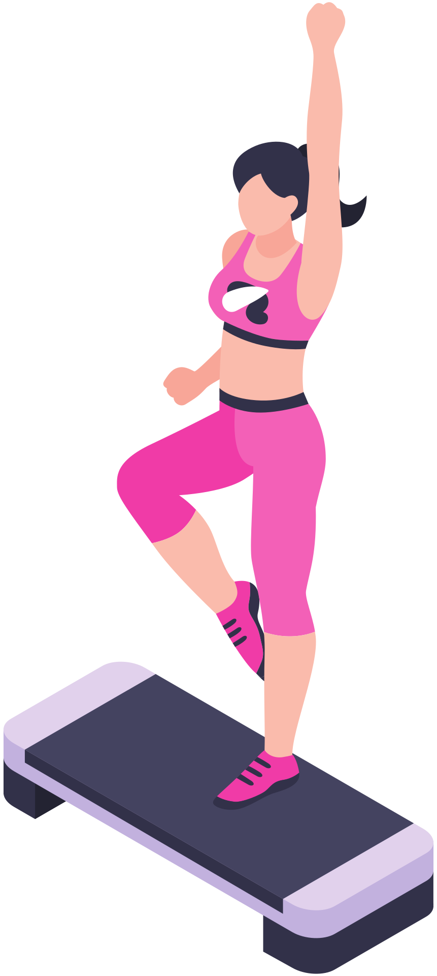

WHY HYBRID
APPROACH?
Sensor-based: Great motion data, poor posture analysis.
Vision-based: Excellent posture analysis, but sensitive to environment.
Combines Strengths
Improves Accuracy
Enables Real-Time,
Sensors capture precise motion and acceleration, while vision (pose estimation) provides detailed posture and joint alignment.
Together, they overcome individual weaknesses and provide a complete understanding of exercise quality.
Vision-only systems can fail in poor lighting or occlusion, and sensor-only systems can't evaluate form.
A hybrid system works consistently in real-world conditions, ensuring more accurate repetition counting and posture evaluation.
Machine learning models analyze both sensor and visual data to provide instant corrections and insights.
This supports safer and smarter workouts without the need for a human trainer.

Slide 4

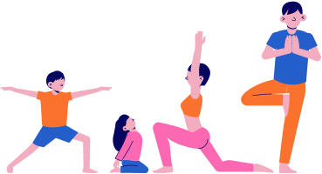
HOW THE EXERCISE RECOGNITION
01
Video Capture & Pose Detection:
Captures live video from the webcam using OpenCV.
Processes each frame with MediaPipe Pose to detect body landmarks (like shoulder, elbow, wrist).
ALGORITHM WORKS
02
Angle Calculation:
Calculates the angle at the elbow using the coordinates of shoulder, elbow, and wrist.
This helps determine the arm's bending during bicep curls.
03
Repetition Counting Logic:
If the elbow angle is >160°, it marks the "down" stage.
If the angle goes <30° after "down", it marks the "up" stage and increments the rep counter.
04
Live Feedback Display:
Displays current angle, rep count, and movement stage ("up" or "down") on the video feed in real-time.
Makes the system interactive and user-friendly.

Slide 5
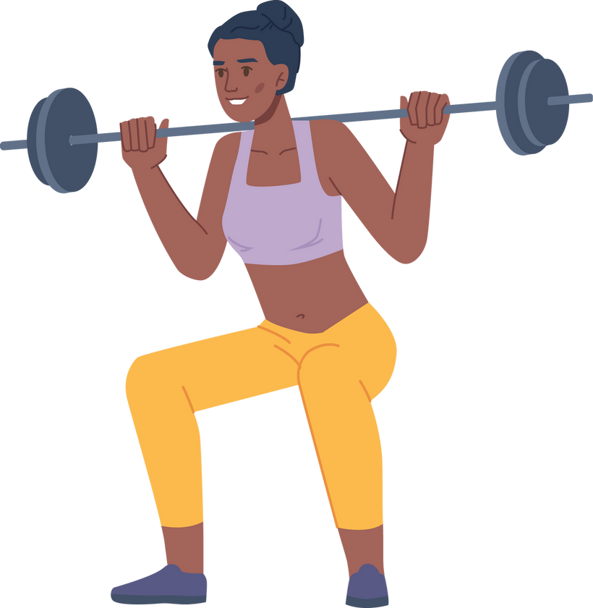
AREAS OF IMPLEMENTATION OF THE HYBRID MODEL
Home Fitness & Smart Gyms
Real-time workout tracking with rep counting and posture correction.
Smart mirrors and fitness apps with AI-driven coaching.
Virtual Personal Training
Remote coaching platforms that offer feedback like a human trainer.
Personalized routines based on user movement and performance.
Professional Sports & Athletic Training
Analyzing form and biomechanics in elite sports for injury prevention and performance optimization.
Detailed motion feedback for complex drills and exercises.
Elderly Care & Fall Detection
Monitoring daily movements to detect unsafe postures or loss of balance.
Ensures safety in assisted living environments.

Slide 6
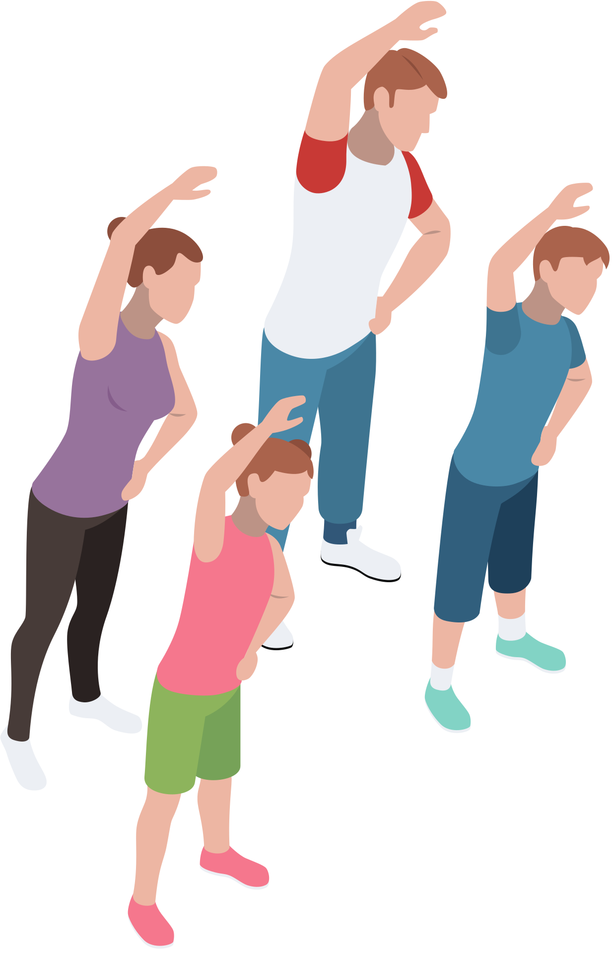

PROPOSED SYSTEM
OVERVIEW
In this project, we’ve designed a hybrid system that combines pose estimation, angle detection, and machine learning to recognize exercises and evaluate performance in real-time. The system works with just a standard camera—no need for wearables—which makes it easy and accessible for users.
Key Components:
Video Input: The system starts by capturing a live video stream from a webcam or smartphone. This acts as the input for detecting movements.
Pose Detection: Using models like BlazePose or OpenPose, the system identifies keypoints on the user’s body—shoulders, elbows, wrists, knees, etc.—which helps in understanding posture and motion.
Joint Angle Calculation: Once the keypoints are tracked, the system calculates joint angles (like the angle between the shoulder, elbow, and wrist) to determine if the user is performing the exercise correctly.
Repetition Counting & Stage Detection: Based on angle thresholds, the system recognizes different stages of movement (like "up" and "down" in a bicep curl) and automatically counts reps.
Machine Learning Feedback: The system uses techniques like Dynamic Time Warping and k-NN classification to compare user motion against ideal exercise patterns and detect mistakes or inconsistencies.
Real-Time Visual Feedback: Users get instant feedback on their screen—like rep count, movement stage, and whether their posture is correct—helping them adjust immediately during the workout.

Slide 7
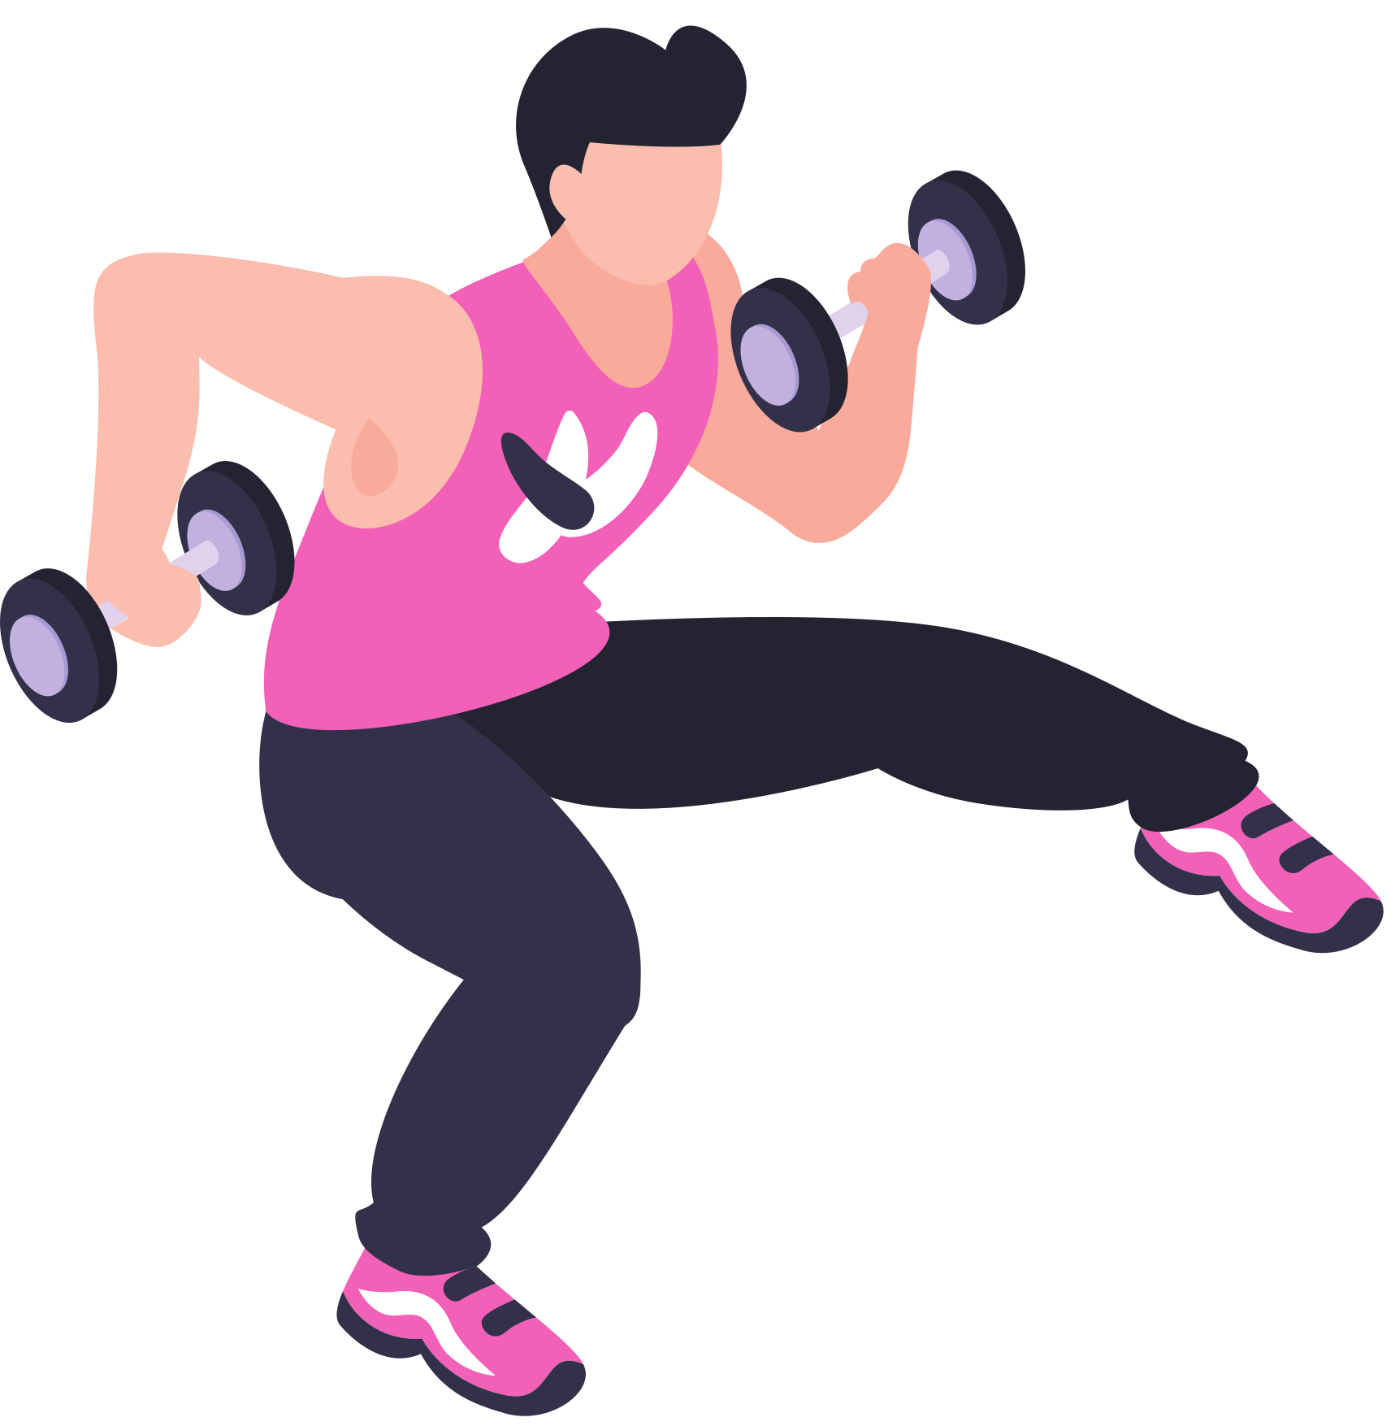
HOW WE DETECT AND
COUNT BICEP CURLS USING AI
Step 1: Spotting the Body Joints
We use MediaPipe, a computer vision tool, to track key body points like the shoulder, elbow, and wrist in real-time through the webcam.
Step 2: Measuring the Elbow Angle
To check if a curl is correct, we calculate the angle at the elbow using simple math between those three points.
If the arm is fully extended, the angle is big (~160°). When curled, it gets small (~30°).
Step 3: Counting the Reps
We keep track of the movement using a stage system:
When the arm is straight → we mark the stage as "down"
When the arm curls up → and the angle drops below 30°, we switch to "up" and count a rep
Only full curls (from down to up) are counted—no cheating with half-reps!
Step 4: Giving Instant Feedback
Everything shows up on the screen:
The angle at the elbow
The current rep count
Whether you’re in the up or down position

Slide 8
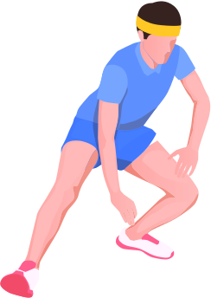
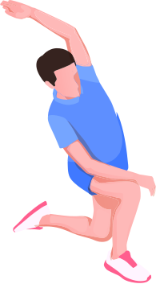
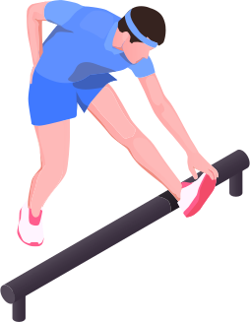


WARM UP MOVEMENT
PUSH UPS
LUNGES
SQUAT

Slide 9
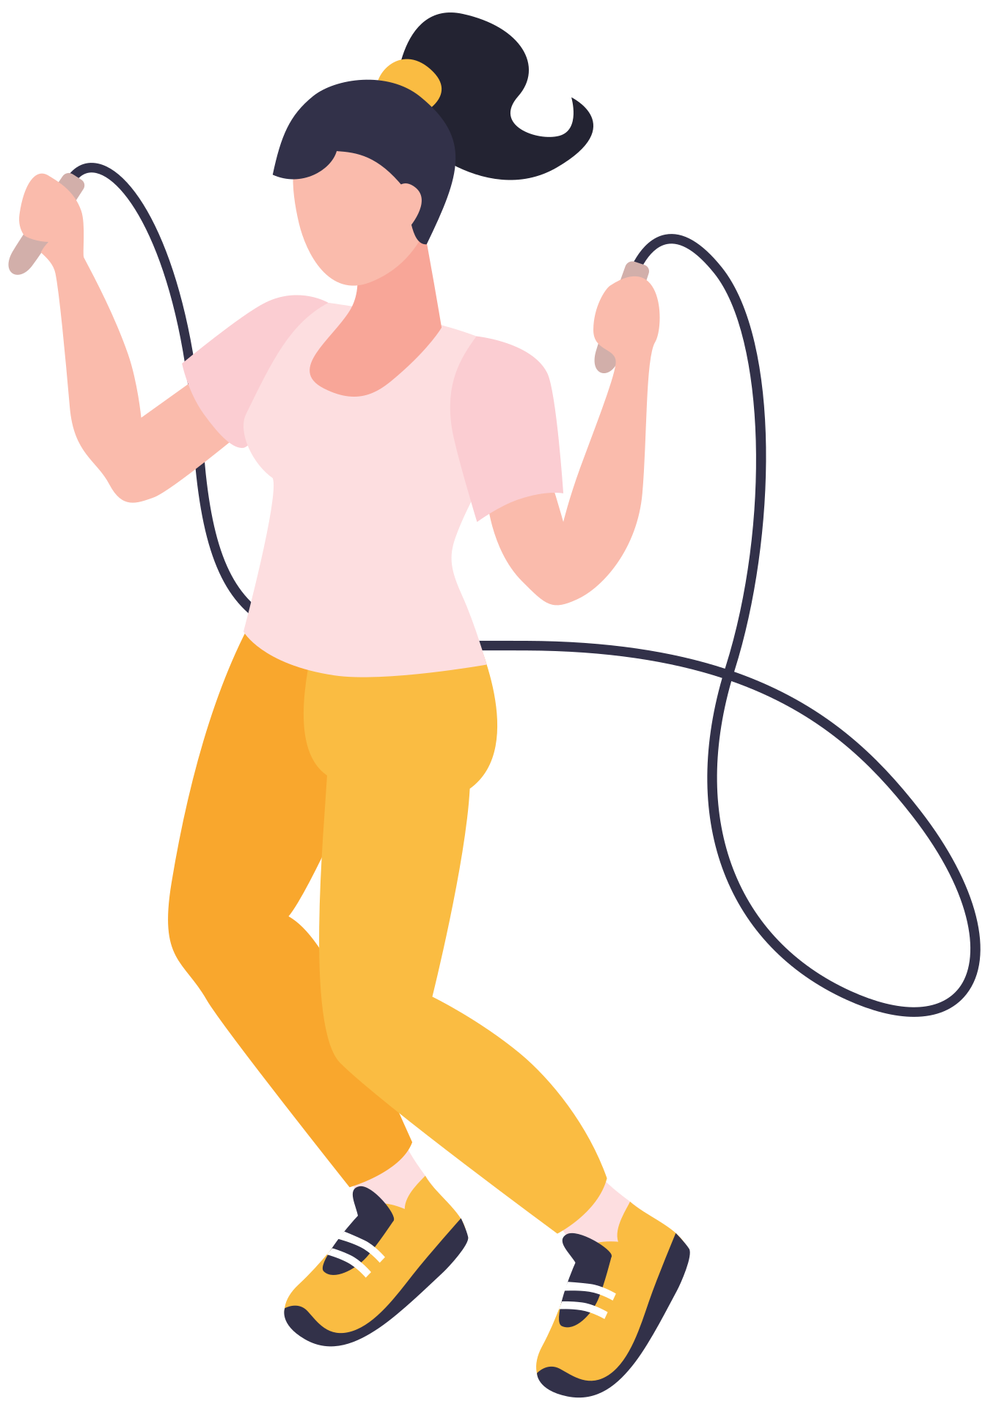
RESULTS &
DISCUSSION
Performance Evaluation of the Hybrid AI System
Achieved high accuracy in exercise recognition using pose estimation (BlazePose).
Real-time feedback overlay effectively highlighted posture correctness and movement errors.
Accuracy Metrics
Pose estimation accuracy: Above 90% in varied lighting and background conditions.
Repetition counting: 95% accuracy in structured environments.
Motion classification with k-NN: Consistent classification of correct vs incorrect forms.
Comparative Study
Outperformed traditional methods (sensor-only, vision-only).
Showed better adaptability to different body types and camera angles.
Observational Insights
System performed well in indoor and moderately-lit environments.
Minor limitations observed in extremely cluttered or low-light backgrounds.
Limitations
Accuracy drops slightly in crowded scenes or occlusions.
Requires a standard camera position for best results.

Slide 10


CONCLUSION
The hybrid AI system offers a reliable, scalable, and user-friendly fitness monitoring solution.
Enhances workout safety, efficiency, and accessibility.
Paves the way for AI-driven digital fitness platforms and personal coaching.

Slide 11

THANK'S

