Slide 1

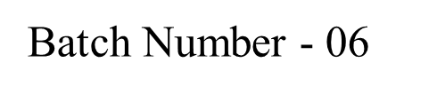
FireGuard: A CRNN-based Fire Detection and Alert System
R.V.R. & J.C. College of Engineering(A) Chowdavaram, Guntur, A.P.
Department of CSE(Data Science)
Under the Guidance of:
Smt. K. Aravinda
Assistant Professor
Y. Meghana | Y21CD065
P. Bhanu Saketh | Y21CD040

Slide 2
Contents
Abstract
Introduction
Problem Statement
Literature Survey
Existing Work
Proposed Work
Block Diagram of the Proposed Work
Algorithm
Dataset
Implementation
References

Slide 3
Abstract
Rising global temperatures have intensified the frequency and severity of wildfires, posing significant threats to forests and biodiversity. These wildfires, driven by both natural occurrences and human activities, have become a pressing global concern. In response to this challenge, we propose a novel lightweight convolutional neural network (CNN) model specifically tailored for wildfire detection using RGB images. Our CNN architecture is optimized for compatibility with aerial images and video surveillance systems, enabling seamless integration on-site image processing.

Slide 4
Introduction
Overview
The project focuses on the development of a novel lightweight convolutional neural network (CNN) model,
named EdgeFireSmoke, for real-time fire and smoke detection in forest environments. The proposed method
aims to address the critical need for effective wildfire detection.
Objective
The project's objective is to provide a reliable and efficient method for real-time wildfire detection,
with potential applications in forest conservation, human health, and the preservation of animal life.

Slide 5
Significance
The project's significance lies in its potential to provide a more accurate and efficient
model for detecting wildfires, with a particular focus on real-time detection using
unmanned aerial vehicles (UAVs). The proposed EdgeFireSmoke model is designed to
reduce computational costs and classification time, making it suitable for
deployment in UAVs.

Slide 6
Problem Statement
Developing a real-time wildfire detection system is crucial for promptly identifying and alerting
authorities to potential fire outbreaks. By enabling swift response actions, such a system can
significantly mitigate damage to forests, biodiversity, and human communities. Leveraging advanced
image processing techniques, the system will analyze RGB images in real-time to accurately detect
wildfires.
Through seamless integration with existing monitoring infrastructure, it will enhance the efficiency
of response efforts, ensuring timely deployment of resources to contain and extinguish fires before
they escalate. This proactive approach not only reduces the environmental impact of wildfires but
also safeguards lives and property, underscoring the urgency of developing such a system.

Slide 7
Literature Survey
Reference | Research Title | Data set | Proposed Methodology | Parameters
[1] | UAV Image-based Forest fire Detection approach using CNN | UAV Images | LBP+SVM& CNN | Accuracy=86
[2] | Forest Fire detection using combined architecture of separable Convolution and Image Processing | UAV Images | Separable CNN | Accuracy=92, precision=95, Recall=91
[3] | Wildfire Front Monitoring with Multiple UAVs using Deep Q-learning | UAV Images | Deep Q-Learning | Score=0.22
[4] | An integrated smoke detection method based on CNN and Image processing | Self-created Dataset | HSV+R-CNN | Accuracy=93.58, precision=96.33
[5] | Early wildfire Smoke detection in videos | Self-created Dataset | FCN | Accuracy=95.6

Slide 8
Literature Survey
Reference | Research Title | Data set | Proposed Methodology | Parameters
[6] | Research on Forest fire image recognition algorithm based on color feature statistics | Self-created Dataset | Fuzzy C-means Clustering | Accuracy=93
[7] | Efficient and compact CNN architecture for non-temporal real time fire detection | Self-created Dataset | ShuffleNetV2-onFire | Accuracy=95, precision=96
[8] | Optimal placement and intelligent smoke detection algorithm for wildfire monitoring cameras | Self-created Dataset | ResNet50 | Accuracy=79.41
[9] | 3D parallel fully CNN for real time video wildfire smoke detection | Self-created Dataset | 3D-PFCN | Accuracy=93
[10] | Video smoke detection based on CNN | Self-created Dataset | CNN& Mixture Gaussian Model | Accuracy=97.6

Slide 9
Existing Work
The preprocessing steps include image normalization and resizing RGB images. It consists of several layers, starting with two Conv2D layers, each followed by a MaxPooling2D layer.
These layers perform convolution operations on the input image, extracting features and reducing spatial dimensions through max pooling. The resulting feature maps are then flattened into a 1D vector using a Flatten layer.
Following this, there are two Dense layers, each with 64 neurons and ReLU activation, which introduce non-linearity to the network.
Finally, the output layer consists of a Dense layer with a number of units equal to the number of classes in the classification task, employing the softmax activation function to produce probability scores for each class.

Slide 10
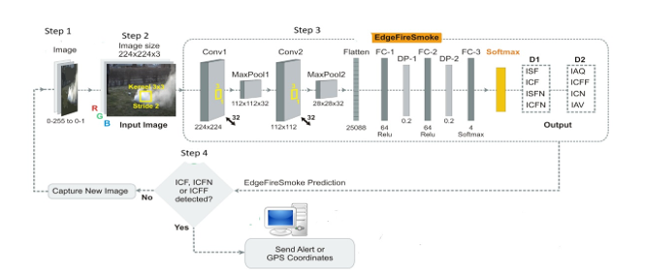
Working of CNN architecture

Slide 11
Proposed Work
CRNN Architecture
Integration of convolutional and recurrent layers for simultaneous spatial and temporal analysis.
Convolutional layers extract spatial features from frames, while LSTM layers capture temporal dependencies.
Dropout regularization ensures model generalization and prevents overfitting.
Fires exhibit dynamic behaviors that evolve over time, necessitating models capable of understanding temporal patterns.
CRNNs excel in capturing temporal information, crucial for detecting changes in fire intensity, size, and movement.
By considering sequences of frames, CRNNs offer superior sensitivity to evolving fire dynamics.

Slide 12
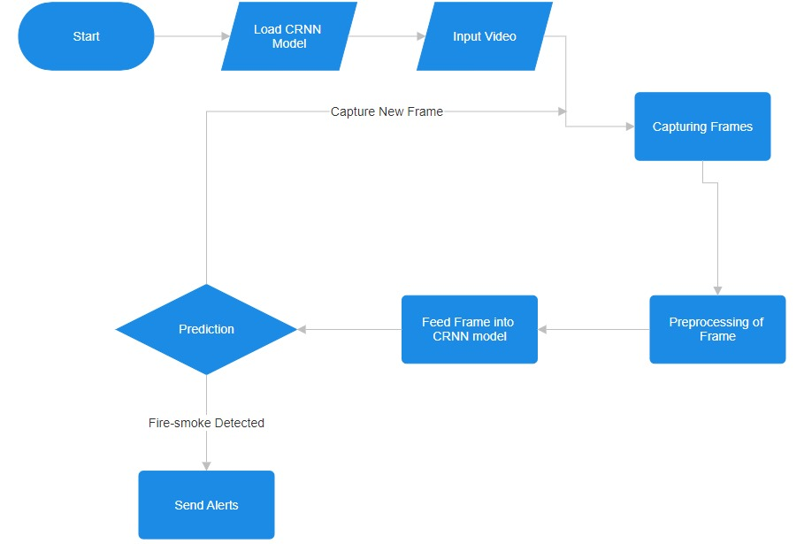
Block Diagram

Slide 13
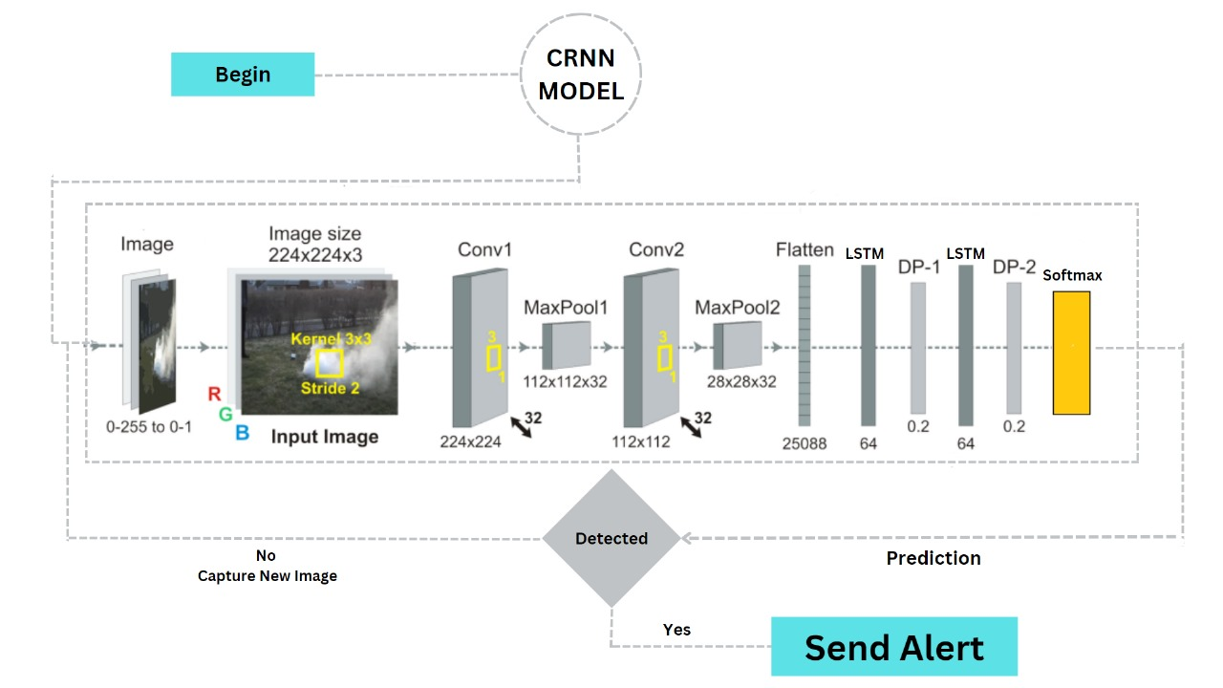
Methodology/Algorithm
Working of CRNN architecture

Slide 14
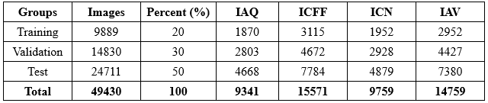
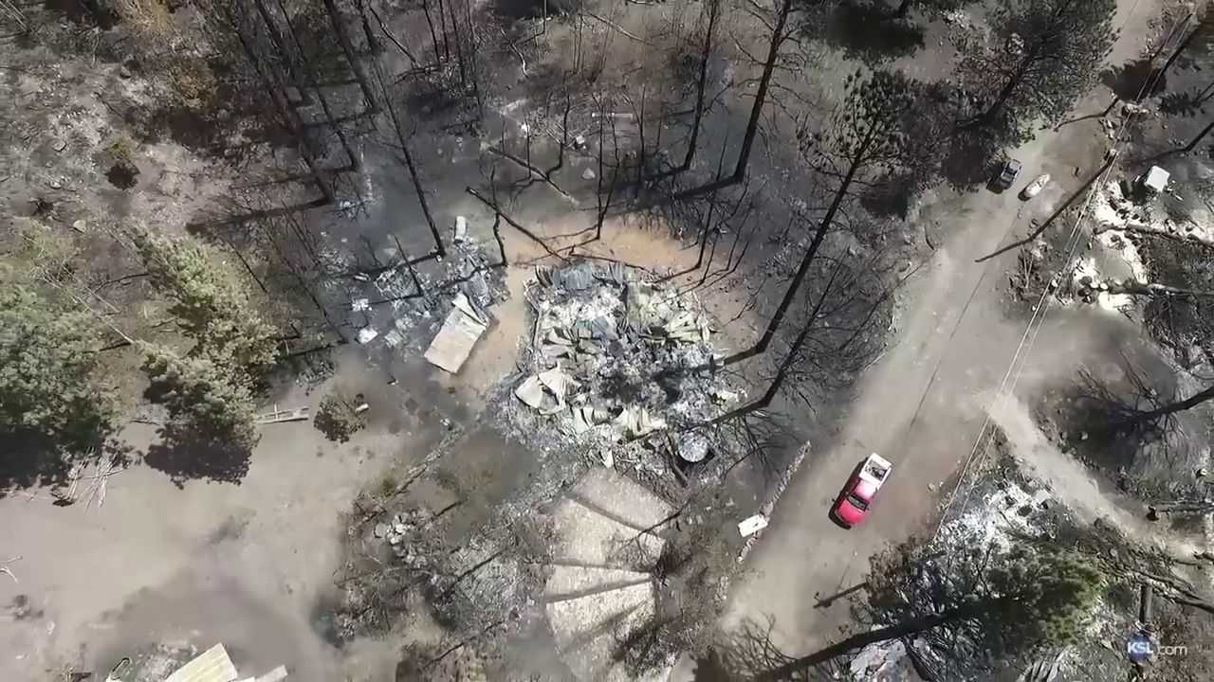
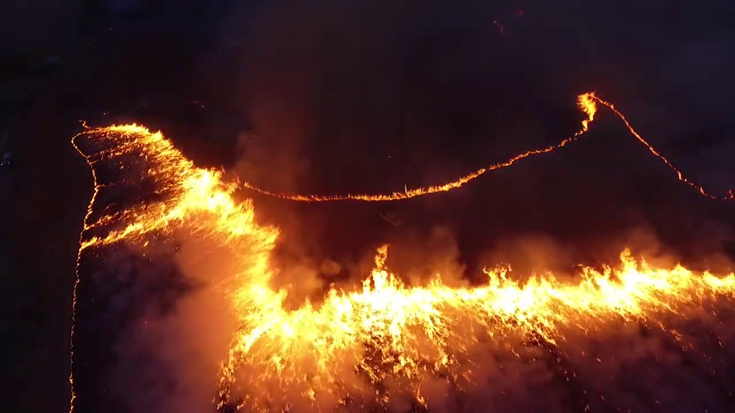
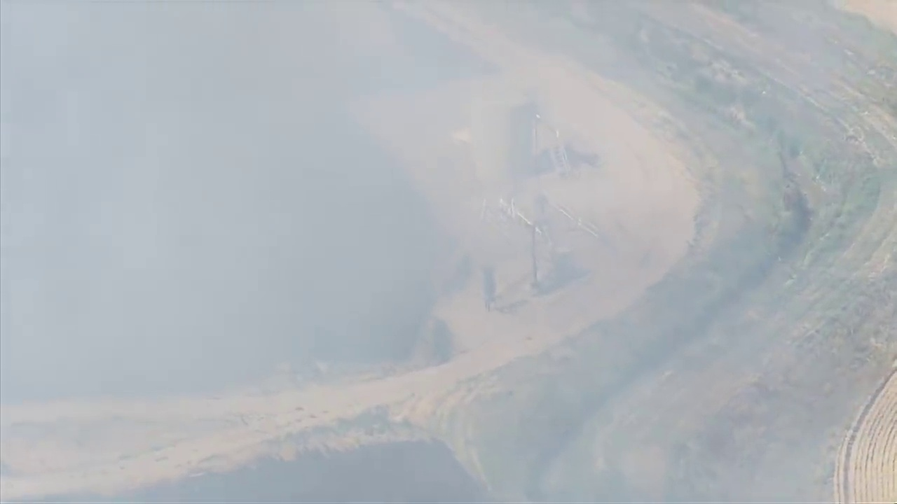
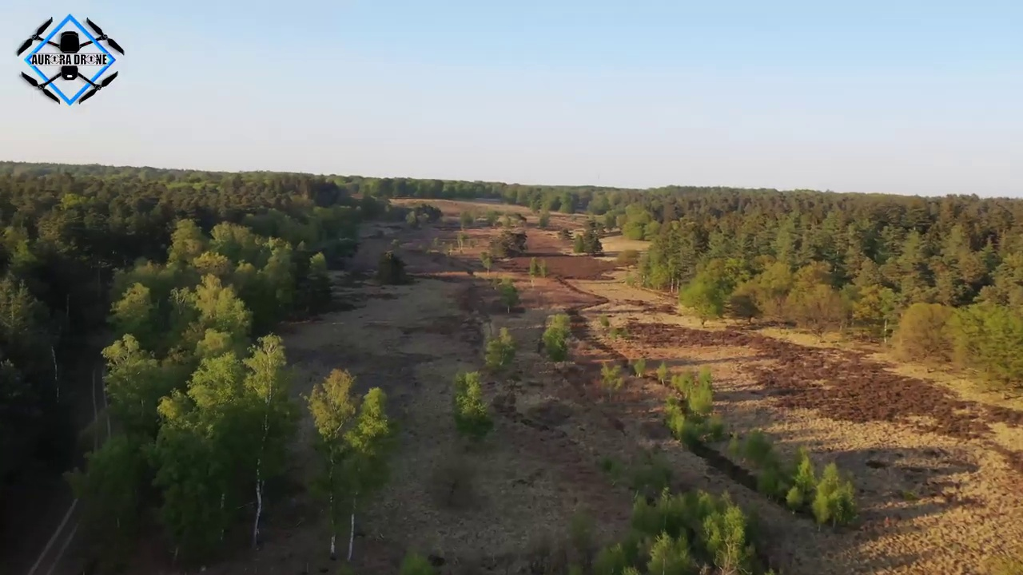
Dataset
burned-area(IAQ)
fire-smoke(ICFF)
fog-area(ICN)
Green-area(IAV)

Slide 15
Implementation with Sample Data
train_datagen = ImageDataGenerator(
rescale=1./255,
rotation_range=40,
width_shift_range=0.2,
height_shift_range=0.2,
shear_range=0.2,
zoom_range=0.2,
horizontal_flip=True,
fill_mode='nearest’
)

Slide 16
Implementation with Sample Data
# Define the CRNN model
model = tf.keras.models.Sequential([
tf.keras.layers.Conv2D(filters=32, kernel_size=(3, 3), strides=(1, 1), padding='same', activation='relu', input_shape=(IMAGE_SIZE[0], IMAGE_SIZE[1], 3)),
tf.keras.layers.MaxPooling2D(pool_size=(2, 2), strides=(2, 2), padding='valid'),
tf.keras.layers.Conv2D(filters=32, kernel_size=(3, 3), strides=(1, 1), padding='same', activation='relu'),
tf.keras.layers.MaxPooling2D(pool_size=(2, 2), strides=(2, 2), padding='valid'), # Adjusted stride here
tf.keras.layers.TimeDistributed(tf.keras.layers.Flatten()),
tf.keras.layers.LSTM(units=64, return_sequences=True),
tf.keras.layers.Dropout(rate=0.2),
tf.keras.layers.LSTM(units=64),
tf.keras.layers.Dropout(rate=0.2),
tf.keras.layers.Dense(units=4, activation='softmax')
])

Slide 17
References
[1] https://ieeexplore.ieee.org/document/8833958
[2] https://ieeexplore.ieee.org/document/9425170
[3] https://ieeexplore.ieee.org/document/9340340
[4] https://ieeexplore.ieee.org/document/9304985
[5] https://ieeexplore.ieee.org/document/9413231
[6] https://ieeexplore.ieee.org/document/9408856
[7] https://ieeexplore.ieee.org/document/9356284
[8] https://ieeexplore.ieee.org/document/9068226
[9]https://www.researchgate.net/publication/329853862_3D_Parallel_Fully_Convolutional_Networks_for_Real-Time_Video_Wildfire_Smoke_Detection
[10] https://ieeexplore.ieee.org/document/8789075

