Slide 1
Real-Time Operating System Support in a Multimedia Communication system
An In-depth Exploration of Paging, Page Tables, and Page Fault Handling
Tejasri .Y (192210461)
M. Bhanu Vardhan (192210219)
A. Krishna Kowshik (192210479

Slide 2
Abstract
This paper presents an abstract for the integration of real-time operating system (RTOS) support within a multimedia communication system. With the increasing demand for multimedia applications, the need for efficient and reliable real-time processing becomes crucial. The proposed system aims to address this need by incorporating RTOS functionalities tailored for multimedia communication tasks. By leveraging features such as task scheduling, resource allocation, and interrupt handling, the RTOS enhances system responsiveness and ensures timely delivery of multimedia data.

Slide 3
INTRODUCTION:
In the dynamic landscape of multimedia communication systems, real-time operating system (RTOS) support plays a pivotal role in ensuring seamless performance and reliability. With the ever-growing demand for instant data processing and transmission, RTOS provides a robust framework that prioritizes timely execution of tasks. This support is particularly crucial in multimedia applications where real-time audio, video, and data streams must be processed without delay to maintain quality and user experience.

Slide 4
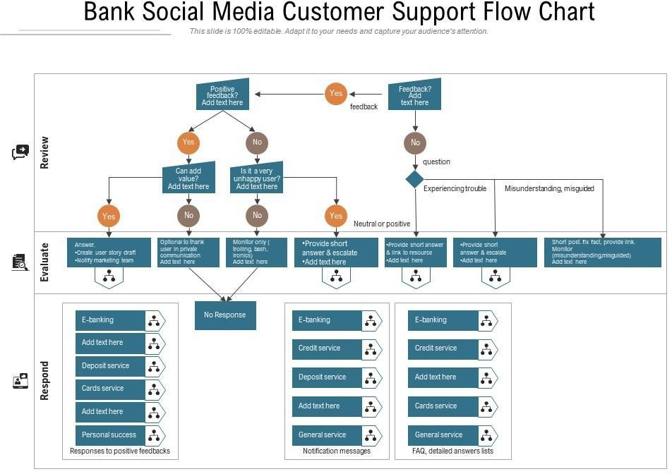
PROCESS:
.

Slide 5
OBJECTIVES
The primary objective of a Virtual Memory Management (VMM) system is to efficiently manage the computer’s memory resources, providing each process with the illusion of a large, contiguous address space while ensuring optimal use of the physical memory. This involves the abstraction of physical memory into a more extensive virtual address space, allowing the execution of programs that require more memory than what is physically available. The VMM system aims to achieve several critical goals: to isolate and protect processes, ensuring that each operates within its own virtual space without interfering with others; to enable multitasking by dynamically allocating and deallocating memory as needed by different processes; and to handle memory shortages gracefully through techniques like paging and swapping, which load and unload memory pages between physical memory and secondary storage. Additionally, the system seeks to optimize performance through efficient address translation mechanisms and effective page replacement strategies, minimizing the overhead and latency associated with memory management. Ultimately, the VMM system is designed to maximize system stability and performance, providing a robust foundation for running diverse and complex applications in a secure and resource-efficient manner.

Slide 6
Applications of Multimedia:
1. Multitasking:Efficient Process Management: Allows multiple processes to run concurrently by providing each with its own virtual address space.
2. Enhanced System Stability:Memory Isolation: Protects the memory of each process from being accessed or modified by others.Fault Tolerance: Handles errors gracefully by isolating faults to specific processes, preventing system-wide crashes.
3. Optimized Resource Utilization:Dynamic Allocation: Allocates memory on demand, optimizing the use of available physical memory.Memory Overcommitment: Allows the system to allocate more memory to applications than is physically available, using techniques like paging and swapping.
4. Support for Large Applications:Extended Address Space: Enables applications to use more memory than the physical hardware limitations by providing a larger virtual address space.
5. Improved Performance:Efficient Memory Access: Reduces latency and improves access times through techniques like demand paging and prefetching.

Slide 7
Recent Developments and Future Directions
Recent advancements in VMM research focus on optimizing performance in multi-core and multi-processor environments, addressing the challenges of managing memory in systems with heterogeneous architectures, and improving the efficiency of virtual memory systems for applications with large memory footprints, such as big data analytics and machine learning workloads . Techniques like transparent huge pages (THP) and memory compression are being explored to improve memory management efficiency and reduce latency. THP combines smaller pages into larger ones to reduce the overhead of managing numerous page table entries, while memory compression techniques aim to increase the effective memory capacity by compressing the data stored in memory .

Slide 8
CONCLUSION
In Conclusion we can integrate a real-time operating system
(RTOS) within a multimedia communication system is pivotal for
ensuring seamless, uninterrupted performance. Through the review, it becomes evident that RTOS support significantly enhances the system's ability to handle diverse multimedia data streams efficiently. By offering precise timing guarantees and prioritized task scheduling, RTOS facilitates the timely processing of multimedia data, thereby minimizing latency and ensuring optimal quality of service.

Slide 9
REFERENCES:
Kilburn, T., Edwards, D.B.G., Lanigan, M.J., & Sumner, F.H. (1962). One-level storage system. IRE Transactions on Electronic Computers, EC-11(2), 223-235.
Denning, P.J. (1970). Virtual memory. ACM Computing Surveys (CSUR), 2(3), 153-189.
Denning, P.J. (1968). The working set model for program behavior. Communications of the ACM, 11(5), 323-333. Lampson, B.W., & Sturgis, H.E. (1976).
Reflections on an operating system design. Communications of the ACM, 19(5), 251-265. Tanenbaum, A.S., & Bos, H. (2014).
Modern Operating Systems (4th ed.). Pearson. Stallings, W. (2012). Operating Systems: Internals and Design Principles (7th ed.). Pearson.
Belady, L.A. (1966). A study of replacement algorithms for a virtual-storage computer. IBM Systems Journal, 5(2), 78-101. McKusick, M.K., Bostic, K., Karels, M.J., & Quarterman, J.S. (1996). T

