Slide 1
Git Hub

Slide 2
Git & GitHub
Git is a command line version control tool and has 3 states that files can reside:
Committed-Data is safely stored in local database
Modified- Changed file but not committed
Staged-Marked a modified file in its current version to go into next commit snapshot.
Git directory is where Git stores the metadata and object database to your project

Slide 3
Continuation…
GitHub provides access control and several collaboration features such as wikis, task management, bug tracking and other features that can be helpful for projects. Centralized location to share repository & web-based interface to view it. And features like forking, pull requests distributed revision control, issues & wikis.
GitHub.com-Website to log into view repositories online.
Git hub desktop-An application that you can install on your computer to help you synchronize local code with Github.com

Slide 4
Git Hub
GitHub is a web-based Git repository hosting service. It offers all of the distributed version control and source code management (SCM) functionality of Git as well as adding its own collaboration features.i,e wiki, task management, bug tracking.
GitHub is a code hosting platform for version control and collaboration. It lets you and others work together on projects from anywhere.
GitHub is a website where you can upload a copy of your Git repository.
GitHub is a hosting service for projects that use Git repositories.

Slide 5
Features of GitHub
Repositories-A repository is usually used to organize a single project. Repositories can contain folders and files, images, videos, spread sheets, data sets- anything project needs.
Branches- Branching is the way to work on different versions of a repository at one time. By default repository has master branch.
Commits-saved changes are called commits. Each commit has an associated commit message, Commit messages capture the history of your changes.
Pull Requests-When you open a pull request, you’re proposing your changes and requesting that someone review and pull in your contribution and merge them into their branch.
Merge Request-Merging the branch in to master branch.

Slide 6
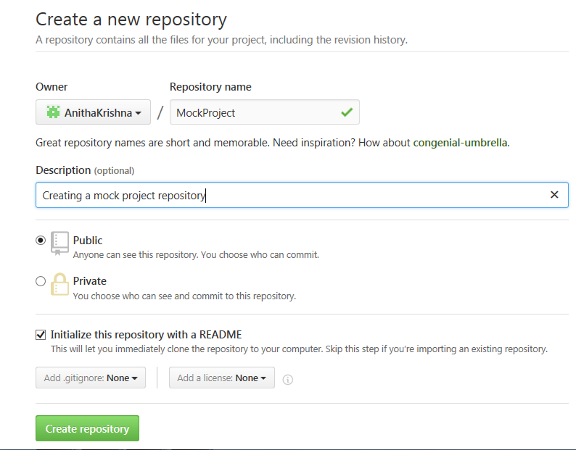
Create Repository
1. In the upper right corner, next to your avatar
or ident icon, click + and then select New repository.
2. Name your repository I,e “MockProject”
3. Write a short description.
4. Select initialize this repository with a README

Slide 7
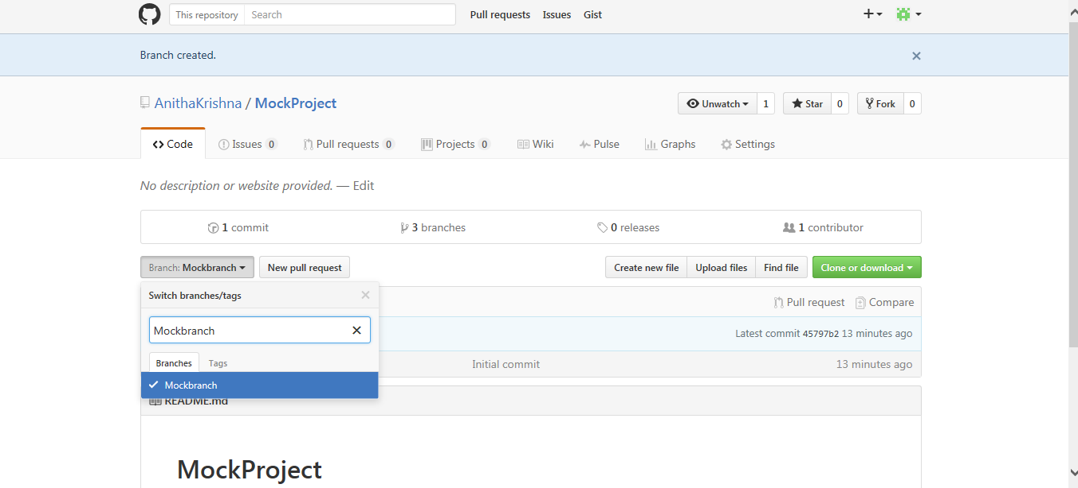
Create Branch
Go to repository “Mock Project”
Click the drop down at the top of the file list that says branch: master
Type branch name, mock branch, into new branch textbox.
Select the blue create branch box or hit “Enter” on your keyboard.

Slide 8
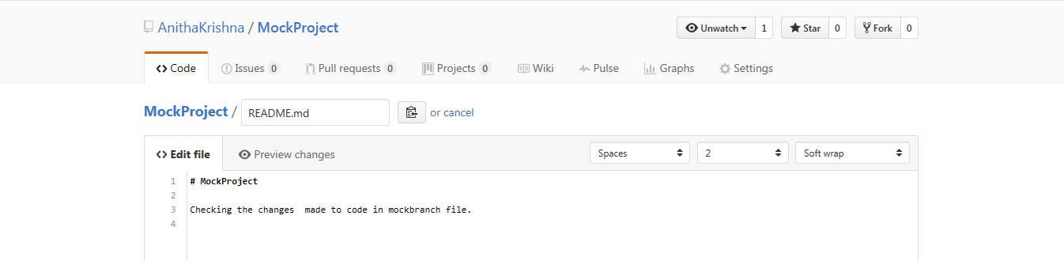
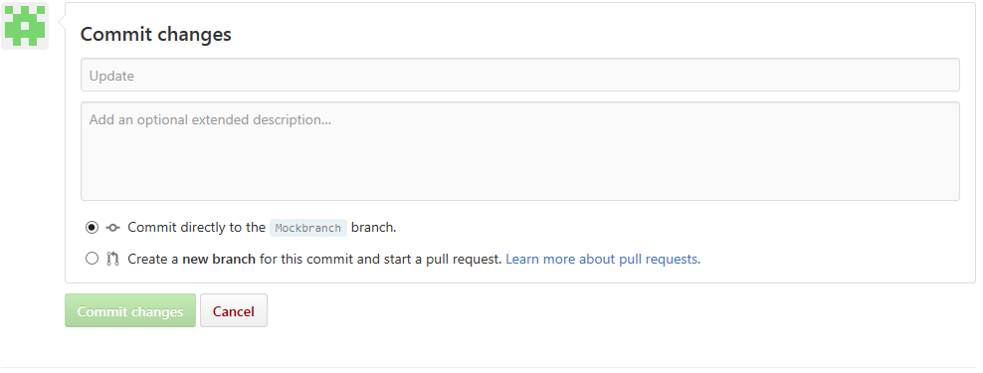
Commit changes
Click the “Readme.md” file.
Click the pencil icon in the upper right corner of the file view to edit.
In the editor, write a bit about yourself.
Write a commit message that describes your changes.
Click Commit changes button.

Slide 9
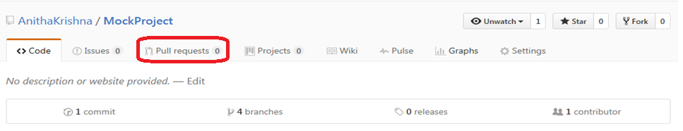
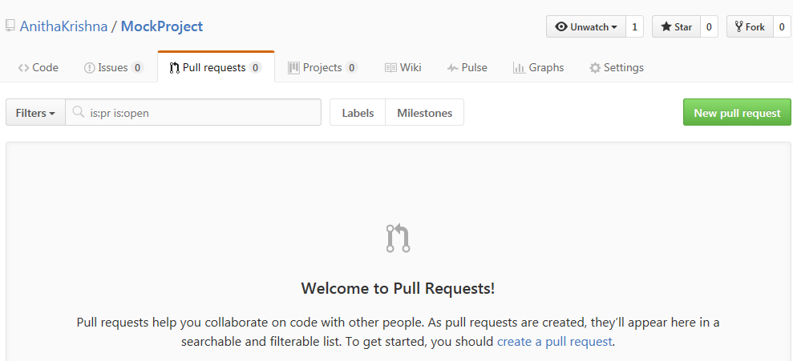
Open pull request and Merge
Click the Pull Request tab, then from the Pull Request page, click the green New pull request button.

Slide 10
Continuation…
Select the branch you made I,e Mockbranch to compare with master(original)
Look over your changes in the diffs on the Compare page, make sure they’re what you want to submit.
When you’re satisfied that these are the changes you want to submit, click the big green Create Pull Request button.
Give your pull request a title and write a brief description of your changes.
When you’re done with your message, click Create pull request!

Slide 11
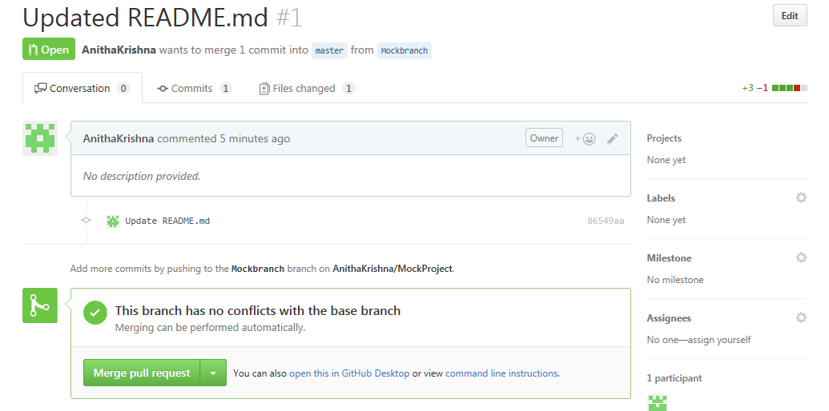
Merge pull request
Click the green merge pull request button to merge the changes into master.
Click confirm merge.

Slide 12
Data migration from Serena to Git
Data migration from PVCS/CVS/SVN to Git can be done by using open source tool Polarion SVN importer.
To migrate from Serena to Git can be done by using Git SVN and CM SVN bridge, with this will be able to use Git client to Access Dimension server. The SVN bridge comes as part of the Git installation. The CMBridge servlet comes as part of a standard CM server install for 14.2
There is no specific utility to Git to dimension, hence use Git fast import by getting all version history from dimension to excel.

Slide 13
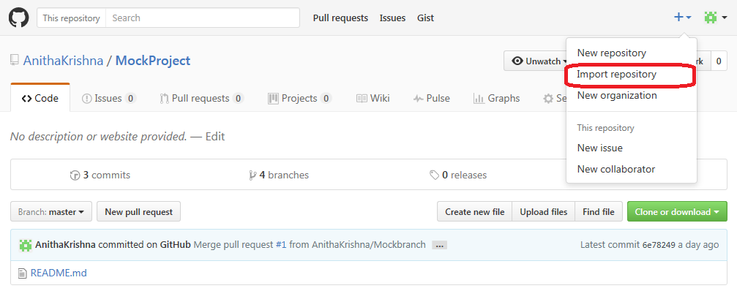
Importing a repository with GitHub Importer from TFS
In the upper-right corner of any page, click , and then click Import repository
Under "Your old repository's clone URL", type the URL of the project you want to import.
Choose your user account or an organization to own the repository then type a name for the repository on GitHub

Slide 14
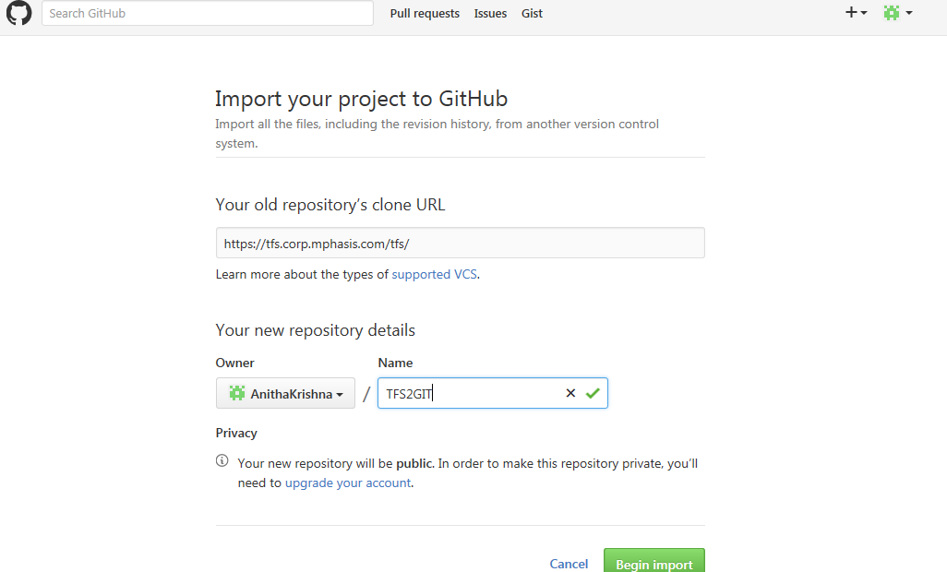
Continuation…
Click on Begin Import

Slide 15
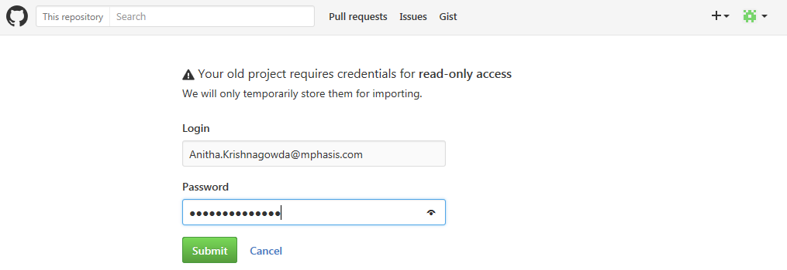
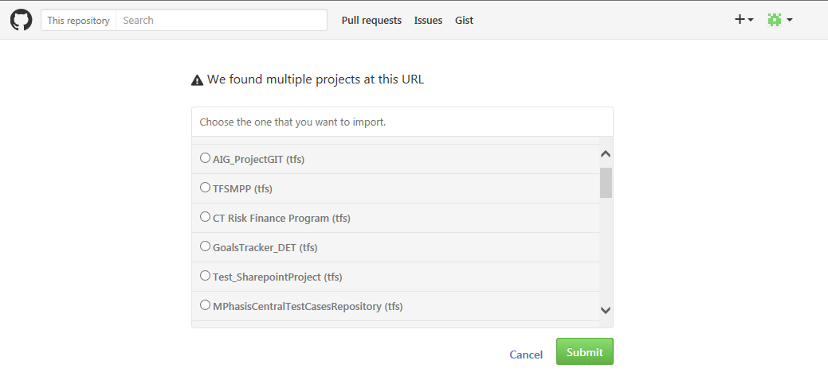
Connect & Choose TFS Project to import

Slide 16
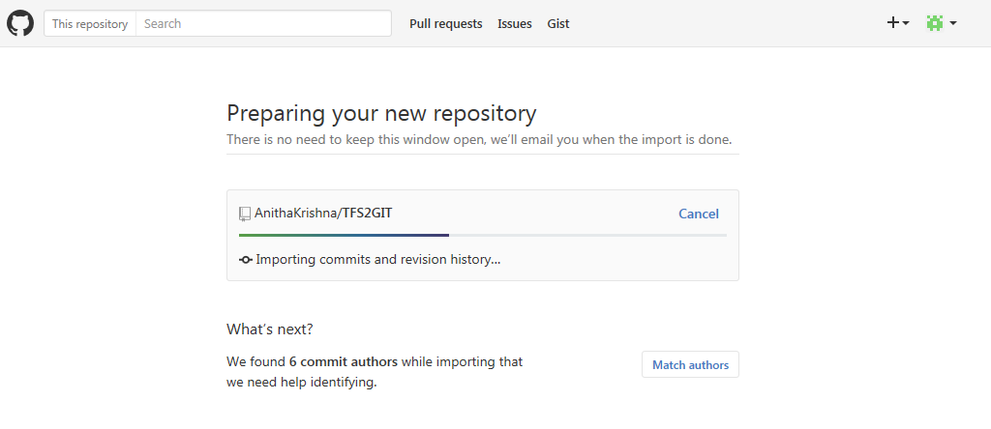
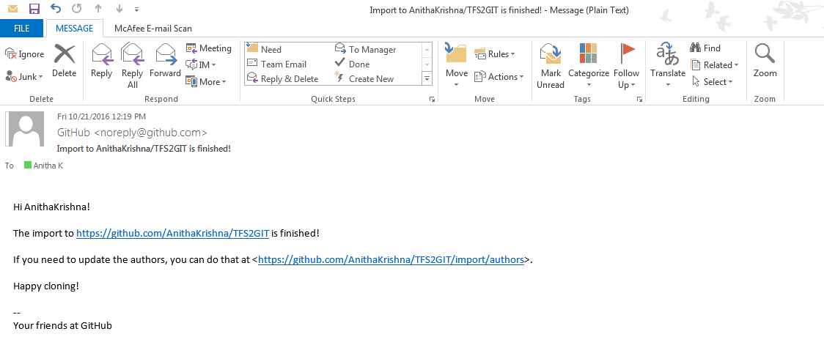
Import in process & mail confirmation

Slide 17
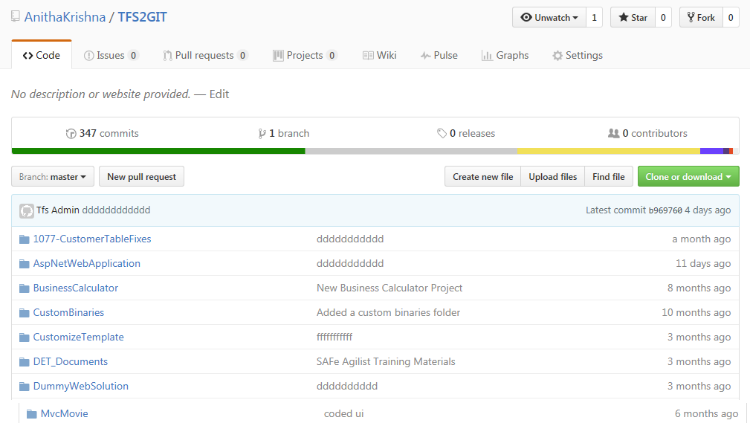
Project Folder version history after import in GitHub

Slide 18
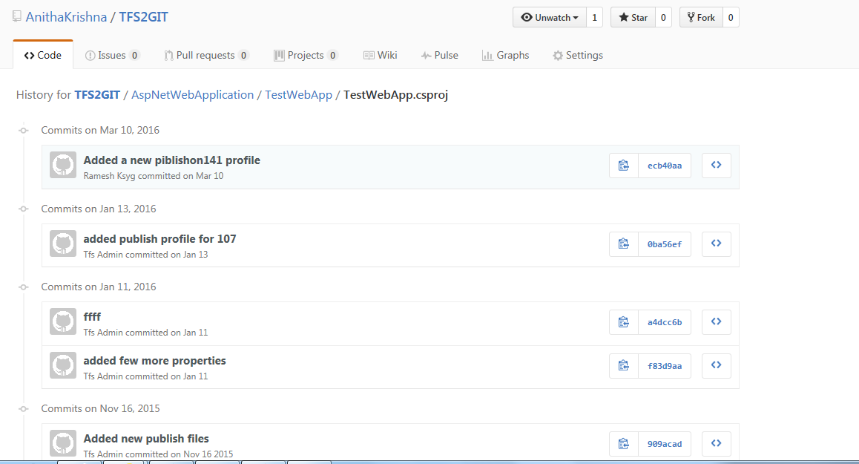
File Version history of each Folder Imported

