Slide 1
CI through Bamboo

Slide 2
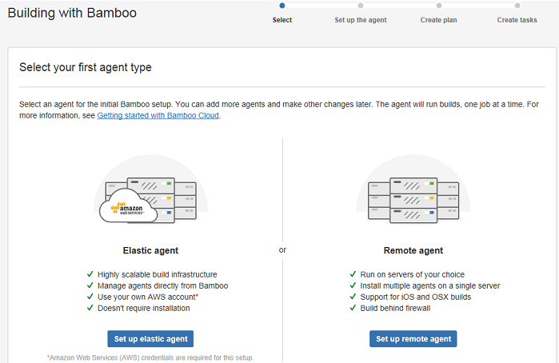
Building with Bamboo
Note: Agent is a service that executes Bamboo builds and service

Slide 3
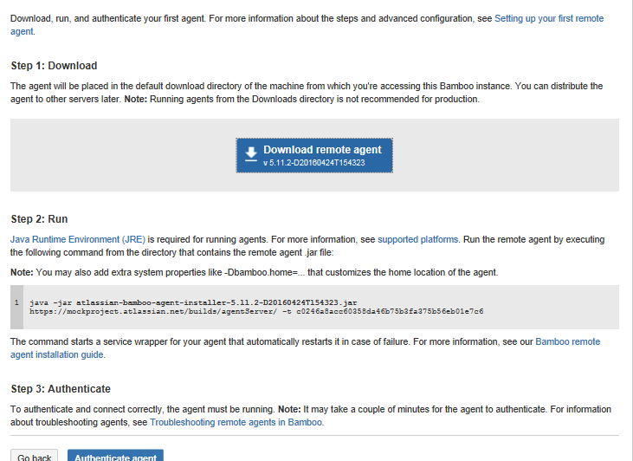
Set up Remote Agent

Slide 4
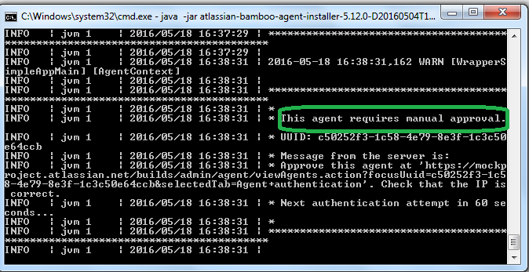
Run the Agent to connect bamboo from local system
Note: Due to firewall restriction with in the network it throws Error Message when command is executed as JVM exited. Else it runs successfully and connects to Bamboo

Slide 5
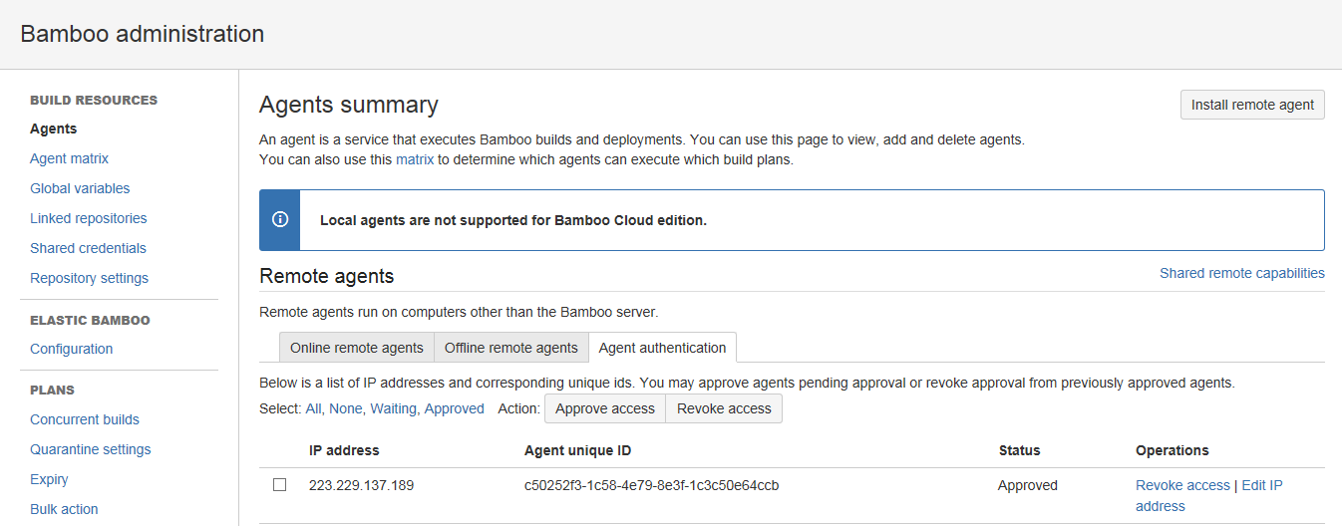
Approve remote agent after installed

Slide 6
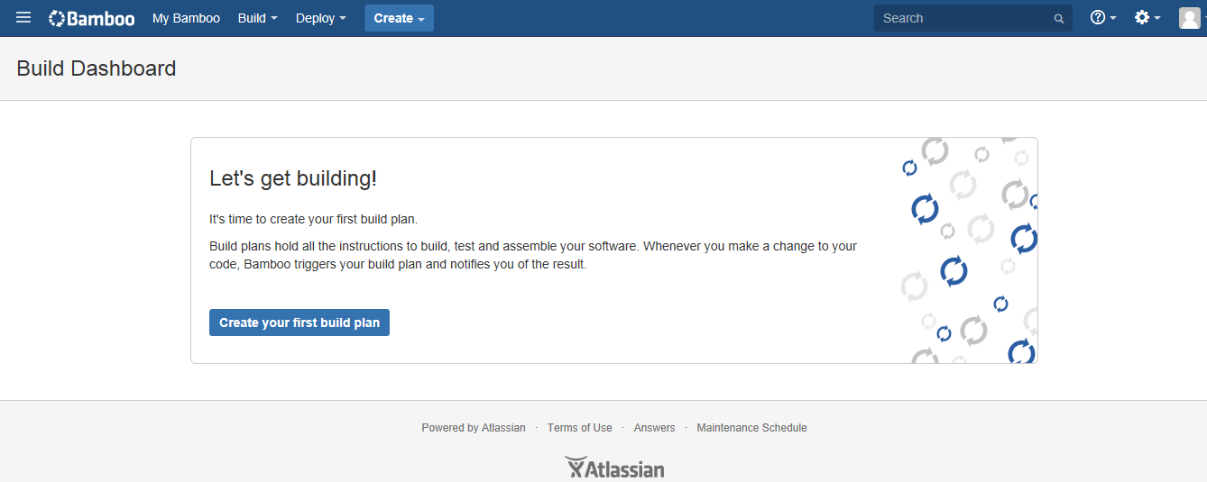
Build Plan

Slide 7
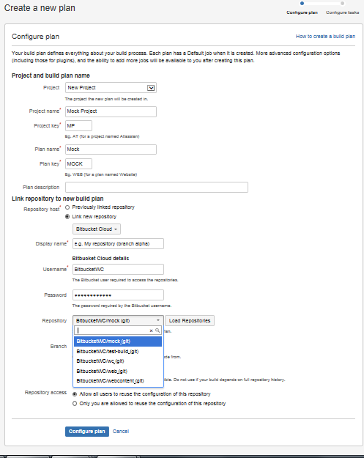
Configure Plan

Slide 8
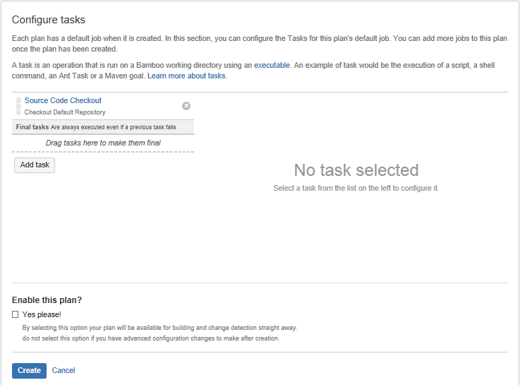
Adding Tasks

Slide 9
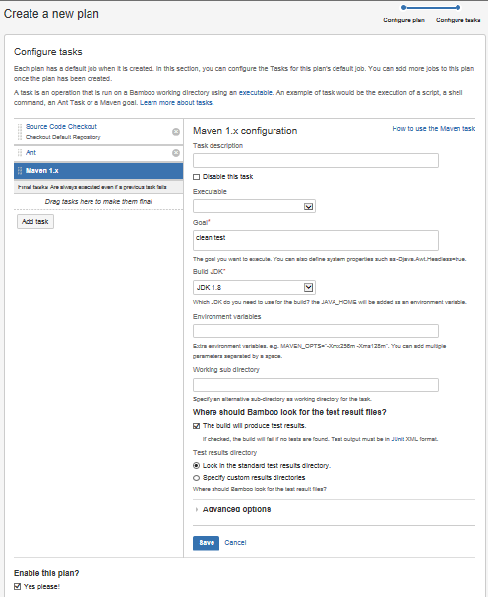
Configuring Task

Slide 10
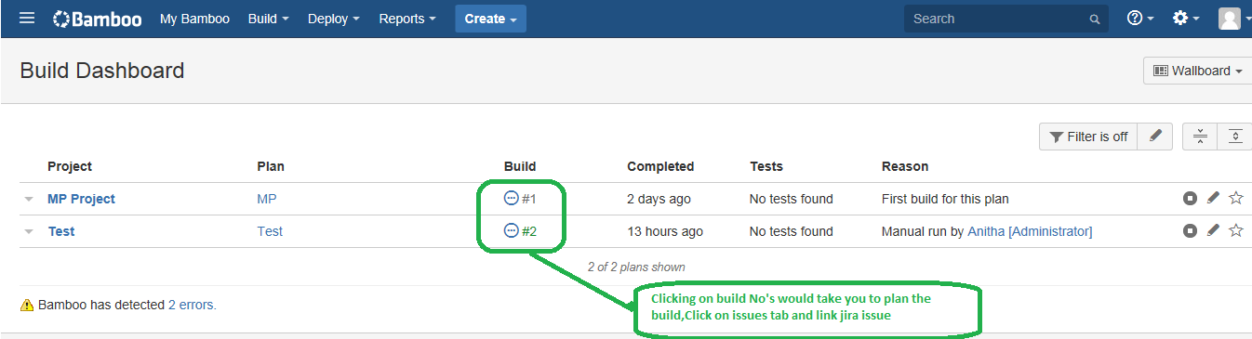
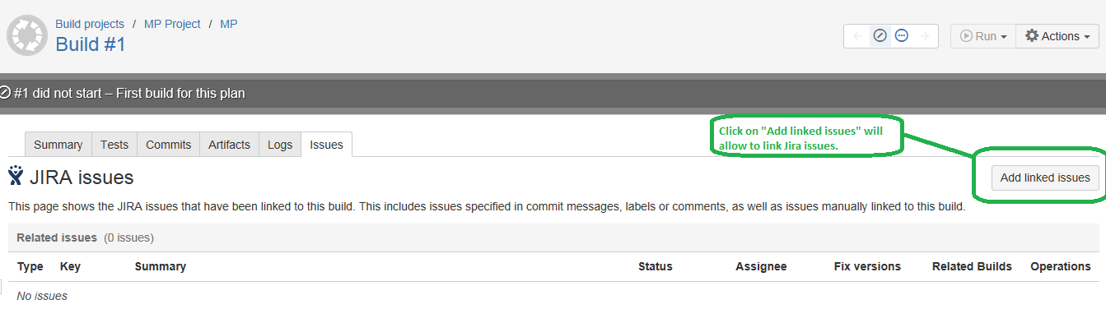
Build Dashboard
Click Build-All build plans-Build dashboard lists all the planned builds for projects

Slide 11
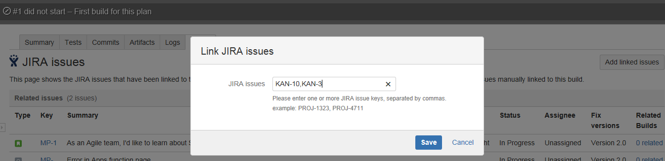
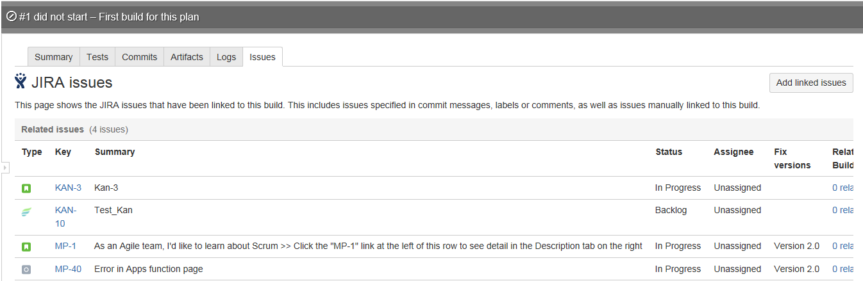
Linking Jira Issues to builds

Slide 12
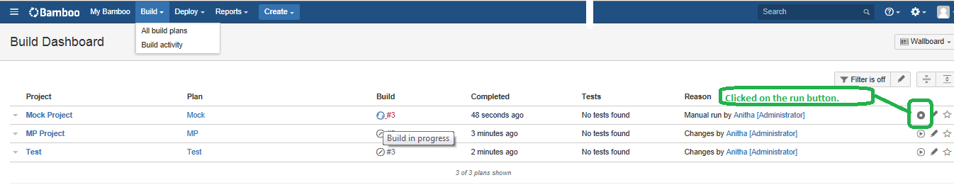
Run the build from planned build activity list
Once build is planned, From build tab, select build activity which list all planned builds, select required to run.

Slide 13
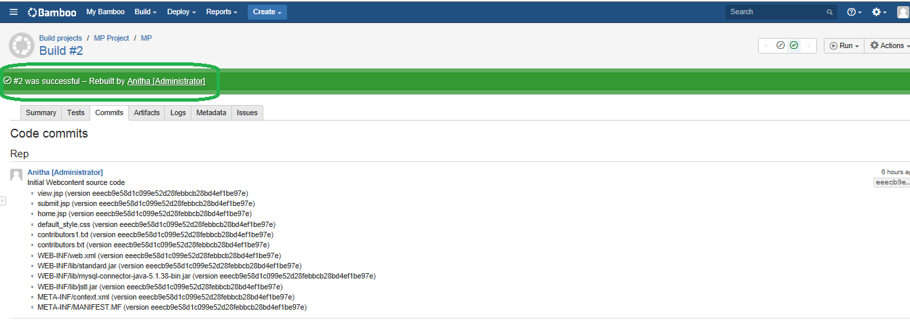
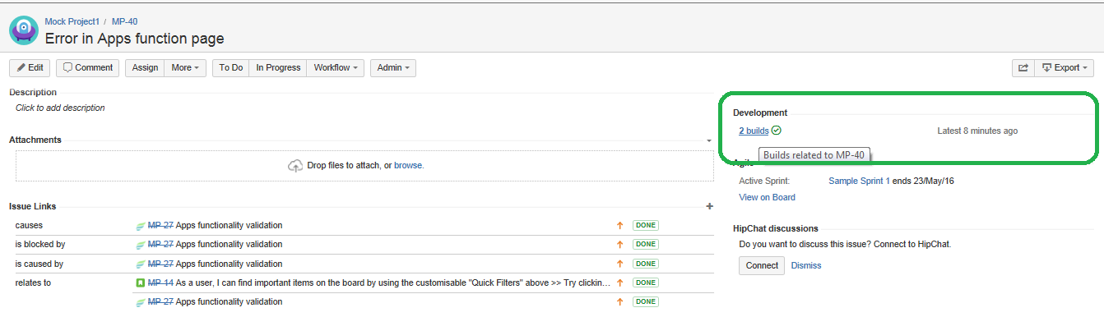
Build Successful and also reflecting in Jira linked issues

Slide 14
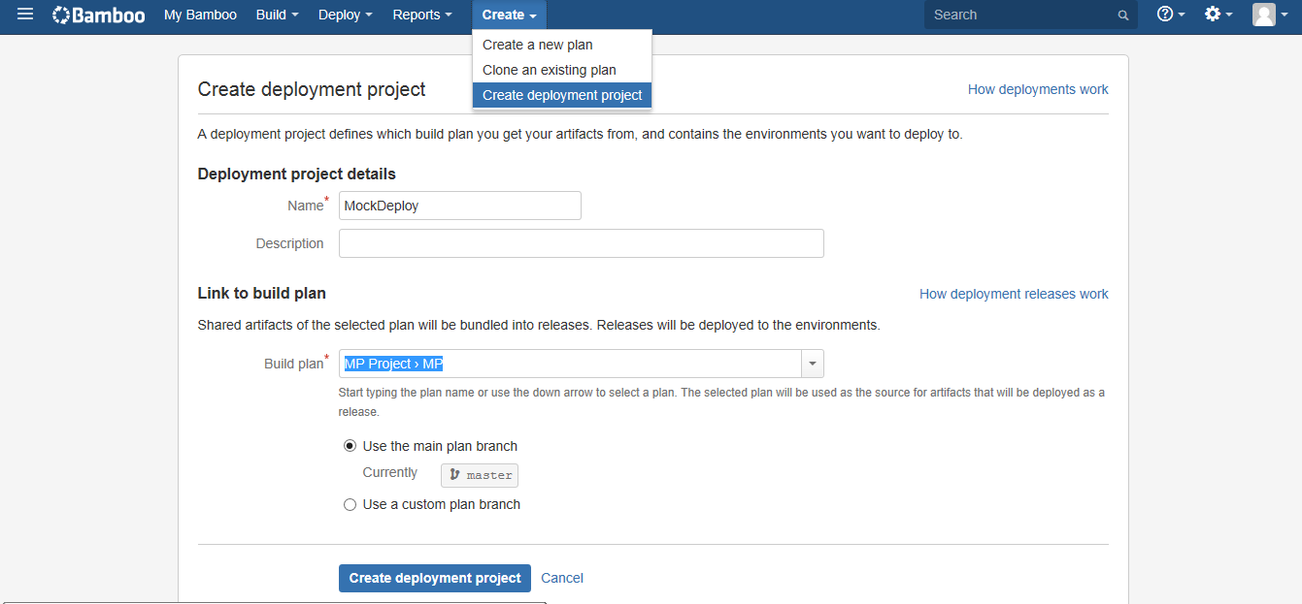
Create Deployment Project once build successful

Slide 15
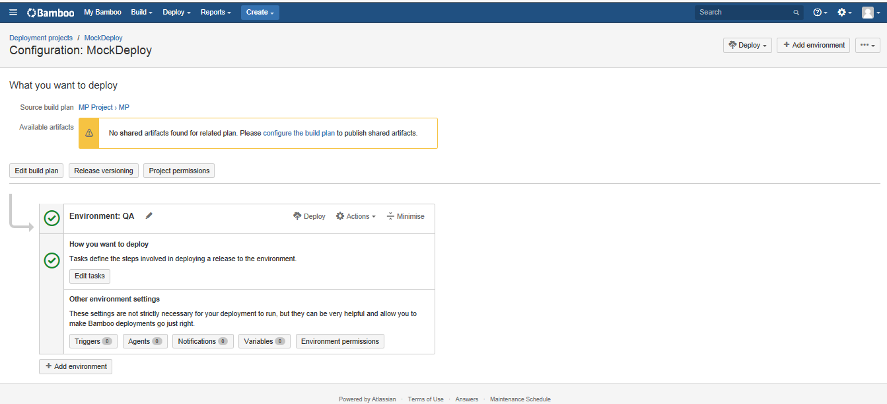
Configure Deployment and Deploy to Required QA/Staging/Prod

Slide 16
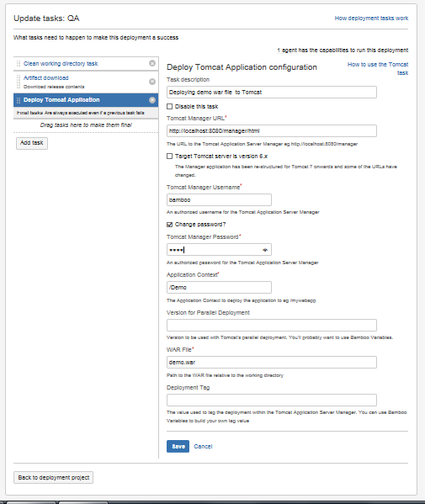
Continuous Build Configuration adding task

Slide 17
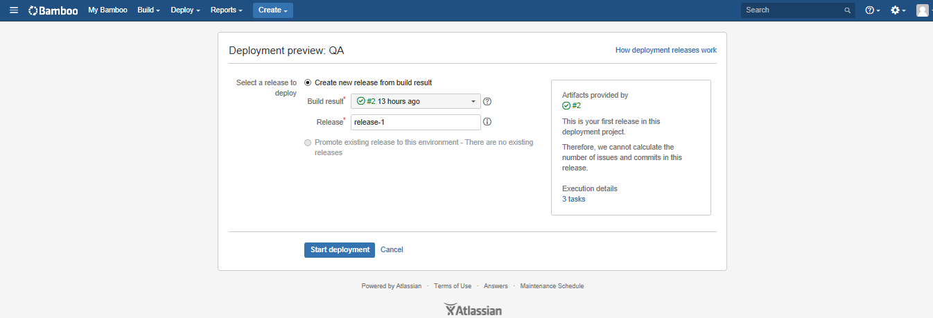
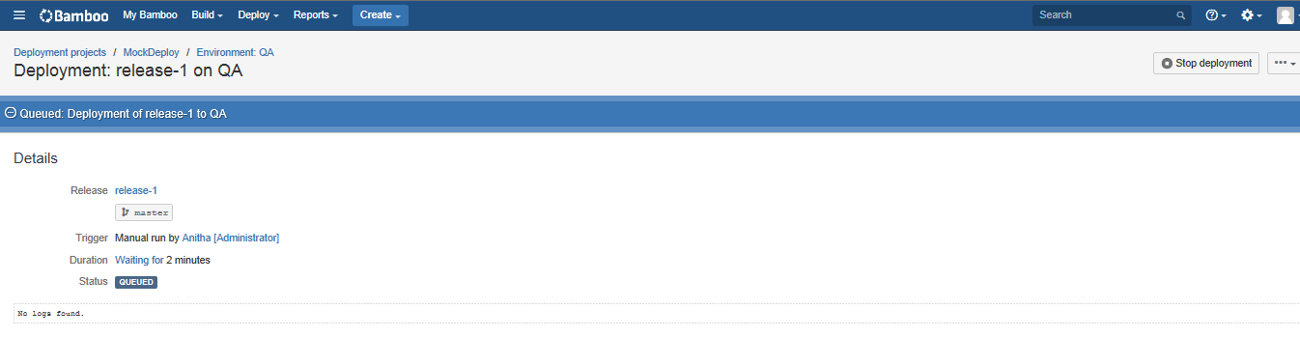
Start Deployment

Slide 18
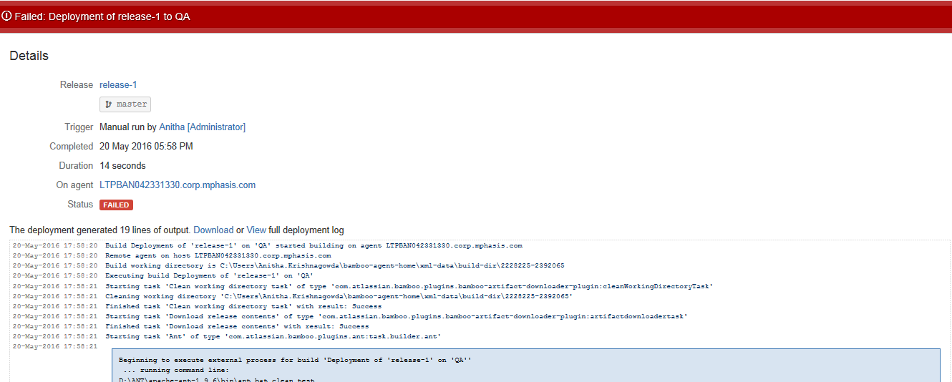
Deployed to Tomcat server failure

Slide 19
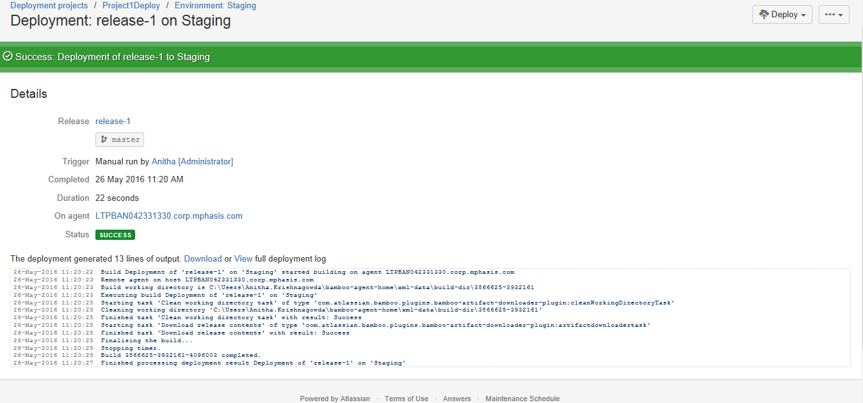
Deployed in Tomcat server Success

