Slide 1
Source Code Management on Bitbucket

Slide 2
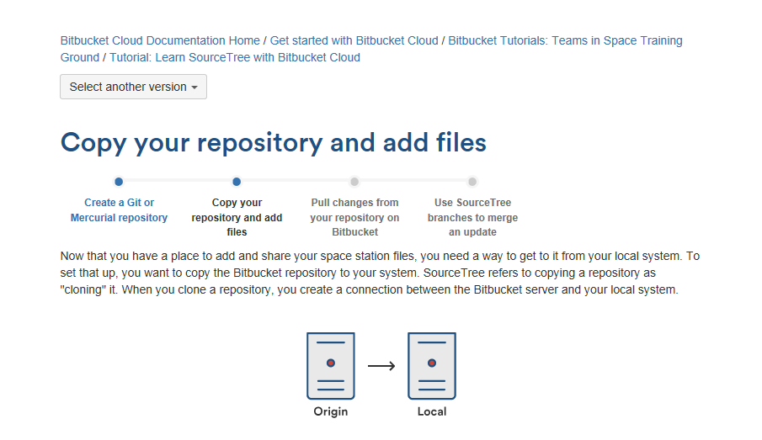
Flow to create repository and add files from local system to Bit bucket

Slide 3
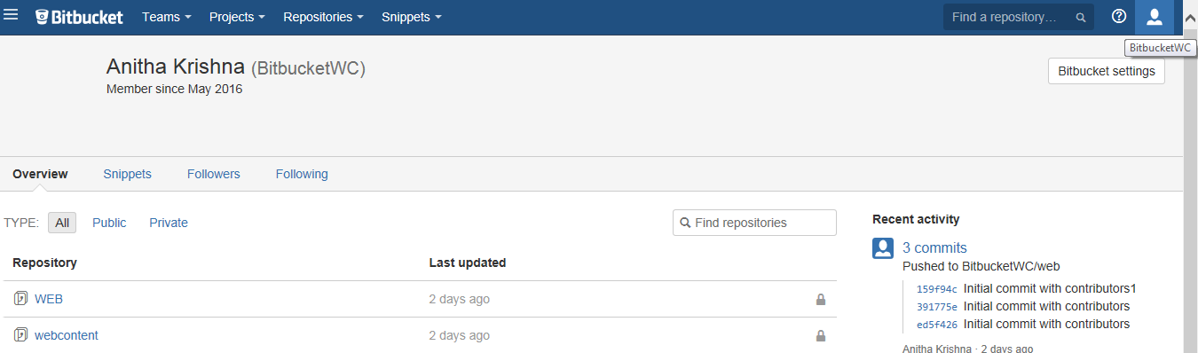
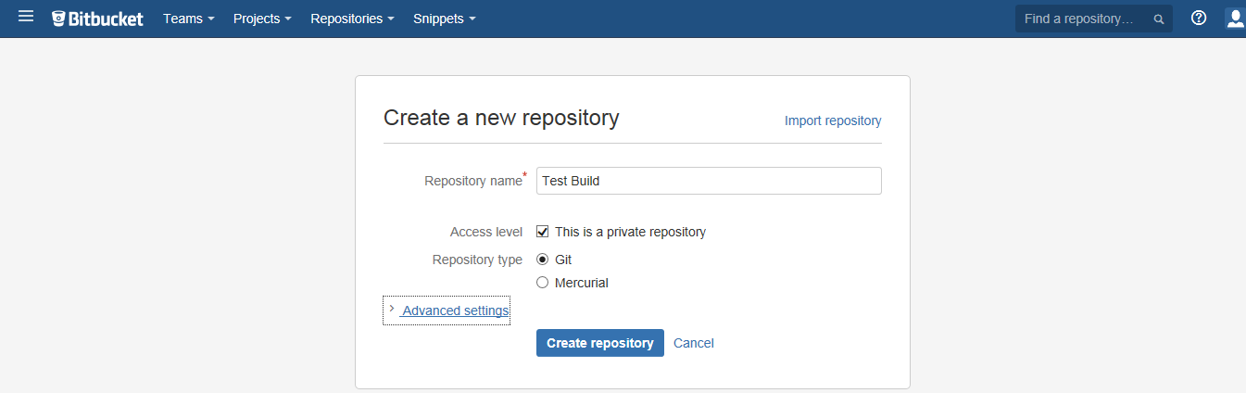
Bit Bucket Repository

Slide 4
Copy source code file from Local System to Bitbucket
Source code can be copied in two ways:
Clone your repository to your local system
Create a file, add it locally, and push it to Bitbucket
SourceTree refers to copying a repository as "cloning" it. When you clone a repository, you create a connection between the Bitbucket server and your local system

Slide 5
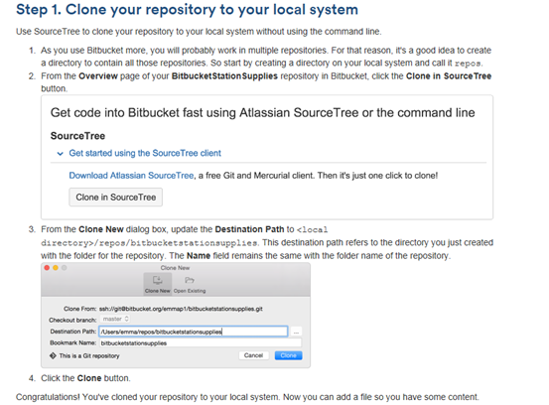
Cloning Repository to Local System using SourceTree

Slide 6
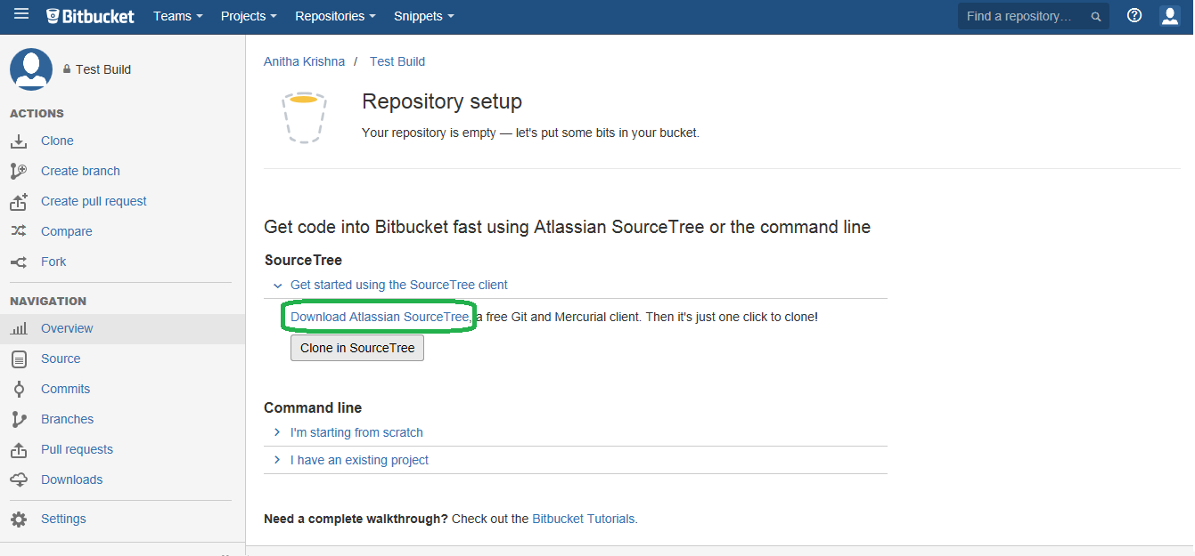
Install SourceTree

Slide 7
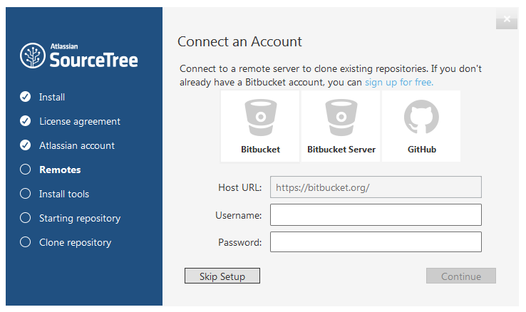
Connect bitbucket via SourceTree

Slide 8
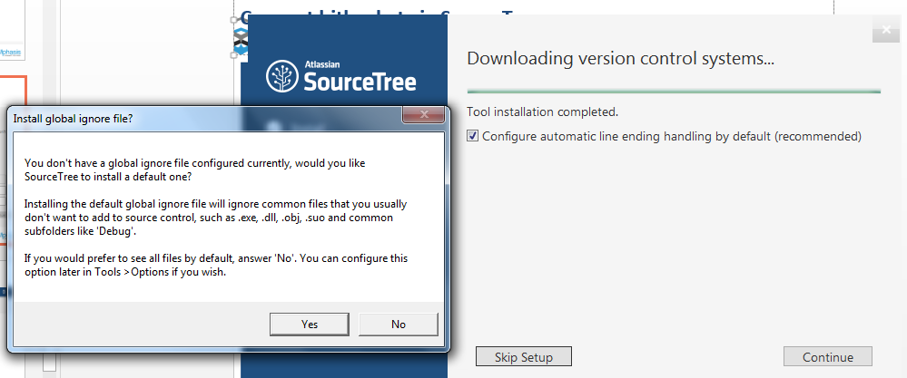

Slide 9
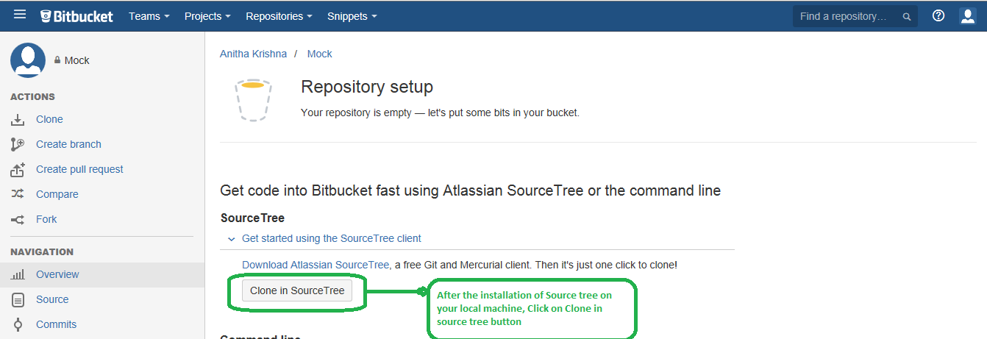
Click on “Clone in source Tree” Button

Slide 10
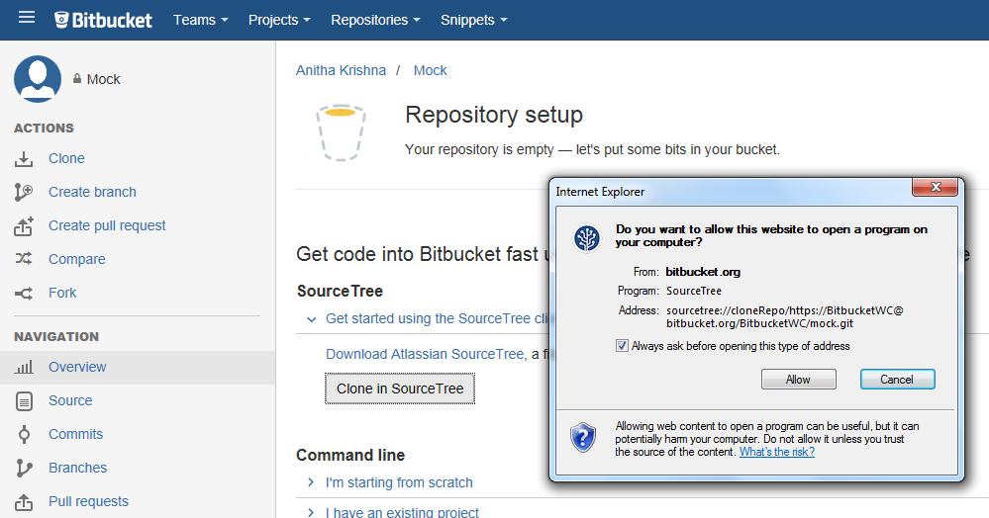
Click on “Clone in SourceTree”

Slide 11
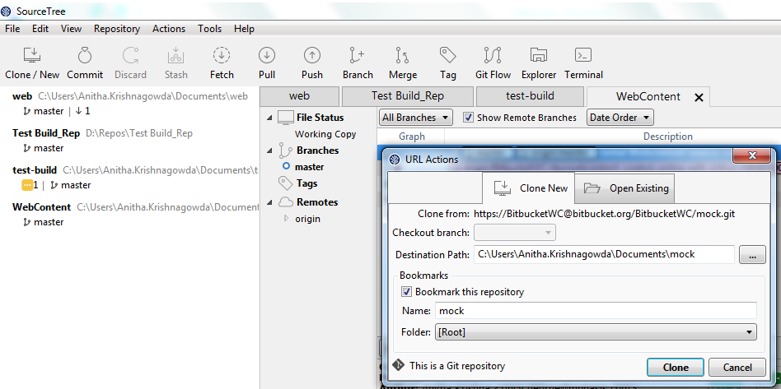
Automatically opens SourceTree window with clone info

Slide 12
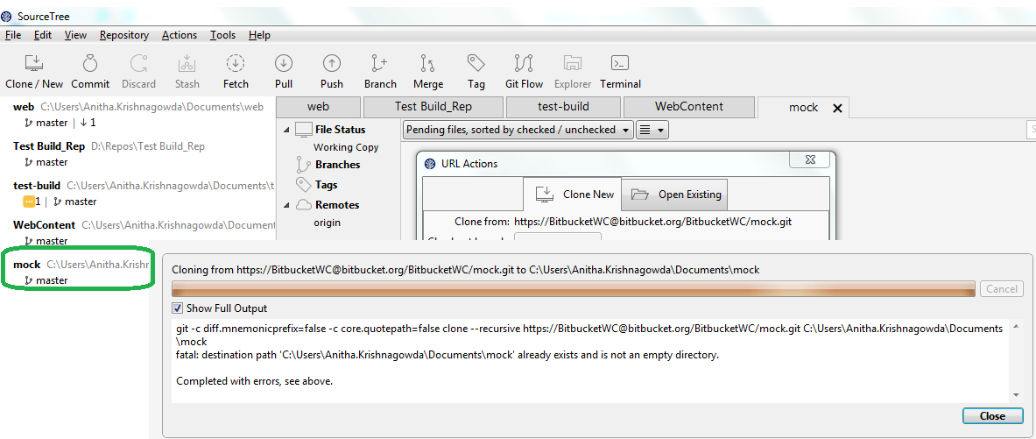
Cloning repository to local system

Slide 13
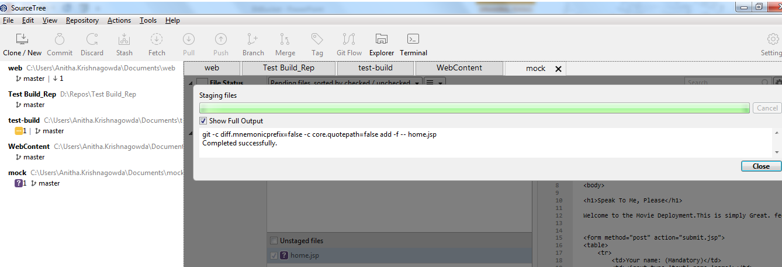
Create file, Add it locally and Push it to Bitbucket
Copy Any source file to mock repository locally ex-home.jsp, soon after which you would be able to see the file in SourceTree Unstaging section.
Select file it will automatically get into stag mode, which is ready to commit now.

Slide 14
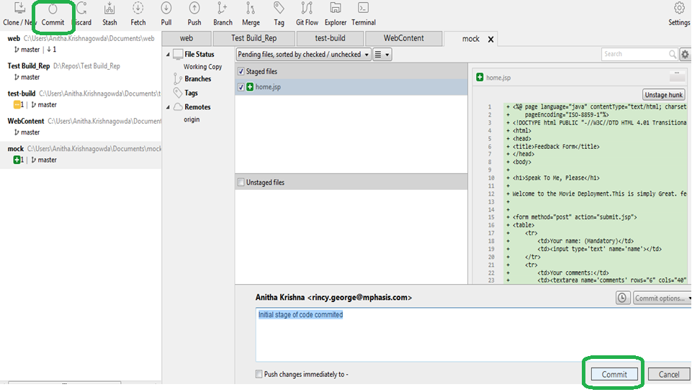
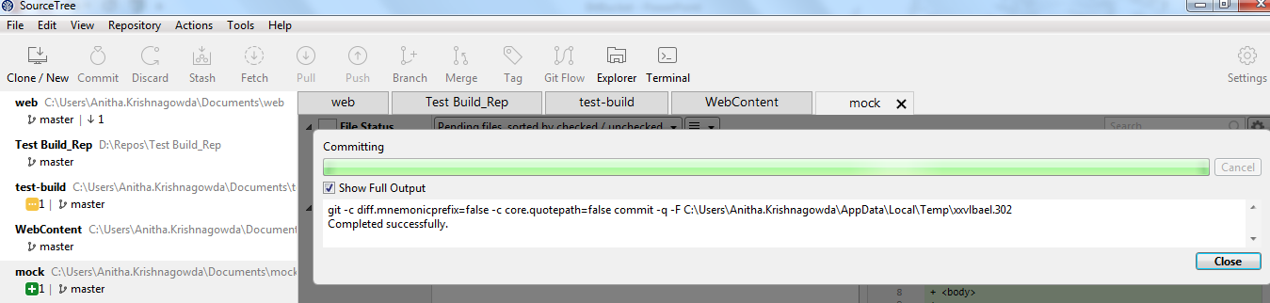
Committing code

Slide 15
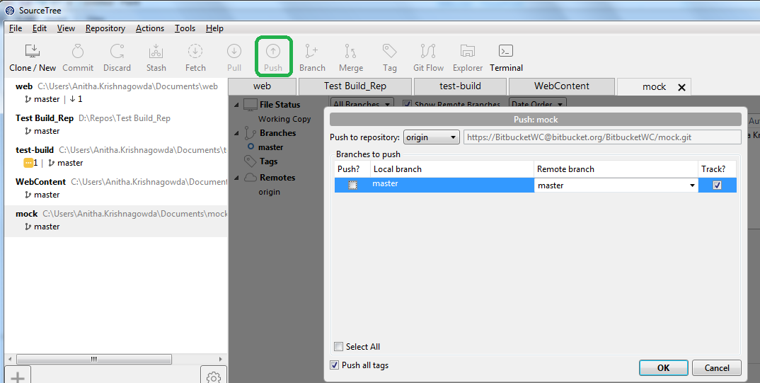
Push to bitbucket from SourceTree
Click on push button. Select all tags and click ok button, it gets stored in bitbucket.

Slide 16
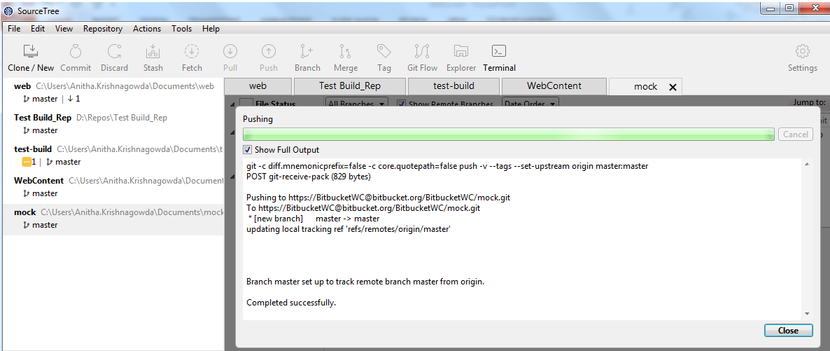
Files pushed to bitbucket succefully

Slide 17
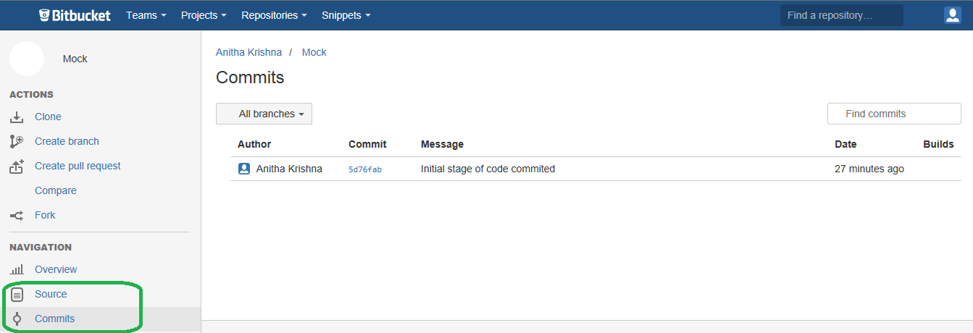
Validating committed file in Bitbucket
Click on source and commits in navigation section to validate.

