Slide 1
Tools Training for Grunt Technology : Java Phase : Build tool for JavaScript

Slide 2
Table of Contents
Description
What is in it for me
Tool usage with Examples
FAQ
Case studies
Installation, Setup and Environment

Slide 3
Grunt – Build tool for Javascript
Grunt an open source task-based command line build tool for JavaScript projects. Grunt is a JavaScript based task runner which means it can automate repetitive tasks in a workflow and it can be used as a command line tool for JavaScript objects.
Features
Grunt makes the workflow as easy as writing a setup file.
You can automate repetitive tasks with minimum effort.
Grunt is a popular task runner based on NodeJS. It is flexible and widely adopted.
It has a straightforward approach which includes tasks in JS and config in JSON.
Grunt minifies JavaScript, CSS files, testing files, compiling CSS preprocessor files (SASS, LESS), etc.
Grunt includes built-in tasks that extend the functionality of your plugins and scripts.
It speeds up the development workflow and enhances the performance of projects.
You can easily work with a new codebase using Grunt because it contains less infrastructure.
The ecosystem of Grunt is huge; you can automate anything with very less effort.
Grunt reduces the chance of getting errors while performing repetitive tasks.
Grunt currently has over 4000 plugins.
It can be used in big production sites.

Slide 4
Grunt - Installation, Setup and Environment
System Requirements
JDK 1.8.x and higher version.
4GB Ram
Operating System − Cross-platform
Browser Support − IE (Internet Explorer 8+), Firefox, Google Chrome, Safari, Opera
Grunt Installation
For grunt installation, Refer the URL
https://www.tutorialspoint.com/grunt/grunt_installing.htm
2. Grunt Configuration & Sample Grunt Application
For configuration and sample application, refer the below URL
https://www.tutorialspoint.com/grunt/grunt_installing.htm
http://mattbailey.io/a-beginners-guide-to-grunt.html
Important ONLINE information websites:
http://mattbailey.io/a-beginners-guide-to-grunt.html
https://www.tutorialspoint.com/grunt/grunt_overview.htm

Slide 5
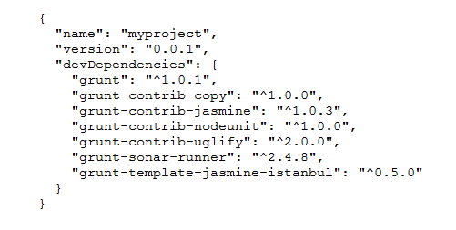
Grunt --- Creating a Build for JavaScript application
Create a project folder where your entire project code (UI and Javascript files) will be kept. Thereafter create a package.json file inside this folder.
It contains
name of the project
version of the project
all libraries files which need for grunt to run and execute
The contents of this file will be look like

Slide 6
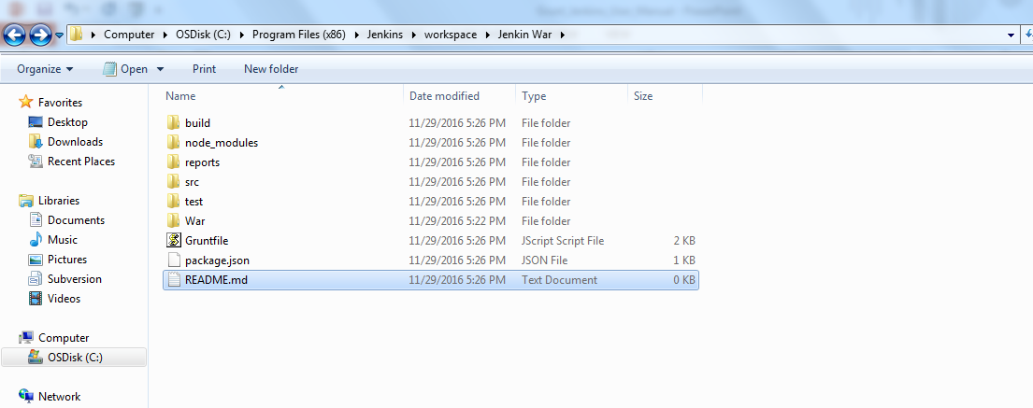
Grunt --- Creating a Build for JavaScript application
The complete project code structure should be like this (given below)
src folder : it contains all source files (UI and JavaScript code)
test folder : it contains all unit test cases written for JavaScript files.
build folder : It contains the war file which grunt generates after successful build.
node_modules folder : It contains all required grunt libraries.
reports folder : It contains all generated report (unit test report and coverage report).
README.md file : It contains some user instructions. It is an optional file. It can be empty.

Slide 7
Grunt --- Creating a Build for JavaScript application
Next create a Gruntfile.js file inside this folder.
It contains different task to be run. It has 2 task
jasmine task : it executes all unit test cases related to JavaScript files and prepare a Unit test result report using jasmine which provides information how many unit test cases have been passed or failed. It also prepares a code coverage report using Istanbul.
war : It compiles all javascript and UI code and creates a war file for deployment.
download all the required libraries like grunt, grunt-contrib-jasmine, grunt-lib-phantomjs, grunt-template-jasmine-Istanbul and grunt-war.
The contents of this file will be look like (provided in next slide)

Slide 8
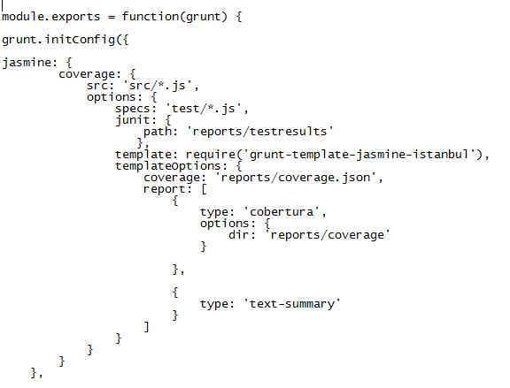
Grunt --- Creating a Build for JavaScript application

Slide 9
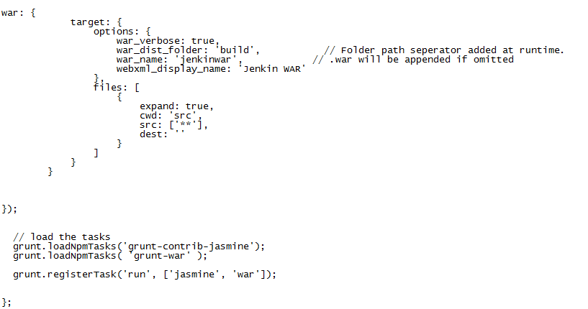
Grunt --- Creating a Build for JavaScript application

Slide 10
Grunt --- Creating a Build for JavaScript application
Open command prompt. Move to project directory where project code resides. Build the JavaScript project using grunt command given below :
grunt run
After successful build, a war file will get generated and will be kept inside build in project directory.

Slide 11
FAQ
Please refer the following links
https://www.tutorialspoint.com/grunt/grunt_overview.htm

Slide 12
Rajiv.Ranjan02@mphasis.com

