Slide 1
COTIVITI INTERN ASSESSMENT · TOPIC 2
Agentic AI for Healthcare
Payment Integrity
Clinical Decision Making & Pattern Recognition in Health Care
Bhanu Kokkula · Rutgers University · Intern — Generative AI / Agentic AI / Research
Notes:
Open on camera: name, university, one-line thesis — agentic AI applied to the payment side of healthcare, where Cotiviti's payment-integrity business lives. 'In five minutes: the problem, my recommendation, and a working proof of concept.'

Slide 2
THE PROBLEM · AND THE MOMENT
Improper payments remain a $100B-scale problem
$28.8B
$37.4B
$100B+
Medicare FFS improper
payments, FY2025 (6.55%)
Medicaid improper
payments, FY2025 (6.12%)
Medicare + Medicaid combined,
FY2023 — 43% of gov-wide total
Why now — health systems (Mount Sinai, Mayo, NHS) are piloting agentic AI while most deployments remain early; CMS itself now applies AI to claims analysis; and governance is formalizing (HHS AI Strategy, Joint Commission / CHAI certification). The capability window is open, and auditability is becoming table stakes.
Sources: CMS FY2025 improper-payment estimates; GAO-24-107487; HHS AI Strategy (Dec 2025).
Notes:
Numbers first: ~$29B Medicare FFS, ~$37B Medicaid in FY2025; over $100B combined in FY2023 per GAO. Improper isn't all fraud — documentation and coding errors too — exactly pattern-recognition territory. Then the timing: agentic pilots everywhere but early, CMS adopting AI itself, governance hardening. Window open; auditability required.

Slide 3
CONCEPT · AND SCOPE
From generative to agentic — scoped to Payment
Generative AI
Agentic AI
One prompt in, one response out
No plan, no tools, no goal
Human drives every action
Plans multi-step tasks toward a goal
Chain reasoning through intermediate decisions
Uses tools and data, adapts to what it observes
Deliberate scope — the “P” in TPO. HIPAA frames health-data use as Treatment, Payment & Operations. This work targets Payment: decisions are auditable against written policy, ROI is measurable, and it is Cotiviti's core payment-integrity business.
Notes:
Define agentic AI in one breath: plans, reasons step by step, uses tools, adapts — versus one-shot generative AI. Then the scoping decision: TPO is the HIPAA umbrella; Payment chosen deliberately — auditable against written policy, measurable ROI, Cotiviti's core business. Scoping is the point, not a limitation.

Slide 4
RECOMMENDATION
Three strategic options for Cotiviti
01
02
03
Pilot agent-assisted claims review
Auditable-by-design agent infrastructure
Public position on autonomy boundaries
Agents read flagged claims, retrieve policy, draft cited recommendations; human analysts decide. Raises analyst throughput, keeps accountability human.
Reasoning-trace capture, decision logging, and evaluation harnesses as product features — aligned to Joint Commission / CHAI frameworks.
Define where agents may act (enrichment, triage) vs. where humans are mandatory (adverse determinations). Shape unsettled standards.
Proves value
Productizes trust
Builds position
Sequenced by commitment: pilot → productize → lead the standard.
Notes:
The graded heart. Option 1: human-in-the-loop pilot inside existing payment-integrity workflows — proves value, generates labeled reasoning data. Option 2: audit/evaluation infrastructure as product — governance becomes a selling point under payer scrutiny. Option 3: publish where autonomy stops — cheap, positions Cotiviti as standards-shaper. Prove, productize, lead. Threats (hallucination, auditability, regulation, provider abrasion) argue for exactly this human-in-the-loop, governed design.

Slide 5






PROOF OF CONCEPT
An agent that reviews claims — deliberately simple
1 · Load
2 · Retrieve
3 · Reason
12 synthetic claims — real CPT / ICD-10 codes; 4 planted anomalies, 1 borderline
match each claim to the relevant billing-policy excerpt (RAG)
Claude reasons step-by-step, grounded in the retrieved policy text
4 · Decide
5 · Log
6 · Evaluate
approve · flag · escalate — only approval is autonomous
full reasoning trace + cited policy line → audit_log.jsonl
score every decision against planted ground truth
Built to “satisfice”: one Python script (~150 lines), Anthropic API, no frameworks. Synthetic data by design — real claims are PHI.
Notes:
Six steps, quickly. Then the philosophy: deliberately simple, per the assessment's own instruction to satisfice — one script, no frameworks. Synthetic data is the correct choice: real claims are PHI. Approve is the only autonomous outcome; flags and escalations go to humans — Option 3's autonomy boundary, implemented. Then cut to the live demo.

Slide 6

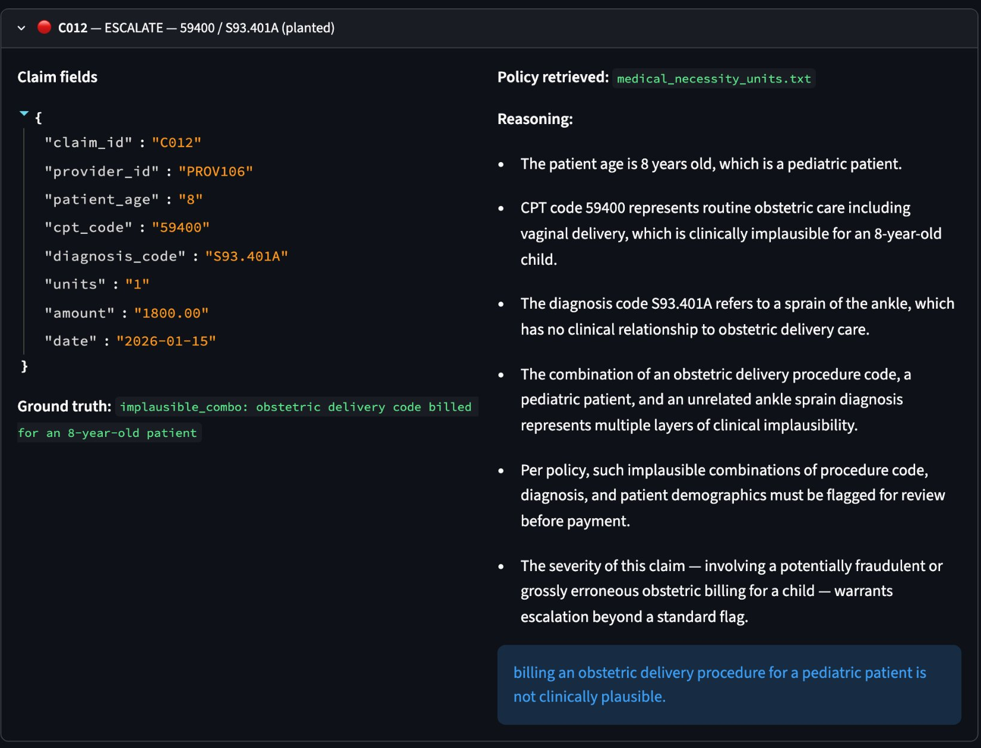
RESULTS · AND NEXT STEPS
Measured against planted ground truth
4/4 planted anomalies caught; 0/7 clean claims falsely flagged; the one deliberately ambiguous claim flagged as designed
Every decision grounded — reasoning ends in a quoted policy line; full trace in audit_log.jsonl (governance, working)
n = 12 proves the mechanism, not production performance
Next: embedding retrieval over full CMS manuals · claims-history database · precision / recall at scale · provider time-series anomalies
Escalation with reasoning trace and cited policy line (claim C012)
Full report, code, audit log, and this deck: github.com/[repo]
Notes:
Numbers first: 4/4 caught, 0/7 false positives, the ambiguous claim flagged as designed. Point at C012's trace ending in a quoted policy line — that's grounding, and the audit log is the auditable-by-design principle working. Be honest: twelve claims proves the mechanism, not performance — then the scale path: embeddings, claims database, precision/recall, provider time-series. Close: everything's in the repo. Replace the placeholder URL before exporting. Thank you.

