Slide 1
SLIDE 01 | EXECUTIVE SUMMARY
Captain Acquisition & Supply: What the Data Says — and What We Should Do
Mature onboarding performance + airport marketplace diagnosis
17.48%
MATURE A2O
Jan–May 2026 ($N=20,207$). Excludes right-censored June cohort.
4,887
RC VOLUME LOSS
Largest absolute bottleneck (72.69% stage conversion).
NO 5×
CAMP_WA_002 SCALE
Lift (+17.8 pp) is selection bias. Run RCT first.
31.91%
NIGHT AIRPORT FULFILLMENT
46,020 unfulfilled rides (83.6% of total airport gap).
CORE STRATEGIC THESIS
"Fix onboarding friction and night return economics before increasing acquisition spend."
• Onboarding Volume Bottleneck: Registration Certificate (RC) is the largest absolute drop (-4,887 captains). Low-device photo blur/OCR failure (5,568 failures, 62.86% low-device share) is the most actionable fixable leak (+52 approved caps/month base-case planning estimate).
• Campaign Evaluation (CAMP_WA_002): Observed 17.8 pp lift is confounded by selection bias (sent exclusively to DL/RC cleared captains). Clickers converted lower (-1.09 pp). Establish incrementality via RCT before scaling.
• Airport Supply Mechanism: Shortage is concentrated at night (31.91% fulfillment, 21:00–03:00). 41.1% suburban drops lead to 83.5% deadheading. Generic headcount acquisition does not address the mechanism.
RECOMMENDATION: Pilot targeted onboarding fixes + test night return economics; establish campaign incrementality before scaling.

Slide 2
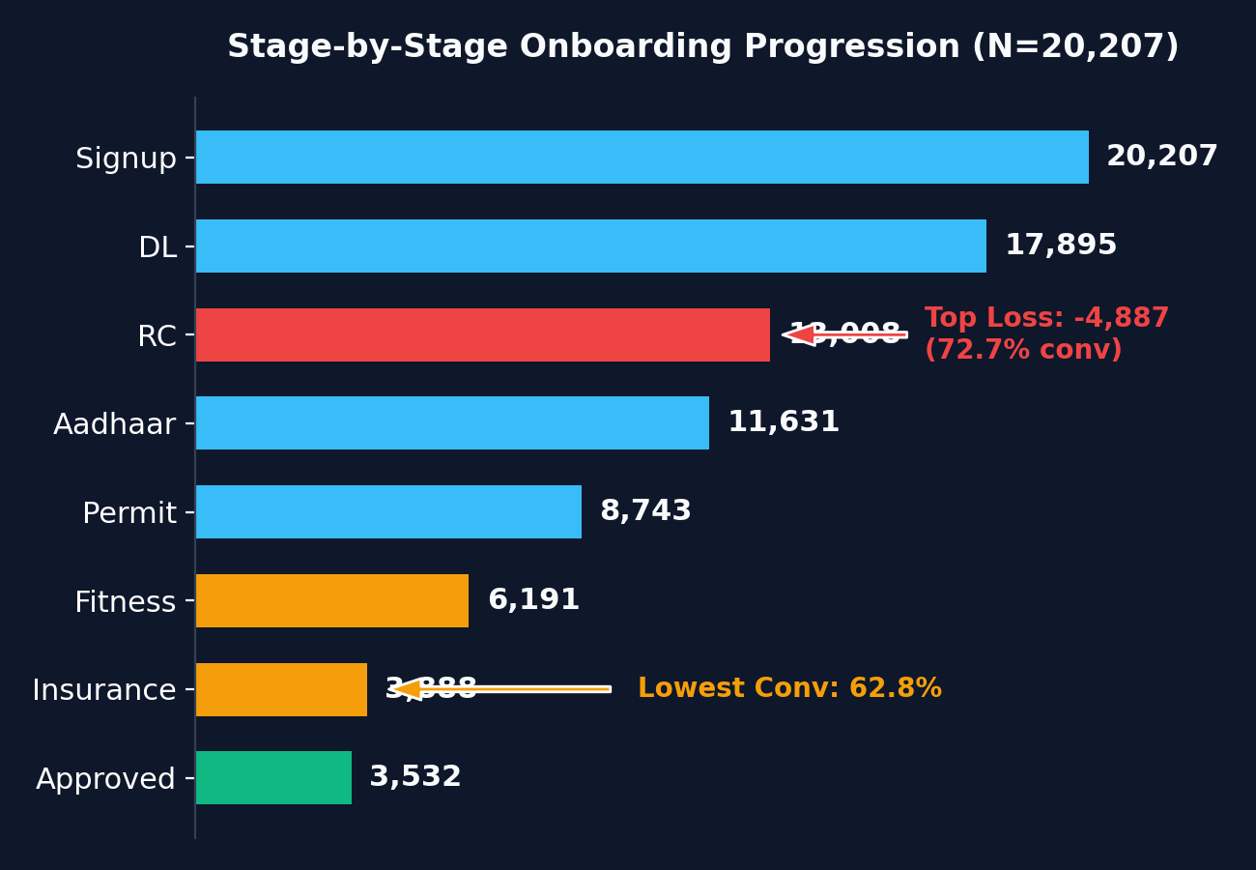
SLIDE 02 | ONBOARDING FUNNEL ANALYSIS
Where Captains Are Lost: Volume Bottlenecks vs Stage Conversions
Sequential stage breakdown across mature signup cohort (Jan–May 2026, N=20,207)
FUNNEL DIAGNOSIS & METHODOLOGY
• Stage 2 RC Volume Drop: Registration Certificate (RC) represents the largest absolute loss (-4,887 captains, 29.3% of total loss), converting at 72.69%.
• Stage 6 Fitness/Insurance Drop: Fitness & Insurance stage has the lowest stage conversion (62.80%), losing 2,303 captains out of 6,191 entering.
• Volume vs Percentage: RC is the highest volume bottleneck (early hesitation/friction); Fitness/Insurance is the lowest stage conversion (mandatory vehicle paperwork).
• Mature Cohort Rule: Extraction date 2026-06-30. Approvals take 6.42 days on average. All 1,297 in-progress signups belong to June. Jan–May mature cohort (N=20,207) yields true baseline A2O of 17.48% (3,532 approved).

Slide 3
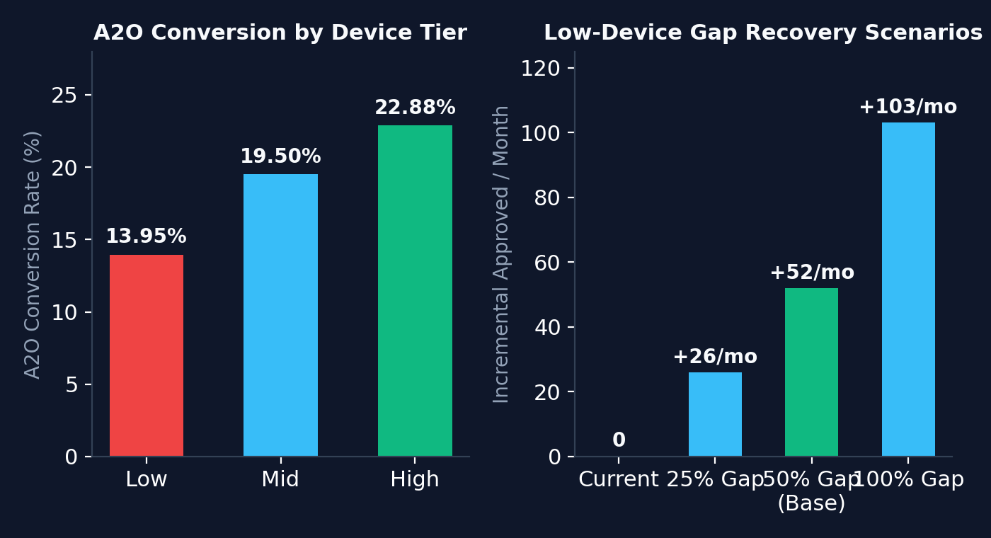
SLIDE 03 | BIGGEST FIXABLE LEAK
The Most Actionable Leak Is Low-Tier Device Document Capture
Low-device hardware quality issues represent 62.86% of low-device verification failures
AUDITED LEAK & UPLIFT WORKING
• Segment Size: 9,290 low-device signups (46.0% of mature cohort).
• Conversion Gap: Low-device A2O is 13.95% vs 19.50% mid-tier (5.55 pp deficit).
• Audited Root Cause: Camera blur (2,573), OCR low confidence (2,041), details unreadable (954) = 5,568 failures.
• Denominator Share: 5,568 failures represent 62.86% of all 8,858 low-device verification failures (or 34.34% of all mature verification failures).
• Planning Scenarios: Monthly low signups = 1,858. 25% gap recovery = +26/mo; 50% gap recovery (Base Case) = +52/mo; 100% gap recovery = +103/mo.
• Scenario Footnote: +52/month is a base-case planning estimate assuming 50% recovery of the low-vs-mid device gap, not a guaranteed causal uplift.

Slide 4
SLIDE 04 | MARKETING CAMPAIGN EVALUATION
CAMP_WA_002 Looks Strong — Until We Examine Targeting Rules
Disentangling raw observed association from selection bias and causal lift
OBSERVED ASSOCIATION (RAW LIFT)
Recipients: 28.98% A2O vs Non-Recipients: 11.21% A2O Raw Observed Difference: +17.78 percentage points
SELECTION BIAS MECHANISM: CAMP_WA_002 was sent EXCLUSIVELY to captains who had ALREADY cleared DL and RC stages. Non-recipients included all 7,199 early drop-offs!
WITHIN-RECIPIENT DIAGNOSTIC
Clicked: 28.34% A2O vs Unclicked: 29.44% A2O Difference: -1.09 percentage points
NO POSITIVE INCREMENTAL EVIDENCE FROM CLICKING: Captains who engaged with the message converted identically or lower than non-clickers within the treatment group.
DECISION: DO NOT SCALE BUDGET 5× IMMEDIATELY
• Business Justification: Scaling 5× before establishing incremental impact creates a material risk of inefficient marketing spend.
• Causal Evidence & Diagnosis: Causal evidence: insufficient from observational data. Selection-bias diagnosis: strongly supported by the campaign targeting rule.
• Proposed Next Step: Run a 14-day Randomized Control Trial (RCT / A/B Test) withholding WhatsApp nudges from a proposed 15% holdout group of downstream captains before allocating capital.

Slide 5
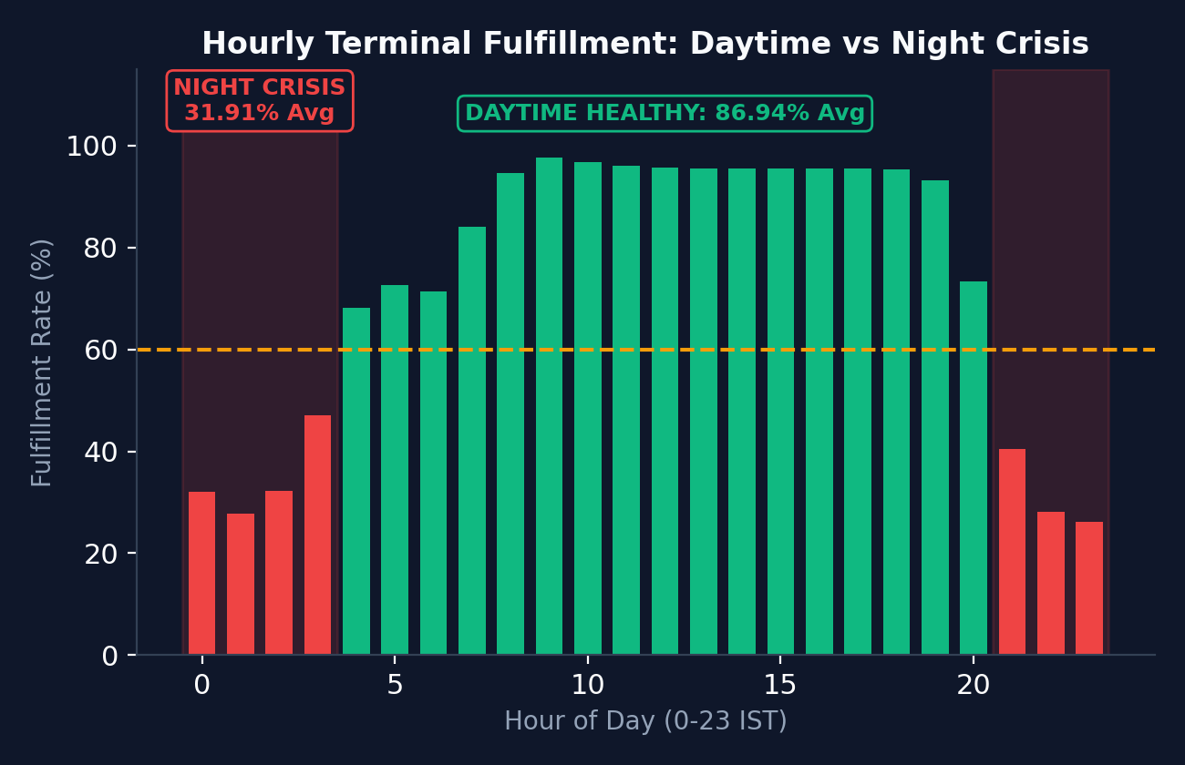
SLIDE 05 | AIRPORT SUPPLY DIAGNOSIS
The Airport Shortage Is a Night-Time Return-Economics Problem
Daytime fulfillment is healthy (86.94%); unfulfilled rides (46,020) occur strictly between 21:00 and 03:00
POST-TRIP DISPERSAL & DECISION
• Night Crisis (21:00–03:00): Fulfillment drops to 31.91% (46,020 unfulfilled rides, 83.6% of total airport gap). Daytime is 86.94% (4.3 min ETA).
• Suburban Stranding: 41.1% of airport trips drop in suburban zones. 83.5% get NO return fare within 20 min (23+ km empty drive back).
• Cancellation Friction: Captains cancel 21.0% of suburban airport trips (vs 8.6% city core). The observed pattern is consistent with deadheading friction reducing return attractiveness.
• Headcount Push Verdict: NO to generic targeted airport captain acquisition. Hiring airport-area captains will not solve night supply if they log off or get stranded.
• Opportunity Goal: Target raising night fulfillment from 31.9% toward 60% (~+9,500 rides/month goal; opportunity estimate, NOT guaranteed causal impact).

Slide 6
SLIDE 06 | ACTION PLAN
Three Moves to Start Monday
Prioritized, operational interventions with explicit planning estimates & pilot assumptions
01
LOW-DEVICE AUTO-BLUR SDK
ESTIMATED IMPACT: +52 / month
Action: Integrate Android image quality SDK checking camera blur & edge detection before upload.
Primary Metric: Low-device pass rate >85%
Illustrative Budget: ₹1.5L illustrative pilot budget assumption
02
WHATSAPP OCR NAME-FIX
ESTIMATED IMPACT: +34 / month
Action: Automated interactive WhatsApp bot resolving DL ↔ Aadhaar name mismatches via 1-click OTP.
Primary Metric: 24-hour resolution >40%
Illustrative Budget: ₹0.50/msg illustrative assumption
03
NIGHT RETURN GUARANTEE
ESTIMATED IMPACT: 31.9% → 60%
Action: Illustrative ₹150 night return-fare guarantee for suburban airport drops (21:00–03:00) + free toll pass.
Primary Metric: Night fulfillment >60%
Illustrative Budget: ₹85 subsidy illustrative assumption
EXECUTIVE TAKEAWAY (MONDAY ACTION PLAN)
1. Fix low-device onboarding friction. 2. Resolve document-name mismatches. 3. Test night return economics. 4. Do not scale CAMP_WA_002 5× until incrementality is proven. 5. Do not solve a night marketplace problem with generic airport headcount.

