Slide 1
Coding – ‘ A relaxed, fun-filled but productive & Efficient’ activity.
Uniqueness of our Features
BreakTime [Take a small relaxing break for better productivity]
Send message(s) to Teammates in native language and let them have some fun.
Compilation Errors [Experienced developer - Code correctly at the first time]
Check your coding efficiency by comparing with the past code compilations and focus to make lesser compilation errors as the lines of code increases.
Code Smell [Detect Code smell early in your Java programs]
Detect code smell in Security, Performance, Best Practices, Design, Code style and Documentation categories to fix potential issues at the earliest before they leak into testing & production.
Play a short game with computer and see if computer can let you ‘Win’ with some offer.
View messages sent to you by your friends.
View the videos posted by your team administrator from time to time that are motivational and relaxing.

Slide 2
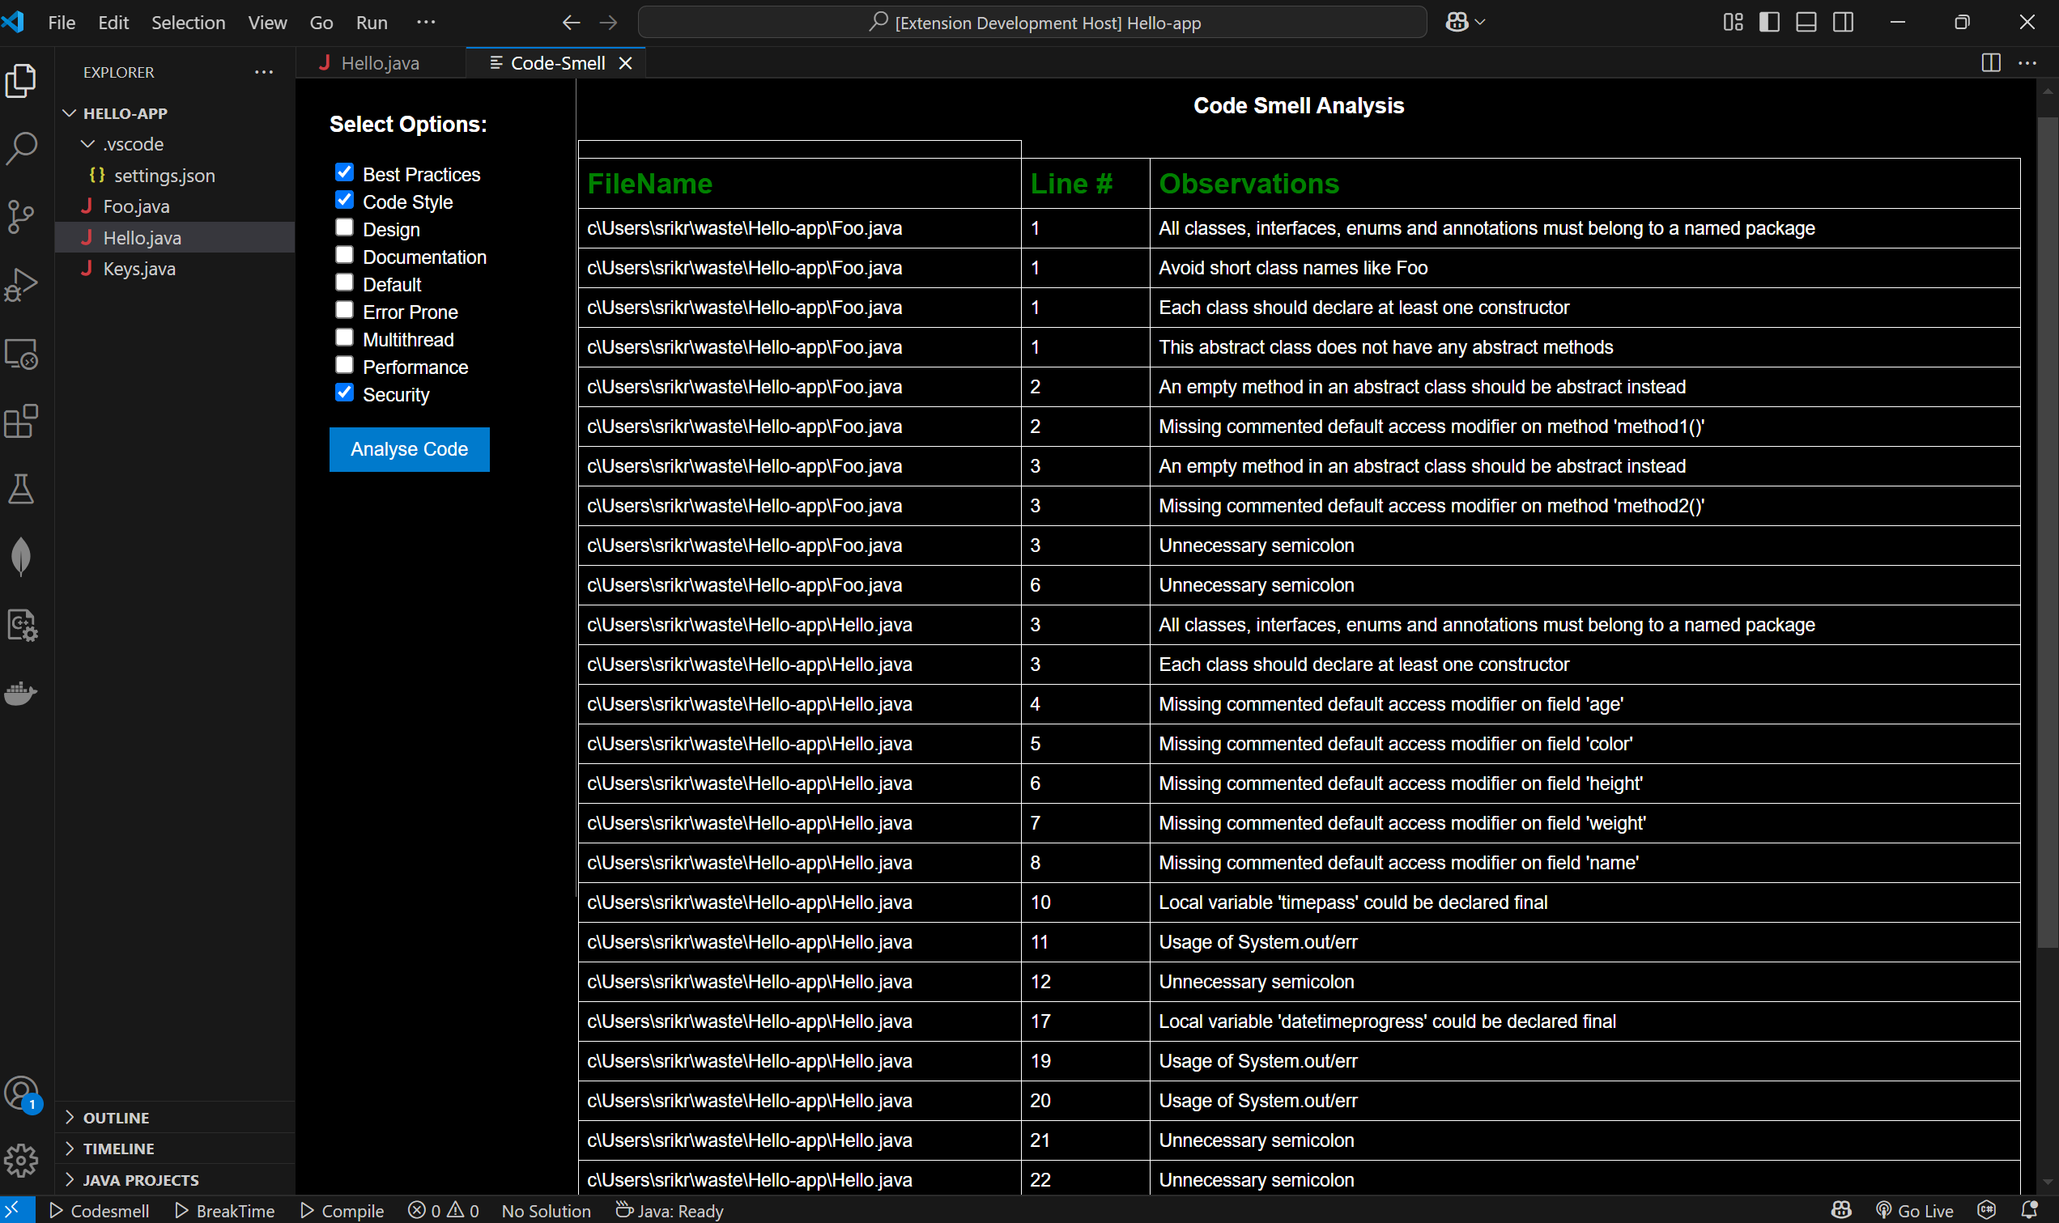
Invoke: Ctrl + Shift + P > ‘Analyze Java Code Smell’.
Select one or more categories of code smell(s) you want to identify in your Java programs and click the ‘Analyse Code’ button to view all the potential code smell in your Java programs.
All the java programs in the folder will be analyzed for code smell.
‘Default’ category is combination of ‘Best Practices’, ‘Code Style’ and ‘Documentation’. So if ‘Default’ is selected along with the above categories then you may see duplicate entries in code smell.

Slide 3
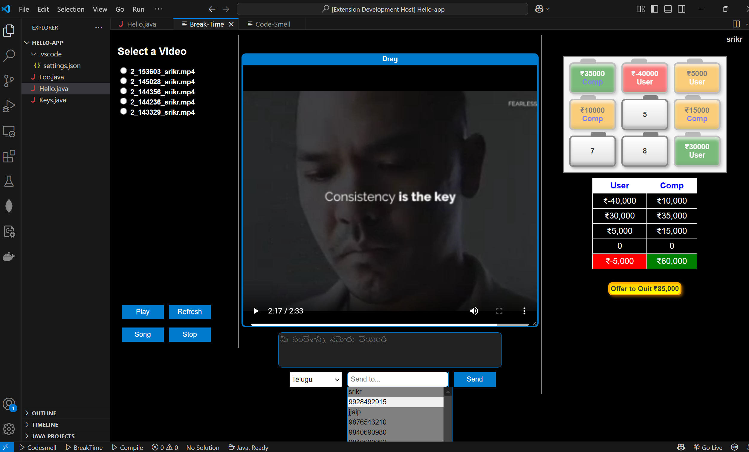
Invoke: Ctrl + Shift + P > ‘BreakTime’.
Select a Video and click the ‘Play’ button to watch the message sent by your team mate.
Click ‘Refresh’ to check for any new video-message(s) sent by teammate(s)
1. Click the ‘Song’ button to view the songs posted by your team administrator.
2. To view the next song, click the ‘Song’ button again.
Click a ‘suitcase’ to start the game.
Computer will select a suitcase after you.
If you choose to accept the ‘Offer to Quit’, the amount will get added to your account, but you will not be able to choose a suitcase after that.
Maximum amount holder is the Winner.
1. Select a language and enter the message in same language.
2. select your teammate id and click ‘Send’ to send message to your teammate.

Slide 4
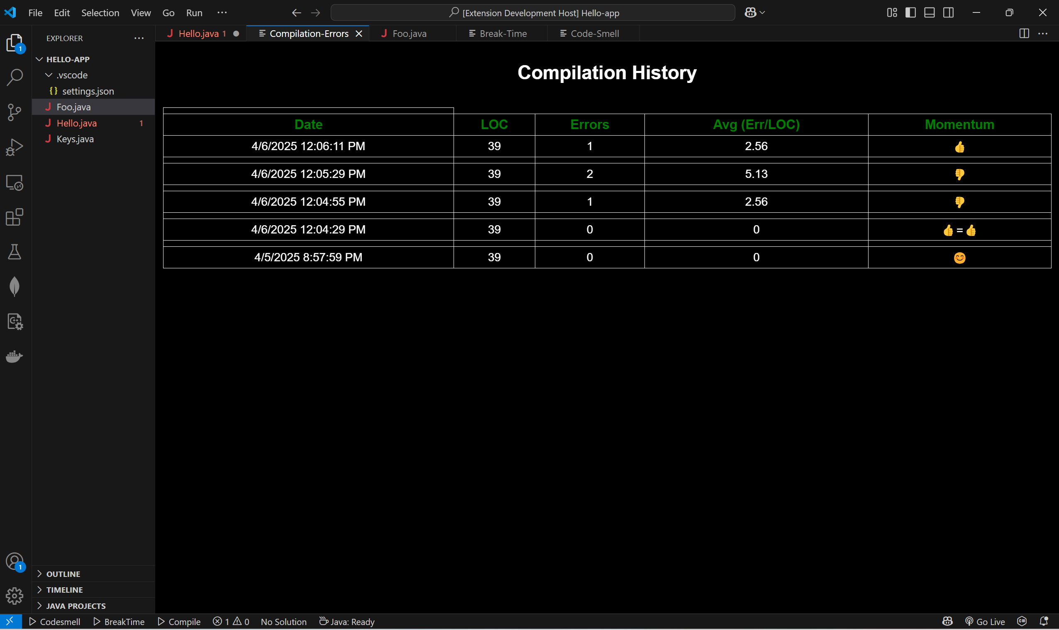
Invoke: Ctrl + Shift + P > ‘Compilation Errors’.
Invoking ‘Compilation Errors’ will perform a fresh code compilation to identify any compilation errors and compare with past history of compilation errors. The ‘Momentum’ field will show if the current compilation error count average is better than the previous compilation error count average.
The average error count is the number of errors detected divided by the total lines of code in all the files in that directory.
A thumbs-up will be shown if the average error count is better than the previous error count average.
A thumbs-down will be shown if the previous error count average is better that the error count average of the current compilation.
A thumbs-up = thumbs-up will be shown if the average error count remains the same between the last and current compilation error counts.
A smiley face will be shown if the compilation is done for the first time.
Ctrl +Shift + P > ‘Retrieve Compilation Details’ will show the past of history of compilation errors without performing a new code compilation.
Ctrl + Sift + P > ‘Clear Compilation Details’ will clear the compilation history.
Maximum of 20 past compilation history will be stored in the history. So, for 21st compilation, the first compilation history will be removed in FIFO (Queue) model.

Slide 5
Release 2 Enhancements
Appreciate Your Teammate [Appreciate / Greet Your Teammate(s)]
Send e-card to your teammate(s) to Appreciate/Thank/Greet.

