Slide 1
Healthify-NWMSU

Slide 2
Soumya Thogiti
Vineetha Yenugula
Naga Anshitha Velagapudi
Shiva Rama Krishna Vodnala
Swaroopa Thirumalareddy

Slide 3
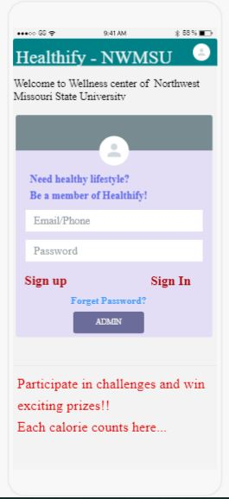
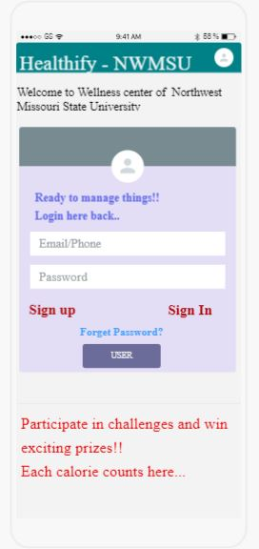
Screens of UI Sketches Login page of user and admin

Slide 4
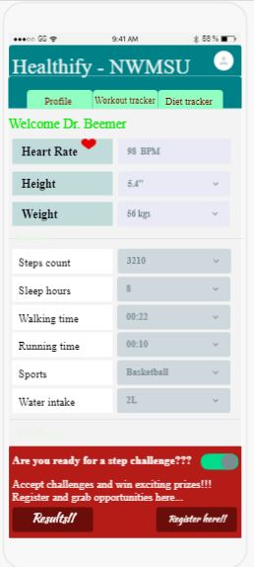
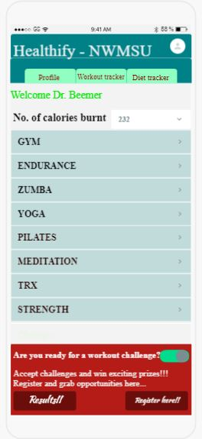
Screens of UI Sketches

Slide 5
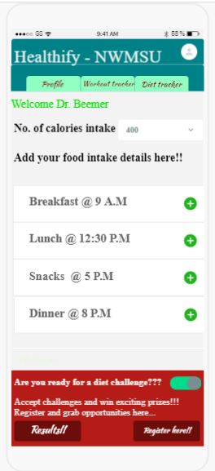
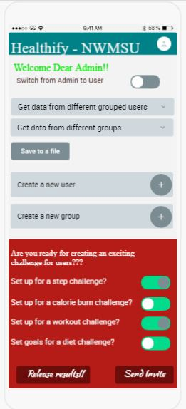
Screens of UI Sketches

Slide 6
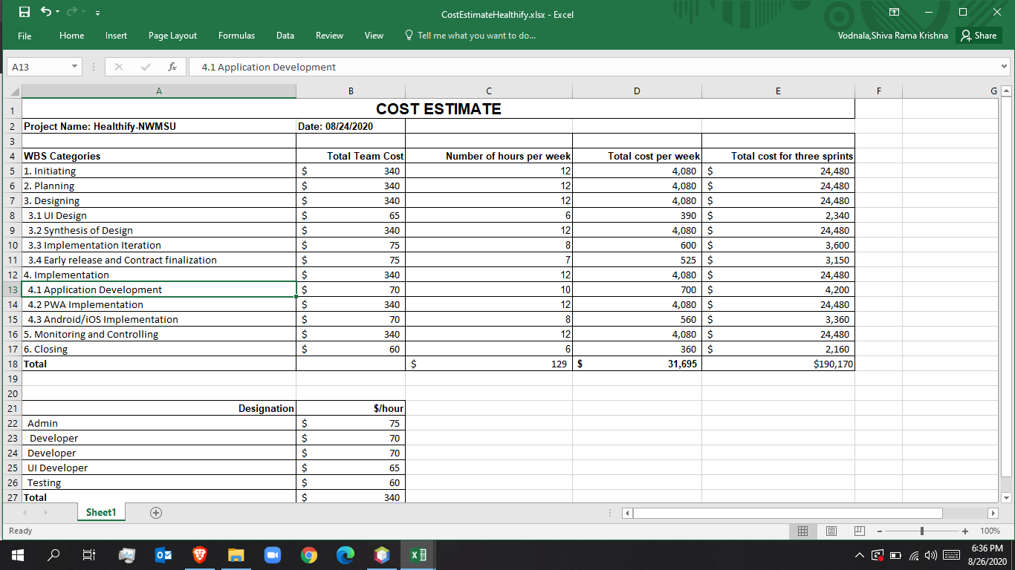
Cost Management

Slide 7
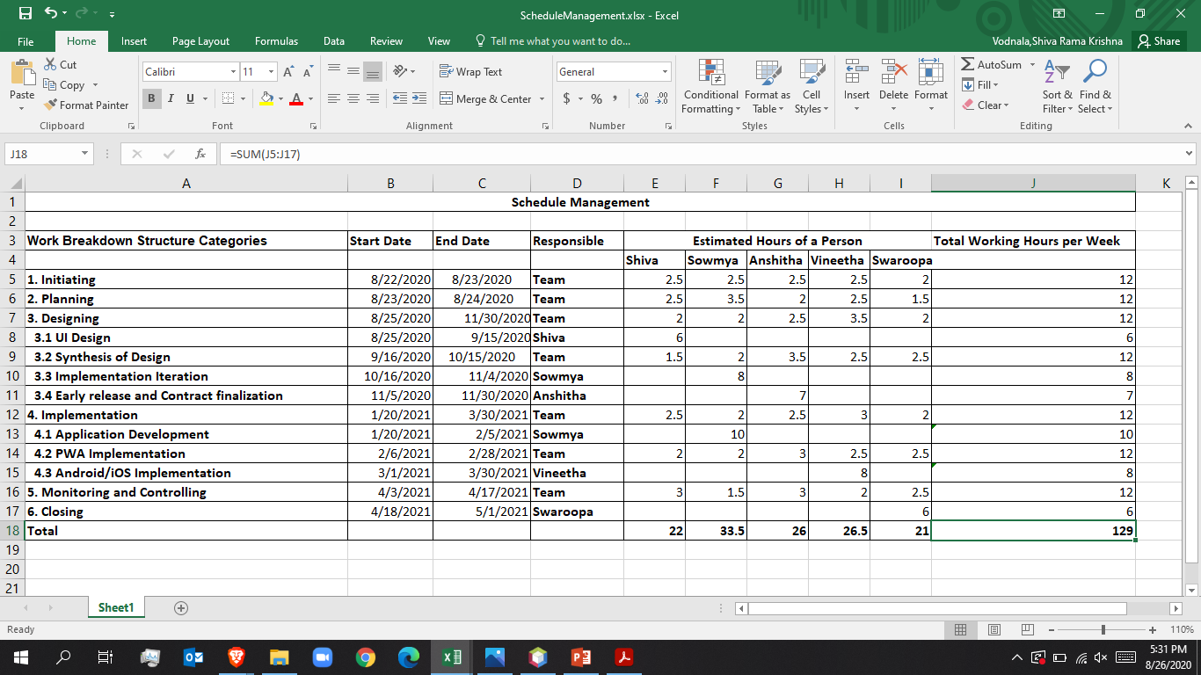
Schedule Management

Slide 8
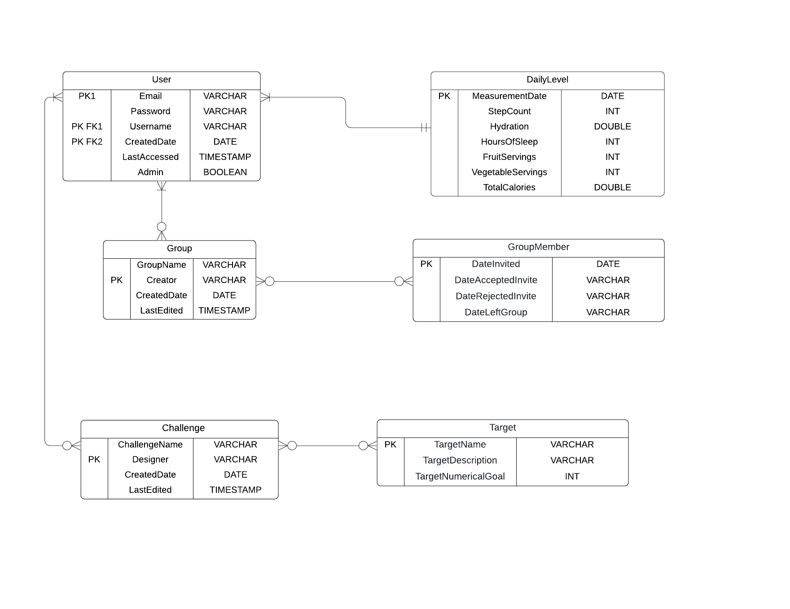
ER Diagram

Slide 9
Thank You

