Slide 1
ANGULAR

Slide 2



TEAM MEMBERS
Venkatayashwanth Damera
Bhanuprakash Thota
https://github.com/BhanuprakashThota
https://github.com/Yashwanth-Damera
Puneeth Annam
https://github.com/Puneeth159

Slide 3
Agenda
Folder Structure
Routing, Components Usage and 2- way binding
API Fetch Calls
Damera VenkataYashwanth

Slide 4
Angular
Angular is an app-design framework and development platform for creating efficient and sophisticated single-page apps. Angular is a complete rewrite from the same team that built AngularJS.
The architecture of an Angular application relies on certain fundamental concepts. The basic building blocks are NgModules, which provide a compilation context for components.
NgModules collect related code into functional sets; an Angular app is defined by a set of NgModules. An app always has at least a root module that enables bootstrapping, and typically has many more feature modules.
Components define views, which are sets of screen elements that Angular can choose among and modify according to your program logic and data.
Components use services, which provide specific functionality not directly related to views. Service providers can be injected into components as dependencies, making your code modular, reusable, and efficient.
Damera VenkataYashwanth

Slide 5
Folder Structure
The folder and file structure looks like this in an Angular 8 project: > e2e > node_modules > src > app > assets > environments ..index.html ..styles.scss
The e2e folder is for end to end testing.
node_modules is a folder, it contains the project's dependencies.
Damera VenkataYashwanth

Slide 6
Continued….
/src contains most of the code
/app is used to write Angular 8 code. It includes routing, components, and more.
/index.html is the entry point to the app.
/styles.scss is where global CSS rulesets will reside
Damera VenkataYashwanth

Slide 7
Angular Components
The fundamental building blocks of your Angular app are the components.
Components consist of 3 elements:
The imports
The component decorator, which are various properties for your component. The component decorator includes locations to the component's template and CSS location.
The component logic, where the code resides.
As we progress, we'll work with all 3 of these concepts to build out the app.
Damera VenkataYashwanth

Slide 8
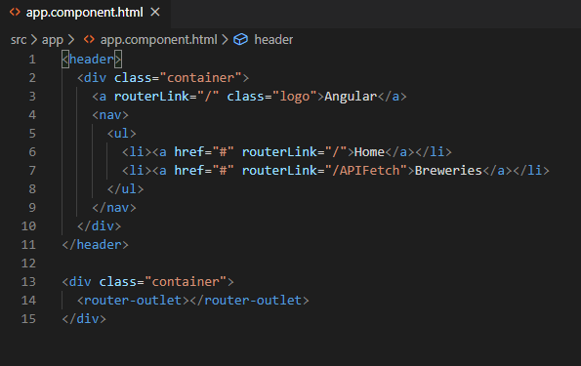
Creating a Navigation
Open up /src/app/app.component.html and remove all of the current code. Replace it with the following:
Damera VenkataYashwanth

Slide 9
Continued..
The two important areas that are specific to Angular 8 here are:
routerLink - This is how we link together different pages of your app. We don't use href.
router-outlet - This is where routed components are displayed within the template.
Damera VenkataYashwanth

Slide 10
Routing
Angular CLI is used to generate a couple components for the pages in our app.
ng generate component componentName
This above command generate several files for each component.
We first import the components that were generated, and then we add them as an object in the Routes array. We left the path: property blank, which signifies the home component that will load by default when the app loads.
If you click on the List and Home links in the navigation, they will now display the component template associated with the clicked component!
Bhanu Prakash Thota

Slide 11
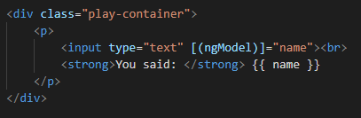
Data binding
One-Way Data Binding:
When you want to communicate data from the component logic to the template (or vice versa), this is called one-way data binding.
Two-Way Data Binding:
The best way to demonstrate the concept of data binding is to do it with a form element.
Visit home.component.html and add the following code:
Bhanu Prakash Thota

Slide 12
Continued..
In order for ngModel to work correctly, we need to import it into our /src/app/app.module.ts:
import { FormsModule } from ‘@angular/froms’
Bhanu Prakash Thota

Slide 13
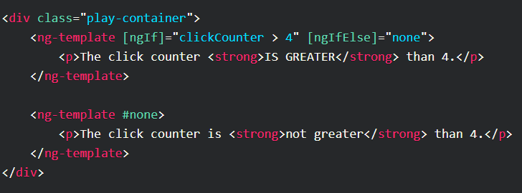
ng-template
Working with if and else within our templates, we can use ng-template for that.
Add the following code at the end of home.component.html:
Bhanu Prakash Thota

Slide 14

Binding
Style Binding:
If we want to modify the appearance of our UI based on events that occur in our app then class and style binding come into play.
Class Binding:
If we wish to add or remove entire classes that are defined in our CSS, we can do this with class binding.
Modify the current .play-container we've been working with, to the following:
Bhanu Prakash Thota

Slide 15

Services
Services are special components that are reusable throughout your app. We're going to create a service for the purpose of communicating with an API to fetch some data and display it on our lists page.
Let's generate the service with the Angular CLI:
Notice "g s", these are just shorthand terms for "generate service". The name we're giving this service is "http".
Puneeth Annam

Slide 16
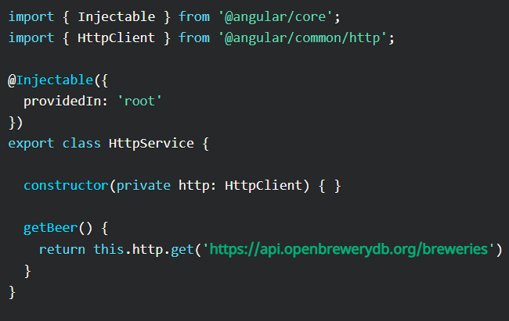
Angular HTTP Client
We need to integrate the HTTP client within our http service, which will allow us to communicate with a public API.
Visit our http.service.ts file and add the following:
Puneeth Annam

Slide 17
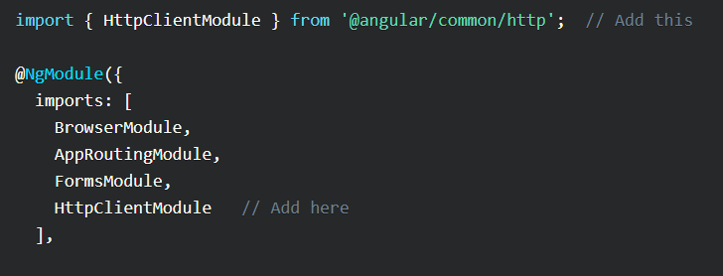
Continued..
First, we import the HttpClient, then we create an instance of it through dependency injection, and then we create a method that returns the response from the API. Simple!
We have to import the HttpClientModule in our /src/app/app.module.ts file:
Puneeth Annam

Slide 18
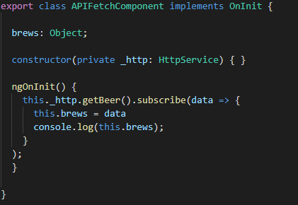
Continued..
Next, open up the apifetch.component.ts file and add the following:
The service returns an observable, which means we can subscribe to it within the component. In the return, we can pass the data to our brews object.
Puneeth Annam

Slide 19
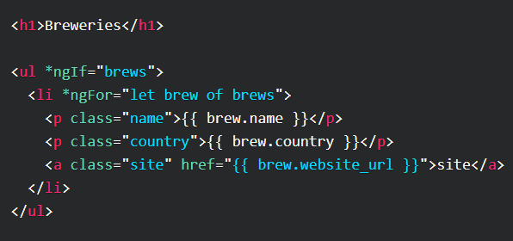
Continued..
Next, visit the api template file and add the following:
First, we add an *ngIf to only show the UL element if brews exists.
Then, we iterate through the array of objects with *ngFor.
After that, it iterates through the results with interpolation!
Puneeth Annam

Slide 20
Resources
https://youtu.be/_TLhUCjY9iA
https://coursetro.com/posts/code/174/Angular-8-Tutorial-&-Crash-Course

Slide 21

Any Queries?

