Slide 1
Building Decentralized Applications
Notes:
Note : Little slow down in presentation pace.
* Title should be comprised with keyword “Blockchain”[This would adds more value].
* Real time scenario with drawbacks.
* How blockchain provides solution to the existing problems, [Idea behind it].

Slide 2
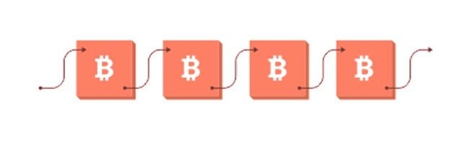
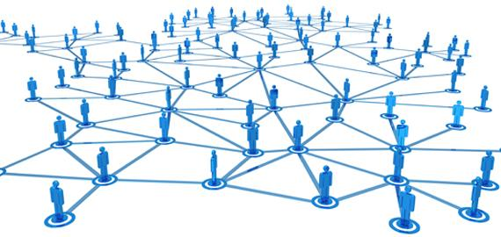
Blockchain?
A Blockchain is a continuously growing list of records, called blocks which are linked and secured using cryptography.
Each block typically contains the cryptographic hash of the previous block, a timestamp and transaction data.
The Blockchain works on the P2P(peer to peer) protocol where every node has an equal say in validating the transactions on the network.
Notes:
* You may relate this to doubly linked list [Just to make audience understood].

Slide 3


Slide 4
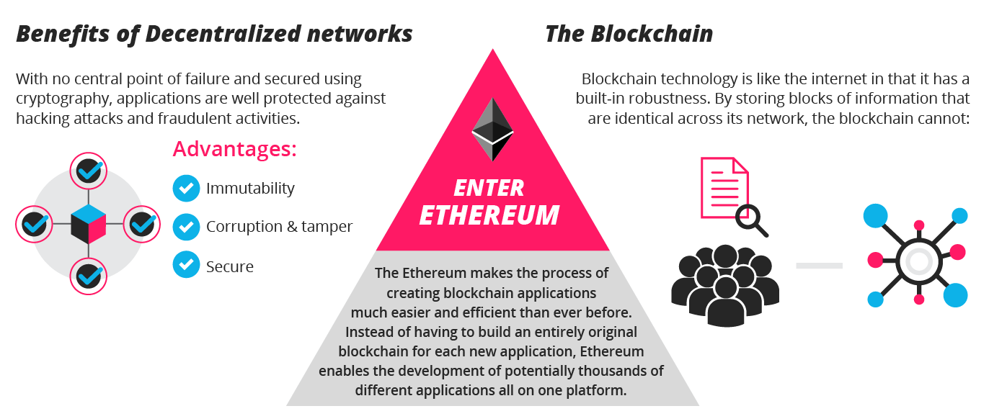
Ethereum
Ethereum is an open-source software platform based on the Blockchain that enables developers to build and deploy decentralized applications without censorship, fraud or third party interference.

Slide 5


Slide 6

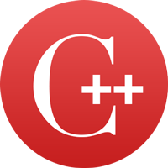
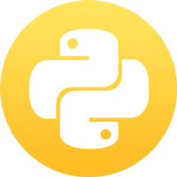
Ethereum Clients
Clients are command line tools that enable our machine to connect to the Ethereum Blockchain,
or a private network of single or multiple nodes.
Officially, there exist 3 implementations of the Ethereum client
Geth
Eth
Pyethapp
Audited for security the most popular widely used client type.
Of interest if GPU mining is the objective
Most readable codebase, easy to understand the inner working of the Ethereum client
All implementations have similar functionalities, so the choice is up to the reader. We’ll be using Geth for this tutorial. Further detailed information on other clients can be found on the Ethereum website https://www.ethereum.org/cli

Slide 7
Installing Geth
To install on Mac, using Homebrew Package manager, run the following commands in the terminal:
$ brew update
$ brew upgrade
$ brew tap ethereum/ethereum
$ brew install ethereum
To install on Linux, run the following commands:
$ sudo apt-get install software-properties-common
$ sudo add-apt-repository -y ppa:ethereum/ethereum
$ sudo apt-get update
$ sudo apt-get install ethereum
This installs the Geth client and the computer is now ready to become a node and contribute to the Ethereum blockchain.
Notes:
* Info on windows setup may be requires since most of the resources are familiar with windows.

Slide 8
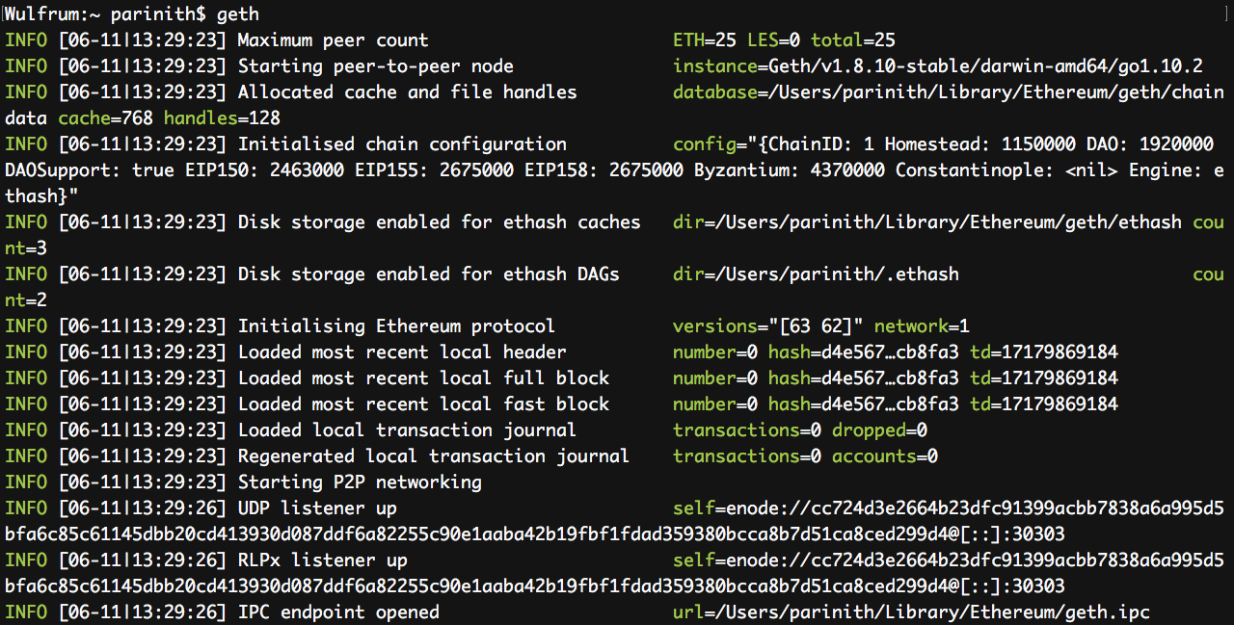
Connecting to the MainNet
Now, to interact with the mainnet, we need to start up Geth by just running the command:
$ geth
This starts up the Geth client, and looks for other available nodes to connect to and be a part of the Main Network.

Slide 9
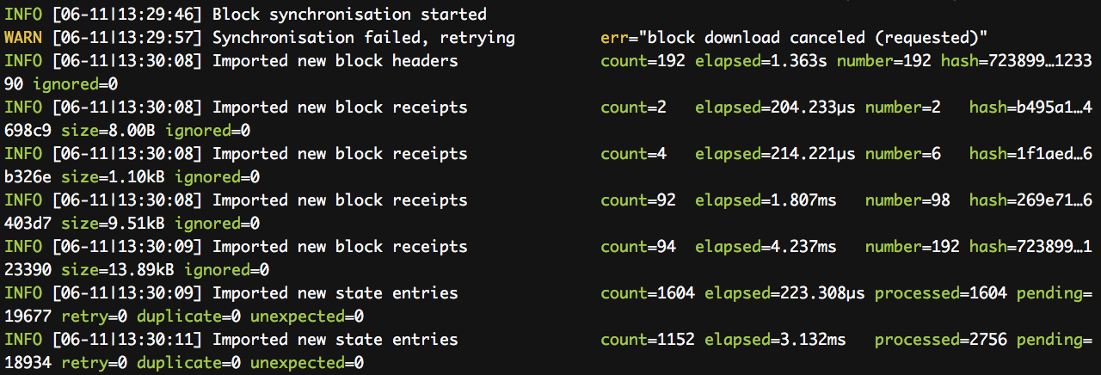
To be able to interact in any way with the main network that everyone in the world uses, our node first needs to be up do date with the blocks that have already been mined (Be aware of what the current status of the Blockchain is as that is important to make any transactions on the network), so it starts synchronizing the blocks from peer(s) that already have all the Blockchain information.
This process involves synchronizing over 667GB of data as of 11 June 2018 for a “full sync”. A “fast sync” syncs only the bare essentials but can still take over weeks to synchronize fully, assuming you have that much hard disk space. As the future DApp developers that we are going to be, we need to be able to test, reiterate and develop as fast as possible. We could use the Public Test Blockchains but those take weeks to synchronize too (over 2 million blocks as of today). Therefore, we use Private Nets.

Slide 10

Private Network using Geth
Private Networks are local Blockchains running on our computer alone and our computer is the single node running the network. We can set such a network up using Geth using the following commands
$ geth --datadir ~/.ethereum_private init ~/dev/genesis.json
$ geth --fast --cache 512 --ipcpath ~/Library/Ethereum/geth.ipc --networkid 12345 --datadir ~/.ethereum_private console
Then, we can interact with the blockchain using a Javascript console connected to the same IPC endpoint, to add account, check account statuses with more complicated terminal commands like:
personal.newAccount("Write a good passphrase!")
web3.eth.accounts
…
…
OR, we could use a simpler straightforward piece of software that
does all this for us…!
“Ganache” does exactly this, runs a private Ethereum network on a specified port and gives us 10 accounts with 100 ether each to get started and test our contracts instantly. Speeding up the development process. It also provides us with a GUI to tweak any detail of the Private Blockchain that we would ever want to!

Slide 11
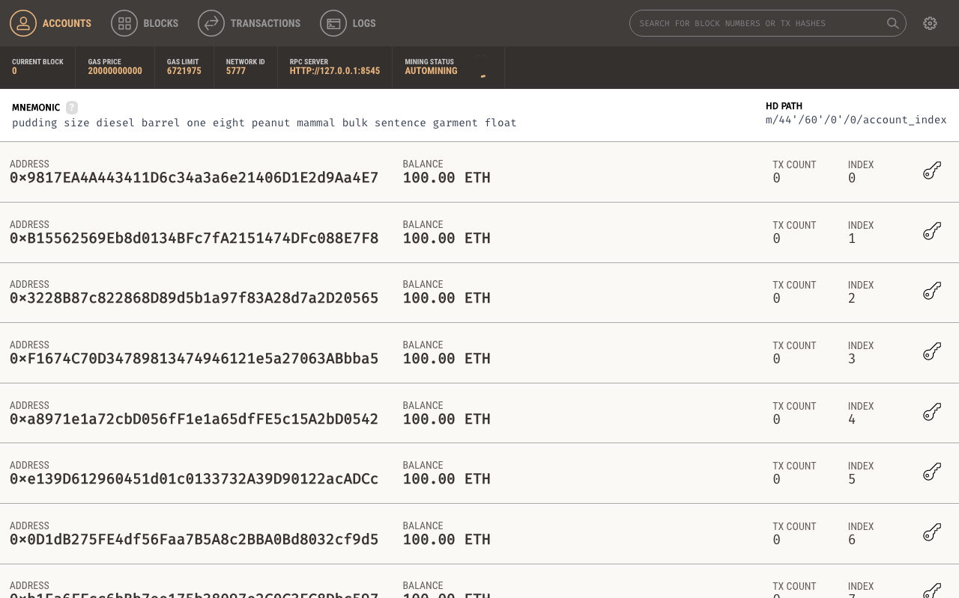
Installing Ganache
Visit the following link to download the appropriate version of Ganache for your operating system:
https://github.com/trufflesuite/ganache/releases
On Mac, the installation is straightforward like any other .dmg file
On Linux, The .AppImage file should first be enabled to be run as an executable before opening it: RightClick on the file → Properties → Permissions → enable “Allow executing file as a program”
This is what we get when we start Ganache. 10 accounts generated from a randomly chosen mnemonic filled with 100 ethers.
The Ganache window must be kept open while deploying for testing purposes.

Slide 12
Smart Contracts
A contract is an agreement between 2 people that both of them will adhere to certain rules and execute specific actions. These contracts are supposed be binding and unchangeable by either one of the two independently.
As the name suggests, these are contracts that are self-executing i.e., “Smart”. They can know when a state or an event occurs and carry out the function predefined by code. Therefore, the programs written to run on the Blockchain are called “Smart Contracts” and are distributed across all peers of a network.
This enables unknown parties to interact with each other without a trusted middle-man while being sure that an action such as payment, transfer of goods, or anything else will definitely take place.
These Smart Contracts can be coded using multiple programming languages that can be compiled onto the EVM ( Ethereum Virtual Machine ). Few of which are:
Solidity
Vyper
Pyramid Scheme
Flint
Notes:
* Following few slides are contents rich, Precised keywords are adequete and explaination should be more.

Slide 13
Solidity
Compared to other languages, Solidity has a number of advantages:
Complex variables and structures like hierarchical mappings are supported.
The contracts support inheritance and multiple inheritance.
An Application Binary Interface (ABI) facilitating multiple type-safe functions within a single contract is supported. Also, any errors are identified during compile time and can be fixed pre execution/deployment.
As a result, Solidity is widely popular among Blockchain developers and has wide support and discussion forums, so our natural choice is to use solidity to code our smart contracts.
The complete documentation for the Solidity language can be found here for reference.
Remix is an online IDE to write, compile and test solidity code.

Slide 14
Sample Solidity program
pragma solidity ^0.4.0;
contract Test {
uint256 counter;
string text = "MaybeSomething";
function incrementCount() public {
counter++;
}
function decrementCount() public {
counter--;
}
function changeText(string message) public payable {
require(msg.value==0.01 ether);
text = message;
}
function getCount() public view returns(uint256) {return counter;} function getText() public view returns(string) {return text; }
}
Now, we’ll see what it looks like, running this on Remix IDE and compiling and testing out the functions

Slide 15
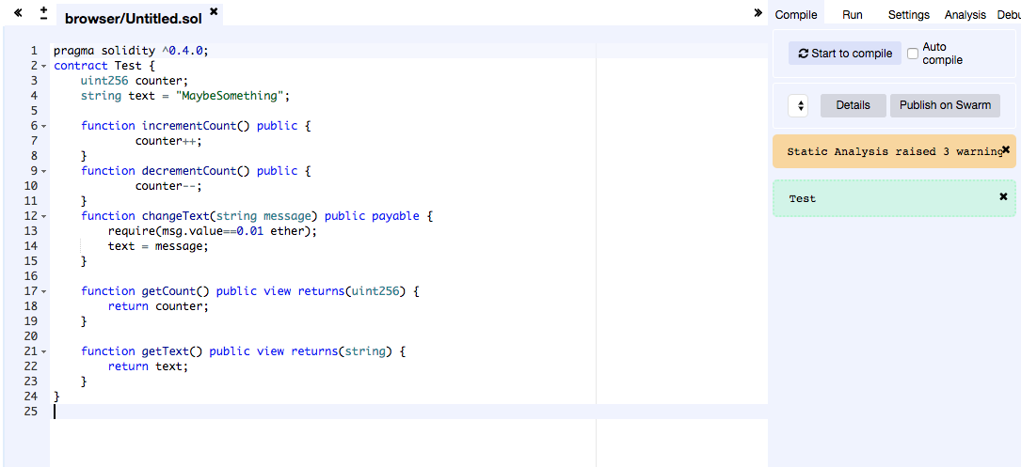
When clicked on “Start to compile”, if the green text box with the name of the contract appears, it means the contract compiled successfully.

Slide 16
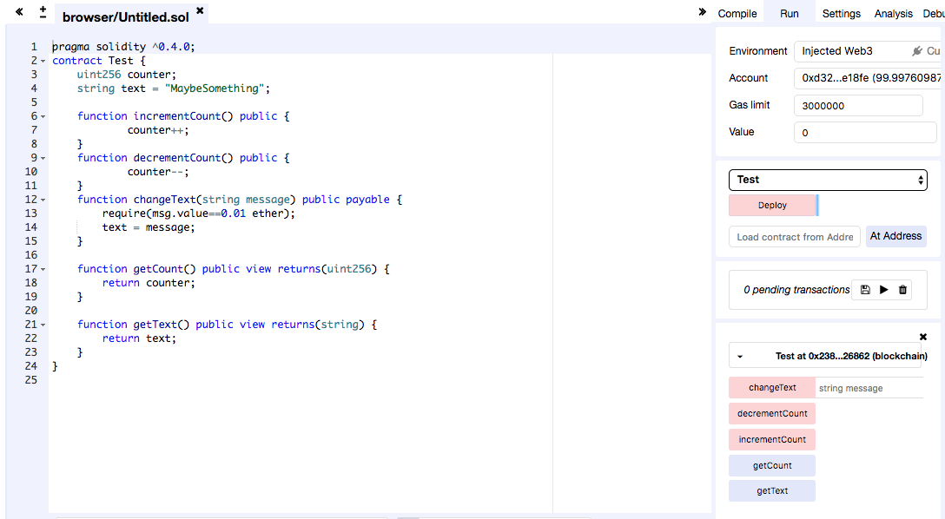
Navigate to the “Run” tab on the top right and deploy the contract to the private net. Now, you can interact and test the functions with the buttons as shown in the image.

Slide 17
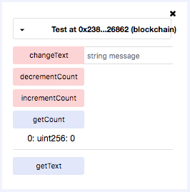
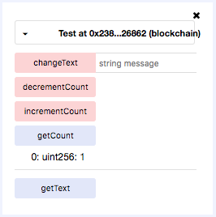
After incrementCount()
These are just auto generated buttons to interact with the contract and test our functions. A real DApp (Decentralized Application) would have it’s own custom front end design, built using existing Web development tools.

Slide 18
Front End
The Front End of the Application is designed using HTML, CSS and Javascript.
This may involve Buttons, Forms, Lists etc. To display the details and handle On Click events
The Front End of the application (in the browser) communicates with the Ethereum backend using the Web3.js framework.
Any Web Development Frameworks/Libraries like Bootstrap, JQuery etc. Can be used to create the Front End of the Application.

Slide 19
What is Web3?
web3.js is a collection of libraries which allow you to interact with a local or remote Ethereum node, using a HTTP or IPC connection.
Inter-process communication (IPC) is a mechanism that allows the exchange of data between processes.
Typically, applications can use IPC, categorized as clients and Servers, where the client requests data and the server responds to client requests.

Slide 20
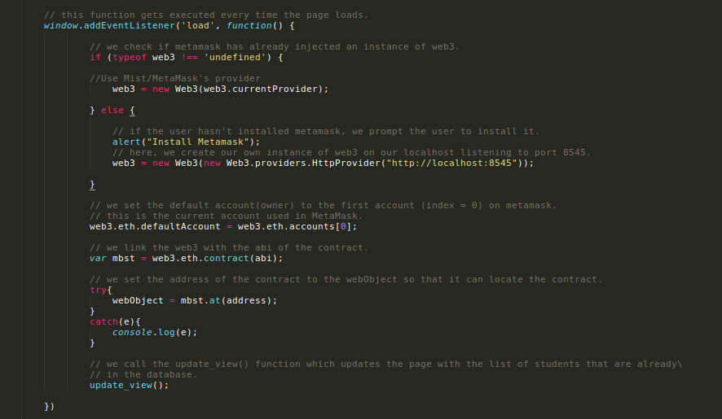
Example Web3 code

Slide 21
Web3 interaction
A web3 object (instance of web3) is used to interact with the Ethereum smart contract.
Using the web3 object, we can communicate between our DApp’s front end and our contract
Considering the possibility of payable functions, we need a way to direct transaction fees to the functions we will be calling.
As the webpage will be seen in a browser, we will need some sort of a “handler” in the browser which manages sending(and receiveing) the transaction fees from our wallet.

Slide 22

Enter MetaMask!
MetaMask is a wallet that is a browser plugin that allows users to make Ethereum transactions through the regular browser.
It allows you to run Ethereum DApps right in your browser without running a full Ethereum node.
MetaMask provides a user interface to manage your identities on different sites and sign blockchain transactions.

Slide 23
Why Metamask
MetaMask allows the user to run Ethereum DApps in the browser without syncing/downloading the whole blockchain.
The plugin will inject(*) the Web3 Javascript library (developed by the Ethereum core team) into your browser (we will discuss more on that later).
The plugin provides you with a very intuitive user interface which makes it easy for the user to interact and make transactions.
(*) Due to browser security limitaions, MetaMask doesn’t inject Web3 to webpages running on file://, hence we’ll need a localhost server to test our websites.

Slide 24
MetaMask Installation
The installation of MetaMask is pretty straightforward.
It has a Chrome and Firefox plugin
Go to the MetaMask website,
Click on "get Firefox addon" if you want to install it on Firefox.
Click on "Get Chrome addon" if you want to install it on Chrome

Slide 25
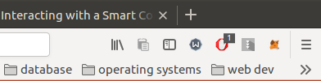
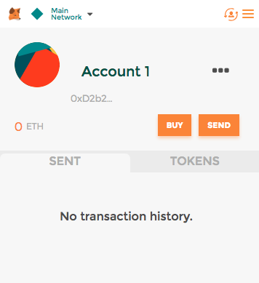
It adds a plugin to the browser.
It provides a GUI (graphical user interface) for the user.

Slide 26

Apache Server
Apache is the most widely used web server software. Developed and maintained by Apache Software Foundation.
Apache is an open source software available for free.
Apache Web Server is designed to create web servers that have the ability to host one or more HTTP-based websites.
It can be used to host a website on your local computer.

Slide 27
Installation
Apache is available within Ubuntu's default software repositories, so we will install it using conventional package management tools.
Open a terminal and type the following commands.
$ sudo apt-get update
$ sudo apt-get install apache2
This installs apache2 web server on your ubuntu computer.

Slide 28
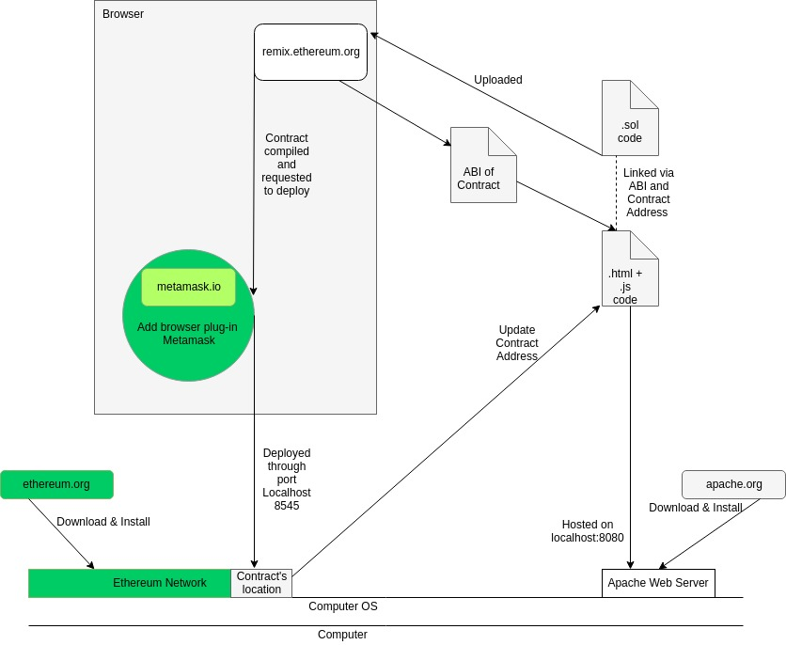
The Bigger Picture
This diagram illustrates all the components that are essential for our DApp to properly function, the nodes will be colored green as we progress through. We already have a Private test network up and running, and we have already installed Metamask

Slide 29
An End-to-end example
To better understand the whole process of building a DApp and deploying it, lets consider an example problem and try to build a solution:
Consider a school owned by "Owner". Owner wants a system, preferably an application that stores and displays the list of students with their details, and a list of employers who may potentially employ these students, directly through this application. The app should also have the status of the homework given to students. A centralized application could be used to maintain these records. However, the school has a history of unauthorized altering and loss of data, which leads to students without proper credentials being recruited and employers being left unsatisfied. In order to put a stop to this, they need an application that doesn’t have a centralized database and properly regulates permissions. It was decided that a Decentralized Application (or DApp) was to be used.
Notes:
* Here scenario should be explained properly, Pace down.

Slide 30
Once the DApp is created, the Owner cannot personally add all the students and employers. The teachers of this school are expected to carry out this task. Hence, the Owner adds the list of teachers, who can then add the students and employers. Only the Owner has the privilege to add teachers.
The teachers have the privileges to :
Add students and their details
Give homework to students
Add employers
The employers have the privilege to employ the students.
The students have the privilege to submit homework.
The parents can only view the details of students.
It is now upon us to build this DApp for this school.

Slide 31
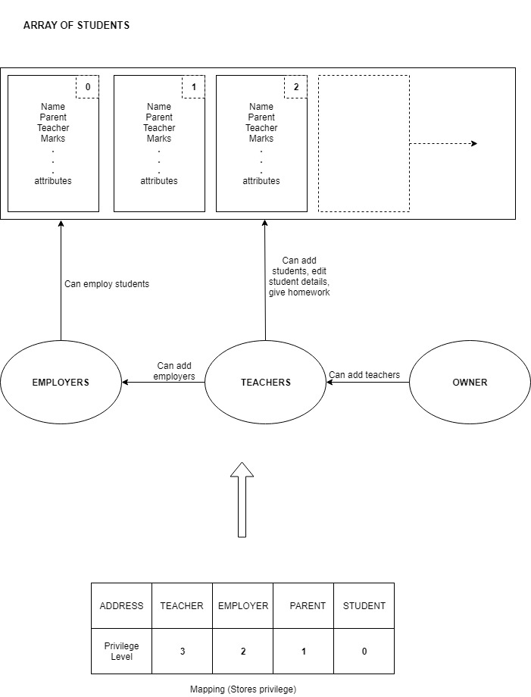
This diagram represents all the requirements for the DApp that will be coded in solidity.

Slide 32
Writing the Smart Contract
We write our smart contract using the programming language – Solidity.
We construct functions based on the requirements and with proper permissions. Therefore we write functions to-
Create Student, with details. Any teacher can do this.
Create Employer. Any teacher can do this.
Create Teacher. Only Owner can do this.
Update details of student. Only teacher who created this student can do this.
Give homework. Any teacher can do this.
Submit homework. Only student to whom this was assigned can do this.
Employ student. Any Employer can do this.
Get details of student, to display on the front end.

Slide 33

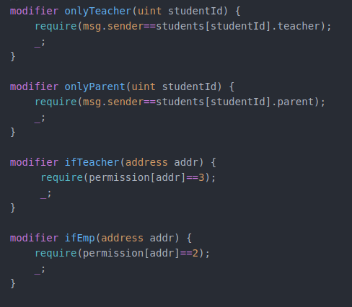
The constructor is created in such a way that the person deploying the contract is considered as the owner. Hence, the owner should deploy the contract. (Deploying is covered in the next section).
Then the modifiers are defined so that permissions can be regulated for owner-only, teacher-only ,etc. functions.
So when these modifiers are added to the respective function definitions, the permissions are set.

Slide 34
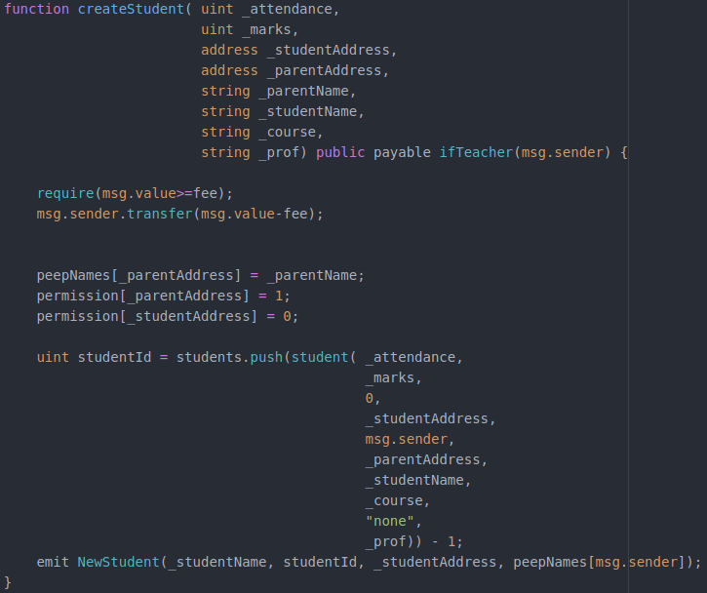
Code snippet of the createStudent() function

Slide 35
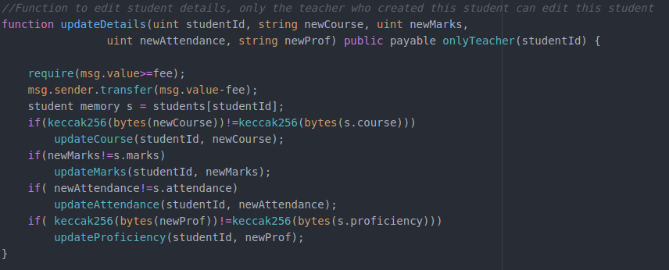
Code Snippet of updateDetails() function
The complete solidity code of our project can be found here

Slide 36
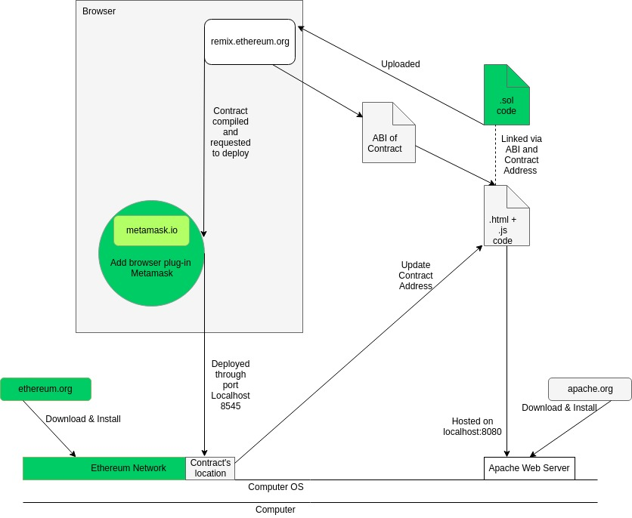

Slide 37
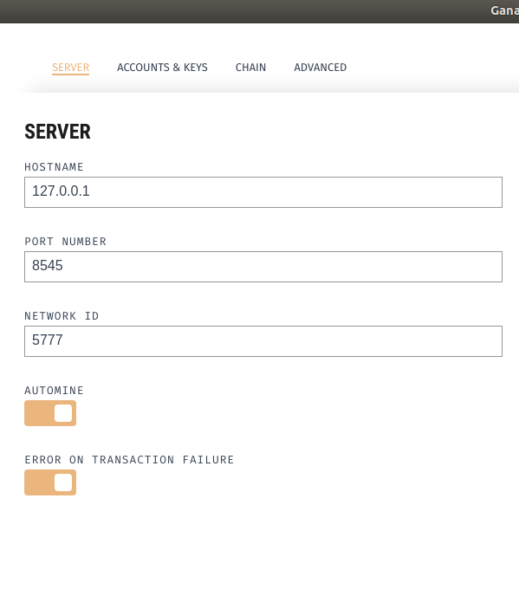
Deploying the Smart Contract
Open Ganache → Settings → Server, set the port to 8545.
Open Browser and login to MetaMask with an account with some Ether. (Copy the private key from one of the Ganache test accounts if necessary). Notice how there was only one block in Ganache → Blocks, ie the 0th block (Genesis state), and there are no transactions yet.
Paste the Smart Contract code in the online Solidity IDE Remix.
Compile the code on Remix.

Slide 38
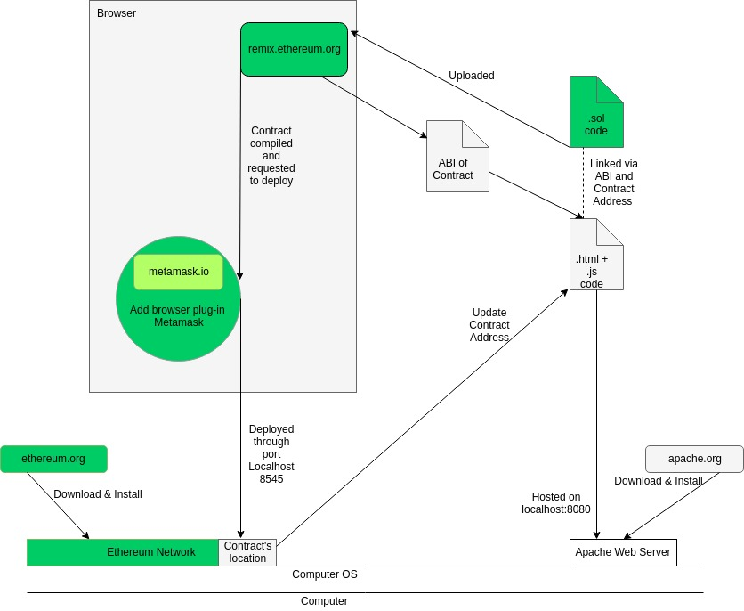

Slide 39
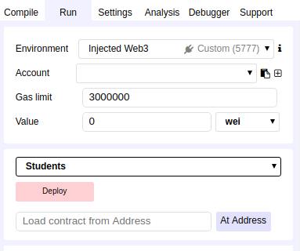
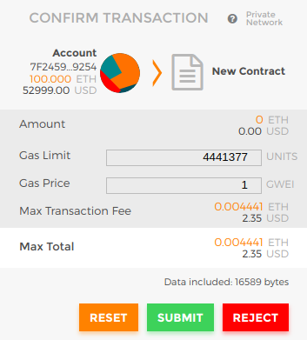
5. Go to the "Run" tab and click on "Deploy" to deploy your Smart Contract.
6. Submit the transation when the MetaMask Notification window pops up.
A very small amount of Ether is charged for deploying a contract, which will be transacted from your account.

Slide 40
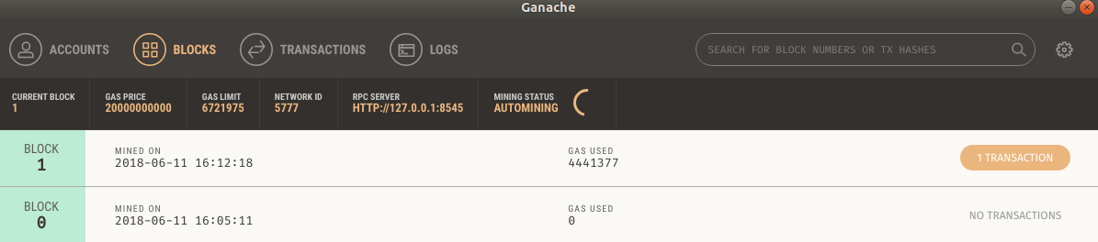
7. You have successfully deployed your contract!
When you check your Ganache -> Blocks , you'll notice that there is a new Block that has been mined. And when you check Transactions, you'll notice a new transaction ie, Contract Created, along with its details.

Slide 41


Slide 42
Coding The Front End
We Code the Front End using HTML, CSS, Javascript and other Front End frameworks like Bootstrap to make it responsive and look better.
We create a Form using Bootstrap to get the details of the students.
We use this data to create a new student in the Back End using the Smart Contract.
We display a list of students that have been created dynamically. When the user clicks on the name of the student, his/her details are displayed dynamically in a panel (created using Bootstrap.)
We add Buttons to :
Submit the details of the students
Add teachers. (owner)
Add employers. (teacher)
Give homework (teacher)
Submit homework (student)
Notes:
* These following slides may be additional info for the audience since they are from technical bakgrounds [Options]

Slide 43
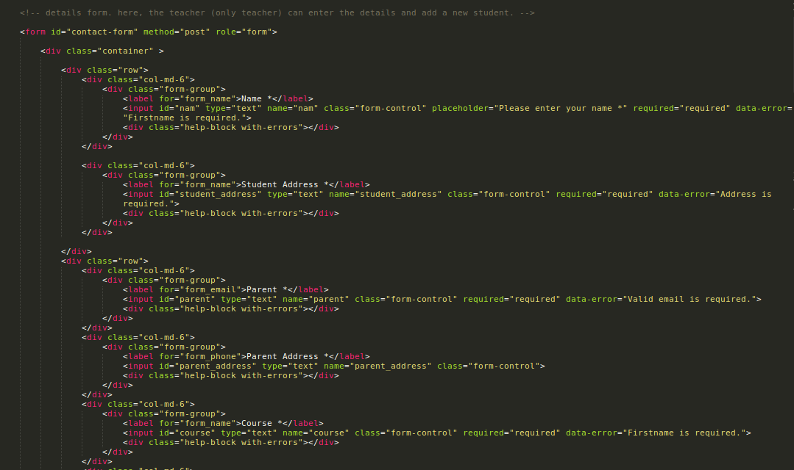
Example - HTML

Slide 44
JavaScript
We use JavaScript to:
Send the details of the student to Ethereum when the submit button is clicked.
Display the names of the student dynamically.
Display the details of the student when we click on their name.
Display the appropriate messages when events occur
To make the website Interactive
We also use Web3.js which is a JavaScript Framework. We will discuss more on this later.

Slide 45
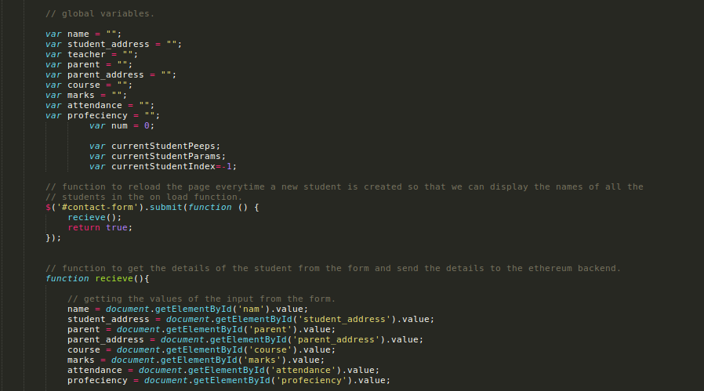
Example - JavaScript
*The entire front end code to our project can be found here.

Slide 46
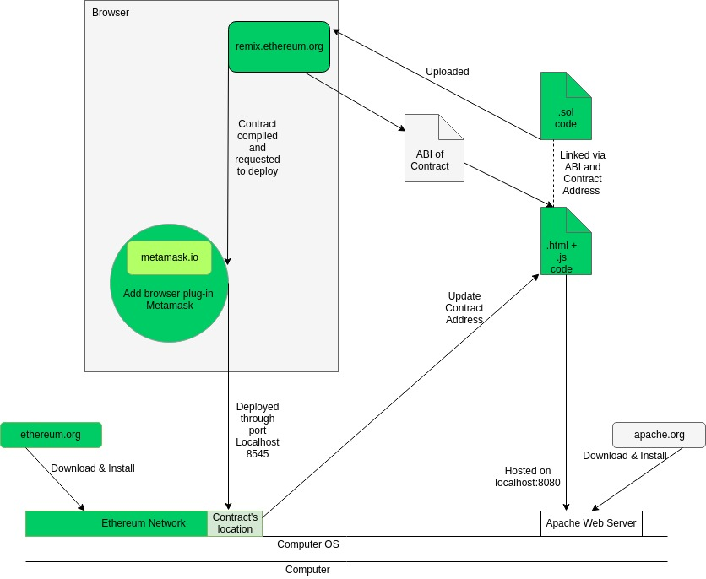

Slide 47
Hosting
We need to set up a server.
On Ubuntu, apache2 sets up a server on your localhost. (127.0.0.1)
We need to copy-paste our .html files into the /var/www/html directory. Ex:
NOTE: We are using apache to set up a local server because MetaMask has no permissions to communicate with DApps that are running on the local file system. (file://).
Note: any other hosting software (nginx etc.) can be used instead.

Slide 48
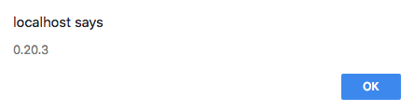
Web3 version
Metamask being the bridge between the normal web browser and the world of Ethereum DApps, does this by “injecting” an instance of Web3, a JavaScript framework into the browser, which the Web developers can use to call their contract functions on the Ethereum Blockchain.
As the framework is still under development, It is important to pay attention to the version of the web3 injected and use the corresponding syntactical rules. You can check the version by using the following line in your webpage’s JavaScript code:
alert(web3.version.api);
Which generates an alert saying:
Therefore, all the code pertaining to web3 in our website code is according to the Web3 version 0.20.3

Slide 49
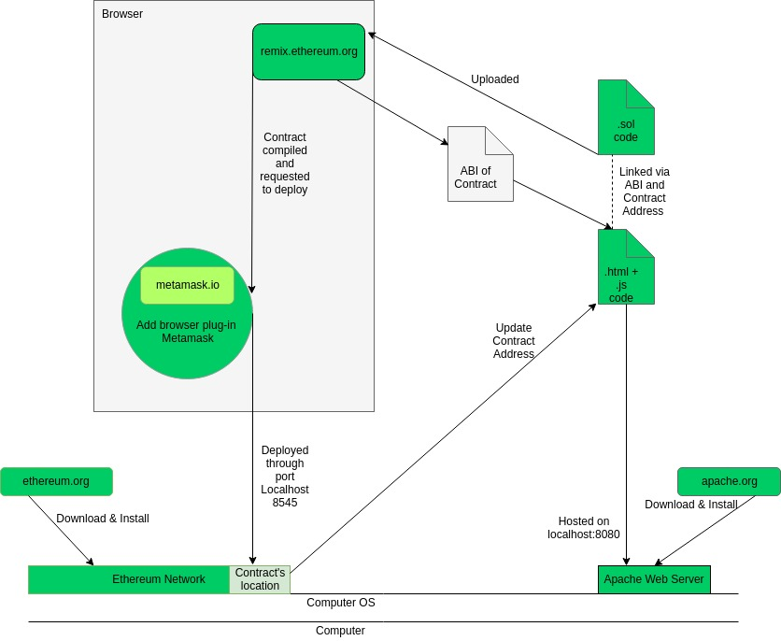

Slide 50
Linking the Smart Contract to our Front End
For our front end to interact with the backend, we need to use an Ethereum-Javascript API called web3.js .web3.js is a collection of libraries which allow you to interact with a local or remote ethereum node, using a HTTP or IPC connection.
Web3 object (instance) is injected into the html by MetaMask and we can use it to access the functions in the solidity smart contract.
So before we do anything with it, we have to check is web3 is injected.
Then we assign the default account of the object as account[0] , which is the currently active account.

Slide 51
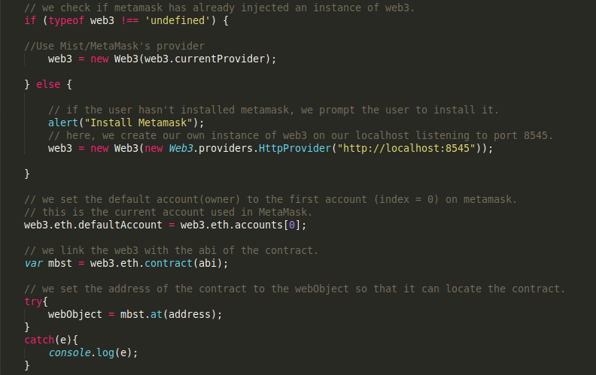
Then we need to initialize the web3 object by giving it the ABI(Application Binary Interface which defines how data structures or computational routines are accessed in machine code, which is a low-level, hardware-dependent format) of the contract, and the Contract's Address in the Ethereum network.
Checking the presence of web3
Setting defaultAccount
ABI to be pasted here
Contract Address to be pasted here

Slide 52
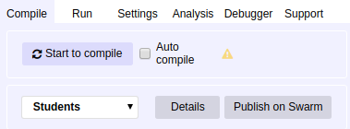
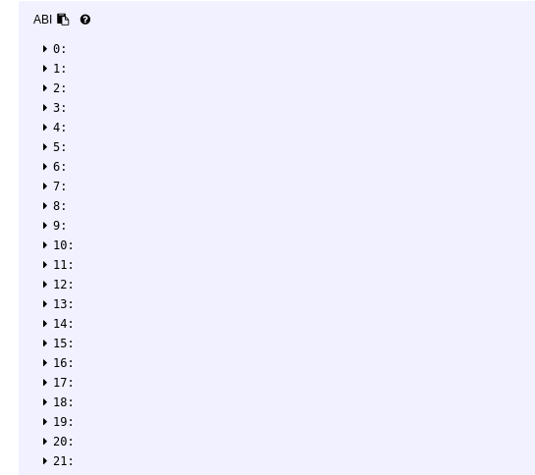
We can retrieve the ABI from Remix.
Once we paste and compile the Smart Contract code, click on Details.
A pop up window appears, and as we scroll down, we see the ABI. Click on the copy-file icon to copy the entire ABI to clipboard.
Paste that to initialize the web3 object as shown in the previous slide.

Slide 53

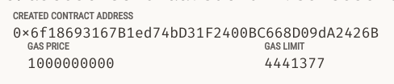
To retrieve the contract's address on the Ethereum network, reopen Ganache.
Go to Transactions, and you will see the transaction that occurred when the Contract was created.
Click on that transaction to see details.
There, you will find the Contract Address.
Copy-paste that to initialize the web3 object.
Now our web3 object is ready to use!

Slide 54
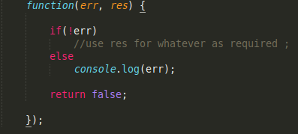
That object can now be used to call functions just like you would if it was an object of any class. The only difference is that after passing all the necessary parameters, it requires a callback function as the last parameter.
This function gets the return value of the function in the smart contract(solidity) the return value is stored in the variable res. res can only be accessed inside the scope of this function. It cannot be set to a global variable and accessed outside the function. This function should be added at the end of every function call from the web3 object. If there's an error, then it is stored in the err variable.

Slide 55
However, it is to be noticed that the syntax for using this object when the Solidity function is payable is slightly different.
Right before adding our callback function in the parameters, we need to add the parameter which looks like this
That parameter is used to define the account from which Ether is to be sent, ie, the defaultAccount, the gas for the transaction and the conversion of 0.01 to Wei, which is the smallest unit of Ether.

Slide 56
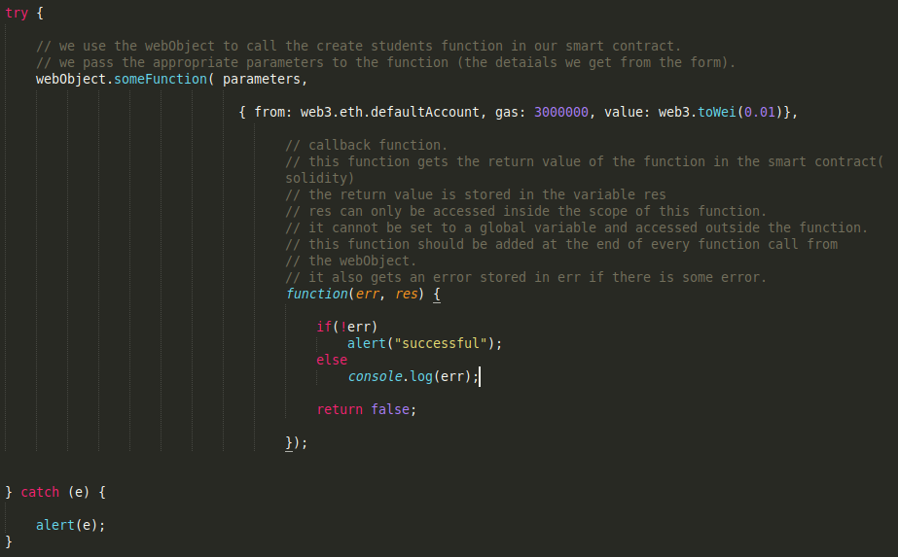
Example code snippet to call payable functions using web3 object

Slide 57
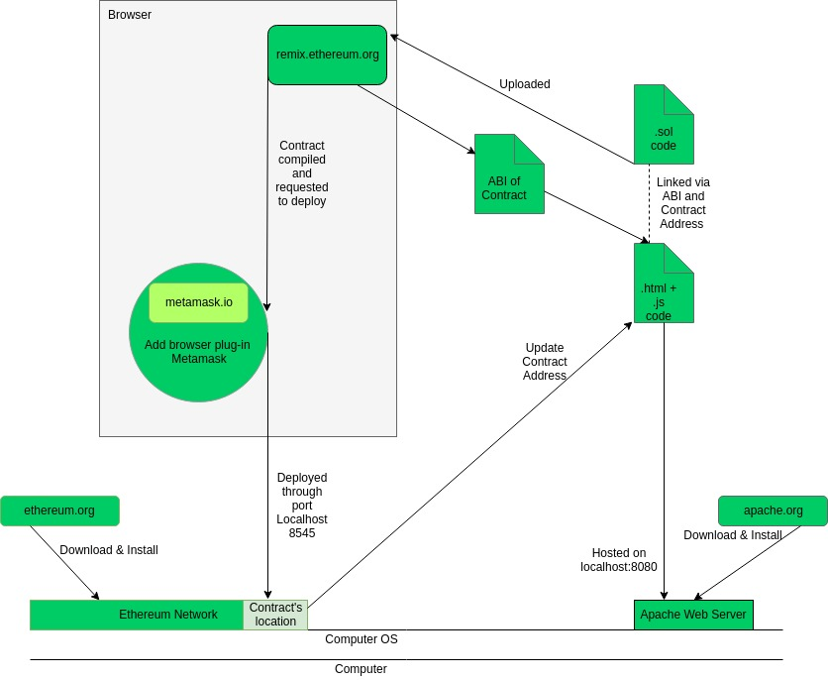

Slide 58
Sequence of Events
When the teacher adds a new student (clicks on the submit button), a JavaScript function is called.
The JavaScript function calls the createStudents() function in the smart contract using the web3 object (instance of web3).
This function sends the details of the students to the Back End and displays the name of the student in the list of students on the Web page.
In the Smart Contract, a new student is created and added to the database .
When the user clicks on the name of a student, another JavaScript function is called. This function calls the GetStudents() function in the smart contract through the web3 object (webObject) which returns the details of the student that was clicked.
The details of the student are displayed dynamically on the Web page.

Slide 59
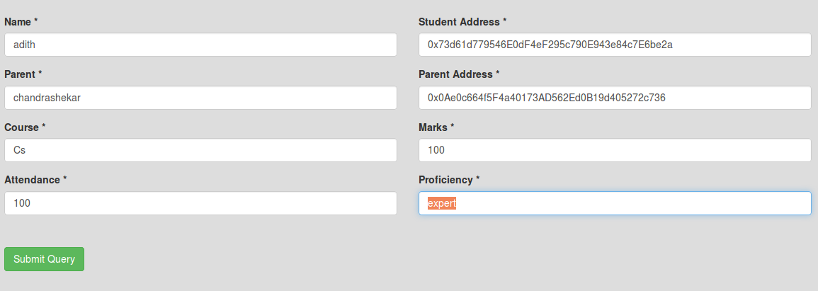
Example
Click on submit query.

Slide 60
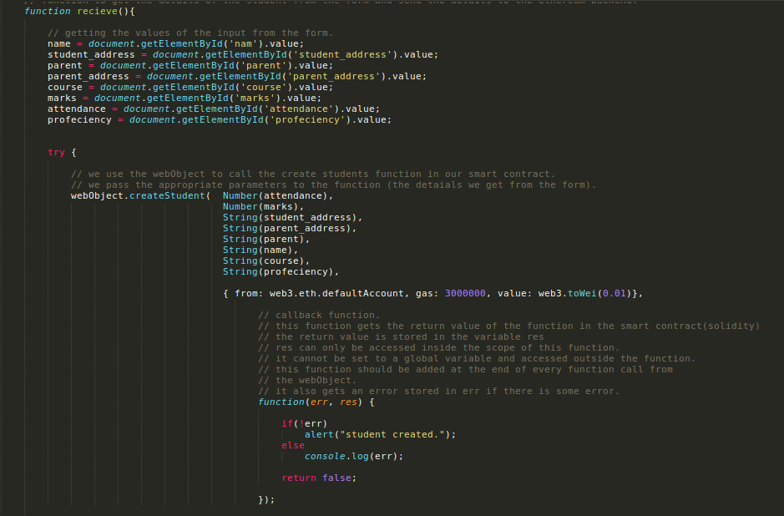
Calls the recieve()
Function in JavaScript

Slide 61
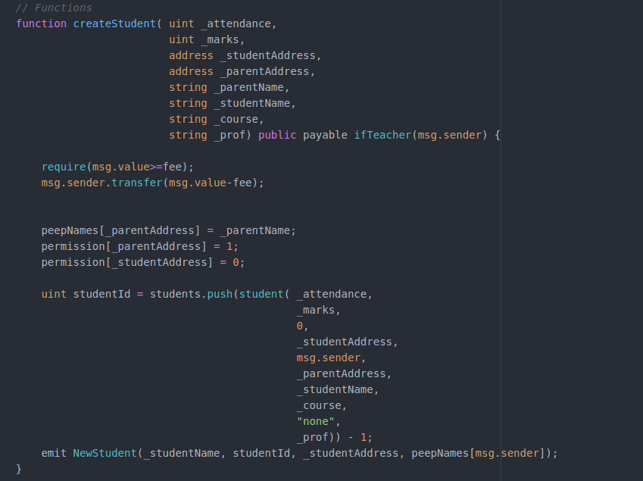

Slide 62
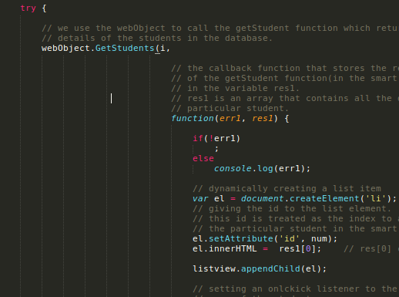
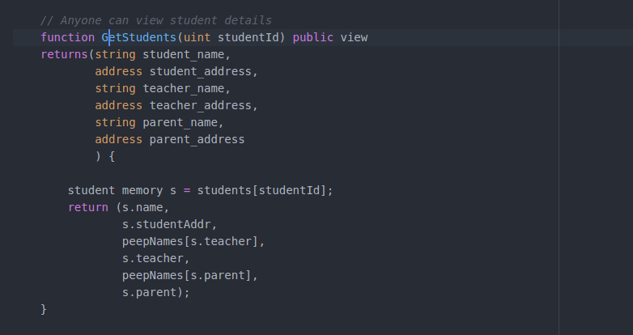
Getting the details
The GetStudents() function is called when the user clicks in the name of a student in the web page.

Slide 63
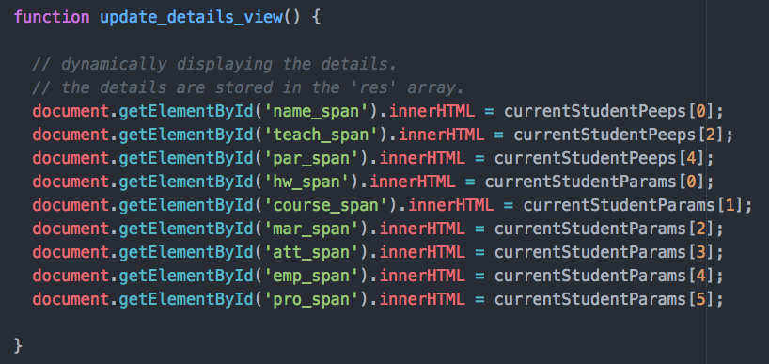
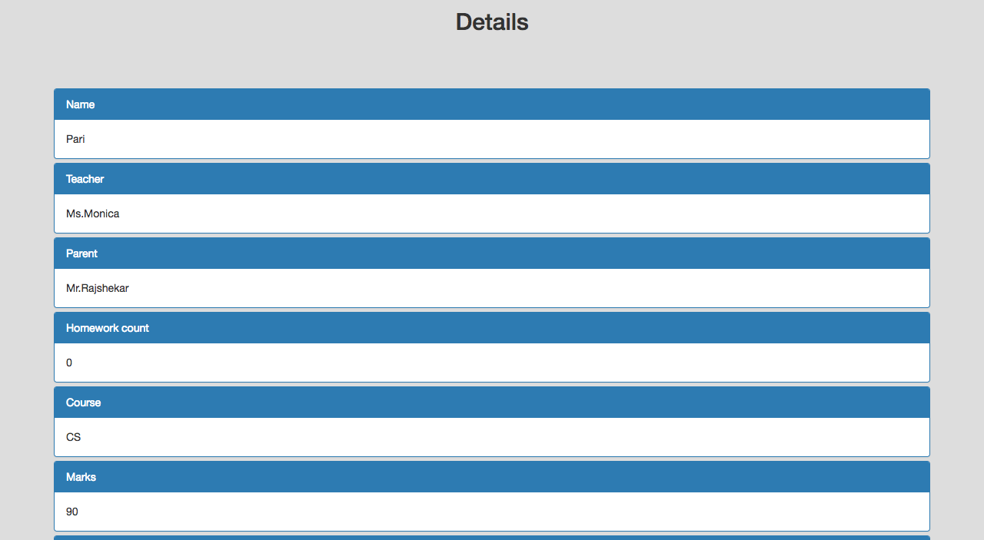
The update_details_view() displays the student details on the Web page.

Slide 64
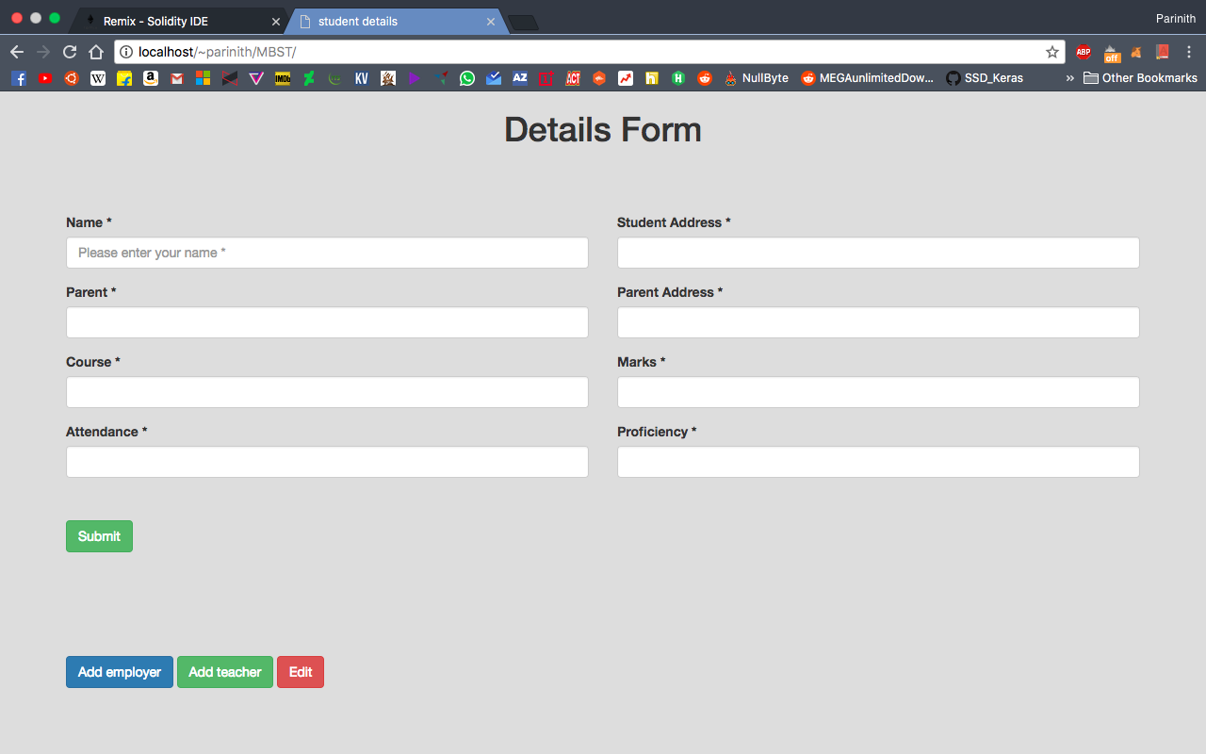
Demo
We import a number of accounts corresponding to the Ganache instance into MetaMask to simulate a multi user scenario.
After the Contract is deployed by the owner, the ABI and the address have been set accordingly in the abi.js file, and the webpages hosted on a local server, when we visit index.html, this is what should be seen.
To perform any more functions, like adding students, there must be a teacher, so lets go ahead and add a teacher

Slide 65
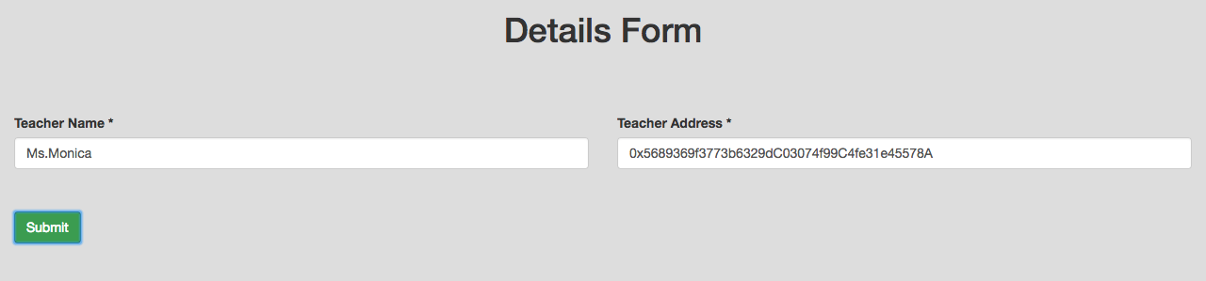
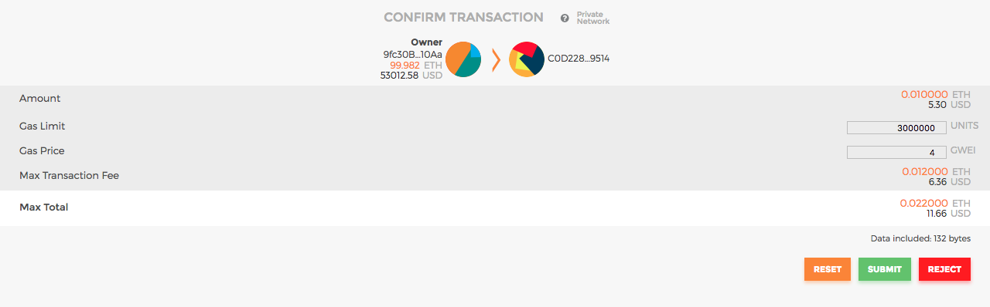
Enter the Name and the public address of the teacher to be created, then clicking on submit will trigger a Metamask transaction (creating a teacher is a payable function).
After submitting the transaction and after it is validated, we can continue in the Teacher’s account and create a student

Slide 66
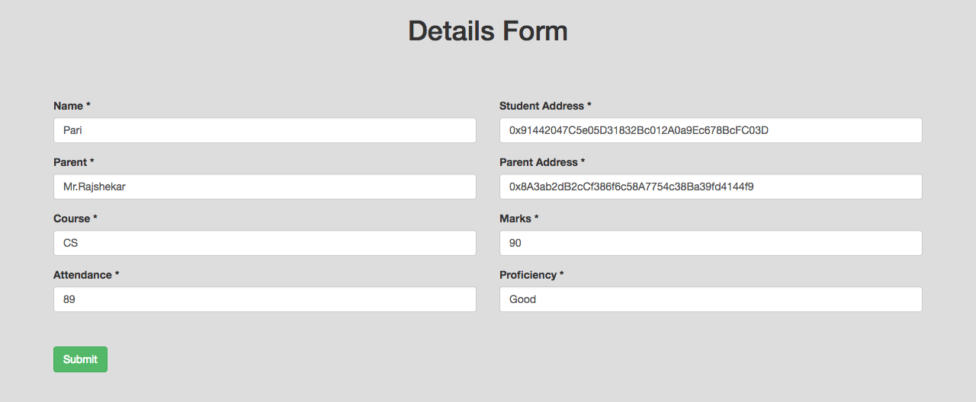
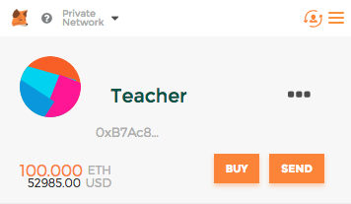

Navigating back to the homepage, we can now create a new student. Let’s enter the details and then submit (Make sure the teacher account is currently active) and accept the transaction.

Slide 67


The transaction of creating a student reduces the ether count in the Teacher’s account. As seen in Metamask
After the transaction is validated, the home page after refreshing will show that a new student is added in the Student List. Clicking on it will display all the details.

Slide 68

The teacher can further give Homework to the student and it will show up in the Details.
The student (with the student account active) can then choose to Finish HW which will decrement the HW count again.
Notes:
How this transactional ledger effective for the organization point of view and its benefit.

