Slide 1

SCHOOL OF SCIENCES
DEPARTMENT OF MCA
HEART DISEASE PREDICTION
MCA 4th Semester
Major Project
P.Sai Chandu (21PG030089)
Ella Bhanu Prasad (21PG030053)
Under the Guidance of
Dr. A.V.S Pavan Kumar
Dr. Premansu Sekhar Rath
Assistant Professor
Dept. Of CSE,
GIET University , Gunupur
(Project Supervisor)
Prof. Satya Narayan Das
HOD BCA & MCA
Dept. Of BCA & MCA,
GIET University , Gunupur

Slide 2

TABLE OF CONTENTS
Introduction
Abstract
Drawbacks of Existing System
Proposed Work
Algorithms
Data Flow Diagram
UML Diagram
Screenshots
Conclusion
References

Slide 3

INTRODUCTION:
Heart disease refers to a range of conditions that affect the heart, including coronary artery disease, arrhythmias, and heart defects.
It is the leading cause of death globally, with risk factors including high blood pressure, high cholesterol, and smoking.
Prevention and early detection are crucial in managing the disease.
This issue can be solved by adopting machine language

Slide 4

ABSTRACT:
This study aims to develop a predictive model for identifying the risk of heart disease based on various risk factors. The model utilizes machine learning algorithms to analyze the data and provide accurate predictions. The results indicate that the model can effectively identify individuals with a high risk of developing heart disease, allowing for early intervention and prevention strategies.

Slide 5
DRAWBACKS OF EXISTING SYSTEMS :
1. Limited scope of risk factors
2. Lack of personalized approach
3. Reliance on self-reported data
4. Inaccuracy in diagnosis
5. Limited accessibility
6. Costly and time-consuming

Slide 6

PROPOSED WORK
This project aims to develop a machine learning model for predicting the risk of heart disease in individuals. The model will be trained using a large dataset of patient information, including medical history and lifestyle factors, and will utilize advanced algorithms to provide accurate risk assessments.

Slide 7

Algorithms / Methods Used
MACHINE LANGUAGE:
Machine learning (ML) is a subset of artificial intelligence (AI) that allows computers to learn and improve from experience without being explicitly programmed.
ALGORITHMS ARE USED:
LOGISTIC REGRESSION
K NEIGHBORS CLASSIFIER
DECISION TREE CLASSIFIER
SUPPORT VECTOR CLASSIFIER

Slide 8
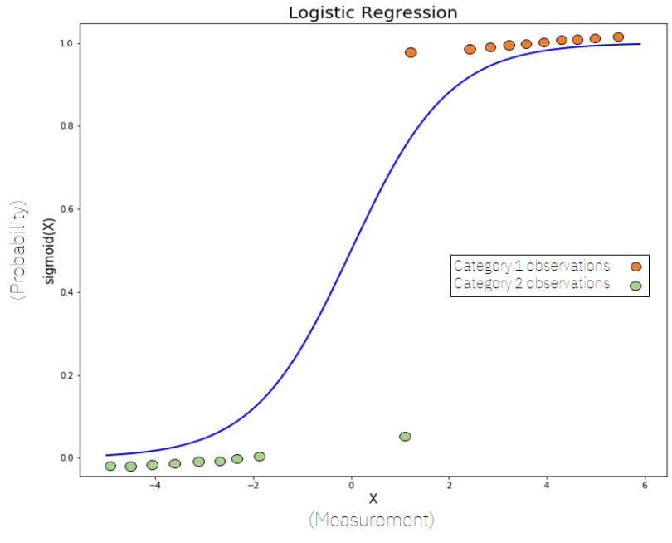
LOGISTIC REGRESSION:
Logistic regression is a statistical method used to analyze and model relationships between a binary dependent variable and one or more independent variables.
It estimates the probability of the dependent variable taking a particular value based on the values of the independent variables

Slide 9
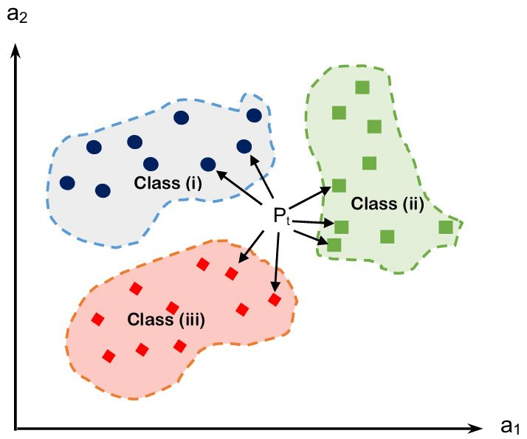
K NEIGHBORS CLASSIFIER:
KNeighborsClassifier is a machine learning algorithm used for classification tasks.
K Nearest Neighbors (KNN) Classifier is a type of supervised learning algorithm that can be used for classification tasks. It classifies new data points based on their similarity to the data points in the training set.

Slide 10
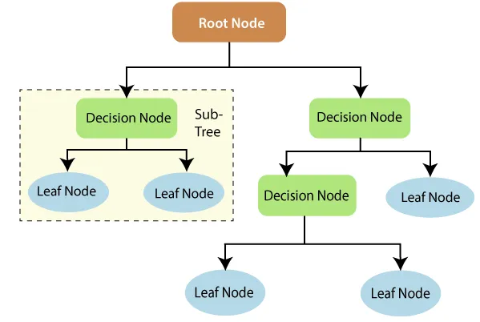
DECISION TREE CLASSIFIER:
Decision Tree Classifier is a supervised learning algorithm that can be used for classification tasks. It works by building a tree-like model of decisions and their possible consequences based on a set of training data.
The tree is constructed by recursively splitting the data into subsets based on the most significant attributes until the classes are completely separated.

Slide 11
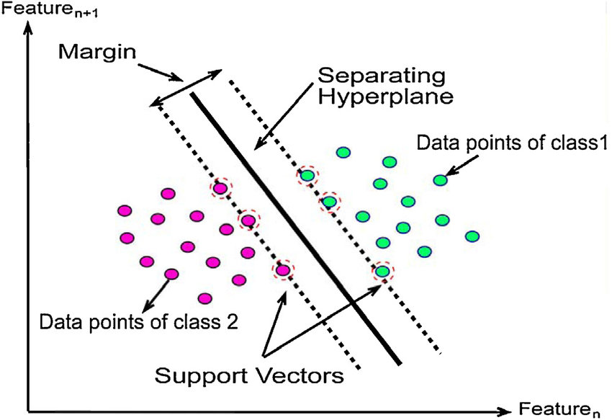
SUPPORT VECTOR CLASSIFIER
Support Vector Classifier (SVC) is a type of supervised learning algorithm that can be used for classification tasks.
It finds the best boundary (hyperplane) that separates the data into different classes while maximizing the margin between them.
It can handle both linearly and non-linearly separable data by transforming it into a higher dimensional space

Slide 12
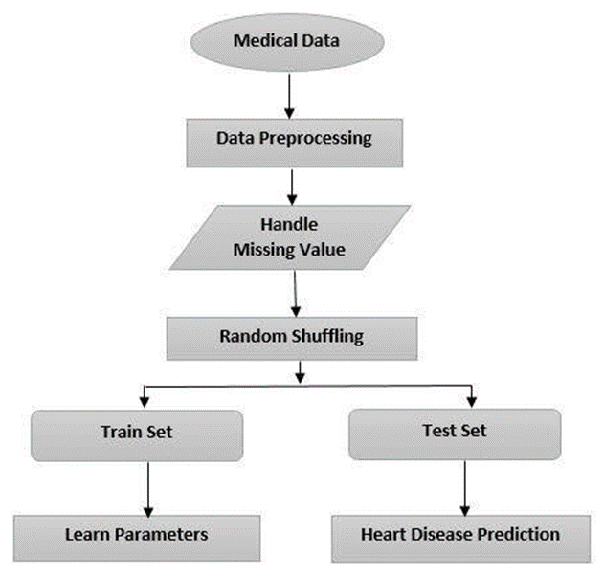
Data Flow Diagram

Slide 13
Use Case Diagram
Registration
Enter the details
User
Collects data
Extract the features
Server
Match the values
Classify the data
Predict the disease
Send the report

Slide 14
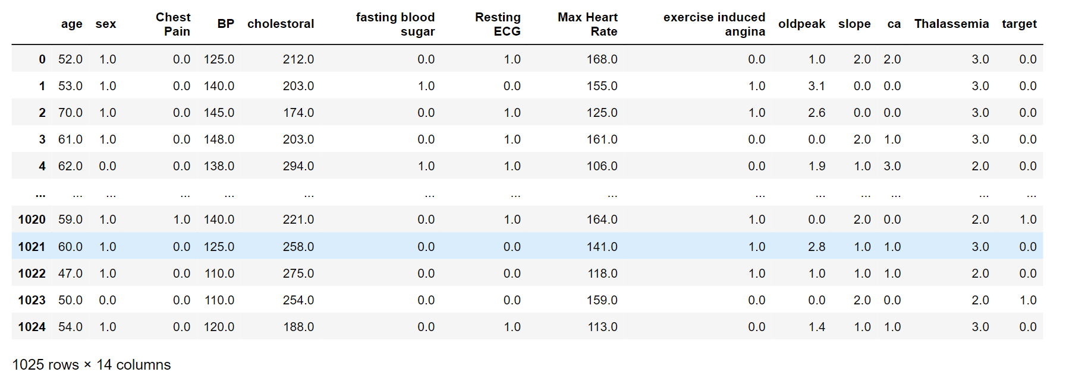

Slide 15
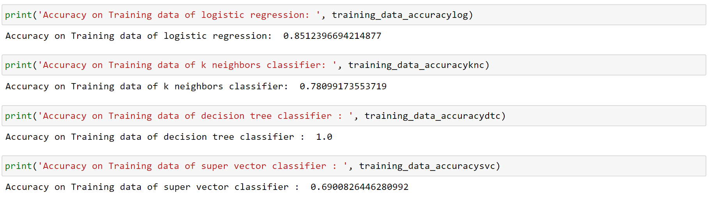

Slide 16
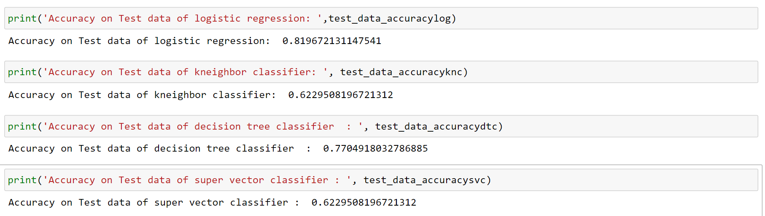

Slide 17
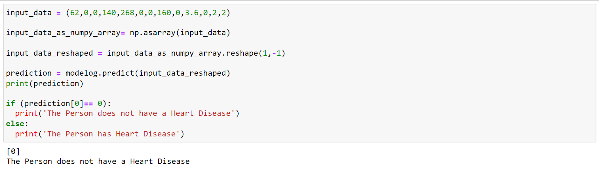

Slide 18
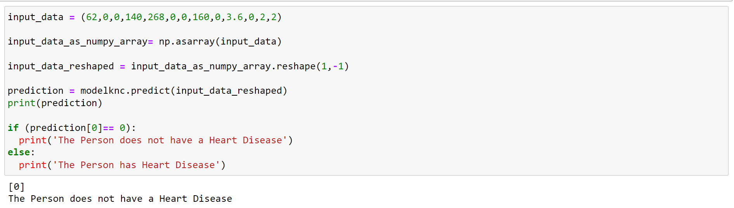

Slide 19
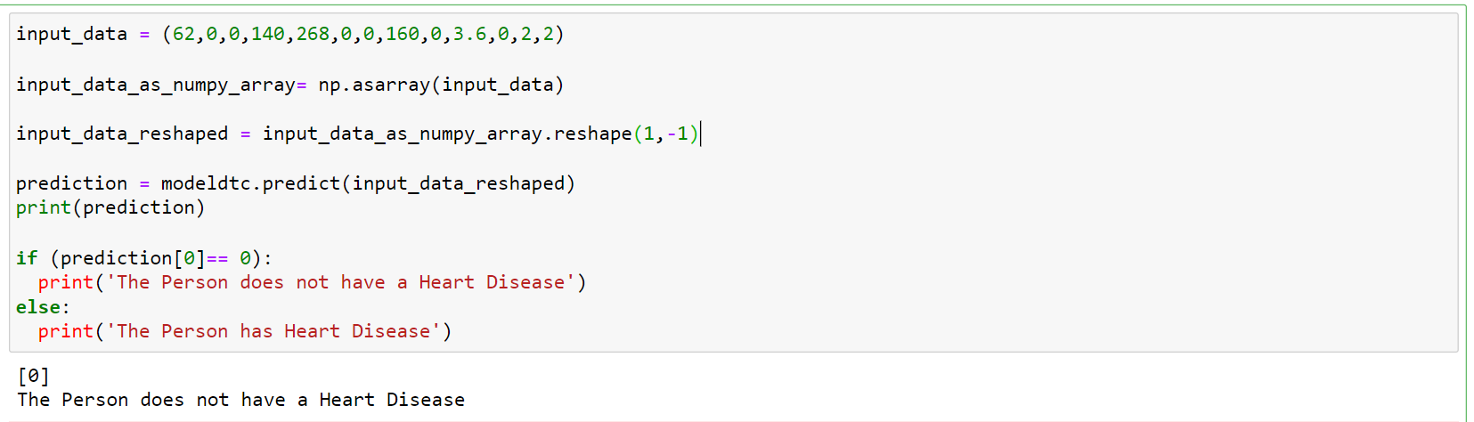

Slide 20
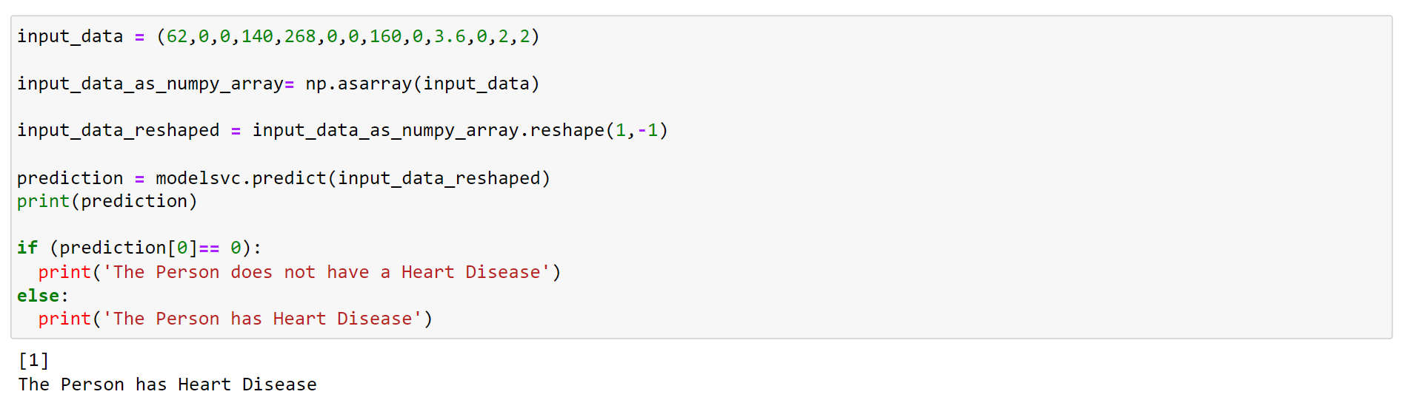

Slide 21
CONCLUSION:
In conclusion, heart disease prediction is an important area of research and can help identify individuals at risk of developing cardiovascular disease. Early detection and management of risk factors can improve outcomes and reduce the incidence of heart disease. Machine learning models can be trained on large datasets to predict heart disease with high accuracy, providing a valuable tool for healthcare professionals.

Slide 22
REFERENCES:
Soni J, Ansari U, Sharma D & Soni S (2011). Predictive data mining for medical diagnosis: an overview of heart disease prediction. International Journal of Computer Applications, 17(8), 43-8
Dangare C S & Apte S S (2012). Improved study of heart disease prediction system using data mining classification techniques. International Journal of Computer Applications, 47(10), 44-8.
Ordonez C (2006). Association rule discovery with the train and test approach for heart disease prediction. IEEE Transactions on Information Technology in Biomedicine, 10(2), 334-43.
Shinde R, Arjun S, Patil P & Waghmare J (2015). An intelligent heart disease prediction system using k-means clustering and Naïve Bayes algorithm. International Journal of Computer Science and Information Technologies, 6(1), 637-9.
Jee S H, Jang Y, Oh D J, Oh B H, Lee S H, Park S W & Yun Y D (2014). A coronary heart disease prediction model: the Korean Heart Study. BMJ open, 4(5), e005025.

