Slide 1

Exploring the Meteoric Rise: Unveiling the Fastest Growing Private Companies and Startups Worldwide
Presented by:
Bhanu Prasad
Bhavani
Irfan raza

Slide 2



OBJECTIVE
Analyzing the performance and characteristics of companies across various industries.
Analyzing the distribution of employee counts across companies and industries.
Exploring a comparative analysis of industries based on metrics such as revenue, employee count, and growth rate.
Analyzing the employee growth percentage to identify rapidly expanding companies.
Analyzing to determine which companies dominate their respective industries.
PROBLEM STATEMENT
To identify the factors influencing revenue growth and performance metrics across various industries and geographic regions, leveraging insights from a detailed analysis of the Website.

Slide 3






WEB SCRAPING
Web scraping is the automated process of extracting data from the websites .
It involves writing code to retrieve specific information from web pages and converting it into a structured format (such as CSV,EXCEL) that can be analyzed and used for various purposes .
Following libraries were used to Analyze data

Slide 4

Website Interface with the HTML

Slide 5
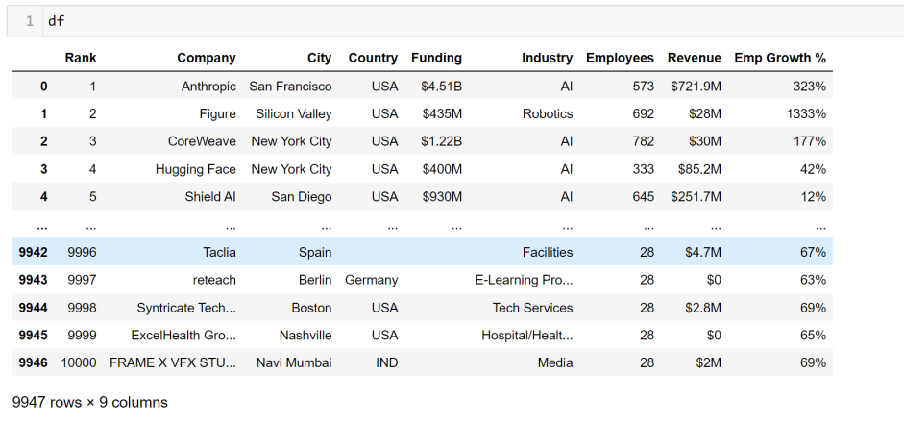
Raw Data
Raw data extracted from the website with the columns of Rank, Company, City, Country, Funding, Industry, Employees, Revenue and Emp growth%.

Slide 6
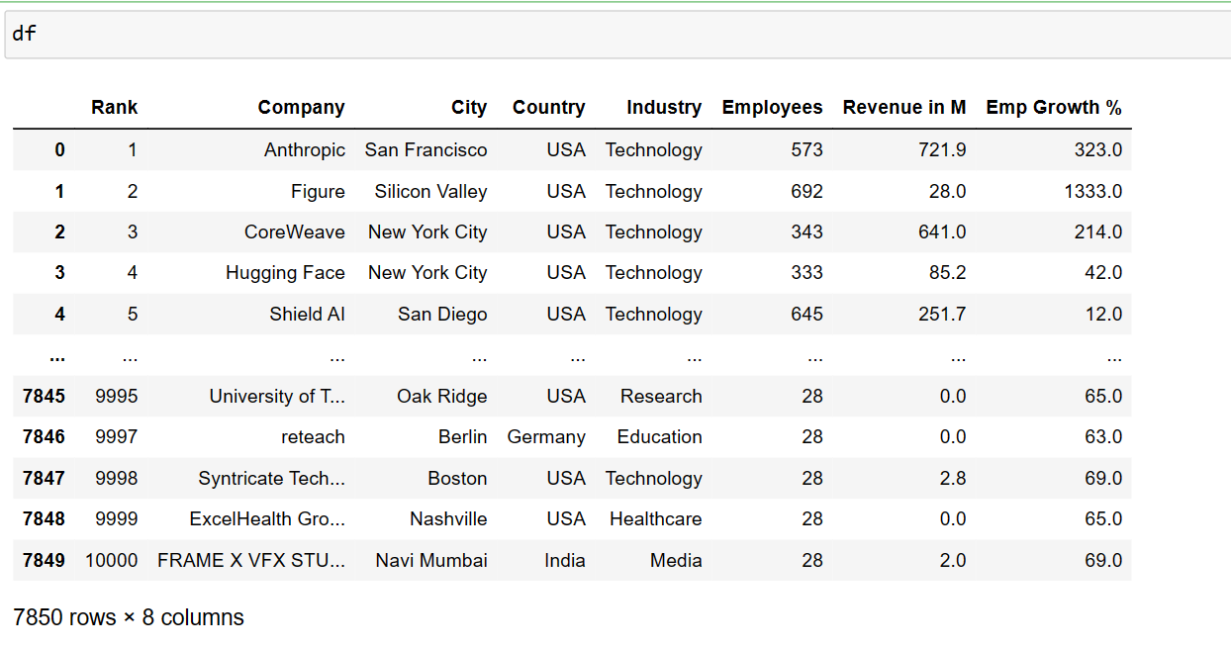
Cleaned Data

Slide 7
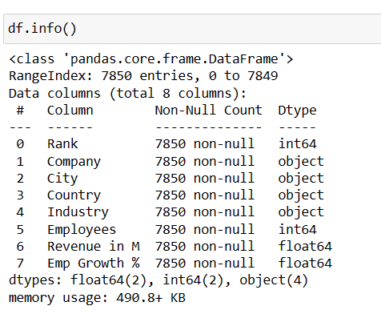
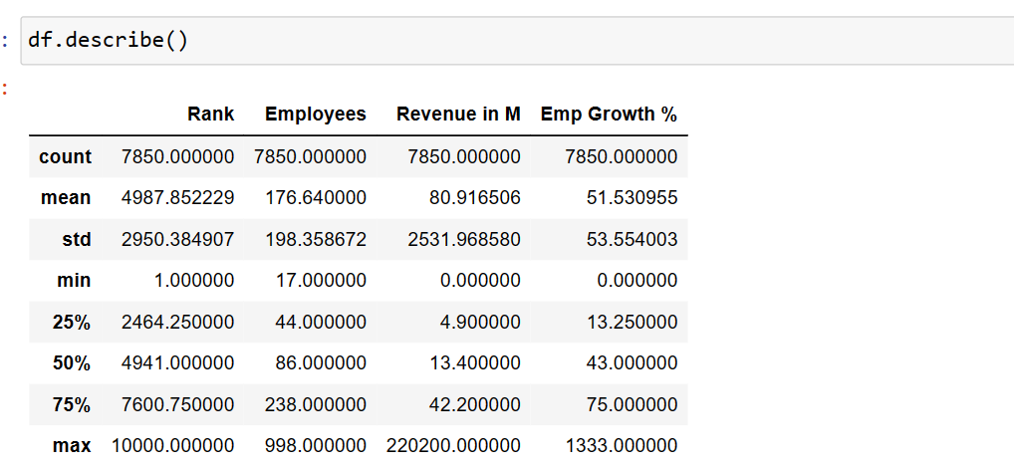
Data Exploration
The data was cleaned by removing the all null values.

Slide 8
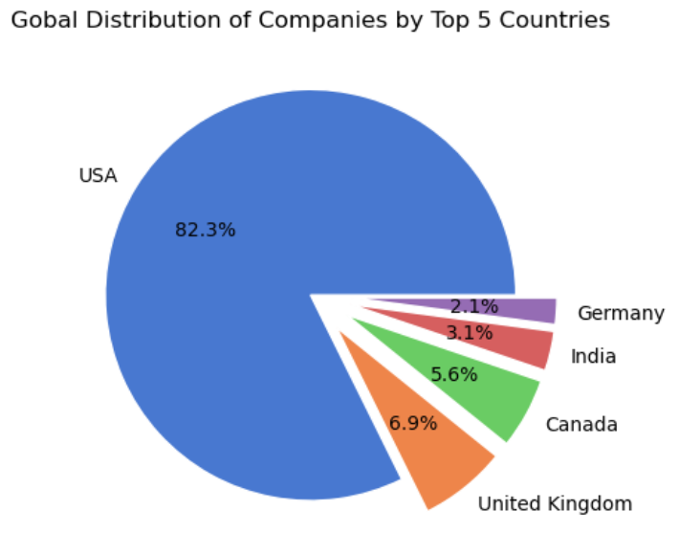
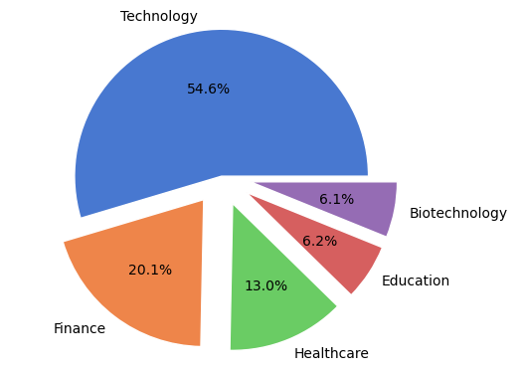
Distribution of Countries And Industries across world
Insights:
This pie chart that represents the distribution of Companies among five countries
USA country has larger shares may indicate intense competition among companies compared to other countries like UK, Canada, India and Germany.
Insights:
pie chart that represents the global distribution of companies across different sectors.
The Technology sector stands out as the most dominant, occupying a significant share of 54.6%.
This suggests that technology companies play a crucial role in the global business

Slide 9
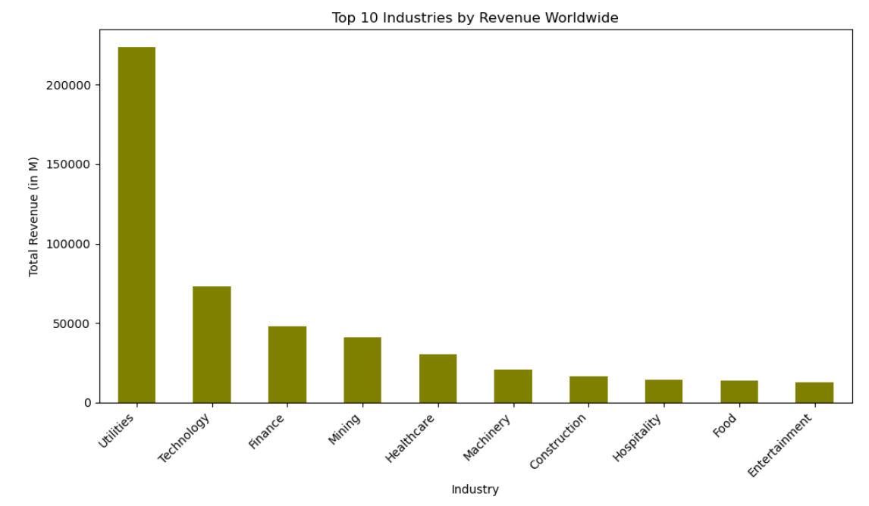
To find the Top 10 Industries By Revenue Worldwide
Insights :
The Utilities sector stands out prominently, with a significantly higher revenue than the other industries.
This suggests that utility companies (such as energy, water, and electricity providers) contribute significantly to the global economy.
The remaining sectors (Mining, Machinery, Construction, Hospitality, Food, and Entertainment) contribute smaller portions to the global revenue.

Slide 10
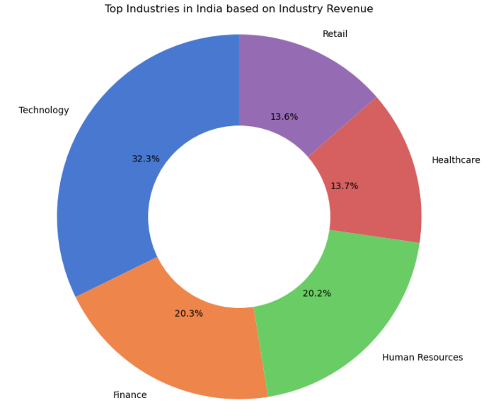
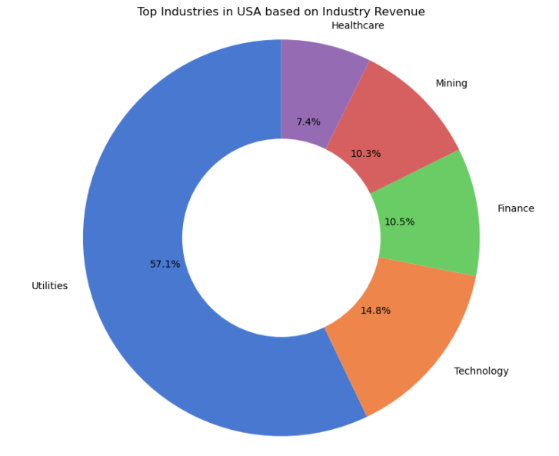
Comparison of India and USA Based on Top Industry Revenue
Insights:
The current plot focuses on the revenue distribution of industries within India.
It highlights five sectors: Technology, Finance, Retail, Healthcare, and Human Resources.
Technology: In both plots, Technology plays a significant role. In India, it contributes 32.3%, while globally, it’s a dominant sector.
Finance: India’s Finance sector (20.3%) is comparable to the global Finance share.
Healthcare: India’s Healthcare (13.7%) aligns with the global trend.

Slide 11
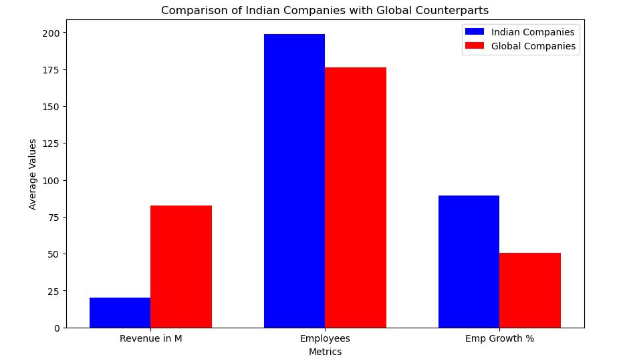
Comparison of Indian Companies with Global Counterparts
Insights :
Indian Companies: Despite lower revenue, Indian companies have a larger number of employees.
Indian companies prioritize employee growth and talent acquisition.
Global Companies: While global companies have higher revenue, their employee count is comparatively lower.
Global companies focus on revenue generation but may have leaner workforces.

Slide 12
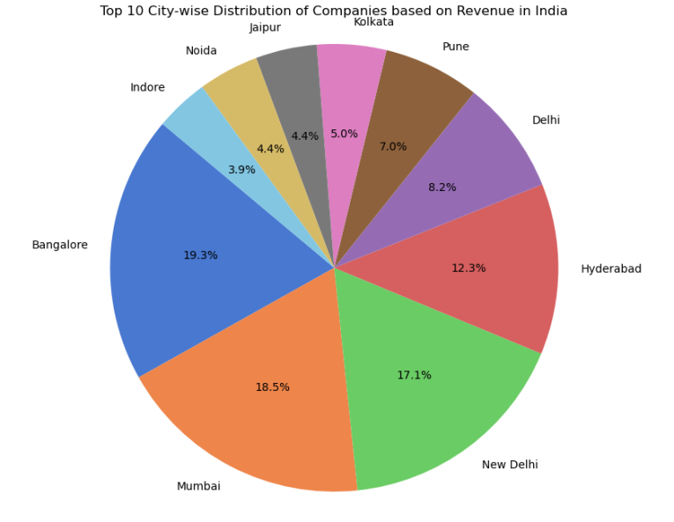
City Wise Distribution of Companies
Insights:
This plot depicts the distribution of companies on top 10 cities based on Revenue in India.
More percentage of the companies lies in Bangalore, Mumbai and New Delhi cities in India.

Slide 13
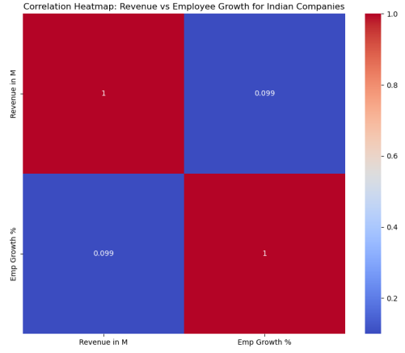
Corelation Heatmap:
Revenue vs Employees Growth in Indian companies
Insights:
This is a Heat map illustrates the relationship between Revenue (in million) and Employee Growth Percentage for Indian companies.
The heatmap shows a low correlation coefficient of approximately 0.099 between Revenue and Employee Growth.
This indicates that there is minimal association between these two variables.

Slide 14
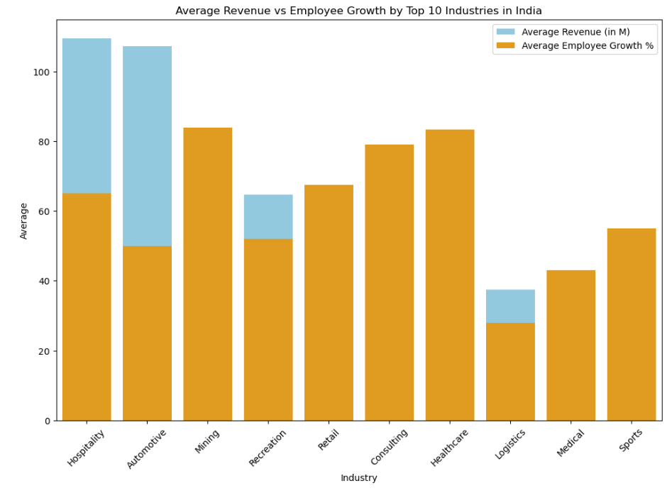
Analyzing on Top 10 Industries in India
Insights:
It is Bar plot that describes about the Average Revenue and Employee Growth in India on top Industries.
In India most of the sectors has maximum average of employee growth.
In sector like Hospitality and automotive has more average revenue compared to other sectors.

Slide 15
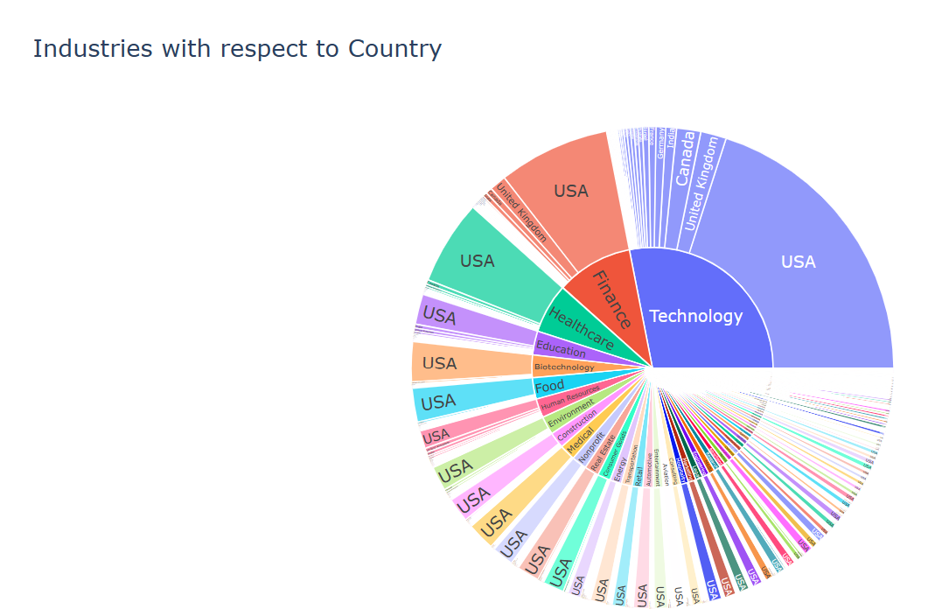
Dominance of Countries over Industry
Insights:
USA Dominance:
The United States (USA) holds a significant presence across multiple sectors.
Not only, the USA dominates the technology industry, occupying a substantial portion of the chart.
Other Industries:
Besides technology, the USA also has influence in finance and the food industry.
However, smaller segments representing other industries are not clearly readable due to their size.
sunburst_chart.html

Slide 16
Observation:
From the above analysis we can infer that there is a no of companies in technology industry . Technology plays a significant role. In India, it contributes 32.3%, while globally, it’s a dominant sector.
India's Talent Priority: Even though Indian companies might not make as much money, they really focus on getting talented people and helping them grow.
USA Rules Different Fields: America is super strong in lots of areas like tech, finance, and food industries. This shows how much power it has globally.

Slide 17
Conclusion:
This analysis provides a comprehensive understanding of the performance and characteristics of companies across industries and regions.
Some sectors, like Utilities and Technology, make a lot of money. But when we look closely, we see lots of different industries helping the global economy.
Indian companies hire more despite earning less; US ones aim for more revenue. Shows how each region has its own strategies based on priorities.

Slide 18

Q ans A :

Slide 19

THANK YOU

