Slide 1
CUSTOMER ANALYTICS
RETAIL INTELLIGENCE
Customer Shopping Behavior Analysis
End-to-end analysis using Python, MySQL and Power BI
Statistical evaluation of 3,900 customer transactions across demographic and merchandising dimensions
3,900
$233,081
$59.76
Customers analyzed
Total revenue
Average purchase
Executive Summary & Strategy Review
Notes:
Introduce the study: 3,900 retail transactions analyzed to evaluate drivers of basket size, revenue, and customer value across channels.

Slide 2
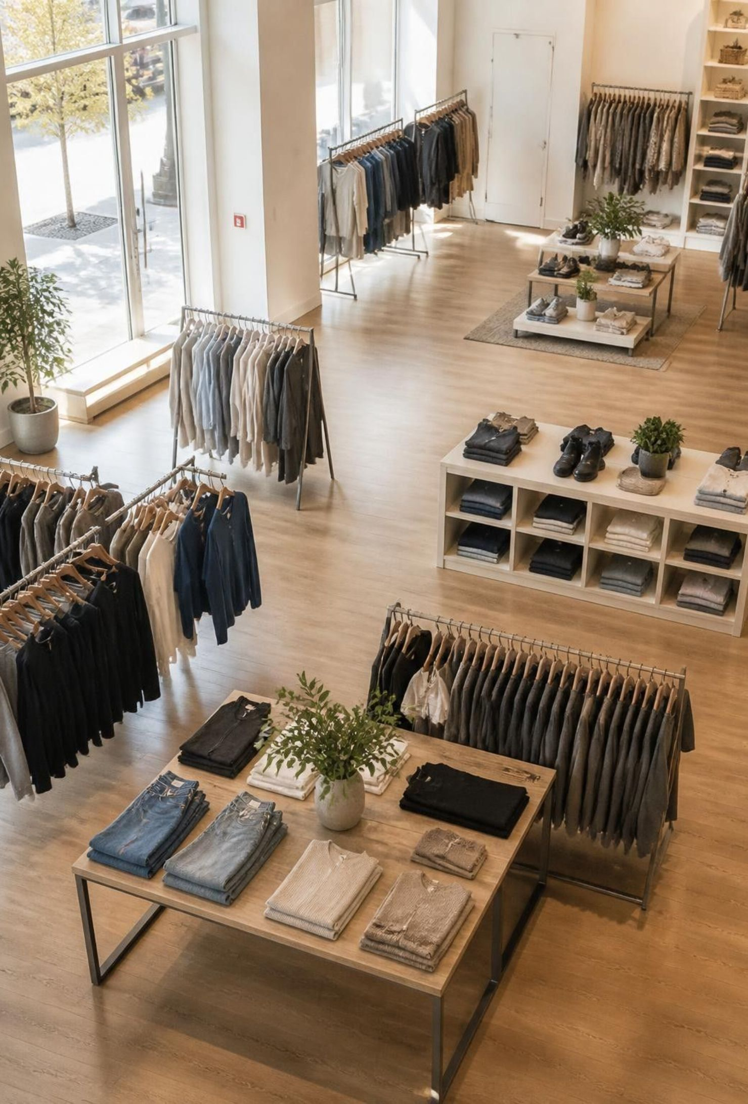
Everyone spends about the same. Only the season changes it
3,900 customers, $233,081 total revenue, $59.76 average purchase
Gender, subscription, discounts, payment, shipping, category and age show no significant difference in spend.
Revenue gaps come from customer volume and mix, not spend per customer.
$59.76
3,900
02
Average purchase
Customers
Notes:
State the fundamental finding: customer basket size is uniform at ~$60. Growth must target customer acquisition and seasonal timing, not basket expansion tricks.

Slide 3
The question and the data behind it
CORE OBJECTIVE: INFORMING ENGAGEMENT, MARKETING, AND PRODUCT STRATEGY
Scope
Catalog
Demographics & Sentiment
Adoption
3,900
25 Items
44 Yrs
27% / 43%
Customers across all 50 US states
Spanning 4 primary retail categories
Average age · 3.75 average rating
Subscribers vs. discount users
THREE-STAGE PIPELINE
1. Python cleaning for imputation and feature engineering ·
2. MySQL querying for cohort and variance analysis ·
3. Power BI interactive executive dashboards.
03
Notes:
Review dataset dimensions: 18 raw columns across 3,900 transactions. Highlight the clean 3-stage analytics workflow.

Slide 4
Cleaning and feature engineering in Python
Four preparation steps turn the raw sales data into model-ready features
Missing ratings
Purchase frequency
37 missing ratings (0.9%) filled with the median of their category
Purchase frequency converted to days; redundant promo code column dropped
Age groups
MySQL
Four quartile-based age groups: 18–31, 32–44, 45–57, 58–70
Cleaned data loaded into MySQL
04
Notes:
Walk through the data preparation steps: handling missing data via category medians, age binning, frequency transformation, and loading to MySQL.

Slide 5
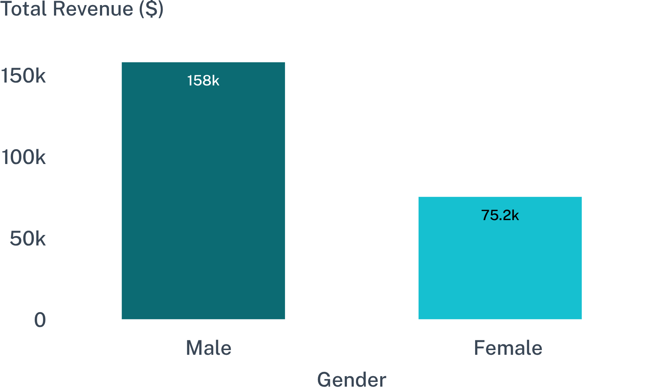
Men bring twice the revenue because there are twice as many
$59.54
Male average spend per purchase (2,652 customers · 68%)
$60.25
Female average spend per purchase (1,248 customers · 32%)
Spend difference is statistically indistinguishable ($0.71 delta). The commercial revenue gap is purely an acquisition imbalance, not purchasing appetite.
Revenue breakdown: Male accounts generate 68% of total gross sales ($157,890 vs. $75,191).
05
Notes:
Clarify the core insight: Men generate double the revenue solely because customer acquisition counts are 2:1. Average purchase value is essentially equal ($59.54 vs $60.25).

Slide 6
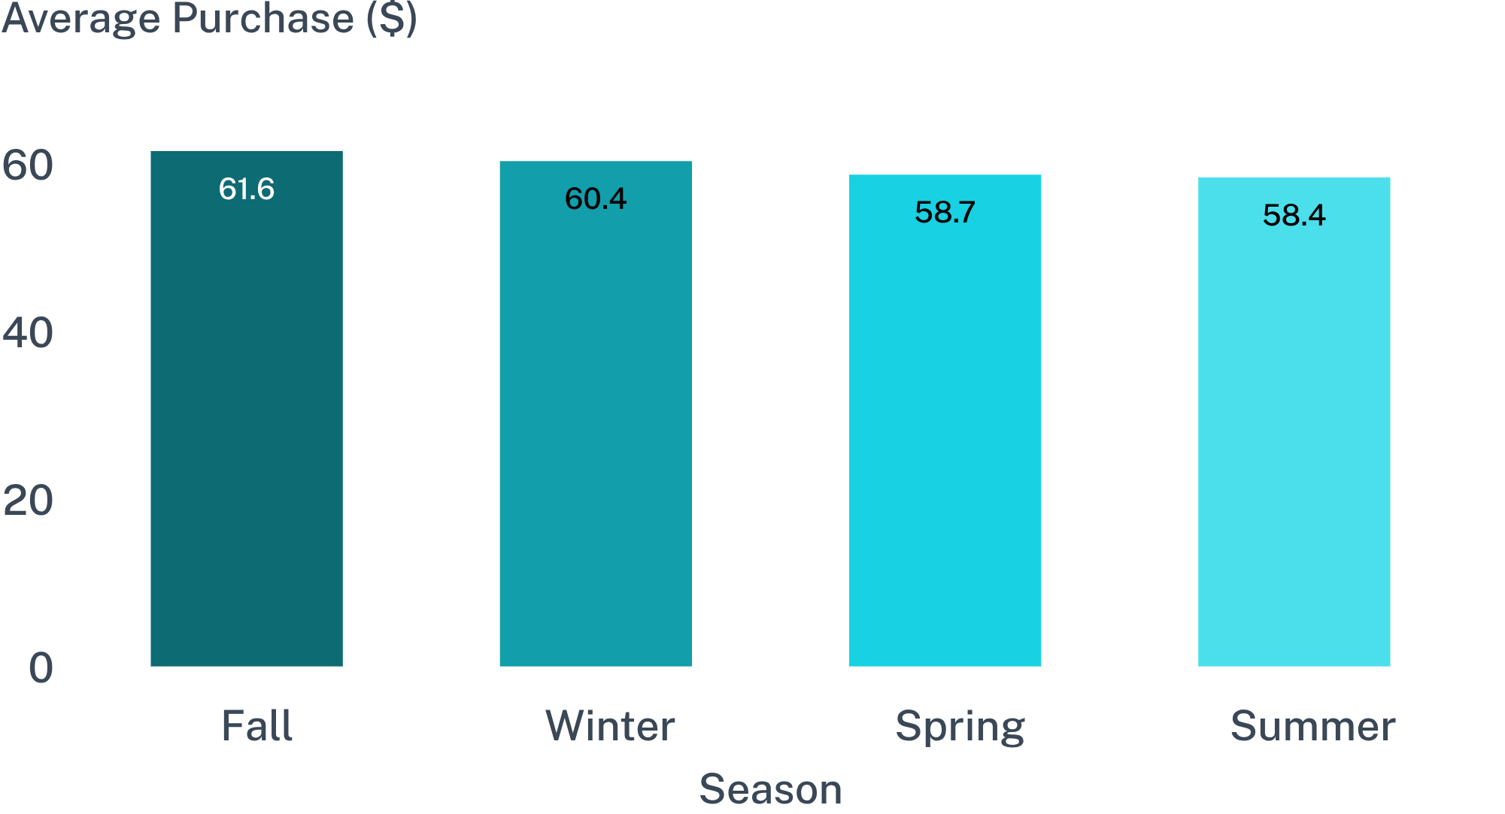
Season is the only factor that moves spend
PEAK VS. TROUGH
SIGNIFICANCE
p = 0.011
+5.4%
Only tested factor achieving p < 0.05
Fall spend elevation over Summer
Colder months lift purchase values as heavier garments and accessories enter the basket, representing the sole verifiable demand elasticity in the business.
Statistically significant seasonal shift (ANOVA p = 0.011): Fall peak exceeds Summer trough by ~5% ($3.15 per transaction).
06
Notes:
Present the ANOVA findings: Season is the only variable that moves ticket size, climbing from $58.41 in Summer to $61.56 in Fall.

Slide 7
Subscribers spend no more, and only 27% subscribe
FINANCIAL IMPACT
RETENTION & PENETRATION
$59.49
27%
Subscriber average purchase
Program subscription penetration
Non-subscribers spend $59.87 (p = 0.66). Despite receiving mandatory discount promotions, subscribers generate zero incremental basket value.
Repeat Buyer Rate: Subscribers achieve 91.0% repeat purchases compared to 88.4% for non-subscribers.
The loyalty program functions purely as a slight retention stabilizer (+2.6% repeat rate) rather than a monetization engine.
Margin Leakage Risk: Program discounts erode unit margin without providing compensatory transaction expansion.
08
Notes:
Examine the subscription program: no basket lift ($59.49 vs $59.87), low penetration (27%), but minor lift in repeat rate (91.0% vs 88.4%).

Slide 8
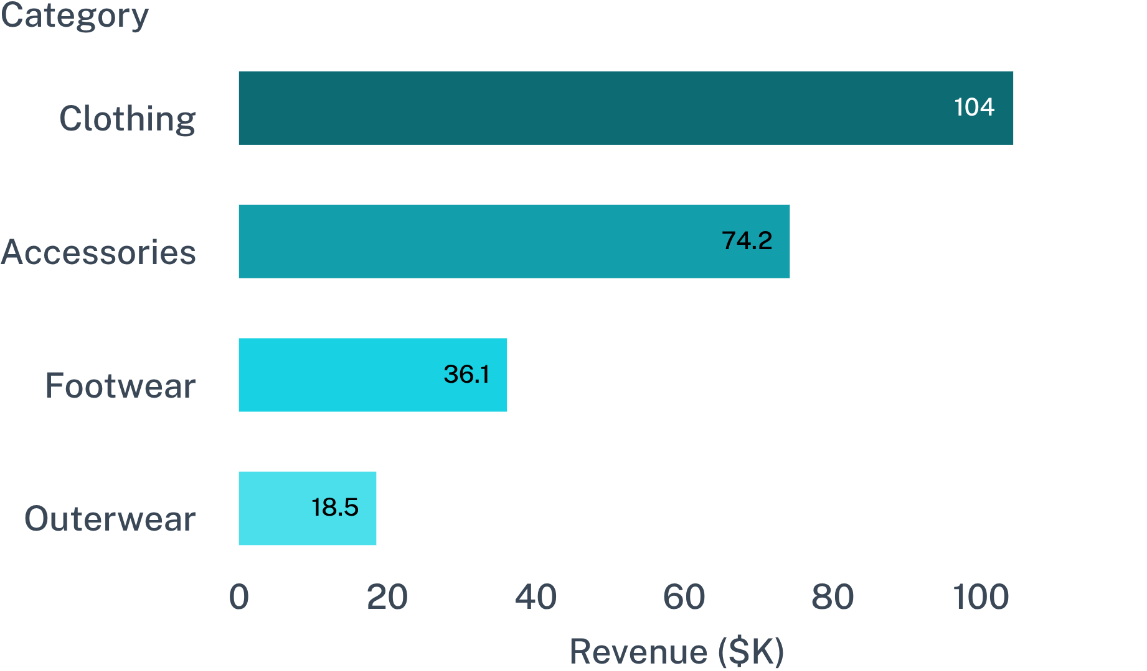
Clothing and Accessories make 77% of revenue
COMBINED SHARE
CATEGORY STABILITY
76.5%
#1 Rank
Clothing & Accessories share of gross revenue
Clothing ranks first across every age group and gender
Footwear (15.5%) and Outerwear (7.9%) represent long-tail volume. Merchandising capital should concentrate on core apparel lines.
Revenue distribution: Clothing generates 44.7% ($104.3K) and Accessories 31.8% ($74.2K), driving $178.5K of total $233.1K sales.
09
Notes:
Present category performance: Clothing ($104.3K) and Accessories ($74.2K) account for 77% of business revenue.

Slide 9
AGE GROUPS AND PRODUCTS
Age groups and products are evenly matched
$62,143
$1.40
3.86
Young Adults revenue, the largest group
Approximate average spend difference between age groups
Top rating, Gloves
Young Adults lead revenue ($62,143) only because they are the largest group; average spend differs by about $1.40
Top-rated: Gloves 3.86, Sandals 3.84, Boots 3.82, Hat 3.80
Best sellers: Jewelry, Blouse, Pants, Jacket; gaps are only a few units
10

Slide 10
SUMMARY
What the data shows
Spend is flat across segments; volume, mix and season drive revenue
Spend is nearly uniform across gender, subscription, discounts, payment, shipping, category and age.
Only season matters: Fall $61.56 vs Summer $58.41 (p=0.011).
Men are 68% of customers and spend the same per customer, so their revenue lead comes from volume.
Subscribers spend no more ($59.49 vs $59.87), and only 27% subscribe.
Clothing and Accessories make 77% of revenue.
3,900
customers
$233,081
total revenue
$59.76
average purchase
11

Slide 11
What to do next
Grow the customer base and time offers to season: spend per customer will not move on its own.
Focus on customer acquisition.
Plan inventory and promotions around season.
Redefine loyalty tiers by quartiles: Loyal covers 80% of customers today.
Test discount and subscription changes.
Use top-rated and best-selling products (Gloves, Sandals, Boots, Hat; Blouse, Pants, Jewelry) in campaigns, but expect small lifts.
Review the Outerwear assortment: 7.9% of revenue, lowest average spend ($57.17), and only two items.
Skip segment-specific pricing, payment and shipping changes, since none of them moves spend.
Next data: add purchase dates and an online/offline flag.
Limitation: one purchase per customer and near-uniform data, so real customers may differ.
12

