Slide 1
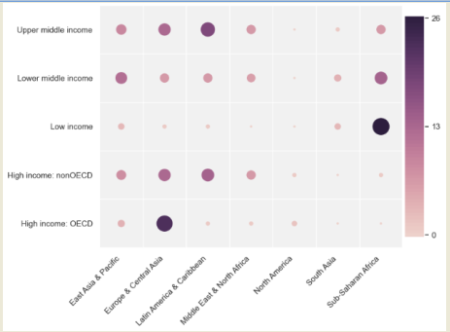
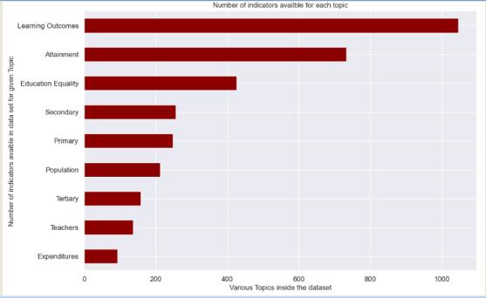
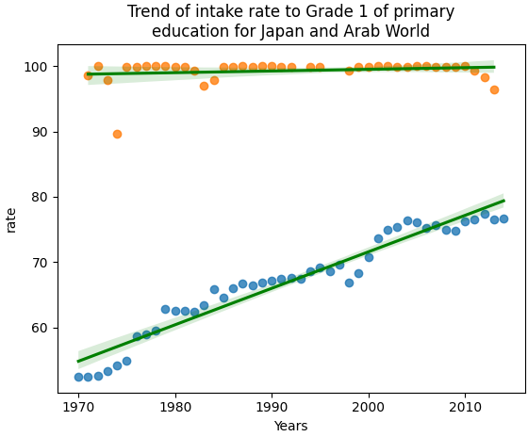
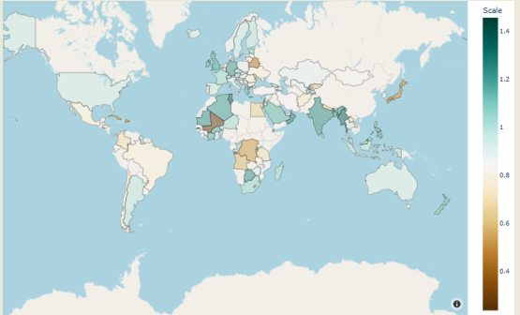
World Primary Education
Student Name- Bhanuprakash Vadiyala
Student ID- 22073539
Github Source: https://github.com/Bhanureddy48/Applied-Data-Science-1.git
Abstract
Education plays an essential role in every field of life and influence the society in short as well as broad term. Economic transformation only happens in the society in an efficient manner due to high probability of education. Primary education is the fundamental requirement to gain economic stability which have been studied in this poster.
Introduction
Growth in the economic status of nation depends upon various factors like government policy, industrialization, education. However, all these factors mentioned in the previous statement is highly variable when whole globe is considered. The purpose of this poster is to present economical status of all the continents by using educational factor and distribution of income.
Analysis of Distinct Income
National accounts represents the expenditure and related activities of economic elements in various countries. Hence, GDP of multiple countries have been thoroughly figured out with the help of National accounts. Subsequently, a complete picture of various levels of income across the different parts of continents is visualized at the global level.
Indicators in the Dataset
This visualization conveys the essential parameters indicating productive information are mentioned. An overview of dataset is picturized. Learning outcomes in the dataset has been found to be highest in terms of providing the information.
Trend in Education
The trend of completing the primary education has been found in the Japan and Arab World. This visualization indicate the increasing rate of getting the primary education in Arab but it has reached to the saturation level in Japan. Therefore, the trend of educating was lowest in Arab during 1970 which completely changed by the year 2010.
Evaluation of Map
Adjusted Net Enrolment rate (ANER) has been used as a tool for scaling the primary education of different countries in the global context. The map reveals that most of the Asian countries like India, Bangladesh, Middle East achieved the ANE rate between 1 and 1.4. Likewise, few African countries stills found to be struggling for getting the optimum value in terms of ANER.
Brief of Outcome
It has been found in various outcomes that the dataset presents the picture of economy at global level. It has used metrics like ANER to convey the countries education system. Likewise, the role of National account in calculating the GDP is being depicted as efficient mechanism for analyzing the various economic parameters at national level. These results in visuals also showcase a gap in the official record few decades ago that gradually increased with the passage of years. It is explored from the various outcomes that economy is deeply linked with the education system of country and most of the nations have maintained it except Africa.
Conclusion
Based-on the obtained visualization, it has been concluded that a nation would become economically strong in the long term if the education system of nation is suitable for its population. Various visualization justified an optimistic growth of economy within most of the countries and there corresponding primary education level is checked precisely.

