Slide 1

Project Review-4
Batch No:1
Project Title: Blood Group Detection Using Image Processing Techniques.
S.No | Regd.No | Student Name
1 | 19A81A05K9 | K.Bhanu Sri
2 | 20A85A0521 | K.Siva Rama Krishna
3 | 19A81A05N3 | P.Santhosh Kumar
4 | 19A81A05K0 | CH.Chaitanya Pavan Kumar
Project Guide
Dr.V.S.Naresh

Slide 2
Contents:
Abstract
Literature Survey
Objective and scope of the project
System Architecture
Methodology and design
UML Diagrams
Implementation
Result Analysis
Attainment of objective
Future Scope of Project

Slide 3
Abstract:
Determining blood type is essential including in emergency situation. Currently, these tests are performed manually by technicians, which can lead to human errors. Various systems have been developed to automate these tests, but none is able to perform the analysis in time for emergency situations.
This work aims to develop an automatic system to perform the tests in a short period of time, adapting to emergency situations. In this project, A images of Blood sample for detection taken as input and we are applying different image processing Techniques and Feature extraction process to detect the blood group.

Slide 4
Literature survey:
Title : ABO blood Group detection Based on Image Processing Technology.
Authors: Yue-fang Dong, Wei- wei Fu , Zhe Zhou , Nian Chen
Summary:
This Project Uses Image processing to detect the blood Group. Firstly the image of the disk region is segmented and identified automatically. Then the characteristic parameters of ABO blood group are extracted according to the gray level distribution of Image. Finally combined with agglutination reaction between antigen and antibody, the final blood group was determined.

Slide 5
Literature Survey:
Title : Image Processing based detection & classification of blood group using color
Images.
Authors: Abubakar Yamin , Faisal Imran, Usman Akbar ,Syed Hassan Tanvir.
Summary:
This Project is Based on Image Processing . This is Useful for Real-Time Applications. various Steps are performed in this project to detect the blood Group.

Slide 6
Literature Survey:
Title: An association between fingerprint patterns with blood group and lifestyle based
diseases.
Authors: VijayaKumar Patil, D.R.Ingle.
Summary:
In this paper, The problem of blood group identification and analysis of diseases those arises with aging like hypertension , type 2-diabetes from a fingerprint by analysing their patterns correlation with blood group and age of an individual.

Slide 7
Objectives:
Develop a system to provide a more effective way of detecting the blood group and to automate the process.
System should produce decisions that would have relatively higher consistency than those of human experts.
Detection of blood group should be done with low cost.
To test the model using test subset.
To evaluate the performance of the model.
Scope of the project:
The proposed system can be used by various hospitals in order to test the blood group of a person by considering the spectrographic hand images of a person. Future work can also be done to increase the efficiency and performance of the proposed system in order to predict the blood group using Convolution neural networks more accurately.

Slide 8
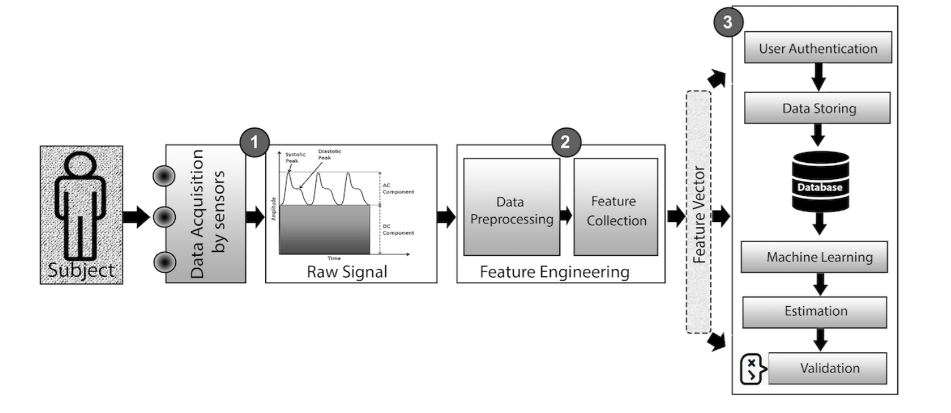
System Architecture:

Slide 9
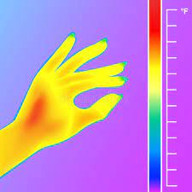
Methodology and design:
Transfer Learning:
Transfer learning is a machine learning (ML) method that reuses a trained model designed for a particular task to accomplish a different yet related task. The knowledge acquired from task one is thereby transferred to the second model that focuses on the new task.
Neural networks usually try to detect edges in the earlier layers, shapes in the middle layer and some task-specific features in the later layers. In transfer learning, the early and middle layers are used and we only retrain the latter layers. It helps leverage the labeled data of the task it was initially trained on.
A Positive
A Negative
B Positive
B Negative
AB Positive
AB Negative

Slide 10
Inception-V3 Model:
Inception-V3 is a pretrained convolutional model that is 48 layers deep.
It is a version of network already trained on more than a million images from the imagenet Dataset.
Since ,Inception-V3 model is already trained, By using transfer learning technique ,It is possible to retrain the last layer of network using hand spectrum images. The other layers of the model remains unchanged.
By using Inception-V3,we do not need a large image dataset to train a model , because almost all the model is already trained.

Slide 11
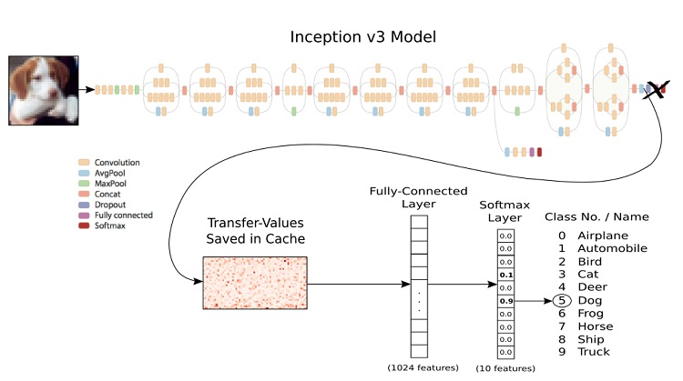
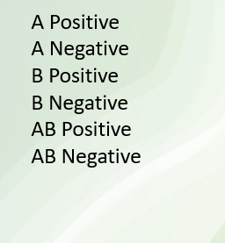
Inception-V3 Architecture:

Slide 12
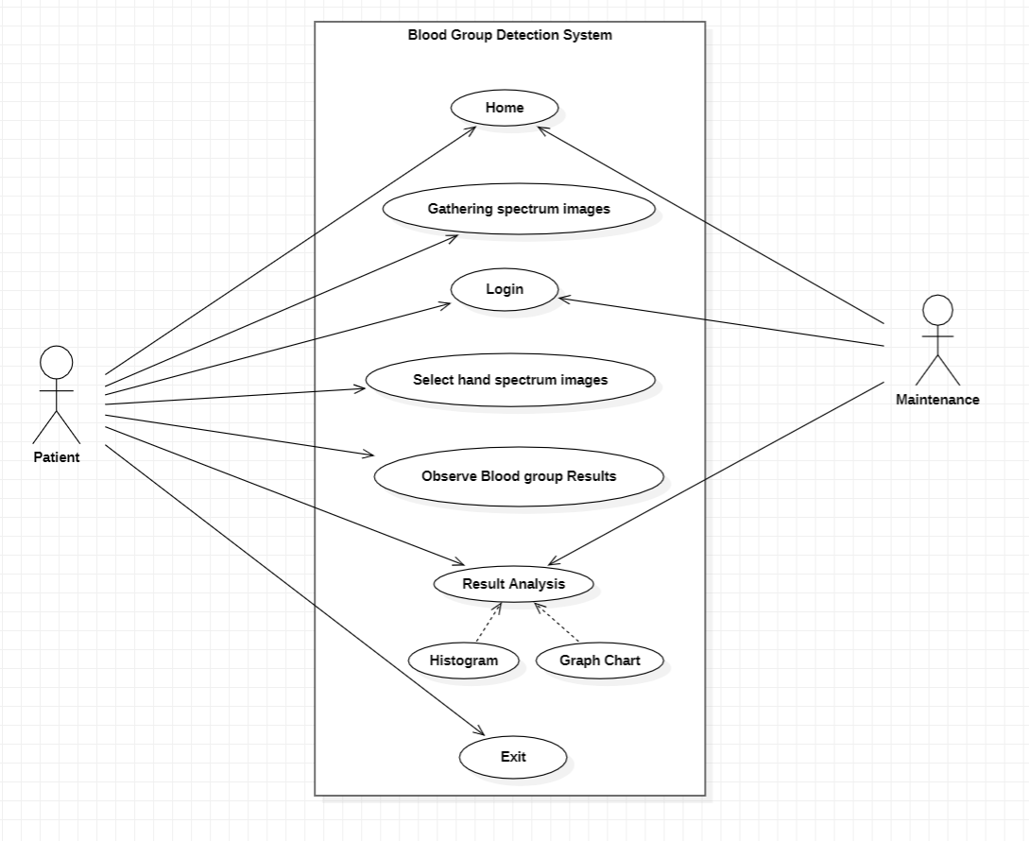
Use Case Diagram:

Slide 13
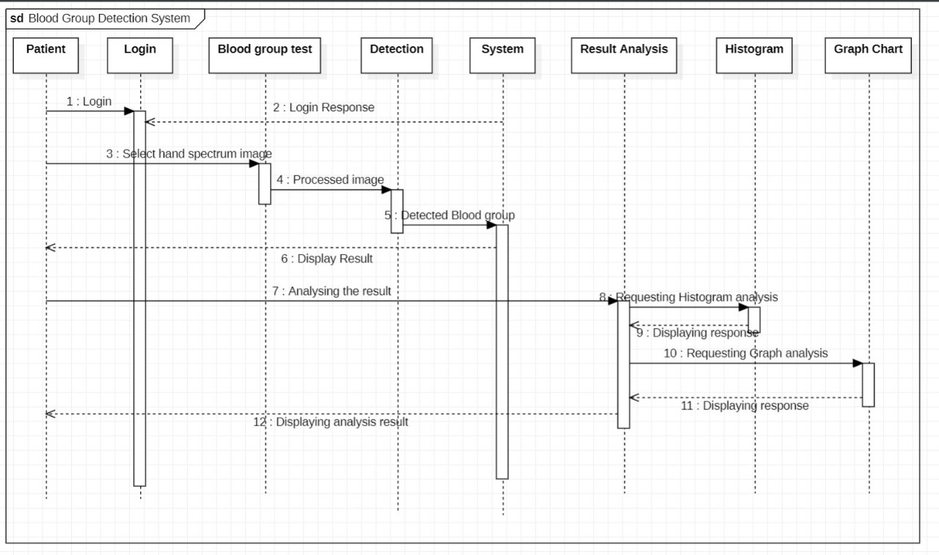
Sequence Diagram:

Slide 14
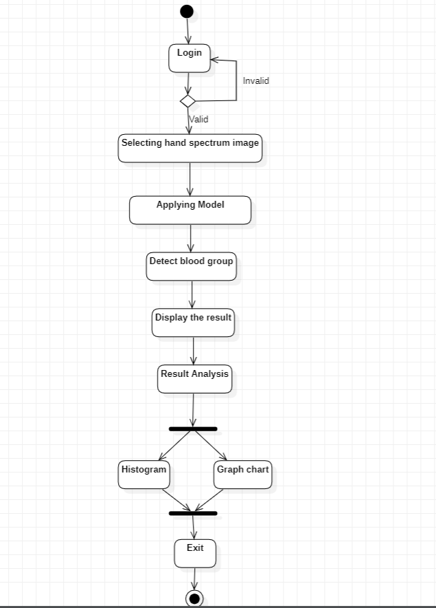
Activity Diagram:

Slide 15
Implementation:
Loading the dataset from a directory
Image data is stored in a multi-level directory structure. Here is the two-level
directory structure :
Dataset:
--------A Positive
-------image1
------image2
--------B Positive
------image1
------image2

Slide 16
Data Pre-Processing:
It is an important step in training machine learning models in general. Let’s, therefore, apply some augmentation to the images. When you apply augmentation to a training set, you’re preventing overfitting, because augmentation exposes different aspects of the image to the model. You especially want to augment the data when there’s not a lot of data for training.
You can augment it using various transformations, like:
random rotations
horizontal flipping
zooming
shearing.

Slide 17
Create a base model from the pre-trained Xception model
Load the model with the weights trained on ImageNet. When that’s done, the desired input shape is defined.
`include_top=False` means that excluding the last layer of the model. Since models are visualized from bottom to top, that layer is referred to as the top layer. Excluding the top layers is important for feature extraction.
Next, freeze the base model layers so that they’re not updated during the training process.
Since many pre-trained models have a `tf.keras.layers.BatchNormalization` layer, it’s important to freeze those layers. Otherwise, the layer mean and variance will be updated, which will destroy what the model has already learned.

Slide 18
Create the final dense layer:
This step adds new trainable layers that will turn old features into predictions on the new dataset.
When loading the model, we used ‘include_top=false’ means that final dense layer of model is not included.so we have to define a final output layer for the model.
We have to add different layers on the top of model and a final softmax layers to classify the blood group.

Slide 19
Train the model:
In this step , we train the top layers of the model.
The top layers can be trained by identifying the signal format in each image of the particular blood group.
While training, model first identifies the name of the folder where image is there and then identifies the format of the signal.
In testing phase of model, whenever we given new image , It identifies the signal format and classifies the image belongs to a particular blood group.

Slide 20
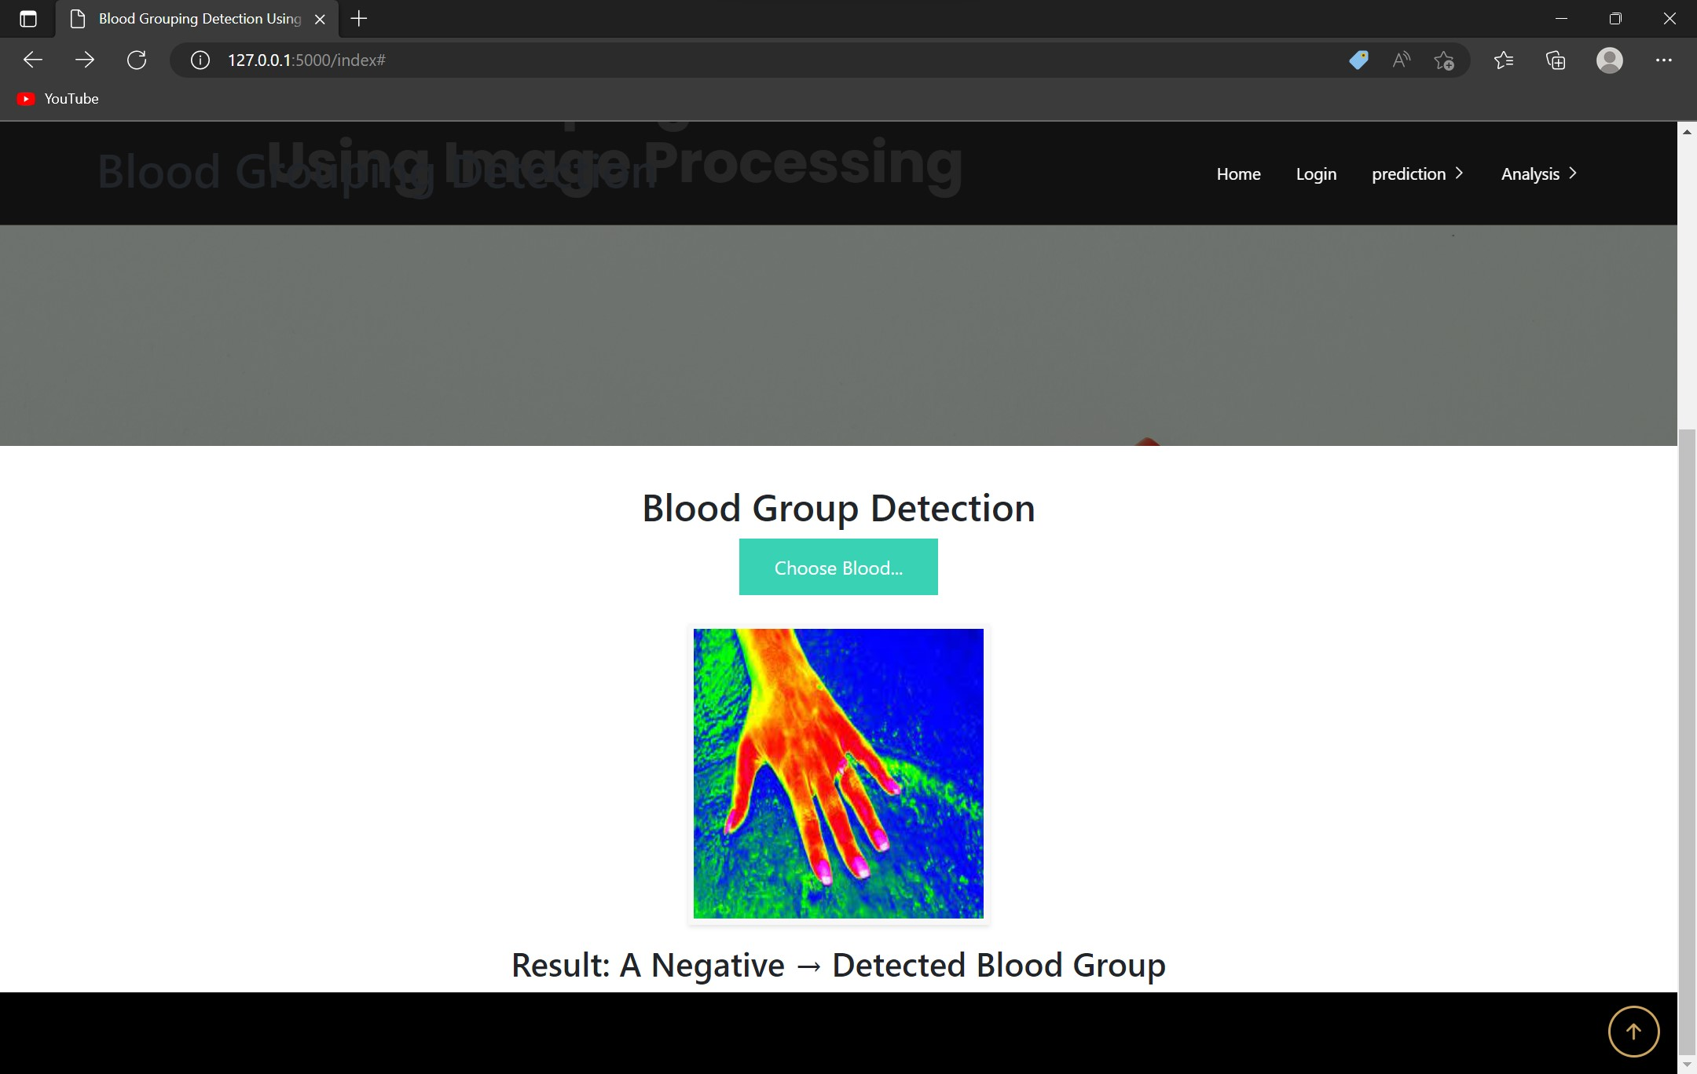
Result Analysis:
Testing with A Negative Blood Group sample

Slide 21
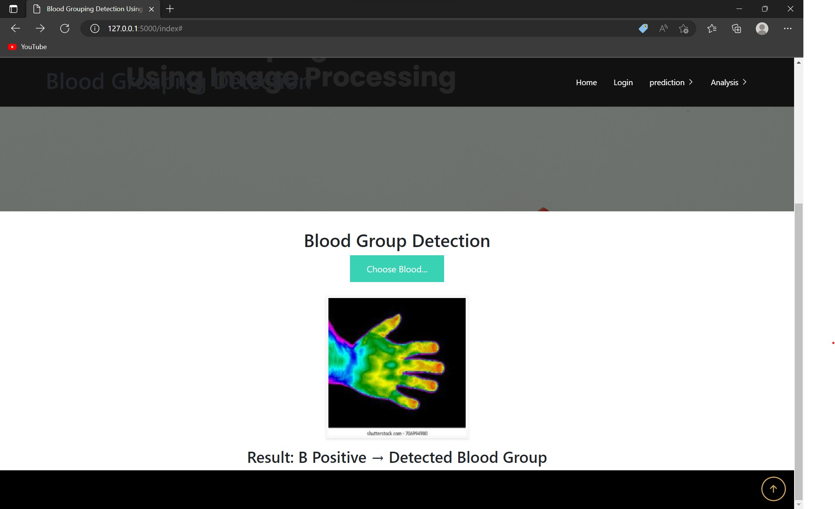
Result Analysis:
Testing with B Positive Blood Group sample

Slide 22
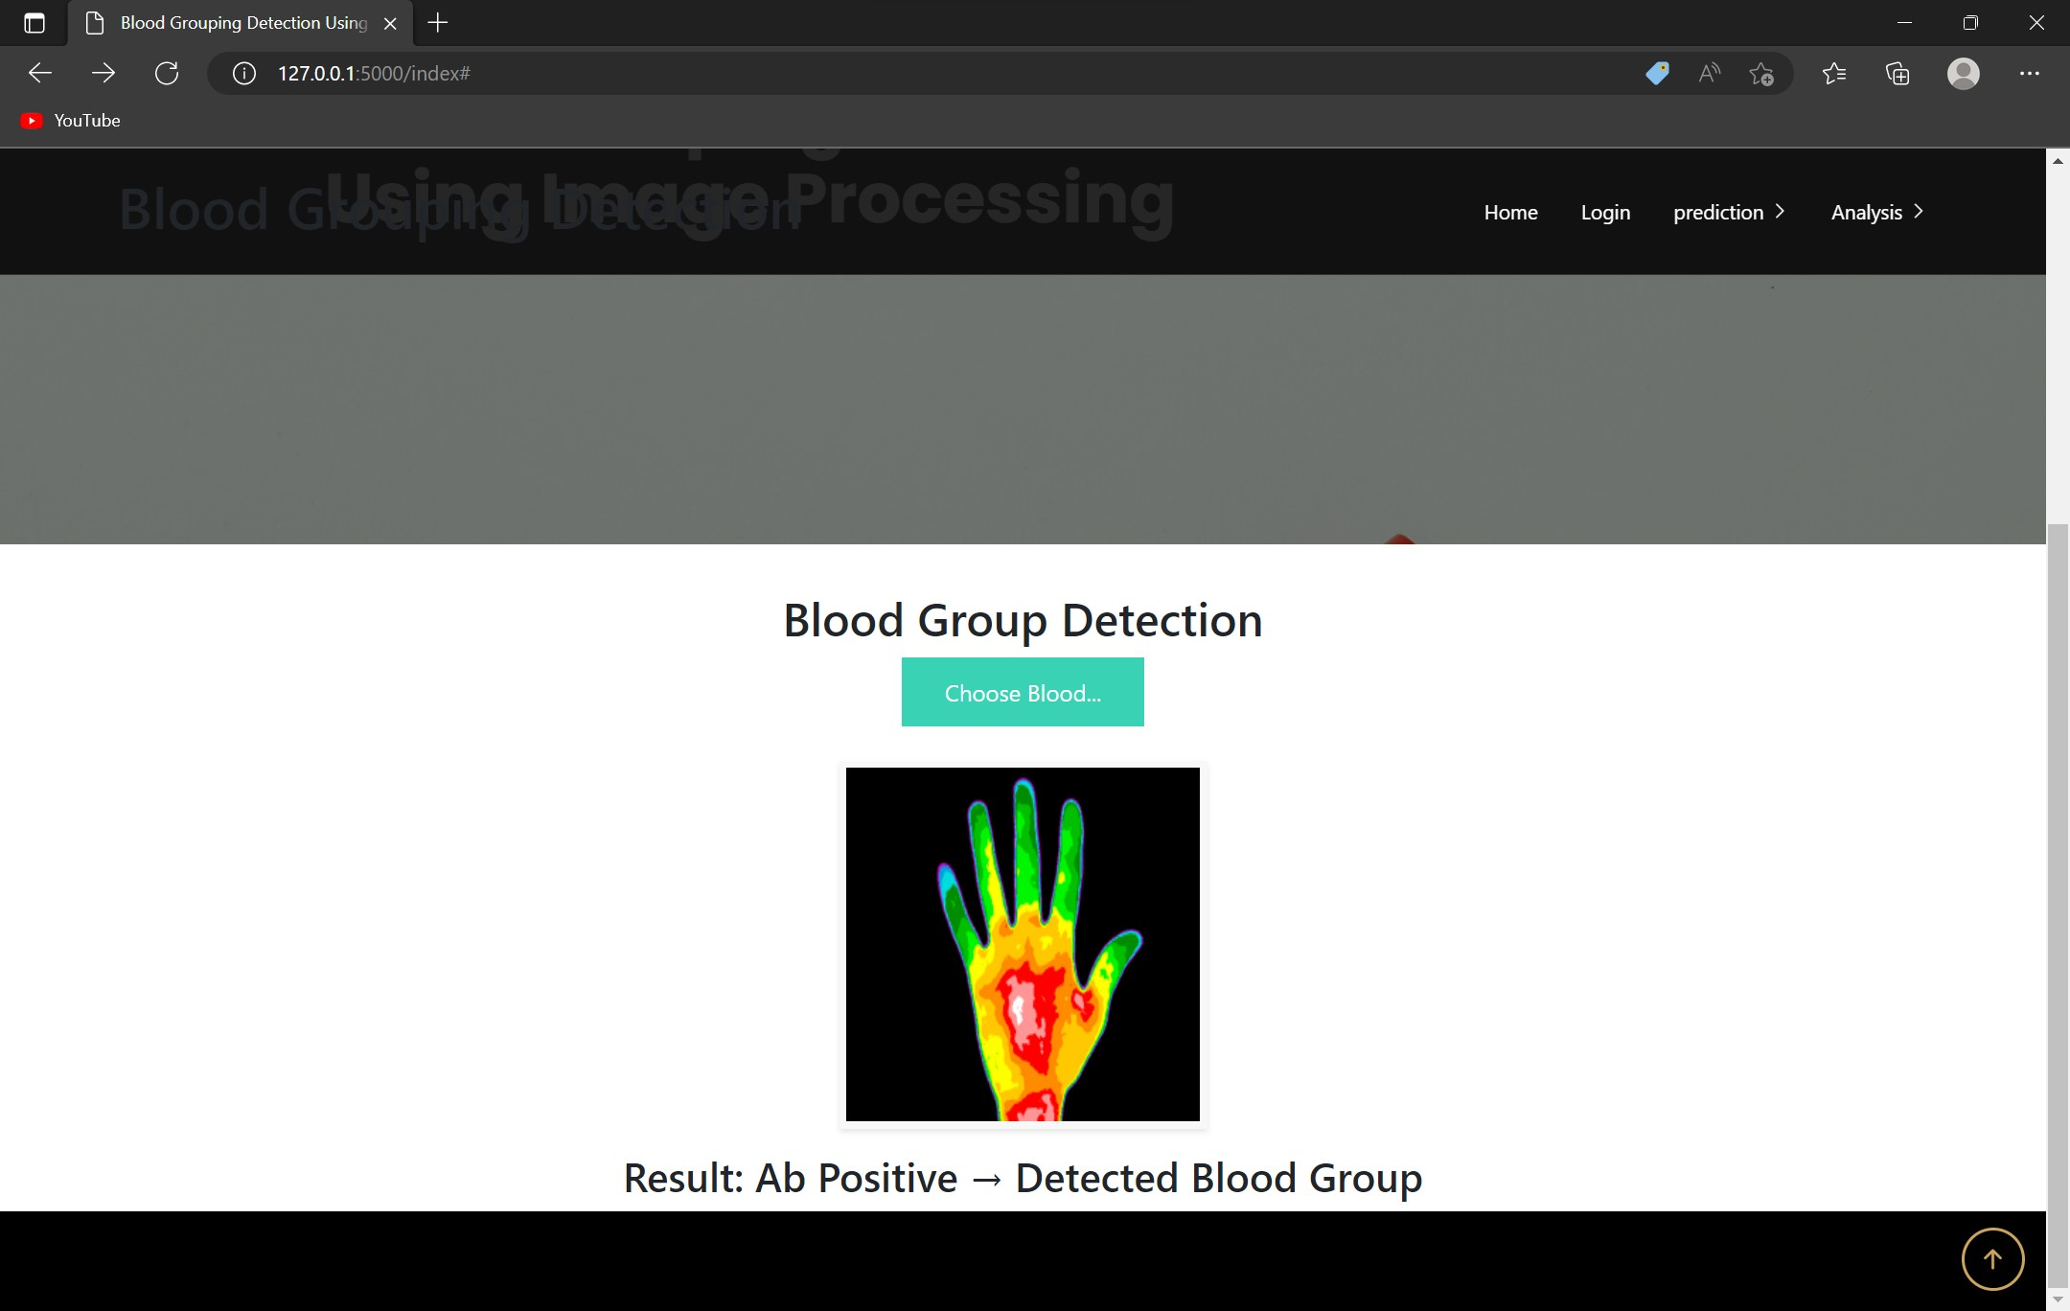
Result Analysis:
Testing with AB Positive Blood Group sample

Slide 23
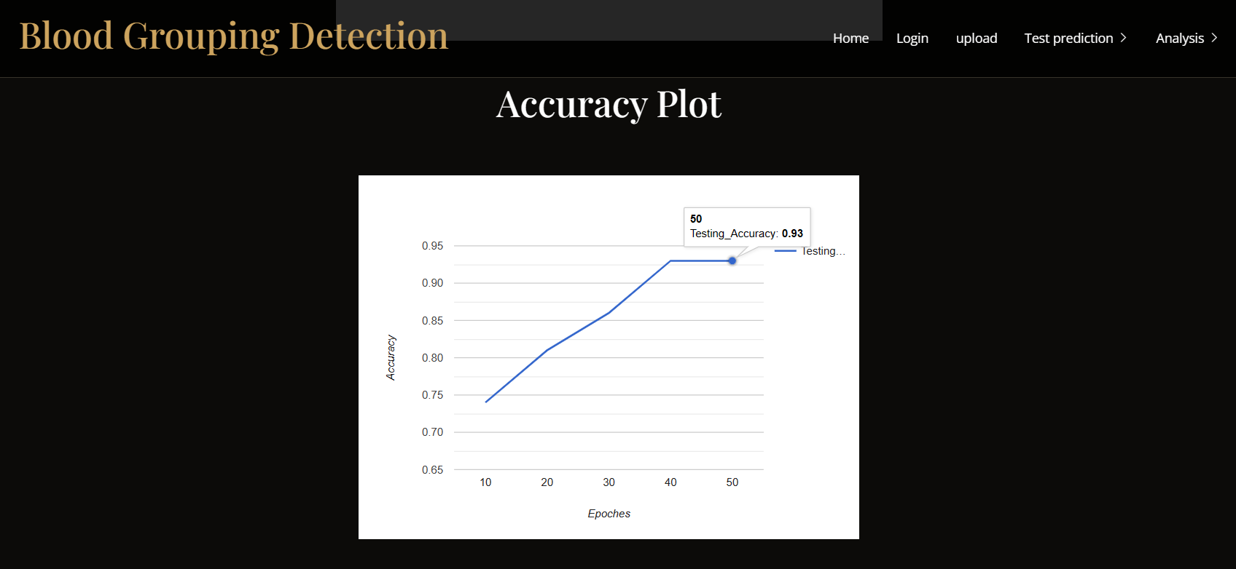
Result Analysis:
Testing accuracy result is 93%

Slide 24
Attainment of Objective:
In this work, the attained objective is blood group of a person is detected by taking spectroscopic image of the hand of a person with an accuracy of 93%.

Slide 25
Future Scope of Project:
The future scope of this project is to develop an application through which a patient can able to install this application in their devices and check their blood group by uploading their spectroscopic images into the application.

Slide 26
Thank you

