Slide 1

Project Review
Global Military Firepower Analysis Dashboard
Presented by:
G. Bhanu Teja – 24B11DS072
Madhan – 24B11DS002
M. Chethan – 24B11DS128
K. Durga – 25B21DS008
Project Guide: P. Srilatha-Assistant Professor
Dept of Data Science

Slide 2
Content for Project Review
Problem Statement
Abstract
Objectives
Data Set Discription
Praposed Data Visulaization Approch
Project Requirments
Data Architecure and Preprocessing
Exploratory Data Analysis & Trend Mapping
Power BI Dashboard — Visual Implementation
Advanced Analytics
Conclusion

Slide 3
Problem Statement
In the modern geopolitical landscape, global defense operates as an intricate ecosystem where power is determined not merely by raw troop counts, but by how efficiently nations transform financial investment into multi-domain military capabilities. True defense dynamics depend on complex strategic balances—weighing high-budget technological superiority against sheer manpower brawn, standing active forces against mobilization-dependent reserves, and naval power projection against ground and air defense. However, raw datasets and surface-level rankings fail to reveal how global defense actually functions, masking vital insights such as per-capita militarization, domain specialization, and the dynamic shift in power created by potential international alliances. Without an interactive visualization system, evaluating actual military readiness, force allocation, and budget efficiency across nations remains fragmented and opaque for defense analysts, researchers, and decision-makers.

Slide 4
Abstract
This project focuses on analysing and visualizing the Global Military Firepower 2025 dataset to uncover meaningful insights into the military capabilities of countries worldwide. The project begins with data cleaning and preprocessing, where missing values, duplicate records, inconsistent column names, and incorrect data types are identified and corrected. Numerical fields are standardized, categorical values are validated, and the dataset is transformed into an analysis-ready format. After cleaning, Exploratory Data Analysis (EDA) is performed to understand the distribution of key variables such as defense budget, military personnel, aircraft, naval strength, armoured vehicles, population, and power index. Relationships between these variables are examined to identify trends and patterns across different countries and regions. The processed data is then used to build an interactive dashboard using visualization tools such as Power BI or Tableau. The dashboard includes KPIs, bar charts, maps, scatter plots, pie charts, and filters that allow users to compare countries, analyze regional military strength, and evaluate the factors influencing global military power rankings. This project demonstrates the complete data analytics workflow—from raw data preparation to insightful visual storytelling—enabling policymakers, researchers, students, and defense analysts to make informed decisions through clear, accurate, and interactive visualizations based on reliable military firepower data.

Slide 5
Objectives
Data Architecture & Preprocessing :To transform raw data into an analysis-ready format by cleaning and preprocessing the dataset, which includes identifying and correcting missing values, duplicate records, inconsistent column names, and incorrect data types
Exploratory Data Analysis & Trend Mapping : To analyze the distribution of key variables (e.g., defense budget, military personnel, aircraft, naval strength) and examine relationships to uncover geopolitical patterns and global military trends.
Core Dashboard Development & UI/UX : To design and construct the primary interactive dashboard using Power BI or Tableau, integrating key visual views such as the Geopolitical Landscape (Choropleth Maps) and Resource Allocation (Scatter Plots & Treemaps).
Advanced Analytics Dashboard Development : To implement innovative "next-level" features using DAX, including dynamic hypothetical alliance building (What-If parameters), readiness versus reserve indices, and per-capita militarization metrics.

Slide 6
Data Set Discription
Dataset Overview: The "Global Military Firepower 2025" dataset contains 145 rows (representing 145 countries) and 57 detailed columns (assessment factors) covering diverse military, economic, and logistical capabilities.
Demographics & Manpower: Includes metrics such as total population, total military manpower, fit for service, annual military age population, active personnel, reserve personnel, and paramilitary forces.
Financial Indicators: Tracks critical economic data including defense budget (in USD), external debt, purchasing power parity (PPP), and foreign exchange/gold reserves.
Hardware - Air Power: Detailed counts of total military aircraft, fighter aircraft, attack aircraft, transport, trainers, special mission, tanker aircraft, total helicopters, and attack helicopters.
Hardware - Land Power: Metrics covering tanks, armored fighting vehicles, self-propelled artillery, towed artillery, and rocket projectors.
Hardware - Naval Power: Accounts for total naval fleet size, total fleet tonnage (MT), aircraft carriers, helicopter carriers, submarines, destroyers, frigates, corvettes, coastal patrol craft, and mine warfare craft.
Logistics & Geography: Quantifies logistical endurance and geographic footprint through total serviceable airports, labor force, major ports and terminals, merchant marine fleets, railway and roadway coverage, land area, coastline, and shared borders.
Natural Resources: Tracks production, consumption, and proven reserves for critical wartime resources: oil (in barrels), natural gas (in cubic meters), and coal (in metric tons/cubic meters).

Slide 7
Proposed Data Visualization Approch
View 1: The Geopolitical Landscape:
  Choropleth Map (diverging color scale) to establish global military hierarchy by PowerIndex.
  Bar/Ribbon Chart for Top 10 Powers and a KPI Banner summarizing global totals.
View 2: Budget vs. Brawn (Resource Allocation):
  Efficiency Scatter Plot (X: Defense Budget, Y: Active Personnel, Size: Total Hardware) to separate high-tech from manpower-heavy forces.
  Treemap to display defense spending concentration by global region.
View 3: Force Specialization (Domain Analysis):
  Triad Radar Chart comparing domains (Army, Navy, Air Force) across nations.
  100% Stacked Bar Chart highlighting Naval vs. Air dominance ratios.
Advanced Interactive Features (DAX):
  "What-If" Alliance Builder: Dynamic slicers to aggregate custom nation blocs and compare against superpowers.
  Readiness Index & Per-Capita Metrics: Gauge/Bar charts calculating Active vs. Reserve ratios and population-adjusted militarization.

Slide 8
Project Requirements
Software Requirements:-
Operating System: Windows 10 / Windows 11 / Linux
Data Visualization Tool: Microsoft Power BI Desktop
Data Source: CSV/Excel Dataset
Data Cleaning: DAX (Power Query )and MS Excel
Web Browser: Google Chrome or Microsoft Edge Software for Data Sets
Hardware Requirements:-
Processor: Intel i3 / i5 or equivalent
RAM: Minimum 8 GB (16 GB recommended)
Hard Disk: Minimum 20 GB free space
Display: 1366 × 768 resolution or higher
Internet Connection: Required for downloading datasets and publishing reports
Keyboard and Mouse: Standard input devices

Slide 9
1. Data Architecture & Preprocessing
From raw dataset to an analysis-ready structure
Project workflow
Raw Dataset
Data Cleaning
Clean Dataset
Pivot Analysis
Power BI
Global Military Firepower 2025
→
Duplicate records addressed
→
Prepared for analysis
→
Aggregations by country / region
→
Interactive visualization
Preprocessing Performed
• Duplicate country records were identified and removed.
• Duplicate Asian country entries were removed to maintain data consistency.
• The cleaned dataset was prepared for further analysis.
• The final dataset was used for pivot-table analysis and Power BI visualization.
.
Global Military Firepower Analysis Dashboard

Slide 10
2. Exploratory Data Analysis & Trend Mapping
Pivot tables provide the analytical layer before dashboard visualization
Pivot tables summarize key variables for exploratory analysis and dashboard development.
Air Power
Population & Manpower
PT1 Fighter Aircraft
PT3 Region-wise Aircraft
PT5 Attack Aircraft
PT2 Regional Population & Manpower
PT4 Asian Population & Manpower
Naval, Military & Geography
Resources
PT6 Naval Fleet
PT7 Military Equipment
PT8 Sea Coverage
PT9 Land Coverage
PT10 Coal
PT11 Natural Gas
PT12 Oil
Global Military Firepower Analysis Dashboard

Slide 11
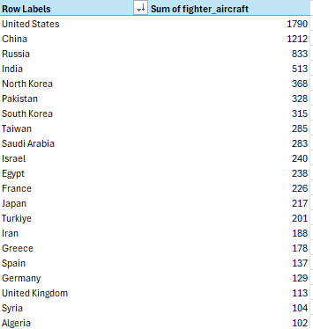
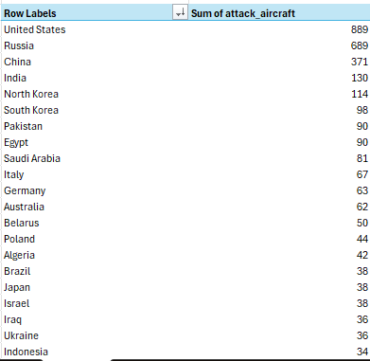
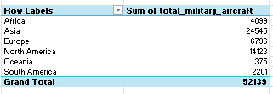
2.1 Air Power Analysis
PT1, PT3 and PT5
Analysis Focus: Compare fighter aircraft, attack aircraft, and total military aircraft across countries and regions.
Global Military Firepower Analysis Dashboard

Slide 12
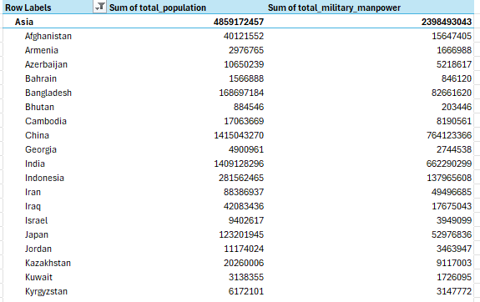
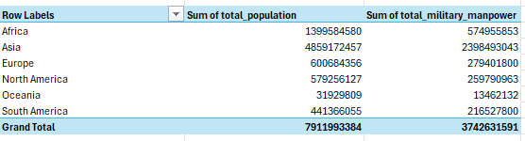
2.2 Population & Military Manpower Analysis
PT2 and PT4
Analysis Focus: Compare population and military manpower across regions and examine the corresponding distribution within Asian countries..
Global Military Firepower Analysis Dashboard

Slide 13
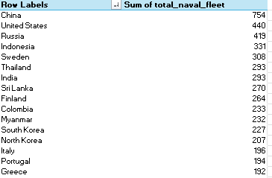
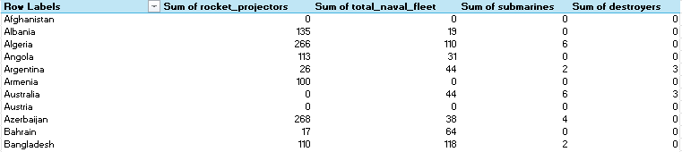
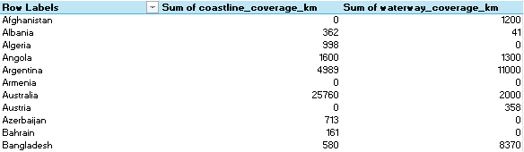
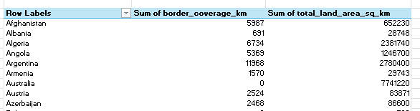
2.3 Naval, Military & Geographic Analysis
PT6, PT7, PT8 and PT9
PT7 — Submarines, Rocket Projectors, Naval Fleet & Destroyers
PT8 — Country-wise Sea Coverage
PT9 — Country-wise Land Coverage
Global Military Firepower Analysis Dashboard

Slide 14
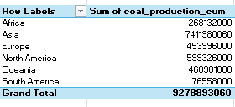
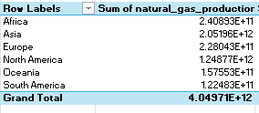
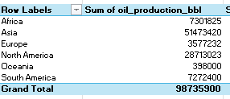
2.4 Resource Consumption Analysis
PT10, PT11 and PT12
PT10 — Coal analysis
PT11 — Natural gas analysis
PT12 — Oil analysis
Analysis Focus: Compare regional resource production and consumption patterns.
Global Military Firepower Analysis Dashboard

Slide 15
3. Core Dashboard Development & UI/UX
Power BI transforms the analytical summaries into interactive visual views
Data
Analysis
Power BI
Insights
Cleaned Global Military Firepower dataset
→
Pivot-table summaries and calculated fields
→
Interactive maps, charts and filters
→
Visual comparison and trend interpretation
Current dashboard development & UI /UX :
Geographical Distribution — Map Chart
Naval & Support Equipment — Submarines, Tankers & Bunkers
Air Power Analysis — Country-wise Aircraft Bar Chart
Resource Analysis — Coal Consumption Pie Chart
Global Military Firepower Analysis Dashboard

Slide 16
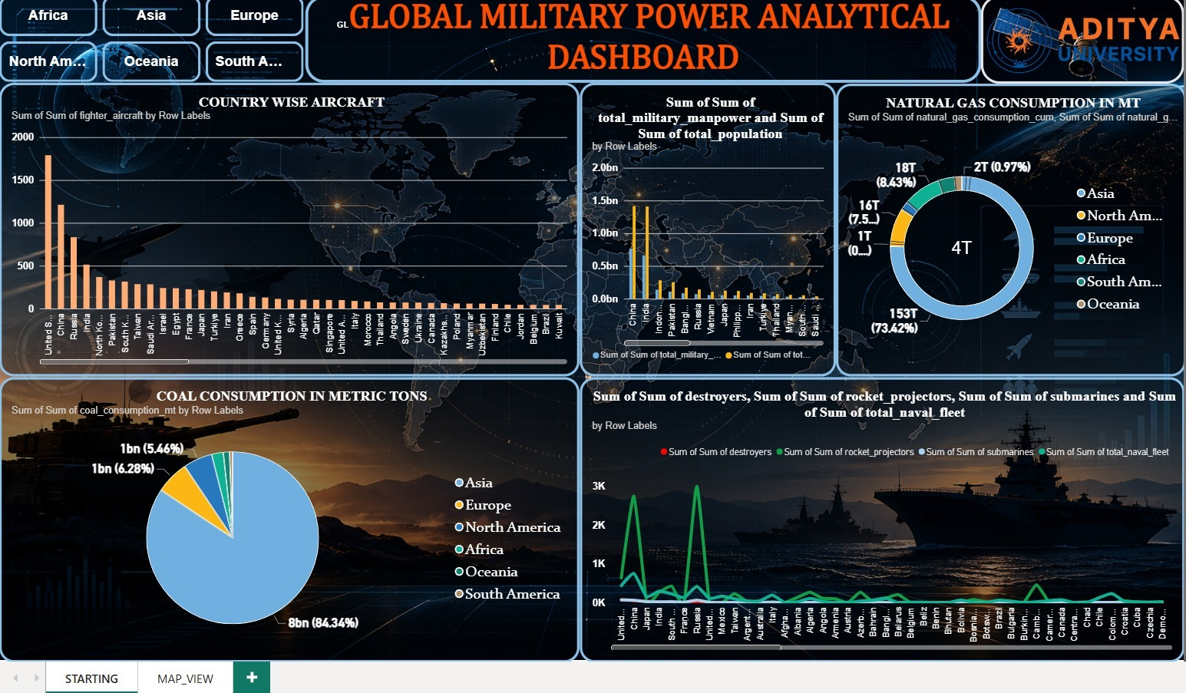
3.1 Power BI Dashboard — Visual Implementation
Purpose
Present military data through interactive visual comparisons.
UI/UX Focus
Clear hierarchy, readable charts, filters and geographic context.
Key Insight
Add only after the final dashboard screenshot is inserted and verified.
Global Military Firepower Analysis Dashboard

Slide 17
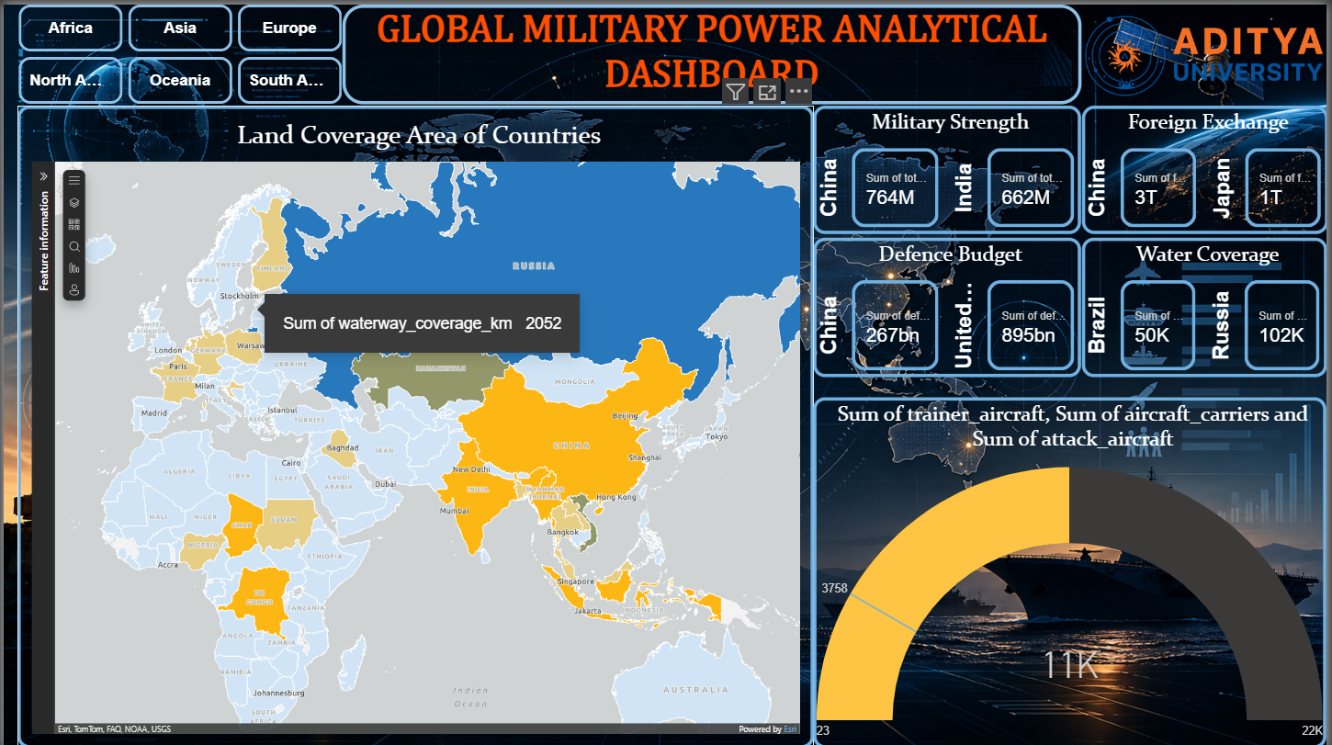
4. Advanced Analytical Dashboard
Proposed capabilities from the original project objective
Purpose
Present military data through interactive visual comparisons.
KPI Cards
Key Performance indicators like Military Strength , Foreign Exchange, Defence Budget , Water Coverage
Key Insight
Add only after the final dashboard screenshot is inserted and verified.
Population-adjusted military indicators.
Global Military Firepower Analysis Dashboard

Slide 18
Conclusion
Dataset Preparation
The Global Military Firepower 2025 dataset was cleaned and prepared for analysis.
Exploratory Analysis
Pivot-table analysis examined air power, population & manpower, naval capabilities, geographic factors, and resource indicators.
Dashboard Development
The analyzed data was structured for Power BI visualization and interactive exploration.
Analytical Outcome
The project brings multiple military and resource indicators together for country-wise and region-wise comparison.
.
Data Cleaning → Pivot Analysis → Power BI Visualization → Insights
Global Military Firepower Analysis Dashboard

Slide 19
THANK YOU

