Slide 1

Introduction to React
Lesson 01
Notes:
Add instructor notes here.

Slide 2
Lesson Objectives
At the end of this module you will
be able to:
Overview of frameworks, libraries for client side Web applications
React introduction,
Understanding “what” and “why” React
React Component Demonstration using codepen
Environment Setup for React Application
Understanding NPM commands
Using VS Code
VS Code extensions for ES6, React
Helloworld app in React
Notes:
Add instructor notes here.

Slide 3
Overview of frameworks, libraries for client side Web applications
As demand increased for processing the page elements and cross browser compatibility, JavaScript frameworks evolved & eased out the process and provide a standard set of methods, functions, and controls.
Some of the popular JavaScript frameworks included Prototype, YUI, ExtJS, MooTools, and jQuery.
These frameworks allow developers to create shortcuts to working with elements in the Document Object Model (DOM).
Some of the more popular frameworks today include AngularJS, EmberJS, ReactJS, Vue Js, Flutter and BackboneJS.
Notes:
Model :
Model is where the application’s data objects are stored. The model doesn’t know anything about views and controllers. When a model changes, typically it will notify its observers that a change has occurred.
View
View is what's presented to the users and how users interact with the app. The view is made with HTML, CSS, JavaScript and often templates
Controller
The controller is the decision maker and the glue between the model and view. The controller updates the view when the model changes. It also adds event listeners to the view and updates the model when the user manipulates the view.
JavaScript now has a number of frameworks boasting support for MVC (or variations on it, which we refer to as the MV* family), allowing developers to easily add structure to their applications without great effort.
These frameworks include the likes of Backbone, Ember.js, and AngularJS.

Slide 4
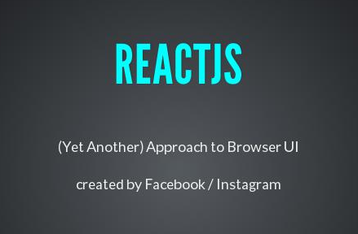
React: Introduction
It is an open source JavaScript library; components are defined and eventually become HTML
Developed by Facebook and Instagram
Intended to be the view("V") or the user interface in MVC
Aims at effortless development of a large scale Single Page Application (SPA)

Slide 5
Understanding “What” and “Why” React
React code is easy to understand for developers, designers, and anyone with the knowledge of XML or HTML
It uses JSX which is clean and easy to understand syntax which can be used directly in our JavaScript
Easy to test
Renders quick views
Enforces good coding practices
Supported and used by Facebook
Notes:
Slide explains regarding the SOAP format

Slide 6
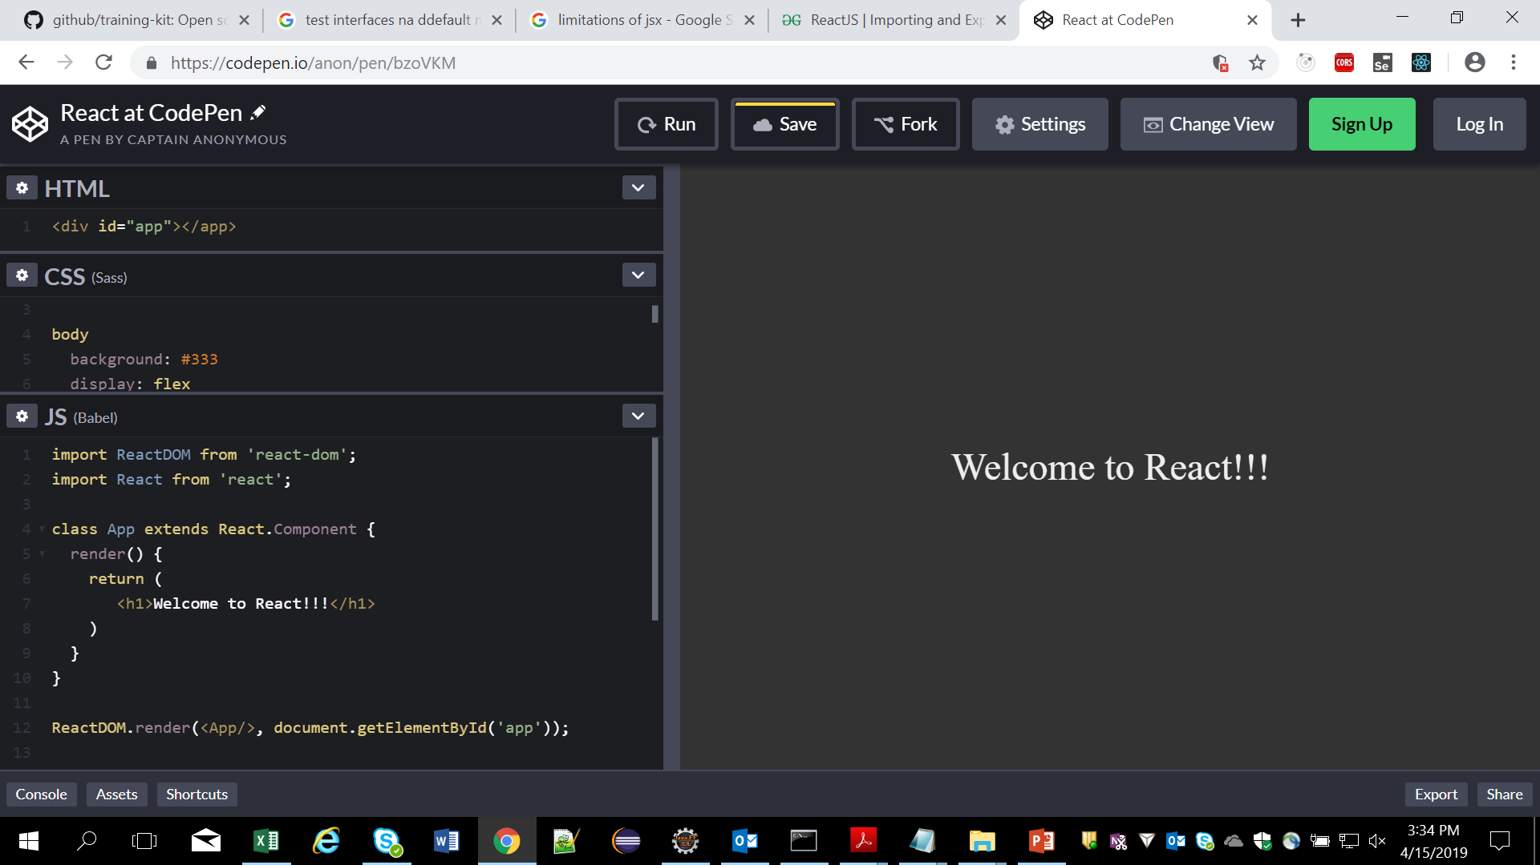
React Component Demonstration using codepen
https://codepen.io
Notes:
Add instructor notes here.

Slide 7
Use these 2 statements for import react and ReactDom library
Into the code and use it

Slide 8
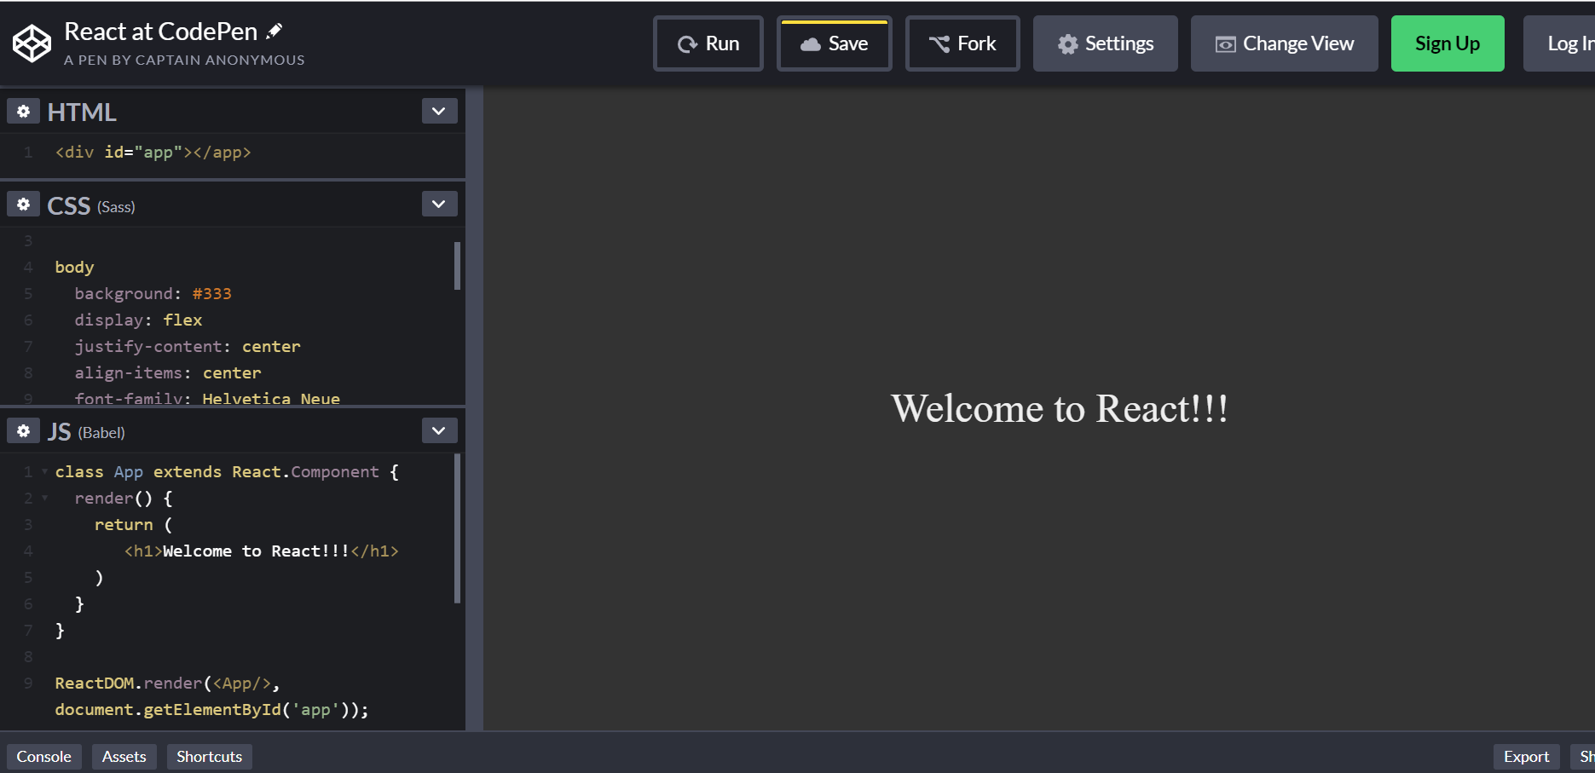
Click on this icon to open settings for changing the js transpiler.
This opens a Modal with 3 tabs , choose javascript.

Slide 9
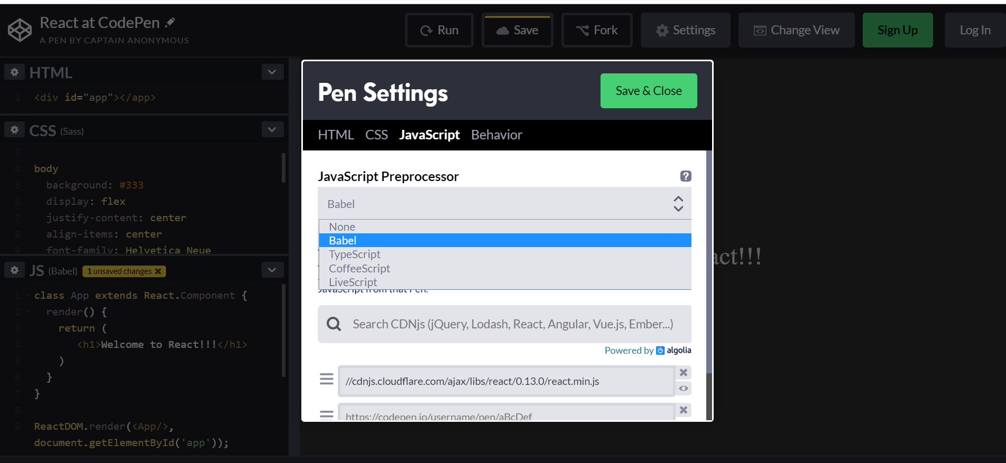
Select the transpiler you need,
Transpiler is nothing but compiles your jsx code into js code

Slide 10
Understanding NPM commands
NPM is the package manager for JavaScript and the world’s largest software registry
To test that you have Node.js and npm correctly installed on your machine, you can type node --version and npm --version in a terminal or command prompt.
You’ll need to have Node >= 6 on your machine.
Frequently used commands in react will be in next slide

Slide 11
Getting Started – Installation Steps of React JS
Environment Setup for React Application
To get started with React, install the React CLI tool (Create React App) and run the command to create a new app:
npm install -g create-react-app
create-react-app my-app
cd my-app
npm start
We use –g for using create-react-app gloabally
You’ll need to have Node >= 6 on your machine.
Create-React-App : creates a frontend build pipeline, so you can use it with any backend you want.
Once created check for Package.json file inside application folder and move to the folder to start server
Notes:
We can also create application using webpack and babel – use another support ppt

Slide 12
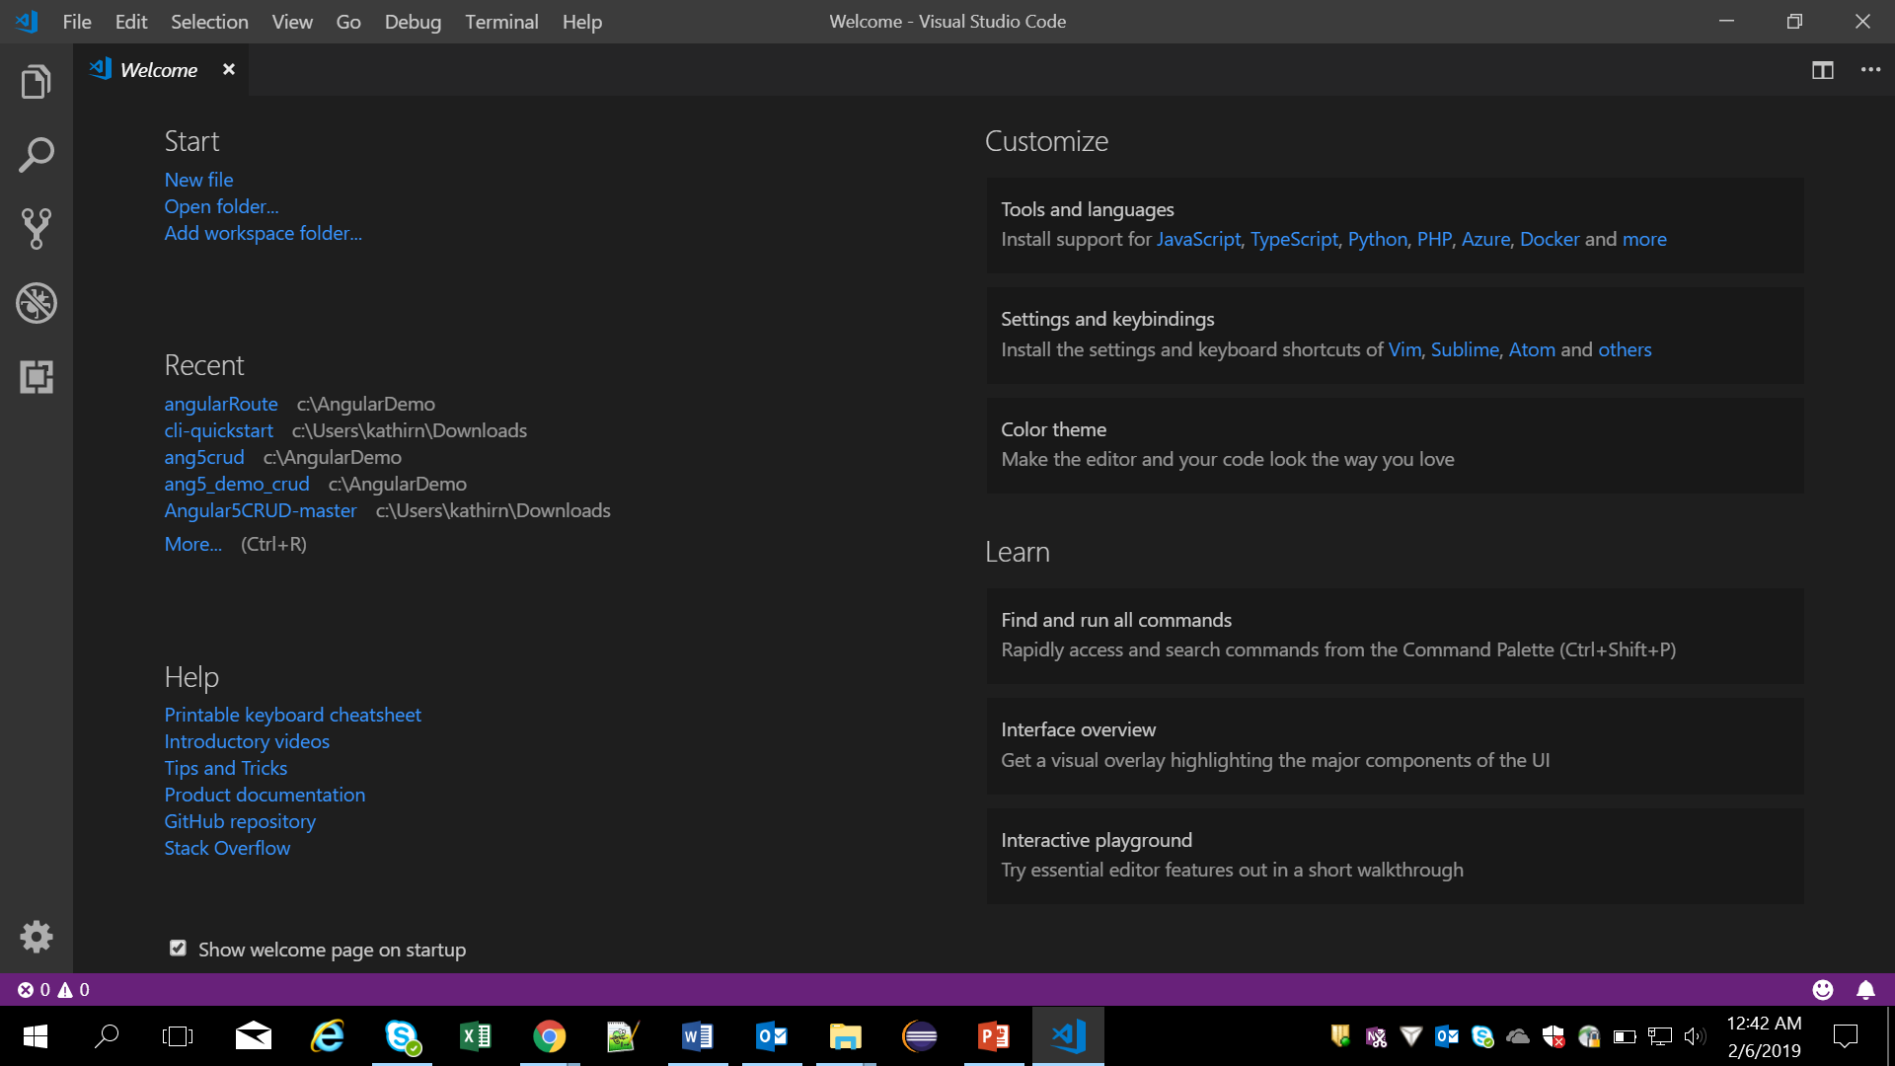
Using VS Code
Visual Studio Code is a lightweight but powerful source code editor which runs on your desktop and is available for Windows, macOS and Linux.
Notes:
It comes with built-in support for JavaScript, TypeScript and Node.js and has a rich ecosystem of extensions for other languages (such as C++, C#, Java, Python, PHP, Go) and runtimes (such as .NET and Unity).

Slide 13
VS Code extensions for ES6, React
Below listed are the extension available for ES6 and react
1. Prettier
2. ES Lint
3. Auto Close Tag
4. Auto Import - ES6,TS,JSX,TSX
5. npm intellisense
6. Git History
7. Git Lens

Slide 14
Hello-world application - Example
Create a new file index.html in the web project directory reactjs-example
Open up your Vs Code
Create a new file index.html & add the code below.
<!DOCTYPE html>
<html>
<head>
<title>React Basic</title></head>
<body>
<div id="root">
</div>
ReactDOM.render(<h1>Hello, world!</h1>,document.getElementById('root'));
</body>
</html>

Slide 15
Demo
React Hello World program
Notes:
Add the notes here.
Add instructor notes here.

Slide 16
Summary
Overview of frameworks, libraries for client side Web applications
React introduction,
Understanding “what” and “why” React
React Component Demonstration using codepen
Environment Setup for React Application
Understanding NPM commands
Using VS Code
VS Code extensions for ES6, React
Helloworld app in React
Notes:
Add the notes here.
Add instructor notes here.

Slide 17
Review Questions
Question 1:
How to install create react app globally?
A) install create-react-app
B) npm install create-react-app
C) npm install –g install create-react-app
D) npm gloabal install create-react-app
Question 2:
Which Command creates a frontend build pipeline, so you can use it with any backend you want.
A) React-App
B) create-react-app C) create-app D) React-app

