Slide 1

Unit Testing in Angular

Slide 2
Our Agenda
01
Unit Testing & its importance
02
Angular CLI setup
03
Angular testing tools
04
Code Coverage
05
Demo

Slide 3
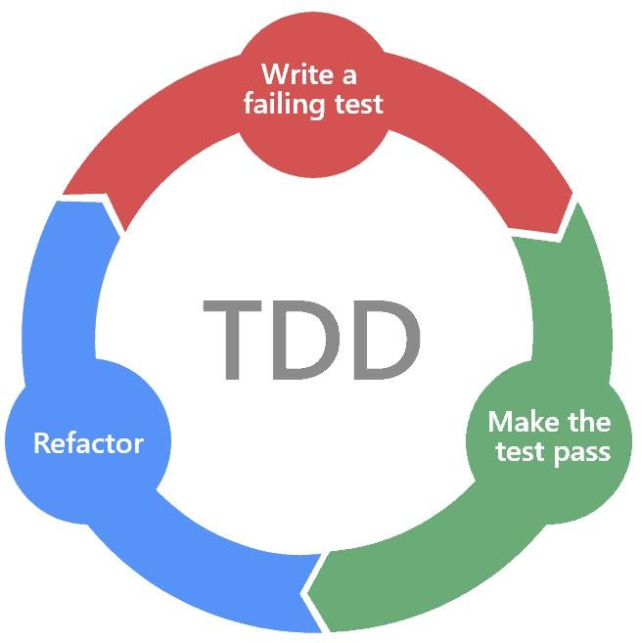
Test Driven Development
Test-driven development is the act of first deciding what you want your program to do (the specifications), formulating a failing test, then writing the code to make that test pass. It is most often associated with automated testing. Although you could apply the principles to manual testing as well.
Let’s look at a simple example: Building a wooden table. Traditionally, we would make a table, then once the table is made, test it to make sure it does, well, what a table should do. TDD, on the other hand, would have us first define what the table should do.

Slide 4
Test Driven Development..
I expect the table to be four feet in diameter. The test fails because I have no table.
I cut a circular piece of wood four feet in diameter. The test passes.
I expect the table to be three feet high.
The test fails because it is sitting on the ground. I add one leg in the middle of the table.
The test passes.

Slide 5
What is Unit Testing?
Unit testing is testing a unit in an isolated environment. A unit can be a class, component, service, directive module, etc. which can be logically separated from the software. Any unit in an app is not isolated, it’s quite normal that it will be depending on the other units in an application for resources like data or methods..
A single unit is any block of code (i.e. function or class) that has one and only one responsibility.
A function might have multiple unit tests according to the uses and output of the function.
So if we do an integrated test of the application and it fails then it’s hard to identify where exactly the code is breaking. So the purpose of unit testing is to test each unit individually and see if it’s working fine.

Slide 6
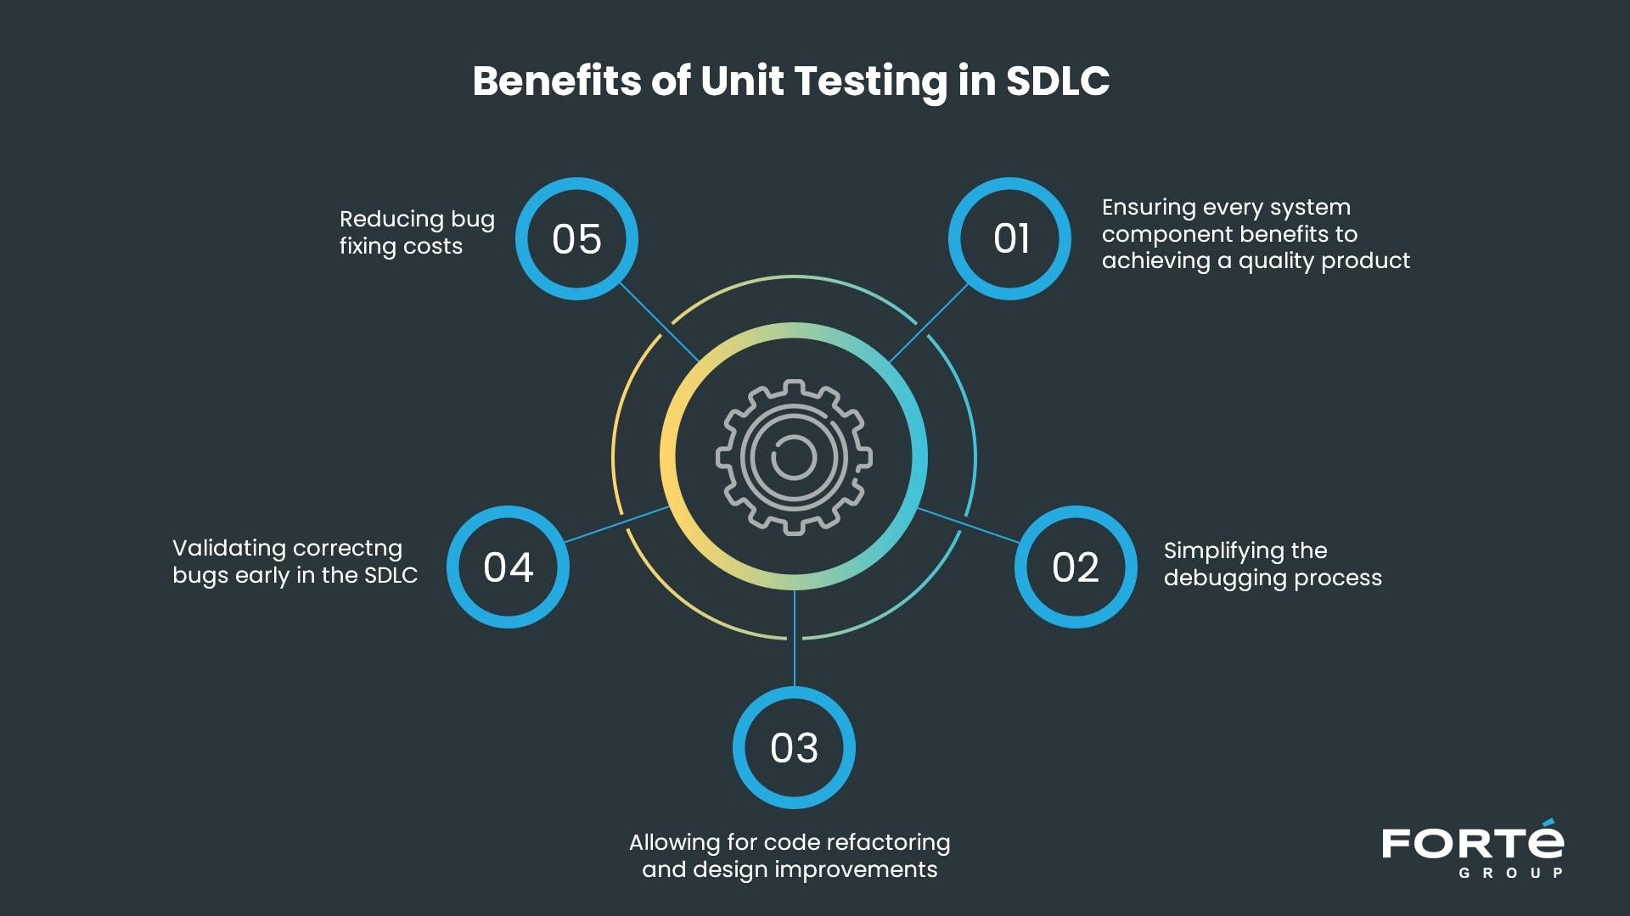

Benefits and Objectives of Unit Testing

Slide 7
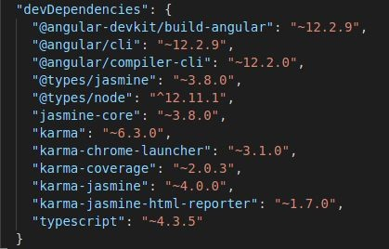
Unit testing in Angular
Prerequisites
Node Js 6.9 +.
Angular cli
A angular project - create a new project using angular CLI which will install everything we need to have to test the application.
ng new unit-test-demo
In the package.json you can find the following:

Slide 8
Jasmine And Karma
Jasmine-core:
Jasmine is a behavior-driven development framework for testing JavaScript code. It does not depend on any other JavaScript frameworks. It does not require a DOM.
Karma:
Karma is essentially a tool that spawns a web server that executes source code against test code for each of the browsers connected. The results of each test against each browser are examined and displayed via the command line to the developer such that they can see which browsers and tests passed or failed.

Slide 9
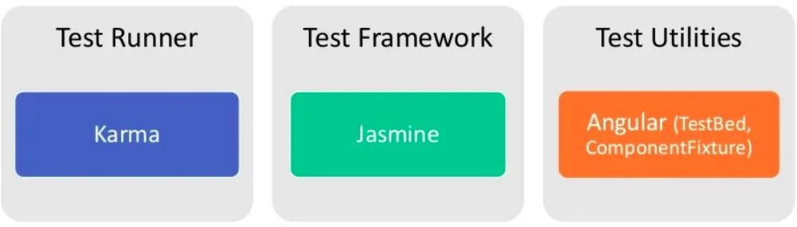
Angular Testing Tools

Slide 10
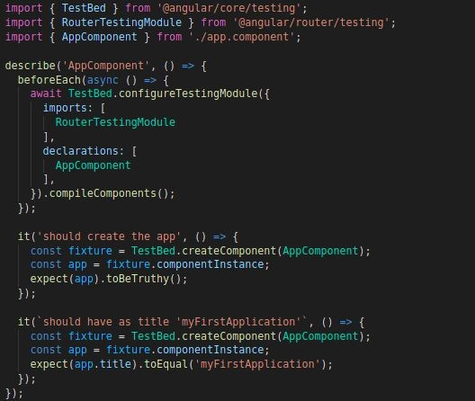
Test Spec File
This is the very spec file that is created with our app i.e., app.component.spec.ts
There are 4 majorly used keywords that we will be using throughout our journey of test cases in angular -
describe()
beforeEach()
TestBed()
it()

Slide 11
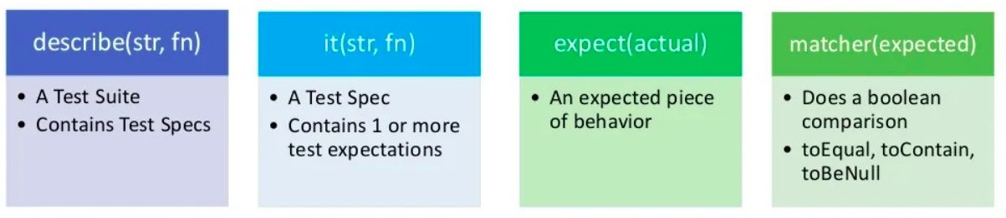
Jasmine Test Spec

Slide 12
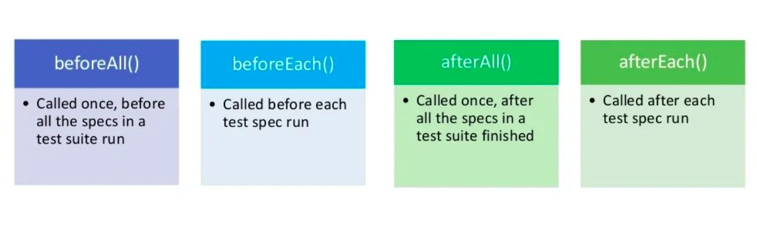
Setup and teardown(Cleaning up)
●

Slide 13
Testbed: TestBed.configureTestingModule() method takes a metadata object that can
have most of the properties of an @NgModule. A spec file does not know any of the custom components, classes, imports you have mentioned in the ts file or module, everything needs to be mentioned and imported in the spec file for creating the environment to run the tests.
TestBed.createComponent(): Creates an instance of the AppComponent, adds a corresponding element to the test-runner DOM, and returns a ComponentFixture.
ComponentFixture: This is a test harness for interacting with the created component and its corresponding element.
detectChange() : In the actual production, data binding is done automatically but in TestBed.createComponent() does not do data binding unless we trigger by detectChange().
nativeElement() : nativeElement() will be HTML element, and we can access its child and dive into its DOM tree using querySelectors().

Slide 14
Important Points About Jasmine
describe() blocks define a test suite and each it block is for an individual test.
beforeEach() runs before each test and is used for the setup part of a test.
afterEach() runs after each test and is used for the teardown part of a test.
You can also use beforeAll and afterAll, and these run once before or after all tests.
You test an assertion in Jasmine with expect and using a matcher like toBeDefined, toBeTruthy, toContain, toEqual, toThrow, toBeNull, … For example: expect(myValue).toBeGreaterThan(3);
You can do negative assertion with not: expect(myValue).not.toBeGreaterThan(3);

Slide 15
TESTING A COMPONENT

Slide 16
Code Coverage
The CLI can run unit tests and create code coverage reports. Code coverage reports show you any parts of your code base that might not be properly tested by your unit tests.
To generate a coverage report run the following command in the root of your project.
ng test --no-watch --code-coverage
When the tests are complete, the command creates a new /coverage folder in the project. Open the index.html file to see a report with your source code and code coverage values.
If you want to create code-coverage reports every time you test, set the following option in the CLI configuration file, angular.json:
"test": {
"options": { "codeCoverage": true
}
}
●

Slide 17

DEMO

Slide 18

References
https://angular.io/guide/testing-code-coverage
https://www.digitalocean.com/community/tutorials/angular-introduction-unit-te sting
https://medium.com/swlh/angular-unit-testing-jasmine-karma-step-by-step-e33 76d110ab4
https://blog.logrocket.com/angular-unit-testing-tutorial-examples/

Slide 19


Thank You !
Get in touch with us:

