Slide 1



Basics of React Hooks

Slide 2
Our Agenda
01
React In Brief
02
Introduction to Hooks
03
Motivation behind Hooks
04
Types and Rules
05
Our First React Hook (useState Hook)

Slide 3
React In Brief

Slide 4
What is React ?
React.js is an open-source JavaScript library that is used for building user interfaces specifically for single-page applications.
It is a component-based, front-end library responsible only for the application’s view layer.
React is not a framework that many of us think rather it is a User Interface library that helps build beautiful and interactive UIs.
React follows Declarative approach and is totally component-based where we develop simple components and then combine them together to build a complex UI.

Slide 5
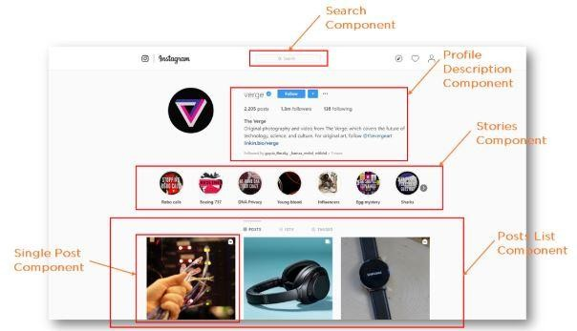

Slide 6
Introduction to Hooks

Slide 7

What are Hooks ?
(Ques.) What is Hook in General terms ?
(Ans.) a curved piece of metal, plastic, etc. that is used for hanging or catching something
Hooks are a new feature addition in React version 16.8 which allow you to use React features without having to write a class
Ex : State of a Component

Slide 8
Motivation behind
Hooks

Slide 9
Why Hooks ?
Reason 1: Classes confuse both people and machines
Understand how this keyword works in JavaScript
Remember to bind event handlers in class components
Classes don’t minify very well and make hot reloading very unreliable

Slide 10
Why Hooks ?
Reason 2: Itʼs hard to reuse stateful logic between components
There is no particular way to reuse stateful component logic
HOC (Higher Order Component) and render props patterns do address this problem but have to do some restructuring of components
Makes the code harder to follow
There is need a to share stateful logic in a better way

Slide 11
Why Hooks ?
Reason 3: Complex components become hard to understand
Create components for complex scenarios such as data fetching and subscribing to events
Related code is not organized in one place
Ex: Data fetching - In componentDidMount and componentDidUpdate
Ex: Event Listeners - In componentDidMount and componentWillUnmount
Because of stateful logic - Cannot break components into smaller ones

Slide 12
Types and Rules of
Using Hooks

Slide 13
Types
Built-In Hooks :
useState Hooks
useEffect Hook
useRef Hook
useCallback Hook
useMemo Hook
useContext Hook
useReducer Hook
Custom Hooks :
You can create your own custom hooks if you have stateful logic that is needed by multiple components in you application.

Slide 14
Rules
Hooks are normal JavaScript functions, but they impose some additional rules :
Hooks are called only at the top level of a component.
Do not call Hooks inside loops, conditions, or nested functions.
Hooks are called only from React functional Components.
Do not call Hooks from regular JavaScript functions.
There is one other way to call Hooks i.e. in your own custom Hooks

Slide 15
Let’s Implement our
First Hook

Slide 16
useState Hook
The useState() is a hook that allows you to have state variables in functional components.
Basically useSate is the ability to encapsulate local state in a functional component.
The useSate hook is a special function that takes the initial state as an argument and returns an array of two entries.
You pass the initial state to this function and it returns a variable with the current state value(not necessarily the initial state)and another function to update this value.

Slide 17
How to implement useState()
Import useState() :-
To use the useState hook, we first need to import it into our component.
import { useState } from “react”;
Initialize useState() :-
useState accepts an initial state and returns two values
The current state
A function that updates the state.
function FavoriteColor() {
const [ color, setColor ] = useState(“ ”);

Slide 18
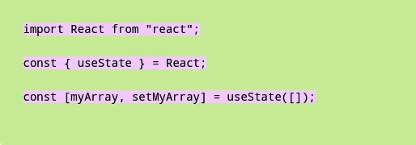
Creating an array state with useState
we destructure the return value of the useState() hook to get a variable that contains the state array and a method for updating the state.

Slide 19
Demo

Slide 20
References
To learn more about Hooks follow the below links : https://reactjs.org/docs/hooks-intro.html
You can find Free and Paid courses here : https://reactjs.org/community/courses.html

Slide 21



Thank You !

