Slide 1



Angular 7
A framework for Presentation Layer

Slide 2


Slide 3


Angular Routing

Slide 4
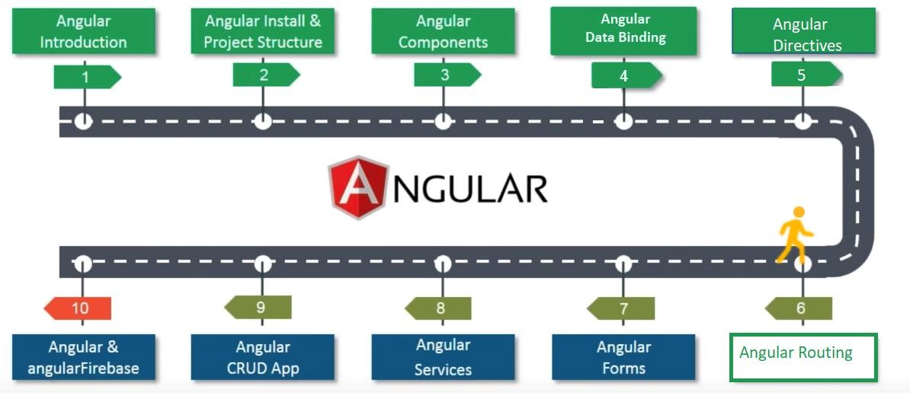
Angular Tutorial: Road Covered So Far

Slide 5
What is Angular Routing ?
Now we will discuss angular routing

Slide 6


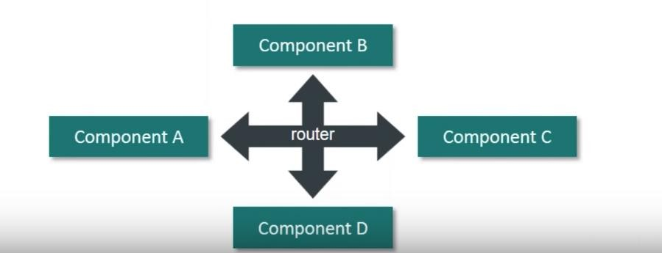
What are Angular Router?
Angular Router is vital part of any application.
Loads the corresponding components with respect to the requested route.
Allows us to control different routes, data and the components that render the data.

Slide 7
Demo
Now we will understand Router through Demo

Slide 8
Highlights of Demo
In this demo, we will do the following tasks:
A page with 3 routes (Home, About, User)
We should be able to navigate to the page assigned to each route.
On our “User” page, we should have a sub-route that navigates to a user page; all in the main “User” page.
Also, if we don’t provide any url route, it should navigate to the “homepage” automatically.
And if we type in a garbage url route (a url that doesn’t exist), it should also navigate to the homepage as well or a 404 page.

Slide 9
Component Generation
Now we will create 3 components

Slide 10
Component Generation
Let us generate the components home, about, userList & user as the following syntax
ng generate component home
ng generate component about
ng generate component userList
ng generate component user

Slide 11
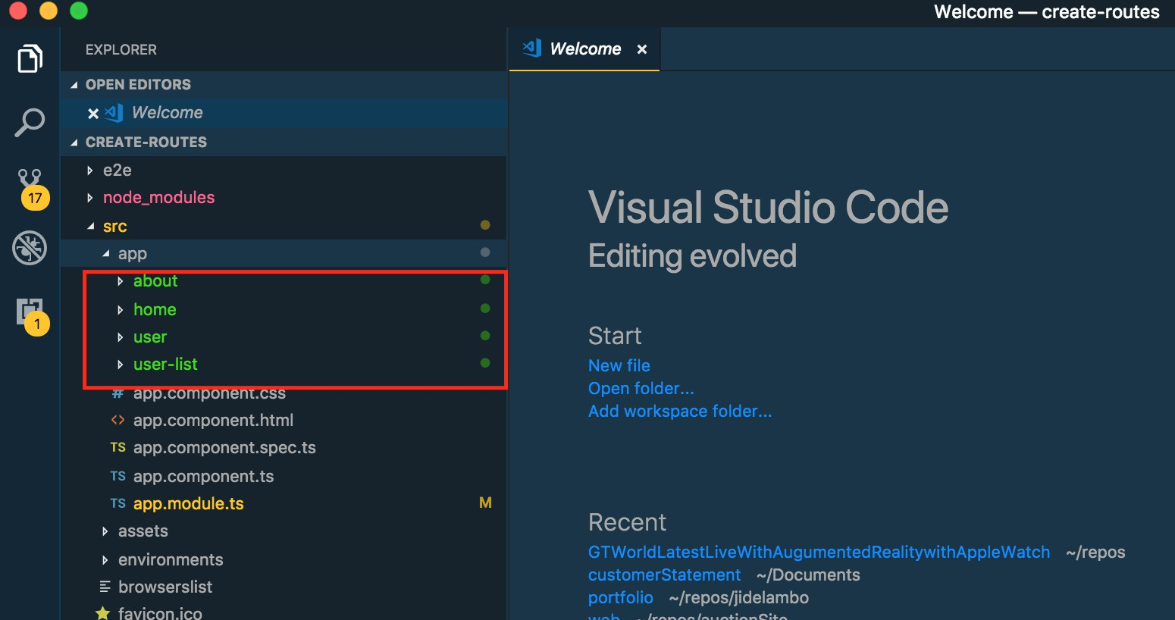
Component Generation

Slide 12
Routes Setup
Now we will setup routes

Slide 13
Routes Setup
Let’s set up the routes. The routes will be set up in app.module.ts.
Inside this file, all the 4 components we created earlier have been imported.
// app.module.ts
import { HomeComponent } from './home/home.component'; import { AboutComponent } from './about/about.component';
import { UserListComponent } from './user-list/user-list.component'; import { UserComponent } from './user/user.component';

Slide 14
Routes Setup
The 4 components have also been declared in the @NgModule declaration in our app.module.ts file.
basically, this helps us set the initial component property.
// app.module.ts
@NgModule({
declarations: [
AppComponent, HomeComponent, AboutComponent, UserListComponent, UserComponent
],

Slide 15
Routes Setup
We will need to import the router from the angular route library.
Now that we have imported the router, the routes have to be configured by creating an object (const appRoutes..).
This object will have all the information about the url path, components and redirect path for the
routes.
In next slide, we will do these tasks.

Slide 16
Routes Setup
import { HomeComponent } from './home/home.component'; import { AboutComponent } from './about/about.component'; import { UserListComponent } from './user-list/user-list.component'; import { UserComponent } from './user/user.component’;
import { RouterModule, Routes } from '@angular/router’;
const appRoutes: Routes = [
{path: 'home', component: HomeComponent},
{path: 'about', component: AboutComponent}
];

Slide 17
Routes Setup
We have defined the routes in our app.module.ts but we need to also import the route in the @NgModule
// app.module.ts
@NgModule({
declarations: [
AppComponent, HomeComponent, AboutComponent, UserListComponent, UserComponent
],
imports: [
BrowserModule, RouterModule.forRoot(appRoutes)
],

Slide 18
Routes Setup
We need to load all our new routes in the app.component.html.
Inside the <router-outlet></router-outlet> tag is where our project content loads in the file named app.component.html.
We also need to create our navigation links. Instead of using the typical html’s href in the a tag, it
should be replaced with routerLink.
The routerLink will link to the paths we earlier configured in the app.modules.ts

Slide 19
Routes Setup
// app.component.html<ul>
<ul>
<li>
<a routerLink="/home">Home</a>
</li>
<li>
<a routerLink="/about">About</a>
</li>
</ul>
<router-outlet></router-outlet>

Slide 20
Routes Setup
With the above solution,
if we click on the home link, it navigates to the Home-page,
while if we click on the about link, it navigates to the About-page.
But what happens when we browse to an empty url path localhost:4200 or an unavailable url path localhost:4200/sultan?
We won’t have any content loaded on the page because neither the empty path nor the unavailable path has been assigned a route yet.
So, let’s automatically make our empty/unavailable route navigate to the homepage. We will edit the app.module.ts to achieve this.

Slide 21
Routes Setup
// app.module.ts
import { HomeComponent } from './home/home.component'; import { AboutComponent } from './about/about.component'; import { UserListComponent } from './user-list/user-list.component'; import { UserComponent } from './user/user.component’;
import { RouterModule, Route } from '@angular/router’;
const appRoutes = [
{path: 'home', component: HomeComponent},
{path: 'about', component: AboutComponent},
//the empty path will be redirected to the home component
{path: '', redirectTo: '/home', pathMatch: 'full’},
//this path redirects to the home component
{path: '**', redirectTo: '/home', pathMatch: 'full’}
];

Slide 22
Sub-route creation
Now we will create sub-routes which will be in the user-list component and the list will contain users.

Slide 23
Sub-routes creation
// app.module.ts
import { RouterModule, Route } from '@angular/router’;
const appRoutes = [
{path: 'home', component: HomeComponent},
{path: 'about', component: AboutComponent},
//the empty path will be redirected to the home component
{path: '', redirectTo: '/home', pathMatch: 'full’},
//this path redirects to the home component
{path: '**', redirectTo: '/home', pathMatch: 'full’},
{path: 'user', children: [
{path: 'list', component: UserListComponent}
]}
];

Slide 24
Sub-routes cration
In the above snippets, we have a path called “user” with children.
The children is an array where we’ll define the children’s user list.
So when we click on the “user” link, it should navigate to localhost:4200/user/list and open the page
in the UserListComponent.
The So, let’s add some users to our user-list.component.ts. .

Slide 25
Sub-routes creation
// user-list.component.ts
import { Component, OnInit } from '@angular/core’;
@Component({
selector: 'app-user-list’,
templateUrl: './user-list.component.html’, styleUrls: ['./user-list.component.css']
})
export class UserListComponent implements OnInit { // adding some users
users = [
{ name: 'Maryann' },
{ name: 'Nife’ }
];
constructor() { } ngOnInit() {}
}

Slide 26
Sub-routes creation
In the user-list.component.html, we need to add these names using *ngFor in a list tag.
<div class="container">
<h2>UserList Page</h2>
<ul class="users">
<li *ngFor="let user of users" [routerLink]="[
'detail', user.name]">{{user.name}}
</li>
</ul>
</div>

Slide 27
Sub-routes Creation
With the above solution, We need to configure this new router-outlet in the app.module.ts
In the app.module.ts , add children to the UserListComponent route.
This new children route will be an array of the new user’s detail path.
The new user path will pass a parameter;
in this case, “name” as seen in {path: ‘detail/:name’, component: UserComponent}

Slide 28
Sub-routes creation
// app.module.ts.....
import { RouterModule, Route } from '@angular/router’;
const appRoutes = [
{path: 'home', component: HomeComponent},
{path: 'about', component: AboutComponent},
{path: '', redirectTo: '/home', pathMatch: 'full’},
{path: '**', redirectTo: '/home', pathMatch: 'full'},//this 'user' path has children
{path: 'user', children: [
{path: 'list', component: UserListComponent, children: [
{path: 'detail/:name', component: UserComponent}
]}
]}
];

Slide 29
Sub-routes Creation
When the user name renders, it needs to have a name pass through to the user page.
So, in the user.component.ts, we need to grab parameters in the routerLink from user- list.component.html .
In the user.component.ts , we need to import ActivatedRoute, and activate new parameters.

Slide 30
Sub-routes creation
// user.component.ts
import { Component, OnInit } from '@angular/core'; import { ActivatedRoute } from '@angular/router’;
@Component({
selector: 'app-user’,
templateUrl: './user.component.html’,
styleUrls: ['./user.component.css']
})
}
export class UserComponent implements OnInit {
name: any;
sub: any;
constructor(private route: ActivatedRoute) { } ngOnInit() {
this.sub = this.route.params.subscribe(params
=> {
this.name = params['name’];
});
}
}

Slide 31
Sub-routes creation
// user.component.html
<div class="container">
<h2>User Page</h2>
<h3>Name: {{name}}</h3>
</div>

Slide 32

Any question?

Slide 33

Thank You

