Slide 1


Self-driving Turtlebot3
Mid-way Presentation
Topic : 06
Group members:
Sai Bharadhwaj Matha 22206819
Divine George Ninan 22202893
Gokul Soman 22209582
Alana Lakshmi Sajan 22205624
Don Mathew 12202332
Under the guidance of
Prof. Dobriborsci Dmitrii

Slide 2
Contents
Project Description
Project Goals.
Hardware ~ Turtlbot3 Burger
Software
Perception
Processing Data
Decision making and Control
References

Slide 3
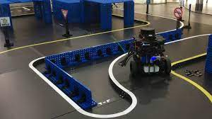
Project Description
The Turtlebot3 burger robot should be able to drive in an environment without any human intervention.
Autonomous driving has significant challenges in the detection of objects in a natural environment.
The scope is to use ROS for turtlebot3 burger to implement autonomous driving like lane following etc.
The model should be simulated on a virtual environment using Gazebo and Rviz.
The tested algorithm and code to be implemented on a physical robot available in the lab.

Slide 4
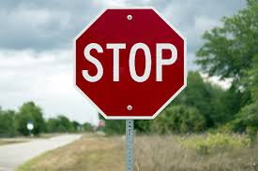
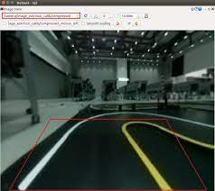
Project Goals
The robot should acquire the ability of
Perception of the environment.
Process the sensor data.
Decision-making ability.
Control Algorithm
The robot should be capable of doing
Lane Detection and Following.
Traffic lights and traffic sign detection.
Obstacle avoidance**.
Lane changing**.

Slide 5
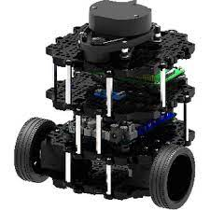
Hardware
TurtleBot3 burger is a small and affordable mobile robot. Some major components include,
Raspberry Pi 3B+ (single-board computer)
OpenCR (microcontroller board)
360 LIDAR (Laser scanner)
Lithium Polymer (Li-Po) battery
Wi-Fi dongle
And neccessay cables, chargers, connectors.
Additionally,
We can also have a
Raspberry pi-camera
RGB camera
Depth camera
Manipulator arm

Slide 6


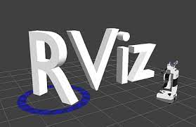

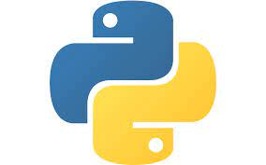
Software and packages
Robot Operating System(ROS) : Open source software for robotic applications
ROS packages and messages : Develop custom package for controlling and communicating with the Robot
Gazebo : Simulation environment for virtual testing.
Rviz or Rqt: visualization tool that aids in visualization and interact with robot's sensor data and behaviour.
OpenCV : Computer vision library for image processing
Programming language : Python

Slide 7
Perception
To navigate, the turtlebot3 robot needs to have an awareness of the environment it is placed.
On TB3_burger, we have LiDAR, IMU, Camera, Encoder and a few other sensors.
For Lane Following and traffic light/sign detection,
IMU and Encoder sensors provide the acceleration, velocity, orientation of the robot.
The camera feeds images of the track to follow.
The track has an yellow strip on the left and white on the right(in reference with Autorace package).
For further tasks like object detection and lane changing
LiDAR and possibly a depth camera can be used.

Slide 8
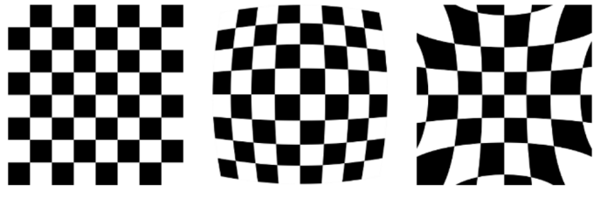
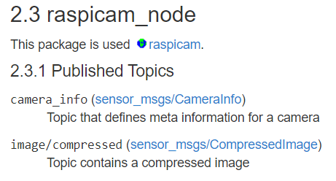
Perception
The camera needs to be calibrated[1].
Intrinsic calibration -> focal length, distortion, skew
Can be done using checkerboard
Extrinsic calibration -> lightness, hue, saturation(HSL), selection of the region of interest, and left and right lane visibility
Apply Hough transform on bird’s eye view to detect the lane.
We can get the relevant information by subscribing to ROS topics.

Slide 9
Processing sensor data
In ROS, nodes can send and receive ROS messages.
The image format is not the same as that of required by OpenCV[2].
The data is pre-processed to extract features and reduce noise.
The parameter tuning requires HSL color space rather than RGB.
For traffic lights, a blob detection is used and matched with the mask.
Subscribe to image topic
Image message
CV_bridge conversion
CV Image processing
CV_bridge conversion
Publish Image

Slide 10
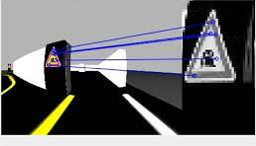
Processing sensor data
For traffic sign detection Brute Force or FLANN technique with SIFT algorithm[3].
A reference image of traffic sign is stored. The same sign is used on track.
Feature matching algorithm on reference image and sign.
The message is published on sensor_msgs.
The messages from IMU are prone to noise and drift.
Before publishing
Correct for bias
Remove noise
Integrate to get accurate estimates.

Slide 11
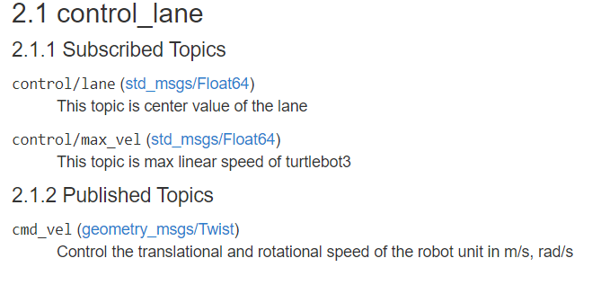
Decision-making and Control
Once the sensor messages are perceived, processed and published, they can be subscribed and be acted on.
For Lane detection, the decision to turn and follow the lane has to be taken.
The error/deviation can be fed into a PID control loop and the cmd_vel can be adjusted accordingly.
For traffic lights and sign detection, based on the processed information and published messages, the necessary control is taken.

Slide 12
Current Work Status
Literature review and understanding of relevant topics
Created our ROS package with standard dependencies.

Slide 13
References
[1] https://yzrobot.github.io/mobile_robotics/A20-TO52-driving.pdf
[2] K. Khnissi, C. Seddik, and H. Seddik, “Smart navigation of mobile robot using neural network controller,” in Proc. Int. Conf. on Smart Communications in Network Technologies, 2018, pp. 205-210.
[3] https://docs.opencv.org/4.x/da/df5/tutorial_py_sift_intro.html
[4] https://emanual.robotis.com/docs/en/platform/turtlebot3/autonomous_driving/#autonomous-driving
[5] https://github.com/ROBOTIS-GIT/turtlebot3_autorace

