Slide 1
Prepared By :-
Kashyap Bharad - 92500584001
Dhaval Parmar - 92500584066
Chirag Pandya - 92500584070
Internal Guide: Dr. Jaypalsinh Gohil
StudyStore
Online Stationery Shopping System
Master of Computer Applications (MCA) — Marwadi University

Slide 2
Introduction to Project
StudyStore is a full-stack web application developed to provide an online platform for purchasing stationery products.
Customers can browse products, search items, add products to their wishlist or shopping cart, and place orders through a simple web interface.
Provides an administrator panel for managing products and customer orders.
Built using the MERN Stack — React.js (Vite) for the frontend, Node.js and Express.js for the backend, and MongoDB Atlas for the database.
JWT is used for user authentication, bcryptjs for password encryption, and Nodemailer for email-based password recovery.
Aims to simplify the online purchase of stationery products through a dedicated, focused platform.

Slide 3
Preamble
Many online shopping websites sell stationery products along with several other categories, making it difficult for users to quickly find what they need.
There is a need for a dedicated stationery shopping platform focused solely on stationery products.
StudyStore allows customers to browse, search, and place orders in a simple and organized environment.
The system also provides administrators with a centralized platform to manage products and customer orders.
The application demonstrates the practical implementation of full-stack web development using the MERN Stack.

Slide 4
Module Description
User Authentication Module
User Profile Module
Product Management Module
Search and Category Filter Module
Wishlist Module
Shopping Cart Module
Order Management Module
Admin Dashboard Module
Password Recovery Module

Slide 5
Review of Literature
Purpose of Study
Analyze existing online shopping and stationery platforms.
Study their major features, product organization, and shopping workflows.
Identify strengths and limitations of existing systems.
Use the findings as a reference for developing StudyStore as a focused, dedicated platform.
Existing Systems Studied
Amazon, Flipkart, Meesho (general e-commerce)
Scooboo, Odd Giraffe, Hindustan Stationery (dedicated stationery)

Slide 6
Technical Description
Hardware Requirement
Component | Requirement
Processor | Intel Core i3 or Higher
RAM | 4 GB Minimum (8 GB Recommended)
Storage | 10 GB Free Disk Space
Display | 1366 x 768 Resolution or Higher
Internet Connection | Required
Software Requirement
Software / Technology | Purpose
React.js + Vite | Frontend Development
Node.js + Express.js | Backend Development
MongoDB Atlas + Mongoose | Database Management
JWT + bcryptjs | Authentication & Password Encryption
Nodemailer | Email Service
Postman / Git & GitHub | API Testing & Version Control

Slide 7
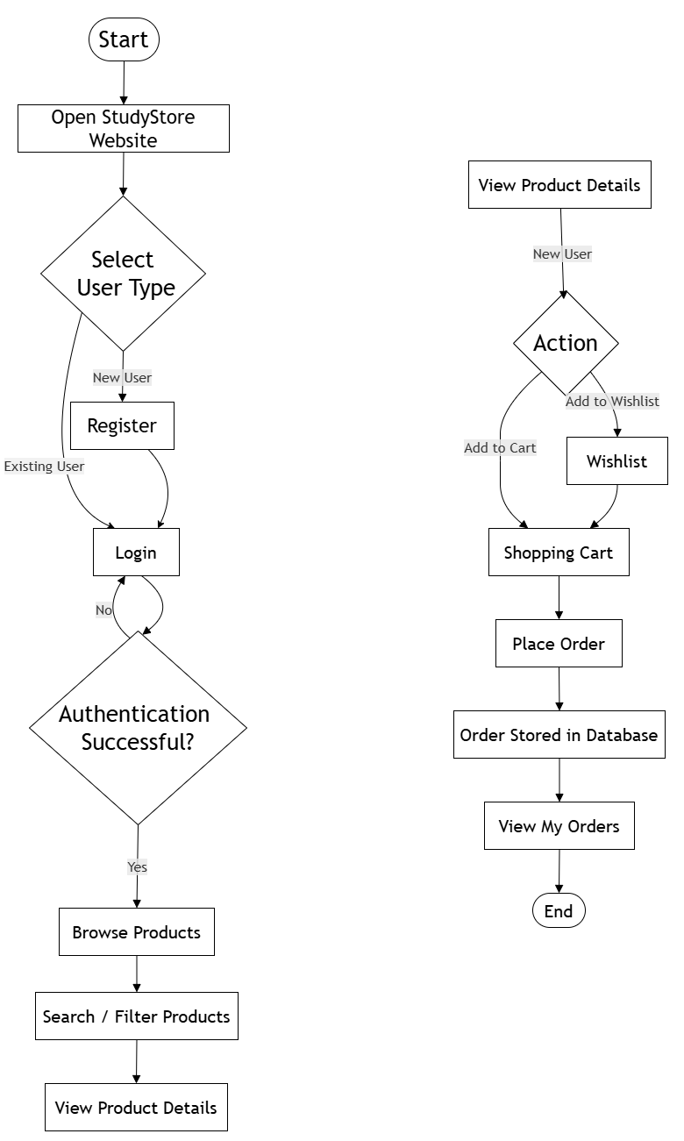
System Design and Development
Figure 5.1: Customer Flowchart of StudyStore

Slide 8
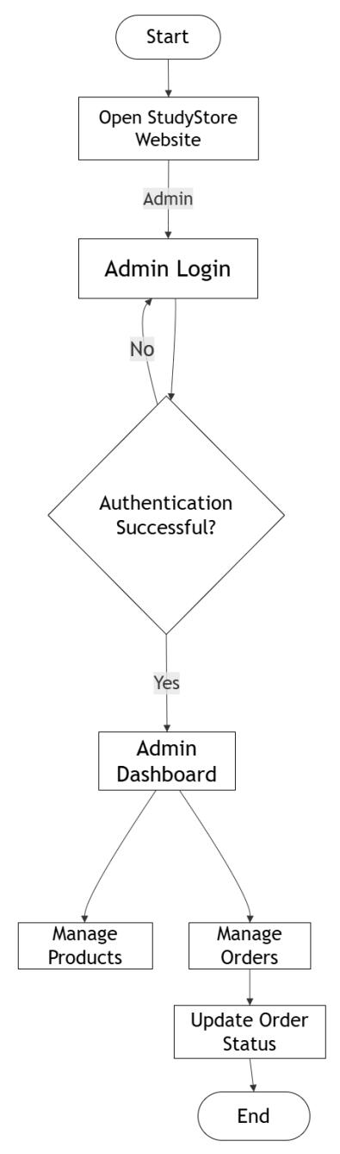
System Design and Development
Figure 5.2: Administrator Flowchart of StudyStore

Slide 9
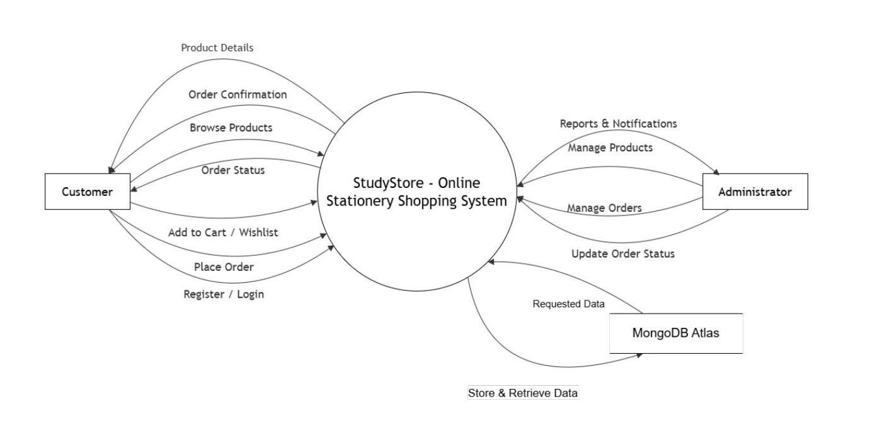
System Design and Development
Figure 5.3: Context Diagram of StudyStore

Slide 10
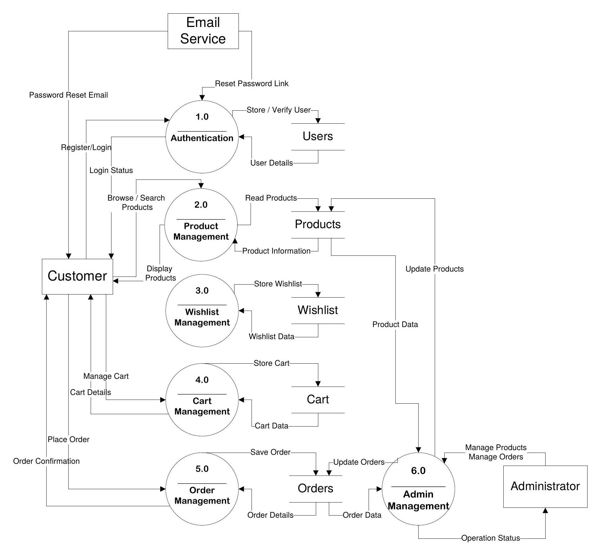
System Design and Development
Figure 5.4: Level 1 Data Flow Diagram of StudyStore

Slide 11
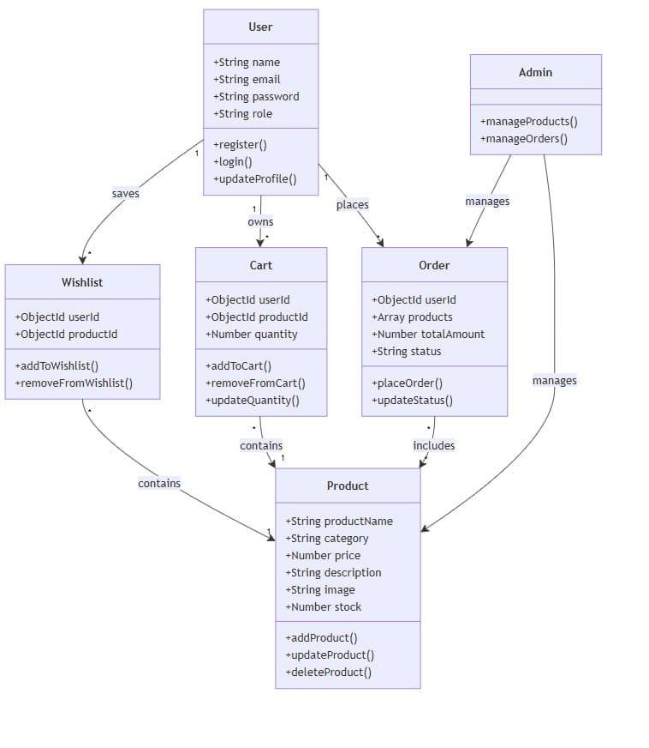
System Design and Development
Figure 5.5: Class Diagram of StudyStore

Slide 12
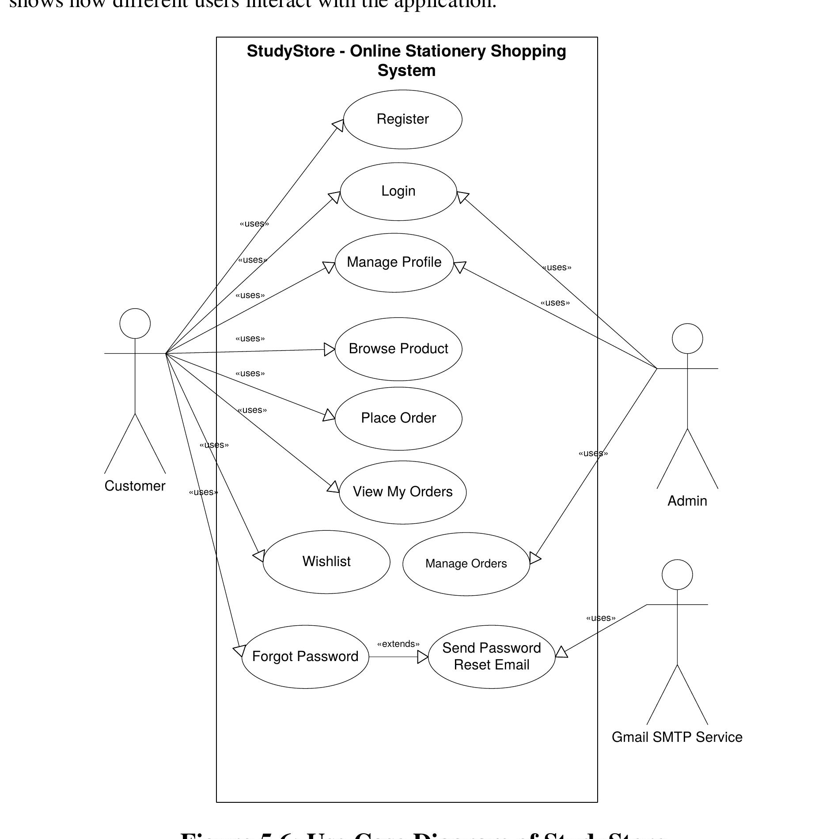
System Design and Development
Figure 5.6: Use Case Diagram of StudyStore

Slide 13
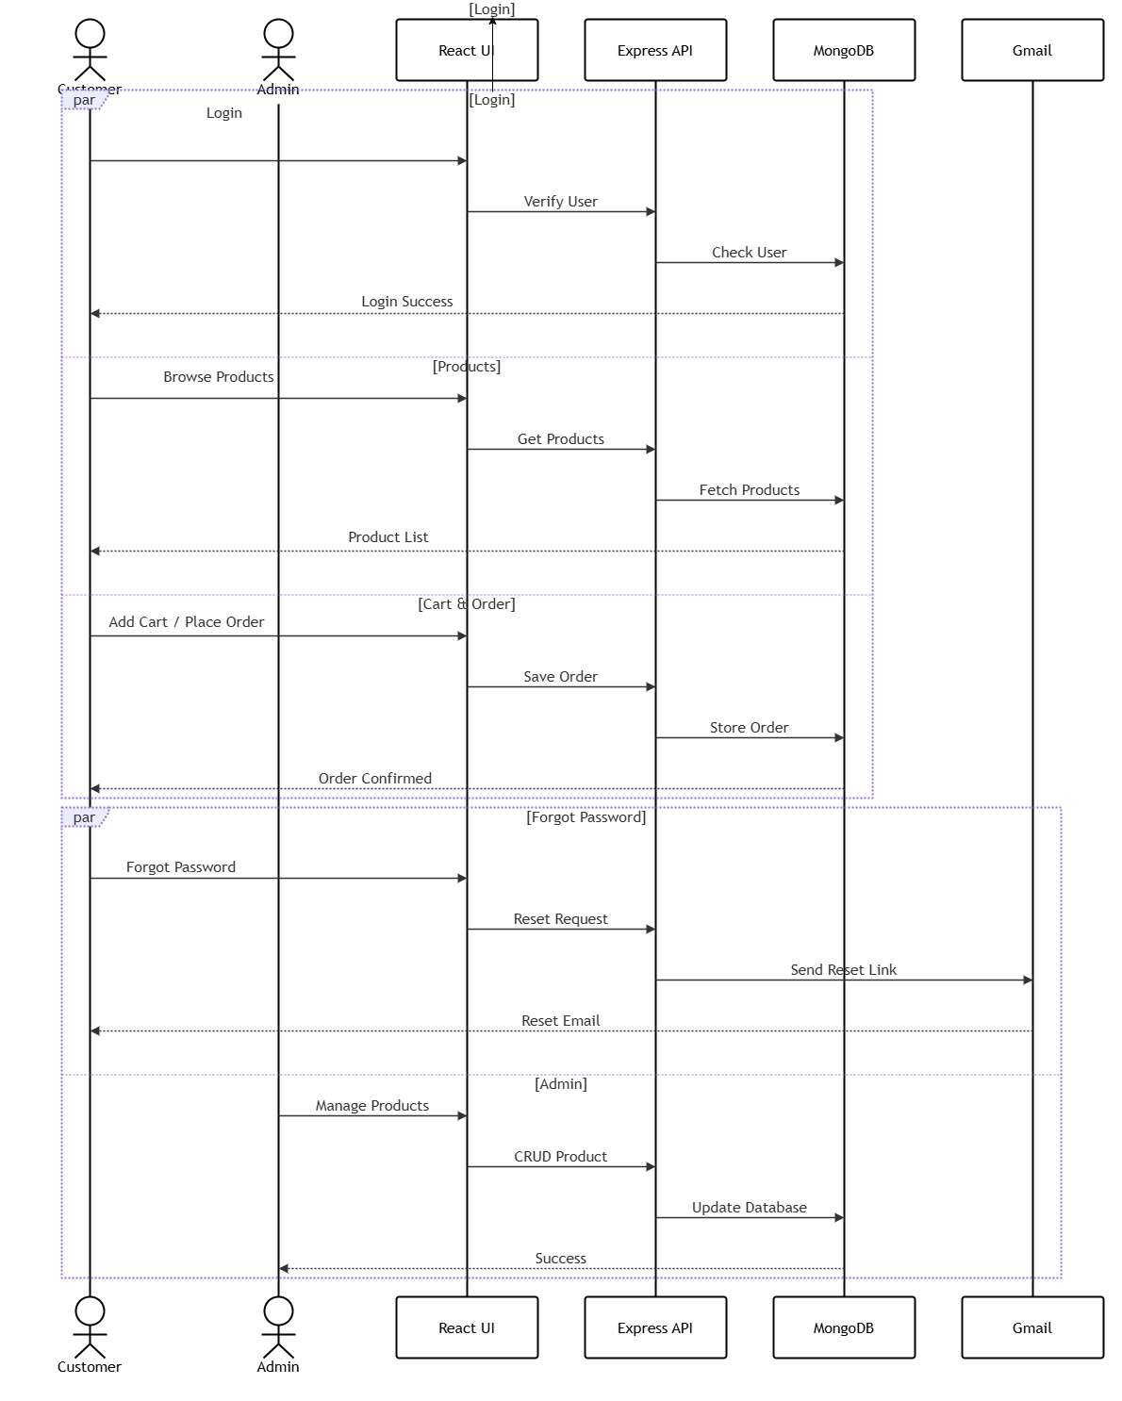
System Design and Development
Figure 5.7: Sequence Diagram of StudyStore

Slide 14
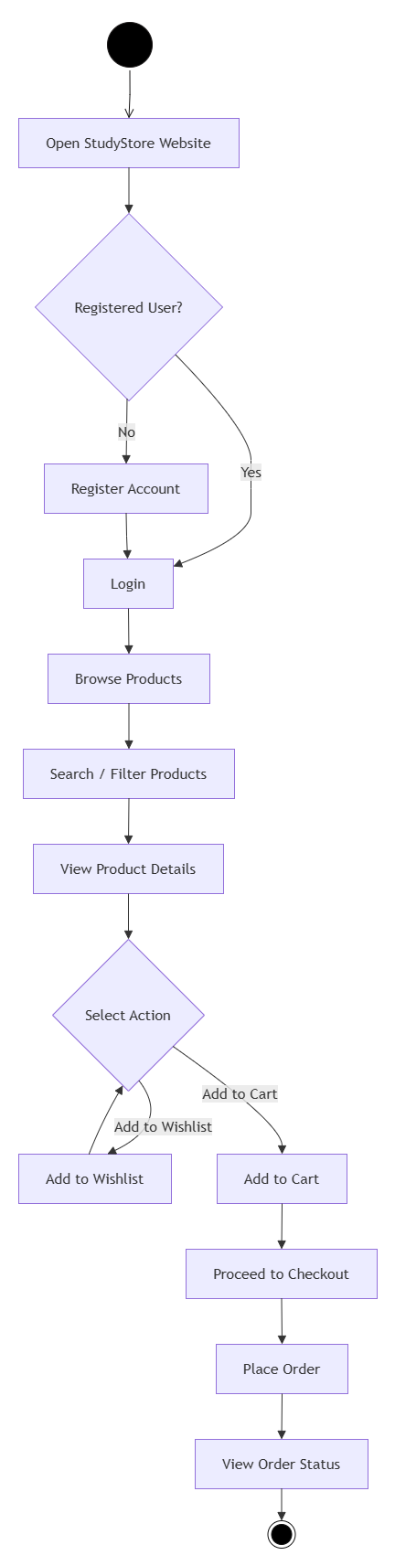
System Design and Development
Figure 5.8: Customer Activity Diagram of StudyStore

Slide 15
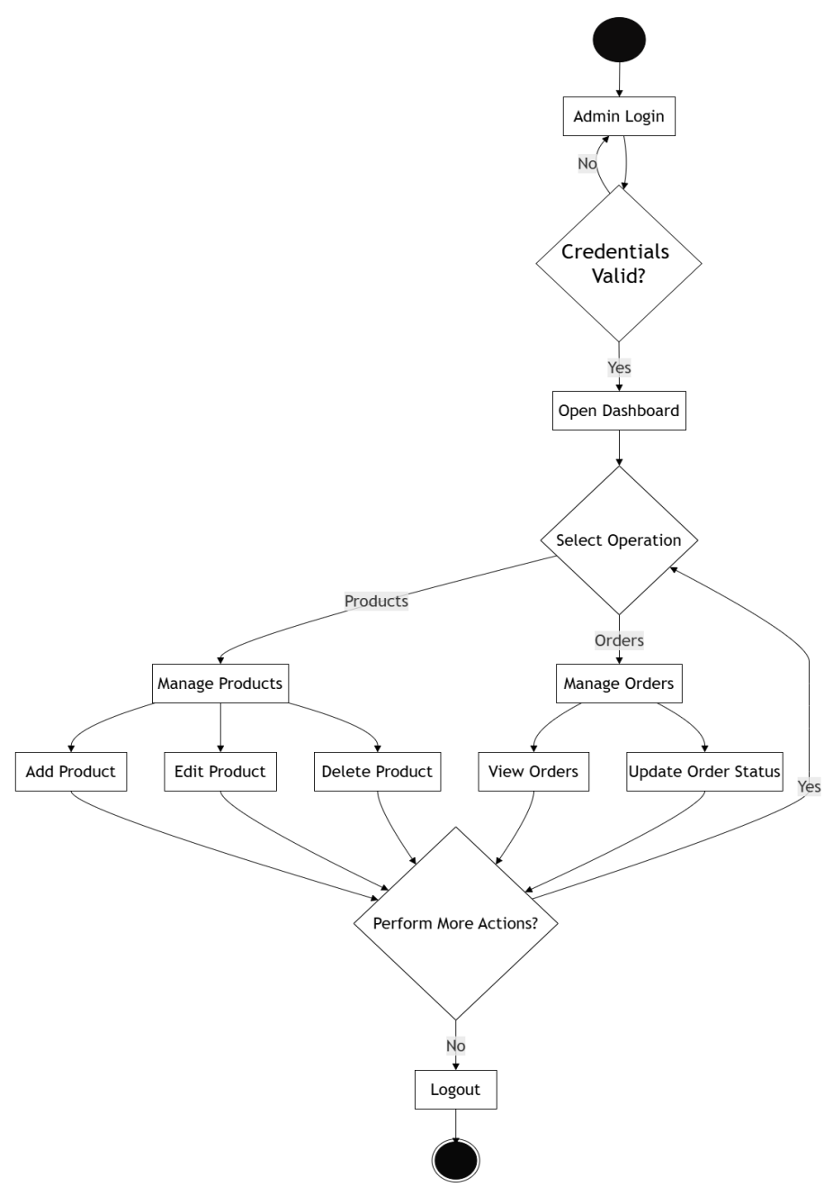
System Design and Development
Figure 5.9: Administrator Activity Diagram of StudyStore

Slide 16
Database Design
Users Collection
Field Name | Data Type | Description
_id | ObjectId | Unique identifier of the user
name | String | Full name of the user
email | String | Unique email address
password | String | Encrypted password using bcryptjs
phone | String | Contact number
address | String | Delivery address
role | String | User role (User/Admin)
createdAt | Date | Account creation date

Slide 17
Database Design
Wishlist Collection
Field Name | Data Type | Description
_id | ObjectId | Unique wishlist identifier
userId | ObjectId | Reference to the user
productId | ObjectId | Reference to the product
createdAt | Date | Date when the product was added

Slide 18
Database Design
Products Collection
Field Name | Data Type | Description
_id | ObjectId | Unique product identifier
productName | String | Name of the product
description | String | Product description
category | String | Product category
price | Number | Product price
image | String | Product image path or URL
stock | Number | Available product quantity
createdAt | Date | Product creation date

Slide 19
Database Design
Cart Collection
Field Name | Data Type | Description
_id | ObjectId | Unique cart identifier
userId | ObjectId | Reference to the user
productId | ObjectId | Reference to the product
quantity | Number | Quantity selected by the user
totalPrice | Number | Total price of the selected quantity
createdAt | Date | Date when the product was added to the cart

Slide 20
Database Design
Orders Collection
Field Name | Data Type | Description
_id | ObjectId | Unique order identifier
userId | ObjectId | Reference to the user
products | Array | List of ordered products
totalAmount | Number | Total amount of the order
shippingAddress | String | Delivery address
paymentMethod | String | Payment method (Cash on Delivery)
orderStatus | String | Current order status
orderDate | Date | Date of order placement

Slide 21
Database Design
Collection Relationships
Parent Collection | Child Collection | Relationship
Users | Wishlist | One user can save multiple wishlist items
Users | Cart | One user can have multiple cart items
Users | Orders | One user can place multiple orders
Products | Wishlist | One product can appear in multiple wishlists
Products | Cart | One product can appear in multiple shopping carts
Products | Orders | One product can be included in multiple orders

Slide 22
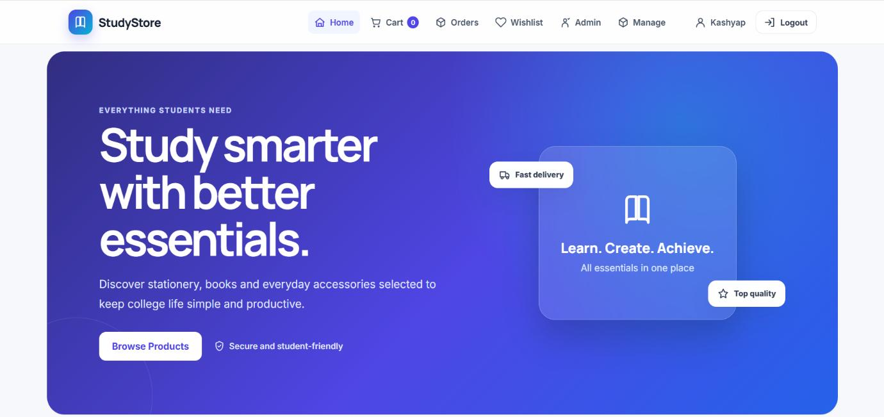
Screen Design
Home Screen

Slide 23
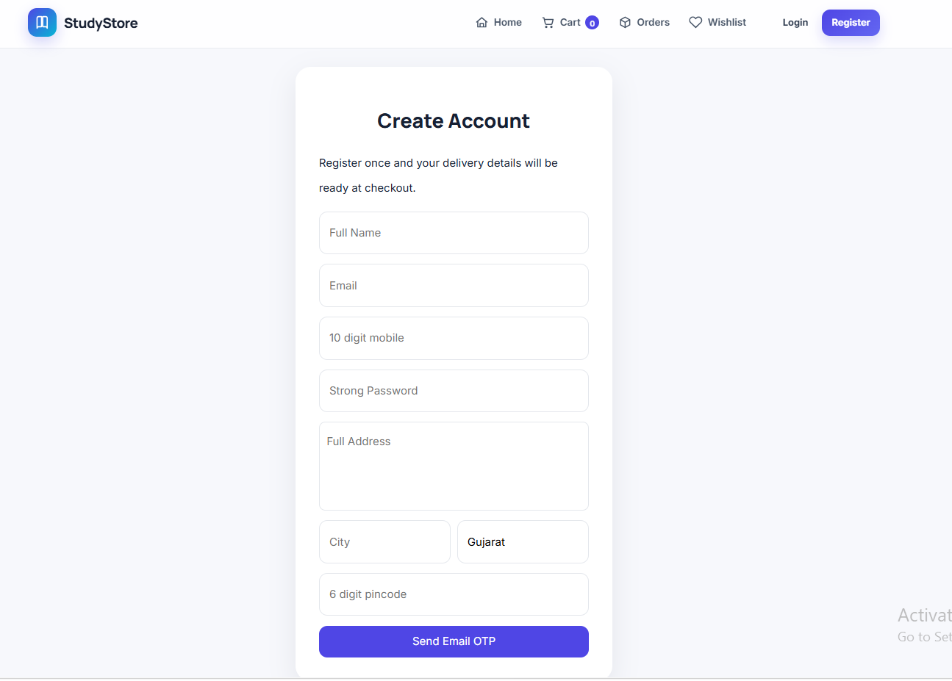
Screen Design
Registration Screen

Slide 24
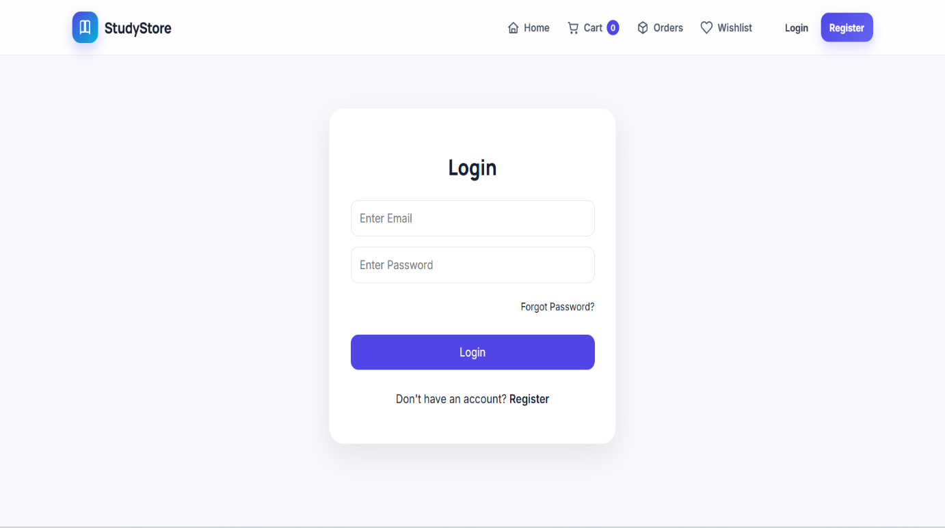
Screen Design
Login Screen

Slide 25
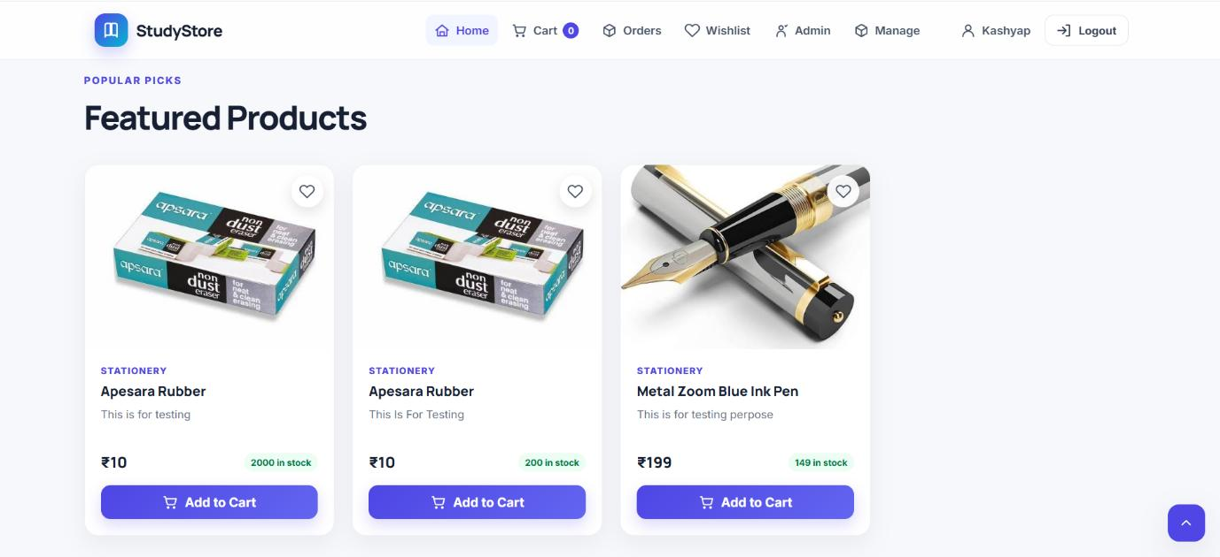
Screen Design
Product Listing Screen

Slide 26
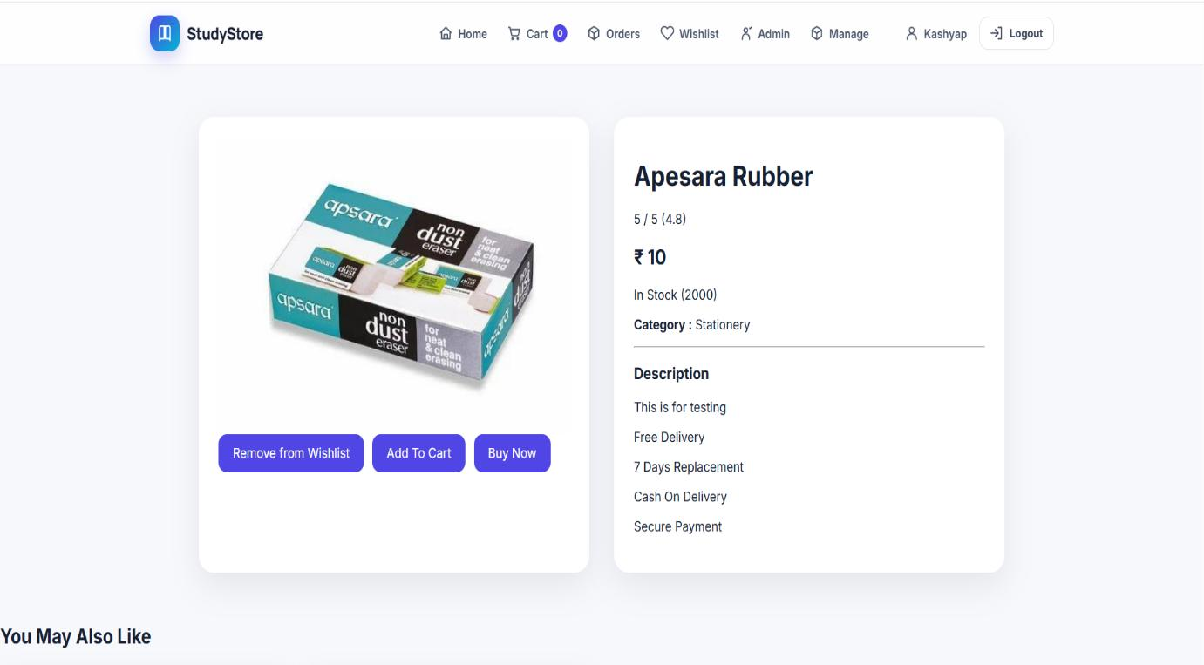
Screen Design
Product Details Screen

Slide 27
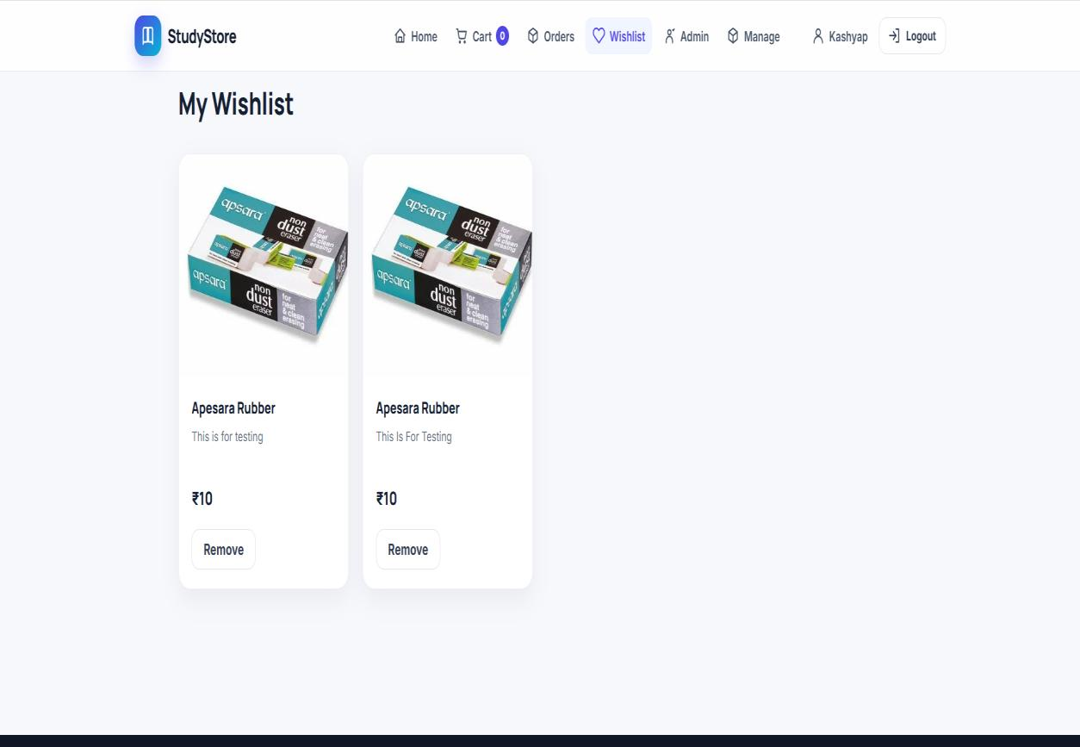
Screen Design
Wishlist Screen

Slide 28
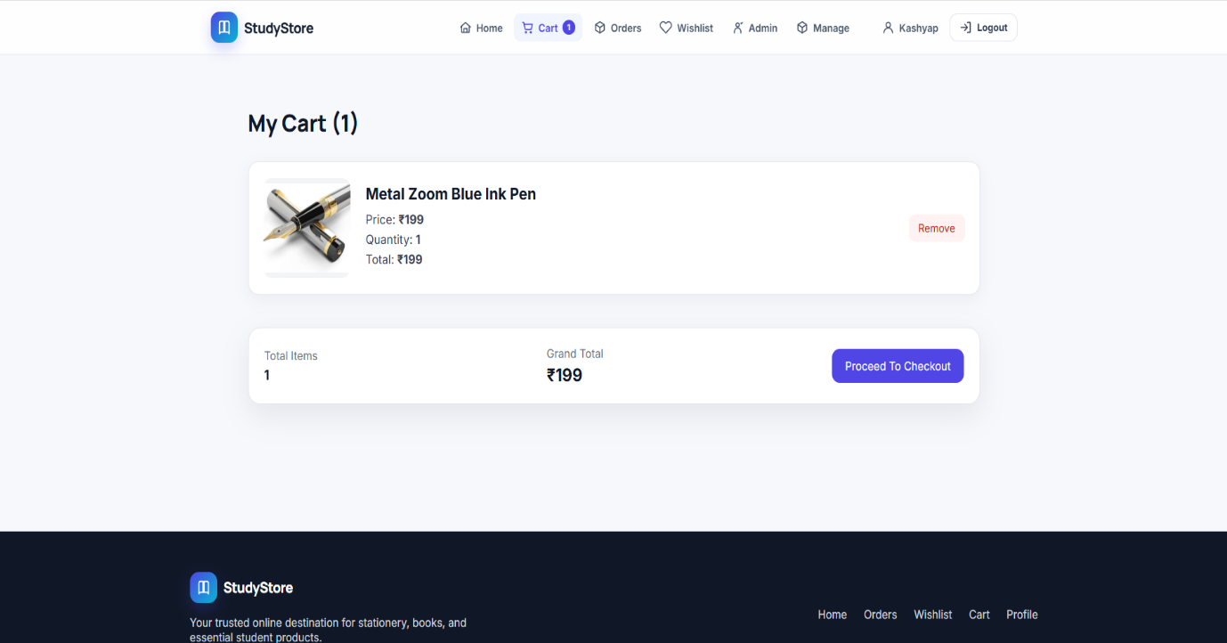
Screen Design
Shopping Cart Screen

Slide 29
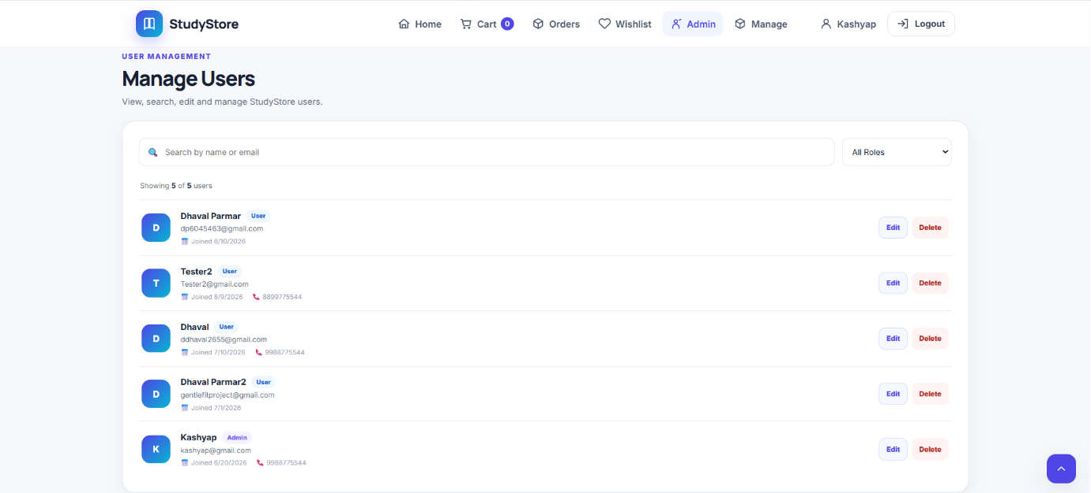
Screen Design
User Management Screen

Slide 30
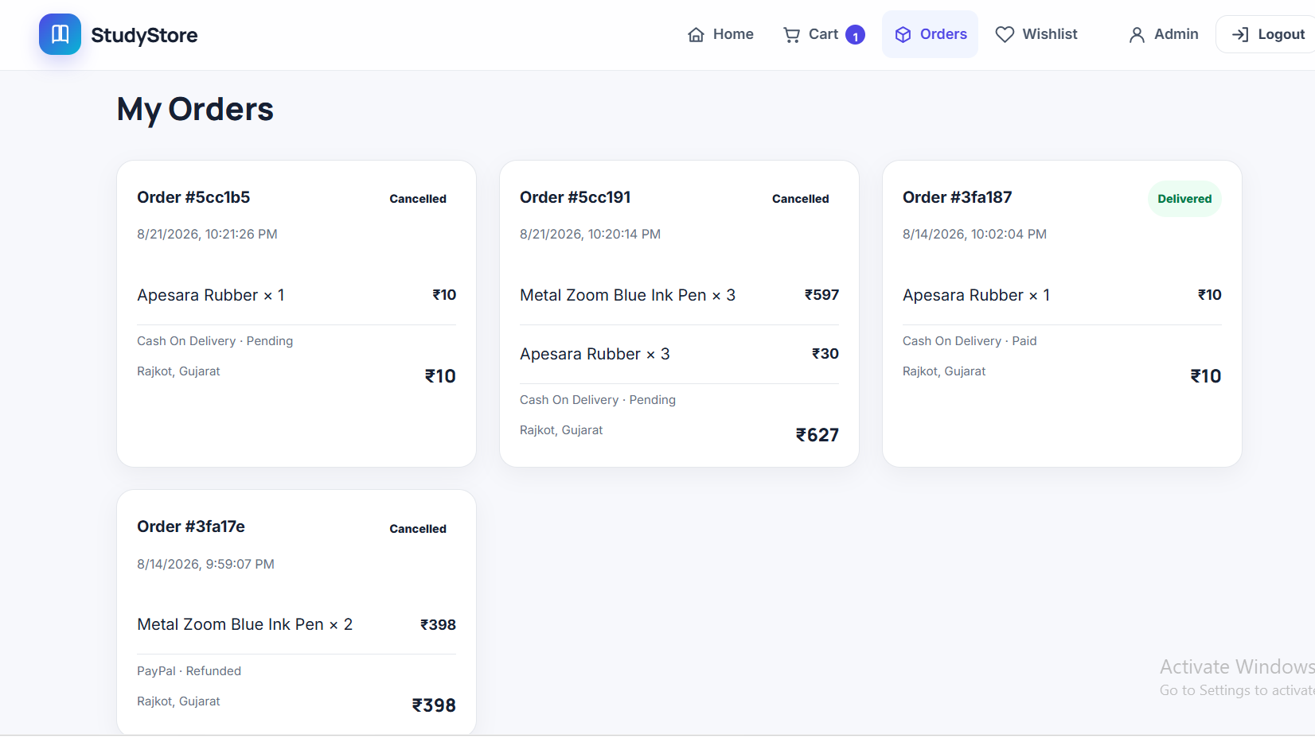
Screen Design
My Orders Screen

Slide 31
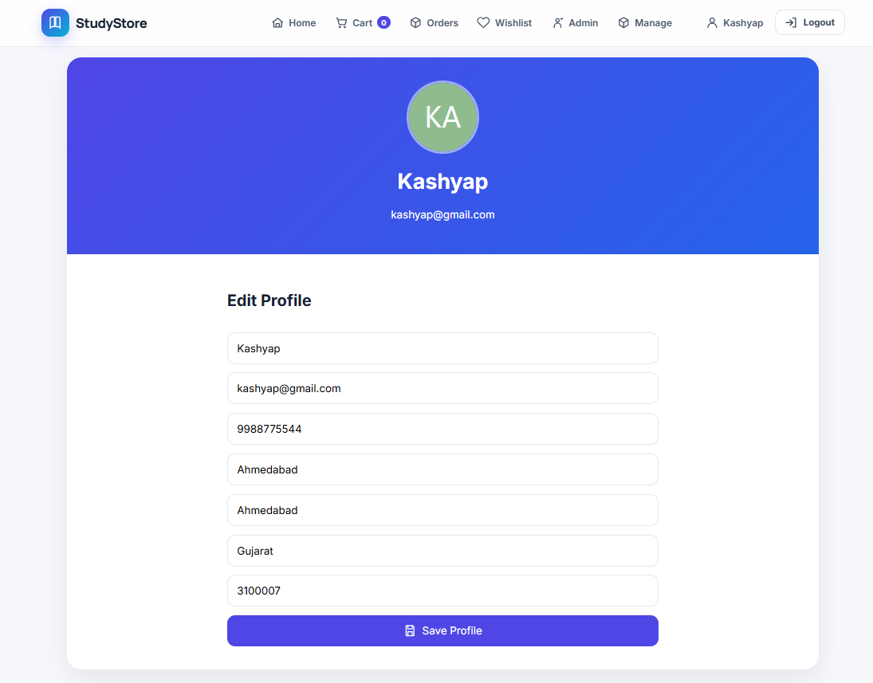
Screen Design
Profile Screen

Slide 32
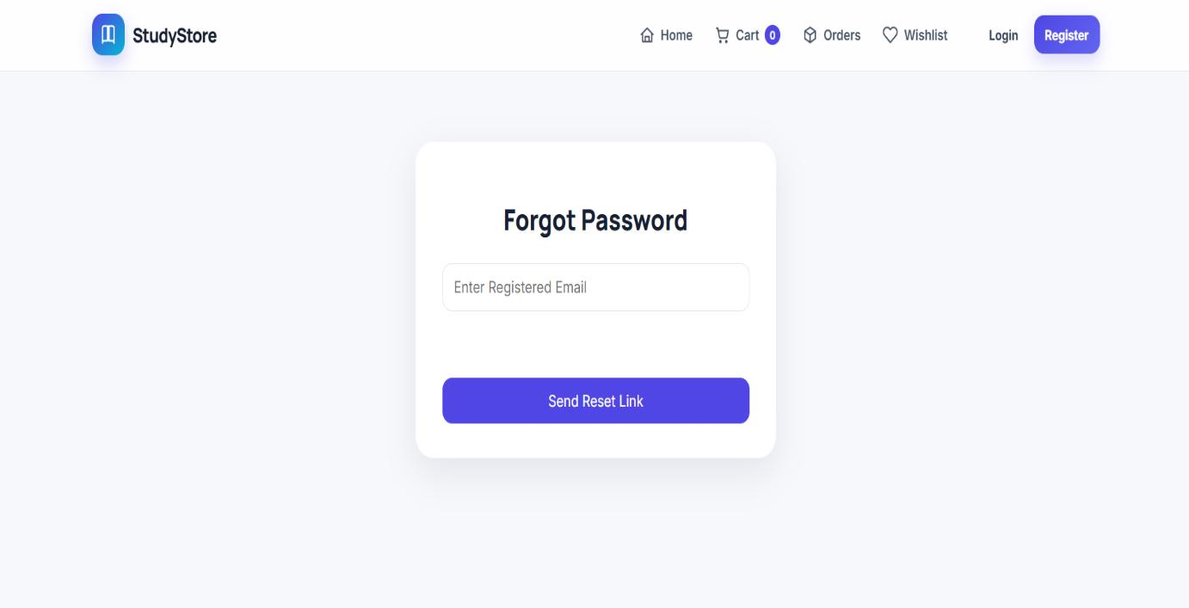
Screen Design
Forgot Password Screen

Slide 33
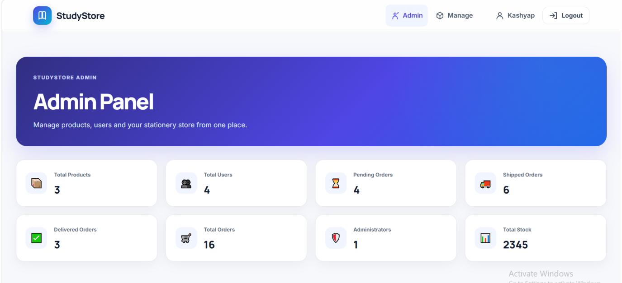
Screen Design
Admin Dashboard Screen

Slide 34
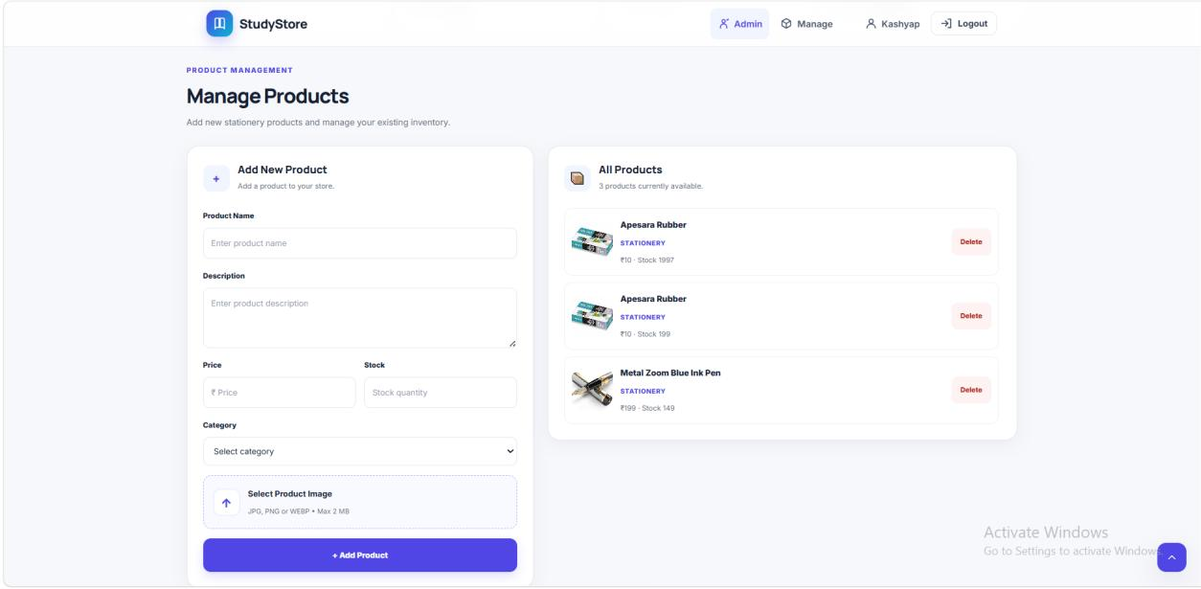
Screen Design
Product Management Screen

Slide 35
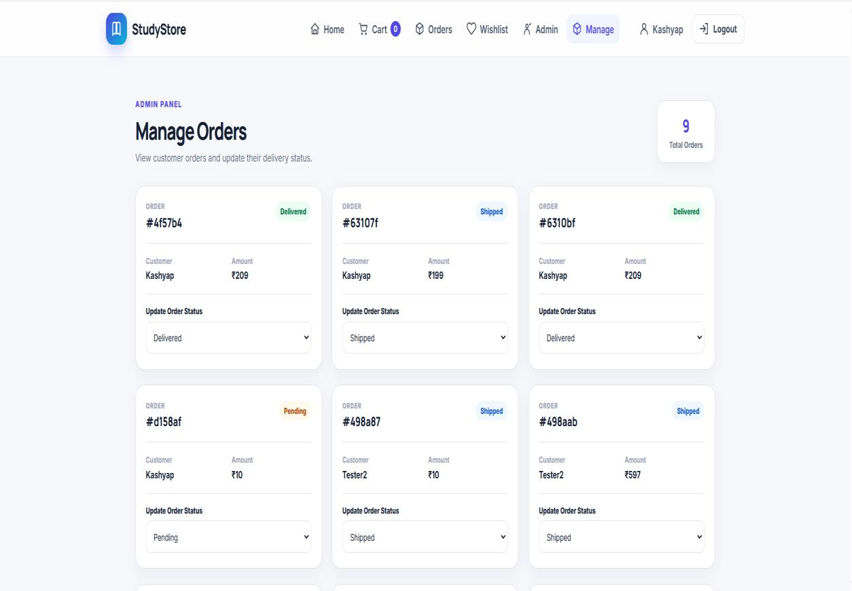
Screen Design
Order Management Screen

Slide 36
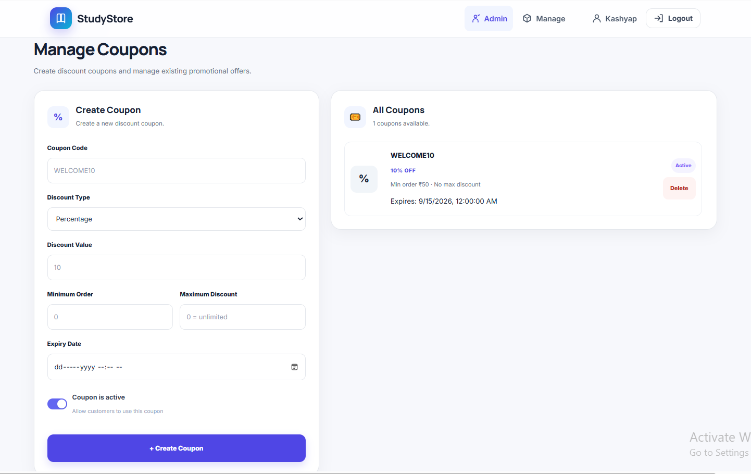
Screen Design
Coupon Management Screen

Slide 37
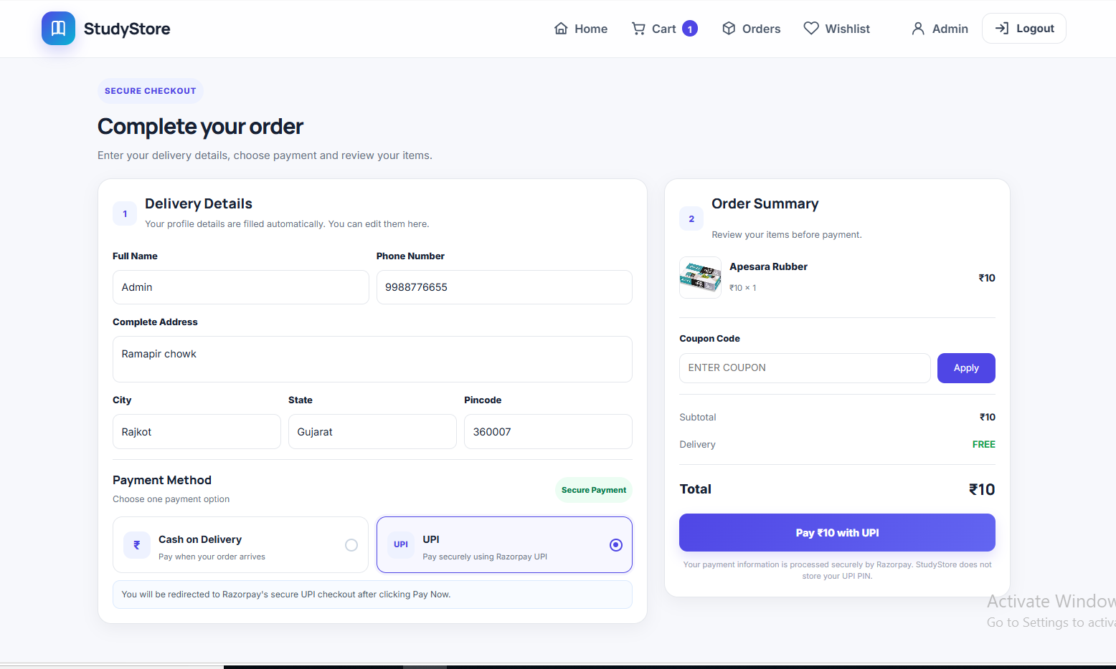
Screen Design
Checkout Screen

Slide 38
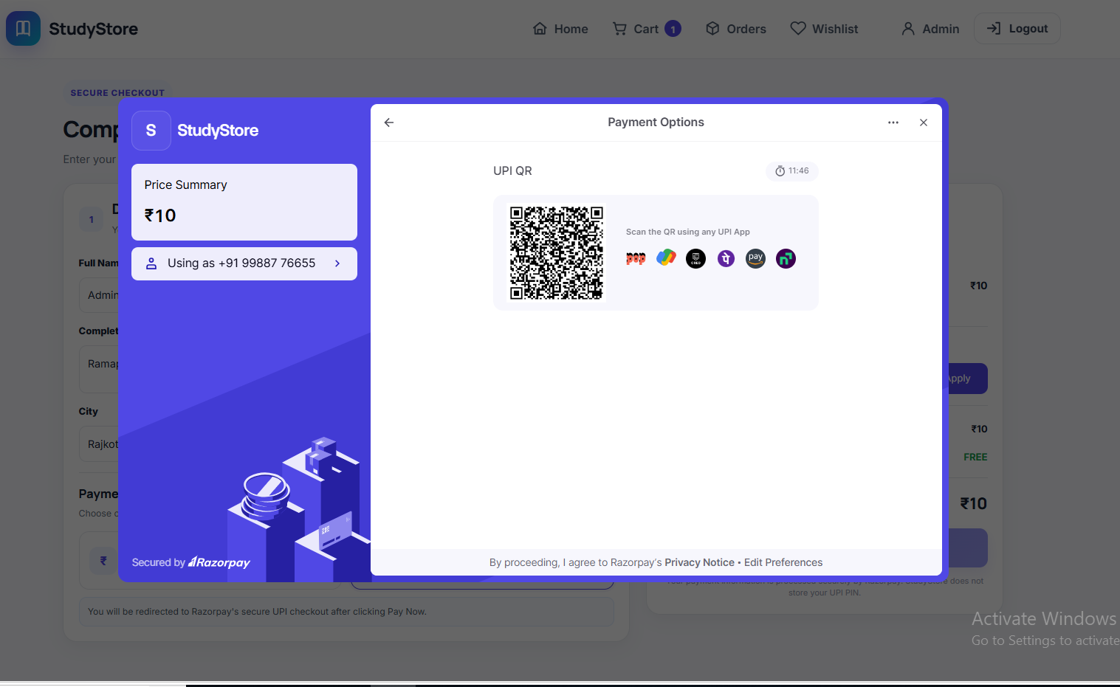
Screen Design
Razorpay UPI Payment Screen

Slide 39
Project Overview
1. User Registration & Login
Users can create a new account with their details.
JWT authentication protects user sessions; passwords are hashed with bcryptjs.
Users can manage their profile information.
2. Product Browsing, Search & Wishlist
Customers browse products with category filters and keyword search.
Products can be saved to a personal wishlist for future purchase.
3. Shopping Cart & Checkout
Products can be added to the cart, with quantities updated before checkout.
Checkout supports Cash on Delivery and secure UPI payments via Razorpay.

Slide 40
Project Overview
4. Order Placement & Tracking
Orders are created from the shopping cart and stored in MongoDB Atlas.
Customers can view order history and track current order status.
5. Admin Dashboard
Administrators can add, edit, or delete products and manage stock.
Order status can be updated, and discount coupons can be created and managed.
6. Password Recovery
Users can reset a forgotten password through an email link sent using Nodemailer.

Slide 41
System Testing
Test Cases (TC-01 to TC-05)
Test ID | Module | Scenario | Expected Result | Status
TC-01 | Registration | Register with valid details | Account created successfully | Pass
TC-02 | Login | Login with valid credentials | User logged in successfully | Pass
TC-03 | Forgot Password | Enter registered email | Reset link sent to email | Pass
TC-04 | Product Search | Search product by keyword | Matching products displayed | Pass
TC-05 | Wishlist | Add product to wishlist | Product added to wishlist | Pass

Slide 42
System Testing
Test Cases (TC-06 to TC-10)
Test ID | Module | Scenario | Expected Result | Status
TC-06 | Shopping Cart | Add product to cart | Product added to cart successfully | Pass
TC-07 | Place Order | Place order from cart | Order placed and stored successfully | Pass
TC-08 | My Orders | View previously placed orders | Order history displayed correctly | Pass
TC-09 | Product Management | Admin adds/edits/deletes product | Product updated successfully | Pass
TC-10 | Order Management | Admin updates order status | Updated status displayed correctly | Pass

Slide 43
Conclusion
Successfully developed a complete online stationery shopping application using the MERN Stack.
Implemented customer features: registration, login, product browsing, wishlist, cart, and order placement.
Designed an administrator dashboard for efficient product and order management.
Applied JWT authentication, bcryptjs password encryption, and Nodemailer for account management.
Developed a structured MongoDB Atlas database for efficient data storage and retrieval.
Implemented RESTful APIs enabling smooth communication between frontend and backend.
Followed software engineering practices including system design, UML diagrams, and testing.

Slide 44
Learning During Project Work
Gained practical experience developing a full-stack web application using the MERN Stack.
Learned to design responsive user interfaces using React.js and Vite.
Improved backend development skills using Node.js and Express.js.
Acquired hands-on experience with MongoDB Atlas for cloud database management.
Learned JWT-based authentication, password encryption, and email-based password recovery.
Improved knowledge of Git and GitHub for version control and collaboration.
Enhanced understanding of UML diagrams, database design, and software testing.

Slide 45
Future Enhancement
Integrate additional online payment gateways such as Stripe.
Implement inventory and stock management with low-stock notifications.
Add product ratings and customer reviews.
Introduce order cancellation and return request features.
Provide real-time order tracking and email notifications.
Develop a mobile application using React Native.
Add AI-based product recommendations based on user preferences.
Generate sales reports and analytics for administrators.
Enhance application security with Two-Factor Authentication (2FA).

Slide 46
Bibliography
Online References
React – React Documentation, react.dev (2026)
Node.js – Node.js Documentation, nodejs.org (2026)
Express.js – Express.js Documentation, expressjs.com (2026)
MongoDB – MongoDB Documentation, mongodb.com/docs (2026)
MDN Web Docs, developer.mozilla.org (2026)
Offline References
I. Sommerville, Software Engineering, 10th ed., Pearson Education, 2016.
A. Banks and E. Porcello, Learning React, 2nd ed., O'Reilly Media, 2020.
A. Silberschatz et al., Database System Concepts, 7th ed., McGraw-Hill, 2019.

Slide 47
Thank You
Thank
You
Kashyap Bharad - 92500584001
Dhaval Parmar - 92500584066
Chirag Pandya - 92500584070

