Slide 1
Hotel Booking & Occupancy Manager
Java Project Review — Core Java Concepts (CO1, CO2, CO3)
Team Members
Project Scope
2620080095 — Bharadwaj
2620090110 — Mukesh
A fully Java-based Hotel Booking & Occupancy Management System demonstrating modular programming, recursion, and array operations. Built to satisfy Course Outcomes CO1, CO2, and CO3 through practical, real-world application.
CO1
CO2
CO3
Basic Java Programming
Decision Making & Methods
Decomposition, Recursion & Arrays

Slide 2
PROJECT OVERVIEW
What the System Does
Core Functionality
Analytical Capabilities
Customer Data Storage
🔍 Search
📊 Revenue Analysis
Captures name, room type, number of rooms booked, and duration of stay in structured Java objects.
Find any booking by customer name using linear search across the bookings array.
Sum total revenue, compute average booking value, and count bookings per room type.
Automated Billing
Instantly computes booking amount and total charges using the billing formula — zero manual effort.
🏨 Occupancy Tracking
Multi-Booking Management
Monitor room occupancy rates and availability using 2D matrix representation.
Handles multiple customer bookings simultaneously using 1D and 2D arrays as the data backbone.

Slide 3

PROBLEM STATEMENT & OBJECTIVES
Why This System Is Needed
Manual Management Challenges
Project Objectives
Repetitive Calculations
01
Room charges must be computed manually for every single booking — slow and error-prone.
Efficient Booking Management
Store and manage customer booking info using structured Java classes and arrays.
Data Disorganization
02
Booking records stored in registers or spreadsheets with no structured retrieval mechanism.
Multi-Room Type Pricing
Support Standard, Deluxe, and Suite categories with distinct per-night pricing.
Occupancy Blind Spots
03
No real-time view of room availability or occupancy rates across room categories.
Automated Charge Calculation
Search Inefficiency
Apply the billing formula automatically: Price × Rooms × Days.
Manual scanning of records to find a customer booking wastes time and invites errors.
04
Demonstrate Core Java CO1–CO3
Modular programming, recursion, 1D/2D arrays, searching, counting, and averaging.
The solution replaces error-prone manual processes with a fully automated, Java-driven system that is accurate, fast, and extensible.

Slide 4
FEATURES & ROOM PRICING
Main Features & Room Categories
System Features
Room Types & Pricing
Room Type | Rate / Night | Code
Standard Room | ₹ 2,000 | Case 1
Deluxe Room | ₹ 3,000 | Case 2
Suite | ₹ 5,000 | Case 3
Customer Details
Store name, contact, and booking date for each customer record.
Booking Search
Billing Formula
Total Charge = Room Price × Number of Rooms × Number of Days
Linear search by customer name across all stored booking records.
Example
2 Deluxe Rooms × 3 Nights = ₹ 18,000
1 Suite × 5 Nights = ₹ 25,000
Revenue Analysis
Total revenue sum, average booking value, and per-type booking count.
Data Persistence
Store and retrieve booking records across the session using arrays.

Slide 5
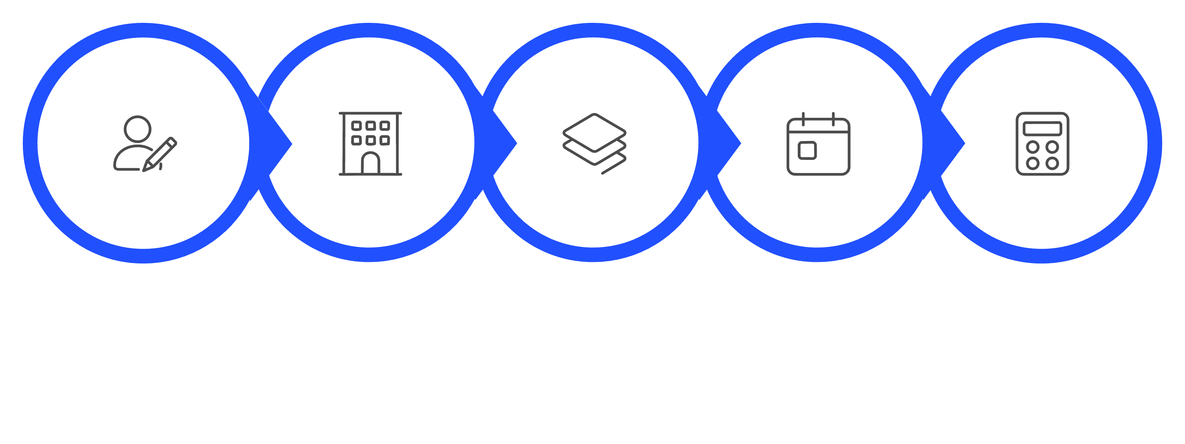
SYSTEM WORKFLOW
End-to-End Booking Workflow
Input Customer
Calculate Charge
Select Room
Enter Rooms
Enter Days
Input Phase (Steps 1–4): Scanner reads customer details and preferences. Switch-case maps room type to price. Inputs validated with if-else before proceeding.
Processing Phase (Steps 5–6): Billing formula applied instantly. Booking object stored in the 1D bookings array at the next available index.
Analytics Phase (Steps 7–8): Array traversal powers search, count, sum, and average operations. Results displayed to the user via formatted console output.

Slide 6

CO1 — BASIC JAVA PROGRAMMING
CO1: Core Java Concepts Applied
Language Constructs Used
Code Snapshot — Booking Class
Variables & Data Types
Scanner Input
class Booking {
String name;
int roomType;
int numRooms;
int numDays;
double totalCharge;
Booking(String n, int rt,
int nr, int nd) {
name = n;
roomType = rt;
numRooms = nr;
numDays = nd;
totalCharge = calcCharge(rt, nr, nd);
}
}
int for rooms/days, double for charges, String for name and contact — chosen to match data semantics precisely.
Scanner sc = new Scanner(System.in) reads customer name, room type selection, and stay duration interactively.
Arithmetic Operators
Conditional Statements
Multiplication and addition operators compute total charge: charge = price * rooms * days.
if-else validates input ranges; switch maps room type integer to corresponding price constant.
Classes & Objects
The Booking class encapsulates all customer and room data. Each booking is an instance of this class stored in the array.
The constructor immediately calls calcCharge() — connecting CO1 object initialization with CO3 method decomposition.

Slide 7
CO2 — DECISION MAKING & METHODS
CO2: Decision Structures & OOP
Key Programming Constructs
Code Snapshot — Room Type Switch
Switch Statement
If-Else Conditions
static double getPrice(int roomType) {
double price = 0;
switch(roomType) {
case 1: price = 2000; break; // Standard
case 2: price = 3000; break; // Deluxe
case 3: price = 5000; break; // Suite
default:
System.out.println("Invalid type");
}
return price;
}
Room type selection and main menu navigation both use switch for clean, multi-branch decision logic.
Input validation (e.g., rooms > 0, days > 0) and conditional output messages use if-else chains.
Constructors
Encapsulation
Parameterized constructor initializes every Booking object with validated customer and room data.
All booking attributes are grouped inside the Booking class — one object per customer record.
Modular Methods
Menu Navigation Switch
Separate methods for billing, search, revenue, and display keep the codebase organized and testable.
switch(choice) {
case 1: addBooking(); break;
case 2: searchBooking(); break;
case 3: showRevenue(); break;
case 4: showOccupancy(); break;
case 0: exit = true; break;
}

Slide 8
CO3 — METHODS, RECURSION & ARRAYS
CO3: Modular Programming & Recursion
Decomposition with Methods
Recursion — Total Revenue Calculation
01
static double totalRevenue(
Booking[] arr, int index) {
// Base case
if(index == arr.length) return 0;
// Recursive case
return arr[index].totalCharge
+ totalRevenue(arr, index + 1);
}
Parameter Passing & Return Values
calcCharge(roomType, numRooms, numDays) accepts three parameters and returns a double — demonstrating value return and argument passing.
02
Method Overloading
displayBooking(Booking b) and displayBooking(Booking[] arr) — same name, different signatures, showcasing overloading.
Case | Logic
Base Case | index == arr.length → return 0 (no more bookings to process)
Recursive Case | Add current booking charge + recurse on index + 1
03
Enhanced For-Each Loop
for(Booking b : bookings) traverses the array cleanly for revenue summation and display operations.

Slide 9
CO3 — ARRAYS & SAMPLE CALCULATION
CO3: 1D & 2D Arrays + Sample Calculation
1D Array Operations
Sample Calculation — 3 Bookings
Traversal
Searching
Customer | Room | Rooms | Days | Total Charge
Bharadwaj | Deluxe | 2 | 3 | ₹3,000×2×3 = ₹18,000
Mukesh | Suite | 1 | 5 | ₹5,000×1×5 = ₹25,000
Ramesh | Standard | 3 | 2 | ₹2,000×3×2 = ₹12,000
Loop through bookings[] to display all records using for-each.
Linear search by name.equals(target) — returns matching Booking object.
Summation
Average
Accumulate totalCharge across all bookings for revenue total.
totalRevenue / bookingCount gives average booking value.
₹55K
Total Revenue
Counting
18,000 + 25,000 + 12,000
Count bookings per room type using an accumulator inside the loop.
₹18.3K
2D Matrix — Occupancy Grid
// occupancy[roomType][day] = 1 if booked
int[][] occupancy = new int[3][30];
// Matrix arithmetic: count occupied rooms
int total = 0;
for(int[] row : occupancy)
for(int cell : row)
total += cell;
Avg Booking
55,000 ÷ 3 bookings
3
Total Bookings
Across all room types

Slide 10

CONCLUSION
Summary & Key Takeaways
What We Built
A fully functional Java-based Hotel Booking & Occupancy Manager that automates billing, tracks room occupancy, and provides revenue analytics — replacing error-prone manual processes with structured, object-oriented code.
CO Learning Outcomes Demonstrated
CO1 — Java Basics
Variables, Scanner, arithmetic, conditionals, classes & objects applied throughout the system.
Future Enhancements
CO2 — Decision Making
01
Switch-case menus, if-else validation, parameterized constructors, and encapsulation.
File I/O Persistence
CO3 — Decomposition
Save and load booking records using Java file handling for permanent storage.
Modular methods, recursion with base & recursive cases, 1D array operations, 2D matrix arithmetic.
02
GUI Interface
Java Swing or JavaFX front-end for a user-friendly graphical booking experience.
03
Database Integration
JDBC connectivity to MySQL for scalable, multi-session data management.
All core Java concepts from CO1, CO2, and CO3 are implemented and demonstrated through practical, working hotel booking operations.

