Slide 1
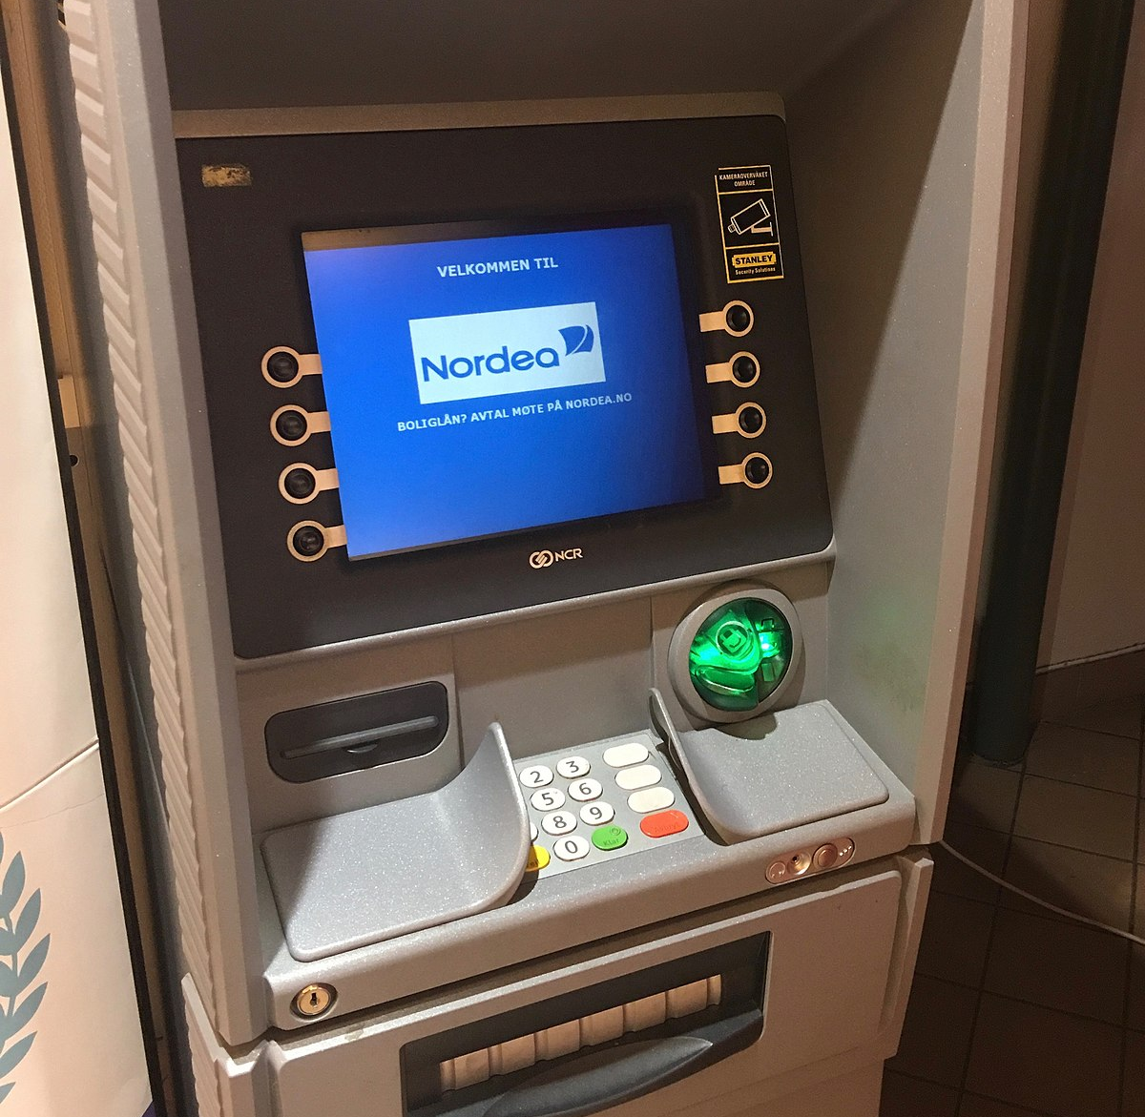
Case Study
ATM
Vuppala Bharadwaj
CS20B051
This Photo by Unknown Author is licensed under CC BY-SA

Slide 2
Abstract Class
Screen
Bank Database
Entry
Withdraw Menu
Deposit
Menu
Fund
Menu
Change Pin Menu
ATM
Account
Interface
transaction
Slip
Withdrawal
Deposit
Change PIN
Fund Transfer

Slide 3
Applications of OOP concept in my design
Inheritance and Polymorphism:
I have used Abstract class and Interference in my design.
Abstract class Screen is the parent class of many classes like entry, withdraw menu, deposit menu, fund menu and change pin menu. So, it is Inheritance
Similarly, interface transaction has many subclasses like Withdraw, deposit, change pin and fund transfer. This is Inheritance
In abstract class Screen, an abstract method display(Scanner scan) is declared. This abstract method has different implementations in different subclasses. So, it is Polymorphism.
In the interface, transaction, a method execute() is declared. This method has different implementations in different subclasses. So, it is Polymorphism.
Encapsulation:
In the class Account, all the variables are private. They cannot be accessed from other classes. Many getter and setter functions are used to access those variables. This is Encapsulation.
In the class BankDatabase, all the variables are private. They cannot be accessed from other classes. Many getter and setter functions are used to access those variables. This is Encapsulation.
Data Abstraction:
Various methods like display(),execute() are called, using objects, in the ATM class. These methods does some specific task. These are not shown here. This is Data Abstraction.
All the tasks, like withdrawal, deposit etc., are performed by calling methods of those classes. This is Data Abstraction.
Some methods in BankDatabase like checkpin(),checkAccountNumber(),changePin() are called at various stages in the code.
Similarly various methods of Accounts class and BankDatabase class are called in other classes to access the private variables. Some of these methods are supposed to take the input and set them to private variables. This process is not shown. This is Data Abstraction.

Slide 4
Functionalities of my ATM
My ATM has 5 functions.
a)Withdrawal of cash-Can take the cash from your account
b)Cash deposit- Can deposit cash to your account
c)Fund transfer to other accounts.- Can transfer the amount from your account to some other account
d)View the bank balance.- Can view and print the balance
e)Change the ATM Pin number.- You can change your ATM Pin.
My ATM first asks for user’s Account number and ATM pin. ATM verifies whether these inputs are correct or not. If these inputs(both) matches with the account numbers and corresponding pin numbers present in the Bank Database, user’s Name is displayed, and various options are displayed.
User needs to choose any one option. There is an exit option also. Based on the input selected by the user, ATM performs the task.
At the end, a Slip is generated showing the task performed, account number, name,initial balance, credited amount, debited amount and final balance.
After completing every task, my ATM automatically logs out.

Slide 5
Assumptions:
ATM has only keypad. User can enter the integer values only. User cannot enter letters or symbols.
Advantages:
This ATM has a fund transfer and change pin feature.
This ATM is very robust. After performing every task, the ATM automatically logs out and asks user to enter his credentials again.
The ATM program will not end. It is auto generated after every task.
From the given menu(user must choose from 1 to 6 choices) if user enters random value(like 201 etc), ATM automatically logs out. We get no error.
In the withdrawal, deposit or fund transfer if user enter negative values of amount, the ATM recognizes and logs out saying that the value entered is wrong.
While doing withdrawal or fund transfer, if the entered amount is greater than your bank balance, you get a message saying insufficient funds and the ATM logs out.
At every stage there is an option of cancelling the process. User can cancel any process at any stage.
There is a slip generated at the end of every task(except change pin, as it cannot be printed on the slip ),giving the complete information about the task and what is done.
In the change pin task also, new pin should be within the range of 1000 and 9999. If user enters any value out of this range, the process will be cancelled.
There is very little chance(almost 0) of getting error.
Disadvantage:
The only disadvantage is, if user enters input other than integers(like and letters or symbols), we get an error. This is because in my ATM design I have assumed that ATM keypad has only numbers from 0 to 9.

