Slide 1

B Stack DEMO
UNDER GUIDENCE OF MRS.VAISHALI SONANIS MAM.

Slide 2
INTRODUCTION
The Browser Stack Demo Website Is A Sample E-commerce Web Application Provided By Browser Stack. It Is Mainly Designed For Practicing Selenium, Cucumber, Playwright, Cypress, And Other Automation Testing Tools.

Slide 3
OVERVIEW
What is BStack?
Browser Stack is a cloud-based testing platform that allows developers and testers to run tests on real browsers and devices without the need for physical infrastructure.
In my project, I have set up a demo using Browser Stack to demonstrate its capabilities.
It helps users gain hands-on experience with cross-browser and cross-device testing. Browser Stack provides instant access to thousands of browsers, operating systems, and mobile devices.
The platform supports both manual and automated testing, with built-in integrations for popular tools like Selenium, TestNG, Cucumber, and Jenkins.

Slide 4
MODULES
MODULE 1: LOGIN
Checked the functionalities of username and password in the sign in page for login.
MODULE 2: SEARCH
Checked the functionality of search field and button by giving search input.
MODULE 3: ADDTOCART
Checked the functionalities of cart like adding an item to cart and deleting button in cart

Slide 5
MODULES
MODULE 4: CHECKOUT
Checked the functionalities of checkout button.
MODULE 5: SHIPPING ADDRESS
Checked the functionality of search field and button by giving search input .
MODULE 6: FAVOURITES
Checked the functionality of Favourite’s by adding an item to Favourite’s list.

Slide 6
MODULES
MODULE 7: OFFER
Checked the functionality of offers button and validate message in that page.
MODULE 8: BRAND SHOPPING
Checked the functionality of shopping by selecting brands like Apple, Samsung, Google, OnePlus.
MODULE 9: FILTER
Checked the functionality of Filters like selecting low to high and selecting high to low buttons.

Slide 7
MODULES
MODULE 10: LOGOUT
Checked the functionality of logout button.

Slide 8
DEFECTS
Search Engine is not working.
Add to cart is when we click on product Img it need to redirect to product details.
Subscribe to newsletter is when we click on subscribe to newsletter it need to accept the email id and it need to take and it has a submit button but it does not have submit button.

Slide 9
Defect identifier :- D_001
DEFECT SUMMARY : Expected result is when "Search" is used for an input Product list should show it's related products but it is navigating to home page. Therefore "Search engine" is not working and No Length limit for input.
TEST ID : TC_001,TC_002,TC_003,TC_004.
TEST CASE NAME : TC_Search_Valid, TC_Search_Invalid, TC_BStack-Search-PartialMatch, TC_Search_Blank.
MODULE NAME : Search.
REPRODUCIBLE : When we search iPhone in search Product list shows iPhone or related products.
SEVERITY : HIGH.
PRIORITY : HIGH.
RAISED BY : Bharadwaj Achimsetty
ASSIGNED TO : DEVELOPER
DATE OF ASSIGNMENT :
STATUS : PENDING
FIXED BY : DEVELOPER
Date of fixing:

Slide 10
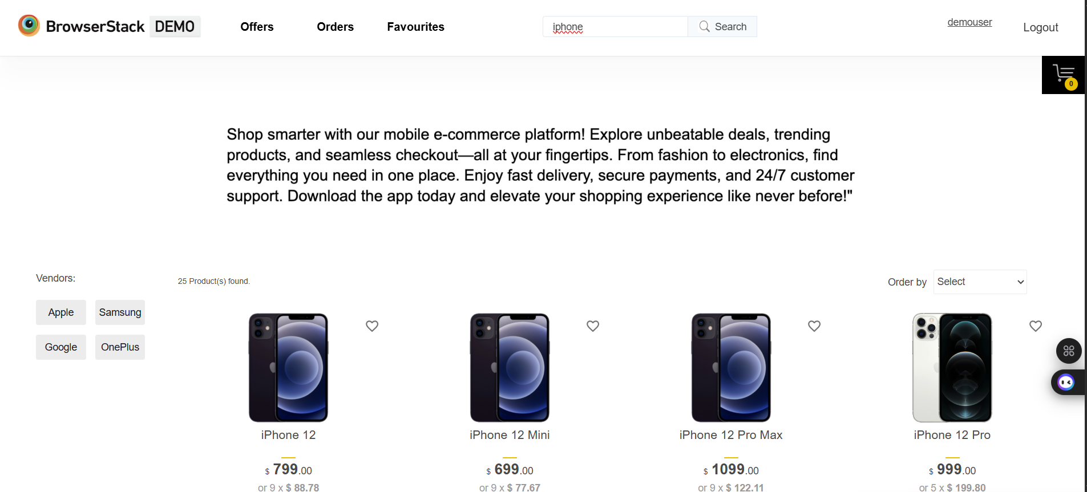
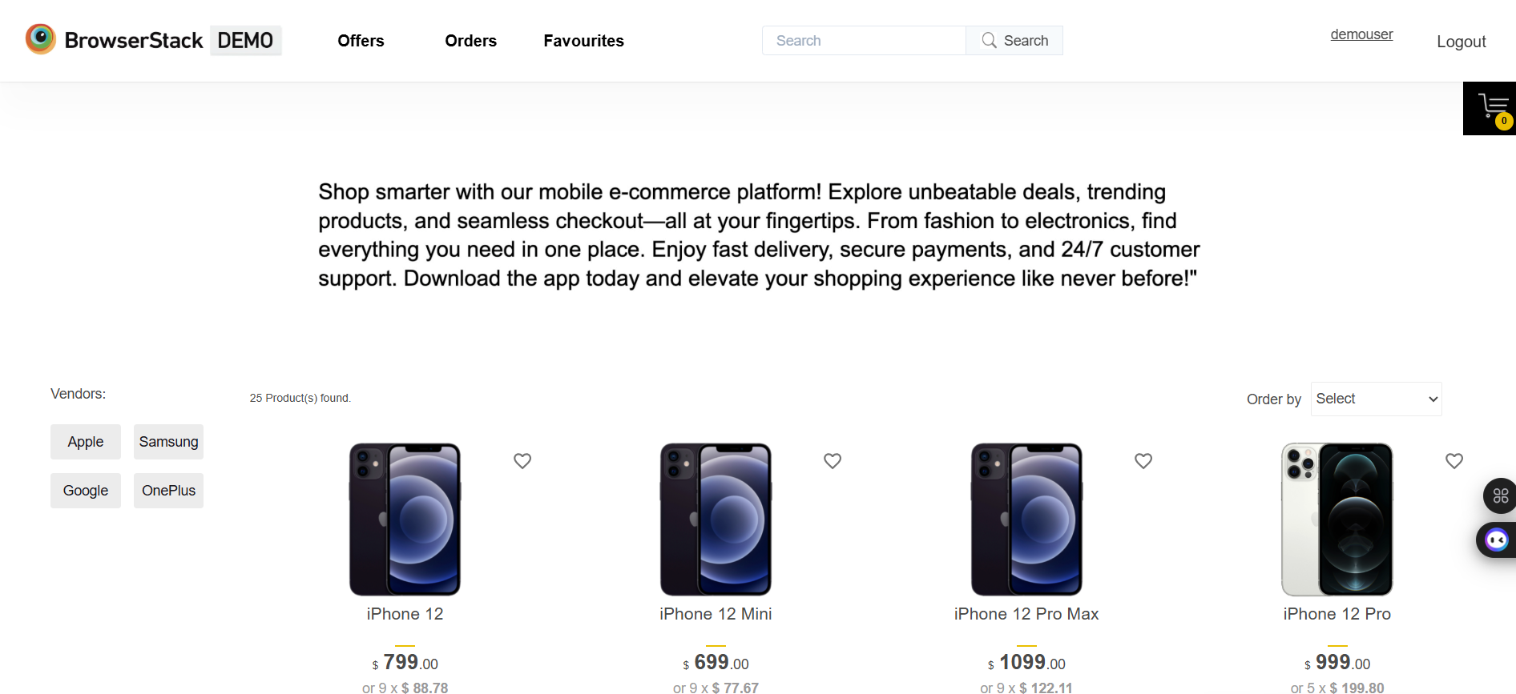

Slide 11
Defect identifier :- D_002
DEFECT SUMMARY : Expected result is when we click on a product image, it should redirect to the product details page. Currently, no redirection happens.
TEST ID : TC_002
TEST CASE NAME : TC_Product_Image_Click
MODULE NAME : Product Catalog / Product Details
REPRODUCIBLE :
Login to the application.
Search for a product (e.g., iPhone).
Click on the product image.
Observe that it does not redirect to the product details page.
SEVERITY : HIGH
PRIORITY : HIGH
RAISED BY : Bharadwaj Achimsetty
ASSIGNED TO : Developer
DATE OF ASSIGNMENT :
STATUS : PENDING
FIXED BY : Developer
DATE OF FIXING :

Slide 12
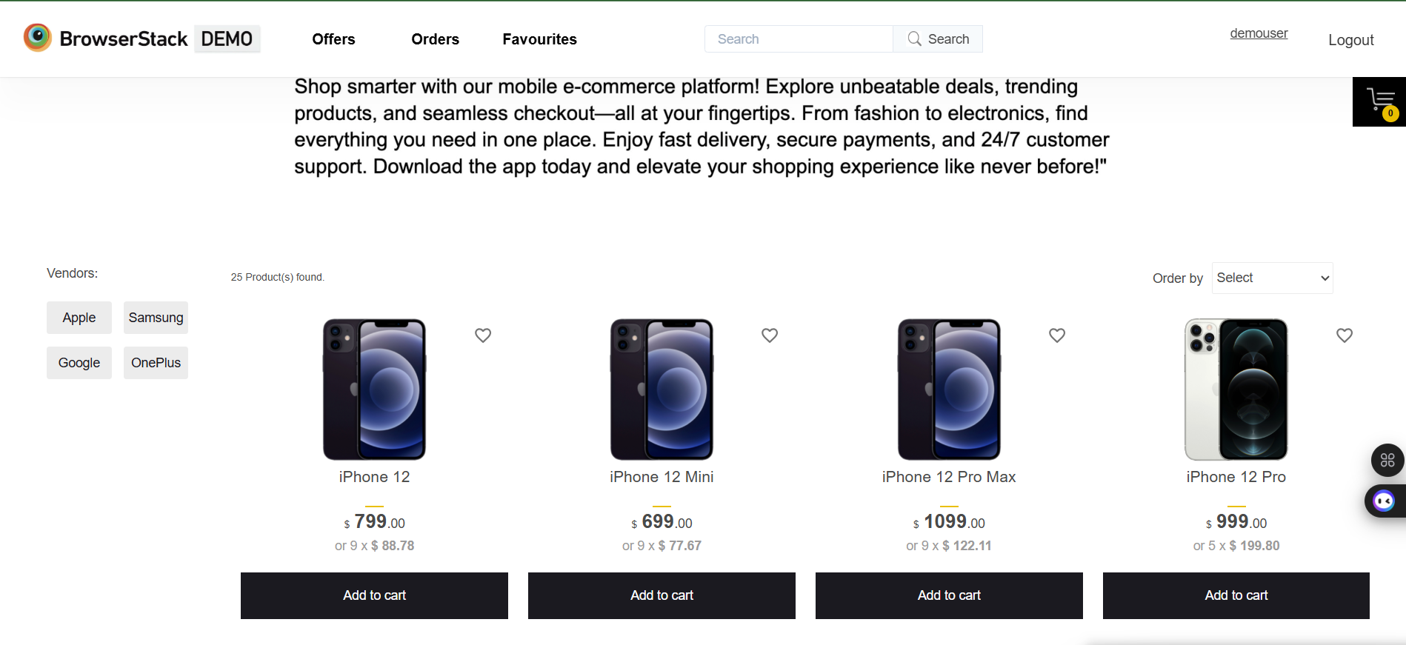

Slide 13
Defect identifier :- D_003
DEFECT SUMMARY : When clicking on "Subscribe to newsletter", it should accept the email ID and provide a submit button. However, the submit button is missing, and the email cannot be submitted.
TEST ID : TC_001
TEST CASE NAME : TC_Subscribe_Newsletter
MODULE NAME : Newsletter Subscription
REPRODUCIBLE :
Navigate to the website home page.
Enter a valid email ID in the "Subscribe to newsletter" field.
Try to submit the email.
Observe that there is no submit button, so the subscription cannot proceed.
SEVERITY : HIGH
PRIORITY : HIGH
RAISED BY :
ASSIGNED TO : Developer
DATE OF ASSIGNMENT :
STATUS : PENDING
FIXED BY : Developer
DATE OF FIXING :

Slide 14
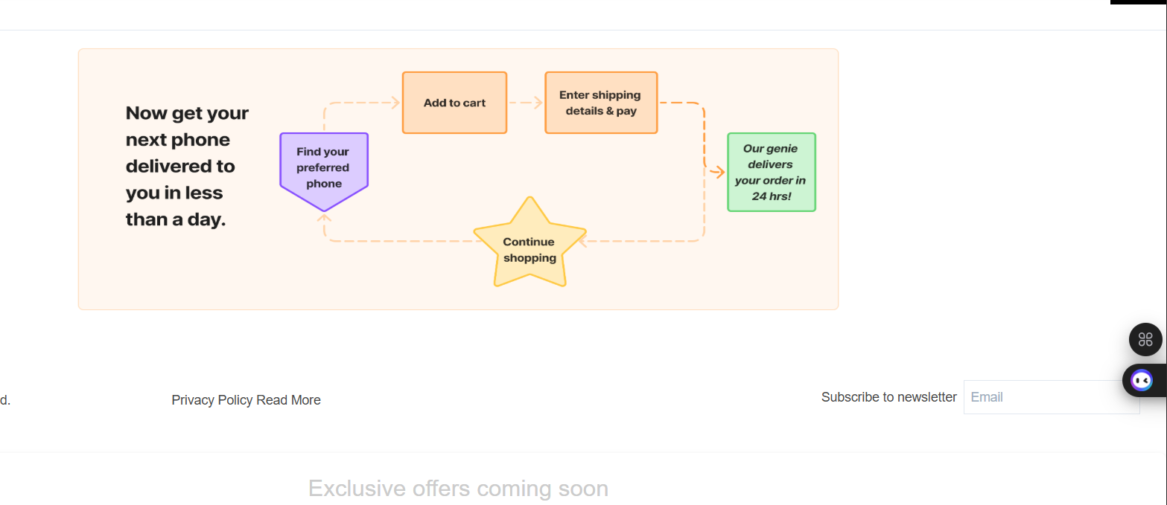

Slide 15
CHALLENGES
Faced multiple issues during login automation, such as inability to send keys to the username and password fields.
Geo-location based offers section created challenges during test execution.
Some elements were not interactable, for example, dropdown fields during automation.

Slide 16
EXPERIENCE
GAINED HANDS-ON EXPERIENCE IN MOBILE E-COMMERCE TESTING BY WORKING ON B Stack DEMO Website.
LEARNED TO WRITE AND EXECUTE AUTOMATION TEST CASES FOR PRODUCT BUYING, SEARCH, CART, AND CHECKOUT FLOWS.

Slide 17

NAME: BHARADWAJ ACHIMSETTY

