Slide 1

Mathematical Programming Applications
in Machine Learning
E V N Sai Bharadwaja
Machine Learning and Computing
IIST

Slide 2
Q. What is the goal of any Machine Learning algorithm?
Training Data
Testing Data
Three basic basic problems that are often Studied in Machine Learning are :
Regression
Classification
Clustering
There are so many approaches to solve above problem
But Mathematical Programming has now become very popular in Machine Learning Community and Mathematical Programming Community

Slide 3
Q. What is the Advantage of Studying Mathematical Programming?
Most of the Machine Learning Models result into Linear Programming , Quadratic Programming , Convex Programming.
But Mathematical Programming has
Theoretical results( KKT conditions and Duality Theory )
Efficient algorithms
Machine Learning Techniques
Supervised Learning (Ex : Classification and Regression)
Unsupervised Learning ( Ex : Clustering )

Slide 4
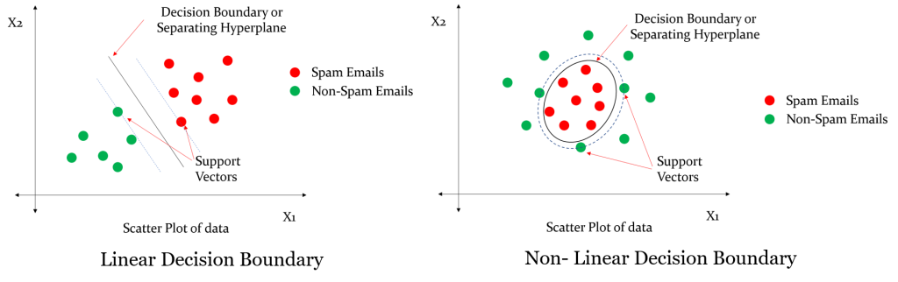
Binary (Two-Class) Pattern Classification Problems
X ∈ R^n
m - patterns ∈ Class +1
k - patterns ∈ Class -1

Slide 5
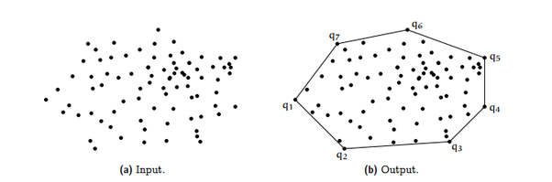
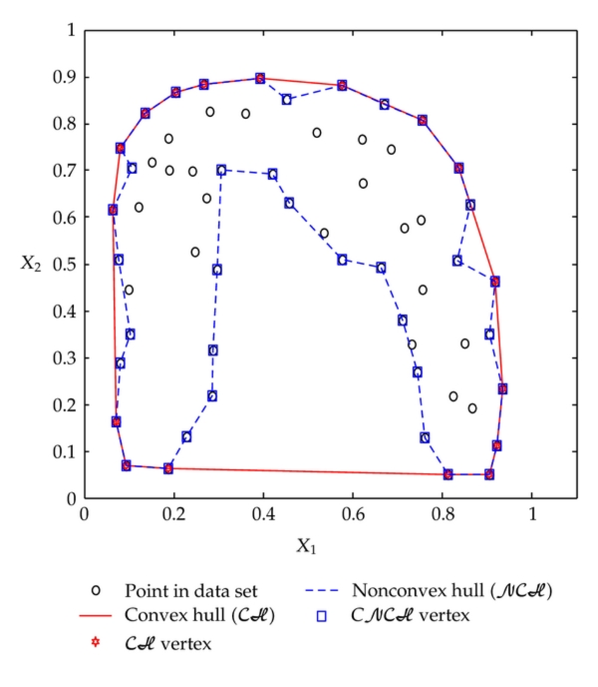
Convex Hull :
The Convex hull of a set of points X in euclidean space is the smallest convex set containing X.

Slide 6
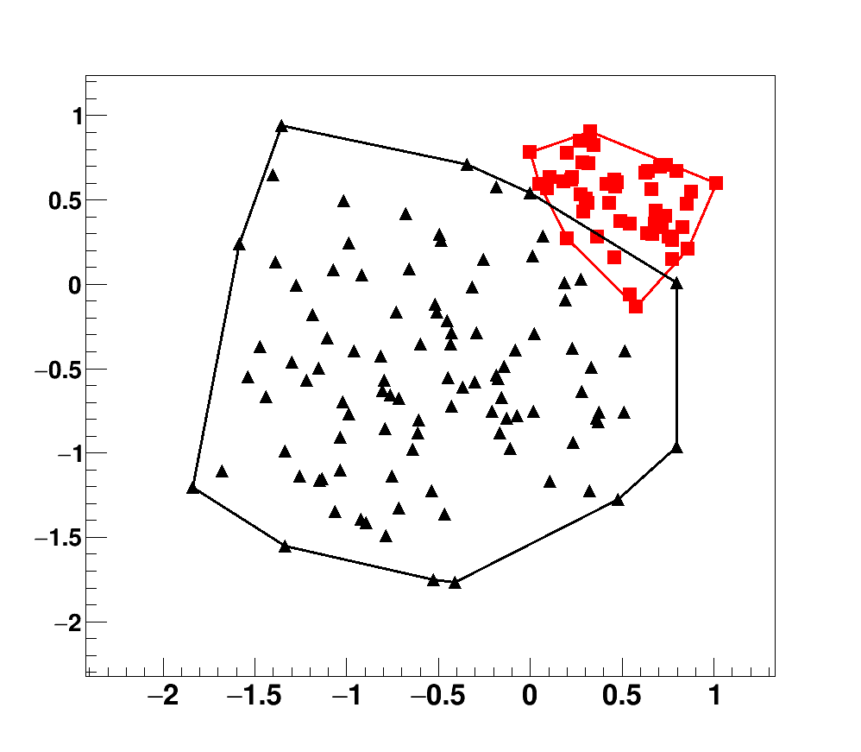
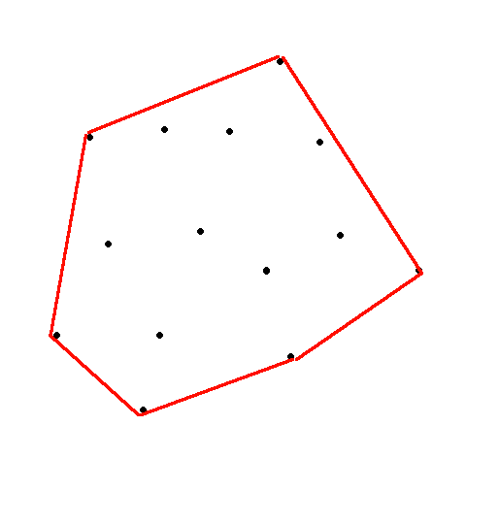
Disjoint Convex hulls
Or Linearly Separable
Joint Convex hulls
Or Linearly non Separable

Slide 7
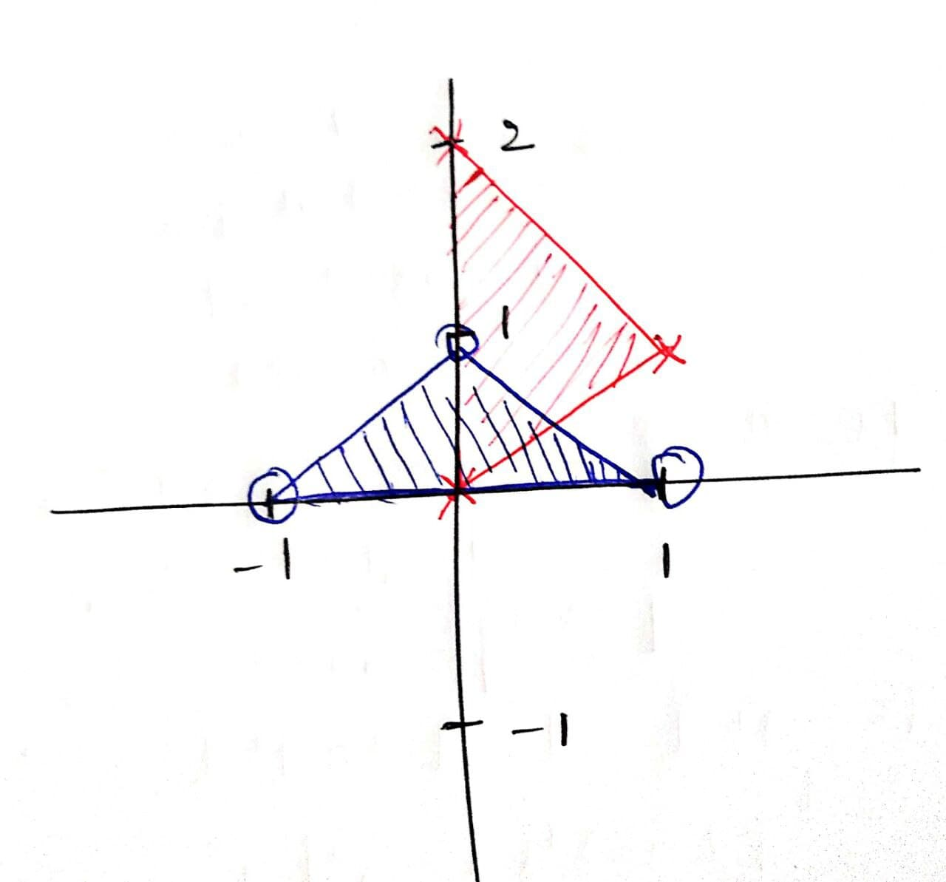
Q. A = { (-1,0),(0,1),(1,0) } ,
B = { (0,0),(1,1),(0,2) }
Are A and B linearly Separable ?
Ans :
Convex Hulls are NOT Disjoint Hence given Problem is NOT Linearly Separable.
But Finding convex hulls is not an easy task
So we make use of Linear Programming to decide whether the problem is Linearly Separable or not

Slide 8
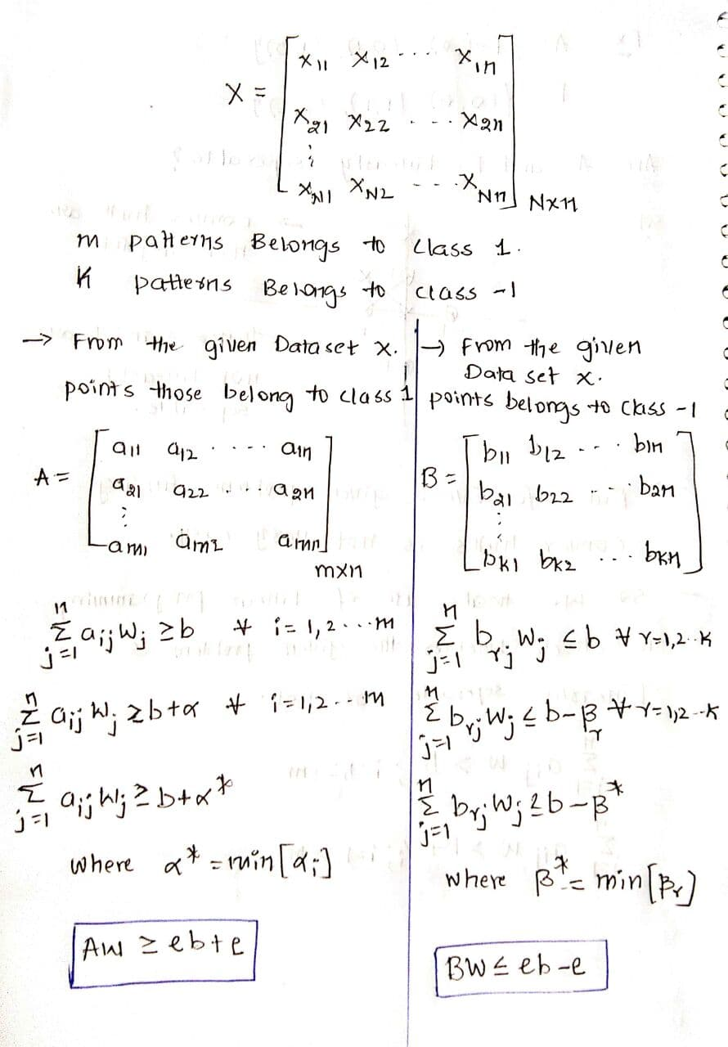
Solving the above problem using Linear Programming

Slide 9
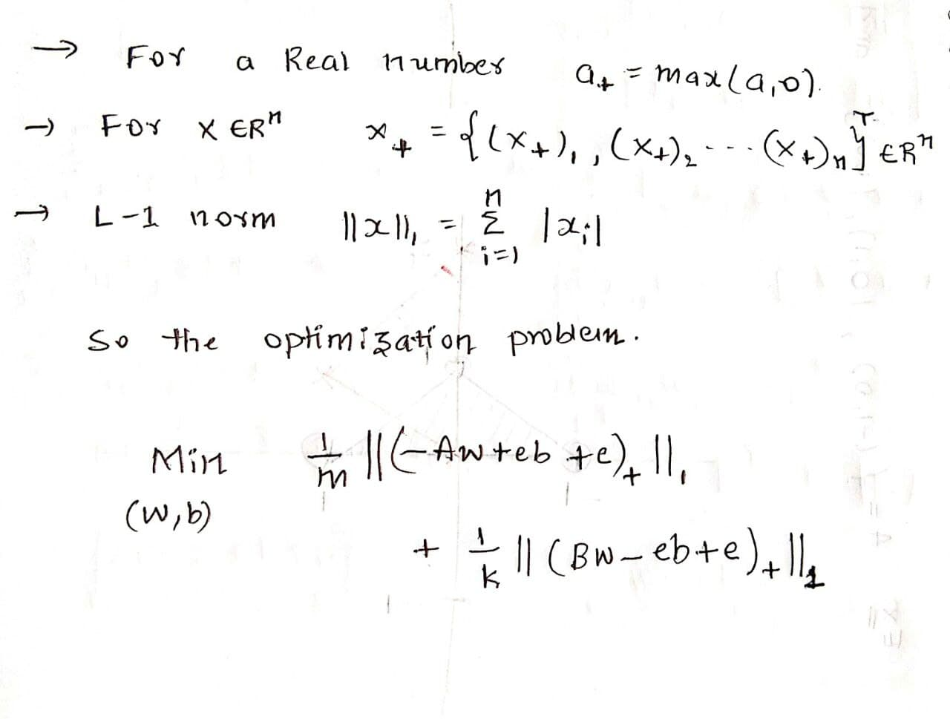
Error Minimizing Linear Programming Problem
If A and B are Linearly Separable then Error is zero and Optimal value for the Optimization problem is zero and the converse is also True.
Converse Statement : If Optimal Value for the optimization problem is zero then A and B are Linearly Separable
otherwise NOT Linearly Separable

Slide 10
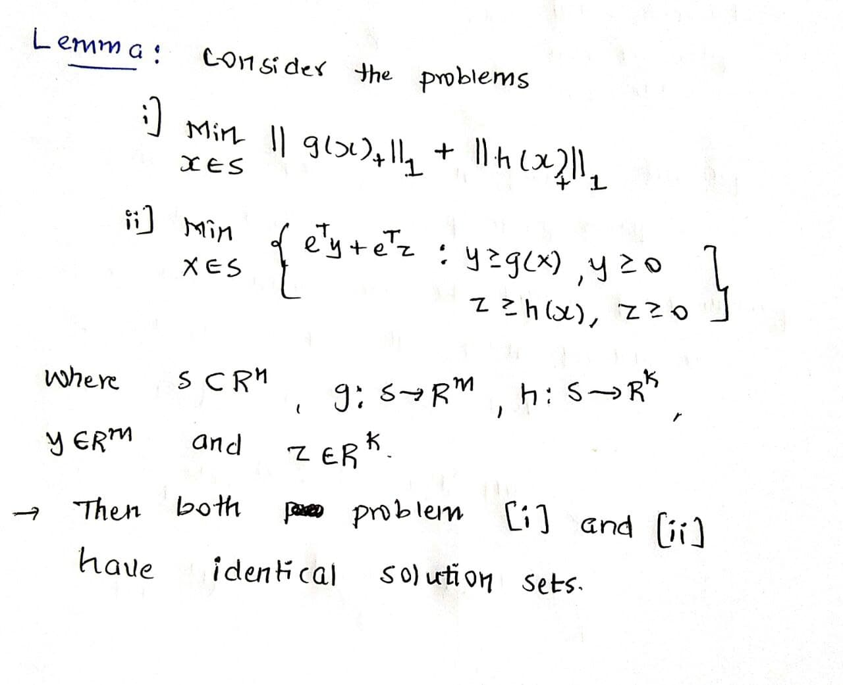
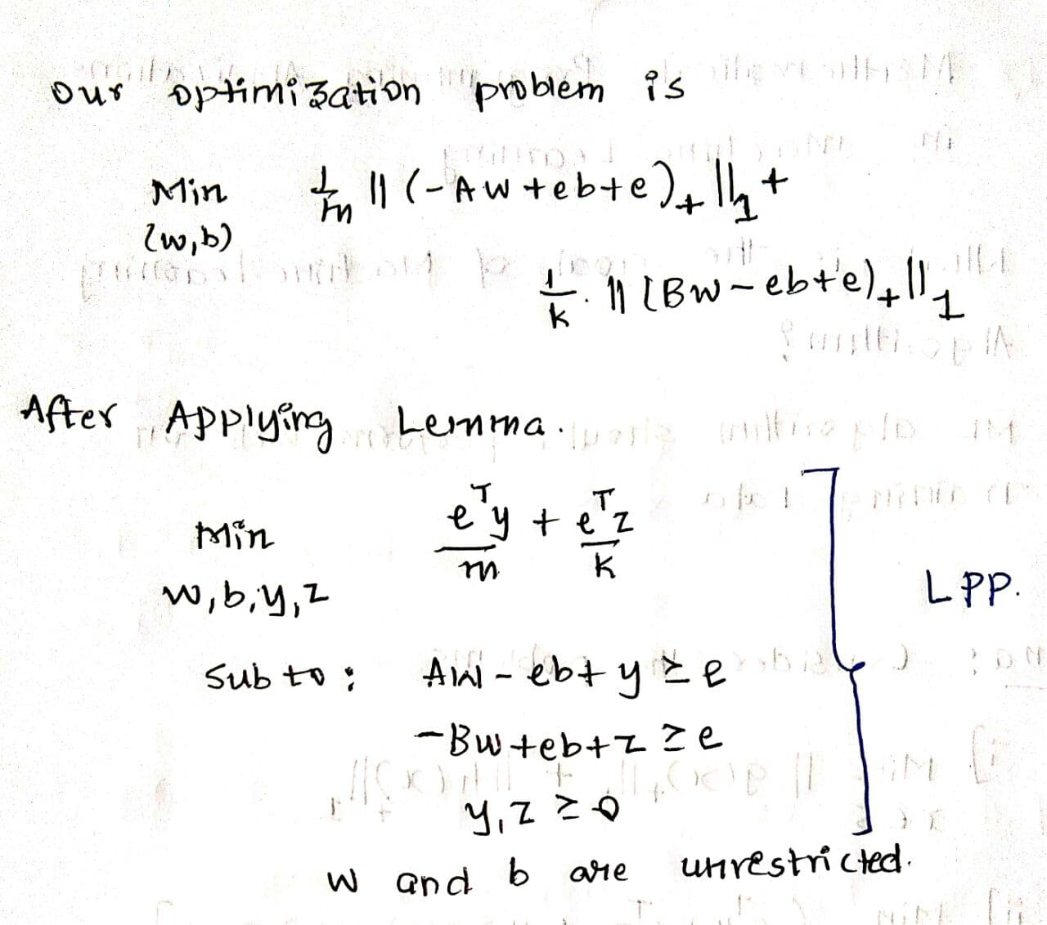
Lemma : Transforms into LPP
Applying Lemma to our Optimization Problem
LPP can be Efficiently Solved by using Simplex Algorithm.
Hence we can find whether A and B are Linearly separable or Not

Slide 11
Conclusion :
A and B are linearly separable iff optimal value for the error minimizing LPP is ZERO . Hence there exists a Hyperplane w.T *x = b which is Linear Separator
A and B are NOT linearly separable then optimal value for the error minimizing LPP is NOT ZERO . Hence there exists NO Hyperplane w.T *x = b which is Linear Separator

Slide 12
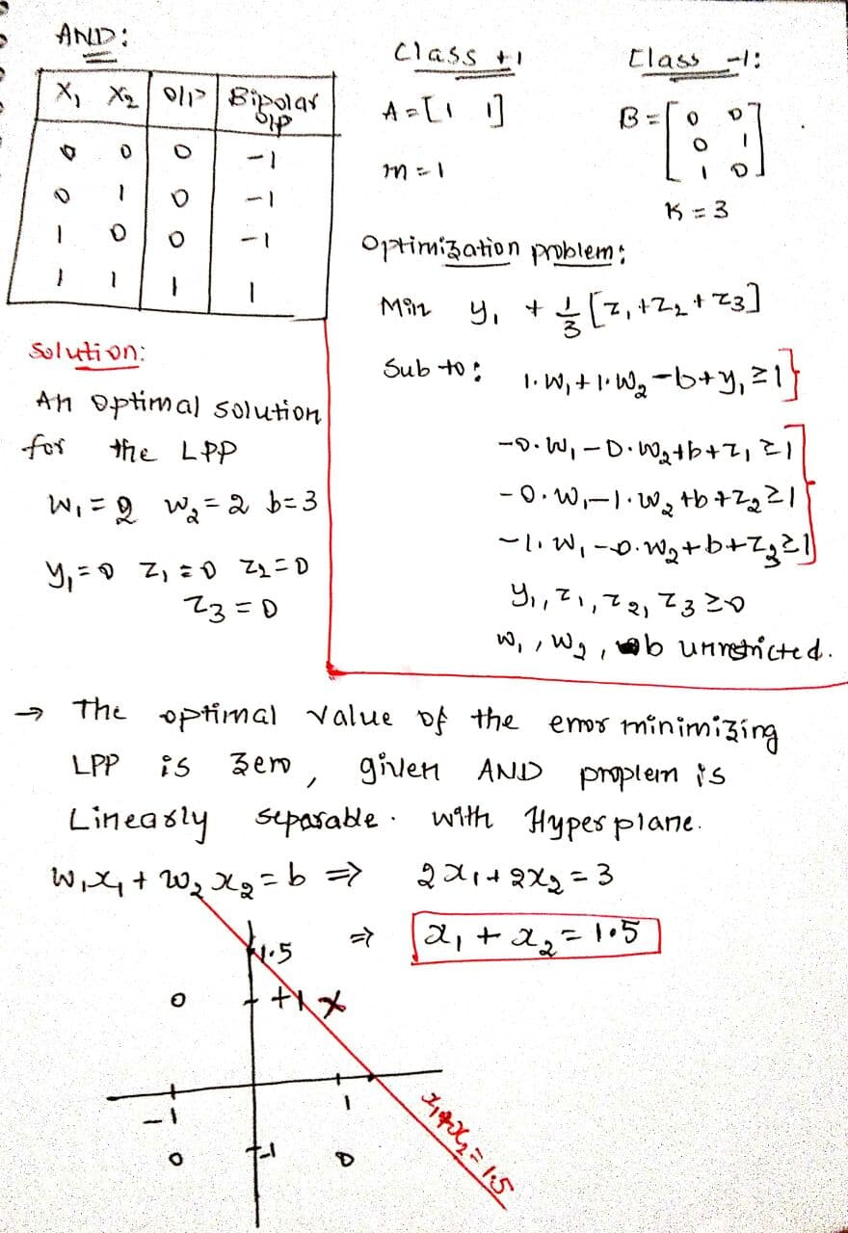
Q. Write error minimizing LPP for AND problem and check if the given Problem is Linearly Separable ?

Slide 13
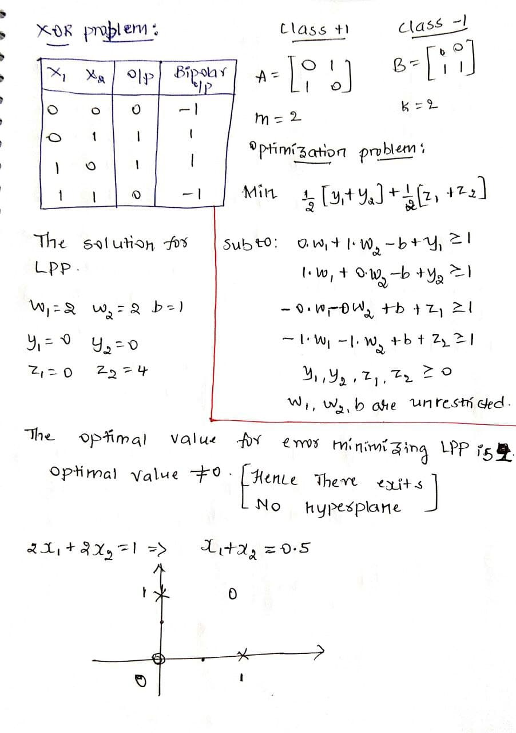
Q. Write error minimizing LPP for XOR problem and check if the given Problem is Linearly Separable ?

Slide 14
If A and B are linearly separable then there exists infinitely many hyperplanes
So how should we choose a Hyperplane ?
Is there any optimal Hyperplane ?

Slide 15
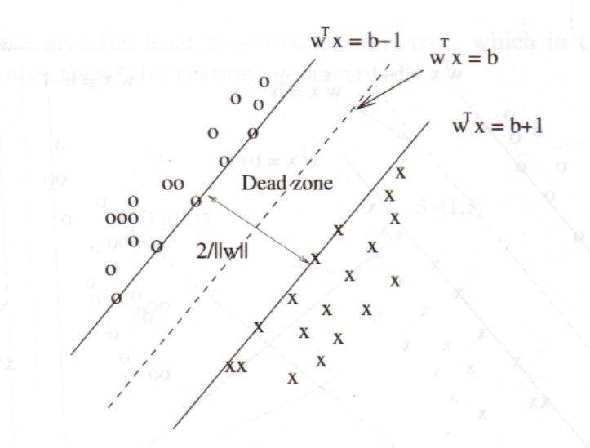
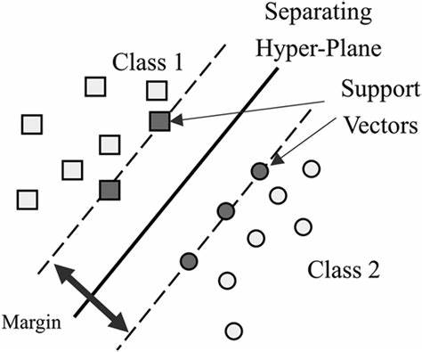

Slide 16
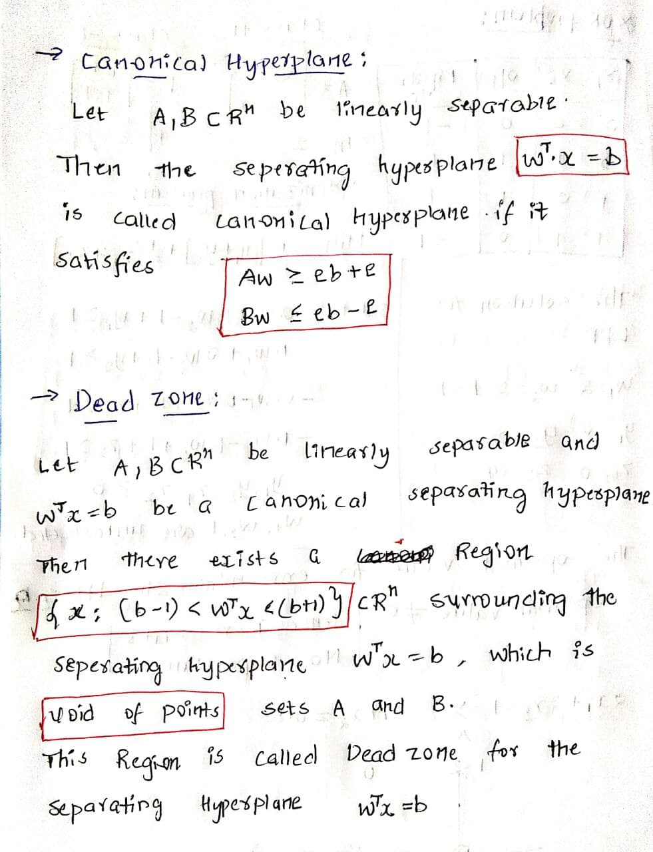
Canonical Hyperplane
Dead Zone

Slide 17
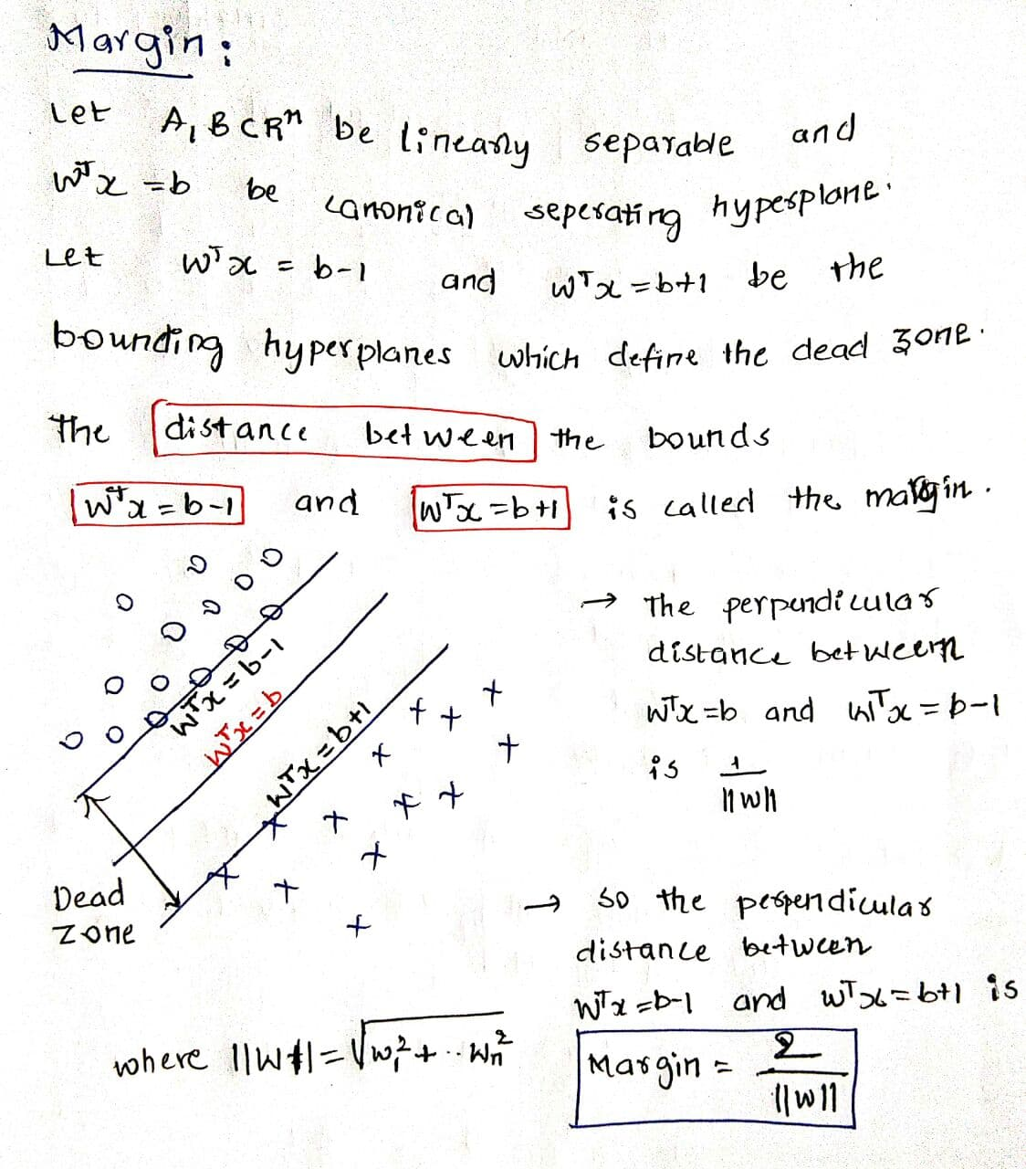
Margin

Slide 18
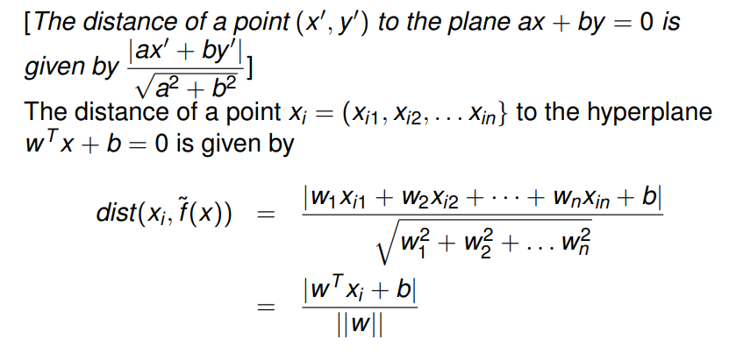

Slide 19
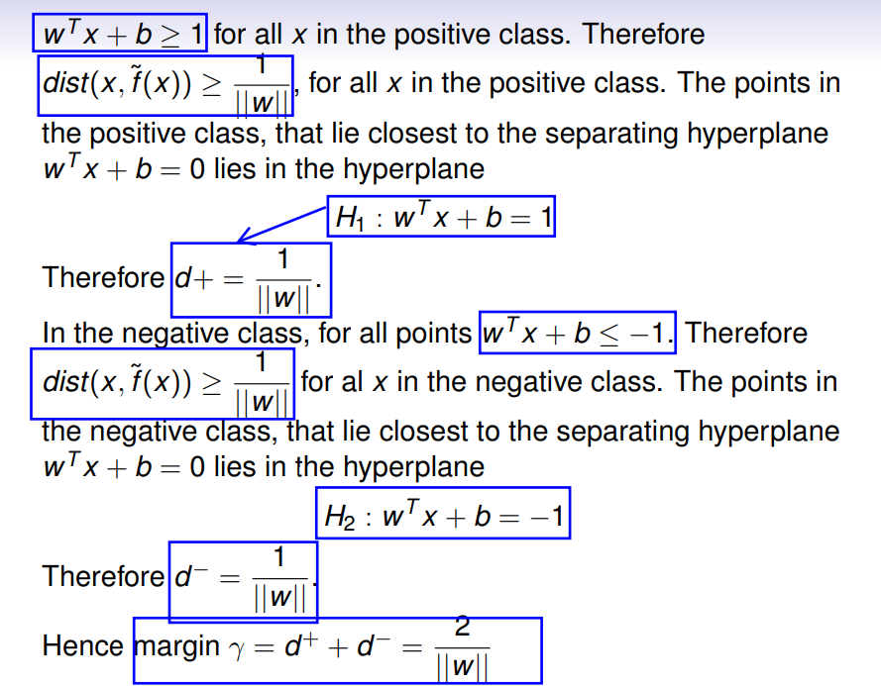

Slide 20
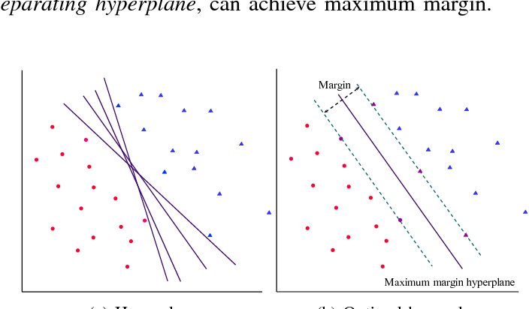
Optimal Separating Hyperplanes:
Let sets A , B be linearly separable and w.T * x = b be a canonical hyperplane .
Then w.T * x = b is called Optimal Separating Hyperplane if it’s Margin is Maximum among all the Canonical Hyperplanes

Slide 21
In Classification , our aim is not only to classify the available to classify the training data in accordance with the class labels
But also to have good generalization on Unseen Data or Test Data
The Larger the dead Zone , the smaller the misclassification Error will be.
Therefore we would like to Maximize the dead Zone , which implies we would like to Maximize the Margin
From the above Point of View , for the linearly Separable patterns , our aim is not only just finding the Hyperplane , But also for which the Margin is Maximum
Ques : Will Error Minimizing LPP gives Optimal Separating Hyperplane ?
So we should construct a Optimization problem in which Objective Function should contain Margin
This Discussion Leads us to Hard Margin Classifier and Support Vector Machines

Slide 22
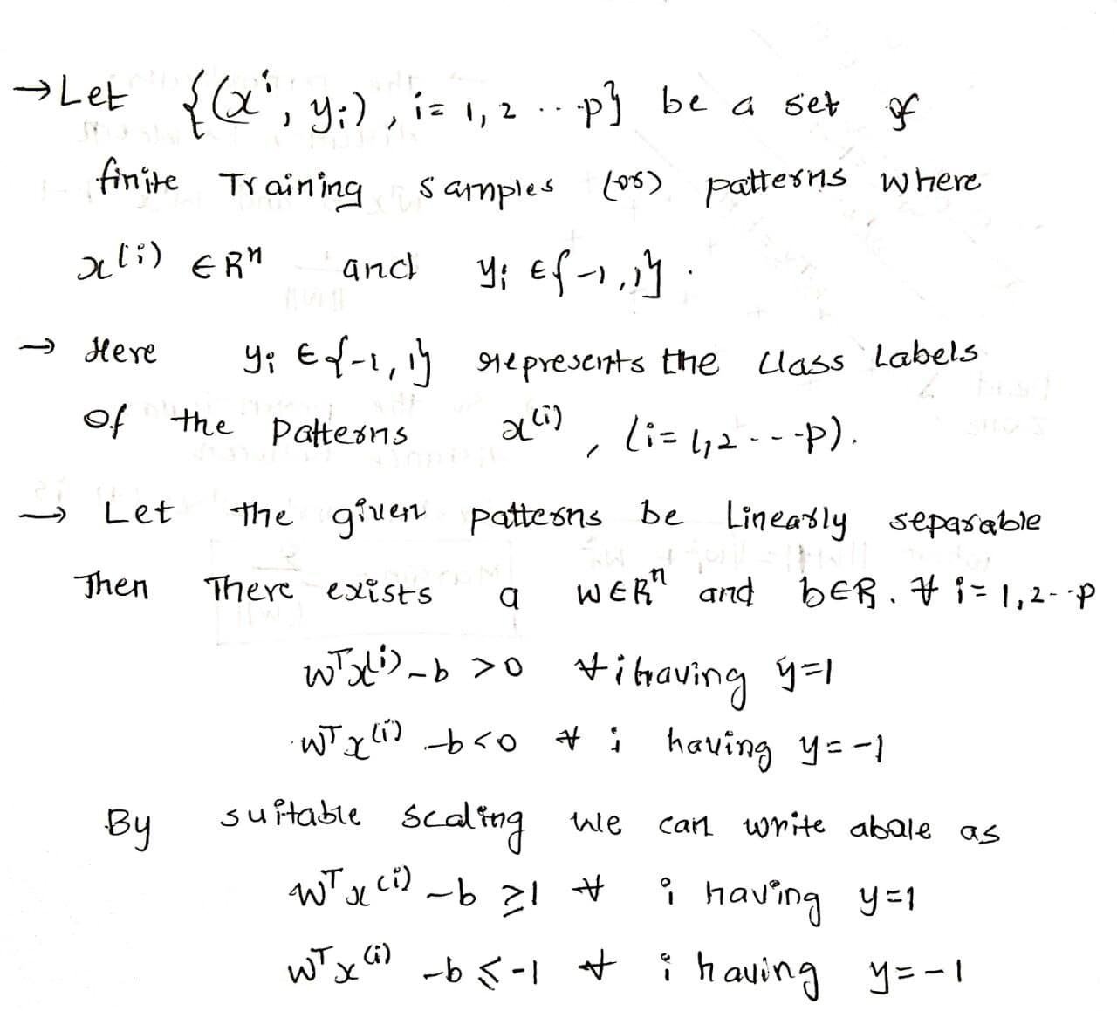
Hard Margin Classifier :
For the given patterns which are Linearly separable

Slide 23
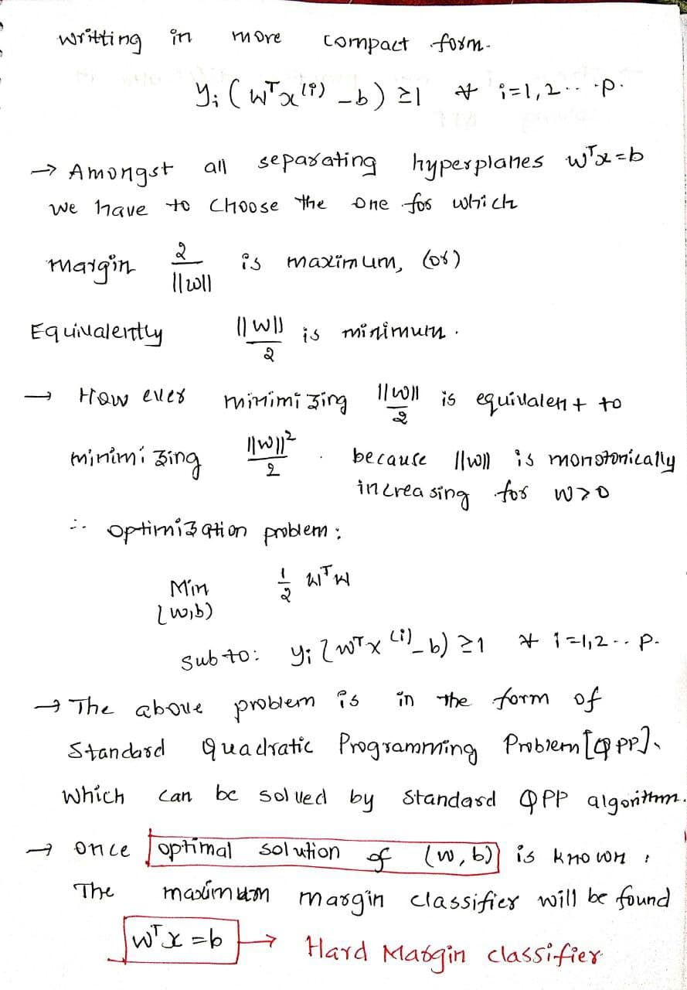

Slide 24
Difficulties in Solving Quadratic Programming Problem
QPP has as many constraints as the number of patterns and hence extremely hard to solve for Large Data sets
This QPP will make use of Kernel Methods, which again is difficult to Store kernel matrices.
In Machine Learning there are special algorithms so that Not all Constraints are included at once
Chunking algorithm
Decomposition algorithm
SMO algorithm (Special Case of Decomposition )
The above Techniques are also called as Active Set or Working Set approach

Slide 25
In Mathematical Programming , Standard approach to handle Large number of constraints is to examine if Dual problem can be solved efficiently
This analysis requires KKT conditions

Slide 26
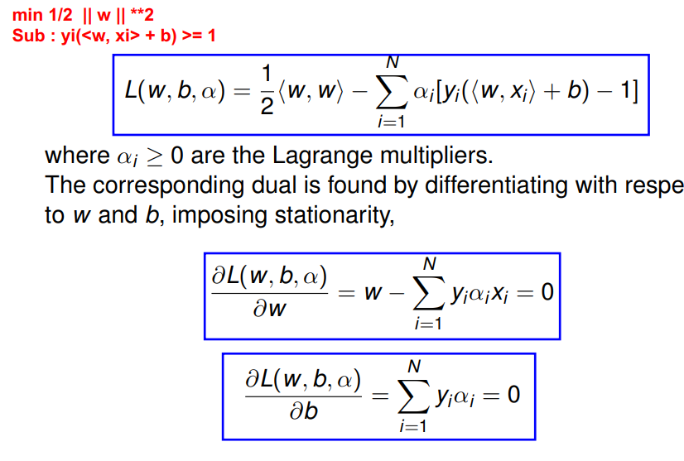
KKT conditions

Slide 27
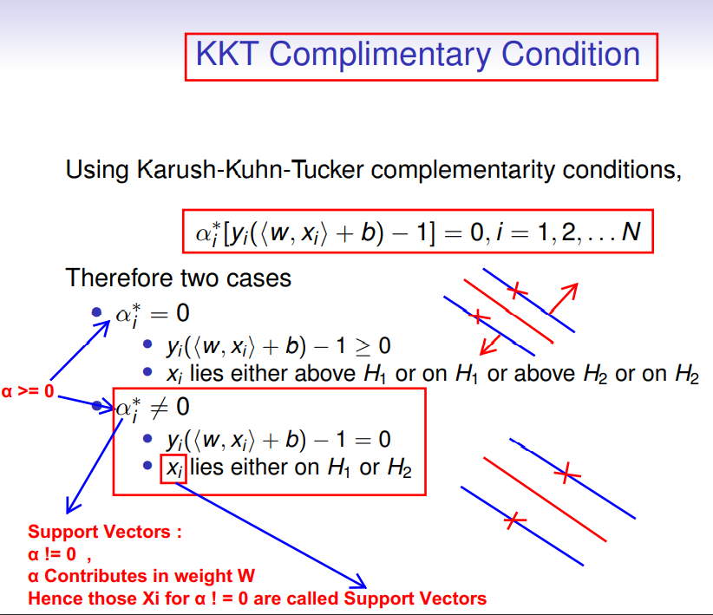
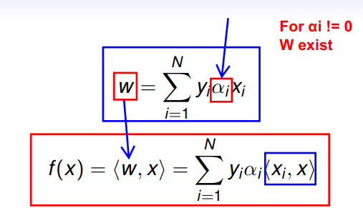
Support Vectors:
Only Those points for which Xi is influencing Weights ‘W’
KKT multipliers (Alpha) > 0
So vector W is know once KKT multipliers are know.

Slide 28
The SVM algorithm clearly needs the knowledge of KKT multipliers
Once KKT multipliers are known Support Vectors
Support Vectors:
Only Those points for which Xi is influencing Weights ‘W’
KKT multipliers (Alpha) > 0
So vector W is know once KKT multipliers are know.
Hence we get to know vector ( w ) and b
From the concept of Non Linear Programming Duality , KKT multipliers are nothing but Dual Variables.
Therefore we go for Wolfe Dual of the Problem to find KKT multipliers

Slide 29
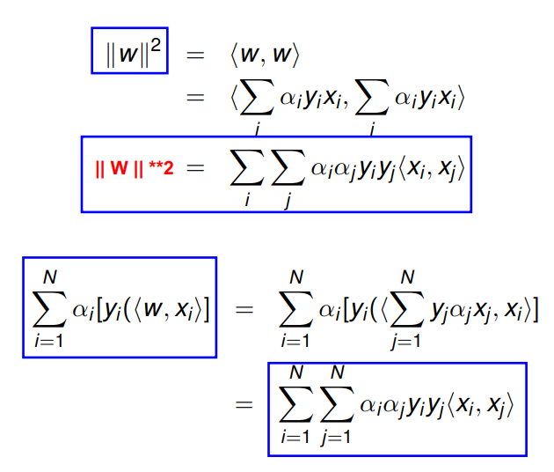

Slide 30
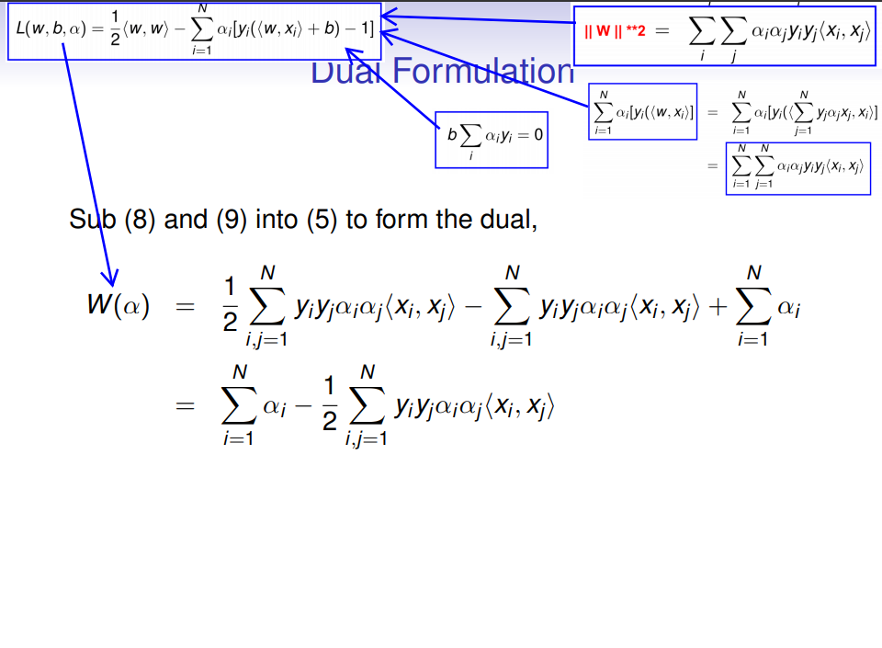

Slide 31
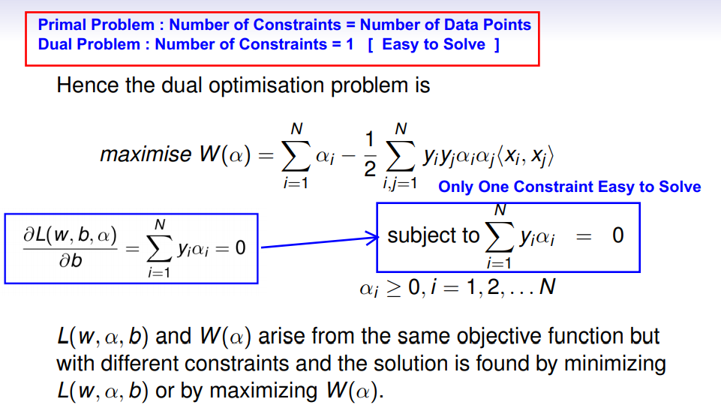
Wolfe Dual :
If we clearly observe dual problem , we can notice that there is only one constraint
The objective Function of the Dual problem is Concave
Therefore Dual problem is Easier to Solve Than Primal problem
Once optimal alpha is known [w] and b can be computed.
Hence separating hyperplane with Maximum Margin can be determined

Slide 32
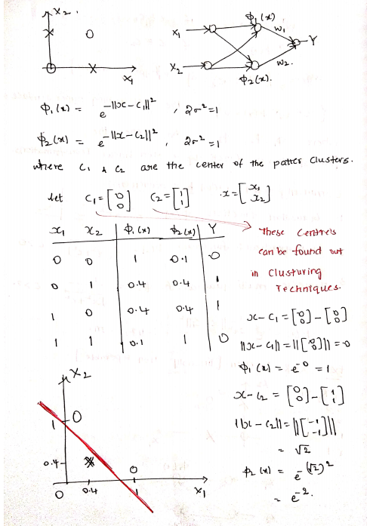
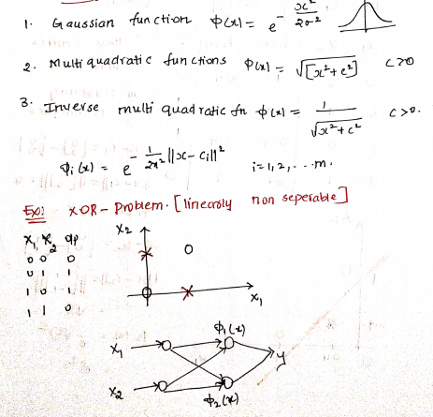

Slide 33
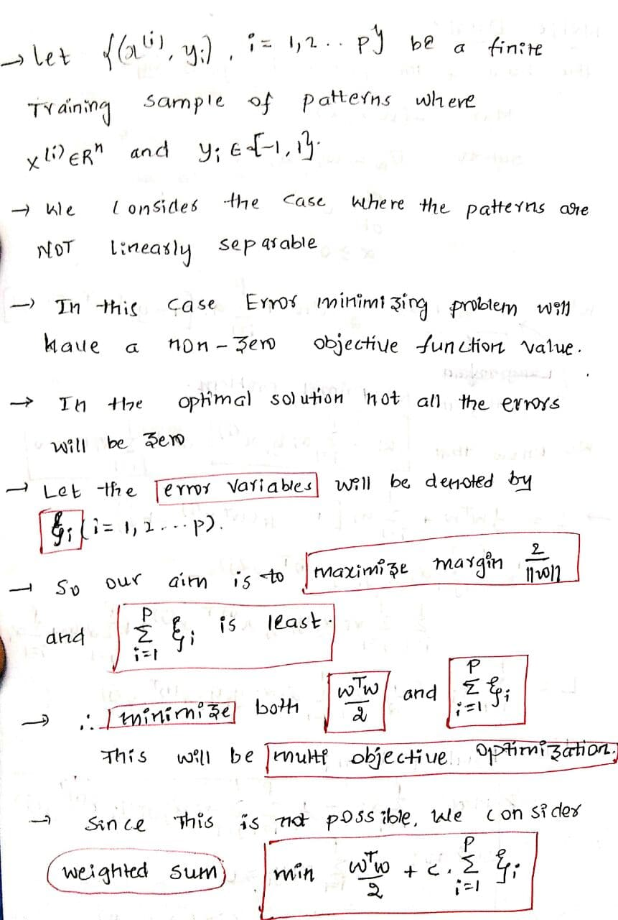
Soft Margin Classifier :
For the given patterns which are NOT Linearly separable

Slide 34
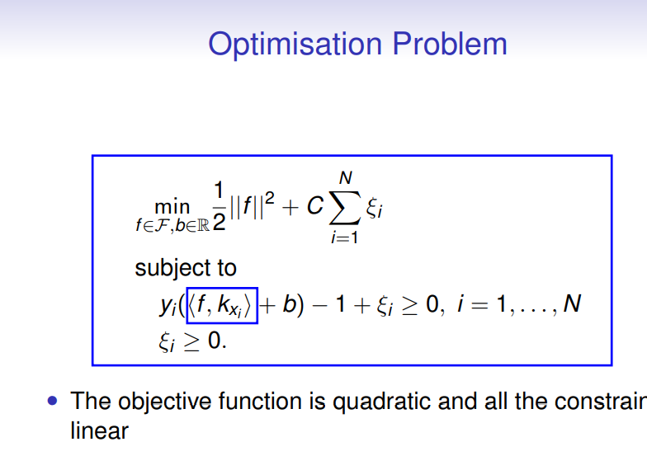
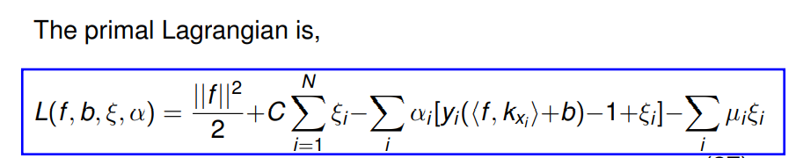

Slide 35
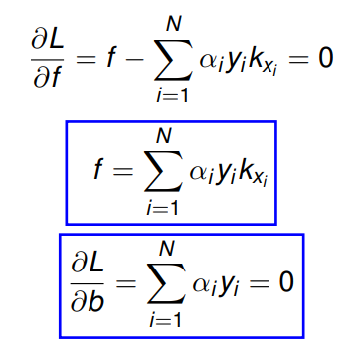
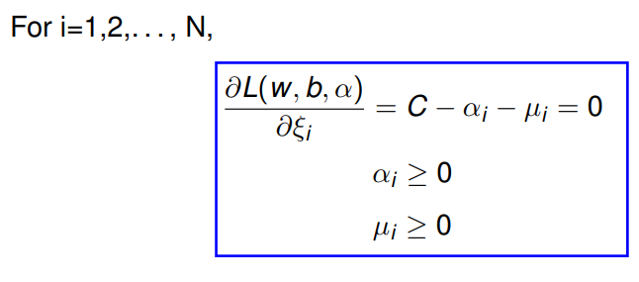

Slide 36
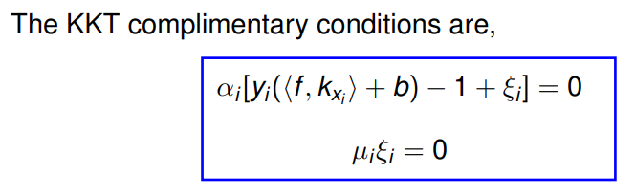
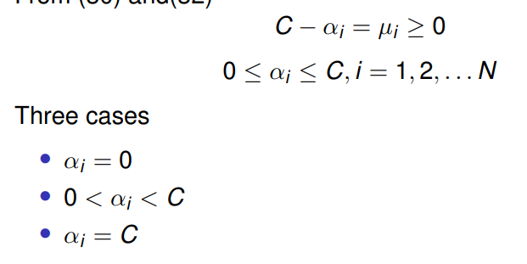




Slide 37
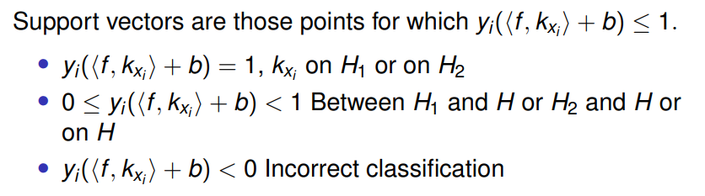

Slide 38
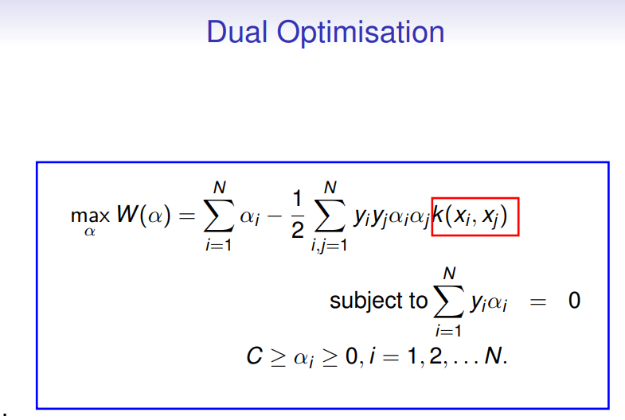

Slide 39
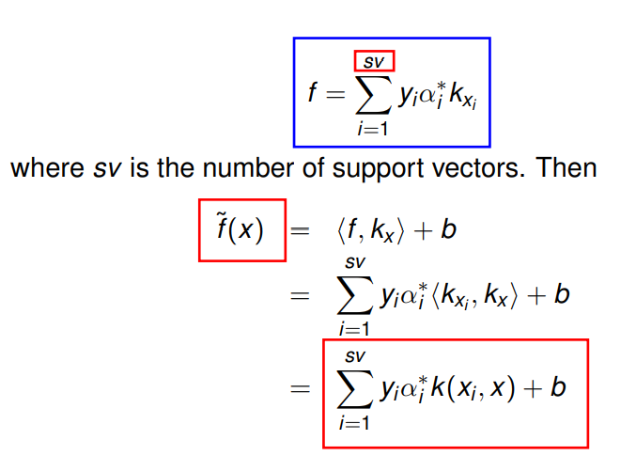

Slide 40
Thank You

