Slide 1




Onion Market Analysis (2020-2025) Source: https://www.data.gov.in/ Dataset: Variety-wise Daily Market Prices Data of Commodity Email: k.h.s.bharadwaj123@gmail.com Phone : 9701095575 LinkedIn : https://www.linkedin.com/in/bharadwajkollepara/
Indian Government Dataset Analysis
Bharadwaj Kollepara

Slide 2
Introduction
This presentation provides an analysis of the onion market dataset, covering:
- Price trends over time
- Distribution of prices by year
- Market distribution
- Arrival Frequency
- Key insights and conclusions

Slide 3
Initial Analysis of the Dataset
Dataset Overview:
* The dataset contains 5,821 rows and 11 columns.
* It records onion market data from 2020 to 2025 across various states, districts, and markets.
* The dataset has no missing values.
* The data types include text (categorical) and numerical values.
Key Analysis:
* State, District, Market: Identifies the location of the market.
* Commodity, Variety, Grade: Describes the type of onion.
* Arrival_Date: Represents the date of the entry (needs conversion to DateTime).
* Min_Price, Max_Price, Modal_Price: Pricing details in the market.
* Commodity_Code: A unique identifier for the commodity

Slide 4
Types of Onions
🧅 1st Sort
Higher quality grade: These onions are generally larger, more uniform in size, and have better appearance.
Premium pricing: They often command higher prices due to their superior quality and better market appeal.
Preferred for export or direct consumer sales: Used in supermarkets or export markets due to their visual appeal and consistent quality.
🧅 2nd Sort
Lower quality grade: Smaller or less visually appealing onions, possibly with minor blemishes or irregularities.
Lower pricing: These are sold at a lower price point.
Used for processing: Often used in food processing (e.g., onion powder, dehydrated onions) or for local sales.

Slide 5
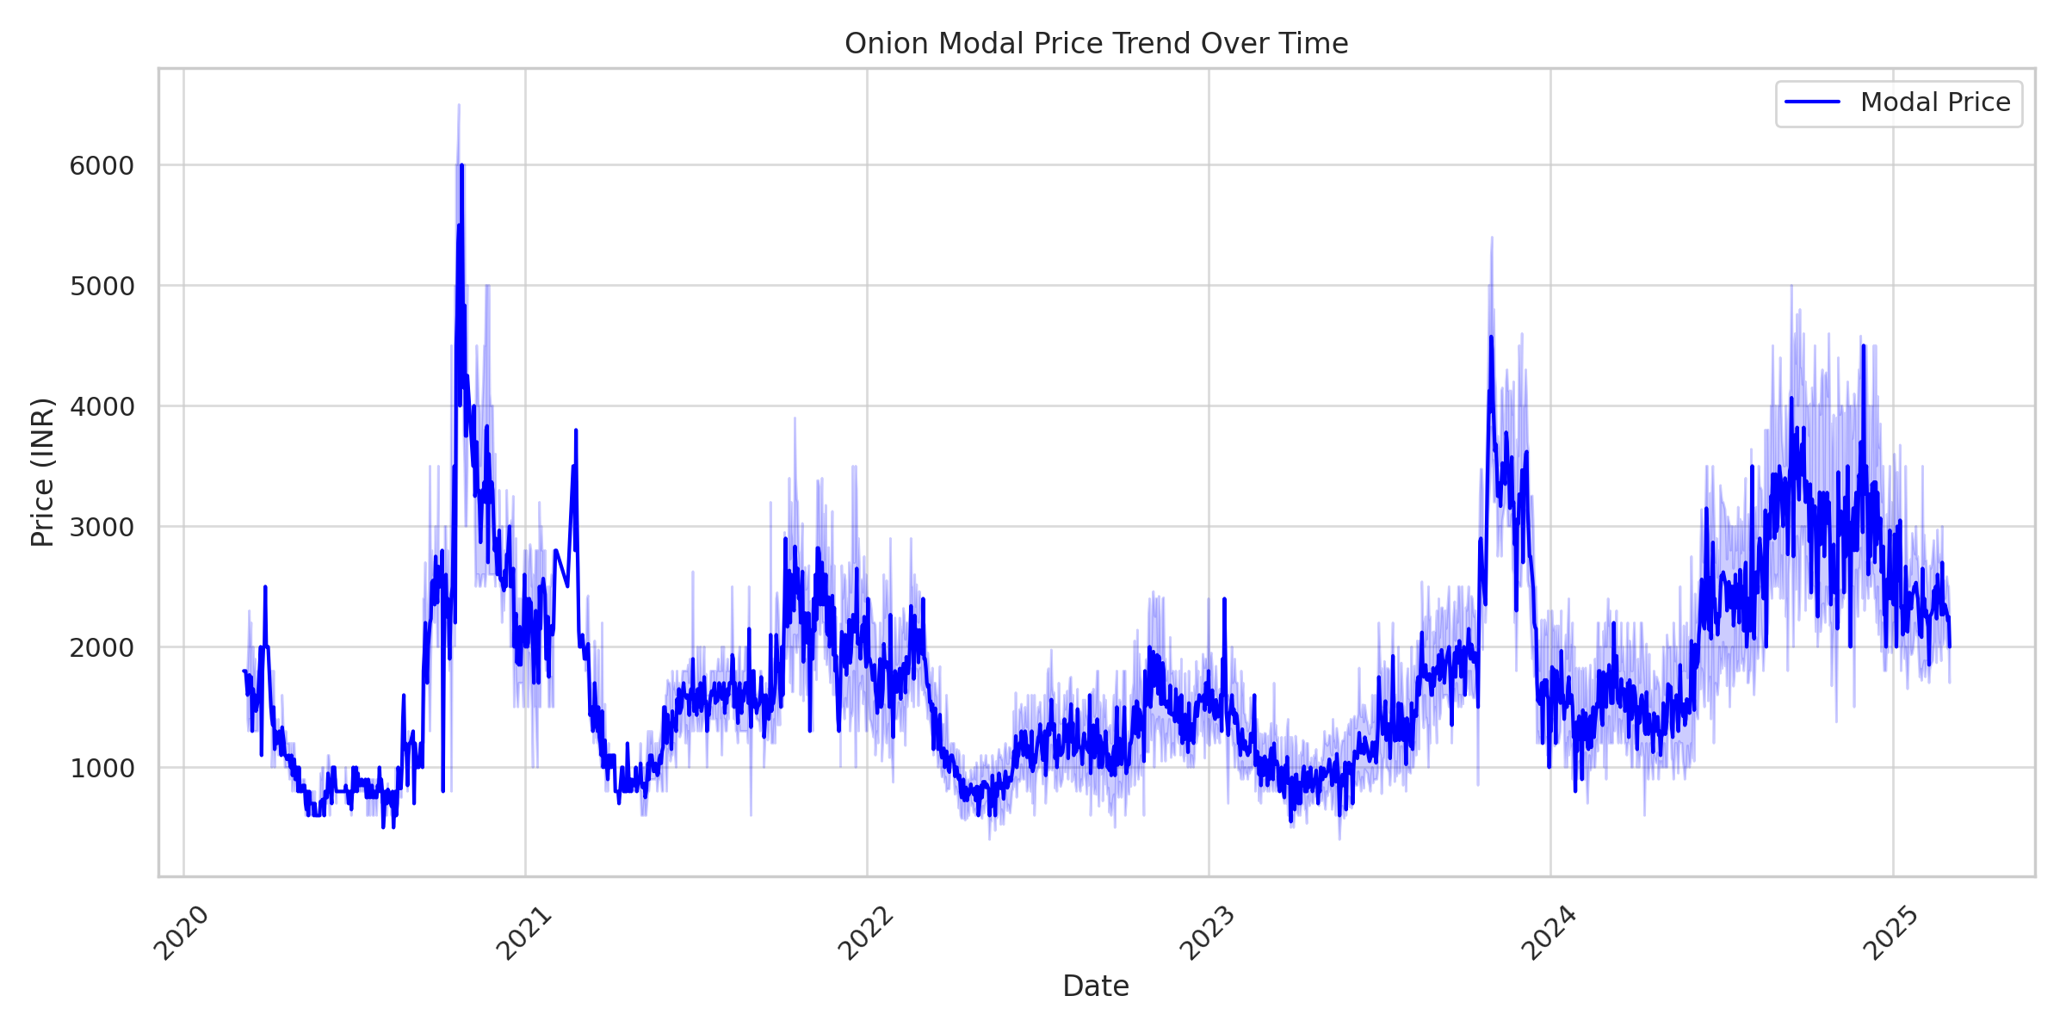
Onion Modal Price Trend Over Time
The price trend shows fluctuations over time, indicating seasonal variations or market influences.

Slide 6
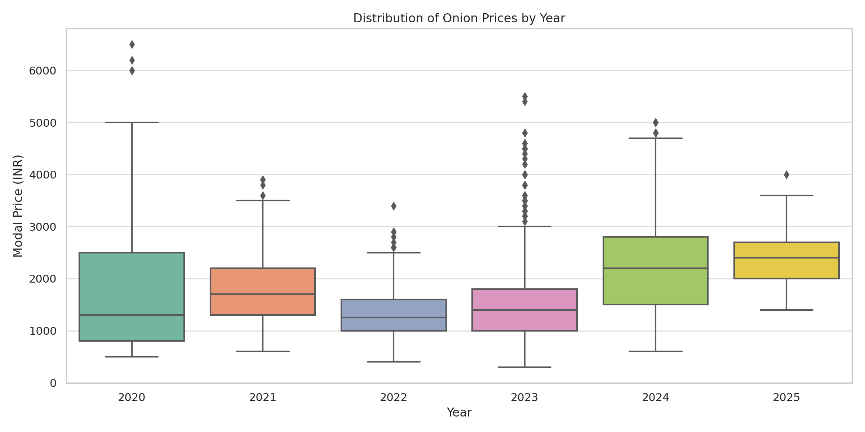
Distribution of Onion Prices by Year
The boxplot shows the variation in prices by year, highlighting market volatility.

Slide 7
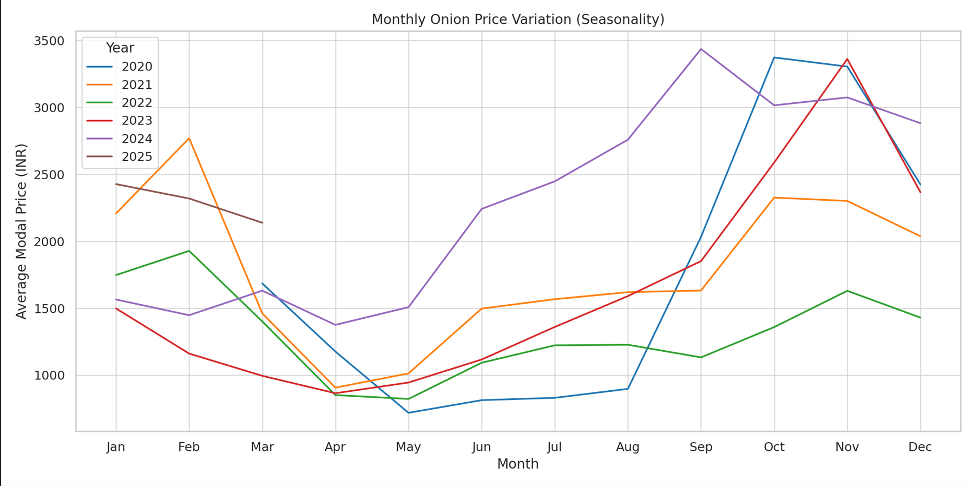
Monthly Onion Price Variation (Seasonality)
This line plot visualizes price changes across different months, grouped by year.
It reveals seasonal trends, such as price surges or drops during specific months.

Slide 8
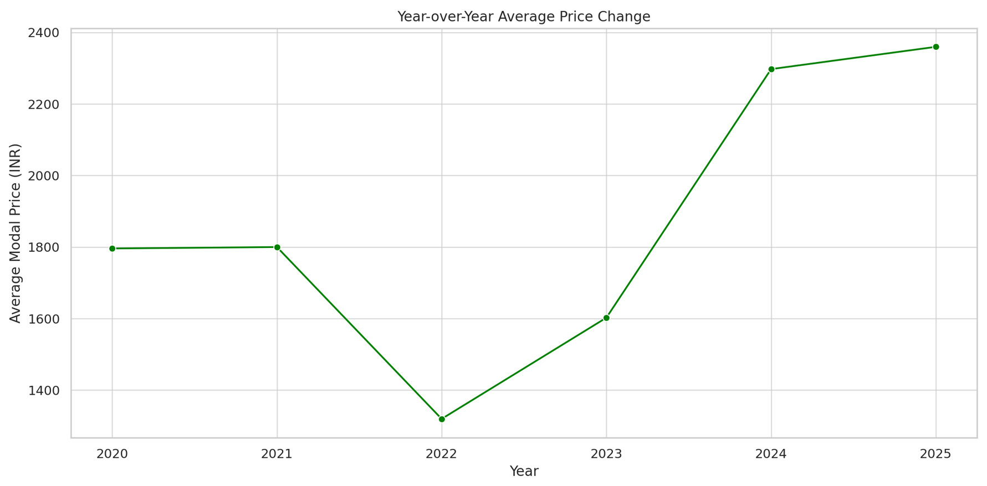
Year-over-Year Average Price Change
This line plot shows how the average onion price has changed year over year.
It helps visualize overall market growth or decline trends.

Slide 9
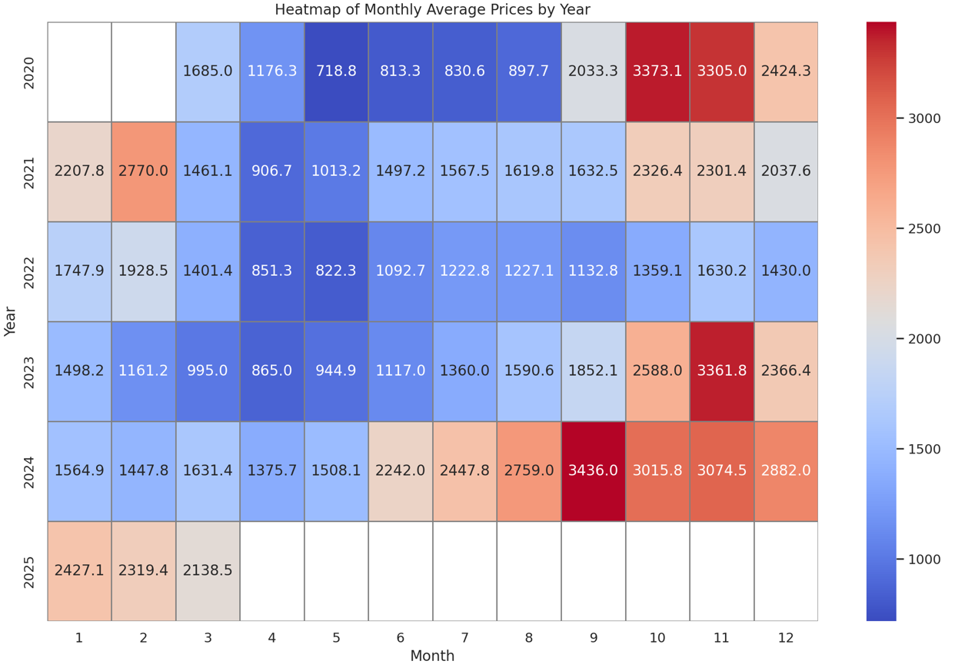
Heatmap of Monthly Average Prices by Year
This heatmap shows the correlation between years and months in terms of average onion prices.
It helps identify seasonal patterns and year-to-year price variations.

Slide 10
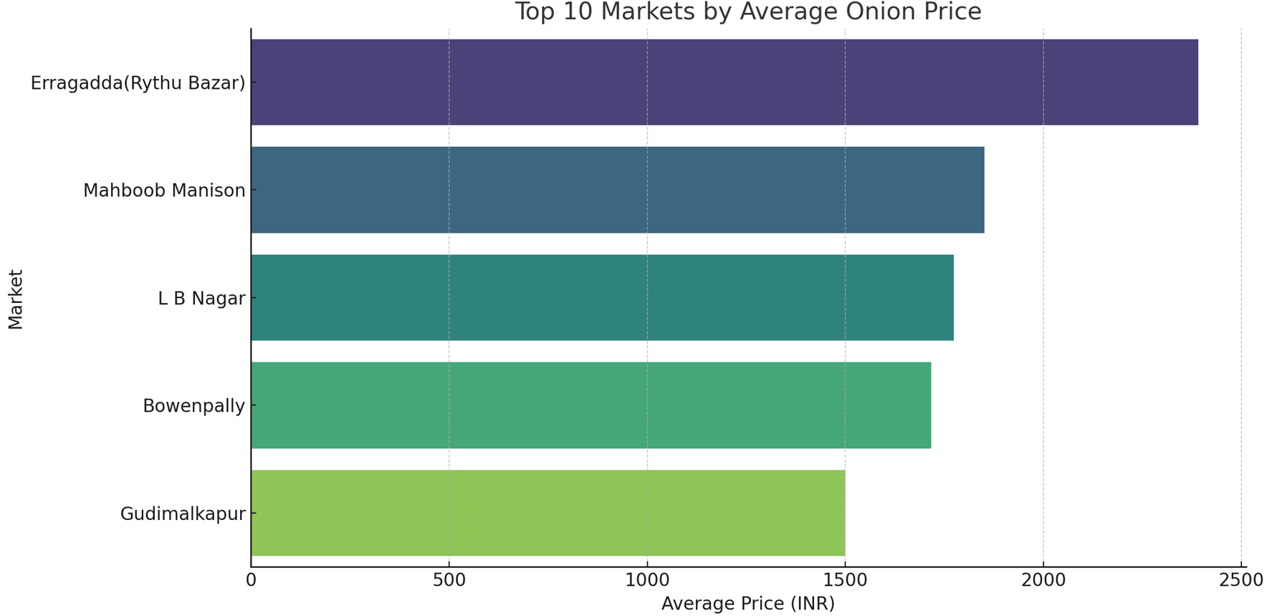
Top 5 Markets by Average Onion Price
This bar plot shows the markets with the highest average onion prices.
It highlights premium markets where onion prices are consistently higher.

Slide 11
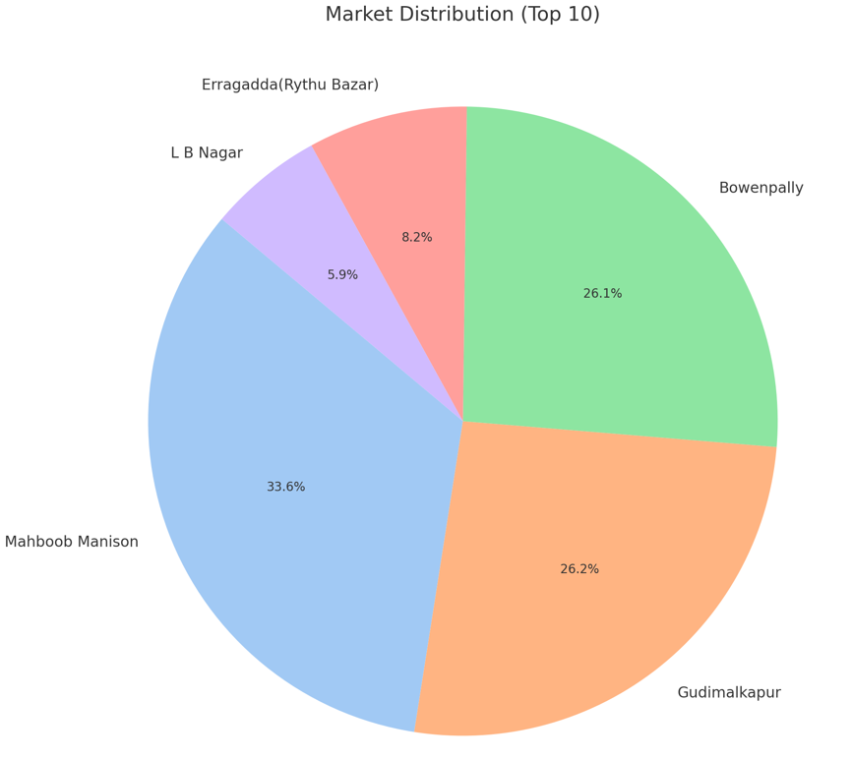
Market Distribution
This pie chart displays the top 10 most frequent markets in the dataset.
It shows the market distribution share.

Slide 12
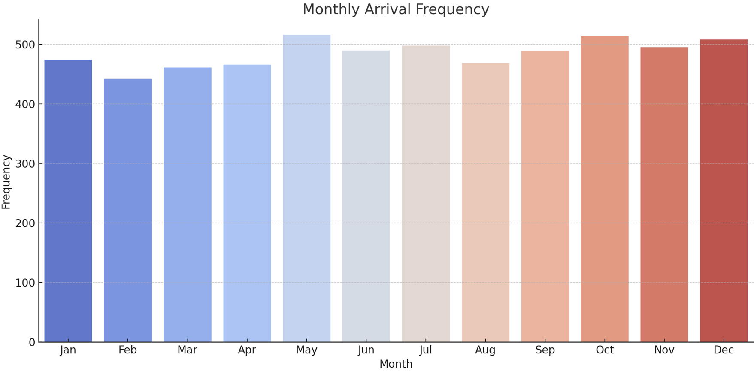
Monthly Arrival Frequency
This bar plot shows the frequency of onion arrivals by month.
It helps identify which months have the most arrivals.

Slide 13
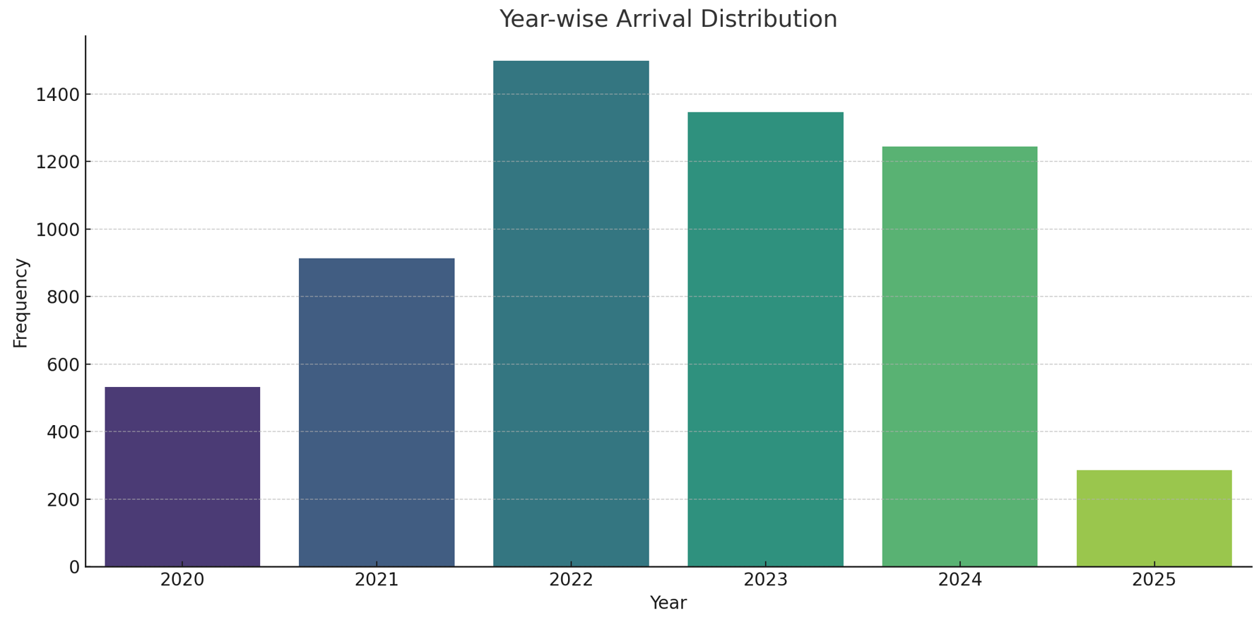
Year-wise Arrival Distribution
This bar plot displays the distribution of arrivals by year.
It shows how onion arrivals vary over the years.

Slide 14
Dataset Observation
1. Date Range & Missing Data:
- The dataset covers onion prices from 2020 to 2025.
- Some missing values exist in the Arrival_Date column.
2. Price Trends & Statistics:
- The minimum, maximum, and modal prices of onions show fluctuations over time.
- The average modal price varies yearly , indicating possible seasonal or market-driven trends.
3. Variety Analysis:
- Multiple onion varieties are recorded in the dataset.
- Some varieties are more frequently listed, as seen in the Variety Countplot.
- The price distribution varies by variety, with some having a wider range of prices.

Slide 15
Dataset Observation
4. Distribution Insights:
- The histogram of minimum prices suggests that most onion prices fall within a certain range.
- The violin and boxplots indicate price spread and outliers among different varieties.
5. Trend Over Time:
- The line chart of average price per year shows a possible rising or fluctuating trend.
- Peak or dip years might be correlated with supply-chain issues, demand surges, or external factors.

Slide 16
Conclusion
Onion prices show seasonal variations and volatility over the years.
Certain states dominate the market with frequent entries.
Understanding these trends can help in better market forecasting and decision-making.

