Slide 1

Machine Learning
Second Review
Stock Price Movement Prediction
Presented by
M V Bharadwaj (24B11CS259)
Macha Vivek(24B11CS258)
Chandra Koushik (24B11CS502)
Department of Computer Science and Engineering

Slide 2




Problem Statement
Stock prices fluctuate continuously due to various market conditions, making it difficult to identify future price movements using historical data alone. Manually analyzing large amounts of stock-price data is time-consuming and may not reveal useful patterns effectively. Therefore, this project aims to develop a Machine Learning-based system to predict the next day's stock price movement as UP or DOWN using historical stock-price data. The system performs data preprocessing, feature engineering, and classification using features such as daily returns, moving averages, volatility, and RSI. Multiple machine learning algorithms, including Logistic Regression, Random Forest, and Support Vector Machine (SVM), are used and evaluated using standard classification metrics to study their performance.

Slide 3
ABSTRACT
The Stock Price Movement Prediction project is a machine learning-based system designed to predict whether a stock price will move UP or DOWN on the next trading day using historical stock-price data. The project follows a structured workflow involving data collection, preprocessing, exploratory data analysis, feature engineering, and machine learning classification. Features such as daily return, moving averages, volatility, and Relative Strength Index (RSI) are used to identify meaningful patterns in historical data. The target variable is represented as 1 for UP movement and 0 for DOWN movement. Machine learning algorithms including Logistic Regression, Random Forest, and Support Vector Machine (SVM) are implemented and evaluated using accuracy, precision, recall, F1-score, and confusion matrix.

Slide 4
OBJECTIVES
To analyze historical stock-price data and identify useful patterns.
To perform data cleaning and preprocessing on the stock dataset.
To generate meaningful features such as Daily Return, Moving Averages, Volatility, and RSI.
To predict the next-day stock-price movement as UP or DOWN.
To implement and compare Logistic Regression, Random Forest, and SVM classification models.
To evaluate model performance using Accuracy, Precision, Recall, F1-score, and Confusion Matrix.
To study the effectiveness of machine learning techniques for stock movement prediction.

Slide 5
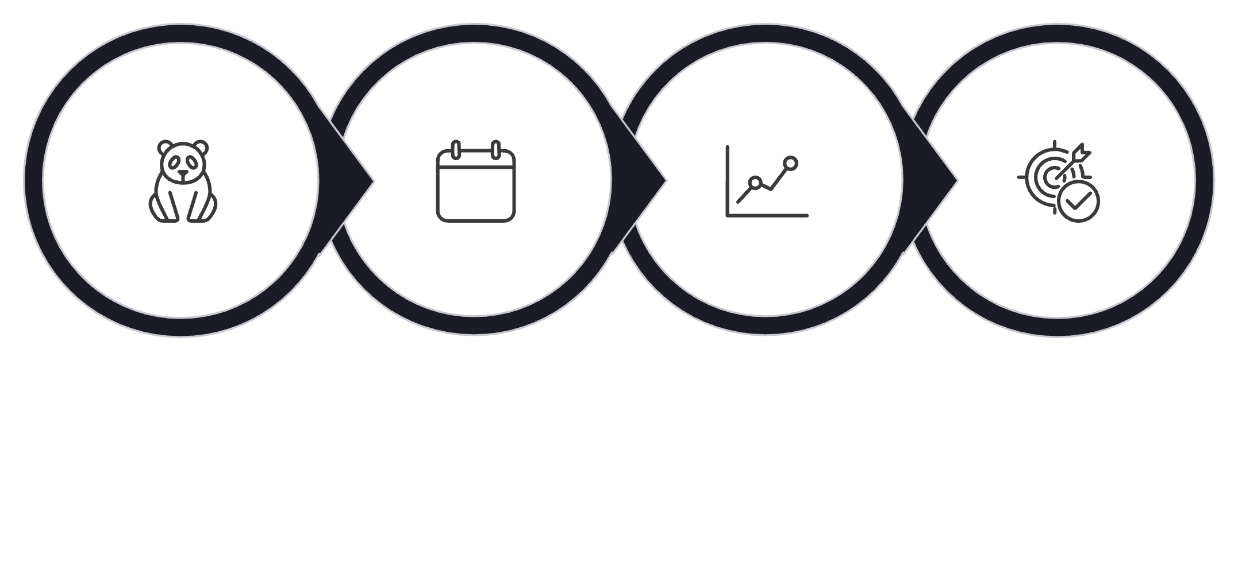
DATA PREPROCESSING
Load & Inspect
Date Handling
Feature Engineering
Target Creation
Load & Inspect Data – Import the stock-price CSV into Pandas and check its shape, columns, data types, and structure.
Clean & Organize Data – Handle missing values and duplicates, convert the Date column, and sort the data chronologically.
Feature Creation – Generate features such as Daily Return, MA_5, MA_10, MA_20, Volatility, and RSI, and remove rows with insufficient historical data.
Target Creation – Create the target variable based on next-day price movement: 1 = UP and 0 = DOWN.

Slide 6
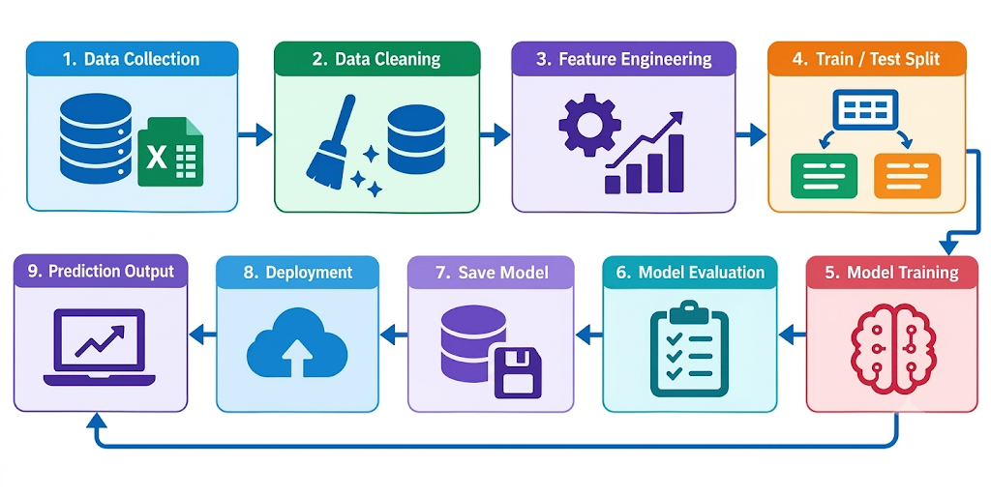
METHODOLOGY
Data Collection & Preprocessing – Collect, inspect, clean, and chronologically organize the stock data, then create the target (UP = 1, DOWN = 0).
Feature Engineering & Data Preparation – Generate returns, lag features, moving averages, volatility, and momentum, followed by feature selection and 80:20 train-test splitting with scaling where required.
Model Training & Evaluation – Train Logistic Regression, SVM, Random Forest, Extra Trees, Gradient Boosting, and HistGradientBoosting, and compare them using Accuracy, Precision, Recall, F1-score, Confusion Matrix, and ROC-AUC.
Model Selection & Saving – Select the model based on evaluation results and save the selected model along with the preprocessing components for future predictions.

Slide 7
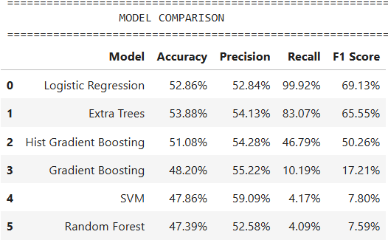
ML MODELS
ML Models Used in the Project
Logistic Regression – Used for binary classification of stock movement as UP or DOWN.
Support Vector Machine (SVM) – Classifies stock movements by finding an optimal decision boundary.
Random Forest – Uses multiple decision trees to make predictions.
Extra Trees Classifier – Uses randomized decision trees to capture complex patterns.
Gradient Boosting – Builds sequential decision trees to improve prediction performance.
HistGradientBoosting – A faster histogram-based boosting model suitable for larger datasets
Final selected model: Logistic Regression, based on the highest F1-score in the tested results.

Slide 8
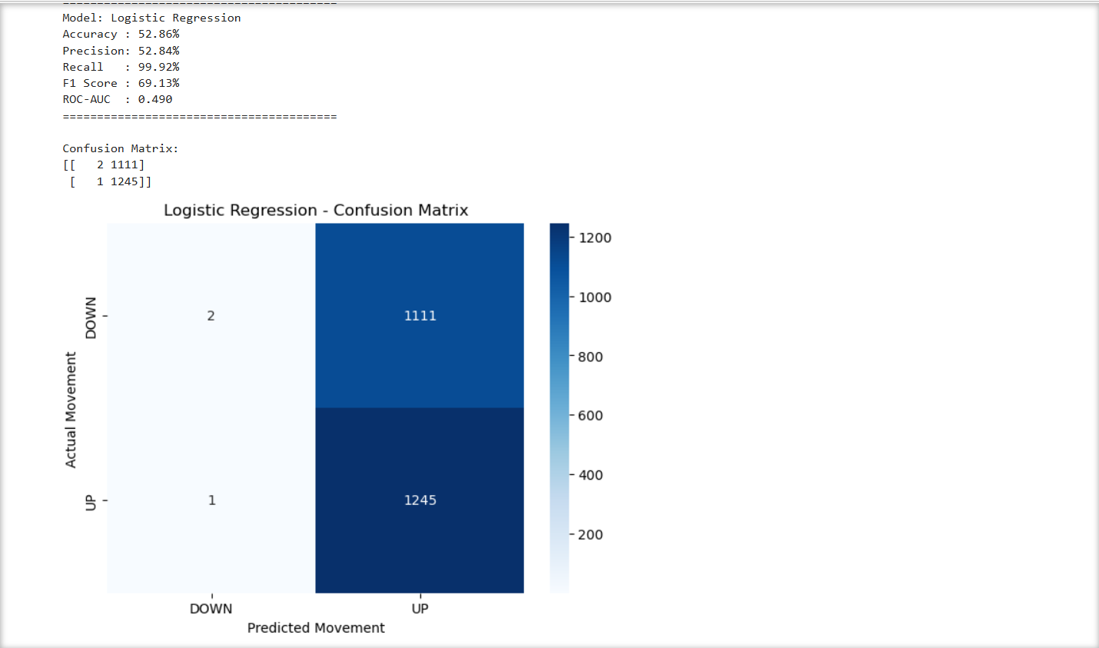
EVALUATION METRICS

Slide 9
CONCLUSION
The project successfully developed a machine learning system to predict next-day stock movement as UP or DOWN. Multiple models were trained and evaluated, with Logistic Regression selected based on the highest F1-score. The system demonstrates how machine learning can be applied to historical stock data for movement prediction.

Slide 10
THANK YOU

