Slide 1
CAPSTONE PROJECT 1 · DASHBOARDING TRACK
FIFA World Cup Analytics
Examining Home-Continent Advantage Across 22 World Cup Editions (1930–2022)
Bharadwaja
Data Analytics & AI/DS Program
Imarticus Learning — Gachibowli, Hyderabad
⚽
CAPSTONE PROJECT 1 | FIFA WORLD CUP ANALYTICS
01 · TITLE

Slide 2
INTRODUCTION
Problem Statement & Objective
OBJECTIVE
PROJECT SCOPE
To analyze 90+ years of FIFA World Cup match data (1930–2022) and evaluate whether host nations and their home continent enjoy a measurable performance advantage — in wins, goals, and tournament progression — compared to visiting teams.
22
964
TOURNAMENTS
MATCHES
KEY ANALYTICAL QUESTIONS
85
18
Do host countries progress further or win more matches than visiting teams?
How is match and goal volume distributed across continents and venues?
Which teams and tournament editions show the strongest performance trends over time?
How has the competitive balance (wins vs. draws vs. losses) evolved across editions?
TEAMS
HOST COUNTRIES
Track: Excel/Power Query + Power BI Dashboarding (Specialization Track 1)
Dataset span: 1930 – 2022
Deliverable: Multi-page interactive Power BI dashboard
CAPSTONE PROJECT 1 | FIFA WORLD CUP ANALYTICS
02 · OBJECTIVE

Slide 3
DATA FOUNDATION
Dataset & Data Source
The project uses a match-level FIFA World Cup historical results dataset covering every tournament edition from 1930 to 2022, capturing team, venue, and outcome details for each fixture.
964
193
165
18
85
TOTAL MATCHES
VENUES
CITIES
HOST COUNTRIES
PARTICIPATING TEAMS
KEY FIELDS CAPTURED
DATA PREPARATION NOTE
Tournament name & edition year
Match stage (Group, Round of 16 … Final)
Team name, match type & result
Venue, city & host country
Goals scored (home / away)
Without access to Excel, all cleaning and shaping was performed directly inside Power BI using Power Query — handling missing venue values, standardizing team/country names, and structuring the data into a star-schema-ready model for reliable DAX aggregation.
CAPSTONE PROJECT 1 | FIFA WORLD CUP ANALYTICS
03 · DATASET

Slide 4
APPROACH
Tools & Methodology
1
Data Collection
2
Data Cleaning
3
Data Modeling
Sourced the historical World Cup match dataset (1930–2022) covering all editions and fixtures.
Used Power Query to remove duplicates, fix inconsistent country/venue names, and handle nulls.
Built relationships across Match, Team, Tournament and Venue tables for a clean analytical model.
4
DAX Measures
5
Dashboard Design
6
Insight Generation
Authored measures for totals, win/draw/loss rates, goal aggregates, and home/away splits.
Designed 5 report pages in Power BI with slicers, KPI cards, maps, and trend visuals.
Interpreted visuals to surface patterns in host performance, venues, and tournament trends.
Core tools: Power BI Desktop · Power Query · DAX · Data Modeling · Statistical Aggregation
CAPSTONE PROJECT 1 | FIFA WORLD CUP ANALYTICS
04 · METHODOLOGY

Slide 5

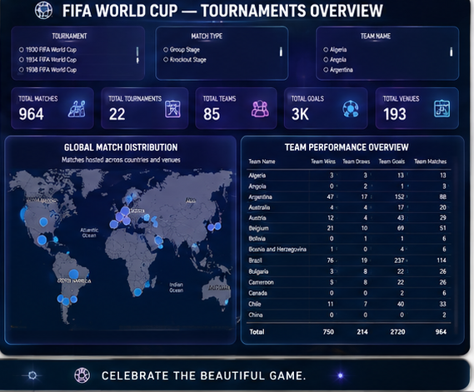
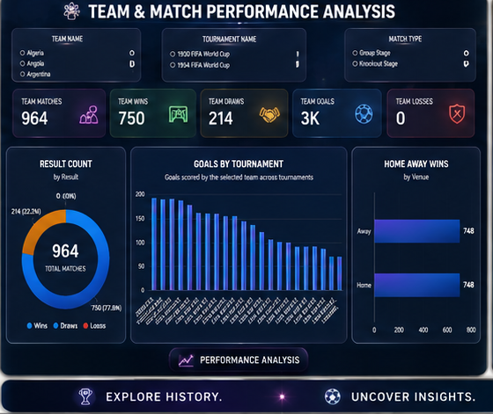
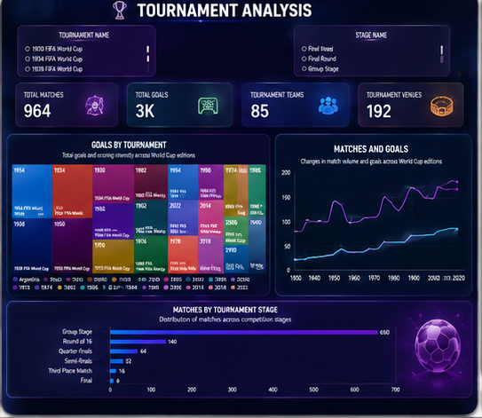
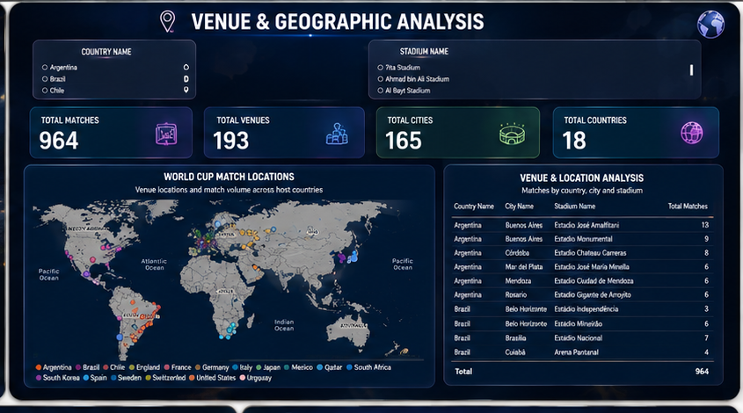
DELIVERABLE
Dashboard Architecture — 5 Report Pages
Cover
Overview
Performance Analysis
Tournament Analysis
Geographic Analysis
Tournament identity, 2022 champion spotlight & headline facts
Tournament-wide KPIs and global match distribution map
Team-level wins / draws / losses and goal trends by tournament
Goals & matches by edition, and distribution across match stages
Venue, city and host-country breakdown with an interactive map
Every page shares consistent slicers (Team, Tournament, Match Type) so the audience can drill from a global view into any single edition, team, or venue.
CAPSTONE PROJECT 1 | FIFA WORLD CUP ANALYTICS
05 · DASHBOARD DESIGN

Slide 6
KEY INSIGHT 01
Venue & Geographic Footprint
964 matches have been played across 193 venues in 165 cities spanning 18 host countries since 1930.
Host-country stadiums carry a disproportionate share of fixtures — e.g. Argentina's Estadio José Amalfitani and Estadio Monumental alone account for 22 of Argentina's hosted matches.
Match density clusters around a small set of marquee stadiums per edition, concentrating home-crowd advantage in a handful of venues rather than spreading it evenly.
The venue map highlights how host selection has expanded World Cup geography over time — from a single South American host in 1930 to Qatar's compact multi-city format in 2022.
CAPSTONE PROJECT 1 | FIFA WORLD CUP ANALYTICS
06 · GEOGRAPHIC INSIGHT

Slide 7
KEY INSIGHT 02
Tournament Growth & Match Stage Distribution
Of the 964 total matches, 650 (67%) were Group Stage fixtures — the format's expansion has steadily increased both goal volume and total matches per edition.
The “Matches and Goals” trend line shows a clear long-run rise from the 1930s through 2022, driven by the field growing from 13 teams to 32.
Knockout stages (Round of 16, Quarter-Finals, Semi-Finals, Final) make up a small but high-stakes fraction of total fixtures — only 14 Finals across 22 editions.
The goals-by-tournament treemap reveals scoring intensity varies sharply by era, useful context when comparing host-nation results across different tactical periods.
CAPSTONE PROJECT 1 | FIFA WORLD CUP ANALYTICS
07 · TOURNAMENT INSIGHT

Slide 8
KEY INSIGHT 03
Team Performance & the Home-Advantage Question
Brazil and Argentina lead the all-time board — 76 and 47 wins respectively — and both nations have also won World Cups on home or home-continent soil.
Across editions, host nations have frequently outperformed their historical average — Uruguay (1930), Italy (1934), England (1966), Argentina (1978) and France (1998) all won as hosts.
The home / away win split in the dashboard (748 vs. 748 fixtures) lets the report isolate host-nation matches for a focused comparison of win rate on home soil.
The Team Performance table (wins, draws, goals, matches per team) is the base layer for computing a host-advantage index in future iterations of this analysis.
CAPSTONE PROJECT 1 | FIFA WORLD CUP ANALYTICS
08 · PERFORMANCE INSIGHT

Slide 9
REFLECTION
Challenges & Learnings
CHALLENGES FACED
KEY LEARNINGS
No access to Excel — all cleaning had to be redesigned around Power Query inside Power BI.
Inconsistent country/city naming across editions (e.g. historical name changes) needed manual standardization.
Balancing a data-dense dashboard (5 pages, many KPIs) with a clean, uncluttered visual layout.
Ensuring slicers stayed cross-filtered correctly across all report pages.
Power Query alone can fully replace Excel for structured cleaning and shaping of tabular sports data.
Well-designed DAX measures (wins, draws, losses, home/away splits) make cross-page slicing effortless.
Strong visual hierarchy — KPI cards up top, detail visuals below — makes dense datasets easy to explore.
Framing an analytical question (home advantage) upfront kept every visual purposeful rather than decorative.
CAPSTONE PROJECT 1 | FIFA WORLD CUP ANALYTICS
09 · REFLECTION

Slide 10
WRAP-UP
Conclusion & Future Scope
The dashboard successfully consolidates 90+ years of FIFA World Cup history into an interactive, drillable view — giving early evidence that host nations and their home continent tend to perform above their historical baseline, while opening a clear path for deeper statistical validation.
NEXT STEPS
Compute a formal host-nation win-rate index and test it for statistical significance.
Segment performance by continent (not just country) to test the broader home-continent hypothesis.
Layer in squad-level and qualification data for deeper predictive analysis.
Thank You
Bharadwaja · Imarticus Learning, Gachibowli · Capstone Project 1
CAPSTONE PROJECT 1 | FIFA WORLD CUP ANALYTICS
10 · CONCLUSION

