Slide 1
CS666: Hardware Security of Internet of Things
Pipelined AES-128 Encryption Module for PYNQ Board
Instructor : Dr. Urbi Chatterjee
IOTians
Ajith Addala [251110006]
Mavilla Bharadwaja [251110021]
Harsh Sanjay Pandey [251110035]
Kamal Gupta [251110041]
Shikha Yadav [251110067]
Department of Computer Science and Engineering, Indian Institute of Technology Kanpur
1

Slide 2
Problem Statement
Start from the provided AES Encryption code.
Modify the Key Expansion logic to be sequential instead of combinational reduces critical path delay and improves timing.
Introduce pipelining in the AES core so that:
The first encryption takes multiple cycles (initial latency).
Each subsequent encryption completes in one clock cycle.
Evaluate and report:
Throughput (bits per second)
Throughput / Area efficiency
Initial latency
Design optimizations and architecture details
2

Slide 3
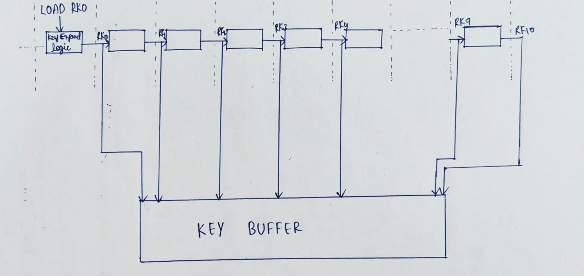
High-Level Design Architecture
3

Slide 4
AES128_KEY_EXPAND_STREAM
This module performs the key expansion for the AES-128 encryption process in a sequential manner.
The load input wire is the same as key_valid (from the testbench), and the busy output register is the same as the kexp_busy wire in the aes128_pipeline_stream module.
The rk_out, rk_round, and rk_valid signals were explained in the aes128_pipeline_stream module description.
4

Slide 5
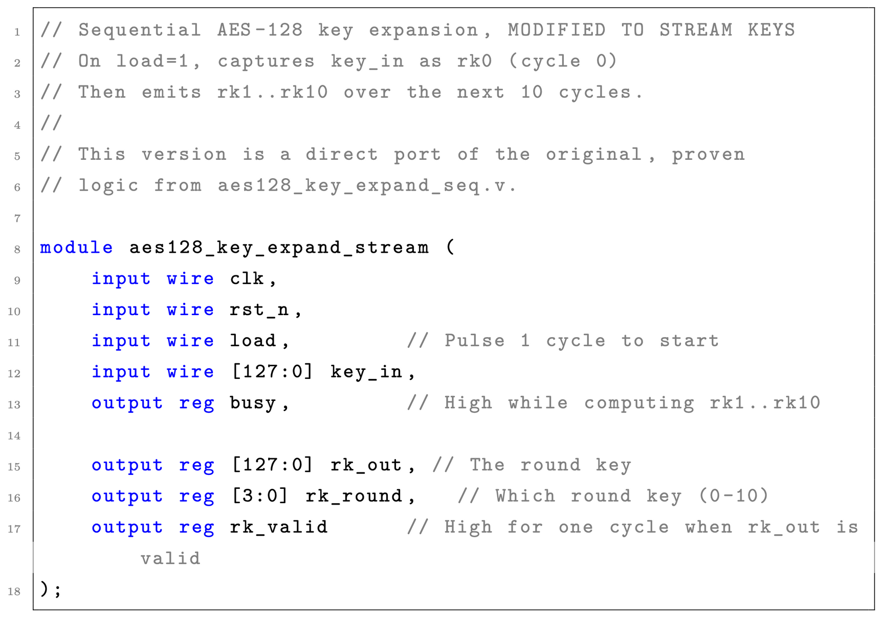
5

Slide 6
The functions aes_sbox_fn, rcon, and rotword are used to generate the keys for each round.
aes_sbox_fn acts as a substitution function, rotword acts as a rotation function, and the rcon function provides the round constants.
These function implementations are identical to the original AES specification.
6

Slide 7
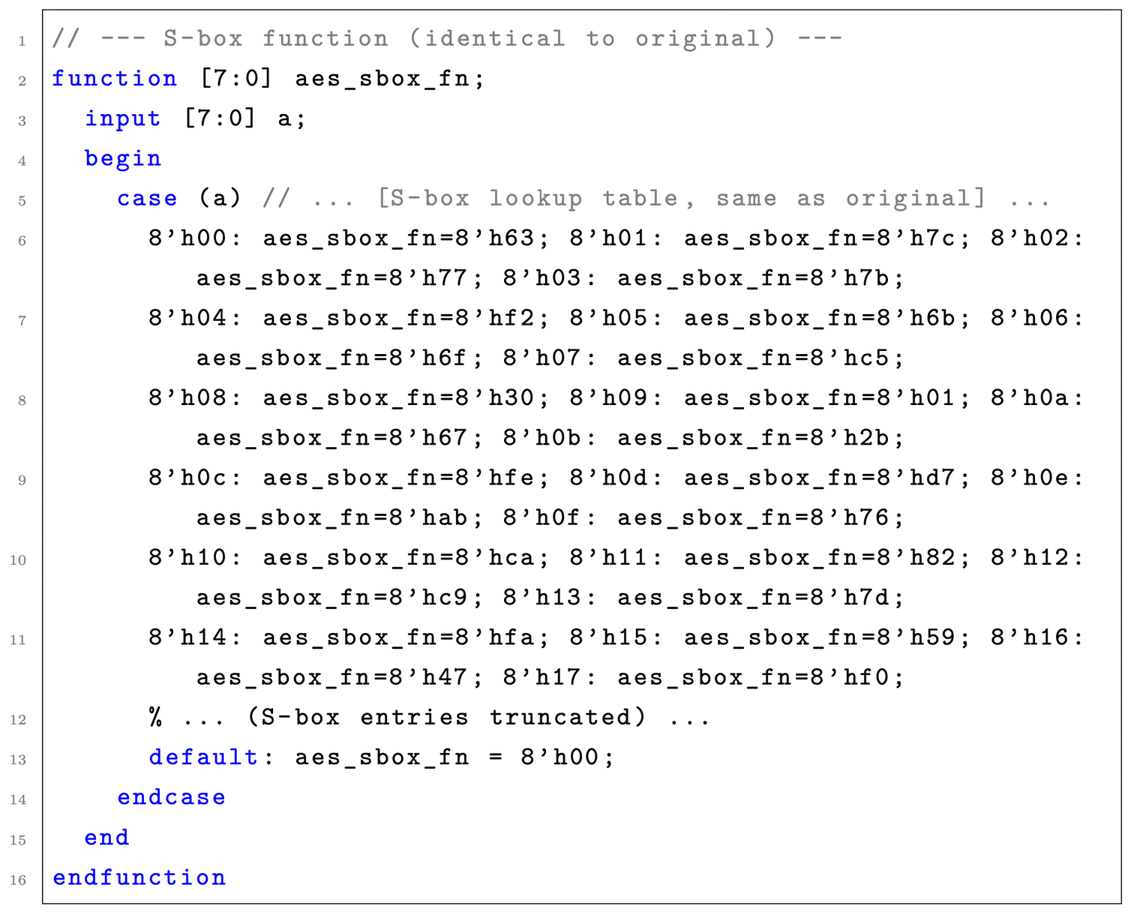
7

Slide 8
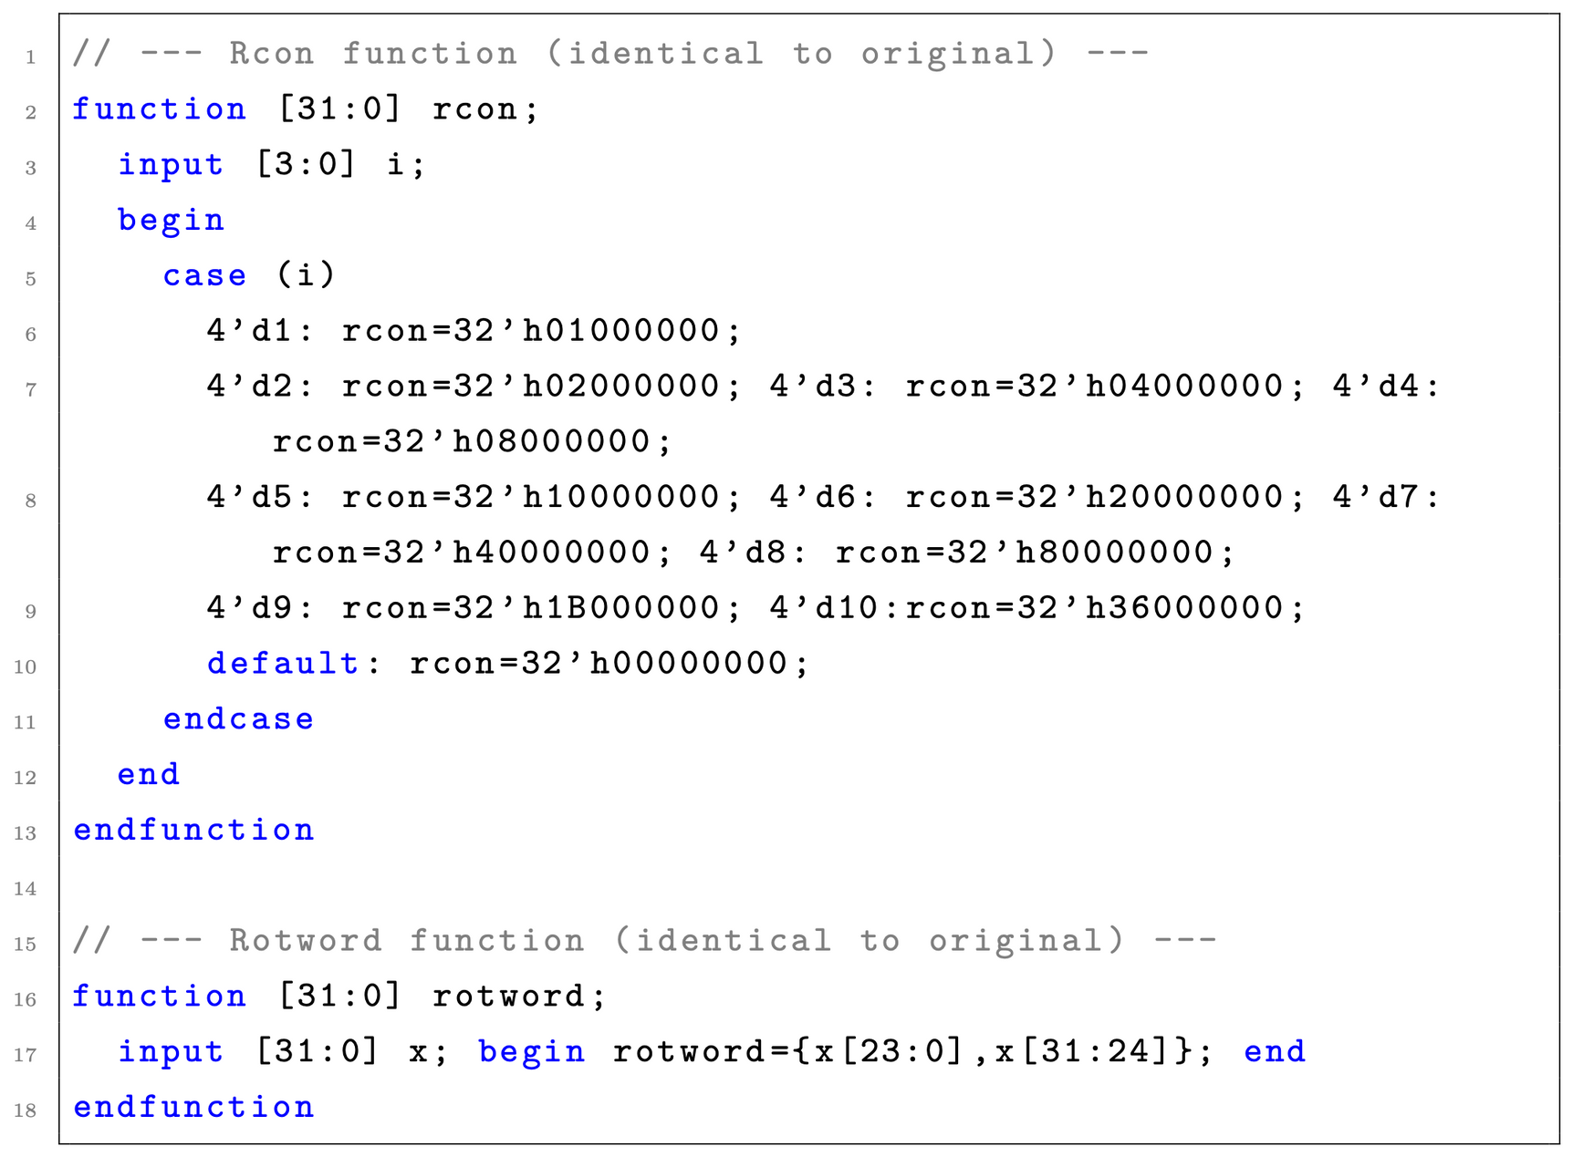
8

Slide 9
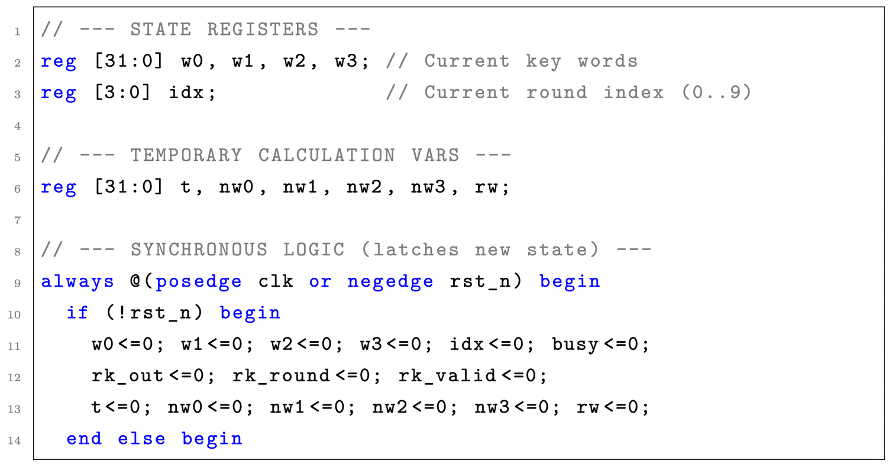
The 32-bit registers w0, w1, w2, and w3 represent the four 32-bit words (or columns) of the current key state. The idx register tracks the current round of key generation, with its value ranging from 0 to 9. The other registers (t, nw0, etc.) act as temporary variables for calculation. During a reset, all these registers are set to 0.
9

Slide 10
Key generation begins here. The load signal(connected to key_valid in the testbench) is checked. If load is 1, this block executes. It loads the initial key (key_in) into the state registers (w0-w3) and sets busy to 1 to begin the expansion process. Crucially, it also *immediately* streams out the 0th round key (which is just the original key_in) by setting rk_out to key_in, rk_round to 0, and rk_valid to 1 for one cycle. In the testbench, key_valid is then set to 0, so this block does not execute again. The busy signal remains high to allow the generation of the next 10 round keys.
10

Slide 11
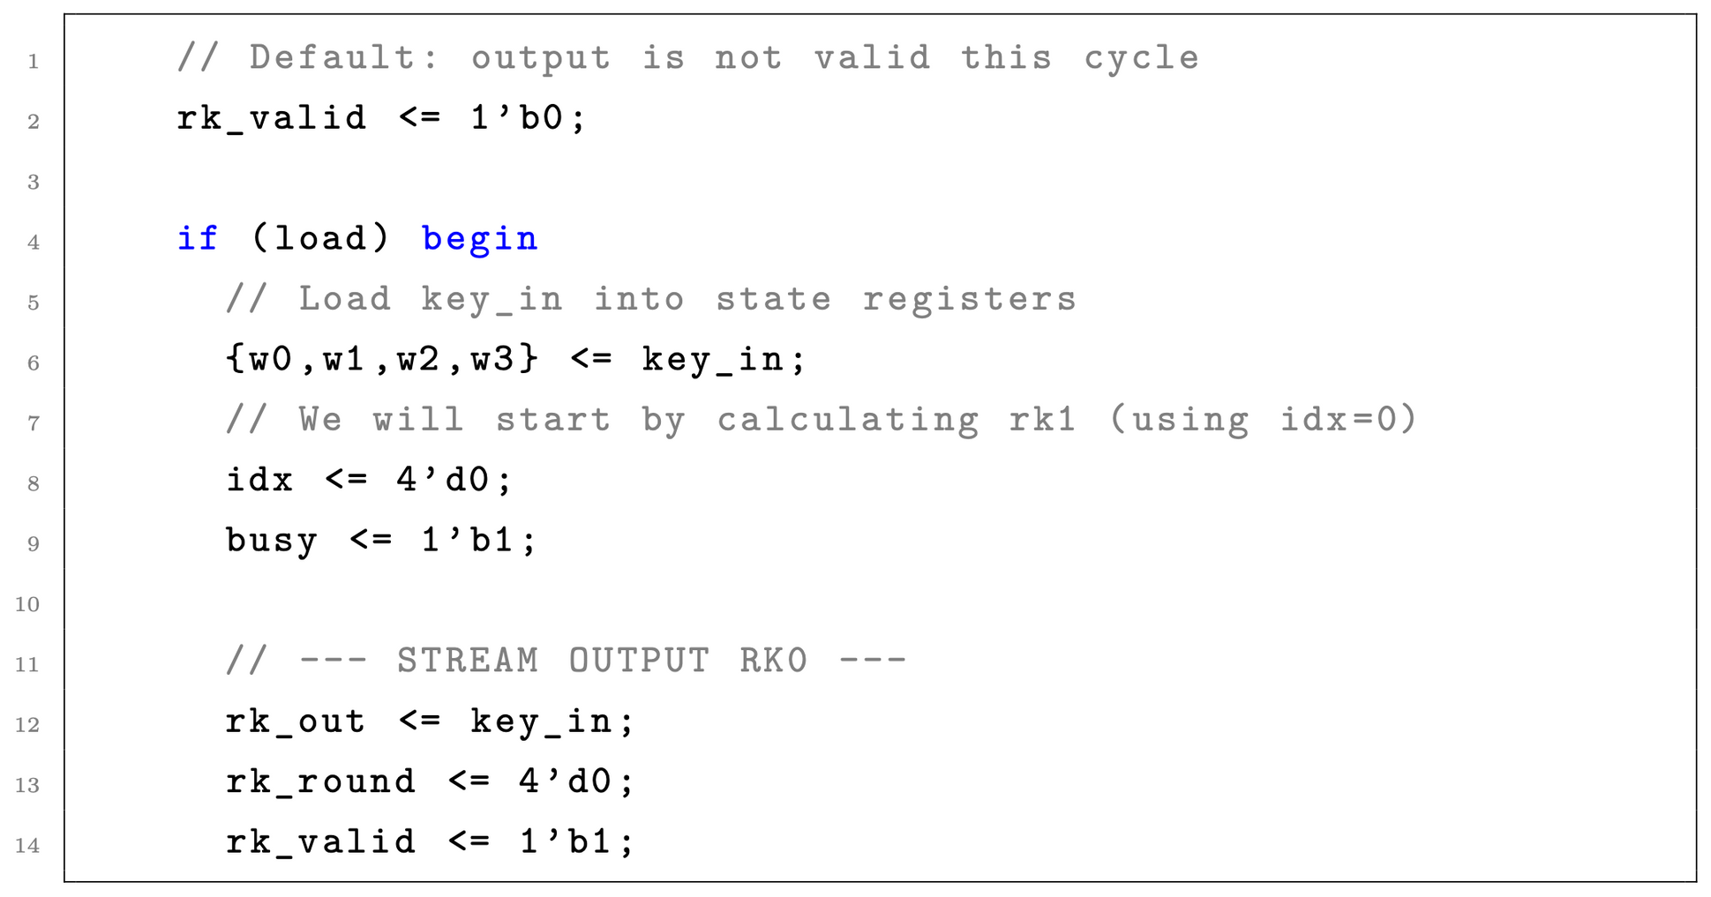
11

Slide 12
If the module is not loading (i.e., load is 0) but is busy, it enters this block to generate round keys 1 through 10.
The logic calculates the next round key based on the current state (w0-w3) and stores it in the temporary variables nw0-nw3.
These new key words are then (1) latched into the state registers (w0-w3) for the *next* cycle’s calculation and (2) simultaneously streamed to the output via rk_out.
The rk_round is updated using idx + 1, and rk_valid is set high for one cycle.
When the final round key (rk10) is calculated (when idx == 9), the busy register is set to 0, stopping the key expansion process.
12

Slide 13
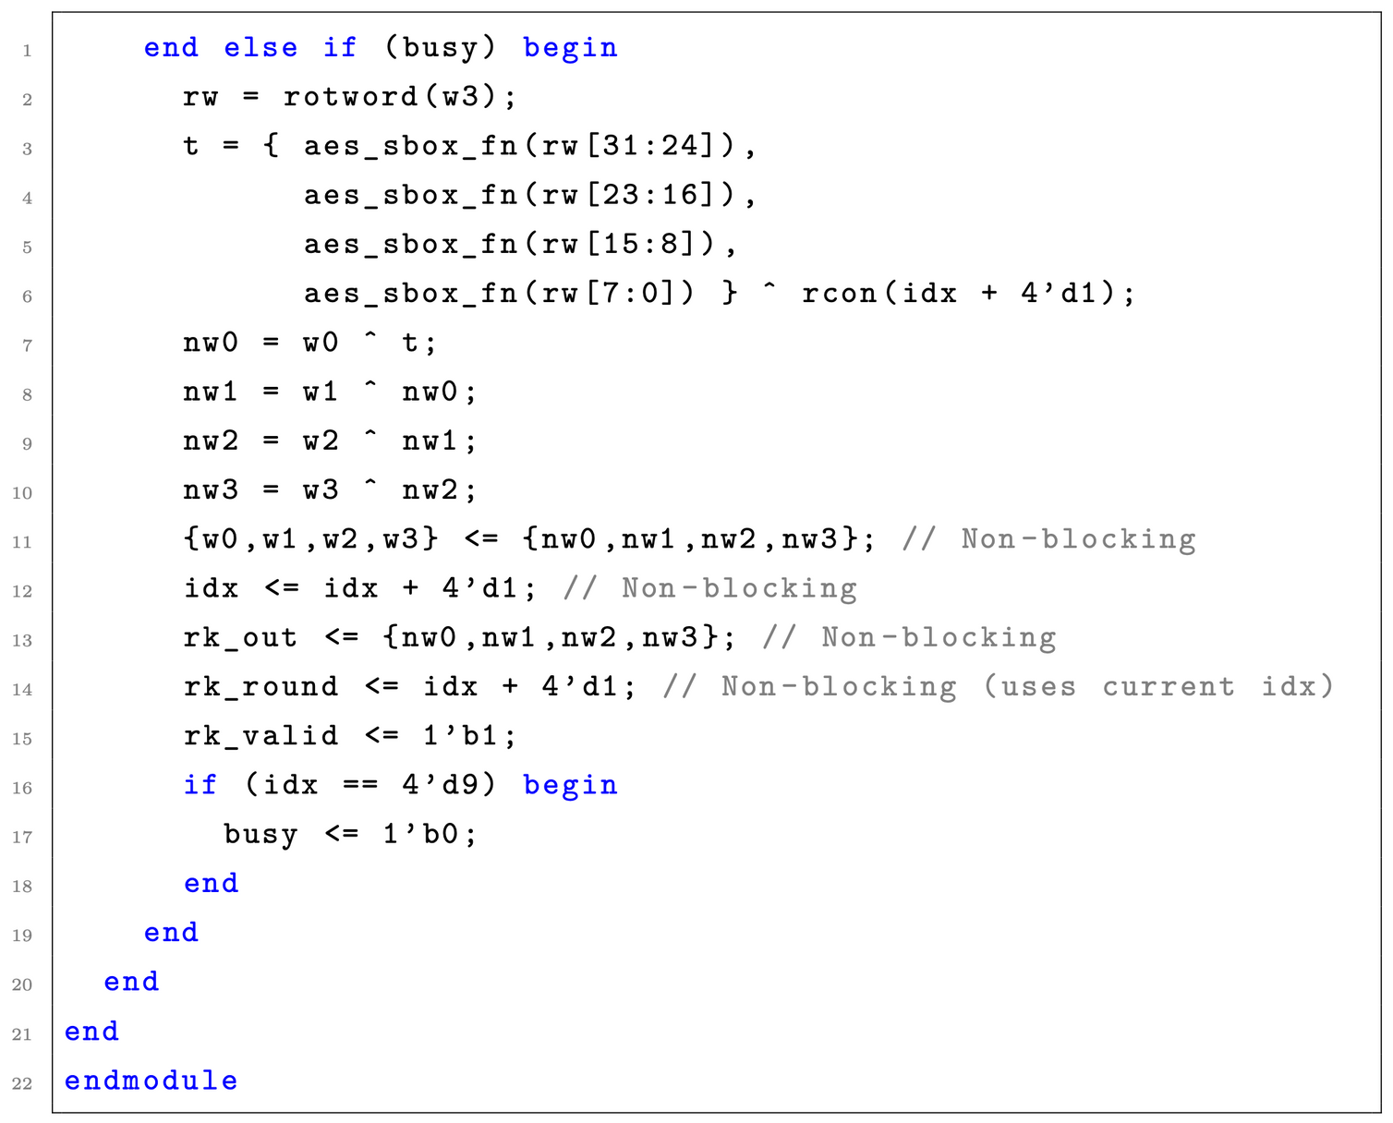
13

Slide 14
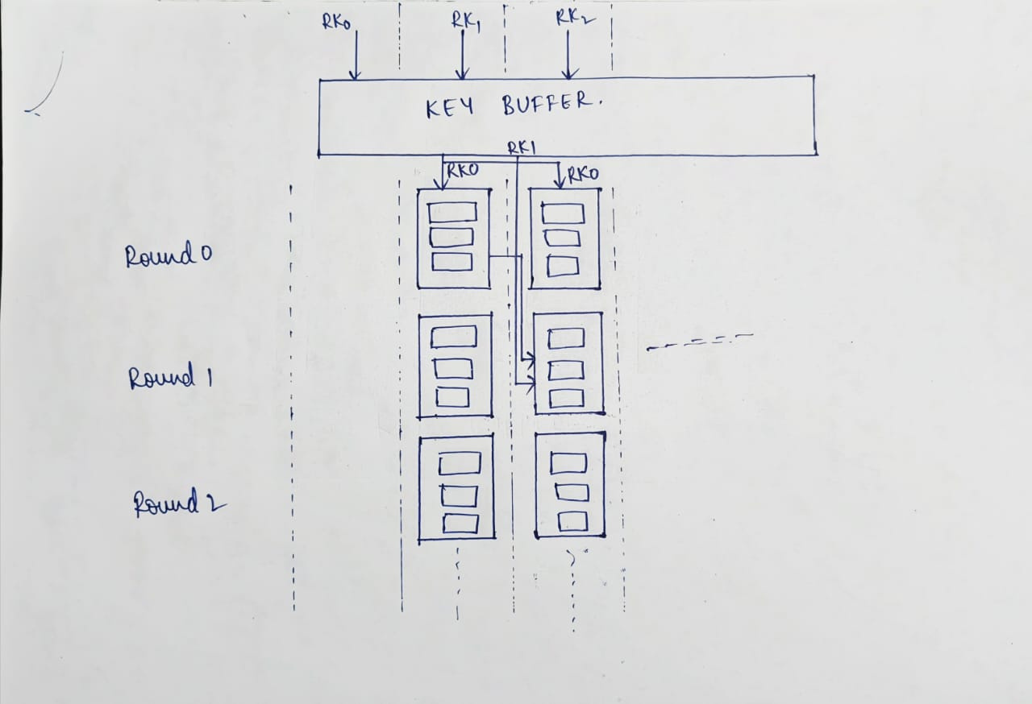
14

Slide 15
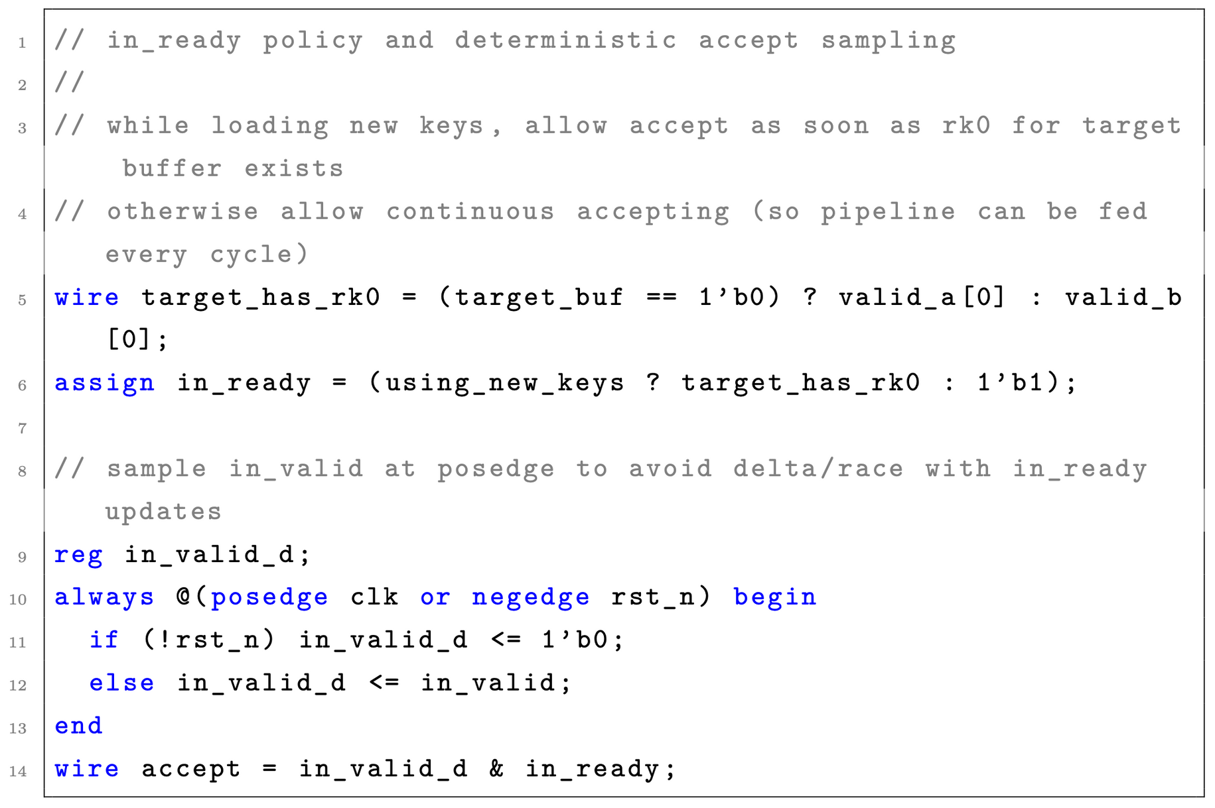
Readiness Policy
After receiving round key 0, we can start the encryption process.
Since the inputs and the 0th key are ready, we set in_ready high.
accept also goes high (as a combination of in_valid and in_ready), allowing the module to start accepting plaintexts.
15

Slide 16
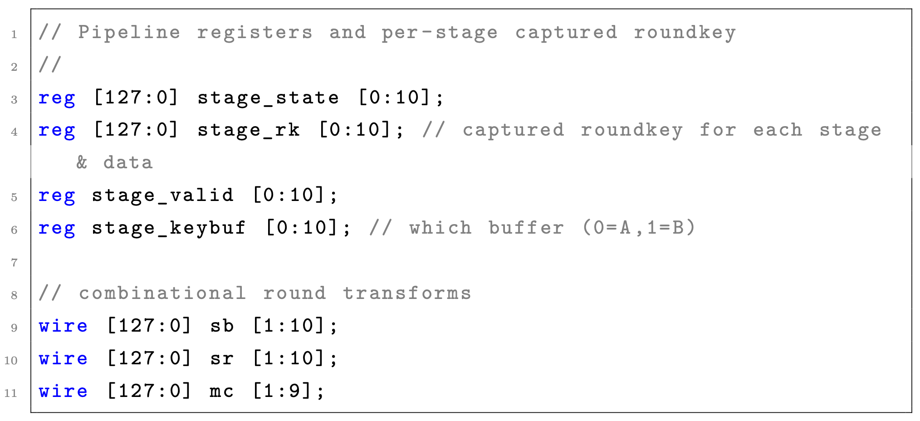
Pipeline Registers and Wires
The following registers and wires are used to build the 11-stage pipeline:
stage_state: An array of 11 registers, each holding the 128-bit output block after each round (stage).
stage_rk: An array of 11 registers, each holding the 128-bit round key for its corresponding stage.
stage_valid: An array of 11 registers; a high value indicates the data in the corresponding stage_state is valid.
16

Slide 17
sb: An array of 128-bit wires connecting the aes_subbytes module output to the aes_shiftrows module input for each round.
sr: An array of 128-bit wires connecting the aes_shiftrows output to the aes_mixcolumns input for each round.
mc: An array of 128-bit wires representing the output from the aes_mixcolumns module for each round.
17

Slide 18
Combinational Round Transforms
We use a generate loop to instantiate the transformation modules for rounds 1 through 9.
This creates 9 instances of aes_subbytes, 9 instances of aes_shiftrows, and 9 instances of aes_mixcolumns.
For the final round (stage 10), aes_subbytes and aes_shiftrows are instantiated separately, as the aes_mixcolumns step is skipped.
18

Slide 19
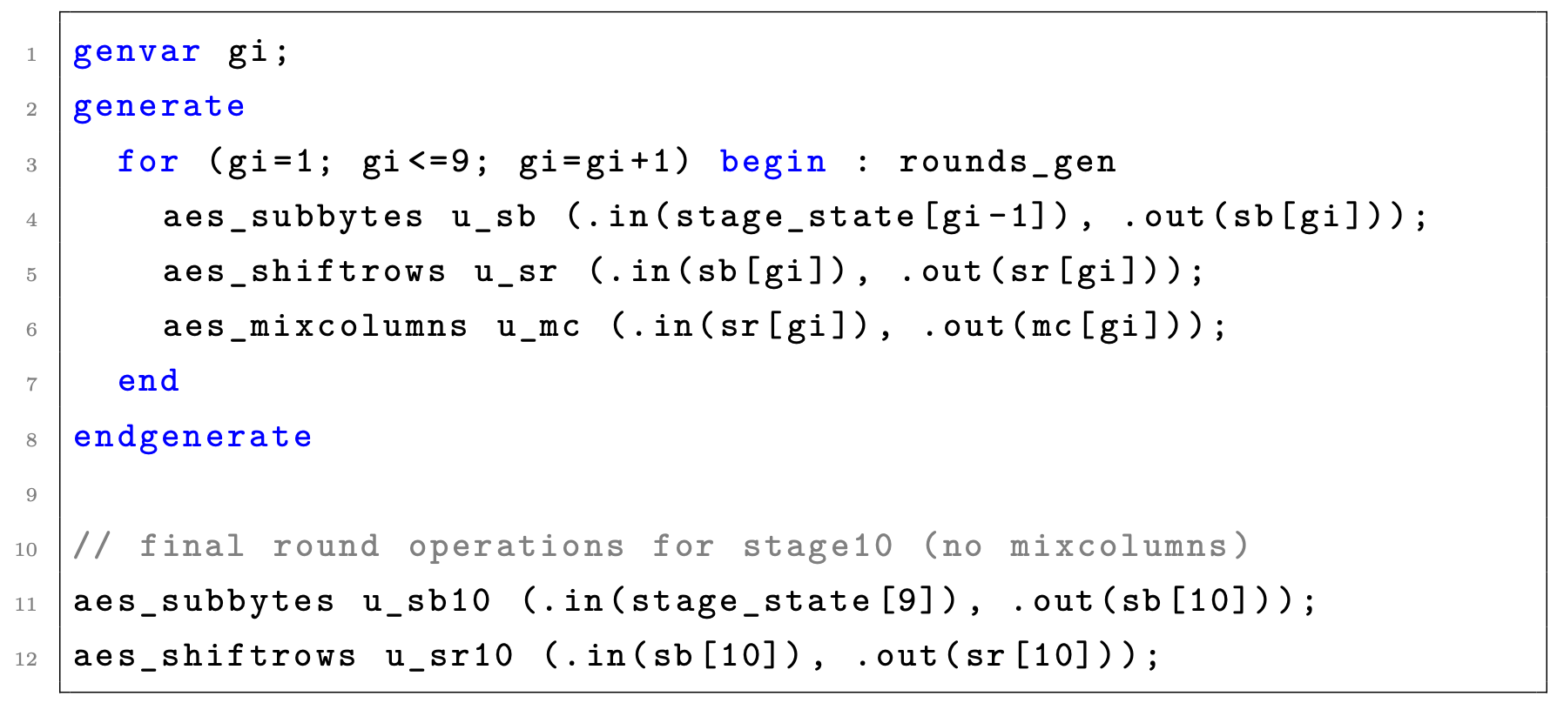
19

Slide 20
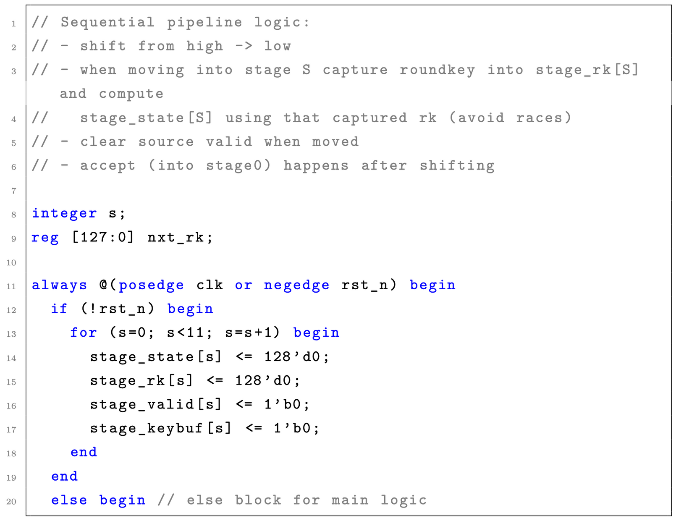
Sequential Pipeline Logic
The main sequential pipeline logic begins in an always block.
Reset: During an active-low reset (!rst_n), a for loop initializes all 11 stages (stage_state, stage_rk, stage_valid) to 0.
20

Slide 21
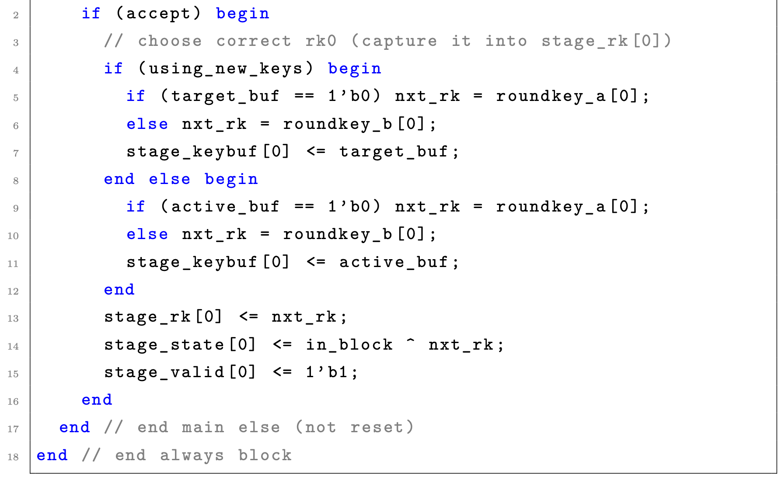
Stage 0 (Initial Round): When a new input is accepted (accept is high), the logic for stage 0 executes. It selects the correct round key 0 and stores it in stage_rk[0].
It then XORs this key with the in_block (plaintext) and stores the result in stage_state[0]. stage_valid[0] is set high.
21

Slide 22
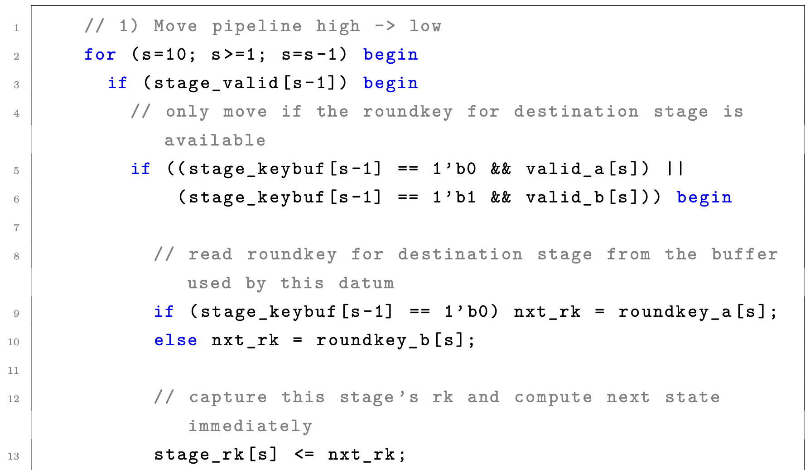
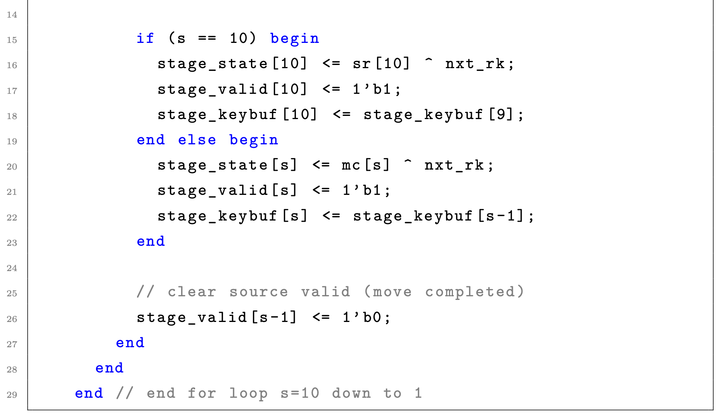
Stages 1-10 (Pipelined Rounds): The pipeline stages are advanced using a for loop that runs from s=10 down to s=1. This structure shifts data from a lower stage (s-1) to a higher stage (s).
The loop computes the state for stage s only if the previous stage stage_valid [s-1] is high.
For rounds 1-9: The next state (stage_state[s]) is computed by XORing the output of the combinational MixColumns (mc[s]) with the captured round key.
22

Slide 23
For the final round (s=10): The next state (stage_state[10]) is computed by XORing the output of the combinational ShiftRows (sr[10]) with the round key.
In all cases, stage_valid[s] is set high.
Now after computing for stage_state[s] and setting it to 1 stage_valid[s-1] is cleared to 0.
23

Slide 24
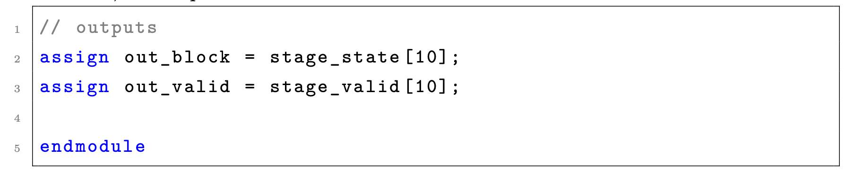
Final Output
The final outputs are assigned combinationally. out_block is assigned the value of the last pipeline stage (stage_state[10]), and out_valid is assigned the validity bit of the last stage (stage_valid[10]). When stage_valid[10] is high, the out_block contains the final, valid ciphertext.
24

Slide 25
Results
Clock Frequency
Slack
Throughput
Area Utilization
Waveform
GTKTerm Output
25

Slide 26

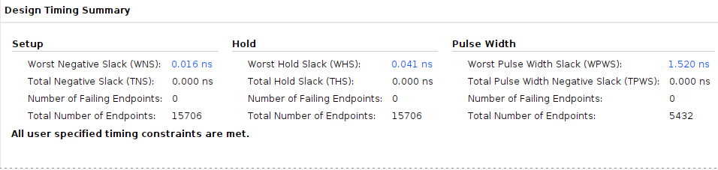
Clock Frequency
Slack
26

Slide 27
Throughput
Throughput = 128 × fmax bits/second
= 128 × 200 × 10⁶
= 25.60 Gbps
Initial Latency = 11 × 5ns
= 55 ns
After the initial latency period, the architecture processes one 128-bit block per clock cycle. Hence, the throughput is directly proportional to the operating frequency (fmax) achieved on the PYNQ board
27

Slide 28
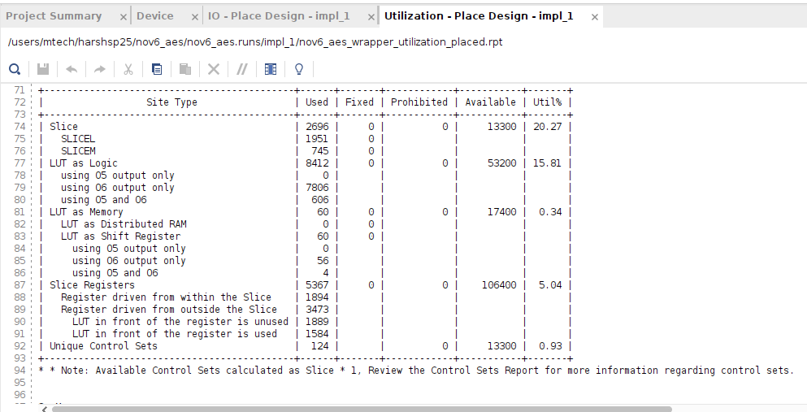
Area Utilization
28

Slide 29
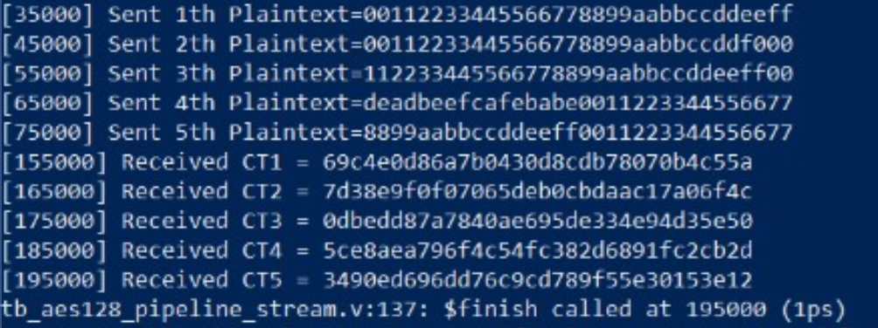
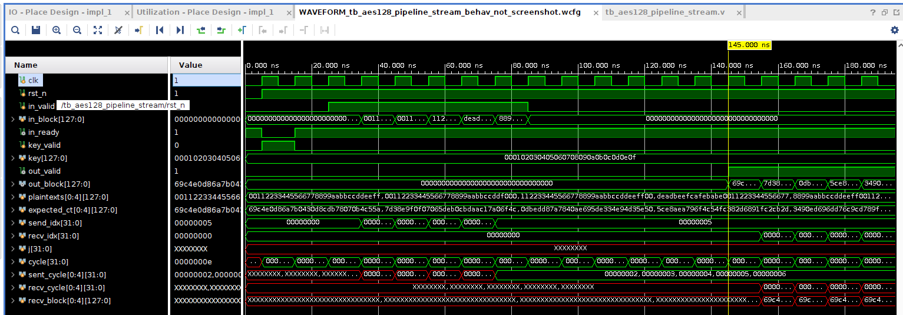
Waveform
29

Slide 30
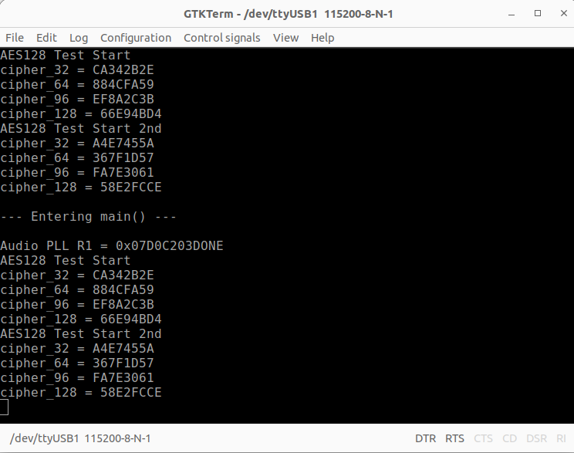
GTKTerm Output
30

Slide 31
References
[1] Y. Zhang and X. Wang, “Pipelined implementation of AES encryption based on FPGA”, in Proceedings of the 2010 IEEE International Conference on Information Theory and Information Security (ICITIS), Beijing, China, 2010, pp. 170–173,doi:10.1109/ICITIS.2010.5688757.
31

Slide 32


Instructor
Instructor
🙏🏻
Dr. Debapriya Basu Roy
Dr. Urbi Chatterjee
Thank You
“The measure of what we are is what we do with what we have"
~Vince Lombard
32

