Slide 1

Basic Details of the Team and Problem Statement
Ministry/Organization Name/Student Innovation: ALL INDIA COUNCLI FOR TECHNICAL EDUCATION(AICTE)
PS Code: DR716
Problem Statement Title:Integrated information platform for information about Indian Universities
Team Name: TINY CODERS
Team Leader Name: VIKYATH KUMAR S
Institute Code:
Institute Name:SRM INSTITUTE OF SCIENCE AND TECHNOLOGY
Theme Name:

Slide 2
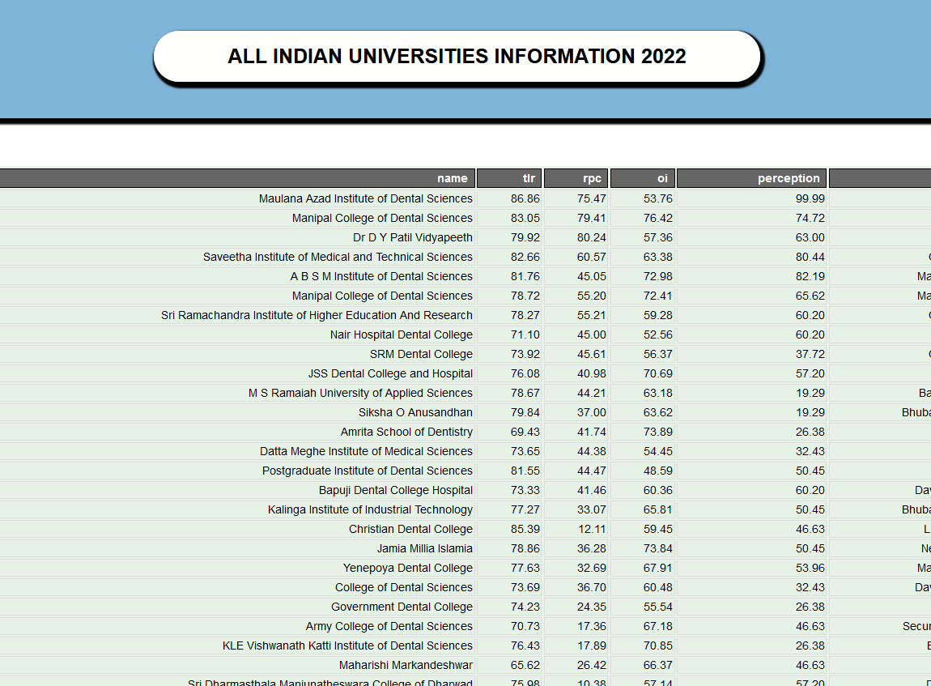
Idea/Approach Details
Add process flow chart or simulated image of prototype or any relevant image related to your idea
* The basic idea of this project is to display all the Top Universities in India and make sure it is a One Stop Search.
*We want to add India map to the webpage so we can get the data of the colleges in each state, for each course in our country.
TECHNOLOGIES USED:
WE GOT TO KNOW THE BASICS OF
HTML
CSS
PHP
JAVASCRIPT
SQL

Slide 3
Idea/Approach Details
USE CASES
Show stopper here
The users who are going to access our website will be the aspiring students who will be looking out for their top colleges
The users will be able to surf through all the top universities in India
They will find it user friendly since the website will be displayed in the ranking order
The respective college they select to will be redirected to the relevant information about it
The best part of the webpage is being able to filter the data on different attributes.
We can navigate through the php and html files without any error.
We have connected the backend module to the home page which helps to move through the webpage.

Slide 4
Team Member Details
Team Leader Name: VIKYATH KUMAR S
Branch : Btech Stream : Computer science and business systems Year: 3
Team Member 1 Name: BARADWAJA SHARMA UPPALA
Branch :Btech Stream:Computer science and business systems Year: III
Team Member 2 Name: SAI DHRUV
Branch: Btech: Stream : Computer science and business systems Year: III
Team Member 3 Name: SNEHHA S
Branch: Btech: Stream: Computer science and business systems Year: III
Team Member 4 Name: VISHNU VARDHAN
Branch: Btech Stream: Computer science and business systems Year: III
Team Member 5 Name: TEJA PYLA
Branch : Btech Stream:Computer science and business systems: Year:III
Team Mentor 1 Name: PAUL T SHEEBA
Category (Academic/Industry): Expertise (AI/ML/Blockchain etc): Domain Experience (in years):

