Slide 1

Ideation Platform with Information Security
SRM INSTITUTE OF SCIENCE AND TECHNOLOGY
FACULTY OF ENGINEERING AND TECHNOLOGY
DEPARTMENT OF DATA SCIENCE AND BUSINESS SYSTEMS
18CSP462L-Project Evaluation - II
Student 1 Reg No:RA1911042010070
Student 2 Reg No:RA1911042010119
Guide name: Dr.Paul.T.Sheeba
Designation: Assistant Professor, Department of DSBS

Slide 2
CONTENTS
Abstract
Literature Survey
Motivation
Methodology
Requirements
Architecture diagram
Modules Description
Code
Conclusion and future Enhancement
Conference Paper Publication

Slide 3
ABSTRACT
In today's world social networks are a part of our daily life. There are millions of users in the social networking sites using them for connecting with their family, friends and sharing private (or) personal information. Social networks are been trusted for communicating purposes in both personal and professional needs. We are proposing a method to create an environment where individuals can express their ideas and built business over them with the help of community (or) network. Here community refers to a group of individuals who are into the same stream of profession. This could be used for helping each other in improving their ideas and developing their concepts collaboratively. In the current scenario social networks are facing a critical challenge of fake users and unauthorized access of them into the network which is leading to the bleaching of privacy to many users. The data of users is not so secured in these social networks, which can be dealt by the incorporation of security policies which improves the environment. This can improve the engagement of community members in being a part of many activities as it is the key to improve once ideas (or) business. In social network individuals are main aspect of the community, protecting them from fake information and users is also very much important and this is achieved by the implementation of security features and policies into the network.

Slide 4
Literature Survey
YEAR | Title | Author(s) | Inference
2015 | Does perceived social networking site security arise from actual and perceived physical safety | Jessica Bodford , Cameron J. Bunker ^{b}, Virginia S.Y. Kwan | The author is talking about reasoning for widespread of concerns with respect to the social network site. The present research proposes that people may derive their sense of security in SNSs from how safe they are and feel in their physical environment.
2016 | Social network security: Issues, challenges, threats, and solutions | Jessica E. Bodford ª, Cameron J. Bunker ^{b}, Virginia S.Y. Kwan | A Social Network Service (SNS) is a kind of web service for establishing a virtual connection between people with similar interests, backgrounds, and activities. A SNS allows its users to find new friends and expand their circle of friends.
2016 | Social media security and trustworthiness: Overview and new direction | Zhiyong Zhang, Brij B. Gupta c | The available studies mainly aim at both social media content and user security, including model, protocol, mechanism and algorithm. This paper consists effective and efficient evaluations for measurements for security and trustworthiness of various social networks. Then the next part of the paper consists the evaluations regarding the trust of individual users on social media.
2020 | Privacy and security issues in the future: A social media | C. Sushama | This paper is focusing on the security issues that might rise in the coming future by analyzing the present growth of the social networks in the internet world. They studied the issues relating to the online social network in the aspects of protection and privacy aspects in the present situation. They are giving the clear explanation on the security factors that are been affected (or) compromised in the Facebook and made few allegations on the man-in–the-middle attackers in the networks.
2021 | Overview of Social Engineering Attacks on Social Networks | Kaouthar Chetiouª, Birom Baha, Abderrahim Ouali Alami, Ayoub Bahnasse | In this paper we are focusing on the analysis of the different types of attacks that are possible in the Online Social Network (OSN). They are using many techniques to steel one’s information from the users. In the pre-Internet world stealing once’s information was too complicated and hard but now it’s too easy for these phishers. This paper is taking about on how individuals are been getting influenced for revealing their confidential information such as password, addresses, bank details by exploiting their vulnerabilities and this is said to be Social Engineering.

Slide 5
2021 | The Role of Employees’ Information Security Awareness on the Intention to Resist Social Engineering | Tanja Grassegger, Dietmar Nedbal | The goal of this paper is to study both individual and organizational factors that affect information security awareness of employees and how this leads to intention to resist social engineering attacks. The spread of social networking platforms enables attackers to collect personal data of employees via their online footprints. By the lack of knowledge regarding the many threats in the social network is resulting to losing their crucial information to the hackers.
2022 | A social network analysis of two networks: Adolescent school network and Bitcoin trader network | Victor Chang, Karl Hall , Qianwen Ariel Xu , Le Minh Thao Doan b , Zhi Wang | This paper is applying social network analysis in two experiments. In the first experiment, social network analysis is conducted on student friendship networks to find relational patterns. Social network analysis (SNA) is a research method that analyzes the relationship of a group of entities, which can be individual persons (or) organizations, companies, countries. The phenomena or data reflected by their relationship models are the focusing on network analysis.
2022 | Deep reinforced learning enables solving rich discrete-choice life cycle models to analyze social security reforms | Antti J. Tanskanen | This paper is discussing about the discrete-choice life cycle models of labor supply can be used to estimate how social security reforms influence employment rate. Dynamic programming (DP) is a well-known method for solving a life cycle model. It gives a good approximation to the optimal agent behavior, which converges towards the optimal solution in the limit of infinitely tight grid. Then we are told how the organizations and employees are moving hand-by-hand to build a secure working environment .
2022 | Do men and women differ in the capability of weaving online social networks: A perspective of gender stereotype activation | Zhi-Jin Zhonga, Ruiyao Jiang, Sini Sua, Shujin Lina | This study aims to identify the gender difference in online social networks by comparing the condition that gender label is manifest and gender stereotype can be activated easily, with the condition under which gender is concealed and the activation of stereotype is difficult. They are trying to reason on what determines the different behaviors by the different genders in the social network.
2022 | A social network perspective on involvement in community energy initiatives: The role of direct and extended social ties to initiators | Goedkoop *, J. Dijkstra, A. Flache | This study investigates the role of social networks in influencing individuals’ decision whether to participate in a community energy initiative (CEI). We are discussing about engagement of community members is crucial for the success of a CEI and thus a key question is how the initiators can reach community members and stimulate involvement.

Slide 6
Motivation
People with great ideas and little exposer, are looking for as much help as they could find. But can’t find reliable people (or) source around them.
Women are not able to find a secure and reliable place to present their ideas and search for job opportunities in the present scenario.
We have many social media platforms like Facebook, LinkedIn… etc. to present ourselves, but these networks don’t focus on the security aspect of data that is been accessed in their networks .
The owner of the idea could be of any gender are not able to find space to share their ideas in social networks which is reliable and secure from copying the concept (or) Idea.

Slide 7
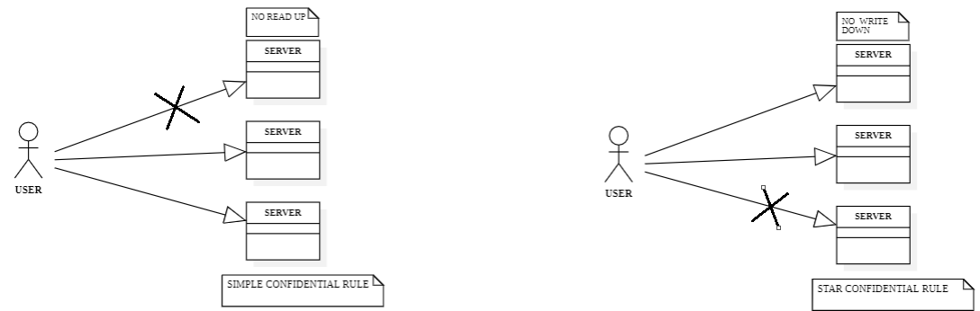
METHODOLOGY
The Bell-LaPadula model offers a variety of features. The concept, which is used to safeguard information from unauthorized access, first establishes a set of security levels. By specifying a set of access rules that specify how individuals can access objects at various security levels, the model offers a framework for managing access to information at various security levels
SIMPLE CONFIDENTIAL RULE: In this the users (or) subjects can only READ the data on the same level of access and the lower level of access but can’t read data to the upper level of access. This rule is called NO READ UP rule.
STAR CONFIDENTIAL RULE: In this the users (or) subjects can only WRITE the data on the same level of access and the upper level of access but can’t write data to the lower level of access. This rule is called NO WRITE DOWN rule.

Slide 8
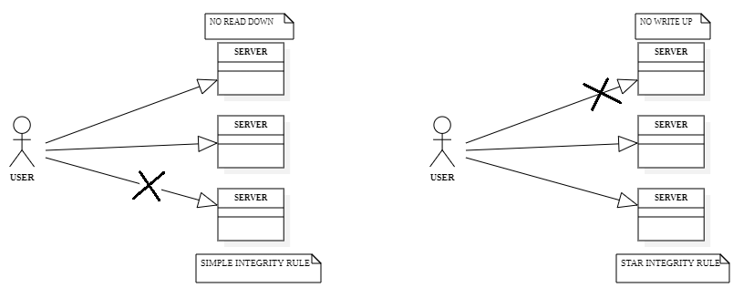
METHODOLOGY
Biba model is using these rules to improve the INTEGRITY of the data that is been shared. Information is validated using integrity. It determines whether or not the information is in the proper format. Additionally, it confirms that the information is accurate and true for the intended purpose. Integrity guarantees that the information sent to the recipient is the same information sent to the originator.
SIMPLE INTEGRITY RULE: In this the users (or) subjects can only READ the data on the same level of access and the upper level of access but can’t read data to the lower level of access. This rule is called NO READ DOWN.
STAR INTEGRITY RULE: In this the users (or) subjects can only WRITE the data on the same level of access and the lower level of access but can’t write data to the upper level of access. This rule is called NO WRITE UP.

Slide 9
Requirements
The structure of the project is using HTML and CSS for the front-end part of the project.
The back-end is been handled by PHP and SQL for storing and accessing the data from the data-base.
The middle tier of the project is been handled by the JavaScript for the smooth and easy usability of the application.
The XAMPP is been used for creating a local data-base for storing the data of the application.

Slide 10
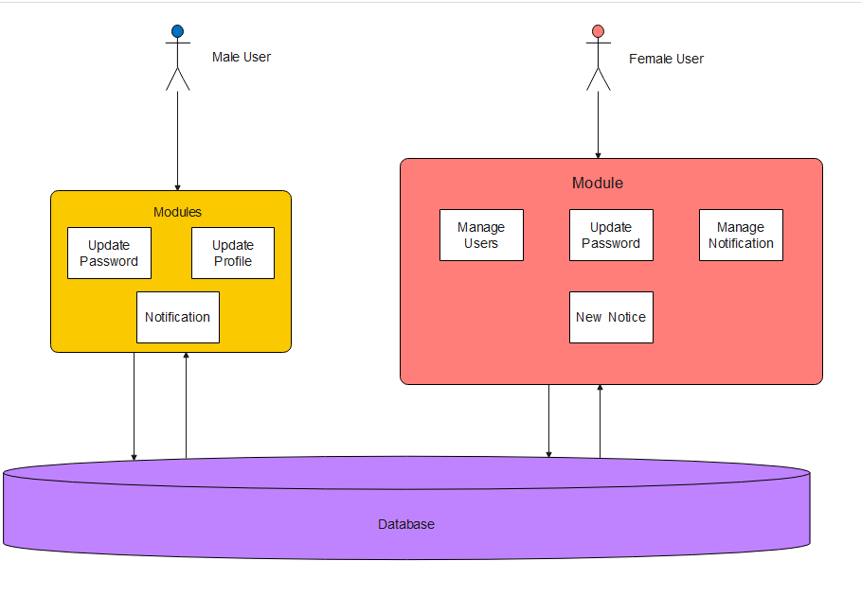
Architecture diagram

Slide 11
MODULES DESCRIPTION
Registration module is same for any user while trying to be a member of the network with requirements to filled in the form.
Once the user gets registered the data can will be stored into two different tables on the gender bases of the user’s entry.
Login module here we have same login page for any user but the as the user logins with his/her own credentials like email id, Password and gender they are been navigated to different accounts as the concept is trying inculcate Information Security models into the network.
The Female users are given a better control over the network for creating a secure network where they can express themselves in the network.

Slide 12
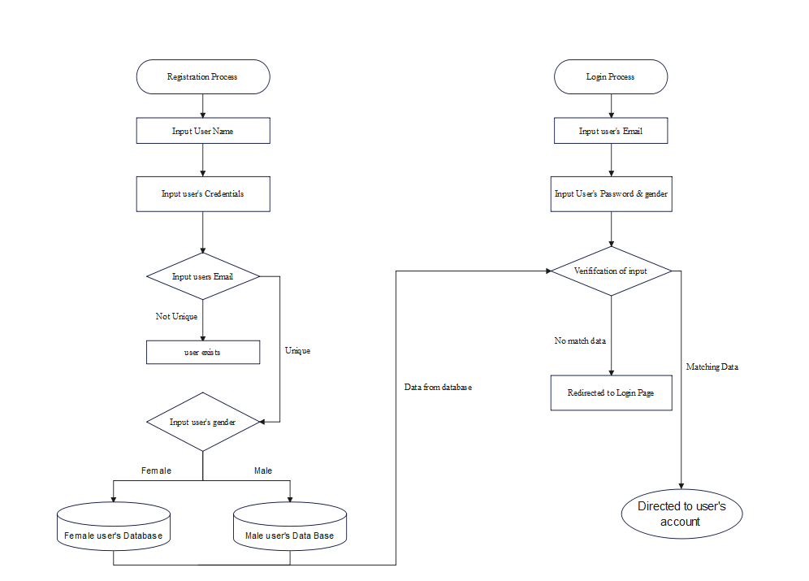
Flow Chart

Slide 13
Female users can create ,edit (or) delete a post when ever they want to do so. Accept the request and share the information by having a private connection establishment with their friends.
Male users can view the notices (or) posts in their dashboard and can change their password, details, comment on the post and add friend request to the users in the network.
The next developed module in the network is proving the users a chat space where they can communicate with their liked people in the network as a primary choice of communication without sharing their private number or mail id.

Slide 14
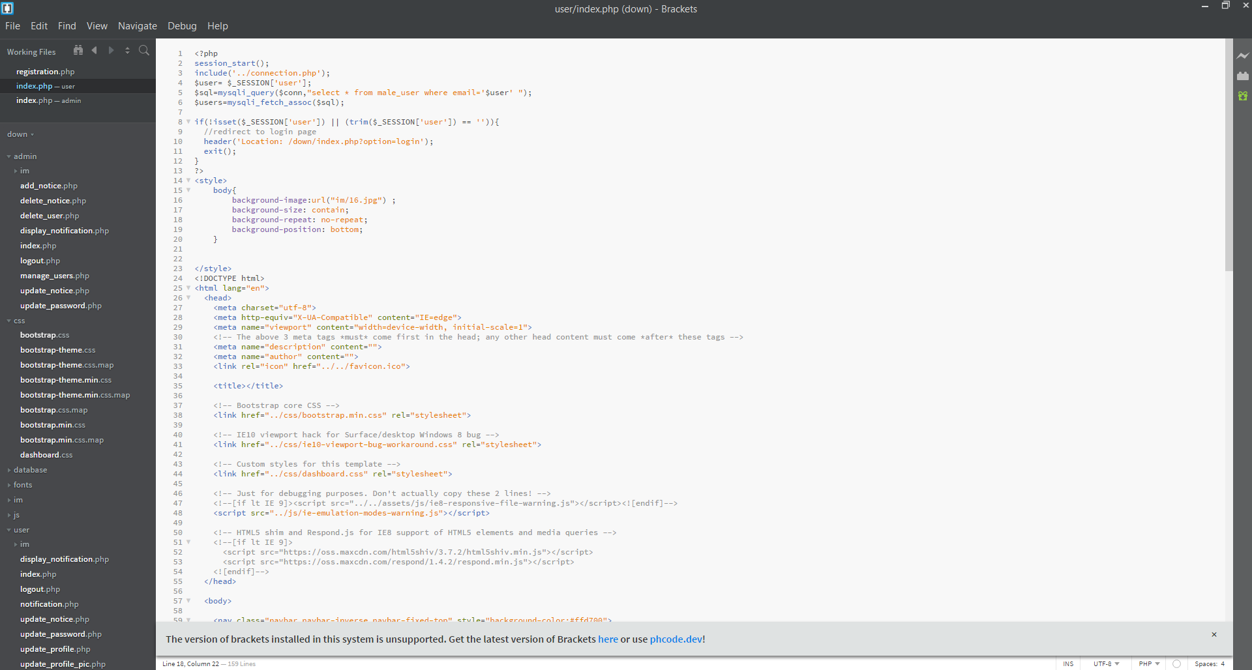
Code

Slide 15
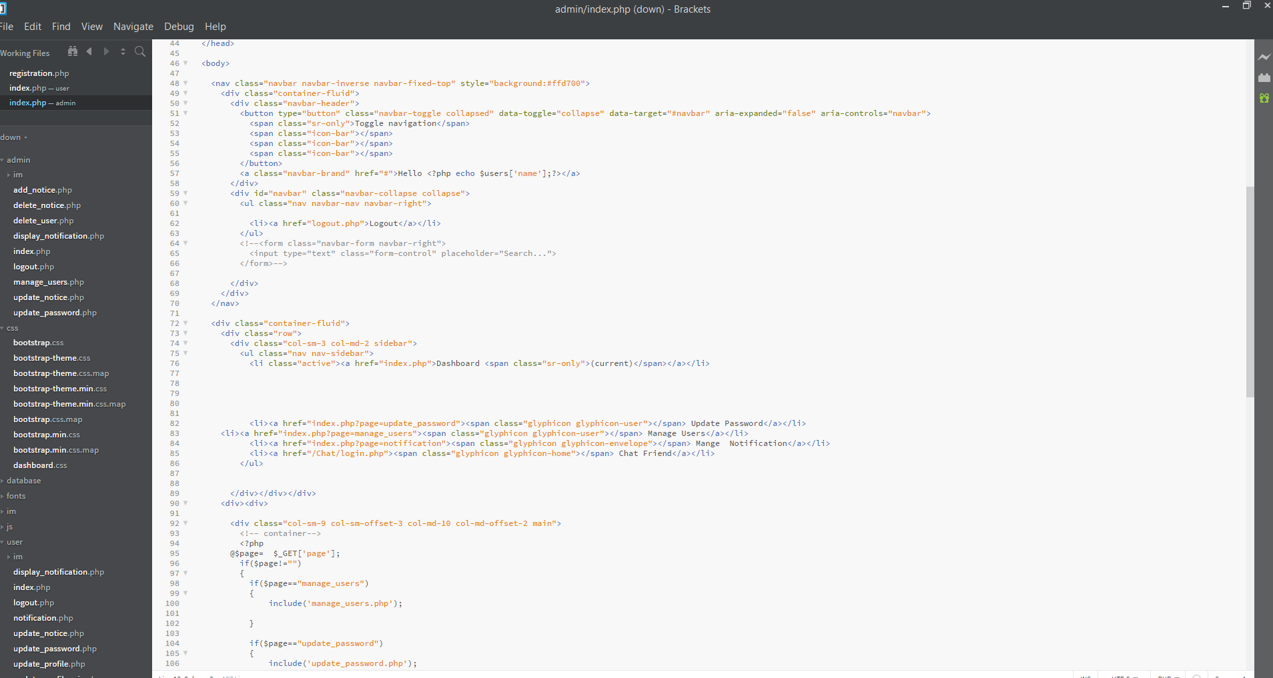
Code

Slide 16
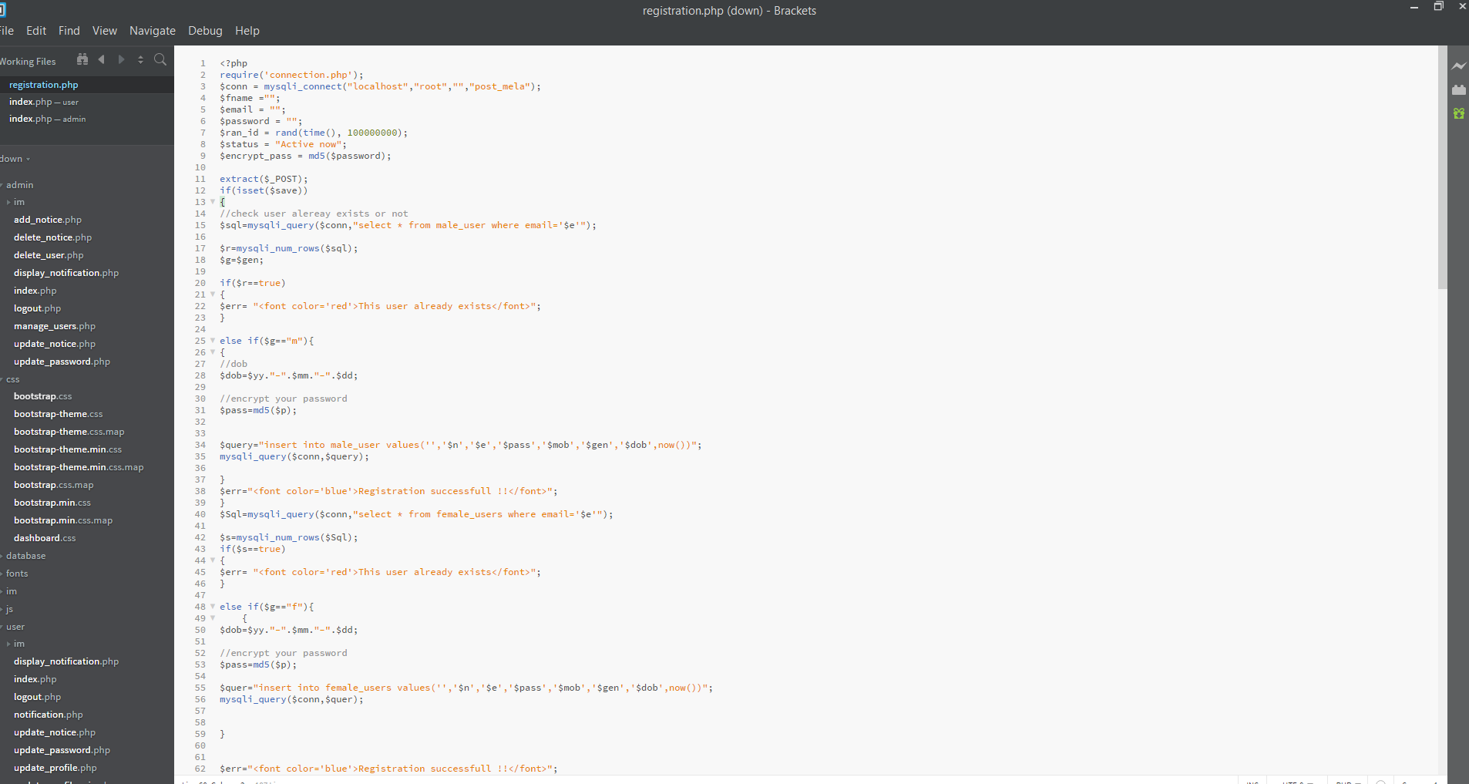
Code

Slide 17
Conclusion and Future Enhancements
This application is mainly trying to introduce a new way of creating a network to have a more secure, accessible and reliable network by using Information Security methodologies incorporated into the process of creating the network and establishing it.
In the future the network can improve more in the aspect of the security of the user. This one is a very basic template of registration.
The inclusion of the real time verification of user’s email id by OTP generation could be next step in the process of development.

Slide 18
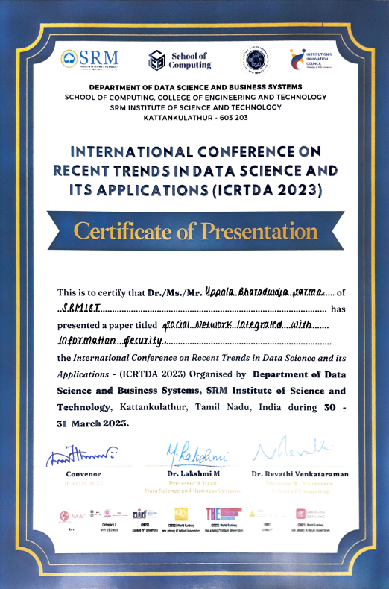
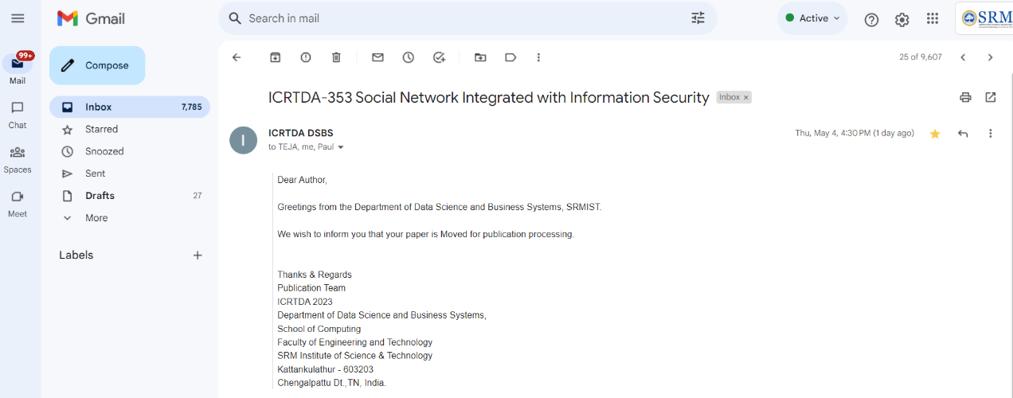
Paper Publication Details

Slide 19
THE END

