Slide 1
Pre-Project Presentation Cloud based vehicle to vehicle communication for traffic monitoring B.Tech in CSE
Mentor(s) : Mr. Nithin Rao R
Group No. : Group 15
Team Leader : Lavanya
Department : Computer Science

Slide 2
Project Team
Sl no. | Registration no. | Students
1. | 16ETCS002092 | PREETI S MATHPATI
2. | 16ETCS002005 | AKSHATA C HUDED
3. | 16ETCS002065 | LAVANYA
4. | 16ETCS002134 | SWAROOPA
5. | 16ETCS002123 | SHREE LAKSHMI.N

Slide 3
Outline
Motivation/Need for study
Title and Aim
Objectives
Methods and Methodology
Expected Outcomes
Cost Estimation
Gantt Chart
Work load allocation
References

Slide 4
Need for the Study
Vehicle to vehicle communication is growing field in present era.
Congestion control has become a major issue due to increase in number of on road vehicles. It can be controlled if the traffic updates can be known in prior.
Millions of people are injured in the traffic accidents.
Accidents also lead to traffic congestion. It can be avoided if the accidents and the blind spots are identified.
Driving becomes less safer if the weather conditions are not good such as heavy fog, rainfall or driving on the crest of a hill.

Slide 5
Need for the Study
The cloud computing plays a major role for implementing the smart traffic monitoring system, as it helps in sharing resources to all vehicles in a network.
This concept aims at increased driving comfort, public safety and potential hazards from other vehicles.

Slide 6
Title
Cloud based vehicle to vehicle communication for traffic monitoring

Slide 7
Aim
To design and develop a system which enables vehicle to vehicle communication through cloud in order to avoid traffic congestion.

Slide 8
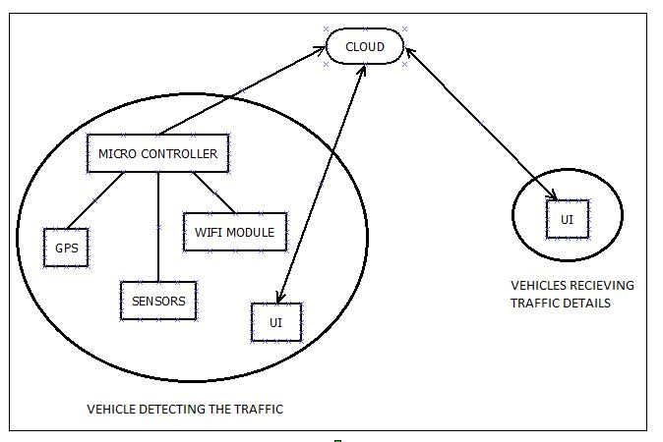
BLOCK DIAGRAM

Slide 9
Objectives
To conduct the literature survey on cloud based vehicle to vehicle communication, GPS based navigation and related techniques and methodologies.
To analyze the literature survey and arrive at the system requirements for cloud based vehicle to vehicle communication.
To arrive at design specification of the system based on the identified requirements and design subsystems like cloud, On-board diagnostics(OBD) and User interface.
To develop the hardware circuitry which includes microcontroller, GPS, sensors and Wi-fi module.

Slide 10
Objectives
5. To develop an user interface through appropriate software tools.
6. To test and validate the developed system for various cases considered and incorporate necessary changes.
7. To document the report by unifying all the results and outcomes.

Slide 11
Methods and Methodology
To conduct the literature survey on cloud based vehicle to vehicle communication, GPS based navigation and related techniques and methodologies.
1.1 To review the literature on existing cloud based vehicle to vehicle communication, their working, functionality and hardware used from peer reviewed journals, reference books and other authentic sources.
1.2 The Literature will be reviewed critically and various methods used for developing cloud based vehicle to vehicle communication will be summarized.

Slide 12
Methods and Methodology
To analyze the literature survey and arrive at the system requirements for cloud based vehicle to vehicle communication
2.1 Based on the characteristics identified in the survey, a generic list of requirements for a cloud based vehicle to vehicle communication will be penned down.
2.2 The functional and non-functional requirements of the cloud based vehicle to vehicle communication will be derived.
2.3 The dependency between the functional requirements will be identified.
2.4 The requirements identified for the system will be checked for the feasibility.

Slide 13
Methods and Methodology
To arrive at design specification of the system based on the identified requirements and design subsystems like cloud, On-board diagnostics(OBD) and User interface.
3.1 Based on the requirements identified, a high level block diagram will be developed.
3.2 Microcontroller, wifi-module and other peripherals which satisfy the functionality and be compatible with each other will be identified.
3.3 A low level block diagram and flowchart will be developed to achieve the required functionality.
3.4 To establish relation between the identified subsystems.

Slide 14
Methods and Methodology
To develop the hardware circuitry which includes microcontroller, GPS, sensors and Wi-fi module.
4.1 Appropriate IDE will be selected and Software implementation for each sub-system will be done.
4.2 Hardware components like microcontroller, wi-fi module, sensors, actuators are connected to build the hardware solution.
4.3 Hardware and software implementation are integrated in order to develop a fully functional system as per the requirements.

Slide 15
Methods and Methodology
To develop an user interface through appropriate software tools
5.1 An appropriate software tool to develop the UI will be identified.
5.2 The home screen, menu and sub-menus required will be designed.
5.3 The required data from the cloud will be extracted and necessary actions will be performed

Slide 16
Methods and Methodology
To test and validate the developed system for various cases considered and incorporate necessary changes.
6.1 The developed application will be tested for different cases considered.
6.2 Test cases for unit, integration and functional testing will be developed.
6.3 The expected outcome and the actual outcome will be validated.
6.4 Based on the results, obtained changes will be incorporated if required.

Slide 17
Methods and Methodology
To document the report by unifying all the results and outcomes
7.1 A scientific project report as per the university template will be developed.
7.2 The design, implementation, verification, testing and validation, results of this system are reported.
7.3 Analyze performance of the application and report the performance test results.
7.4 Demonstrate the working model of the cloud based vehicle to vehicle communication system.

Slide 18
Expected Outcomes
Demonstration of Working Model
Product Prototype
Conference/ paper publication
Report generation

Slide 19
Cost Estimation
Sl.no | Work | Cost (₹)
1 | Hardware | 8,000
2 | Software | 0
3 | Report Writing | 0
3 | Human Resources (4x5x30000) | 600,000
 | TOTAL | 6,08,000

Slide 20
Gantt Chart
Project Work (UG) 16 weeks
Week | 1 | 2 | 3 | 4 | 5 | 6 | 7 | 8 | 9 | 10 | 11 | 12 | 13 | 14 | 15 | 16
Major Activities
1
2
3.1
3.2
3.3
3.4
4
5
6.1
6.2
6.3
6.4
7.1
7.2
7.3
7.4

Slide 21
Work Load Allocation
objectives | PREETI S MATHPATI | AKSHATA C. HUDED | LAVANYA | SWAROOPA | SHREE LAKSHMI N.
Analyzing requirements
Design specification
Hardware implementation
Software implementation
Testing
Documenting Report

Slide 22
References
Kolisetty, A., Kristinsson, J.G. and Wisniewski, J., Ford Global Technologies LLC, 2016. Vehicle Operation Based On Activity Tracking. U.S. Patent Application 14/517,256.
Kong, L., Khan, M.K., Wu, F., Chen, G. and Zeng, P., 2017. Millimeter-Wave Wireless Communications for IoT-Cloud Supported Autonomous Vehicles: Overview, Design, and Challenges. IEEE Communications Magazine, 55(1), pp.62-68.
Mekki, T., Jabri, I., Rachedi, A. and ben Jemaa, M., 2017. Vehicular cloud networks: Challenges, architectures, and future directions. Vehicular Communications, 9, pp.268-280.

Slide 23
Thank You

