Slide 1
DELIVERY OPERATIONS
Power BI User Guide
THIS GUIDE SHOWS
• What each page contains
• How page navigation works
• How to use slicers
• How bookmarks switch views
• How drill-through works
• How RLS is tested
• How to use custom tooltips
How to navigate the report, use filters and interact with the analysis
Report pages
1. Executive Overview
2. Delivery Performance
3. Profitability Analysis
4. Warehouse Details
Synthetic dataset • Project demonstration

Slide 2
1. Report navigation
Use the report’s built-in buttons to move between pages.
Home / Executive Overview
Delivery Performance
Profitability Analysis
Warehouse Details
Start here
→
Operations
→
Bookmark view
→
Drill-through
Overall KPIs + business snapshot
Delay, processing, transit and partner analysis
Warehouse, region and profit analysis
One selected warehouse in detail
Navigation rule: click the page button you need. Use Home to return to the Executive Overview. Warehouse Details is normally reached through drill-through rather than by opening it directly.
1
From Page 1
2
On Page 2
Click Delivery Performance or Warehouse Detail from the navigation sidebar.
Use the two top-right view buttons to switch Operational Analysis ↔ Profitability Analysis.
3
On Page 3
4
Keep context in mind
Use the Back button after a drill-through to return to the source page.
Slicer selections remain part of the current filter context while exploring.

Slide 3
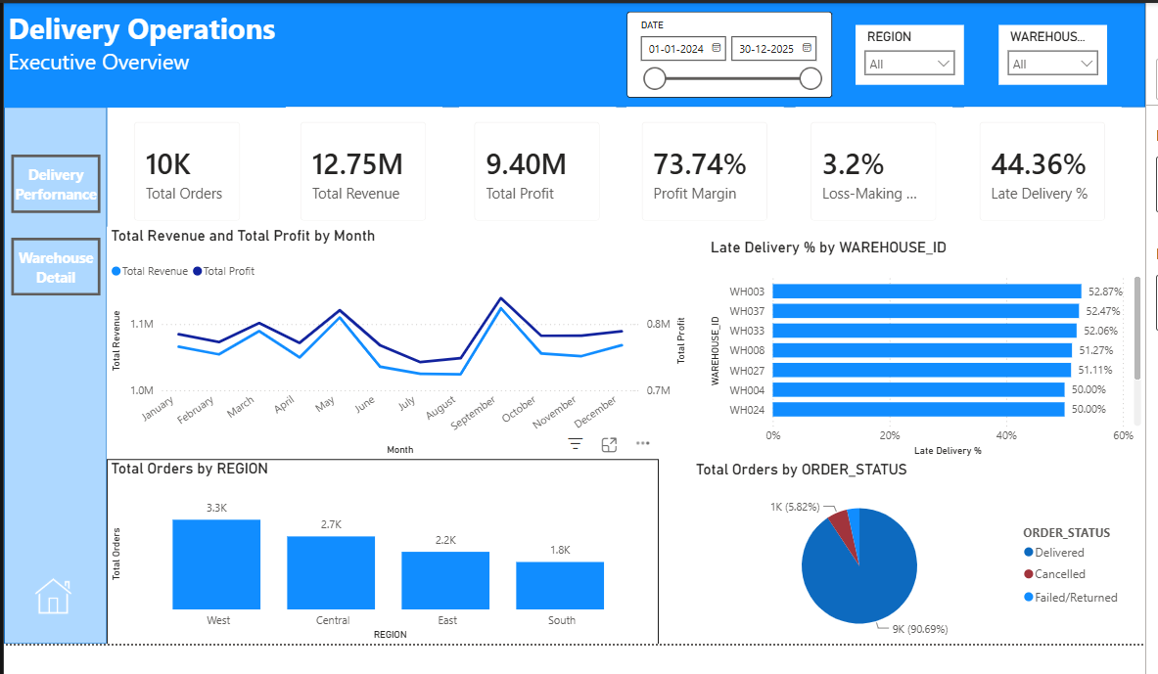
2. Page 1 — Executive Overview
What is on the page and how to use it.
1
Date slicer
Choose a date range. The KPI cards and charts update to that period.
2
Region slicer
Select a region from the dropdown to filter the overview.
3
Warehouse slicer
Select a warehouse to focus the report on one location.
4
What you can see
KPI cards, monthly Revenue/Profit, late-delivery ranking, regional orders and order status.
PAGE NAVIGATION
Use Delivery Performance or Warehouse Detail from the sidebar to go deeper.

Slide 4
3. Using slicers
Slicers are the main way to narrow the report to a date, region or warehouse.
1
Date slicer
Pick the start and end dates, or drag the handles to adjust the range.
2
Region dropdown
Open the dropdown and select a region. The report recalculates for that selection.
3
Warehouse dropdown
Select a warehouse to isolate its performance. This is useful before deeper investigation.
4
Clear the filter
Use the slicer’s clear/reset control when you want the full dataset back.
Tip: combine slicers. Example: choose a region, then choose a warehouse inside that analysis context.

Slide 5
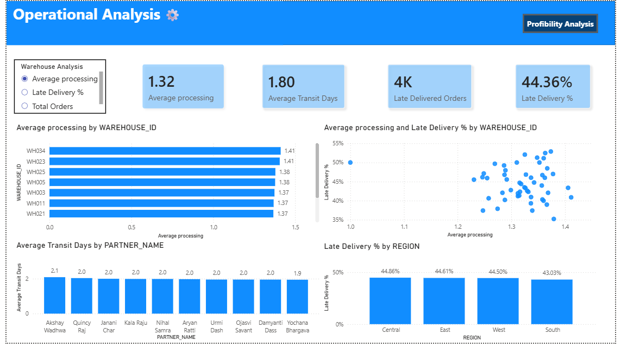
4. Page 2 — Operational Analysis
Use this view to investigate delivery performance and operating patterns.
1
Warehouse Analysis selector
Choose Average processing, Late Delivery % or Total Orders. The warehouse ranking changes to that metric.
2
Operational visuals
Use the warehouse comparison, processing-vs-late relationship, partner transit and regional late-delivery visuals.
3
Hover for details
Hover over a warehouse bar or other visual element to inspect the exact value or tooltip details.
4
Switch views
The Profitability Analysis button changes the page to the profitability bookmark state.

Slide 6
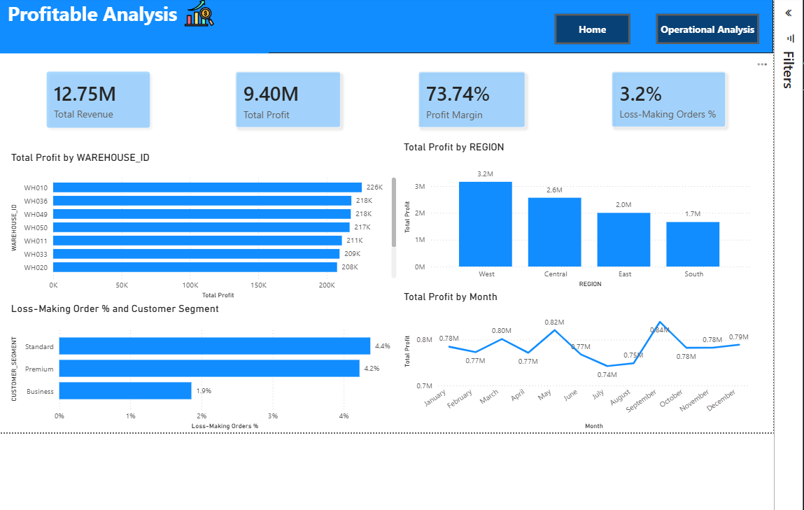
5. Bookmarks — switching Operational ↔ Profitability
Bookmarks save a report view so the same page can behave like two analysis modes.
OPERATIONAL ANALYSIS
PROFITABILITY ANALYSIS
Operational state
Profitability state
1
Click Operational Analysis
2
Click Profitability Analysis
Shows the saved operational visuals and KPI set.
Shows the saved profitability visuals and KPI set.
Use this when you want to change the analysis focus without moving to another page.

Slide 7
6. Page 2 — Profitability Analysis
The same report page, switched into a saved profitability view.
1
Profit KPIs
Revenue, Profit, Profit Margin and Loss-Making Orders % summarize the financial position.
2
Warehouse profit
Shows which warehouses generate more total profit.
3
Regional profit
Compares total profit across West, Central, East and South.
4
Segment + month
Compare loss-making order % by segment and see monthly profit movement.

Slide 8
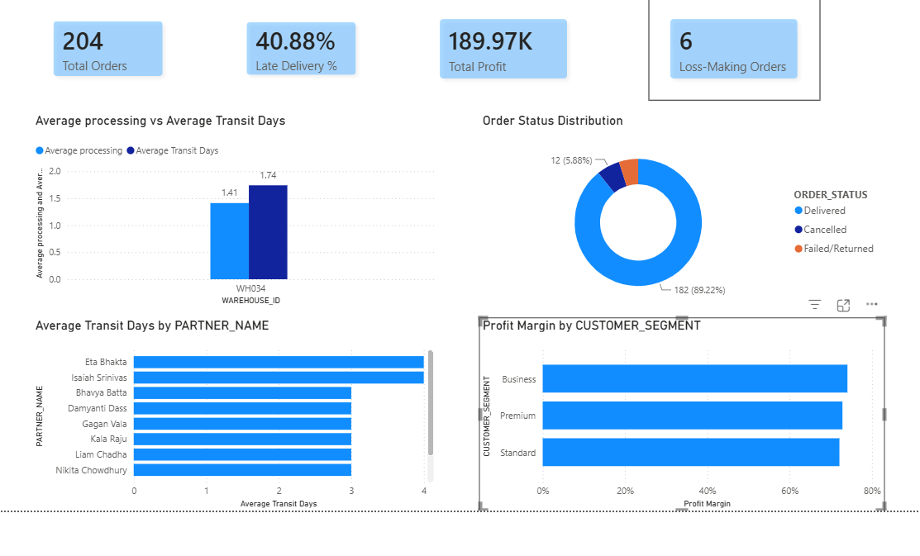
7. Page 3 — Warehouse Details
This page is designed to be reached through drill-through from a warehouse visual.
1
Warehouse-specific KPIs
Once drilled through, the KPI cards show only the selected warehouse.
2
Operational detail
Processing vs transit days and partner transit performance are filtered to that warehouse.
3
Order outcomes
The donut shows Delivered, Cancelled and Failed/Returned orders for that warehouse.
4
Profitability detail
Profit Margin by Customer Segment shows margin rates within the selected warehouse.
Use the Back button in the top-left of the page to return to the page you drilled from.

Slide 9
8. Drill-through — how to use it
Drill-through moves from a warehouse summary to a warehouse-specific detail page.
SOURCE PAGE
DETAIL PAGE
1. Find a warehouse
4. The selected Warehouse_ID filters Page 3
2. Right-click the warehouse bar
5. Review warehouse-specific KPIs and charts
3. Choose Drill through → Warehouse Details
6. Click Back to return
Drill-through field: DIM_WAREHOUSE[Warehouse_ID] • Keep all filters: On • Cross-report: Off

Slide 10
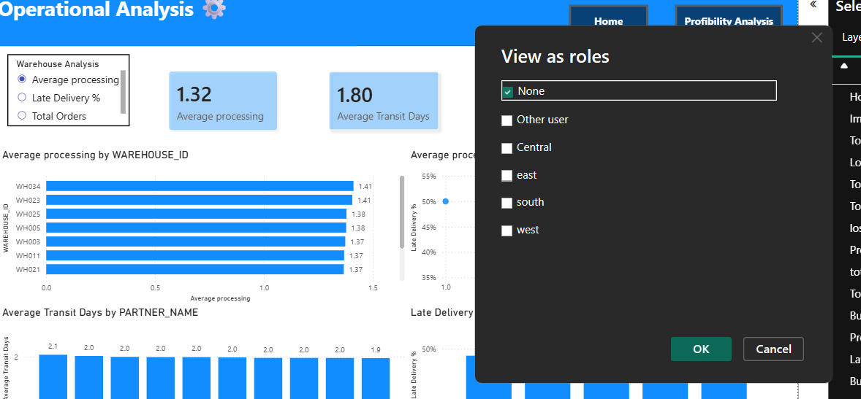
9. RLS — Row-Level Security
RLS is used to restrict which rows a user can see based on a defined role.
1
Open View as
In Power BI Desktop, use Modeling → View as roles.
2
Select a region role
Choose a role such as South, West, East or Central.
3
Verify the report
Check that the report visuals show only the allowed region’s data.
4
Return to None
After testing, return to the unrestricted Desktop view.
Important: RLS is an access-control feature. It changes what data a role can see; it is not a dashboard filter for analysis.

Slide 11
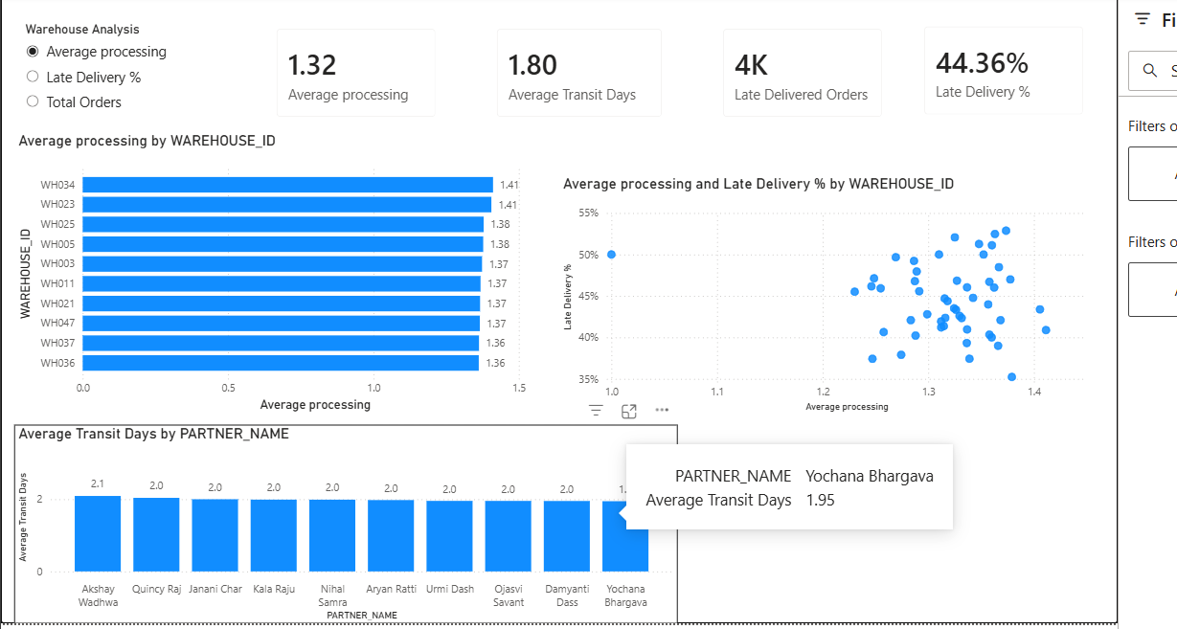
10. Custom tooltip — inspect a warehouse without leaving the page
Hover over a warehouse visual element to reveal contextual metrics.
1
Hover
Move the pointer over a warehouse bar or data point.
2
Read the tooltip
The Warehouse_Tooltip page shows contextual values such as Partner Name and Average Transit Days.
3
Return to the analysis
Move the pointer away and continue exploring; no page navigation is required.
Tooltip values are contextual: the same tooltip design can show different values depending on the warehouse or visual element being hovered.

Slide 12
11. Quick user workflow
Use this sequence when reviewing the report.
1
Start
4
Switch financial view
Open Executive Overview and review KPI cards.
Click Profitability Analysis to compare profit and margin.
2
Filter
5
Go deeper
Apply Date, Region or Warehouse slicers.
Right-click a warehouse → Drill through → Warehouse Details.
3
Investigate operations
6
Test access
Open Delivery Performance and use the Warehouse Analysis selector.
Use Modeling → View as to validate RLS roles in Desktop.
The report is designed to be explored interactively: filter first, investigate second, drill-through only when a specific warehouse needs deeper review.

