Slide 1
CAPSTONE PROJECT
Final Project
Personal Development and Goal Tracking App
Presented By
BHARANITHARAN M
711721244009
III BTech CSBS
KGISL Institute of Technology
3/21/2024 Annual Rev iew

Slide 2
PROJECT TITLE
Personal Development and Goal Tracking App AI using Autoencoder.
3/21/2024 Annual Rev iew

Slide 3


AGENDA
Problem Statement
Project Overview
End Users
Solution and Value Proposition
The Wow Factor in Your Solution
Modelling
Results
3/21/2024 Annual Rev iew

Slide 4

PROBLEM STATEMENT
Challenges in Personal Development Tracking
Need for Automated and Intelligent Goal Monitoring

Slide 5

PROJECT OVERVIEW
Introduction to Personal Development and Goal Tracking App
Importance of Goal Setting in Personal Growth
Role of AI in Enhancing Personal Development

Slide 6

WHO ARE THE END USERS?
Individuals Seeking Personal Growth
Professionals Striving for Skill Enhancement
Students and Learners Wanting to Track Learning Progress
3/21/2024 Annual Rev iew
6

Slide 7

YOUR SOLUTION AND ITS VALUE PROPOSITION
Introduction to Autoencoders in AI
Utilizing Autoencoders for Data Compression and Reconstruction
Real-time Monitoring and Analysis of Personal Development Goals
Personalized Insights and Recommendations

Slide 8

THE WOW IN YOUR SOLUTION
Adaptive Learning and Feedback Mechanism
Anomaly Detection for Unusual Behavior and Insights
User-Friendly Interface with Interactive Visualizations
Seamless Integration with Other Personal Development Tools

Slide 9
MODELLING
Data Collection and Preprocessing
Autoencoder Architecture and Design Choices
Training and Optimization Process
Reconstruction Error and Anomaly Detection Threshold Setting

Slide 10
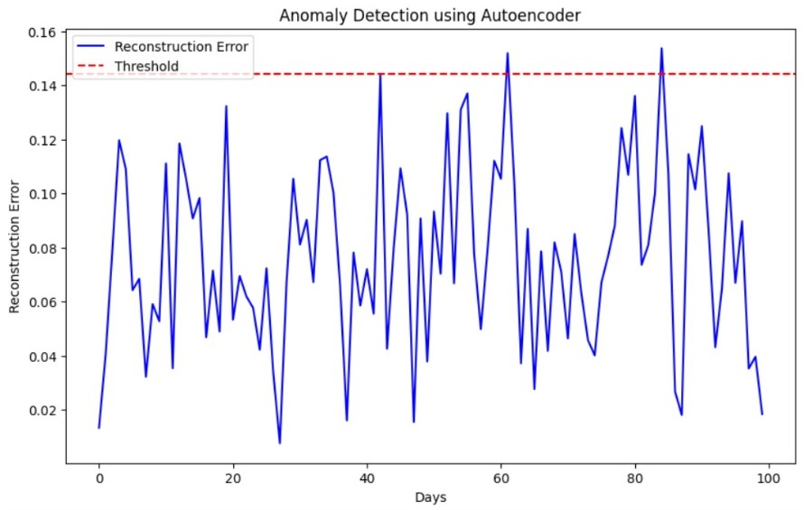
RESULTS
https://drive.google.com/drive/folders/1Hepuk5-qjWdHUFatcrt_zEHxThENyKIx?usp=drive_link

