Slide 1


COLLEGE OFFICE AUTOMATION
SRI KRISHNA ARTS AND SCIENCE COLLEGE
Under the guidance of
Dr C.SUNITHA
MCA.,M.PHIL.,PH.D.,
HEAD OF THE DEPARTMENT
M.BHARANIDHARAN
18MSS007
IV MSC SS
DEPARTMENT OF COMPUTER SCIENCE

Slide 2
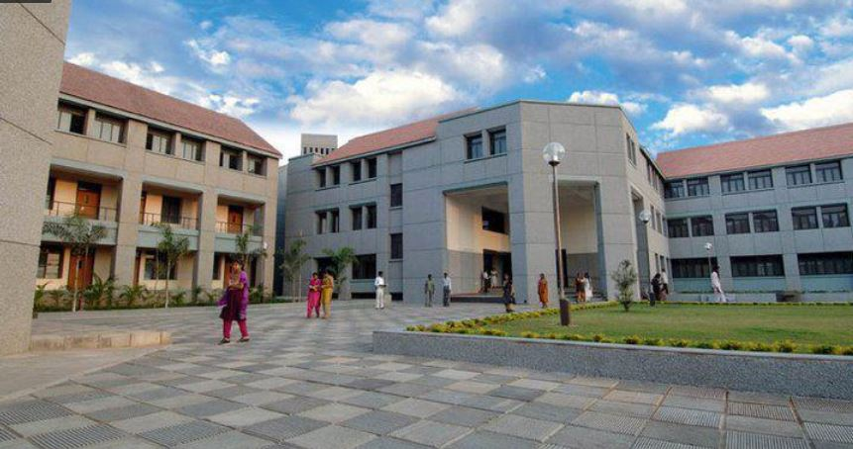
AGENDA
INTRODUCTION
ABSTRACT
ABOUT ORGANIZATION
SYSTEM SPECIFICATION
MODULE DESCRIPTION
METHODOLOGY
DFD & USE CASE
REPORTS
FUTURE ENHANCEMENTS
CONCLUSION

Slide 3
Introduction
It is a web based application that mainly focus on the automation process. It is helpful in storing information and data that revolves around the office. The motive of this application is to make the process in a easier and in organized manner. The application is mainly designed to automate the process taking place in college office. This application handles storing and retrieving the essential information such as faculty details, programme details, attendance and payroll.

Slide 4
ABSTRACT
College office automation is a web based application developed for making complex operations in a simple manner. Its main goal is to unite everything under single application. It holds the faculty information, programme details that is introduced recently, payroll calculation of each staff, attendance being recorded daily and able to store essential documents related to UGC, Bharathiyar university and MOU.HTML and CSS are used for front end whereas backend is handled using core PHP and MySQL.

Slide 5
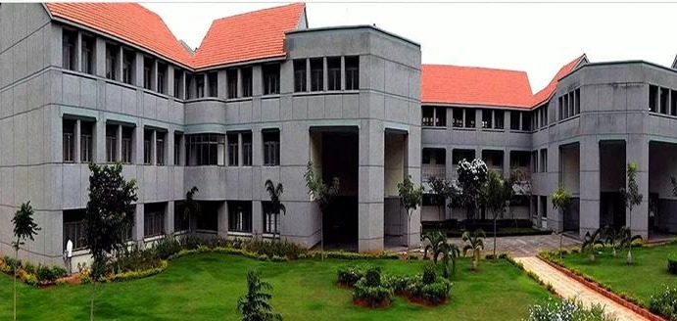
About Organization
Sri Krishna Arts and Science College was established by the V.L.B trust in 1997 and is an ISO certified co-educational institution. Situated in Suganapuram, Kuniyamuthur. Sri Krishna Arts and Science College with a vision of “Fitness for purpose” established in the year 1997 is an autonomous institution imparting quality education imbibing scientific and artistic knowledge to the needs of current generation. A college offering 32 Undergraduate programmes 13 post graduate programmes 7 Research programmes and one integrated programme is re-accredited with ‘A’ grade by the National Assessment and Accreditation Council (NAAC). From a student strength of 623 in the academic year 2004-2005 the college had grown extensively in infrastructure, technical developments and quality Faculty strength to incorporate 8500 in the year 2019-2020

Slide 6
System Specification
Hardware specification
Software specification
RAM | 4 – 8 GB RAM in DDR3, DDR4 TYPE
HARDDRIVE | 40 GB of DISK SPACE of 5400 – 7200 RPM.
PROCESSOR | INTEL CORE-i3, CORE- i5, CORE -i7 (OR) AMD RYZEN-3 3350, RYZEN-5 3600, RYZEN- 7 3800
KEYBOARD | INCLUDED 105 KEYS
MOUSE | COMPATIBLE POINTING DEVICE
OPERATING SYSTEM | WINDOWS (OR) MAC (OR) LINUX
SERVER OPERATING TOOLS | XAMPP
FRONT END | HTML, CSS and JAVA script
BACK END | PHP and MYSQL
DEPLOYMENT | SUBLIME TEXT 3

Slide 7
Module description
ADMIN
STAFF
Staff Registration
Programme Details
Department Details
Attendance
Payroll
Documents
Student Details
Scholarship Details
Programme Details
Payroll

Slide 8
Contd..
Staff Registration
Programme Details
Department Details
Details of every staff is recorded along with their personal information. The details includes which department they belong and what is their role. The admin generates the user credentials for those staffs.
The programme details module handles the records of newly added programme. The department of that programme is specified for easy access and also approval document of that specific programme is uploaded.
The list of various departments present in our college is viewed which also can be generated as in report form.
Attendance
Payroll
Documents
Daily attendance of each staff is marked. Each staff can be marked as present, half day and absent. These data helps in the calculation of payroll for that particular staff. Present counts as one whole day and the half day as 0.5 day.
The Payroll section displays the staffs salary details for that particular month. Payroll is calculated from the basic pay obtained during staff registration. The value is divided by 30 which gives he per day salary. That amount is multiplied along with the no.of days present by that particular staff.
Essential information related to the UGC, Bharathiyar University and MOU can be stored in a document form which can be viewed and downloaded. These documents can be accessed any time by the admin.

Slide 9
Contd..
Student Details
Scholarship Details
The Excel sheet of each and every student that contains their information can be stored by the staff which also can be downloaded for reference purpose.
The list of students details under the specific staff who have availed scholarship can be uploaded and accessed for reference at any time.
Programme Details
Payroll
The newly added programme in the admin section can be viewed by the staffs which helps them to know about that programme briefly
The calculated payroll from the admin tab is viewed by the staffs. The staff can know about the details regarding their salary. The payroll view is set for the specific staff who logged through their credentials.

Slide 10
Methodology
Existing System
In existing system these processes are handled separately. It consumes more time and adds up more workload.
Also the documentation regarding essential information can be misplaced sometime that might lead to the loss of that data.
The input of manual work is more and it made things complex.
Due to the presence of hard copy of documents it takes even more time to search that specific document.
Limitations
Consumes more work
Takes more time since its is not easily accessible
Every process is handled separately

Slide 11
Contd..
Proposed System
The proposed system automates the office work and each information is digitalized.
The time being consumed is saved and minimum number of man power is utilized for handling processes
The space occupied by storing the large amount of hardcopy data are sorted.
Important documents and details are uploaded into the database which stays for long period of time and easy accessible.
Separate processes are combined into a single format.
Advantages
Easy access at any time
No loss of data
Manual works are automated

Slide 12
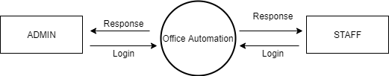
Data Flow Diagram
Level 0

Slide 13
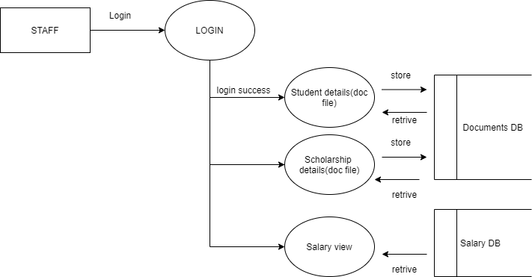
Level 1 (STAFF)

Slide 14
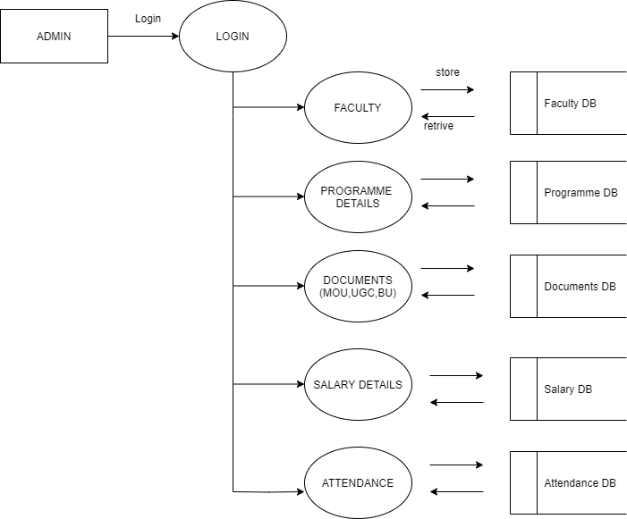
Level 1 (ADMIN)

Slide 15
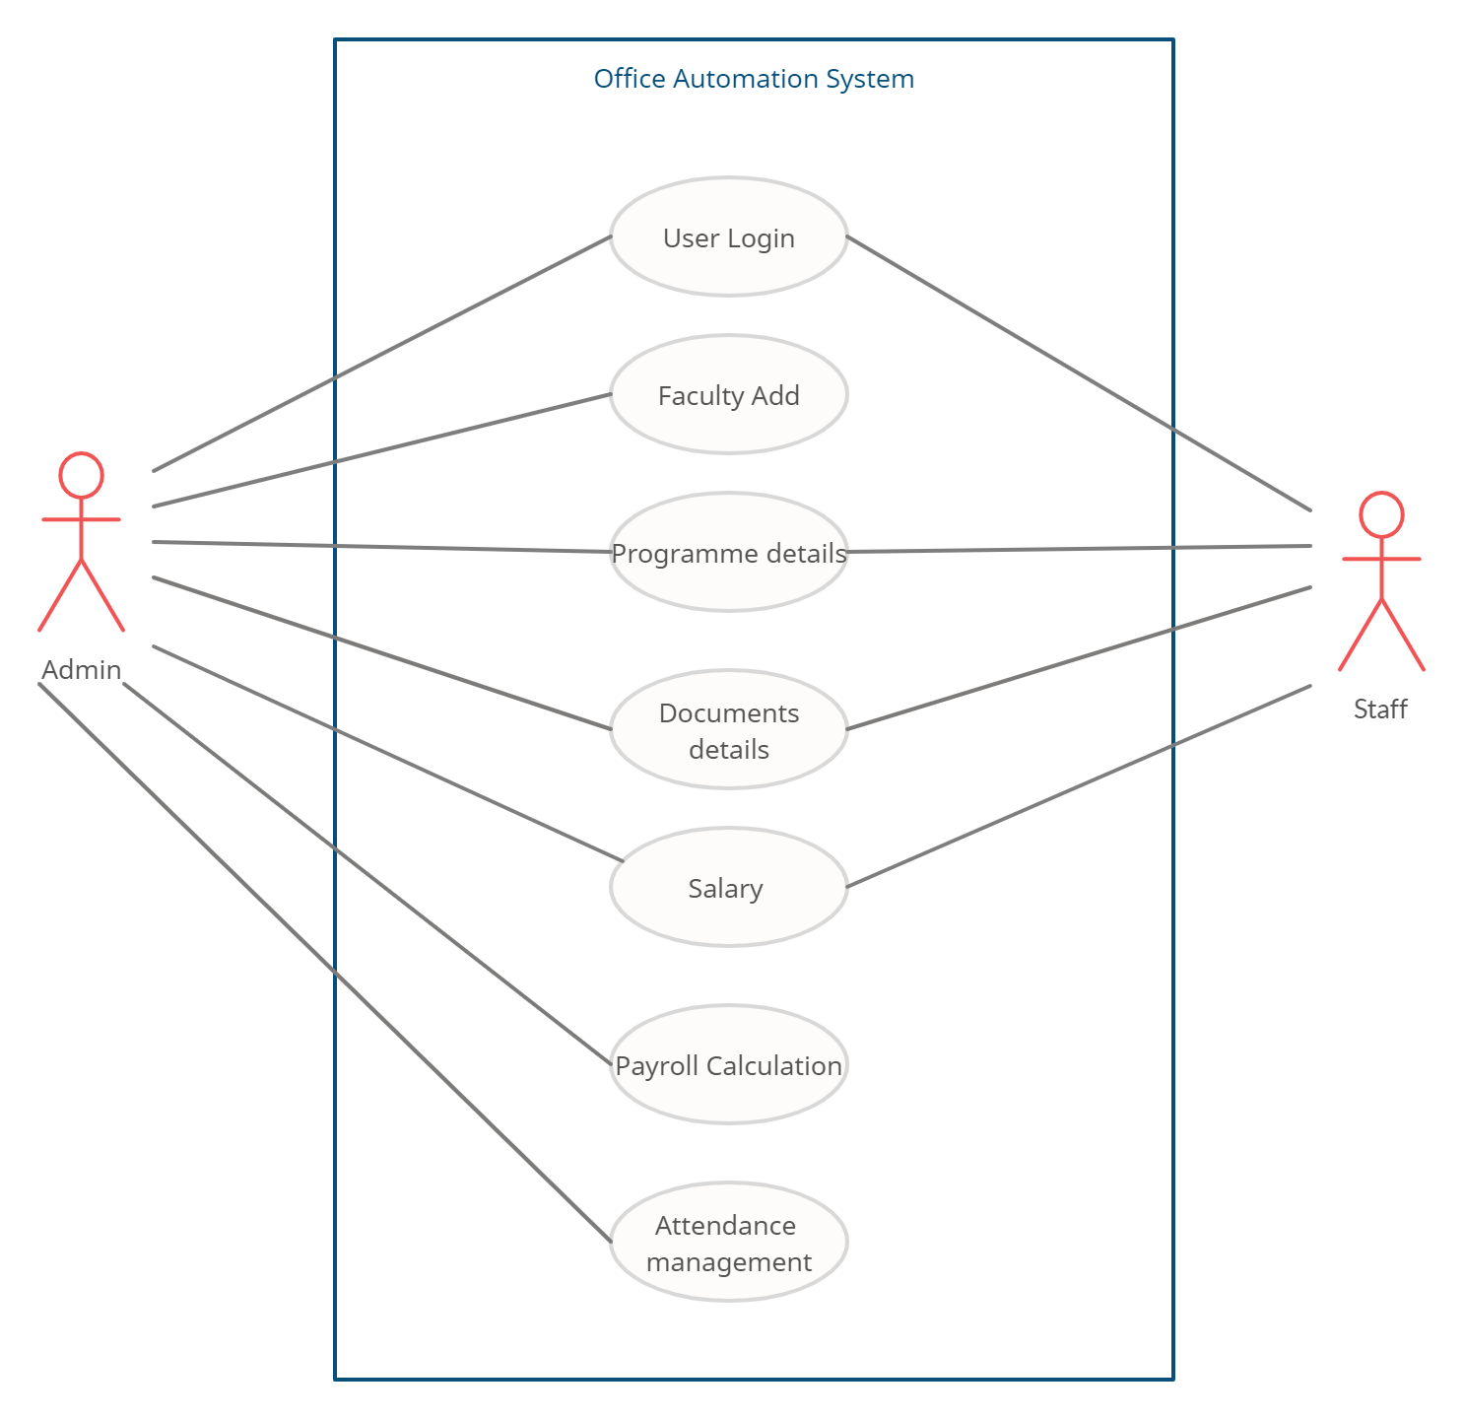
Use Case

Slide 16
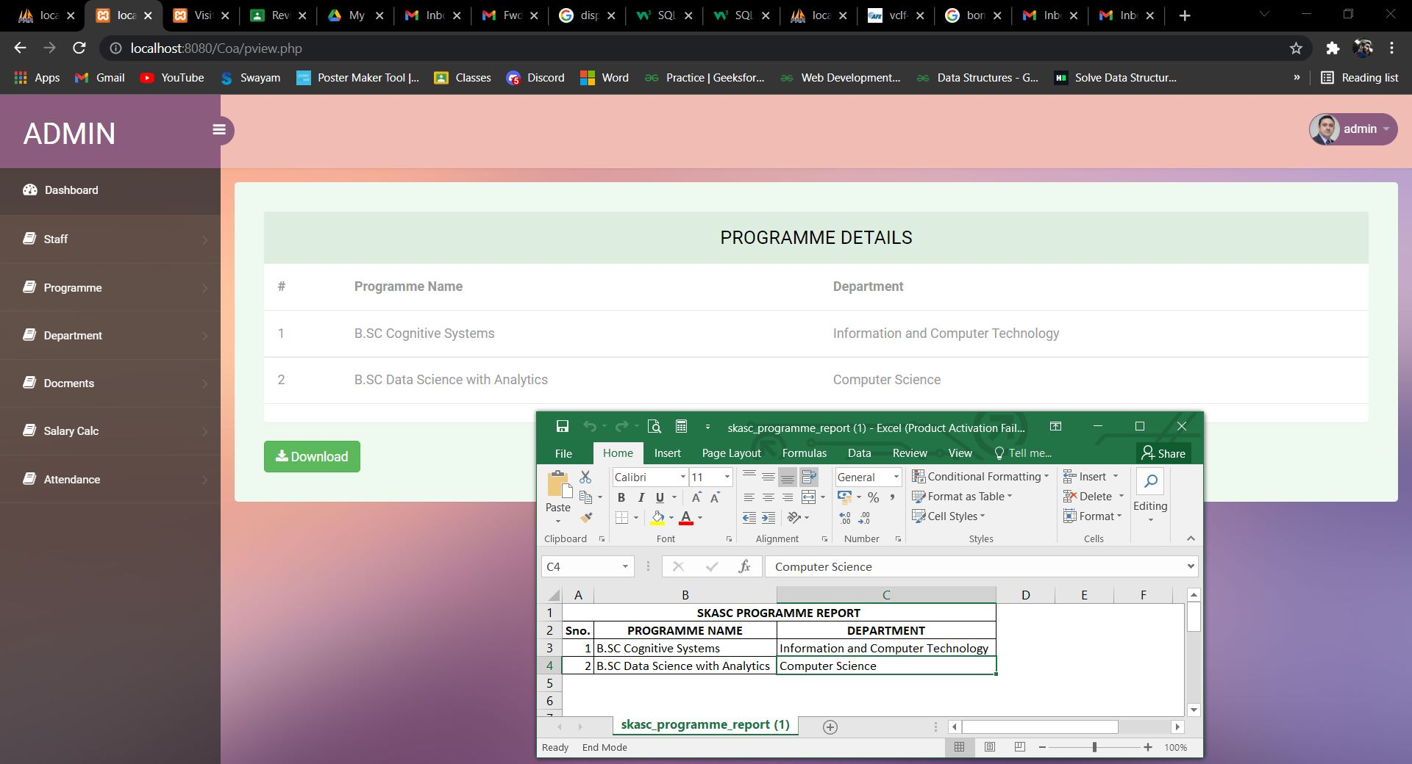
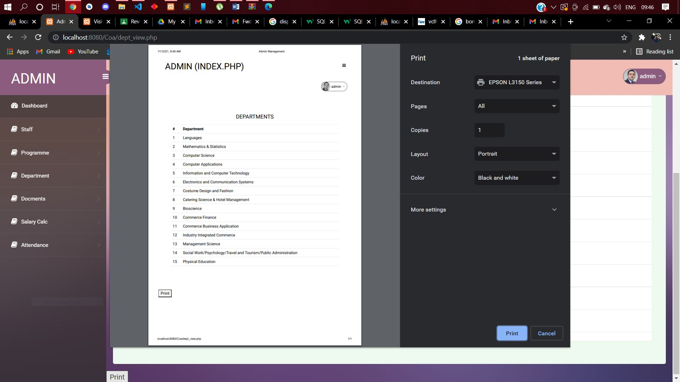
Reports

Slide 17
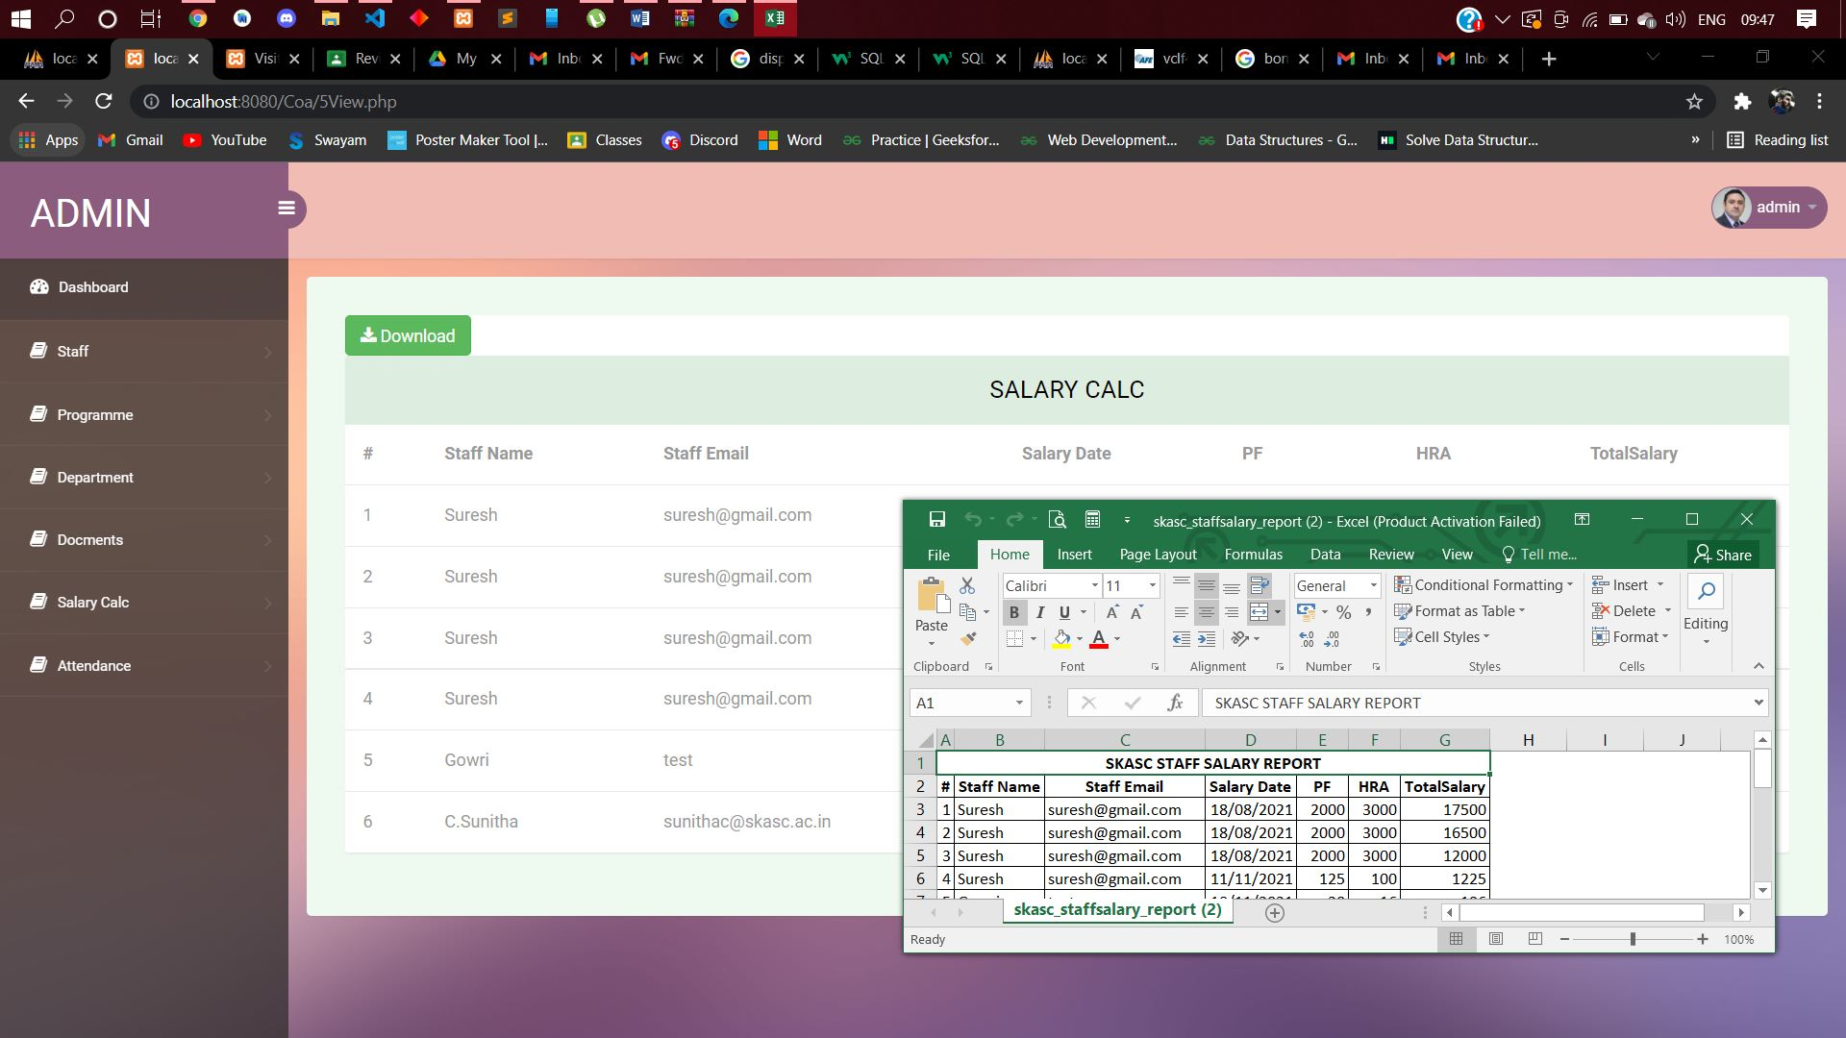
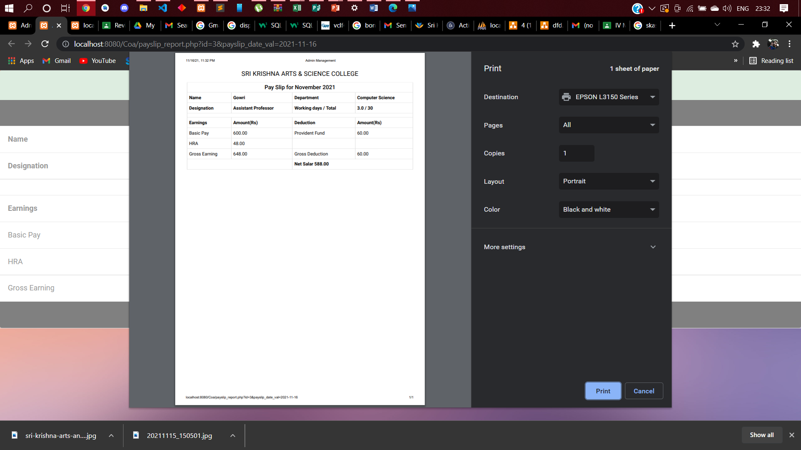

Slide 18
Future enhancements
As a part of future enhancement the user interface is to be designed in dynamic manner which results in user friendly environment
The attendance of the staff can be directly recorded from data of the bio-metric device.
The framework can be shifted to React Native for cross-platform experience.
There are also possibilities for enhancing and further developing the project with customized reports according to the latest information and needs of the user.

Slide 19
Conclusion
The introduction, problem definition of the project has been completed successfully to college web based office automation system by maintaining the details related to faculty course etc. in an efficient manner.
From the proper analysis of positive points and constraints of the component, it can be safely concluded that this project is highly effective and its user-friendly application.
Most of the paper work is limited and loss of important documents can be controlled. Since we digitalized the information it can stored and accessed at any time.

Slide 20
Thank you!

