Slide 1

BUSINESS CASE STUDY
-Bharani Kadamban S (MBT8)

Slide 2
In the Business Case study , we could see the two companies:
Zepto (Quick Commerce)
BumTum (Baby Care)

Slide 3
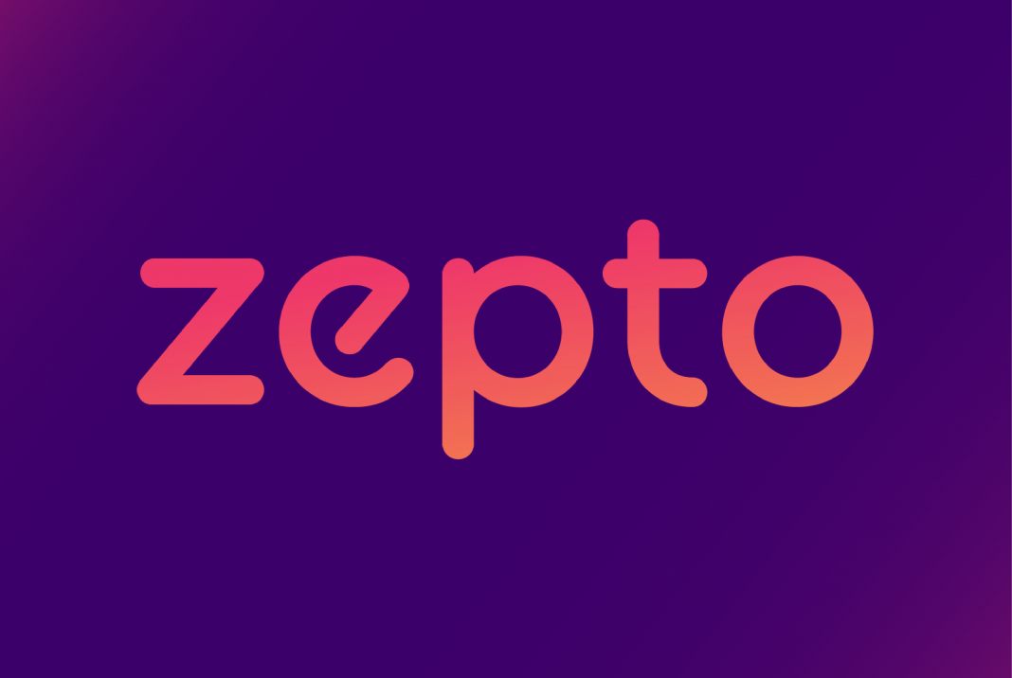
Zepto
It is basically a quick commerce company which sells the groceries, snacks, House hold things, kitchen things, etc in online application (Mobile, Laptop)
Founded by Aadit Palicha and Kaivalya Vohra in the year 2020.
Main goal of this company is to revolutionize the urban convenience by providing ultra-fast grocery and food delivery within 10 minutes,
Ensuring the customers will receive fresh products quickly and efficiently, enhancing their daily lives.

Slide 4
Business Model
Dark Stores: Warehouse-style stores in residential areas, accessible only to delivery drivers
Ultra-fast Delivery: Promises 10-minute delivery by leveraging strategically located dark stores
AI Integration: Uses AI for efficient inventory management, order picking, and delivery
Revenue Model: Earns through small commissions on each order placed via the app

Slide 5
SWOT Analysis of Zepto
Strength
Deliver the products within 10 minutes.
Providing the products in lesser price compared to market price
Weakness
Limited brands and limited products available in the site
Ultra fast delivery needs more human power
Opportunities
Make more hub and concentrate to delivery in all districts in the state
Need to use current technological power to enhance the brand level and attain more profits
Threats
Competitors such Swiggy instamart, Blinkit are selling more products in more brands

Slide 6
STP Analysis of Zepto
Segmentation: Zepto targets urban, tech-savvy consumers aged 18-45, focusing on time-starved professionals and students. They prioritize high-demand metro areas. Benefits are Convenience, speed, and reliability
Targeting: Utilizing hyper-local delivery models, Zepto ensures 10-minute deliveries, appealing to consumers valuing convenience and speed. Their primary audience is middle to high-income brackets, emphasizing quality and efficiency.
Positioning: Zepto positions itself as the fastest and most reliable quick-commerce solution, backed by a robust technology platform. With a 95% on-time delivery rate and 4.8/5 customer satisfaction score, they lead in rapid grocery delivery, enhancing urban lifestyles.

Slide 7
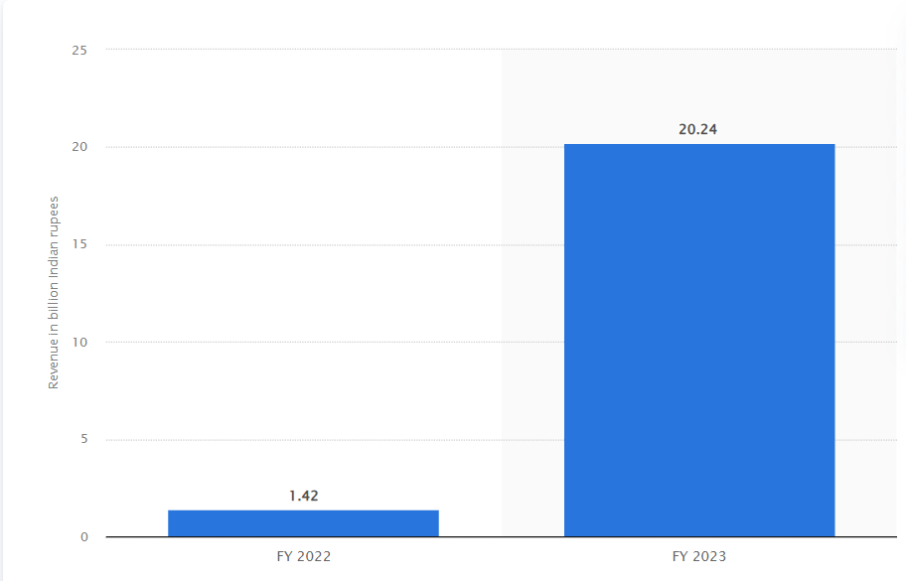
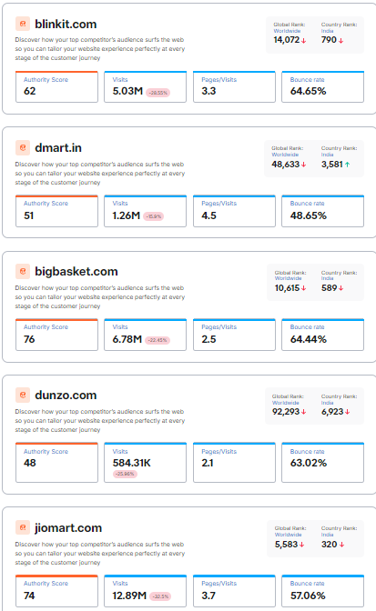
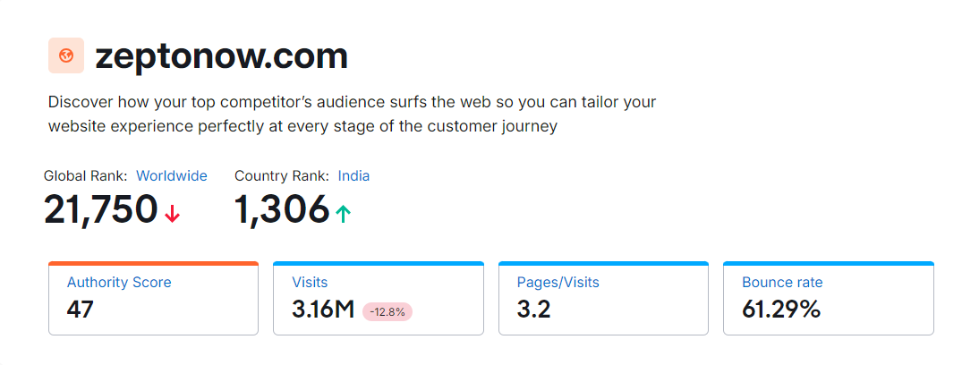
Zepto’s Statistical Analysis
Revenue of the year (2022-2023) : INR 2,024.3 Cr Competitor’s analysis Analysis

Slide 8
Zepto’s Statistical Analysis
Revenue from advertising attained over 6% in the total revenue
Employee benefit expenses rose 80% from Rs 50.7 crore to Rs 263.4 crore.
Customer’s Review
High Impact - Zepto’s 10-minute delivery is a gamechanger. Fresh produce and essentials delivered swiftly. Exceptional service!
Medium Impact - Good for quick needs, but sometimes the quality of fresh produce can be inconsistent
Low Impact - Delivery is fast, but customer support needs improvement. Had issues with order replacements

Slide 9

BumTum
BumTum is a Indian brand specializing in premium baby care products. Renowned for its high-quality, eco-friendly diapers, BumTum prioritizes comfort, safety, and sustainability.
Founded by Mayank Beria
Main goal of this company is to provide comfort, smooth and safety diapers to the children and establish themselves as a trusted and reliable name in the baby care industry, delivering premium solutions that parents can depend on.

Slide 10
Business Model
Product Offering: Provides Premium, eco-friendly baby diapers.
Value Proposition: Ensuring utmost comfort, safety, and sustainability.
Revenue Streams: Sales happening via Direct sales, retail partnerships, and subscription services.
Target Market: Middle to high-income urban parents.
Distribution Channels: E-commerce platforms and partnered retail stores.
Marketing Strategy: Digital campaigns, influencer partnerships, and customer education.

Slide 11
SWOT Analysis of BumTum
Strength
High-Quality, Premium, eco-friendly materials ensuring comfort and safety for babies.
Strong Brand Reputation: Trusted by parents for reliable baby care solutions.
Continuous product improvement based on customer feedback and research.
Weakness
Premium quality materials may lead to higher production costs, affecting pricing.
Dependency on Retail Partnerships that is reliance on third-party retailers for distribution.
Opportunities
Potential to enter new geographic markets and diversify product range.
Increased online sales through enhanced e-commerce strategies
Threats
Intense competition from established baby care brands and new entrants
Changes in health and safety regulations could impact production and costs.

Slide 12
STP Analysis of BumTum
Segmentation: BumTum targets urban and sub urban areas with consumers aged 20-40, focusing on working professional and house hold makers. Benefits are safety, soft, and eco friendly products
Targeting: BumTum targets eco-conscious parents who seeks high-quality, sustainable baby care products. These customers value the assurance of safety and comfort for their children. BumTum's primary audience includes urban people who prioritize convenience and reliability in their purchasing decisions
Positioning: BumTum positions itself as the epitome of premium baby care products , offers comfort, safety to the children. The brand provides its commitment to eco-friendly and high-quality materials to differentiate itself in a competitive market.

Slide 13
BumTum Statistical Analysis
Revenue of the year (2022-2023) : INR 150 Cr
65% higher in online platforms and 35% comes from offline sales
The total revenue from advertising for BumTum in the fiscal year 2023 was approximately $25 million
BumTum’s advertising revenue was also boosted by a 10% rise in average cost-per-click (CPC) rates and a 12% improvement in click-through rates (CTR) across their platforms.

Slide 14
Customer’s Review
High Impact This diaper is good for long time usage. It's fabric is soft on baby skin. Its fitting is comfortable and having no leakage issue. I like the packaging of this diaper.!
Medium Impact - The diapers are quite affordable and had good absorbency. The only issue I faced is that there is used to be leakage from the top.
Low Impact - New diapers are not at all good. The quality is deteriorated. The earlier diapers were really good but now the diapers easily leak in just 1 use.

Slide 15
Thank You

