Slide 1
Case Quest 2.0
- BHARANI KADAMBAN S(MBT8)

Slide 2
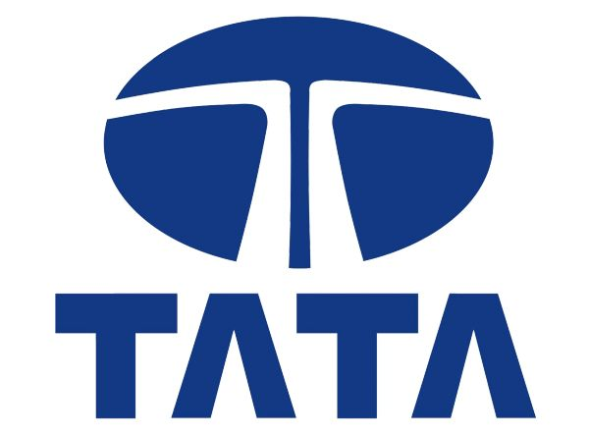
In this case study , we’ll explore the below company

Slide 3
TATA Group
Founded: 1868 by Jamsetji Tata, Natarajan Chandrasekaran is the Chairman of TATA Groups
Headquarters: Mumbai, Maharashtra. one of India's largest and most prestigious multinational conglomerates, operates in over 100 countries, setting benchmarks across industries.
Diverse Portfolio: From steel, automotive, and IT to telecommunications, hospitality, and consumer goods, Tata’s diversified businesses cover a wide array of industries, each a leader in its domain.
Iconic Brands: Tata is home to globally recognized brands like Tata Consultancy Services (TCS), Tata Motors, Jaguar Land Rover, and Taj Hotels, which exemplify quality and excellence.
Philanthropic Legacy: Through the Tata Trusts and other initiatives, the group has a profound impact on society, contributing significantly to education, healthcare, and rural development.
Financial Stability: Backed by strong financial fundamentals, Tata companies exhibit robust growth, maintaining leadership positions in both emerging and developed markets.
Visionary Leadership: Guided by ethical business practices and visionary leaders, Tata’s mission-driven ethos ensures long-term value creation for stakeholders and communities alike
Business Sectors / Companies: Operating in sectors like steel, automotive, information technology, telecommunications, power, consumer products, chemicals, and hospitality.

Slide 4
BUSINESS MODEL
Conglomerate Structure: Tata Group operates as a diversified conglomerate with more than 100 companies across sectors like technology, automotive, steel, hospitality, and consumer goods, providing a robust and dynamic portfolio that balances risk and opportunity.
Operational Model: Tata companies enjoy operational autonomy, allowing each entity to foster innovation and agility while adhering to the group's overarching vision of excellence, ethics, and community welfare.
Value Creation: By integrating businesses that span from industrial products to consumer-facing services, Tata Group strategically creates value across multiple verticals, capturing synergies and leveraging cross-industry expertise.
Sustainability-Centric: Sustainability is at the core of Tata's business model. From green technologies in Tata Motors to responsible sourcing in Tata Steel, the group ensures that its businesses operate with minimal environmental impact and maximum social benefit.
Innovation Growth: Tata companies, particularly in technology and automotive, are innovation powerhouses, consistently investing in R&D to remain at the cutting edge of industry advancements, ensuring sustainable competitive advantages.
Global Expansion with Local Impact: While maintaining a global footprint, Tata prioritizes local relevance in its operations, ensuring that its businesses contribute positively to the economies and communities in which they operate.
Philanthropy-Embedded Structure: Through its unique ownership structure, where the majority of shares are held by Tata Trusts, the group's profits feed into philanthropic initiatives that uplift society, enhancing its social impact alongside financial success.
Customer-Centric Approach: Tata’s companies are highly attuned to customer needs, continuously enhancing product quality, service, and innovation to ensure unparalleled customer experiences across its broad array of sectors.

Slide 5
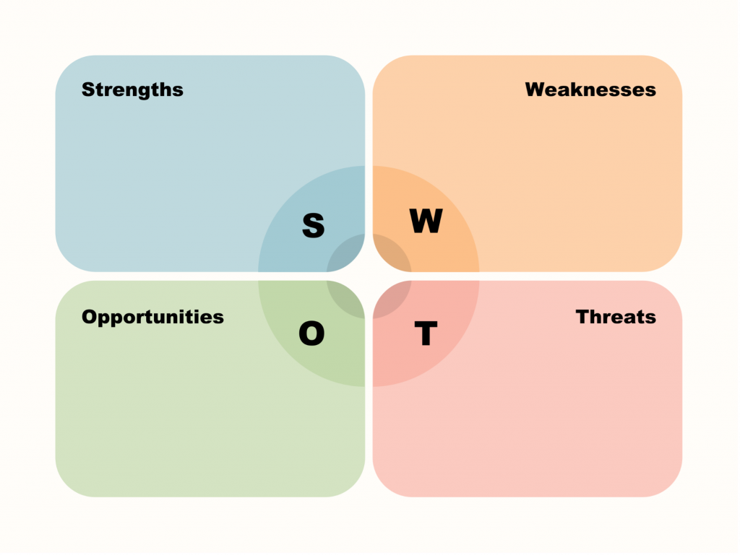
SWOT ANALYSIS
Strengths:
Diverse Portfolio: Tata operates across industries like TCS, automotive, steel and hospitality
reducing dependency on any single sector.
Global Presence: With operations in over 100 countries, Tata has established as a global brand. Jaguar Land Rover (JLR), acquired by Tata Motors, showcases Tata’s ability to turn around global brands and expand its international footprint.
Strong Brand Equity: Tata is synonymous with trust and quality, with brands like Tata Salt and Titan enjoying household recognition and customer loyalty.
Commitment to Innovation: Tata companies, invest heavily in R&D. TCS is a prime example, leading innovations in AI and blockchain technology, while Tata Motors is pioneering electric mobility solutions.
Weaknesses:
High Capital-Intensive Industries: Some of Tata’s businesses, such as Tata Steel and Tata Motors, are highly capital-intensive and subject to cyclical risks.
Overdependence on TCS: While TCS is a global leader in IT services, the group is heavily reliant on TCS for profitability. TCS generates over 50% of Tata Group's total revenue, making it a critical pillar of the conglomerate's financial health.
Complex Organizational Structure: Tata Group's conglomerate structure can sometimes lead to operational inefficiencies and slower decision-making processes across its diverse companies.

Slide 6
SWOT ANALYSIS
Opportunities:
Expansion in Markets: Tata’s global presence provides the group with opportunities to tap into growing emerging markets, especially in sectors like telecommunications, technology, and automotive.
Renewable Energy Leadership: With the world moving towards sustainability, Tata Power is well-positioned to capitalize on the growing demand for renewable energy. Tata's expertise in solar and wind power offers significant growth potential.
Digital Transformation: As businesses worldwide undergo digital transformation, TCS is poised to lead with its cutting-edge solutions in AI, cloud computing, and cybersecurity, offering significant opportunities for growth in the IT services sector.
Threats:
Global Economic Fluctuations: Tata’s businesses are exposed to global economic conditions, especially in sectors like steel and automotive. For example, economic slowdowns or trade wars could impact Tata Steel's international operations and export revenues.
Intense Competition: Tata operates in highly competitive industries. For instance, Tata Motors faces stiff competition from global giants like Tesla and traditional automakers like Hyundai in the electric vehicle segment.
Regulatory Challenges: Changing regulations, especially in industries like telecom and automotive, can pose significant threats. For example, stricter environmental regulations could increase compliance costs for Tata Motors.
Technological Disruption: Rapid technological advancements could disrupt industries where Tata operates, particularly in automotive and IT.

Slide 7
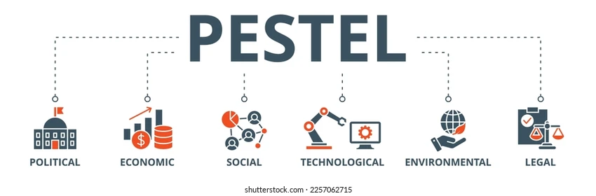
PESTLE ANALYSIS
Political Factors:
Government Policies : Tata operates in industries like steel, automotive, and telecommunications that are highly regulated. For example, Tata Motors must comply with stringent environmental regulations related to vehicle emissions in India and abroad.
Political Stability: Tata benefits from India’s relatively stable political environment, which fosters long-term business growth. The group’s strong relationship with the Indian government has enabled it to navigate regulatory landscapes and partner in national initiatives like Make in India.
Global Trade Policies: With significant operations in international markets, Tata Group is impacted by global trade policies and tariffs.
Economic Factors:
Economic Growth and Consumer Demand: Tata's businesses are sensitive to both global and domestic economic trends. For instance, Tata Motors’ growth in India is directly linked to rising middle-class incomes and increased demand for affordable and electric vehicles, like the Tata Nexon EV.
Foreign Exchange and Global Market Exposure: With a large global footprint, Tata’s revenue streams are influenced by foreign exchange fluctuations.
Economic Recession and Inflation: Tata Group’s companies, especially those in capital-intensive sectors like steel and automobiles, are vulnerable to economic downturns. Inflationary pressures can increase operational costs, as seen with rising raw material costs in Tata Steel’s operations.

Slide 8
PESTLE ANALYSIS
Social Factors:
Changing Consumer Preferences: Tata is attuned to evolving customer expectations, especially the growing demand for sustainable and eco-friendly products. Tata Power and Tata Motors are both investing heavily in renewable energy and electric vehicles to meet the demand for green solutions.
Demographic Shifts: Tata companies, particularly in sectors like consumer goods and IT services, are positioned to benefit from India’s youthful population and rising digital literacy.
Corporate Social Responsibility: Tata’s strong focus on CSR initiatives, including its investments in education, healthcare, and rural development through Tata Trusts, has cemented its reputation as a socially responsible conglomerate.
Technological Factors:
Digital Innovation: Tata Group is embracing digital transformation across sectors. TCS is a leader in IT services, driving innovation in areas like AI, blockchain, and cloud computing. Tata Motors is also leveraging technology to enhance its electric vehicle offerings.
R&D and Technological Advancements: The group’s investment in R&D ensures it stays competitive across industries. Tata Motors, for example, is pioneering advancements in electric mobility and connected vehicles to compete with global automotive giants.
Industry 4.0: Tata Steel is adopting smart manufacturing technologies (Industry 4.0) to optimize operations, increase productivity, and enhance sustainability across its steel plants.

Slide 9
PESTLE ANALYSIS
Legal Factors:
Compliance with International Laws: Tata’s global operations require adherence to varying legal frameworks. For example, Jaguar Land Rover must comply with both EU and UK regulations post-Brexit, influencing product design and supply chain management.
Intellectual Property Laws: Tata companies, particularly in technology and pharmaceuticals, are impacted by intellectual property laws that protect innovations. TCS ensures its proprietary technologies and software solutions are safeguarded across international markets.
Employment and Labor Laws: As a large employer, Tata is subject to labor laws across multiple countries. Its commitment to fair labor practices and strong employee welfare policies is essential to maintaining a motivated and diverse workforce.
Environmental Factors:
Climate Change and Sustainability: Tata is committed to reducing its carbon footprint. Tata Steel and Tata Motors are implementing greener manufacturing processes, while Tata Power is expanding its renewable energy portfolio with significant investments in solar and wind energy.
Environmental Regulations: Stringent environmental regulations in industries like automotive and steel push Tata companies to innovate. For instance, Tata Motors is investing in electric vehicle technology to comply with global emission standards.
Sustainable Supply Chain: Tata focuses on creating an eco-friendly supply chain. For example, Tata Chemicals incorporates green chemistry into its operations, ensuring minimal environmental impact while delivering high-quality products.

Slide 10
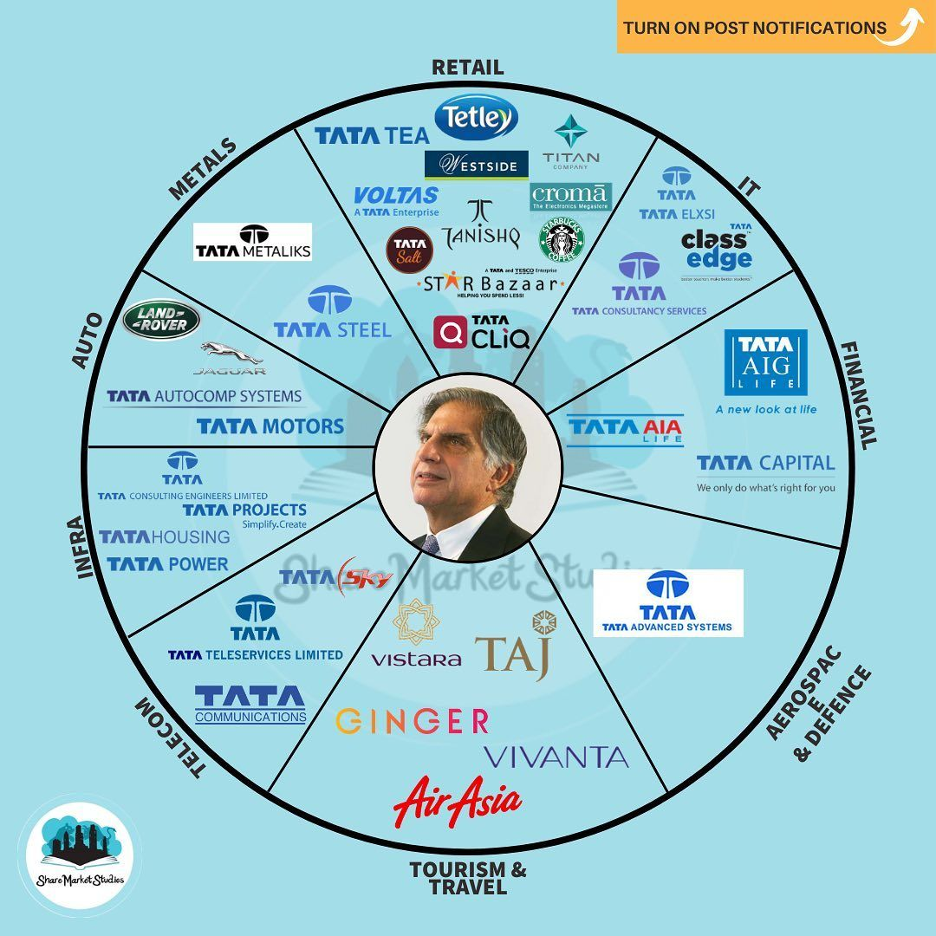
Statistical Data
Revenue: Tata Group generated an estimated $150 billion in revenue for FY 2022-2023, reinforcing its position as one of India’s largest conglomerates and a global leader.
Employee Strength: The group employs over 935,000 people worldwide, making it one of the largest employers across multiple industries, with Tata Consultancy Services (TCS) alone contributing over 600,000 employees.
Global Reach: Tata Group operates in over 100 countries across six continents, demonstrating its far-reaching impact and ability to drive global innovation and growth.
IT Dominance: Tata Consultancy Services (TCS) remains the crown jewel of the group, contributing over $27 billion in revenue and consistently maintaining profit margins above 25%.
Automotive Excellence: Tata Motors sold over 1 million vehicles worldwide in 2023, with electric vehicles (EVs) like the Tata Nexon EV showing rapid growth, contributing significantly to the company’s sustainable mobility vision.
Steel Powerhouse: Tata Steel, one of the world’s largest steel producers, has an annual production capacity of 34 million tones, with operations spanning India, Europe, and Southeast Asia.
Sustainability Impact: Tata Power is India’s largest renewable energy company, with an installed capacity of over 3.8 GW in renewable energy assets, reflecting the group’s commitment to a sustainable future.

Slide 11
Conclusion
SWOT, including its diversified portfolio, global presence, and strong brand equity, position it as a resilient and adaptive conglomerate. However, the group must address challenges like its over-reliance on TCS and high capital demands in sectors like steel and automotive. The group's opportunities lie in harnessing emerging market growth, leading the renewable energy transition, and capitalizing on digital transformation. Yet, it faces threats from global economic fluctuations, increasing competition, and regulatory pressures. Overall, Tata's ability to innovate and sustain ethical leadership ensures it can continue to navigate challenges while capitalizing on future opportunities.
PESTLE analysis reveals that Tata Group operates in a complex macro-environment shaped by political, economic, social, technological, legal, and environmental factors. The group benefits from supportive government policies, strong consumer demand, and advancements in technology, all of which contribute to its growth. However, regulatory challenges, global economic uncertainties, and environmental regulations require ongoing adaptability. Tata’s proactive approach to sustainability, R&D, and social responsibility provides a strong foundation for long-term success. By staying agile and aligned with global trends, Tata is well-positioned to thrive in an ever-evolving global landscape.

