Slide 1

BUSINESS CASE STUDY
-Bharani Kadamban S (MBT8)

Slide 2
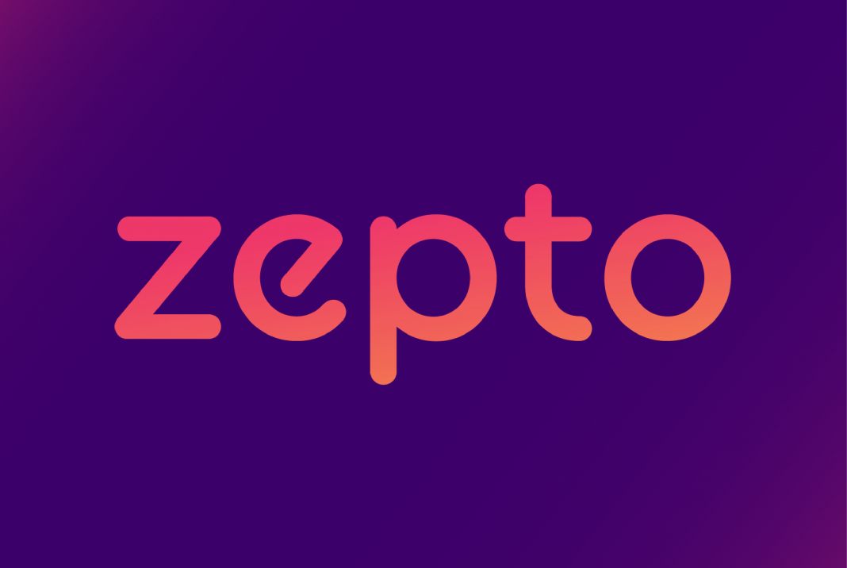
Zepto
It is basically a quick commerce company which sells the groceries, snacks, House hold things, kitchen things, etc in online application (Mobile, Laptop)
Founded by Aadit Palicha and Kaivalya Vohra in the year 2020.
Main goal of this company is to revolutionize the urban convenience by providing ultra-fast grocery and food delivery within 10 minutes,
Ensuring the customers will receive fresh products quickly and efficiently, enhancing their daily lives.

Slide 3
Business Model
Dark Stores: Warehouse-style stores in residential areas, accessible only to delivery drivers
Ultra-fast Delivery: Promises 10-minute delivery by leveraging strategically located dark stores
AI Integration: Uses AI for efficient inventory management, order picking, and delivery
Revenue Model: Earns through small commissions on each order placed via the app

Slide 4
SWOT Analysis of Zepto
Strength
Deliver the products within 10 minutes.
Providing the products in lesser price compared to market price
Weakness
Limited brands and limited products available in the site
Ultra fast delivery needs more human power

Slide 5
SWOT Analysis of Zepto
Opportunities
Make more hub and concentrate to delivery in all districts in the state
Need to use current technological power to enhance the brand level and attain more profits
Threats
Competitors such Swiggy instamart, Blinkit are selling more products in more brands

Slide 6
STP Analysis of Zepto
Segmentation: Zepto targets urban, tech-savvy consumers aged 18-45, focusing on time-starved professionals and students. They prioritize high-demand metro areas. Benefits are Convenience, speed, and reliability
Targeting: Utilizing hyper-local delivery models, Zepto ensures 10-minute deliveries, appealing to consumers valuing convenience and speed. Their primary audience is middle to high-income brackets, emphasizing quality and efficiency.
Positioning: Zepto positions itself as the fastest and most reliable quick-commerce solution, backed by a robust technology platform. With a 95% on-time delivery rate and 4.8/5 customer satisfaction score, they lead in rapid grocery delivery, enhancing urban lifestyles.

Slide 7
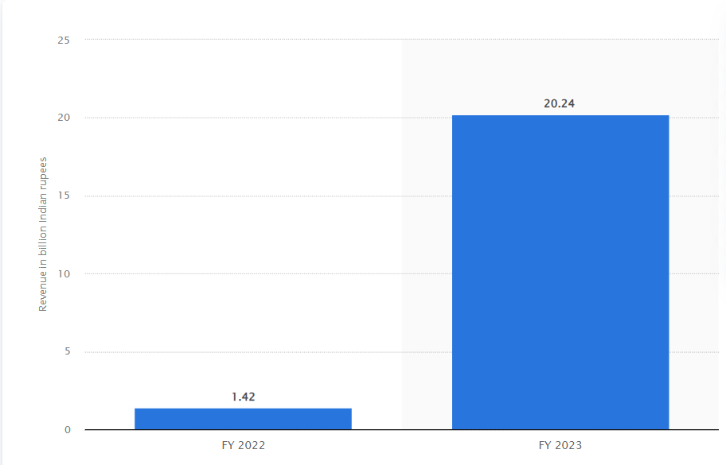
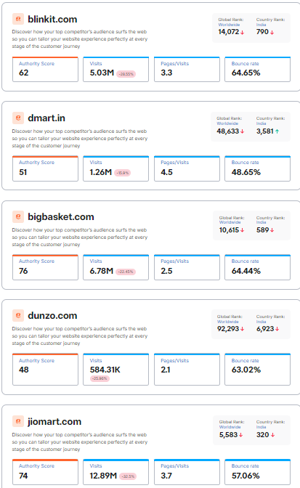
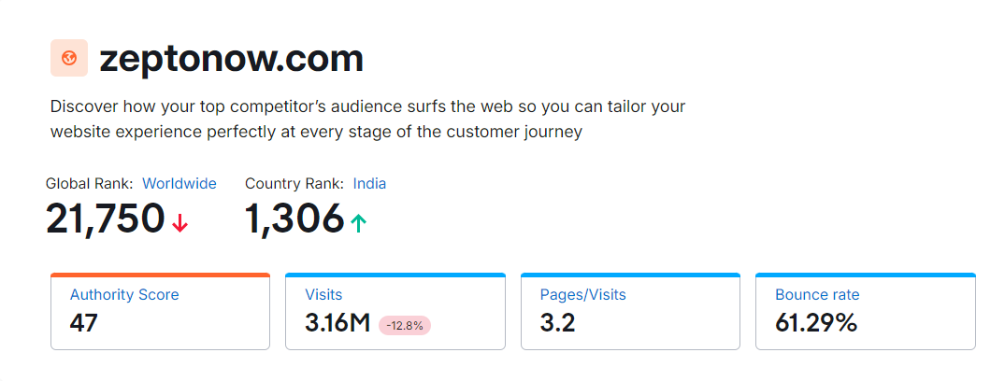
Zepto’s Statistical Analysis
Revenue of the year (2022-2023) : INR 2,024.3 Cr Competitor’s analysis Analysis

Slide 8
Zepto’s Statistical Analysis
Revenue from advertising attained over 6% in the total revenue
Employee benefit expenses rose 80% from Rs 50.7 crore to Rs 263.4 crore.
Customer’s Review
High Impact - Zepto’s 10-minute delivery is a gamechanger. Fresh produce and essentials delivered swiftly. Exceptional service!
Medium Impact - Good for quick needs, but sometimes the quality of fresh produce can be inconsistent
Low Impact - Delivery is fast, but customer support needs improvement. Had issues with order replacements

Slide 9
Thank You

