Slide 1
TABLEAU CAPSTONE
CYCLIST BIKE SHARE ANALYSIS

Slide 2
CYCLIST BIKE SHARE ANALYSIS
We received the capstone project of Cyclist bike share analysis.
In this capstone , we need to understand how casual riders and annual members use cyclist bikes differently.
We have been provided the data set which contains information of the riders who are all casual / annual membership riders , who are all using electric and docked bikes and time frame of the riders
From the given datasets, we need to clean the data by removing errored and unwanted details of the riders.
With the help of cleaned data, we need to analyze and provide the key insights to the business with help of Tableau visualization

Slide 3
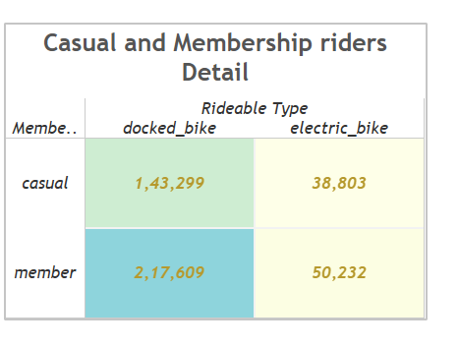
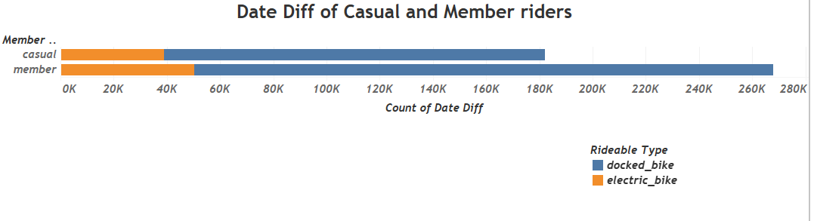
Casual and Membership riders Detail

Slide 4
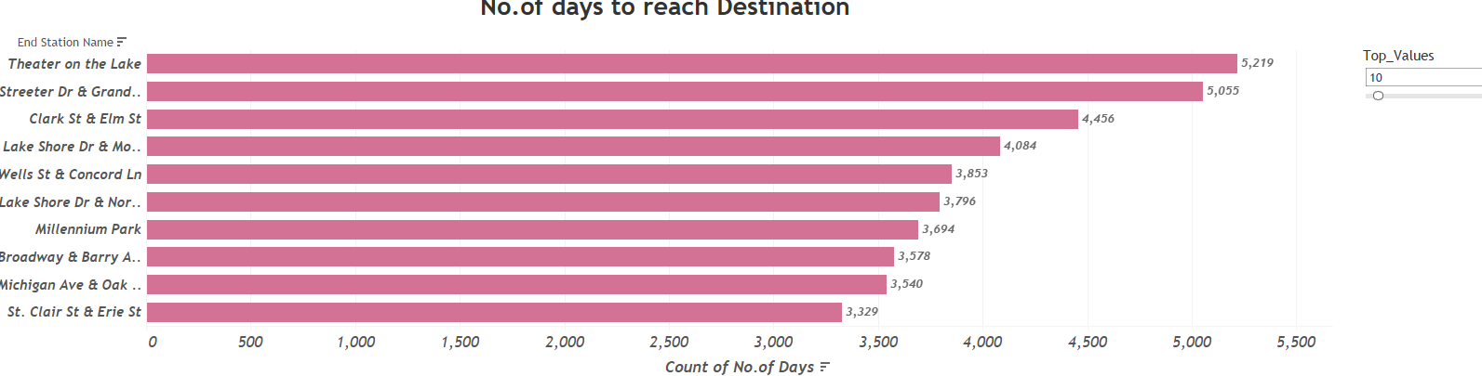
Days to reach Destination

Slide 5
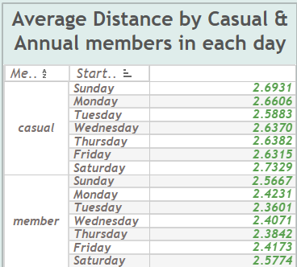
Average Distance by Casual & Annual members in each day

Slide 6
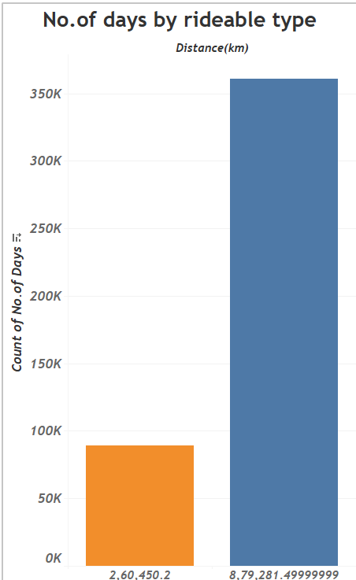
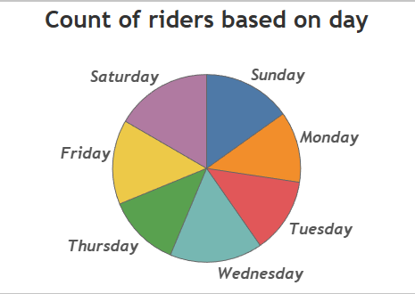
Riders and Rideable type information

Slide 7
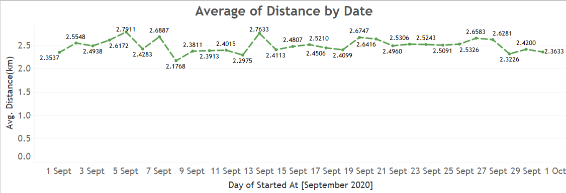
Calculates the average distance based on the date

Slide 8
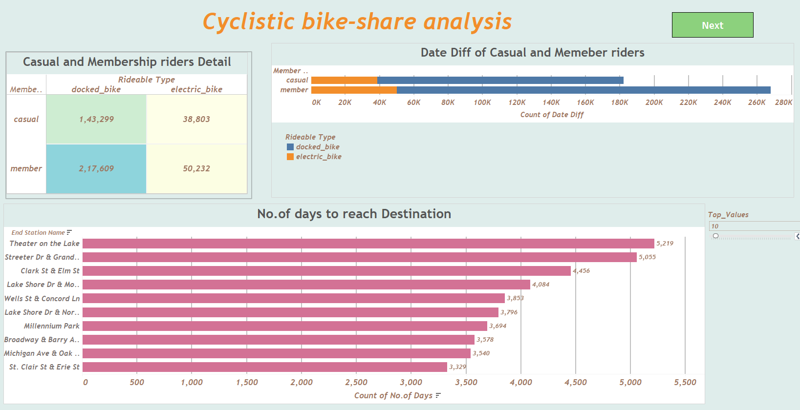
Dashboard Page 1

Slide 9
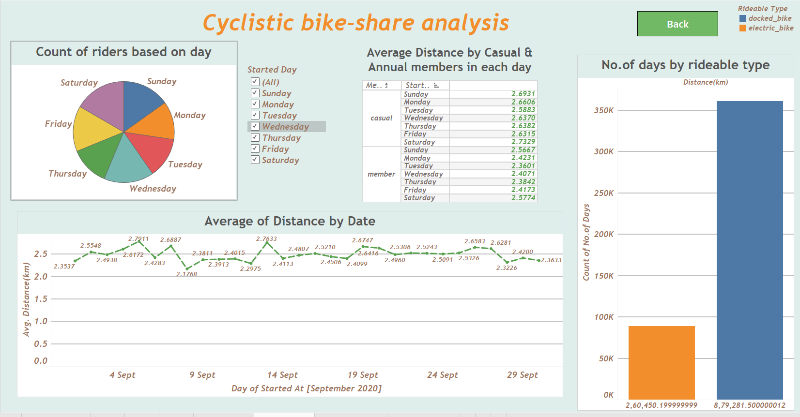
Dashboard Page 2

Slide 10
Thank You

