Slide 1
FINAL PROJECT Customer Purchase Behavior in Retail using Data Analytics
Bharani Kadamban S
Batch No : MBT8

Slide 2
Overview of the Project
From this capstone, We could get the insights of customers purchase behaviour in retail shops.
Information such as what kind of products customers purchase, in which brands , under which category, how many sales done so far happened for a store, what is profit for a particular period of time/ month.
Also we could see the what are all the Business use cases and it’s insights in the upcoming slides.

Slide 3
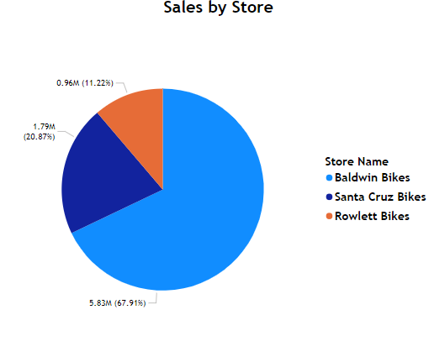
Sales Performance Analysis
Sales Performance provides us the detailed information of sales that are happened in each brands , categories, products, stores ,etc.
It will help us to make the wise decisions to increase the sales in each sector of a product.
For example , From the store data, we could see that Baldwin Bikes store has more sales compared to remaining stores

Slide 4
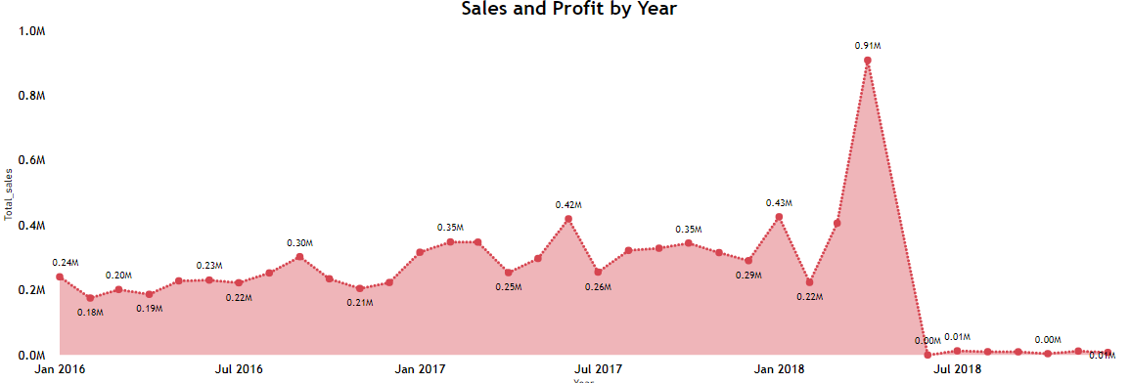
Sales Performance Analysis
Another example, In the below chart we could see that that sales happened over the months and years.

Slide 5
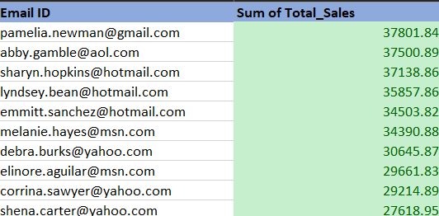
Customer Insights
To improve the sales, attain the better profit and sustain in the market, it’s very important to know the customer’s value and their feedbacks.
For example, below are the Top 10 customers who has bought more products.

Slide 6
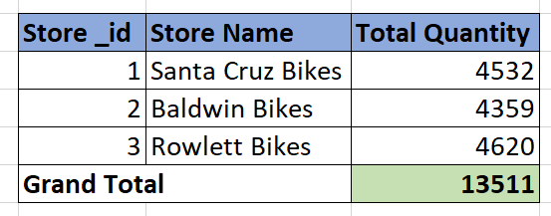
Inventory Management
Inventory Management is one of the most prioritized thing in the retail shop. Customer should not leave our shop if in case there is no stocks of a particular product
Products with high turnover rates maintain optimal stock availability, minimizing stockouts while avoiding overstocking.
Regular restocking cycles ensure that the products are available at any given time, minimizing customer wait times and lost sales due to stockouts.

Slide 7
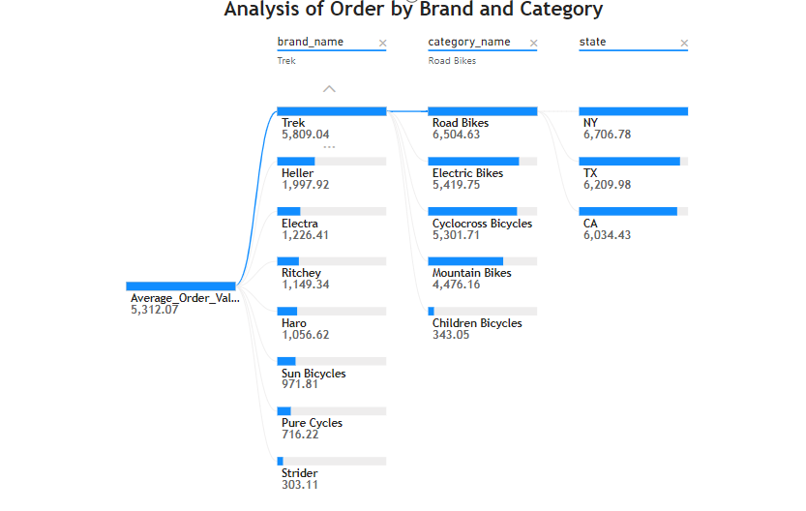
Order Fulfilment Optimization
Optimize the order delivery services to better meet the needs of the consumers.
Especially, need to track on which brands, categories the more orders placed. Also to gain more profit , it is important to calculate the order date and shipped date for each products.
From the below decomposition tree, we could see the detail information of orders placed on which brand , categories, states.

Slide 8
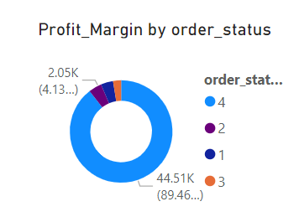
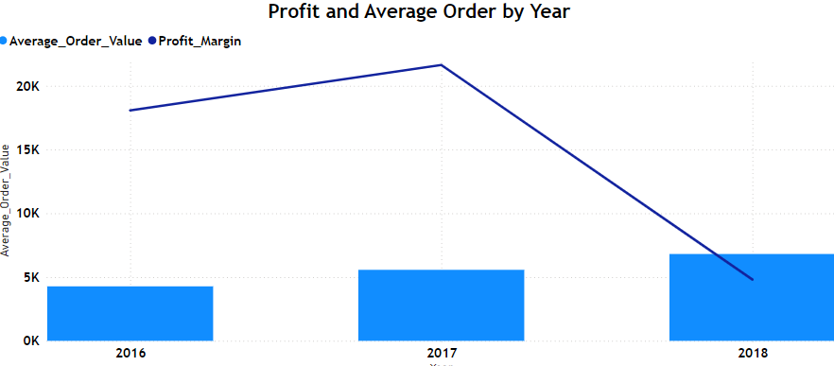
Order Fulfilment Optimization
The below Donut chart depicts the profits on each order status
Below bar chart shows the profit and average order placed over the years.

Slide 9
Financial Reporting
Financial Reporting includes the overall sales / revenue of products in a particular period, profit statistics and total quantity of products in each categories.
This reporting will helps us to make decisions in more efficient manner.
Financial reporting ensures transparency, enabling decision-makers to assess the organization’s financial health, track growth, and ensure regulatory compliance.
By leveraging the insights, financial reporting supports strategic planning and drives operational efficiency, positioning the business for sustainable success in competitive markets.

Slide 10
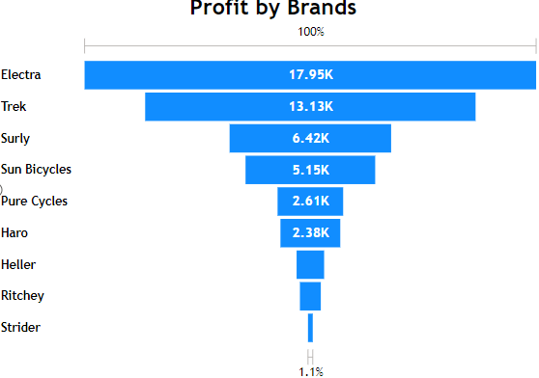
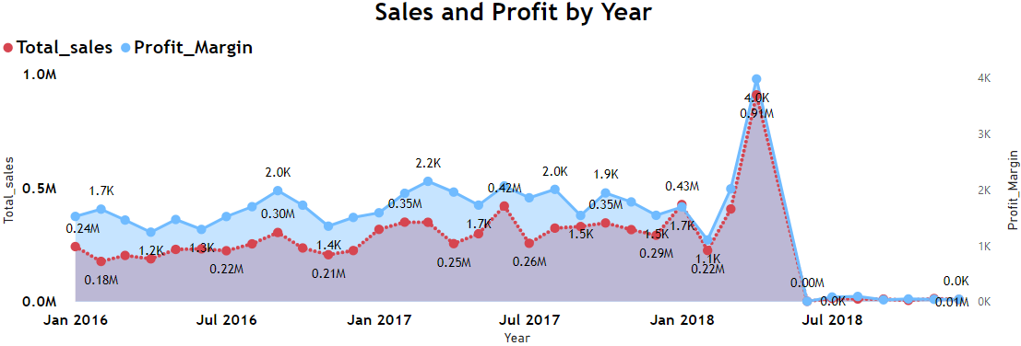
Financial Reporting
Below are some example charts for Financial Reporting

Slide 11
Staff Performance Evaluation
Staff Performance also plays a vital role in sales in the stores.
Work performance of staffs such as handling the customers, how many products the staff sold, what is turn over from a particular staff, etc.
Financial reporting ensures transparency, enabling decision-makers to assess the organization’s financial health, track growth, and ensure regulatory compliance.
By leveraging insights, financial reporting supports strategic planning and drives operational efficiency, positioning the business for sustainable success in competitive markets.

Slide 12
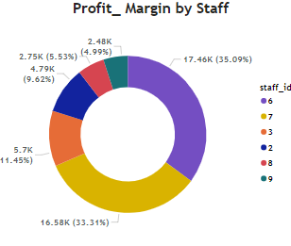
Staff Performance Evaluation
By leveraging insights, financial reporting supports strategic planning and drives operational efficiency, positioning the business for sustainable success in competitive markets.
Below chart shows the overall sales done by each staff

Slide 13
Market Trend Analysis
Market trend analysis involves understanding the sales patterns, customer behavior, and product performance over time to identify the consumer demand and emerging opportunities.
Also need to know and analyse the competitor’s products which have high demand in market sales and what make the customers wants to purchase the competitor’s product compared to our products.
By analyzing key variables such as order frequency, product popularity, market trend analysis helps to reveal fast-moving products, and underperforming categories. It also highlights changing customer preferences, enabling businesses to adjust inventory, marketing strategies, and pricing models

Slide 14
Business Strategy Growth
Business strategy growth focuses on leveraging insights from sales, customer behavior, and inventory management to revenue and profitability.
Business can upgrade growth strategies to enhance customer retention, improve market penetration.
Data-driven decisions on pricing, discounting, and product offerings drive targeted marketing efforts and regional expansion. Efficient inventory management reduces operational costs.
Ultimately, a focused business strategy based on these insights promotes scalable growth, increased market share, and long-term sustainability.

Slide 15
THANK YOU

