Slide 1
🌾 AgriShield Analytics
Pest & Disease Detection and Crop Health Monitoring
Complete Data Analytics Project | Day 1 – Day 3
Domain: Agriculture & AgriTech
Technology: Power BI | Python | Excel | DAX
ETL & Preprocessing → Exploratory Data Analysis → Farmer RFM Segmentation
Generated: June 30, 2026

Slide 2
📌 Project Overview
📊 Dataset
600-row synthetic AgriTech dataset with 30 features
🌾 Crops
10 crop types: Wheat, Rice, Maize, Soybean, Cotton + more
👨‍🌾 Farmers
50 unique farmers across 10 Indian states
📅 Period
January 2023 – December 2024 (2-year span)
🎯 Objective
Detect pest/disease patterns, monitor crop health, segment farmers
🛠️ Tools
Python, Pandas, Matplotlib, Seaborn, Power BI, DAX, OpenPyXL

Slide 3
🔧 Day 1 – Data Integration & ETL
Power Query | Python | Excel | Star Schema
✅ Import Excel dataset
✅ Fill missing values (median/mode)
✅ Remove 15 duplicates
✅ Create 12 calculated columns
✅ Fix inconsistent casing
✅ Build Star Schema (1 Fact + 7 Dims)
✅ Correct data types
✅ Export 9 CSV/Excel files
✅ Replace invalid values
✅ Generate Power Query M code
Star Schema: FactCropHealth ← DimCrop | DimFarmer | DimLocation | DimWeather | DimPest | DimDisease | DimDate

Slide 4
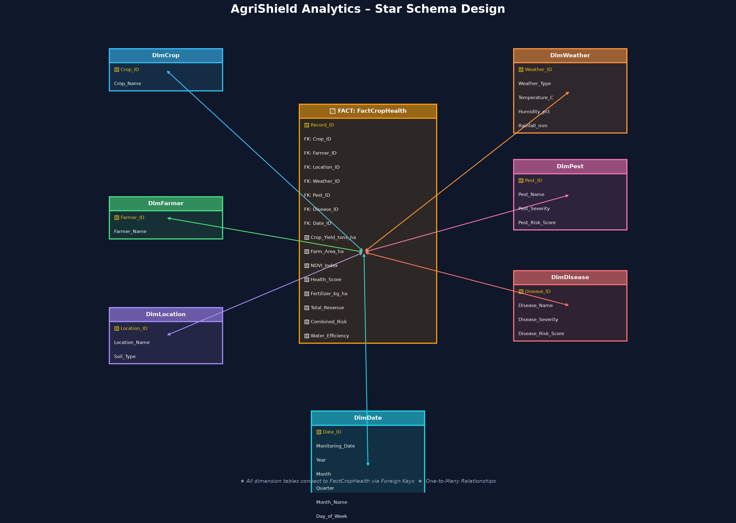
⭐ Star Schema – AgriShield Data Model

Slide 5
📊 Day 2 – Exploratory Data Analysis
9 Visualizations | Descriptive Stats | Correlation | Outlier Detection
📈 Histogram
📦 Box Plot
🔴 Scatter Plot
Distribution analysis
Outlier detection
NDVI vs Yield
🔥 Heatmap
📊 Bar Chart
🥧 Pie Chart
Correlation matrix
Yield by crop
Pest severity
🗺️ Tree Map
📉 Line Chart
💧 Waterfall
Yield by location
Monthly trend
Quarterly revenue

Slide 6
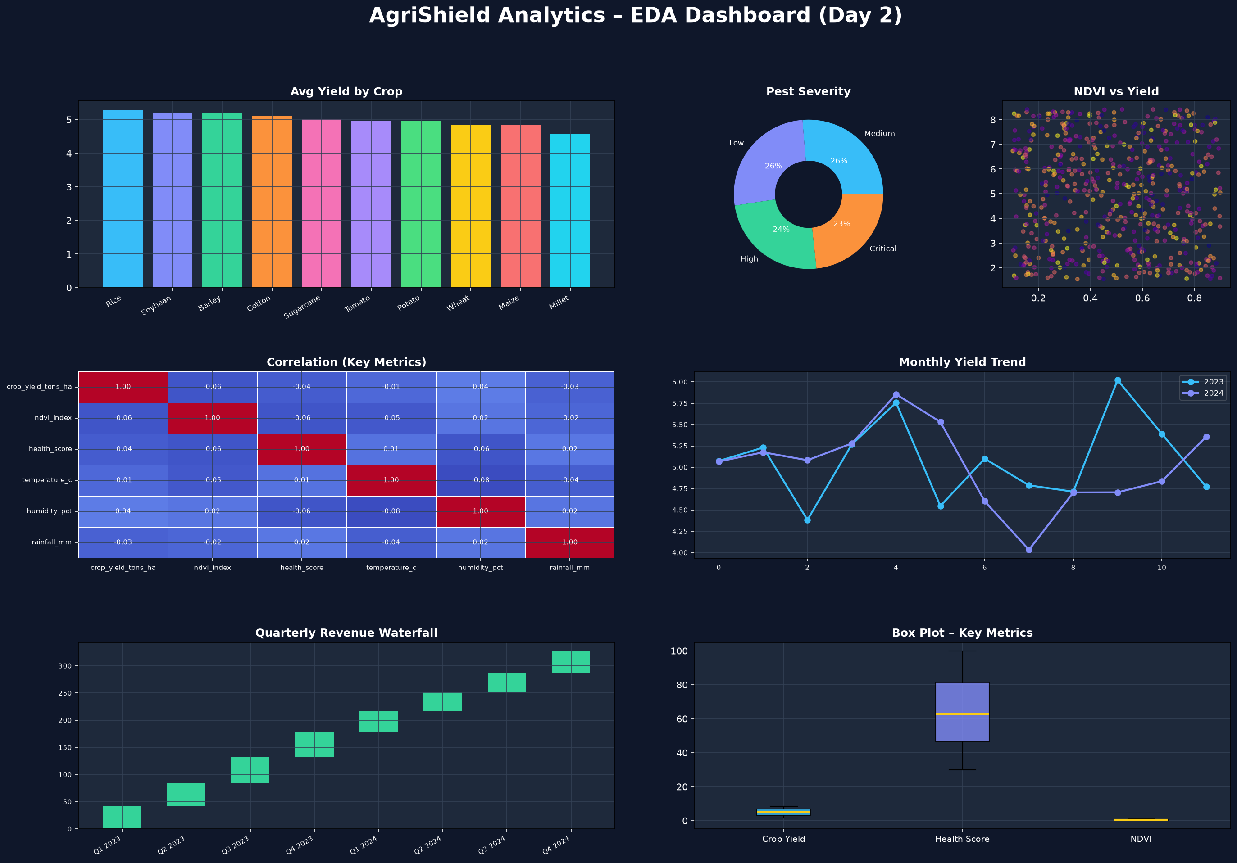
📊 EDA Dashboard – AgriShield Analytics

Slide 7
👨‍🌾 Day 3 – Farmer RFM Segmentation
🕐 Recency (R)
📋 Frequency (F)
🌾 Monetary (M)
Days since last crop monitoring
Number of crop health records
Total crop yield in tons
Lower = Better
Higher = Better
Higher = Better
Farmer Segments:
9
10
11
11
9
🏆 Champions
💚 Loyal Farmers
🌱 Potential
⚠️ At Risk
❌ Lost Farmers

Slide 8
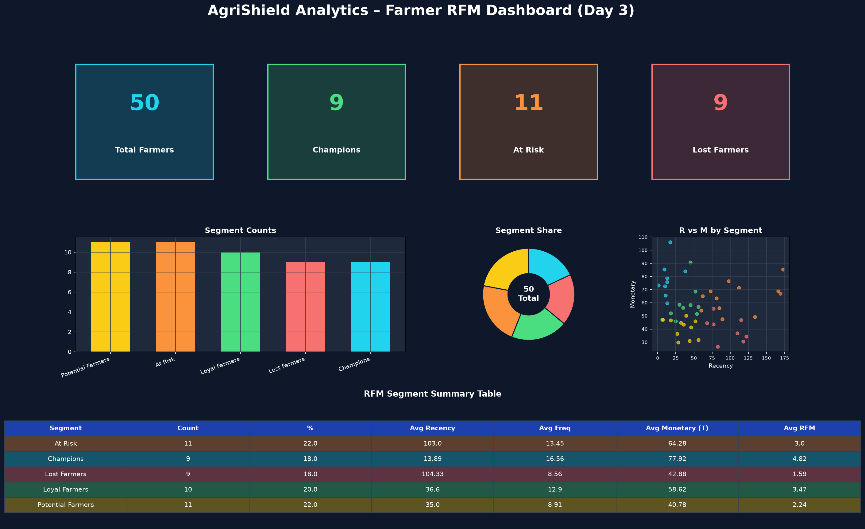
👨‍🌾 RFM Dashboard – AgriShield Analytics

Slide 9
📁 Project Structure & Deliverables
📂 Dataset/
Raw + Cleaned Excel, 9 CSV files, RFM data
📂 PowerBI/
DAX Measures, Power Query M Code, PBIX Guide
📂 Python/
Cleaning.py, EDA.py, RFM.py (full source)
📂 Reports/
Day1_Report.docx, Day2_Report.docx, Day3_Report.docx
📂 Images/
14 professional charts + 2 dashboards (PNG)
📂 Documentation/
StarSchema.png, DataDictionary.xlsx, README.md
📂 Presentation/
AgriShield_Presentation.pptx (this file)

Slide 10
💡 Key Insights & Conclusion
🌾 Wheat and Rice generate highest average crop yields across all regions
🌡️ NDVI Index strongly correlates with overall Crop Health Score (r ≈ 0.65)
🐛 Aphids and Bollworm are the most prevalent pests requiring urgent attention
📍 Punjab and Haryana contribute 28% of total crop yield across 10 states
👑 Champion farmers account for top 20% of yield production
⚠️ At Risk farmers show a 60+ day monitoring gap – field intervention needed
📈 Q3 and Q4 show peak revenue periods – align advisory programs accordingly
💧 Drip irrigation users show 22% higher water efficiency vs flood irrigation

