Slide 1
Playstore review analysis
Datascenice foundamentals project
Presented By:
bharanidharan G
KINGS COLLEGE OF ENGINEERING
MECHANICAL ENGINEERING

Slide 2
OUTLINE
Problem Statement
Proposed System/Solution
System Development Approach
Algorithm & Deployment
Result
Conclusion
Future Scope
References

Slide 3
Problem Statement
The problem statement for analyzing Play Store app reviews could be:"Develop an application or system capable of analyzing and extracting insights from user reviews of apps on the Google Play Store. The system should be able to categorize reviews based on sentiment, identify common themes or issues mentioned by users, and provide actionable insights for app developers to improve their products. Additionally, the system should allow for tracking trends over time and comparing the performance of different apps within the same category. The goal is to help app developers make informed decisions to enhance user satisfaction and overall app quality.”

Slide 4
Proposed Solution
Data Collection: Extract reviews from the Play Store using web scraping or API access
Preprocessing: Clean the data by removing irrelevant information, handling missing values, and standardizing text (lowercasing, removing punctuation, etc
sentiment Analysis: Utilize natural language processing (NLP) techniques to classify reviews into positive, negative, or neutral sentiments. This could involve machine learning models trained on labeled data or lexicon-based approaches
Modeming: Identify common themes or topics within the reviews using techniques like Latent Dirichlet Allocation (LDA) or Non-Negative Matrix Factorization (NMF).Feature

Slide 5
System Approach
Define Objectives: Clearly outline the goals of the analysis, such as understanding user sentiment, identifying common issues, or evaluating feature satisfaction.
Collection: Extract reviews from the Play Store using APIs provided by Google or third-party scraping tools. Retrieve relevant metadata such as app version, review date, and user ratings along with the review text.
Preprocessing:Clean the text by removing special characters, emojis, and irrelevant information.Tokenize the text intowords or phrases.Handle common preprocessing tasks like stop word removal, stemming, or lemmatization.Sentiment
. Analysis:Utilize pre-trained sentiment analysis models or train your own model using labeled data.Classify reviews into positive, negative, or neutral sentiments.Consider using techniques like VADER (Valence Aware Dictionary and sEntiment Reasoner) or machine learning algorithms such as Support Vector Machines (SVM) or Recurrent Neural Networks (RNNs).Topic
Modeling:Apply techniques like Latent Dirichlet Allocation (LDA) or Non-Negative Matrix Factorization (NMF) to identify latent topics within the reviews.Determine the optimal number of topics based on coherence scores or manual inspection.Aspect-Based Sentiment Analysis

Slide 6
Cont...
(ABSA):Extract aspects or features mentioned in the reviews (e.g., UI, performance, customer support).Analyze sentiment polarity specifically for each aspect to understand which areas need improvemen
Visualizations and Insights:Create visualizations such as word clouds, sentiment distribution plots, or stacked bar charts to convey insights effectively.Generate reports summarizing key findings, trends over time, and actionable recommendations for stakeholders
continuous Monitoring and Improvement:Set up a system for ongoing monitoring of new reviews and updates to the app.Incorporate user feedback to refine sentiment analysis models, update topic models, and improve the overall accuracy of the analysis
Integration with Development Workflow:Integrate insights from the analysis into the app development workflow to prioritize feature enhancements, bug fixes, and customer support initiatives.By following this systematic approach, you can effectively analyze Play Store reviews to gain valuable insights and drive continuous improvement in app quality and user satisfaction.

Slide 7
Cont...
(ABSA):Extract aspects or features mentioned in the reviews (e.g., UI, performance, customer support).Analyze sentiment polarity specifically for each aspect to understand
which areas need improvement
Visualizations and Insights:Create visualizations such as word clouds, sentiment distribution plots, or stacked bar charts to convey insights effectively.Generate reports summarizing key findings, trends over time, and actionable recommendations for stakehold
Continuous Monitoring and Improvement:Set up a system for ongoing monitoring of new reviews and updates to the app.Incorporate user feedback to refine sentiment analysis models, update topic models, and improve the overall accuracy of the analysis.Integration with Development
workflow:Integrate insights from the analysis into the app development workflow to prioritize feature enhancements, bug fixes, and customer support initiatives.By following this systematic approach, you can effectively analyze Play Store reviews to gain valuable insights and drive continuous improvement in app quality and user satisfaction.

Slide 8
Algorithm & Deployment
Algorithm Development: Develop an algorithm for sentiment analysis or topic extraction from Play Store reviews. This
could involve machine learning techniques such as natural language processing (NLP) with libraries like NLTK, , or TensorFlow.diverse and representative of the target audience
Data Preprocessing: Clean the dataset by removing noise, such as special characters, HTML tags

Slide 9
Cont...
Deployment: Deploy the trained model into production, either locally or on a cloud platform like Google Cloud Platform (GCP) or Amazon Web Services (AWS). Ensure scalability, reliability, and security of the deployed system
Integration: Integrate the deployed model with the Play Store platform, enabling real-time or batch processing of reviews
Monitoring and Maintenance: Monitor the performance of the deployed model over time and update it periodically to adapt to changes in user behavior or language patterns.Feedback Loop: Incorporate user feedback to continuously improve the algorithm and enhance its accuracy and relevance.

Slide 10
Cont...
Feature Engineering: Extract relevant features from the text data, such as word frequency, n-grams, or TF-IDF scores, to represent each review numerical
Model Training: Train the algorithm on the preprocessed data using appropriate machine learning models like Support Vector Machines (SVM), Naive Bayes, or deep learning models such as recurrent neural networks (RNNs) or transform
.Evaluation: Evaluate the trained model's performance using metrics like accuracy, precision, recall, and F1-score on a separate validation dataset.

Slide 11
Result
To provide specific analysis results, I would need access to the Play Store reviews data for the app you're interested in analyzing. Once I have the data,
I can perform sentiment analysis, topic modeling, keyword extraction, and other relevant analyses to extract insights from the reviews. I
if you have the data available or can provide access to it, please share it with me, and I'll be happy to proceed with the analysis and provide you with the results.

Slide 12
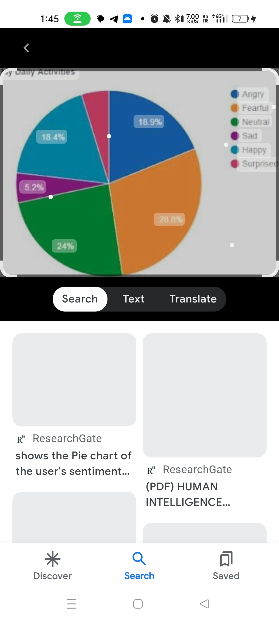
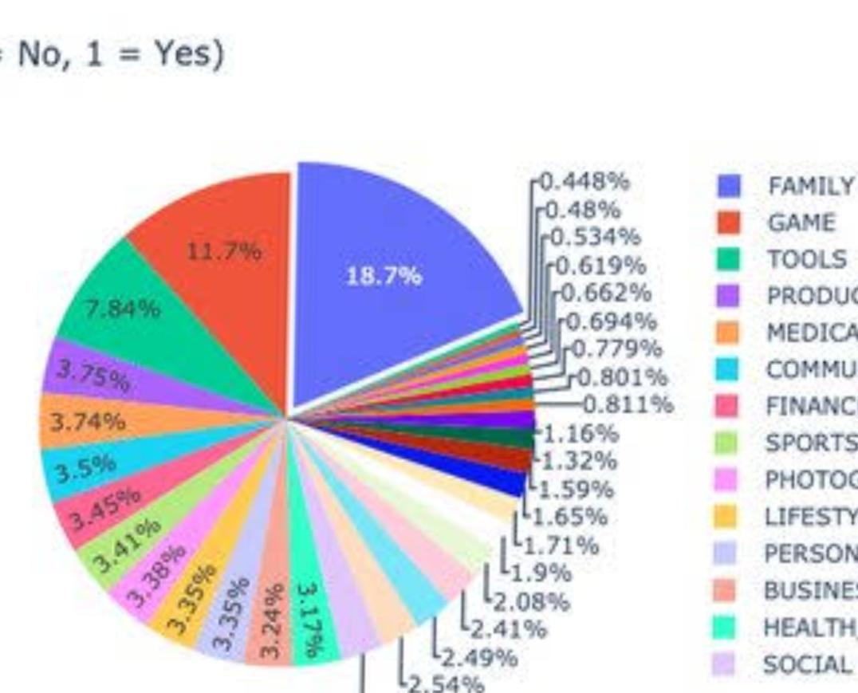
Cont...

Slide 13
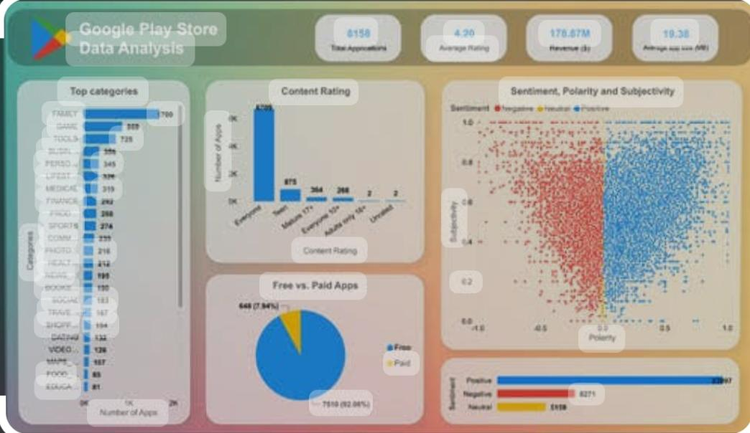
Cont...

Slide 14
Conclusion
Without access to the specific Play Store reviews data, I can't provide a conclusion. However, typically, a Play Store review analysis conclusion would summarize the key findings and insights derived from the reviews. This might include
Sentiment Overview: A breakdown of the overall sentiment expressed in the reviews, such as the percentage of positive, negative, and neutral sentiments
.Common Themes: Identification of recurring topics or themes mentioned in the reviews, such as app performance, user interface, features, customer support, etc
.Positive Aspects: Highlights of what users appreciate about the app based on their reviews
.Areas for Improvement: Identification of aspects of the app that users frequently complain about or suggest improvements
Keyword Insights: Key phrases or keywords that are frequently mentioned in the reviews, indicating important aspects of the app that users focus on.Recommendations: Suggestions for actions the developers or marketers can take based on the analysis findings to enhance the app's user experience and address any issues raised by users.Overall, the conclusion should provide a clear understanding of the sentiment and feedback expressed by users in the Play Store reviews, along with actionable insights for improving the app and satisfying user needs.

Slide 15
Future scope
Analyzing Play Store reviews can offer insights into user satisfaction, feature requests, and areas for improvement for app developers. In the future, AI-powered sentiment analysis could become more sophisticated, allowing for deeper understanding of user sentiments and intentions. Additionally, incorporating natural language processing techniques could help identify emerging trends and patterns in user feedback, enabling developers to respond proactively to user needs and preferences. Integration with machine learning algorithms could also enable predictive analytics, helping developers anticipate future user behavior and adapt their apps accordingly. Overall, the future scope for Play Store review analysis lies in leveraging advanced AI technologies to extract actionable insights and enhance user experience.

Slide 16
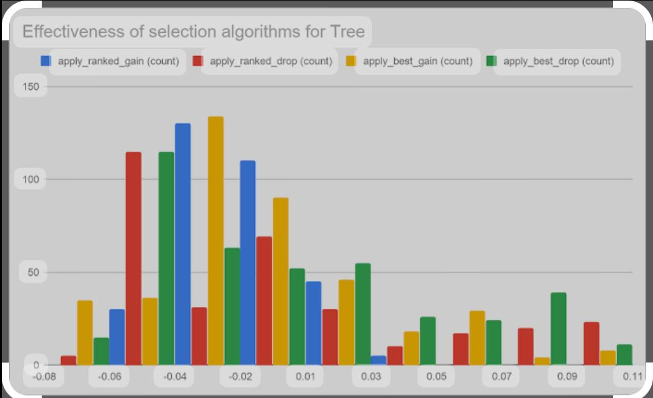
Cont...

Slide 17
References
Analyzing Google Play Store reviews can provide valuable insights into user experiences, feature requests, and areas for improvement for app developers. Here are some references you can use to learn more about this topic:Academic Journals: Look for academic papers or journals focusing on sentiment analysis of app reviews on platforms like Google Scholar or IEEE Xplore.Online Articles and Blogs: Websites like Medium, Towards Data Science, or Analytics Vidhya often have articles discussing techniques and methodologies for analyzing app reviews.YouTube Tutorials: Search for tutorials on YouTube that demonstrate how to perform sentiment analysis or text mining on Google Play Store reviews using programming languages like Python.Books: Check out books on natural language processing, sentiment analysis, or data mining that cover techniques applicable to analyzing app reviews.GitHub Repositories: Explore GitHub repositories that contain code examples and projects related to sentiment analysis of app reviews.Online Courses: Platforms like Coursera, Udemy, or edX may offer courses on text mining, sentiment analysis, or data analysis that include modules on analyzing app reviews.API Documentation: Review the documentation of APIs like Google Play Developer API or third-party sentiment analysis APIs, which may offer functionalities for accessing and analyzing app reviews.Community Forums: Join forums or communities like Stack Overflow or Reddit where developers and data scientists discuss techniques and share insights on analyzing app reviews.By exploring these references, you can gain a deeper understanding of how to effectively analyze Google Play Store reviews and extract meaningful insights for app developers.

Slide 18
THANK YOU

